Slide 1
Virginia’s Nutrient Trading Program
(aka Water Quality Trading)
(aka Nutrient Credit Exchange Program)
Then Now Where To?
_________________________________
Citizens Advisory Committee
To The Chesapeake Executive Council
September 6, 2018
Jeff Corbin
Restoration Systems, LLC

Slide 2

In the beginning…

Slide 3
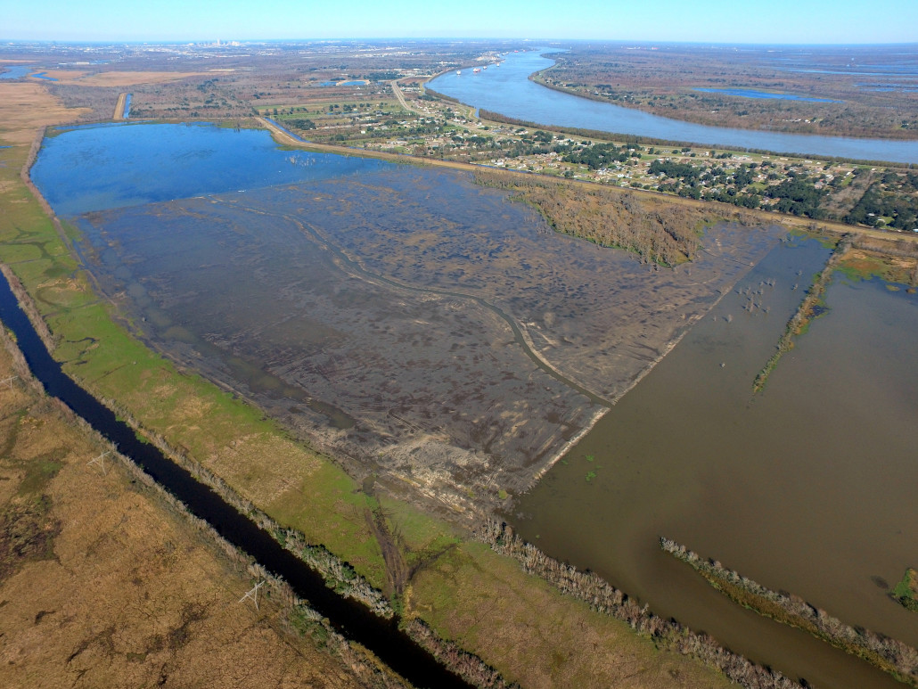
Wetlands Mitigation

Slide 4
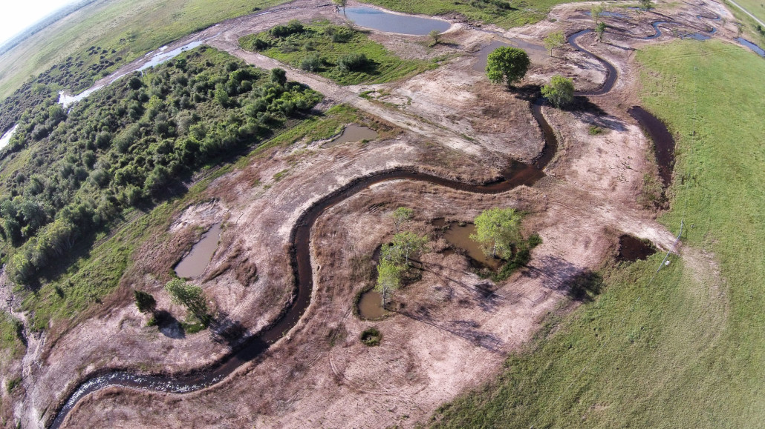
Stream Restoration

Slide 5
The Fundamentals
- CWA §404
- Fed Guidance since early 1980s
- Permittee Responsible (“PRM”) projects weren’t working
- Created a Niche for Private Providers
- Mid-1990s – Fed Multi-Agency Guidance – things got serious
- “2008 Rule” – Joint EPA/USACE Regulations -- Banks given a preference
- Public Database - RIBITS

Slide 6
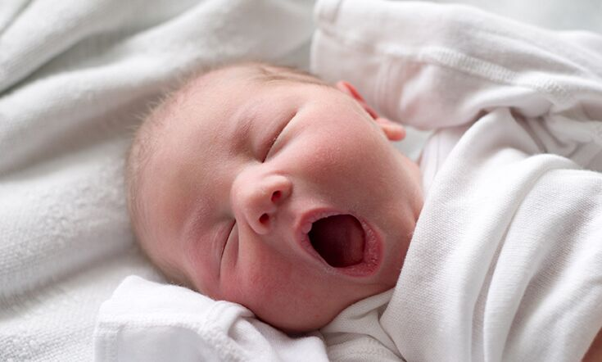
(1 part) Wetland + (1 part) Streams…
….in 2005….
VA Water Quality Trading

Slide 7
2005
“The Bill”
(40 Patrons)
“providing a foundation for establishing market-based incentives to help achieve the Chesapeake Bay Program’s nonpoint source reduction goals”
B. Waste load allocations required by this section to offset new or increased delivered total nitrogen and delivered total phosphorus loads shall be acquired in accordance with this subsection.
1. Such allocations may be acquired from one or a combination of the following:
a. Acquisition of all or a portion of the waste load allocations from one or more permitted facilities in the same tributary;
b. Acquisition of nonpoint source load allocations through the use of best management practices acquired through a public or private entity acting on behalf of the land owner. Such best management practices shall achieve reductions beyond those already required by or funded under federal or state law, or the Virginia tributaries strategies plans, and shall be installed in the same tributary in which the new or expanded facility is located and included as conditions of the facility’s individual Virginia Pollutant Discharge Elimination System permit; or

Slide 8
Good Intentions
Focused on meeting Point Source caps
Nonpoint Sources were intended to help address future growth
$$$ Tremendously successful…on the Point Source side of things

Slide 9
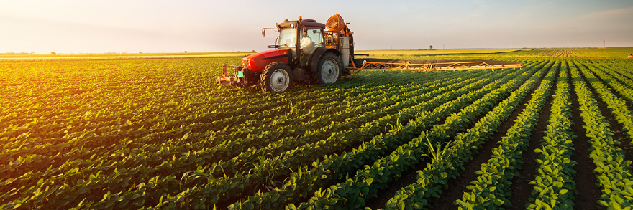

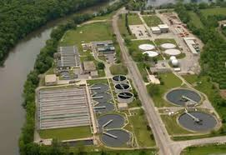
Supply - Demand

Slide 10
The “Save” for Nonpoint Source Trading
2009 – VA Stormwater Management Act – Nutrient Offsets
- VSMP Regs/Permits
- Perpetual Credits – Driven by TMDL Cap
- Stringent Driver (0.41 lbs. P/acre/yr)
- P is the tradable pollutant
Very Successful
  92 Banks Approved
  5748 Credits released
  3374 credits sold
  >$40 million market
  --- 19 banks pending---

Slide 11
Credit Use Triggers
** (Does NOT Address Water Quantity) **
– Under VA Code §62.1-44.15:35, credits may be used to meet VSMP phosphorus requirements when:
  - Phosphorus removal requirement <10 lb. per year; OR
  - Project area contains <5 AC disturbance; OR
  - Project achieves 75% phosphorus removal on-site; OR
  - Project meets MEP approval;
  - Replacing on-site BMPs not functioning or treating <10 LB phosphorus per year
HUC – permit applicant must purchase credits in 8-Digit HUC or adjacent in same tributary

Slide 12
Applicable Project Types
- New Development
- Redevelopment
- EPA TMDL Compliance
- Water Quality BMP Substitution
- Replacement of on-site BMPs
- Linear Projects (e.g., VDOT)
- Compliance
- Enforcement Actions

Slide 13
All “Land Conversion” with the exception of….
…CMP

Slide 14
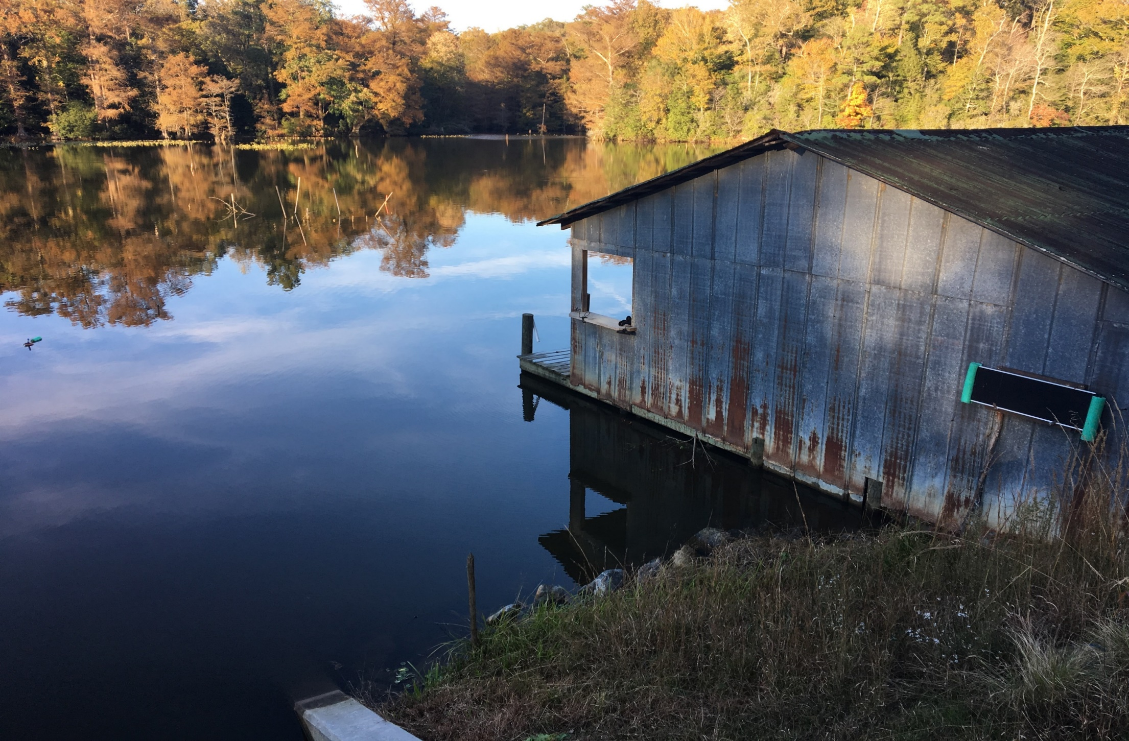
Cranston’s Mill Pond Nutrient Bank

Slide 15
Project Location

Slide 16
CMP History
Long History Back to Mid-1800s
  Dam failed in 2006 – Hurricane Ernesto
  We Purchased in 2009
  Award Winning Dam and Spillway (2013)
2011 Certified by the State as a Nutrient Offset Facility
    ------- 752 lbs of Phosphorus
Current State = 50-Acre Water Impoundment
Captures Water from a 7 Mile² Watershed
Surrounding Watershed is Relatively Undeveloped

Slide 17
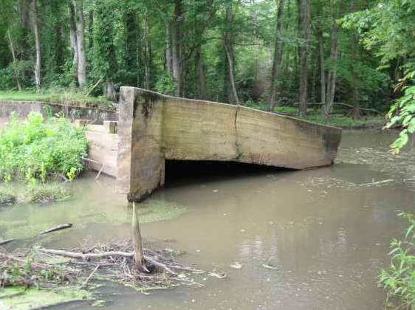
Old Spillway (after dam failure)

Slide 18
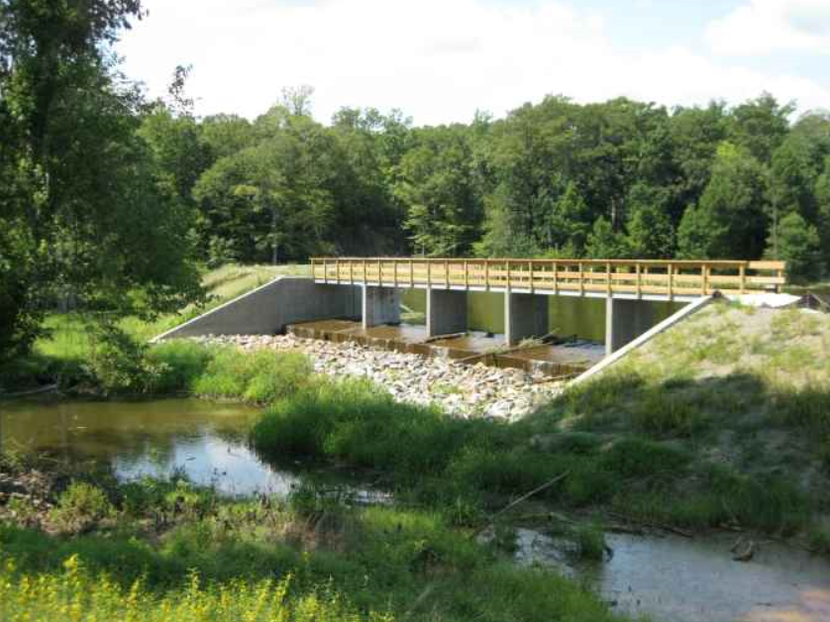
CMP Spillway Today

Slide 19
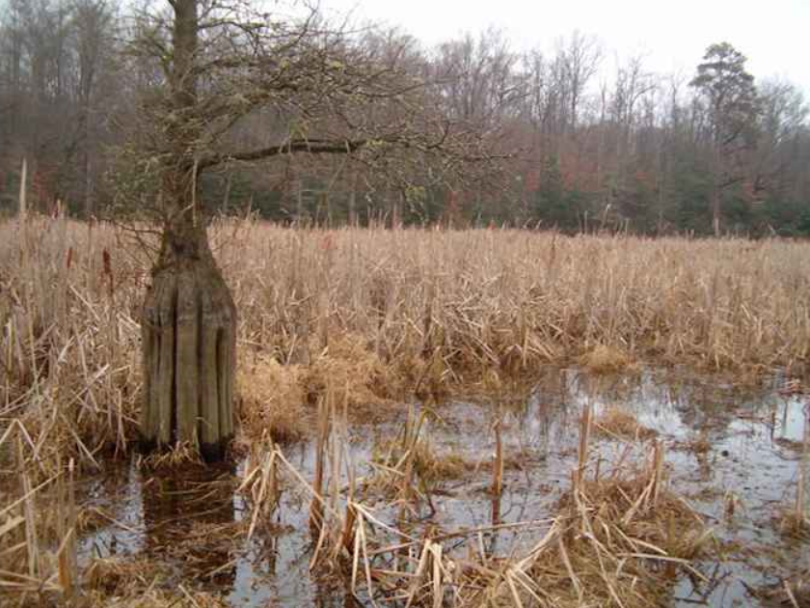
CMP Before (after dam failure)

Slide 20
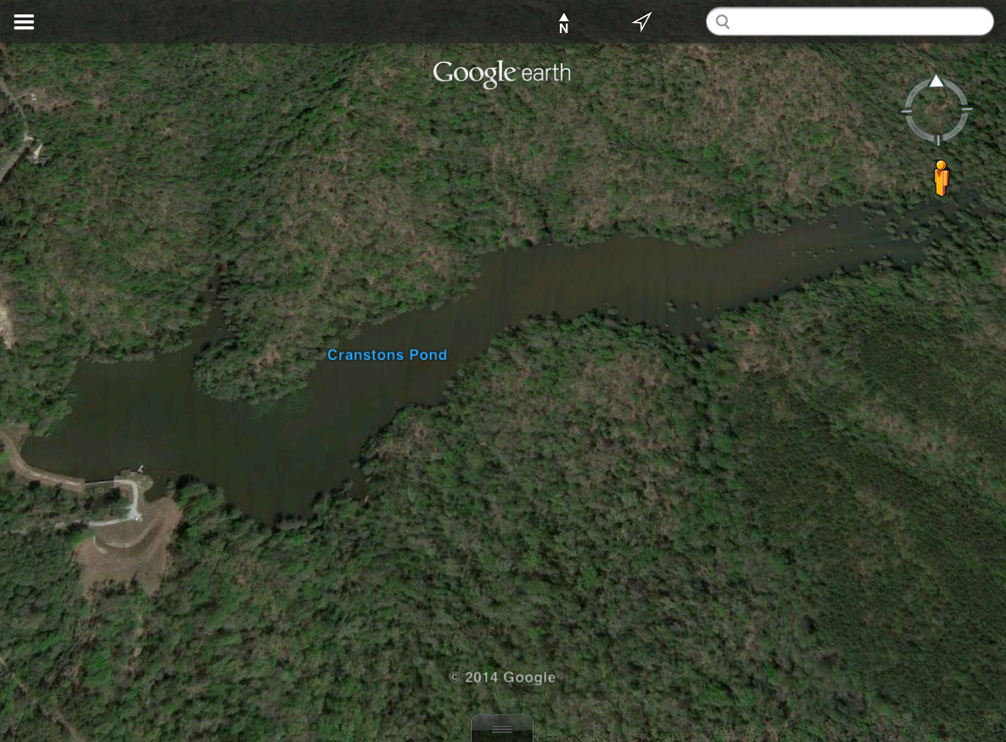

Slide 21
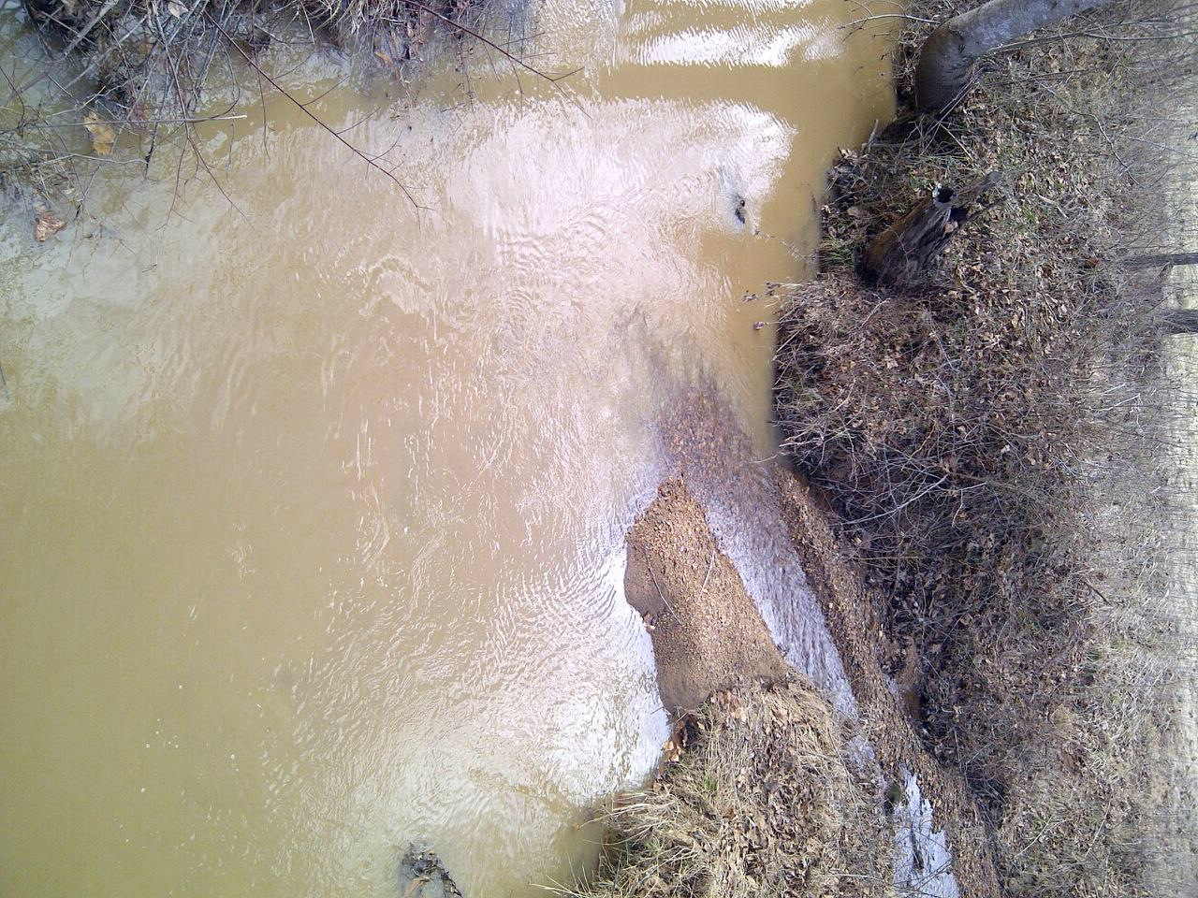
Results Matter
Water from our Nutrient Bank
Little Wreck Island Creek
* Wildwood Farm Nutrient Bank, Appomattox County Virginia

Slide 22
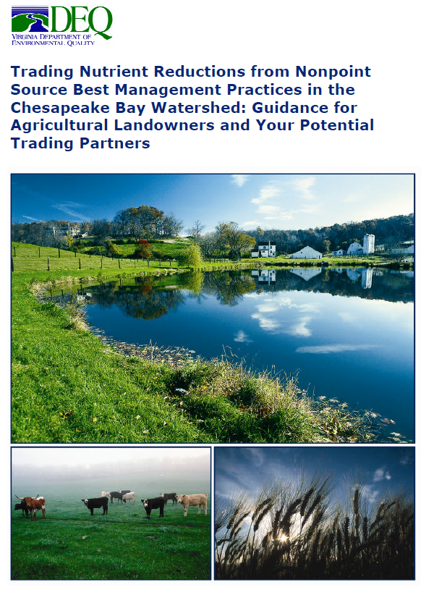
State Law + 1 Guidance Doc

Slide 23
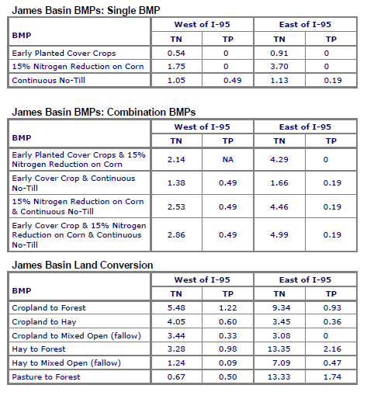
It’s Simple

Slide 24
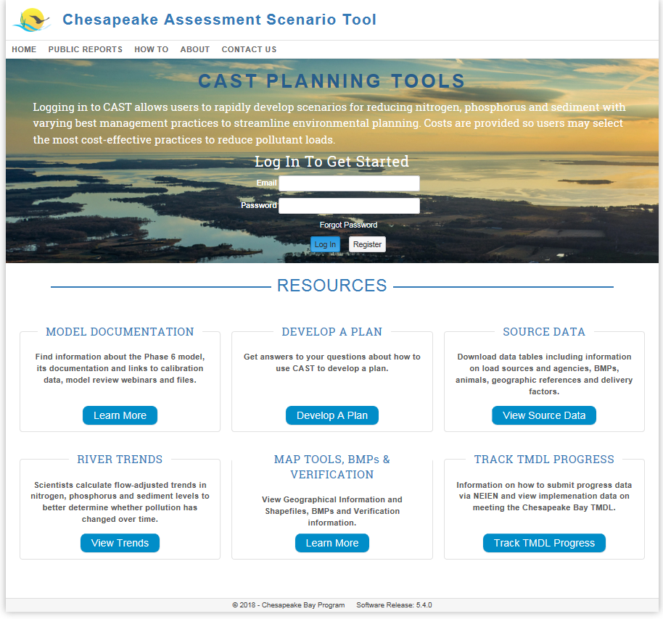
Keeping Up With the Times

Slide 25
A History of Willingness to Expand/Innovate
2010 Phase I WIP called for expansion of VA Trading Program
**Compiled Under Republican Leadership**
2011 SJR 334- Study/Expand Trading Program
2012 SNR Trading expansion report
2014 VIP event
Executive Order 52 on January 28, 2016

Slide 26

The Evolution of Nutrient Trading in Virginia
??
Sediment
MS4
Stormwater
NonPt. Sources
Pt.
Sources

Slide 27
Why Has VA Been Successful?
- Incremental Approach
- Tied to the TMDL
- the #s are real
- scientifically defensible process
- cautious/conservative
- safety factors
- delivery ratios
- local WQ protection
- Broad Support
- Transparent

Slide 28
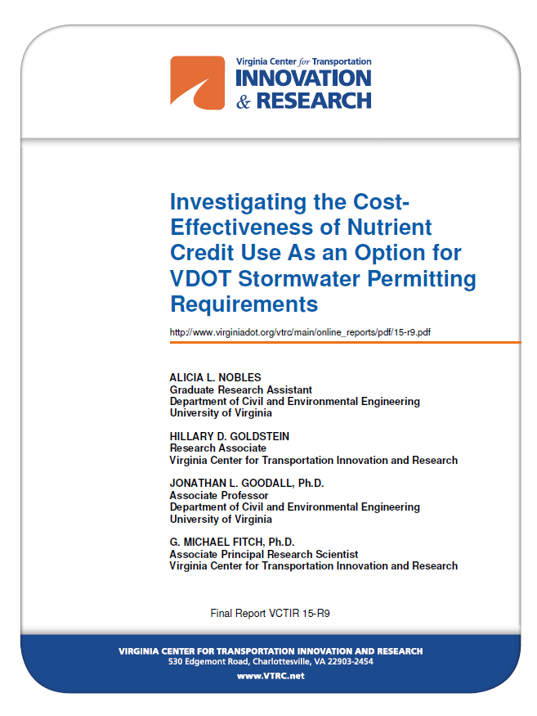
In the hypothetical scenario where VDOT’s participation in the WQT program was allowed in lieu of VDOT’s construction of nine BMPs, VDOT would have realized a cost savings of 5% to 75%, with an average cost savings of 51%. These results suggest that participating in WQT at current market rates in lieu of constructing onsite structural BMPs is an economically feasible solution for VDOT to manage stormwater quality.

Slide 29
BUT…
…this is not what the intent of the original trading law was
“establishing market-based incentives to help achieve the Chesapeake Bay Program’s nonpoint source reduction goals”
--- get agriculture to baseline…and beyond
--- aggregate/bundle BMP reductions = credit
--- do it via a market-based process

Slide 30
So….
HOW do we get back to the original intent?
SHOULD we get back to the original intent?
And…
___________________________________________________________________________________________________________________________________________________________________________________________________
Can we use private investment and market-based programs to meet other Chesapeake Restoration Goals?

Slide 31
In Addition to “Offsetting” Pollution
- 2017-18 Bay TMDL Midpoint Assessment
- Phase III WIP
- ag reductions are lagging
- stormwater reductions will be challenging (to say the least)
- Additional Nutrient/Sediment Reductions due to Climate Change, Conowingo Dam, etc.
__________________________________________________________
…it’s time think broadly and comprehensively
How to use private $ to help meet Bay restoration goals?

Slide 32
Lagging Restoration Goals
Wetlands
Riparian Buffers
Stream Restoration
Water Quality (nutrients)

Slide 33
It’s not a question of what, who, where…
It’s a question of how do we pay for it?
…So how do we use private $ to meet goals & fill gaps?

Slide 34

VA Nutrient Trading V. 2.0?
Software Updates are available for your Trading Program – would you like to update now or be reminded later?

Slide 35

Call me crazy…

Slide 36
New Answers for “What’s a Credit?”
A credit is a credit is a credit
- Do we need “Grades” of credits? Higher Grade = More Credit = Higher Value
- Incentivize more diversity and multiple benefits
Crack the nut on aggregating ag BMPs for credit
- We are never going to get all of the public $ we need for Cost-Share Programs
- State buys credits to jump start?
Stormwater/MS4
- Limit the use of excess wastewater allocations?
- Does this violate “additionality?”
“Bundled” Credits (“Unicredit?”)
- Single Credit, but Buyer can disaggregate and use N, P, Sediment separately and for different requirements

Slide 37
New Uses for Credits
Use the VA Nutrient Offset Fund
- State buys credits
- Allocate as needed
- MD is already doing it!! – Clean Water Commerce Act – NOT Ag lands
Issue “Full Service” RFPs for Nutrient Reductions
- MD State and Several Counties already doing this
- Hugely Successful in NC
- State Level?
- Locality Level?
Use Credits for Enforcement
- N, P, Sediment
- Require > 2:1 to ensure environmental improvement

Slide 38
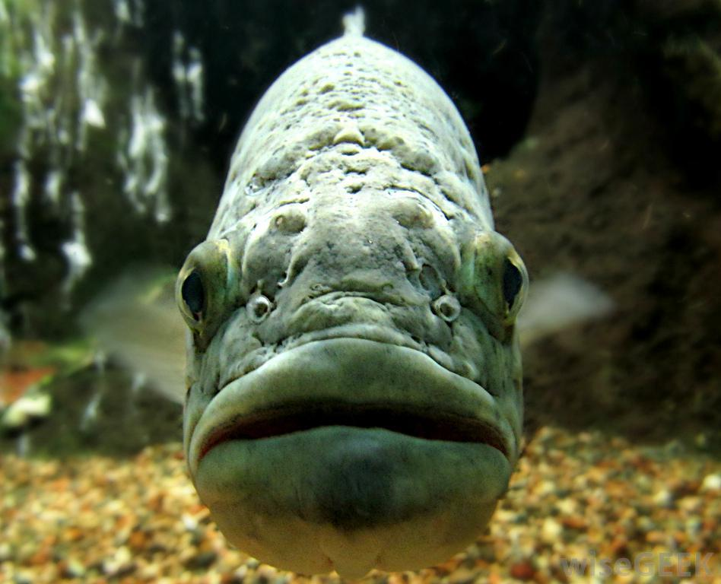
Questions?

