Slide 1
Chesapeake Bay Program’s DEIJ Strategy and EC and PSC DEIJ Statements
Jim Edward, EPA, Diversity Workgroup Chair
Wendy O’Sullivan, NPS, Diversity Workgroup Vice-Chair

Slide 2
Outline for Today
Brief overview of three documents that will guide CBP’s work to operationalize DEIJ in our work
CBP DEIJ Strategy
Executive Council DEIJ Statement
PSC DEIJ Action Statement
Discussion: meeting commitments in the PSC Action Statement

Slide 3
1. THE CBP
DEIJ STRATEGY

Slide 4
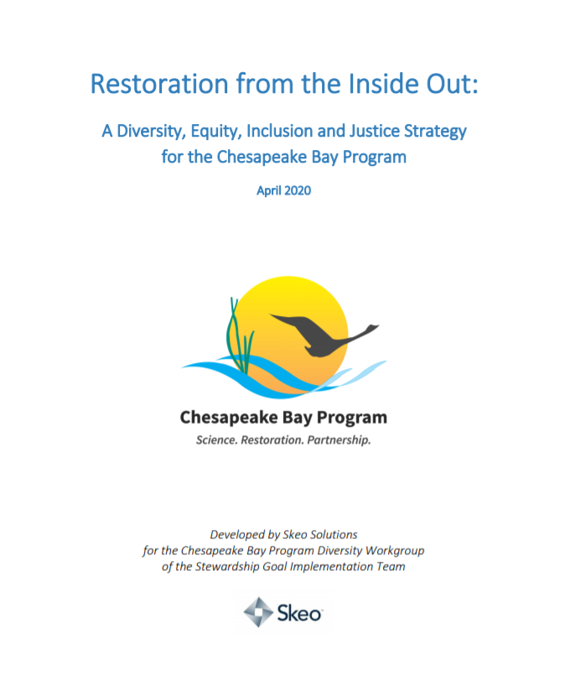
Restoration from the Inside Out:
A Diversity, Equity, Inclusion and Justice Strategy for the Chesapeake Bay Program
Developed by Skeo Solutions, April 2020
59 pages long
20 broad recommendations
detailed action plans with 48 actions
Notes:
The Chesapeake Bay Program (CBP) retained Skeo to complete a Diversity, Equity, Inclusion and Justice (DEIJ) Readiness Assessment and develop a DEIJ Strategy that helps the organization to : 1. Grow racial and ethnic diversity from 13% to 25% (including 15% of leadership). 2. Help partners to develop as DEIJ leaders who understand, respect and embrace cultural diversity. 3. Provide partners with the tools to continually assess progress towards diversity goals.

Slide 5
THE DEIJ STRATEGY RECOMMENDATIONS
Examples of recommendations from the strategy include:
Updating authorizing and governance documents (e.g. the Governance and Management Framework) as well as management strategies to include language that reflects DEIJ priorities.
Increasing diversity and inclusion for staff, appointees, and volunteer bodies.
Building relationships with underrepresented groups and incorporating these leaders into decision-making and implementation.
Advancing DEIJ in management strategies and workplans, implementation and grantmaking
Notes:
In these next couple of slides, I am going to provide a summary of the recommendations which are grouped into four DEIJ Framework focus areas.

Slide 6
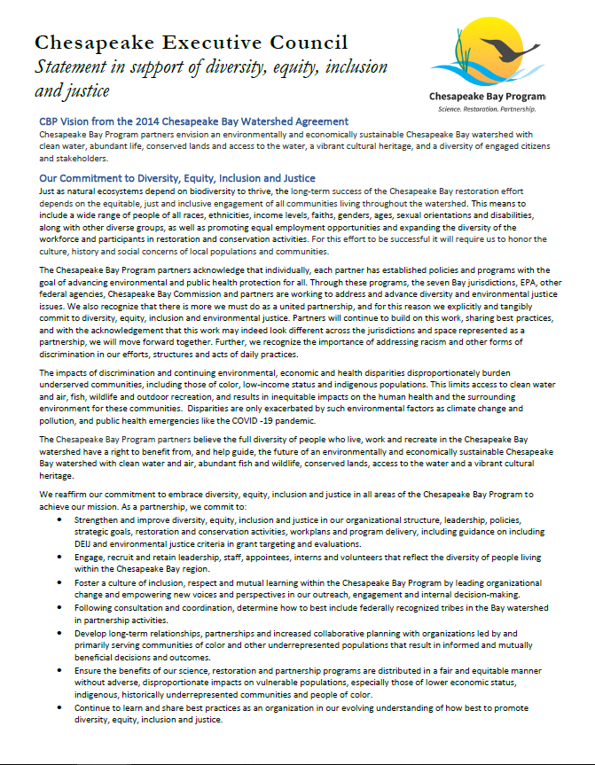
2. The CBP DEIJ
STATEMENT

Slide 7
NEW DEIJ STATEMENT SIGNED BY THE EXECUTIVE COUNCIL ON AUGUST 18TH
The Executive Council DEIJ Statement reaffirms the CBP’s commitment to embrace DEIJ in all areas of the Chesapeake Bay Program to achieve our mission.
It articulates our commitment to :
Strengthen DEIJ in our organizational structure, policies, goals, and activities;
Engage, recruit and retain leadership, staff, appointees, interns and volunteers that reflect the diversity of people living within the Chesapeake Bay region;
Foster a culture of inclusion, respect and mutual learning;
Develop long-term relationships, partnerships and increased collaborative planning with underrepresented stakeholder groups;
Ensure the benefits of our science, restoration and partnership programs are distributed in a fair and equitable manner;
Continue to learn and share best practices as an organization.

Slide 8
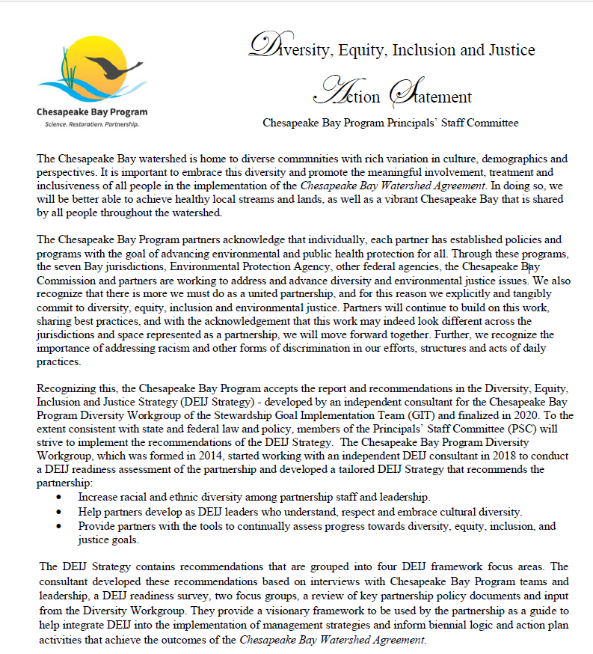
3. PRINCIPALS’ STAFF COMMITTEE DEIJ ACTION STATEMENT

Slide 9
THE PSC ACTION STATEMENT
“Continuing our path toward embracing the human diversity in the Chesapeake Bay watershed and promoting diversity, equity, inclusion and justice in our work to restore the Bay, we hereby strive to implement the recommendations in the Chesapeake Bay Program DEIJ Strategy to the extent consistent with applicable state and federal law and policy.”

Slide 10
5 PSC ACTION STATEMENT COMMITMENTS
To implement the recommendations in the DEIJ Strategy, the PSC commits to:
Within six months of the signing of the Chesapeake Executive Council statement, a draft implementation plan for the DEIJ Strategy will be presented to the PSC. The development of this plan will include direct outreach to underrepresented communities for input and feedback.
Within three months of the signing of the Chesapeake Executive Council statement, explore a process for a community advisory board composed of environmental justice leaders and representatives from organizations led by people of color or other underrepresented groups. This board could be part of one of the partnership’s existing advisory boards (Citizens Advisory Committee or Local Government Advisory Committee).

Slide 11
5 PSC ACTION STATEMENT COMMITMENTS
Advancement of the DEIJ Strategy through work plan development and implementation for all GITs and Workgroups on their respective strategy review system schedules.
Meaningful inclusion of DEIJ milestones on the agendas for the Management Board and PSC meetings at a minimum every six months with a commitment to update the Chesapeake Executive Council annually.
Meaningful consideration of DEIJ in development of any future Chesapeake Bay Watershed Agreement(s).

Slide 12
Recent and Ongoing Discussions
Discussed the PSC Action Statement commitments with the Goal Implementation Team Chairs and Diversity Workgroup last week
Talking to the Management Board tomorrow (09/17) to achieve the following:
Discuss and agree on a schedule for moving forward with implementation of commitments made by the PSC in the Action Statement.
Discuss possible MB recommendations to the PSC on the Action Statement commitments.
Discuss forming a MB action team charged with developing the implementation plan for the DEIJ Strategy and ensuring the PSC Action Statement commitments are met.

Slide 13
Question for today’s discussion
What are your thoughts and ideas for meeting each of the PSC DEIJ Action Statement commitments, in particular commitment #2 to explore a process for a community advisory board?

Slide 14
PSC Commitment #2: Additional Considerations
There is value in creating a Community Advisory Board (CAB) that would stand separate from the existing advisory committees. However, some members of the Diversity Workgroup are concerned with having a separate board since CAC is meant to be representative of perspectives from all watershed residents.
At this time, we will share a draft Community Advisory Board Options/Issues paper that summarizes other issues for consideration.

