Slide 1

Achieving the Goal of Stewardship
2014 Chesapeake Watershed Agreement
Developing a Citizen Stewardship Indicator
Pilot Survey Results
May 18, 2016

Slide 2

Stewardship Goal
“Increase the number and diversity of local citizen stewards and local governments that actively support and carry out conservation and restoration activities that achieve healthy local streams, rivers and a vibrant Chesapeake Bay.”
Notes:
Amy/Kristin

Slide 3
Citizen Stewardship Framework
Increasing citizen actions for watershed health
Community Leaders/ Champions
Mobilize/Increase
Volunteerism/ Collective Community Action
Knowledge & skills
Individual Citizen Actions
and Behaviors
Increasingly Environmentally Literate Population (Elit Goal)
Notes:
Amy/Jamie

Slide 4

Why Measure Stewardship?
Track progress in engaging the public
Design social marketing campaigns for BMP adoption and behavior change
Improve strategic communications to build public support for Bay restoration work
Prioritize investments in citizen-led action
Improve local decision-making
Notes:
Jamie

Slide 5
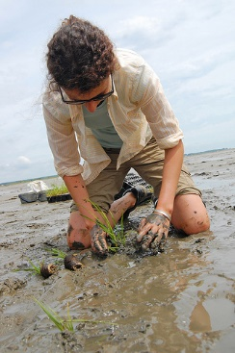

Photos Courtesy Chesapeake Bay Program
STEWARDSHIP
INDICATOR
Notes:
Transition to Steve

Slide 6
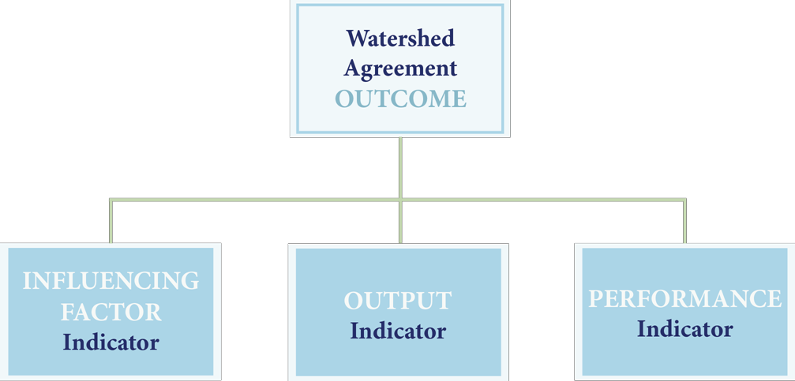
Chesapeake Bay Program Indicators Framework
Approved November 2015 Management Board Meeting
Information Support
Three information types are needed to support adaptive management and communication needs.
Influencing Factors – What KEY influencing factors are impacting the achievement of an outcome?
Outputs – Are we doing what we said we would do in our work plans and management strategies?
Performance – Are we achieving the outcome?

Slide 7
Stakeholders:
NGOs
EPA Representatives
State Department Representatives
Bay Program staff
Funders
Local government
Chesapeake Stormwater Network
UMCES
VA Tech University
University of Maryland

Slide 8
From 2015 Stakeholder Process:
2025 time horizon for this Indicator.
Tracking human behavior.
Measure:
Stewardship Behaviors
Future Likelihood of Adoption
Volunteerism
Keys to Individual Engagement
Civic Engagement Behaviors

Slide 9
Targeting Limited Resources:
Level of Adoption x Likelihood x Impact
Goal : Pursue one behavior at a time
Choose behavior with the largest weight
Well-designed programs may use less-impactful behaviors as stepping-stones to more substantive actions

Slide 10
What This Survey Tool is Not
The citizen stewardship index will NOT verify implementation of behaviors or practices per Bay Program protocols. Other tools like the Smart Tracker exist for this purpose.
It will NOT answer why questions.
It will NOT measure public policy preferences.
It will not measure perceptions and attitudes, except those that directly drive stewardship behavior.

Slide 11
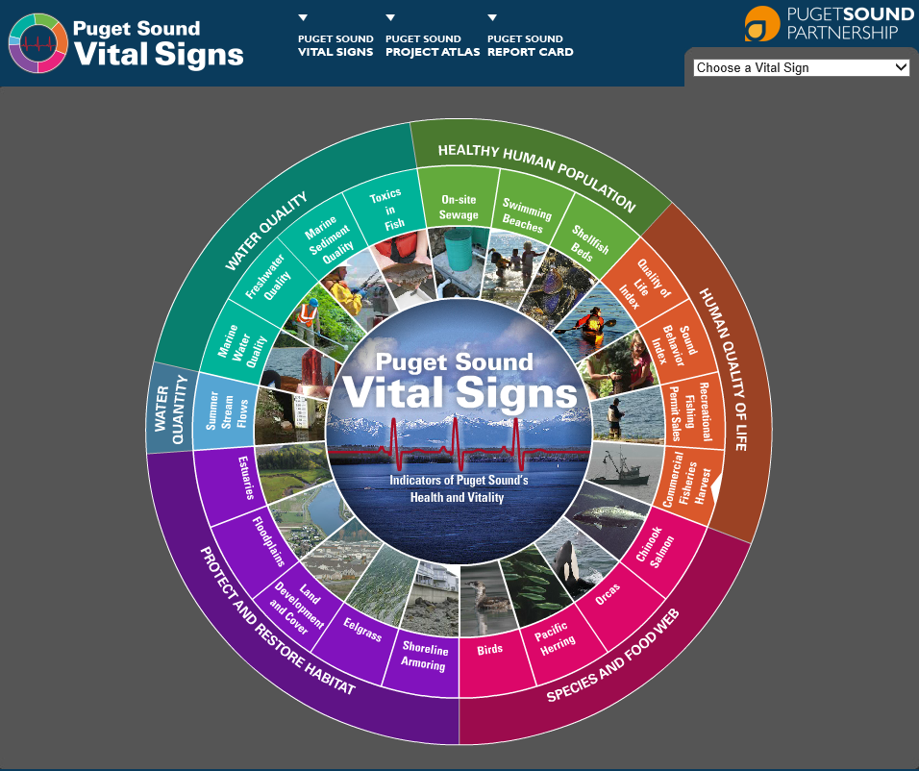
Puget Sound Behavior Index
Measures 28 positive and negative behaviors
Stratified for 12 counties
Conducted biennially by telephone
3,131 interviews (2013)
Measures progress; drives decision-making

Slide 12
Stewardship Behavior
Measurement Criteria
Involves individual decision-making
Is repetitive and can be tracked over time
Can be broadly adopted
Not just by experts
Not pre-emergent
Has an impact on water health
And/or will engage the public

Slide 13
Measured Behaviors
Pet waste
Leaves/Lawn clippings (2)
Litter (2)
Fats, grease, contaminants down the drain (2)
Fertilizer use (2)
Pesticide/Herbicide use (2)
Conservation landscaping
Rain garden installation
Septic system
Tree planting
Downspout redirect
Rain barrel (2)
Water conservation

Slide 14
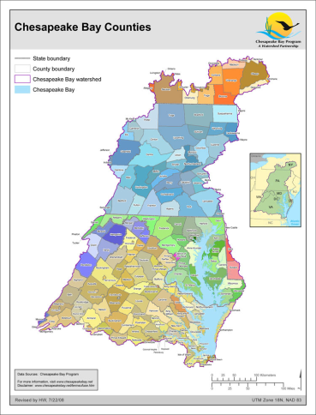
Citizen Stewardship Index
Pilot Sampling Methodology
 | Pilot Program Feb 2016
 | N=2,000
DC | 402 (±4.9%)
MD | 400 (±4.9%)
PA | 398 (±4.9%)
VA | 400 (±4.9%)
WV | 199 (±6.9%)
NY | 101 (±9.8%)
DE | 100 (±9.8%)
23 days in field
13-minute interview
43% cell/57% landline

Slide 15
Performance:
Stewardship Behaviors

Slide 16
Performance of Behaviors (Yes/No)
Pilot Citizen Stewardship Indicator
Weighted Data: (4/12/2016)

Slide 17
Top Performing Behaviors (Scaled)
Pilot Citizen Stewardship Indicator
Weighted Data: (4/12/2016)

Slide 18
Second Tier Behaviors (Scaled)
Pilot Citizen Stewardship Indicator
Weighted Data: (4/12/2016)

Slide 19
“Threshold” Behaviors
Not highly penetrated
Require intentionality/effort
Conservation landscaping
Rain garden installed
Septic system pumped out
Planted a tree
Rain barrel connected and emptied
Conserve water at home
Pick up and dispose of pet waste
Pick up litter
Fertilizer use
Herbicide use

Slide 20
Threshold Behavior Performance Converted to 0 – 100 Scale
Pilot Citizen Stewardship Indicator
Weighted Data: (4/12/2016)

Slide 21
Number of Behaviors Performed Of 10 “Threshold Behaviors”
Pilot Citizen Stewardship Indicator
Weighted Data: (4/12/2016)
Average:
3.73 Behaviors Performed

Slide 22
Number of Behaviors Possible Of 10 “Threshold Behaviors”
Pilot Citizen Stewardship Indicator
Weighted Data: (4/12/2016)
Average:
7.38 Behaviors Possible

Slide 23
Number of Behaviors Possible By State
Pilot Citizen Stewardship Indicator
Weighted Data: (4/12/2016)

Slide 24
Segmentation Opportunities
Jurisdiction
Age
Educational attainment
Health care professionals
Home ownership
Housing type
Community size
Agriculture
Religious affiliation
Race/ethnicity
Household income
Gender

Slide 25
Likelihood to Change Behavior

Slide 26
Behaviors Most Susceptible to Change Asked Only of Those Not Performing the Desired Behavior Today
Pilot Citizen Stewardship Indicator
Weighted Data: (4/12/2016)
Now I would like to ask you about a few of those actions again. Looking forward over the next year or so, how likely are you to do each of these things using the scale (rotate high to low/low to high): [very likely, somewhat likely, (or) not likely].

Slide 27
Behaviors Less Susceptible to Change Asked Only of Those Not Performing the Desired Behavior Today
Pilot Citizen Stewardship Indicator
Weighted Data: (4/12/2016)
Now I would like to ask you about a few of those actions again. Looking forward over the next year or so, how likely are you to do each of these things using the scale (rotate high to low/low to high): [very likely, somewhat likely, (or) not likely].

Slide 28
Behaviors Least Susceptible to Change Asked Only of Those Not Performing the Desired Behavior Today
Pilot Citizen Stewardship Indicator
Weighted Data: (4/12/2016)
Now I would like to ask you about a few of those actions again. Looking forward over the next year or so, how likely are you to do each of these things using the scale (rotate high to low/low to high): [very likely, somewhat likely, (or) not likely].

Slide 29
Volunteerism

Slide 30
Volunteerism
Pilot Citizen Stewardship Indicator
Weighted Data: (4/12/2016)
40% can think of at least one group in their own community that is working to clean up and protect local waters.

Slide 31
Keys to Individual Engagement

Slide 32
I want to do more to help make local waters healthier. Level of Agreement
Pilot Citizen Stewardship Indicator
Weighted Data: (3/1/2016)
74% agree

Slide 33
If I wanted to volunteer to help the natural environment locally, I would know how to do that. Level of Agreement
Pilot Citizen Stewardship Indicator
Weighted Data: (3/1/2016)
54% agree

Slide 34
I am causing water pollution where I live. Level of Agreement
Pilot Citizen Stewardship Indicator
Weighted Data: (3/1/2016)
16% agree

Slide 35
Indicator
Scale-up

Slide 36
Uses
Measuring change over time
Benchmarking against a Bay-wide norm, other communities
Maximizing limited resources through smart behavior selection
Informing outreach to target audiences

Slide 37
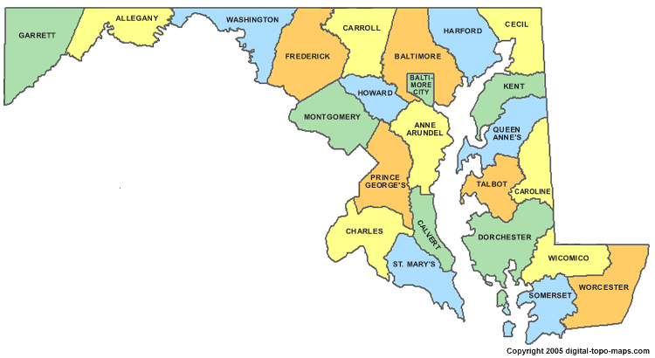
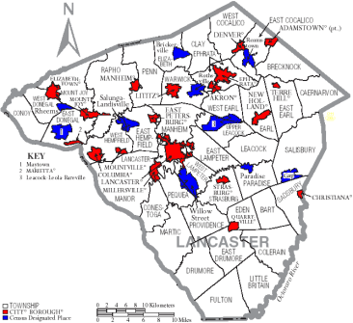
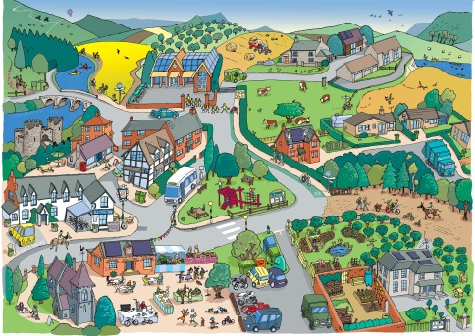
Citizen Stewardship Index
Measuring Stewardship Progress
 | Regional Index | State or Jurisdiction Index | County or Municipality Index | Community Index
Tool | Index Survey | Index Survey | Index Survey | Baysurvey.org
Date | Pilot Winter 2015/2016 | Pilot Winter 2015/2016 | TBD | Ongoing
Result | Pilot (+/- 2.2%) | Pilot (+/- 4.9% to 9.8%) | 2016 TBD | Scalable to most local level

Slide 38
Citizen Stewardship Index
Sampling Methodology
 | Pilot program (2015) | Rollout Option 1 (2016+)
 | N=2,000 | All states statistically significant N=5,200
MD | 400 (±4.9%) | 1,000 (±3.1%)
VA | 400 (±4.9%) | 1,000 (±3.1%)
PA | 400 (±4.9%) | 1,000 (±3.1%)
DC | 400 (±4.9%) | 800 (±3.5%)
WV | 200 (±6.9%) | 600 (±4.0%)
NY | 100 (±9.8%) | 400 (±4.9%)
DE | 100 (±9.8%) | 400 (±4.9%)

