Slide 1
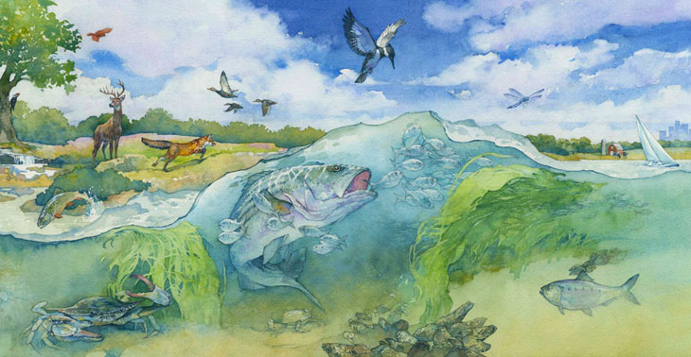

The Bay’s Health & Future: How it’s doing and What’s Next
Management Strategy for the Local Leadership Outcome
Carin Bisland, Associate Director
Chesapeake Bay Program Office
Environmental Protection Agency
November 21, 2014
Notes:
Today I will quickly talk about management strategies – the key elements and the process
Feel free to interrupt as I go to ask any questions

Slide 2

Stewardship
Increase the number and diversity of local citizen stewards and local governments that actively support and carry out the conservation and restoration activities that achieve healthy streams, rivers and a vibrant Chesapeake Bay.
Image Chiot’s Run/Flickr

Slide 3

Local Leadership Outcome
Continually increase the knowledge and capacity of local officials on issues related to water resources and in the implementation of economic and policy incentives that will support local conservation actions

Slide 4
Two Near Term Approaches
Funding for Assessment of Local Leadership Development Programs
Workshop to get input from local leaders

Slide 5
Assessment of Local Leadership Development Programs
$20,000 through the MD Chesapeake Bay Implementation Grant to the Chesapeake Bay Trust.
Early December, CBT will request proposals for the work.
The project is intended to:
  identify and research existing local leadership development programs that have a focus on leadership, particularly on water resource issues
  provide insight into the current efforts for building local leadership in the Chesapeake Bay watershed,
  identify gaps in the current efforts,
  discover successful strategies that are being used in other places outside of the watershed

Slide 6
Workshop for Local Leaders
Scheduled for December 3, 2014 at Patuxent Wildlife Center
Invitees include
  Local elected officials
  Local appointed officials
  Key local staff
  Educators for building local knowledge and capacity
  Signatory representatives interested in the development of this management strategy

Slide 7
Intended Outcome of the Workshop
Gain insight into how participants became leaders
Identify unique leadership characteristics of current leaders in local conservation actions
Identify elements of and barriers to effective leadership training and education programs
Gather input for the development of a management strategy for local leadership
Solicit volunteers to serve as advisors.

Slide 8
In Addition . . .
“Where appropriate, Management Strategies should describe how local governments, nonprofit and private partners will be engaged; where actions, tools or technical support are needed to empower local governments and others to do their part; and what steps will be taken to facilitate greater local participation in achieving the Outcome.”
2014 Chesapeake Bay Watershed Agreement

Slide 9
Timeline and Process
Use Workgroup to begin to frame the management strategy – TODAY
Improve draft management strategy with input from workshop – (12/3 – 12/15)
Get Assessment of local leadership development programs started (December-June)
Fill gaps in information through research, advisors, and informal focus groups (December-March)
Public input (March-April)
Finalize Management Strategy (June)

