Slide 1
Case Study format and content discussion
Lgei call on February 16, 2017

Slide 2
Example case study series
EPA’s Nonpoint Source (NPS) Success stories www.epa.gov/nps/success
EPA’s Low Impact Development (LID) barrier busters www.epa.gov/nps/urban-runoff-low-impact-development
VA DEQ Pollution Prevention Case studies http://www.deq.virginia.gov/CaseStudies.aspx
EPA’s Green Infrastructure case studies http://www.sustainablecitiesinstitute.org/Documents/SCI/Report_Guide/Guide_EPA_GICaseStudiesReduced4.pdf

Slide 3
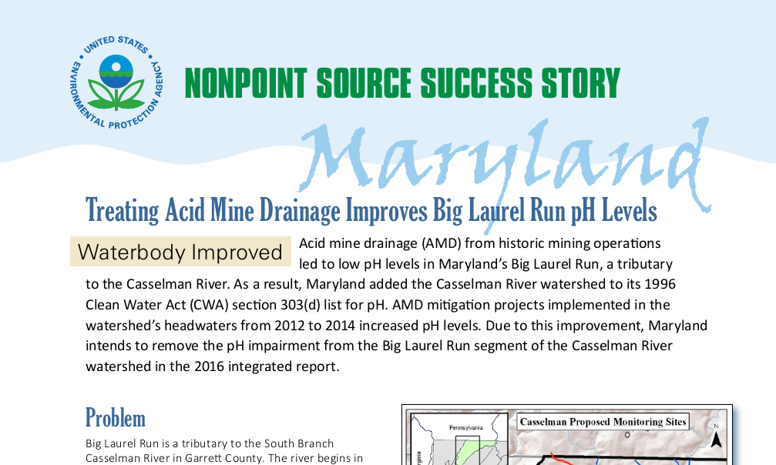
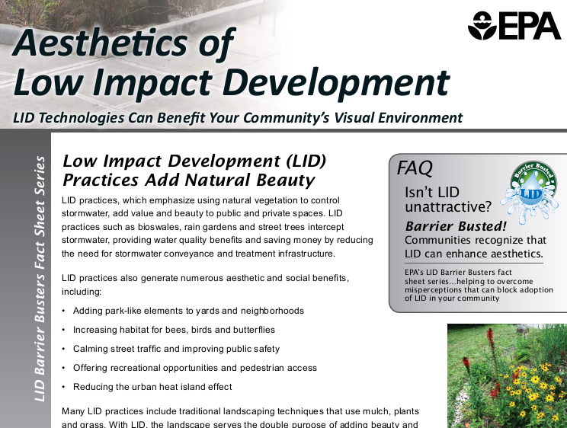
Example content and format
NPS Success stories (2 pages)
  Waterbody improved (includes maps)
  Problem
  Project highlights
  Results
  Partners and funding
LID barrier busters (2-4 pages)
  9 fact sheets that address multiple LID practices
  High level Discussion of results achieved

Slide 4
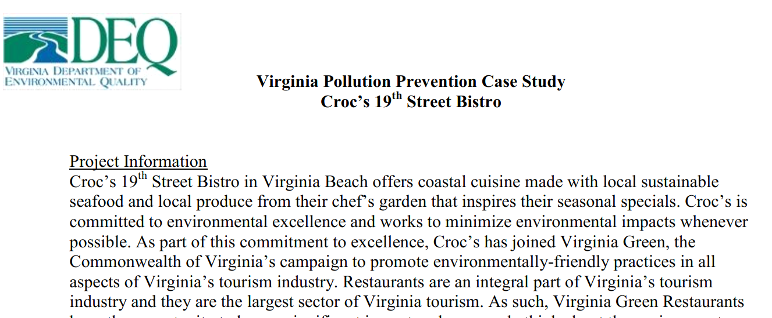
Example content and format
VA DEQ P2 case studies (3-5 pages)
  Project/facility information
  Environmental Challenges and Opportunities
  Implementation of the Program
  Evaluation of the process
  Continual Improvement of the Program

Slide 5
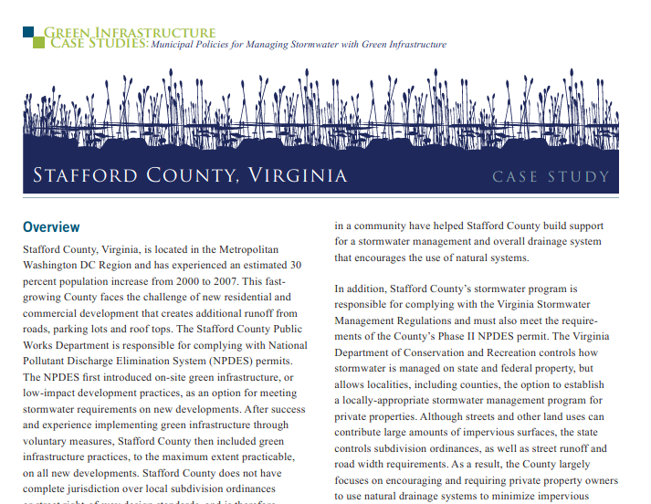
Example content and format
Green Infrastructure case studies (2-4 pages)
  Overview
  Drivers
  Regulatory Strategy/Policy approaches (retrofits, code review, stormwater regulation, stormwater fee, fee-based incentives, etc.)
  Implementation
  Land Acquisition strategies/Information strategies
  funding
  Barriers and failures

Slide 6
What we heard you need in a case study
Title and summary
Landscape (Ag, urban, rural)
Timeline and steps of the process
partners
Details of bmp(s) effectiveness
How was the bmp chosen?
How was it funded?
How will it be maintained?
Contact information

Slide 7
What other sections/details should be included?
Location?
Aesthetics?
Funding?
Regulatory Strategy/Policy approach?
Evaluation and lessons learned?
Multi-objective benefits (job creation, public access, meets other local goals such as public safety)?

