Slide 1
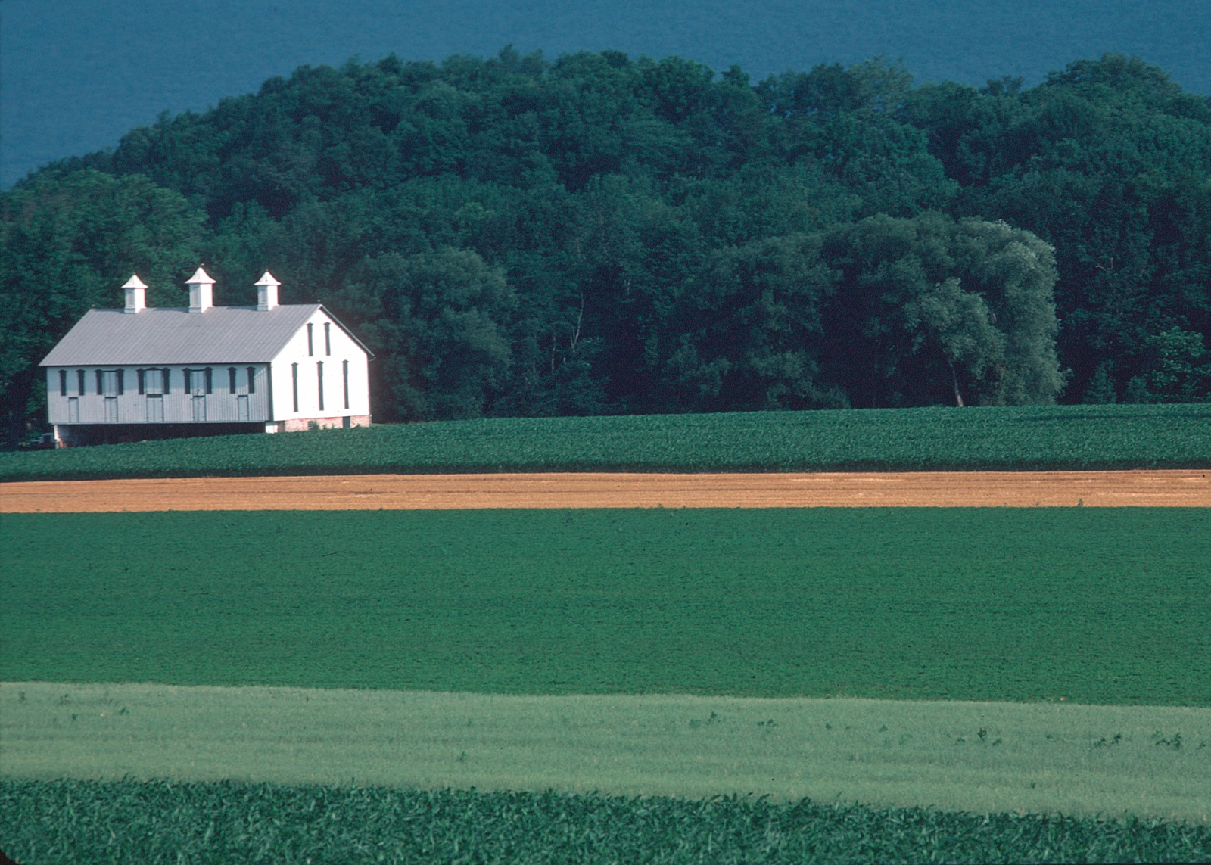
Chesapeake Bay Program Partnership’s Agriculture Workgroup (AgWG)
AgWG Membership Workshop
December 17, 2015

Slide 2
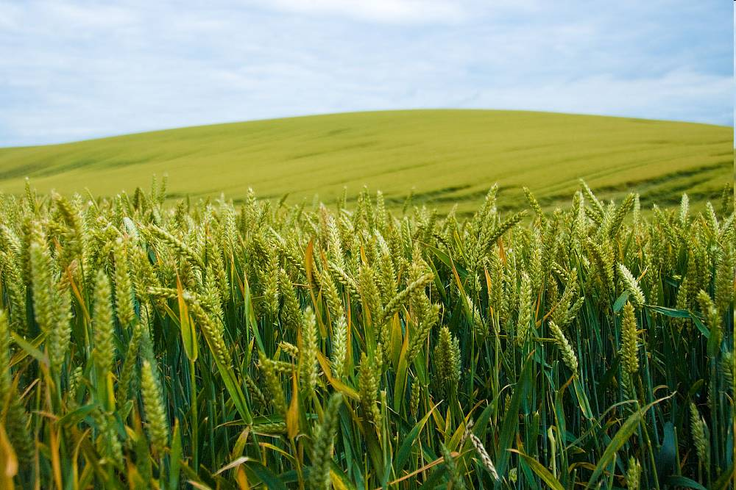


Mark Dubin Agricultural Technical Coordinator
University of Maryland Extension-College Park College of Agriculture and Natural Resources
Department of Environmental Science & Technology mdubin06@umd.edu
EPA Chesapeake Bay Program Office mdubin@chesapeakebay.net

Slide 3
Chesapeake Bay Program: An Agricultural Perspective
Topic Highlights:
Agriculture Workgroup
Agricultural Best Management Practices (BMPs)
Chesapeake Bay Program BMP Verification
Agricultural BMP Verification Guidance
Agricultural BMP Verification & You
Questions

Slide 4
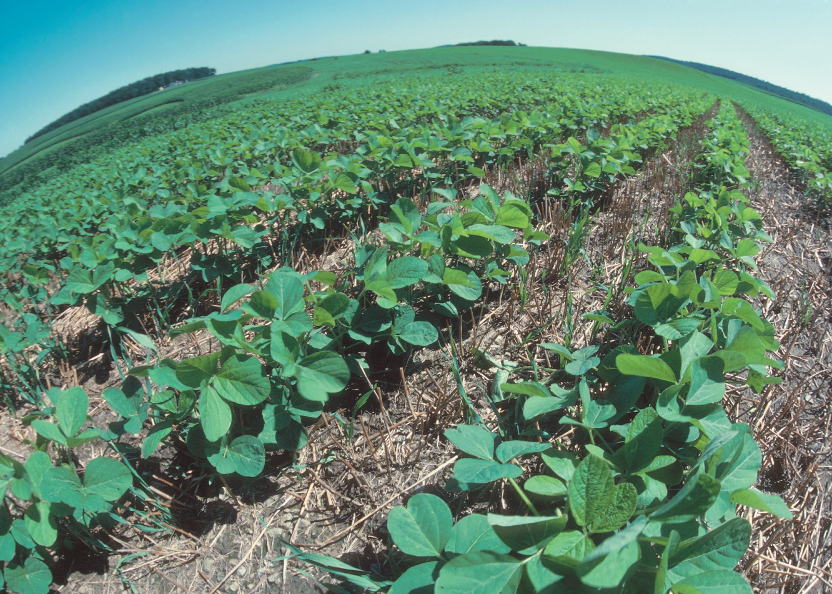
Chesapeake Bay Program: An Agricultural Perspective
Agriculture Workgroup

Slide 5

Chesapeake Bay Program: An Agricultural Perspective
Agriculture Workgroup (AgWG)
Agricultural forum for federal, state, and local agencies, conservation districts, universities, agri-business, and the corporate sector.
Recommend prioritization of federal and state technical and financial resources on specific practices.
Technical leadership to support the development and implementation of agricultural elements of the Chesapeake Bay TMDL.
Identify, define, quantify, and incorporate agricultural conservation practices into the Chesapeake Bay Program modeling tools.

Slide 6
Chesapeake Bay Program: An Agricultural Perspective
Agriculture Workgroup (AgWG)
Signatory Members from each Chesapeake Bay Program Partnership Agreement signatory with the exception of Washington DC [up to 8 signatory members (one each) with an alternate identified]
Chesapeake Bay Commission
Delaware
Maryland
New York
Pennsylvania
West Virginia
Virginia
US EPA

Slide 7
Chesapeake Bay Program: An Agricultural Perspective
Agriculture Workgroup (AgWG)
At-large Member Categories** [up to 12 members (one or more each) with option to identify alternates]
Academic (e.g. regional Colleges and Land Grant Institutions)
Agri-Business and Industry (e.g. regional Commodity, Fruits and Nuts, Livestock and Poultry, and Nursery Representatives or Associations)
Conservation Districts (e.g. regional Conservation Districts or Associations)
Conservation/Environmental NGO's (e.g. regional Agricultural and Conservation NGO's)
USDA (e.g. ARS, NRCS)

Slide 8
Chesapeake Bay Program: An Agricultural Perspective
Agriculture Workgroup (AgWG)
Decision-making for the AgWG will primarily be accomplished by consensus-based discussion and voice polling of the full workgroup participants attending an official partnership advertized meeting or conference call. If full participant consensus can not be achieved after due diligence to resolve the non-consensus opinion(s) (e.g. all parties can live with the decision), the question will be elevated to the recognized workgroup signatory and at-large members for a unanimous or consensus based process (e.g. all parties can live with the decision) that ultimately concludes in the voice or electronic polling of members to determine the will of the group. If, after substantial negotiations, consensus cannot be reached by the signatory and at-large members, the workgroup recognized members will be electronically polled, and the non-consensus decision will be elevated to the next decision-making body (WQGIT) along with a description of the positions of the polled members.

Slide 9
Chesapeake Bay Program: An Agricultural Perspective
Agriculture Workgroup (AgWG)
Criteria for At-Large Membership: In an effort to empower non-signatory partners in the decision-making process, priority for at-large membership will be reserved for non-governmental organizations, quasi-governmental organizations, Federal Agencies, academic institutions, and other local practitioners that have a role in agricultural water quality improvements. Nominations will be accepted from all AgWG members, advisors, and interested parties, and the selection of the at-large membership will be determined by the signatory AgWG members with consideration to their level of commitment, skills and perspectives (e.g., geographic diversity and expertise).

Slide 10
Chesapeake Bay Program: An Agricultural Perspective
Agriculture Workgroup (AgWG)
AgWG Governance Membership Selection Signatory Members: A request for signatory governance representation will occur when the workgroup identifies that there is a vacant position from any of the Chesapeake Bay Program Partnership Agreement signatories, with the exception of Washington DC. The signatory will be asked to provide a new nominee for the primary and/or alternative governance position, along with an associated brief bio, C.V. or resume.

Slide 11
Chesapeake Bay Program: An Agricultural Perspective
Agriculture Workgroup (AgWG)
AgWG Governance Membership Selection At-large Members: A request for at-large governance representatives will occur when the workgroup identifies that there is a need for filling vacant primary and/or alternative position(s). Nominations will be accepted from the full partnership, and will be reviewed and selected by the signatory members. When multiple nominees are identified for vacant position(s), the nominee(s) receiving the largest signatory endorsement will be selected to fill the position(s). The workgroup will review the recommended at-large selected candidates for acceptance.

Slide 12
Chesapeake Bay Program: An Agricultural Perspective
Agriculture Workgroup (AgWG)
AgWG Governance Membership Length of Term Signatory Members: Signatory governance representatives will serve until replaced by their associated signatory body, or by workgroup request due to extenuating circumstances, such as persistent non-participation in workgroup activities.

Slide 13
Chesapeake Bay Program: An Agricultural Perspective
Agriculture Workgroup (AgWG)
AgWG Governance Membership Length of Term At-large Members: At-large governance representatives will serve in their position(s) for a maximum of two-years. At the end of their term, the representative(s) may be re-nominated for consideration in refilling the vacant at-large position(s). In order to prevent the turn-over of all twelve at-large positions with their alternates within one year, the position terms will be staggered so that only one-half of the positions may be eligible for reconsideration annually. The determination of which representatives will initially serve one-year terms will be based on the level of signatory endorsement; i.e. those at-large candidates receiving the lowest level of endorsement will be assigned to one-year terms.

Slide 14
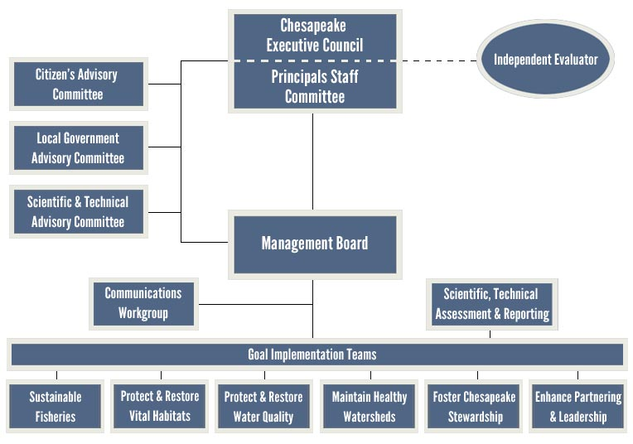
CBP Partnership Structure

Slide 15
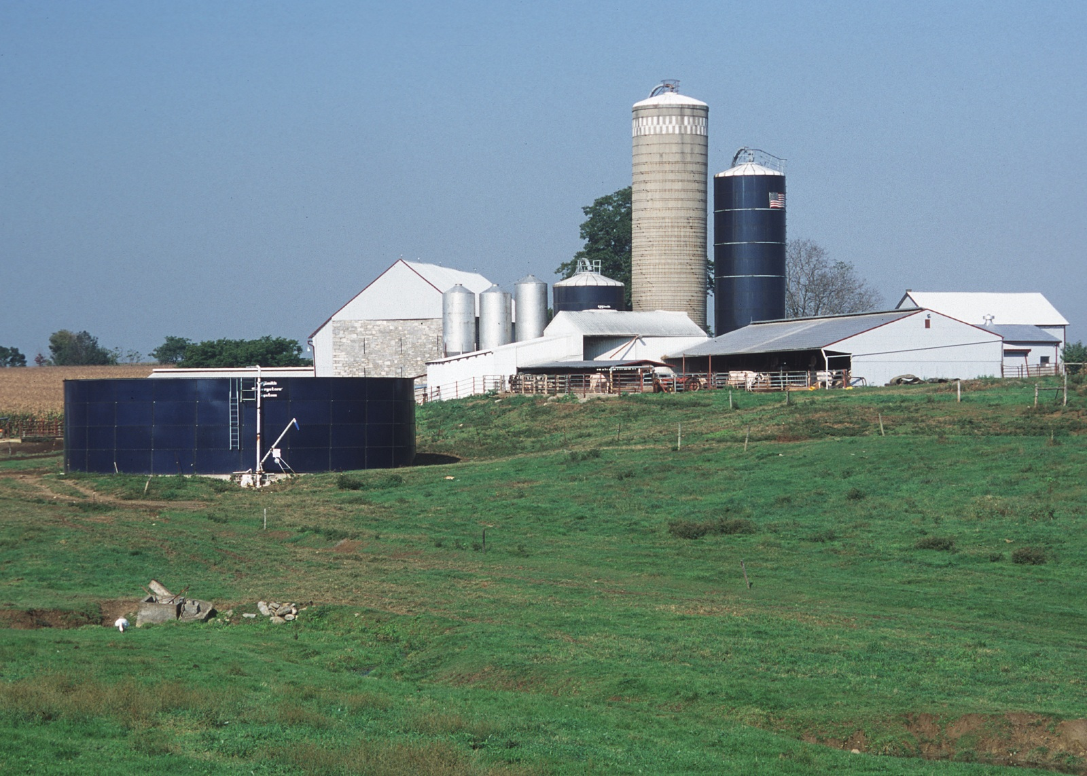
Chesapeake Bay Program: An Agricultural Perspective
Agricultural BMPs

Slide 16
Chesapeake Bay Program: An Agricultural Perspective
Best Management Practices (BMPs)
ALL decisions on what BMPs to credit and what are their pollutant load reduction capabilities are Chesapeake Bay Program Partnership decisions.

Slide 17
Chesapeake Bay Program: An Agricultural Perspective
Best Management Practices (BMPs)
The Partnership follows its “Protocol for the Development, Review, and Approval of Loading and Effectiveness Estimates for Nutrient and Sediment Controls in the Chesapeake Bay Watershed Model”
Link: http://www.chesapeakebay.net/publications/title/bmp_review_protocol

Slide 18
Chesapeake Bay Program: An Agricultural Perspective
Best Management Practices (BMPs)
The BMP Protocol is updated periodically to reflect better ways to go about this independent expert panel driven, Partnership consensus building decision process.

Slide 19
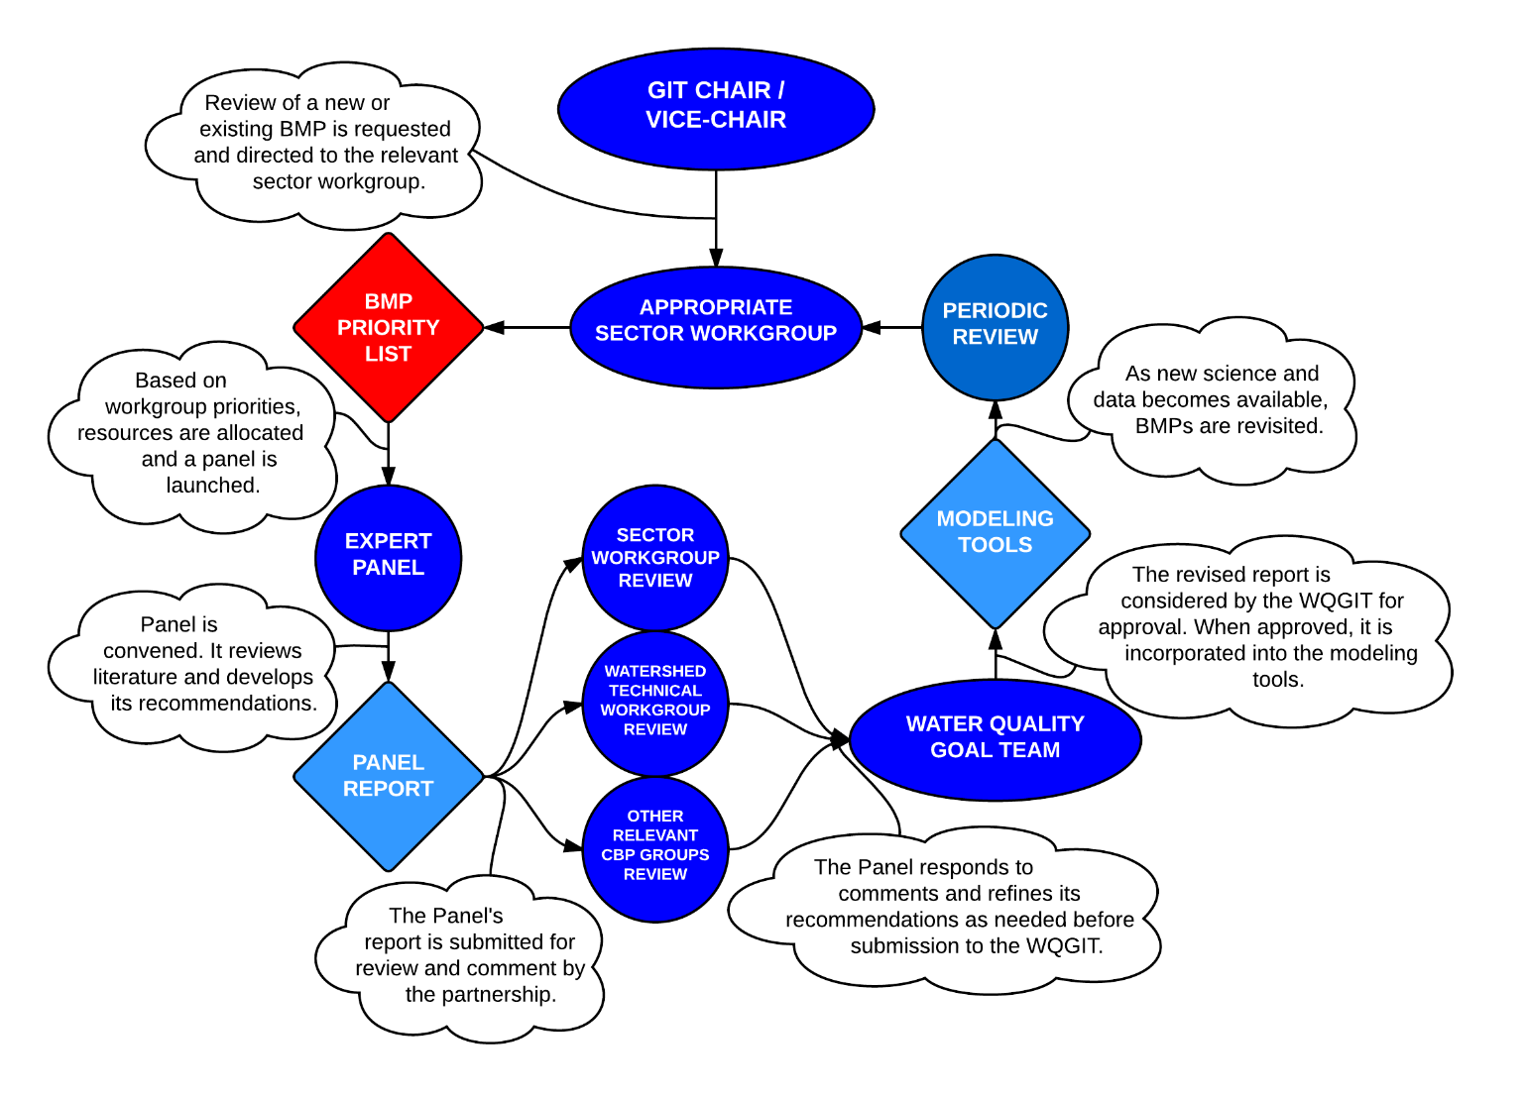
CBP Process for Approving BMPs
http://www.chesapeakebay.net/publications/title/bmp_review_protocol

Slide 20
Partnership Approved BMPs
91 categories of agricultural, forestry, urban, and natural sector BMPs.
190 separate BMPs with N, P and sediment efficiencies.
368 state-specific unique practice names mapped to the CBP defined practices available for reporting through NEIEN.
36 state-specific unique practice names available for conservation plans alone
94 individual cover crop BMPs available in the cover crop group alone

Slide 21
CBP Agricultural Practices

Slide 22
Chesapeake Bay Program: An Agricultural Perspective
BMP Expert Panels
Panels review all available data and studies to develop a definition and a pollution reduction efficiency for nitrogen, phosphorus, and/or sediment. Panels are comprised of technical experts from USDA, land grant universities, state agencies, etc. Panel recommendations must be reviewed and approved by the Agriculture Workgroup, the Watershed Technical Workgroup, and the Water Quality Goal Implementation Team.

Slide 23
Chesapeake Bay Program: An Agricultural Perspective
BMP Expert Panels
Agriculture : Completed
Nutrient Management, Tier 1 recommendations for Phase 5.3.2
Cover Crops, Short term recommendations for Phase 5.3.2
Conservation Tillage, Short term recommendations for Phase 5.3.2
Poultry Litter
Cover Crops, Full recommendations for Phase 5.3.2
Conservation Tillage, Full recommendations for Phase 5.3.2
Resource Improvement BMPs

Slide 24
Chesapeake Bay Program: An Agricultural Perspective
BMP Expert Panels
Agriculture: Ongoing
Manure Treatment Technologies
Cover Crops, recommendations for Phase 6
Conservation Tillage, recommendations for Phase 6
Nutrient Management, recommendations for Phase 6
Manure Injection/Manure Incorporation

Slide 25
Chesapeake Bay Program: An Agricultural Perspective
BMP Expert Panels
Agriculture: 2015-2016
Cropland Irrigation Management
Agricultural Stormwater and Tailwater Management
Animal Waste Management Systems and Poultry Heavy Use Area Concrete Pads

Slide 26
Chesapeake Bay Program: An Agricultural Perspective
BMP Expert Panels
Agriculture: Future
Agricultural Drainage Ditch Management
Vegetative Environmental Buffers
Potential Others

Slide 27
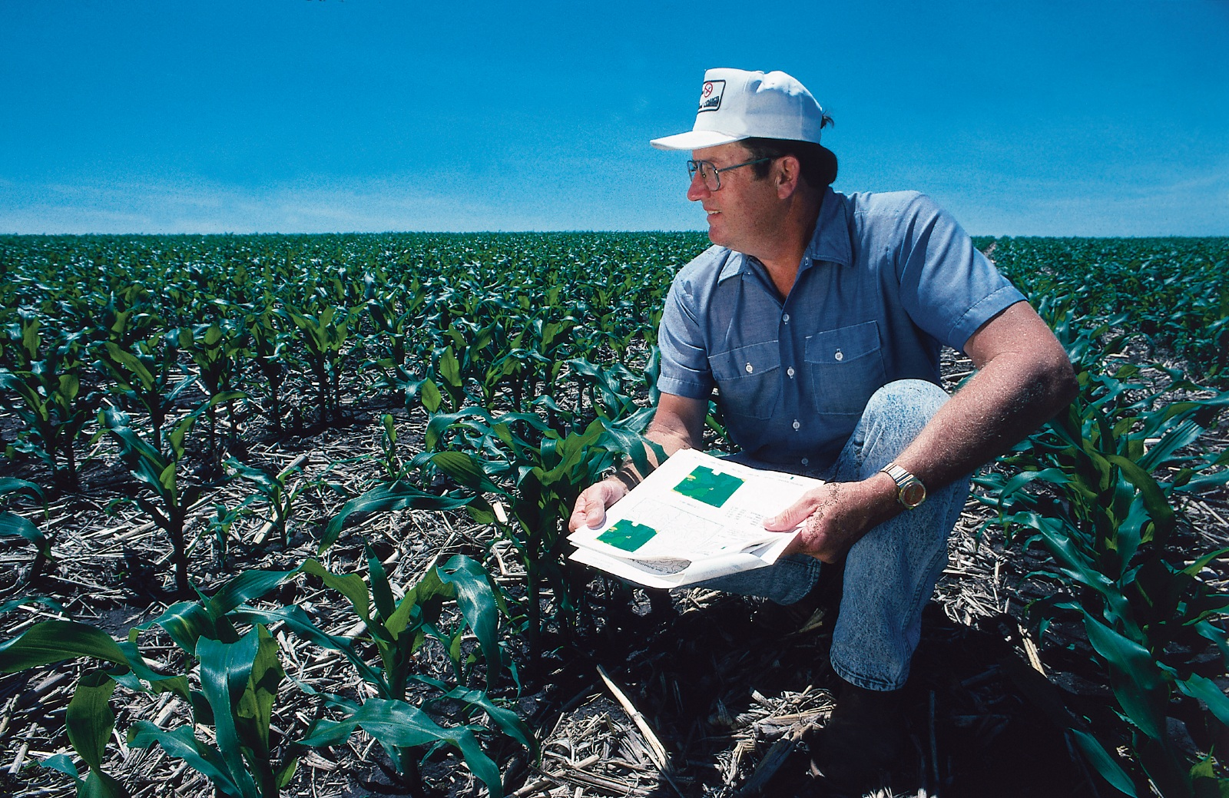
Chesapeake Bay Program: An Agricultural Perspective
BMP Verification

Slide 28
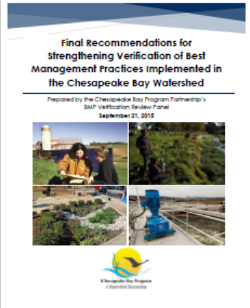

Slide 29
Chesapeake Bay Program: An Agricultural Perspective
“Verification: the process through which agency partners ensure practices, treatments, and technologies resulting in reductions of nitrogen, phosphorus, and sediment pollutant loads are implemented and operating correctly.”

Slide 30
Chesapeake Bay Program: An Agricultural Perspective
Verification: ensuring the hard work and out of pocket dollars paid by farmers, city engineers, organizations, homeowners, volunteers and many, many others will result in real progress toward cleaner streams, safer drinking water, more recreation opportunities and a healthier Bay

Slide 31
BMP Verification Life Cycle
BMP no longer present/functional removed from database
OR
erified, and rBMP
installed,
veported by Jurisdiction
BMP verified/
upgraded with new technology
Initial Inspection
BMP gains efficiency
Data quality assurance/ validation
BMP lifespan ends – re-verify
BMP Performance
BMP nears end of life span
Follow-up Checks
BMP fully functional
BMP performance metrics collected

Slide 32
Chesapeake Bay Program: An Agricultural Perspective
November 15th: jurisdictions submit their revised BMP verification program plans to EPA
December 15th: EPA approves the jurisdictions’ BMP verification program plans or requests specific changes prior to approval
2016-2017: two year ‘ramp-up’ period
2018: only verified practices will be credited in the future

Slide 33
Chesapeake Bay Program: An Agricultural Perspective
Basin-wide BMP Verification Framework
The Chesapeake Bay Basin-wide BMP Verification Framework addresses twelve specific elements in the report and the supporting appendices.
A complete listing of the twelve framework elements and links to their documentation within the report are provided.

Slide 34
Chesapeake Bay Program: An Agricultural Perspective
BMP Verification Principles
The Chesapeake Bay Program partnership defined and adopted five principles to guide partners’ efforts as they build on existing local, state and federal practice tracking and reporting systems and make enhancements to their BMP verification programs.
Adopted in December, 2012.

Slide 35
Chesapeake Bay Program: An Agricultural Perspective
BMP Verification Principles – Practice Reporting
Affirms that verification is required for practices, treatments and technologies reported for nitrogen, phosphorus and/or sediment pollutant load reduction credit through the Bay Program.
This principle also outlines general expectations for BMP verification protocols.

Slide 36
Chesapeake Bay Program: An Agricultural Perspective
BMP Verification Principles – Scientific Rigor
Asserts that BMP verification should assure effective implementation through scientifically rigorous, defensible and professionally established and accepted sampling, inspection and certification protocols.
Recognizes that BMP verification shall allow for varying methods of data collection that balance scientific rigor with cost effectiveness and the priority placed upon the practice in achieving pollution reduction.

Slide 37
Chesapeake Bay Program: An Agricultural Perspective
BMP Verification Principles – Public Confidence
Calls for BMP verification protocols to incorporate transparency in both the processes of verification and of tracking and reporting the underlying data.
Recognizes that levels of transparency will vary depending upon source sector, acknowledging existing legal limitations and the need to respect individual confidentiality to ensure access to non-cost shared practice data.

Slide 38
Chesapeake Bay Program: An Agricultural Perspective
BMP Verification Principles – Adaptive Management
Recognizes that advancements in practice reporting and scientific rigor are integral to assuring desired long-term outcomes while reducing the uncertainty.
Calls for BMP verification protocols to recognize existing funding and allow for reasonable levels of flexibility in the allocation or targeting of funds.

Slide 39
Chesapeake Bay Program: An Agricultural Perspective
BMP Verification Principles – Sector Equity
Calls for each jurisdiction’s BMP verification program to strive to achieve equity in the measurement of functionality and effectiveness of implemented BMPs among and across the source sectors; i.e. agriculture, forestry, urban, wastewater, etc.

Slide 40
Chesapeake Bay Program: An Agricultural Perspective
BMP Verification Review Panel
An independent BMP Verification Review Panel of 13 regionally and nationally recognized experts was established by the Bay Program partnership to examine the degree to which jurisdictions’ practice tracking, verification and reporting programs meet the parameters delineated in the Bay Program partnership’s adopted verification principles and verification guidance.

Slide 41
Chesapeake Bay Program: An Agricultural Perspective
Sector Verification Guidance
Six Bay Program technical workgroups were tasked with developing verification guidance for use by the seven watershed jurisdictions in further developing and enhancing their existing BMP tracking, verification and reporting programs.
The six sets of workgroup-based verification guidance are: agriculture, forestry, urban stormwater, wastewater, wetlands and streams.

Slide 42
Chesapeake Bay Program: An Agricultural Perspective
Practice Life Spans
Agreement to establish practice life spans for all of the approved BMPs and apply these life spans within the workgroup’s verification guidance and the jurisdictions’ verification programs and underlying protocols.
Agreement to the crediting of a practice after its recorded lifespan as long as the proper level of re-verification occurs, confirming the practice is still present and functioning.

Slide 43
Chesapeake Bay Program: An Agricultural Perspective
Access to Federal Cost-shared Practice Data
Recommend that all six states within the Chesapeake Bay watershed have full access to all federally cost-shared conservation practice data.
Give a greater capacity for analysis and understanding of agricultural conservation practice implementation across the landscape.
To support the adaptive management and targeting of conservation programs.
To fully credit producers for their implemented conservation practices.
To eliminate any double counting.
To promote success in attaining water-quality goals.
Recommend that states establish a USDA1619 Conservation Cooperator agreement between the Natural Resources Conservation Service (NRCS) and one of more of their state conservation agencies.

Slide 44
Chesapeake Bay Program: An Agricultural Perspective
Enhanced Reporting of Federal Cost-shared Practices
The Agriculture Workgroup identified opportunities to enhance the recordkeeping associated with USDA conservation practices, in order to:
Capture specific information that can be used to more efficiently integrate the data with jurisdictional datasets.
More accurately represent the practices in the Bay Program partners’ modeling tools.
A number of USDA conservation practices were identified as having substantial limitation in the amount of data available for translating between USDA conservation practice codes and Bay Program-approved practice definitions.

Slide 45
Chesapeake Bay Program: An Agricultural Perspective
Accounting for Non-cost Share Practices
For practices installed outside of a regulatory program and without the assistance of a federal or state cost-shared program, there is no permit or contractual vehicle to ensure adherence to specific practice standards, specific planning requirements, and project performance.
Typically there is no established mechanism for requiring reporting or monitoring through time or for ensuring public access to the practice data.

Slide 46
Chesapeake Bay Program: An Agricultural Perspective
Accounting for Non-cost Share Practices
The CBP Resource Improvement Practice Definitions and Verification Visual Indicators Report provides partners with the guidance required for the collection and verification of non-cost-shared agricultural conservation practices that meet Bay Program partners’ BMP definitions and establish definitions and verifications methods for Resource Improvement Practices.

Slide 47
Chesapeake Bay Program: An Agricultural Perspective
Preventing Double-counting
There are many situations where a jurisdiction tracks an implemented conservation practice and the USDA also tracks the identical practice. Typically, both the state and the USDA are tracking the same practice, because they both provided financial assistance to the farmer for the practice implementation.
To prevent double counting, the six watershed states have employed various techniques to address this issue.

Slide 48
Chesapeake Bay Program: An Agricultural Perspective
Cleaning Up Historic BMP Data
The Bay Program’s partners are attempting to create more accurate BMP records from 1985 through the present to better support the basin-wide and Bay-wide efforts underway and explain observed long-term water quality trends in the hundreds of monitoring stations across the watershed and tidal waters.

Slide 49
Chesapeake Bay Program: An Agricultural Perspective
Evaluation and Oversight
Bay Program partners have agreed to a suite of ongoing evaluation and oversight procedures and processes to ensure the five BMP verification principles adopted by partners are adhered to and effectively carried out.
These procedures and processes also reflect the Bay Program partners’ commitment to adapt to new scientific findings and experiences from verification efforts underway.

Slide 50
Chesapeake Bay Program: An Agricultural Perspective
Communications and Outreach
The Bay Program has developed a BMP verification communications and outreach strategy to enable partners to have consistent, clear internal messages as they gradually build toward public implementation of the BMP verification framework.
Having solid internal understanding and messaging will enable Bay Program partners to more smoothly and consistently communicate about BMP verification with various external audiences and “implementers” across the watershed as the BMP verification process moves forward.

Slide 51
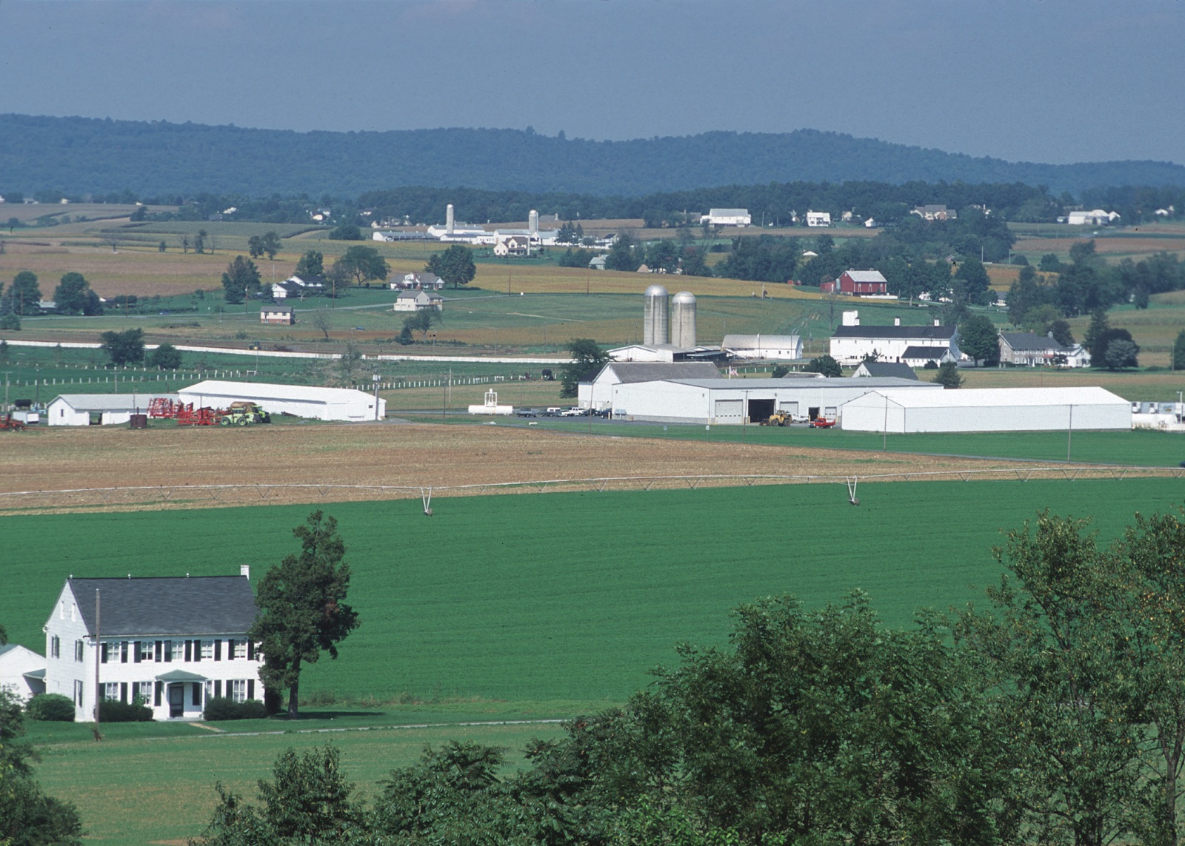
Chesapeake Bay Program: An Agricultural Perspective
Agricultural BMP Verification Guidance

Slide 52
Chesapeake Bay Program: An Agricultural Perspective
Agricultural BMP Verification Guidance - Basic
Three BMP Categories:
Visual Assessment BMPs: Single Year
Example- Cover Crops
Visual Assessment BMPs: Multi-Year
Example- Animal Waste Management Systems
Non-Visual Assessment BMPs
Example- Nutrient Application Management

Slide 53
Chesapeake Bay Program: An Agricultural Perspective
Agricultural BMP Verification Guidance - Basic
Four BMP Implementation Mechanism Types:
Non-Cost-Shared BMPs:
Example- Farmer or privately funded practices.
Cost-Shared BMPs:
Example- Federal, state and county financial assistance programs.
Public grant funded NGO programs.
Regulatory Program BMPs:
Example- State nutrient management regulatory programs.
Permit Program BMPs:
Example- Federal/state CAFO programs.

Slide 54
Chesapeake Bay Program: An Agricultural Perspective
Agricultural BMP Verification Guidance - Basic
Two Verification Inspection Categories:
Initial Inspections:
Example- BMP Implementation inspections for cost-shared BMPs.
Initial BMP identification assessments for non-cost shared BMPs.
Follow-up Checks:
Example- O & M compliance inspections for federal, state, and county contractual BMPs.
Compliance inspections for regulatory or permit state programs.

Slide 55
Chesapeake Bay Program: An Agricultural Perspective
Agricultural BMP Verification Guidance - Basic
Three Verification Inspection Levels:
Initial Inspections:
Minimum 100% BMP implementation inspections for cost-shared BMPs or initial BMP identification assessments.
Transect sub-sampling allowed for Visual Assessment BMPs: Single Year.
Follow-up Checks:
Minimum 10% sub-sampling for BMPs accounting for more than 5 percent of the state WIP sector goals.
Minimum 5% sub-sampling for BMPS accounting for 5 percent or less of the state WIP sector goals.
Minimum once per 5-year permit program BMPs.

Slide 56
Chesapeake Bay Program: An Agricultural Perspective
Agricultural Verification Guidance – Verification Matrix
Organized by BMP Categories:
Visual Assessment BMPs: Single Year
Visual Assessment BMPs: Multi-Year
Non-Visual Assessment BMPs
Provides examples of recommended and non-recommended verification methods.

Slide 57
Chesapeake Bay Program: An Agricultural Perspective
Agricultural Verification Guidance – Alternative Approach
The AgWG developed a statistical analysis approach based on research and existing examples.
Emphasis of verification based on physical lifespan of BMP and vulnerability of BMP to be modified or removed.
Higher levels of follow-up verification required for annual BMPs vs. structural.

Slide 58
Chesapeake Bay Program: An Agricultural Perspective
Agricultural Verification Guidance – Alternative Approach
A jurisdiction may propose an alternative strategy for follow up sub-sampling for BMPs achieving greater than 5% of the jurisdiction’s agricultural sector annual progress nutrient and/or sediment load reductions.
Any such alternative shall be accompanied by a justification providing the rationale for the alternative.
The BMP Verification Review Panel shall review the alternative percentage and justification and make a recommendation to EPA on the adequacy of the alternative.

Slide 59
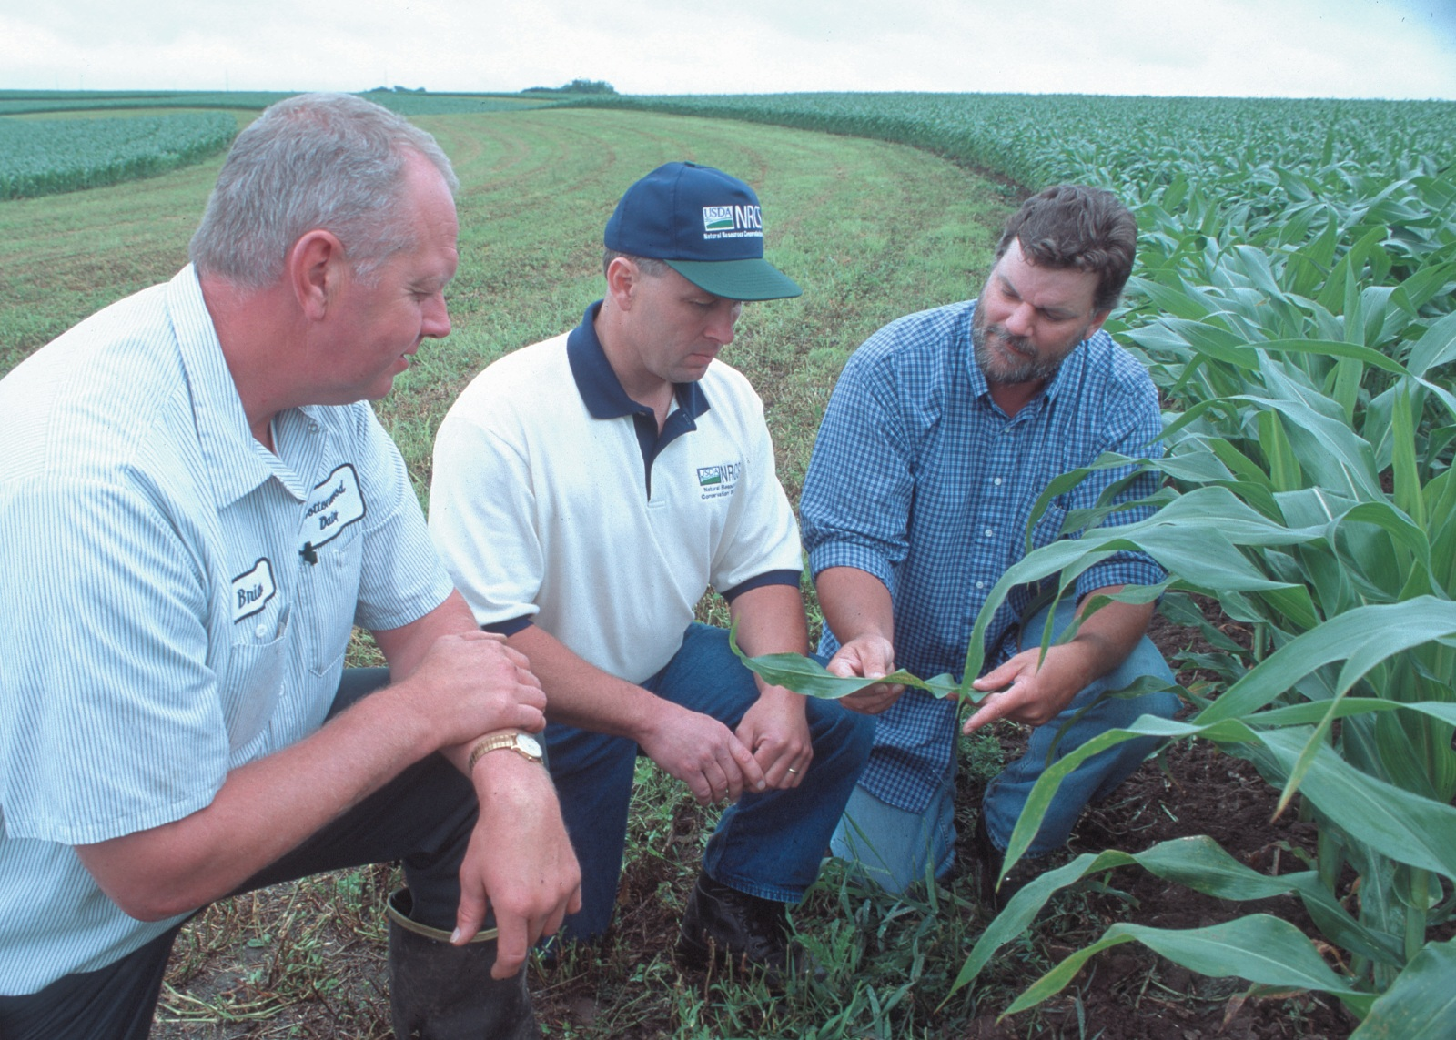
Chesapeake Bay Program: An Agricultural Perspective
Agricultural BMP Verification & You

Slide 60
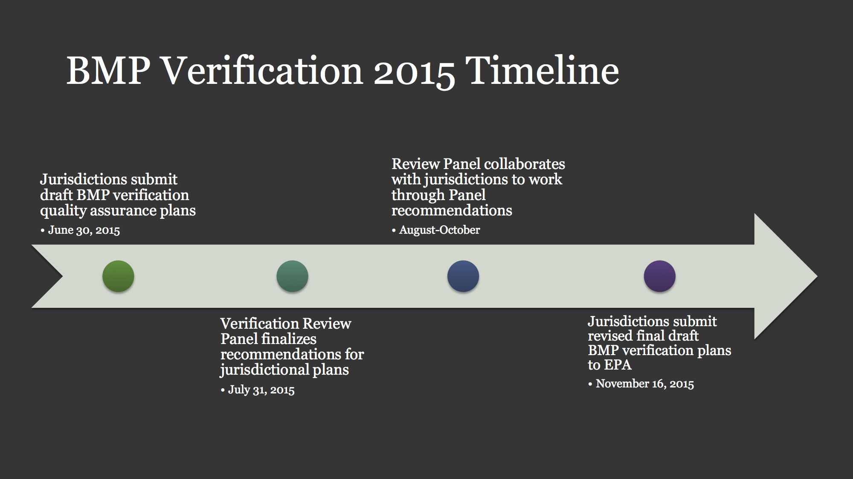
Chesapeake Bay Program: An Agricultural Perspective

Slide 61
Chesapeake Bay Program: An Agricultural Perspective
When is BMP Verification Coming?
The Bay jurisdictions have submitting their final BMP verification plans to EPA for review.
There is a two-year phase-in period for the BMP verifications plans to be fully implemented (2017).
By 2018, BMP implementation data reported by the jurisdictions for credit towards their TMDL goals will be need to be verified.

Slide 62
Chesapeake Bay Program: An Agricultural Perspective
What Does BMP Verification Mean to Me?
Landowners: Potentially increased compliance visits for contractual and permitted operations.
Conservation Partners: Potentially more time dedicated to verifying past conservation projects and non-cost shared practices.
Service Providers: New potential opportunities for cooperating with local conservation and academic partners.

Slide 63

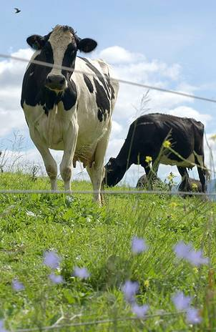




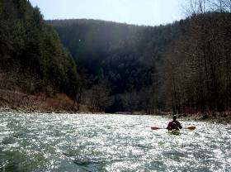
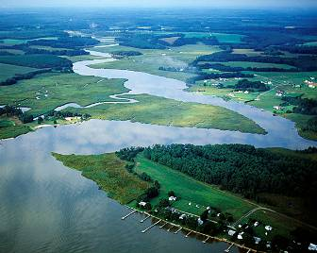
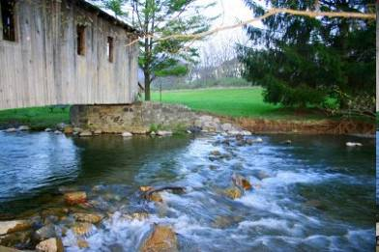
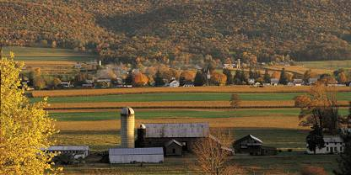
Questions & Comments
63

