Slide 1
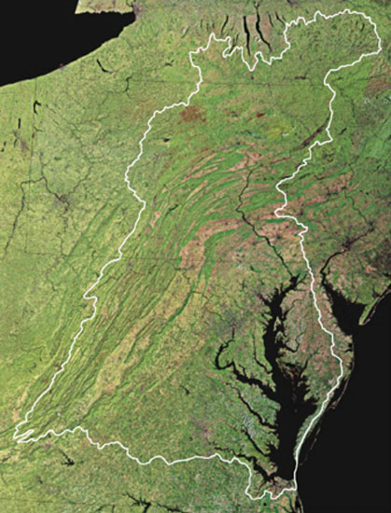
Understanding Upcoming Policy Challenges and Decisions for Water Quality
Citizen Advisory Committee Meeting
September 7, 2016
Rich Batiuk
Associate Director for Science, Analysis and Implementation
and
Lucinda Power
Implementation and Evaluation Team Leader
Chesapeake Bay Program Office
U.S. Environmental Protection Agency
Annapolis, Maryland

Slide 2
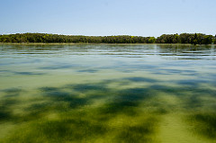
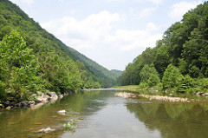
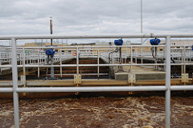
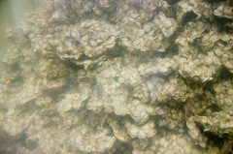
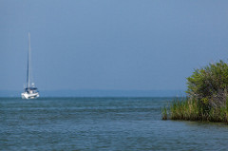
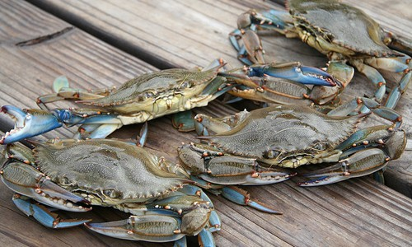
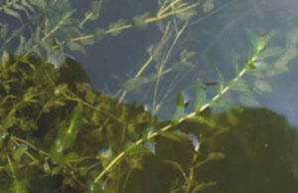
SUCCESSES—SEEING REAL BAY AND WATERSHED RESPONSES

Slide 3
Setting the Stage: Partnership’s Midpoint Assessment Calendar

Slide 4
“Getting to Yes” on the Midpoint Assessment
Focus on incremental, consensus decision-making up through the Partnership
Topics fully vetted through webinars and informational briefings to tee up policy decisions to wider partners, stakeholder, public audiences
Principals’ Staff Committee is driving decision-making schedule for the Partnership

Slide 5
WQGIT October 24-25, 2016 Decisional Meeting
Meeting Theme: Getting Ready for Development of the Phase III WIP Planning Targets
Objective: Reaching agreement on…
Phase III Planning Targets Methodology
Climate Change Assessment Procedures & Range of Options for Phase III WIPs
Preliminary Recommendations on Local Area Targets
Assigning responsibility for Conowingo
How monitoring trends can inform Phase III Planning Target development

Slide 6
Key PSC Decisional Meetings
December 2016 | Late May Retreat | December 2017
Phase III WIP Planning Methodology | Draft Phase III WIP Planning Targets | Final Phase III WIP Planning Targets
Conowingo Dam extra loads allocation | Final Phase 6 modeling tools | Presentation of Local Engagement Strategies
Climate change assessment procedures | Use of 2025 conditions in Phase III WIPs | Presentation of final Midpoint Assessment Profiles
Range of options for addressing climate change in Phase III WIPs | Quantification of Conowingo Dam extra loads to be offset
Recommendations on Local Area Targets | If, when and how to address climate change in Phase III WIPs
 | Presentation of final Phase III WIP expectations

Slide 7
Key Phase 6 BMP Panel Reports: Targeted WQGIT Approval Dates
Nutrient Management: September 26, 2016
Manure Technologies: September 26, 2016
Wetlands: September 26, 2016
Oyster Restoration: November 2016

Slide 8
Chesapeake Bay Watershed Water Quality Trends

Slide 9
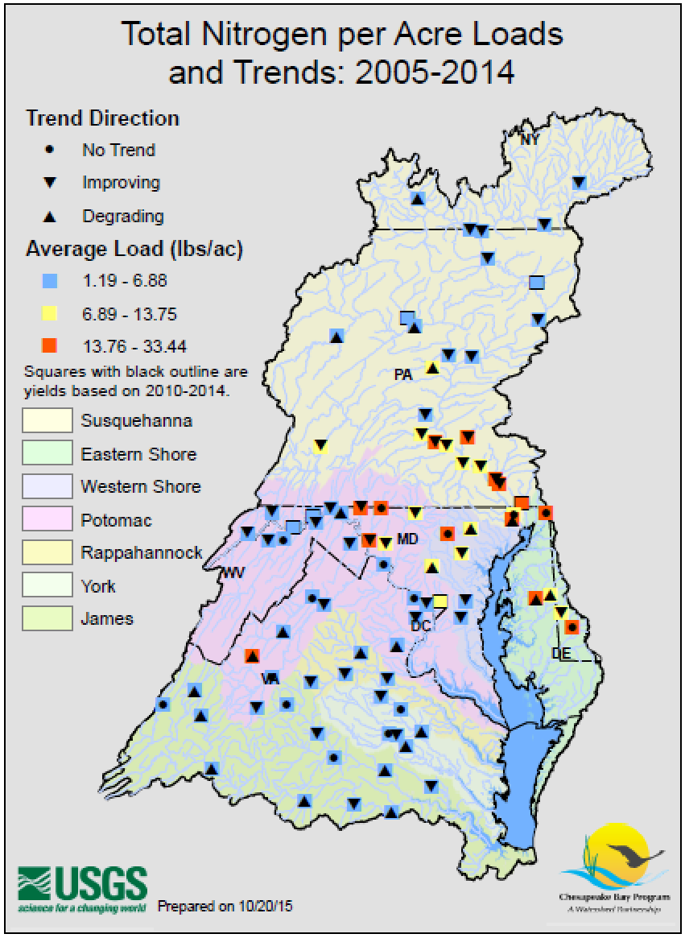
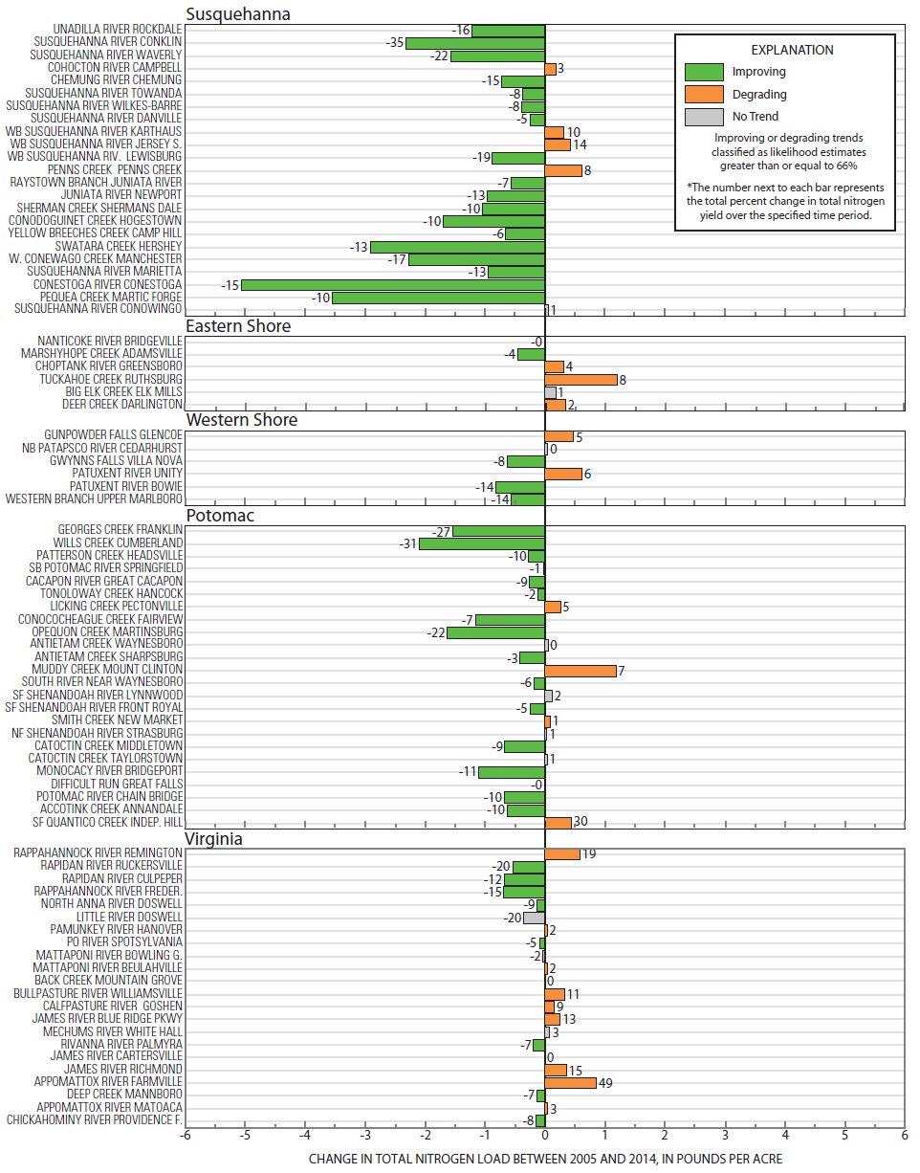

Slide 12
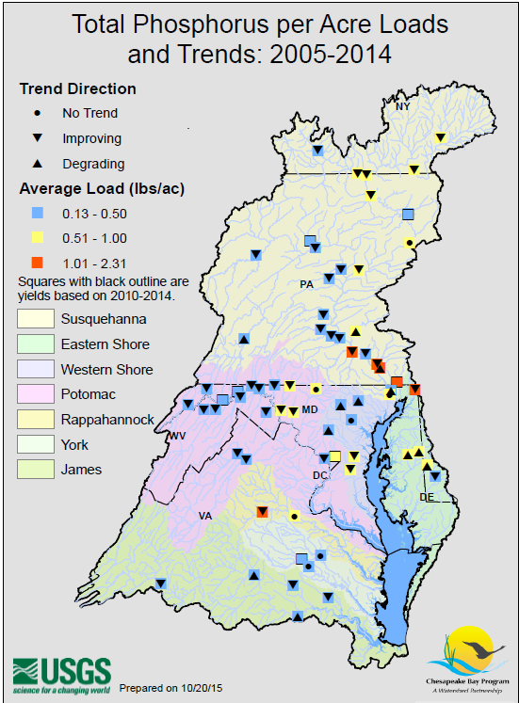
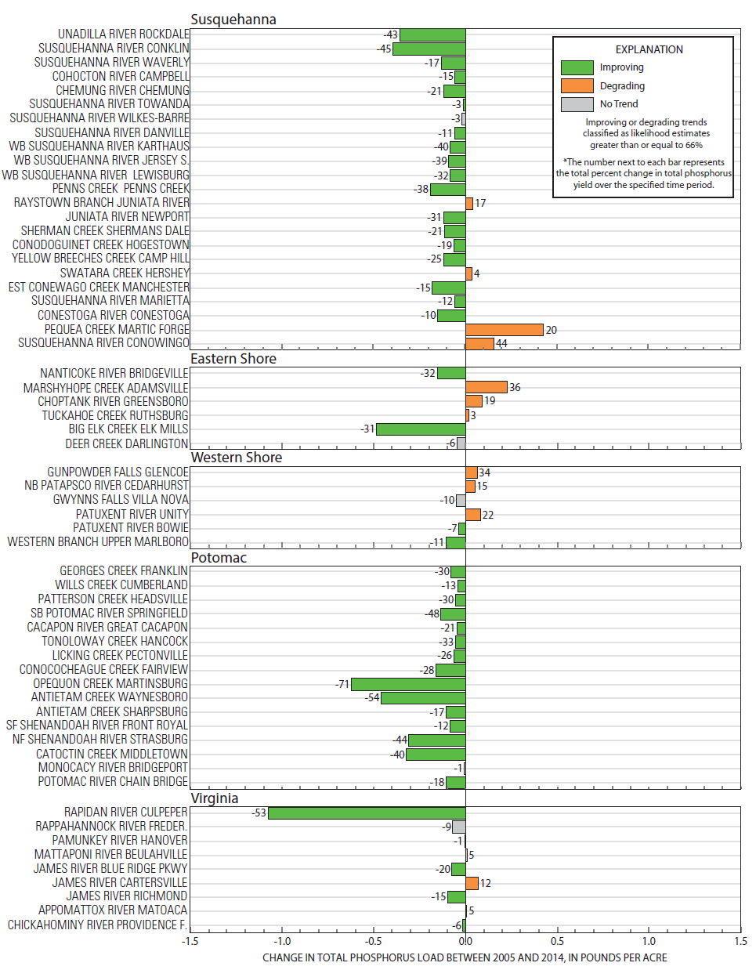

Slide 13
Watershed Trends:
Findings and Implications
Nutrient loads in the majority of the monitored streams and rivers are decreasing
More recent river input trends in nitrogen and phosphorus loads are either flattening out or increasing
We must better understand the causes of the increasing trend in phosphorus at Conowingo Dam when upstream stations are showing downward trends
We must factor in findings from these observed trends into Partnership and jurisdiction-specific decisions on how we get to our 2025 goals

Slide 14
Chesapeake Bay Tidal Water Quality Trends

Slide 15
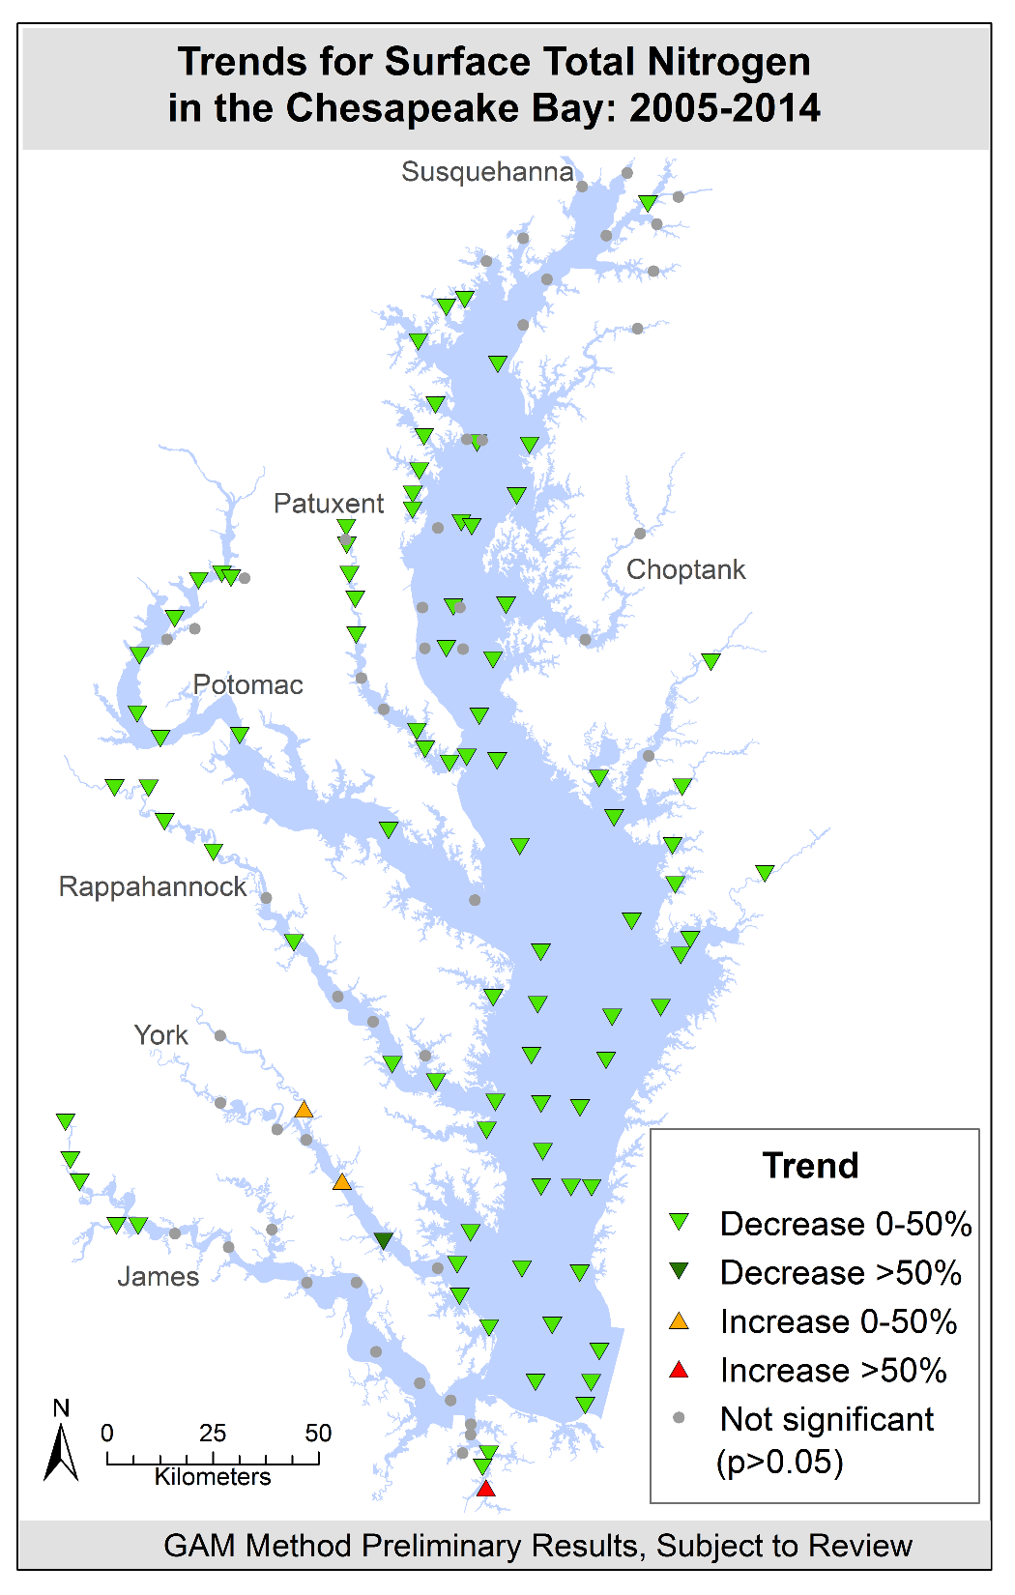
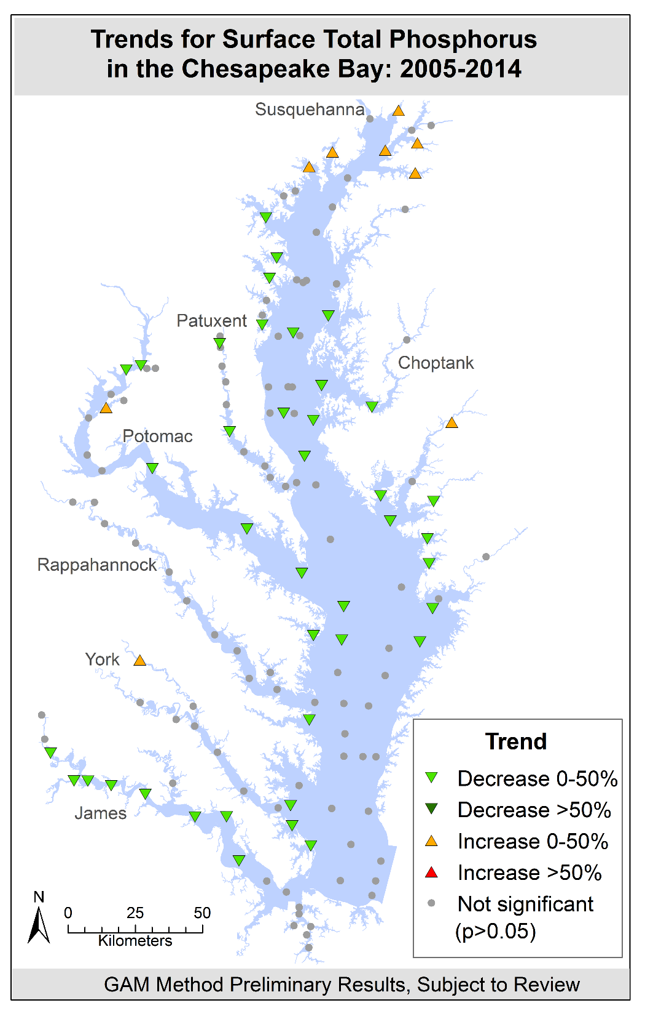

Slide 17
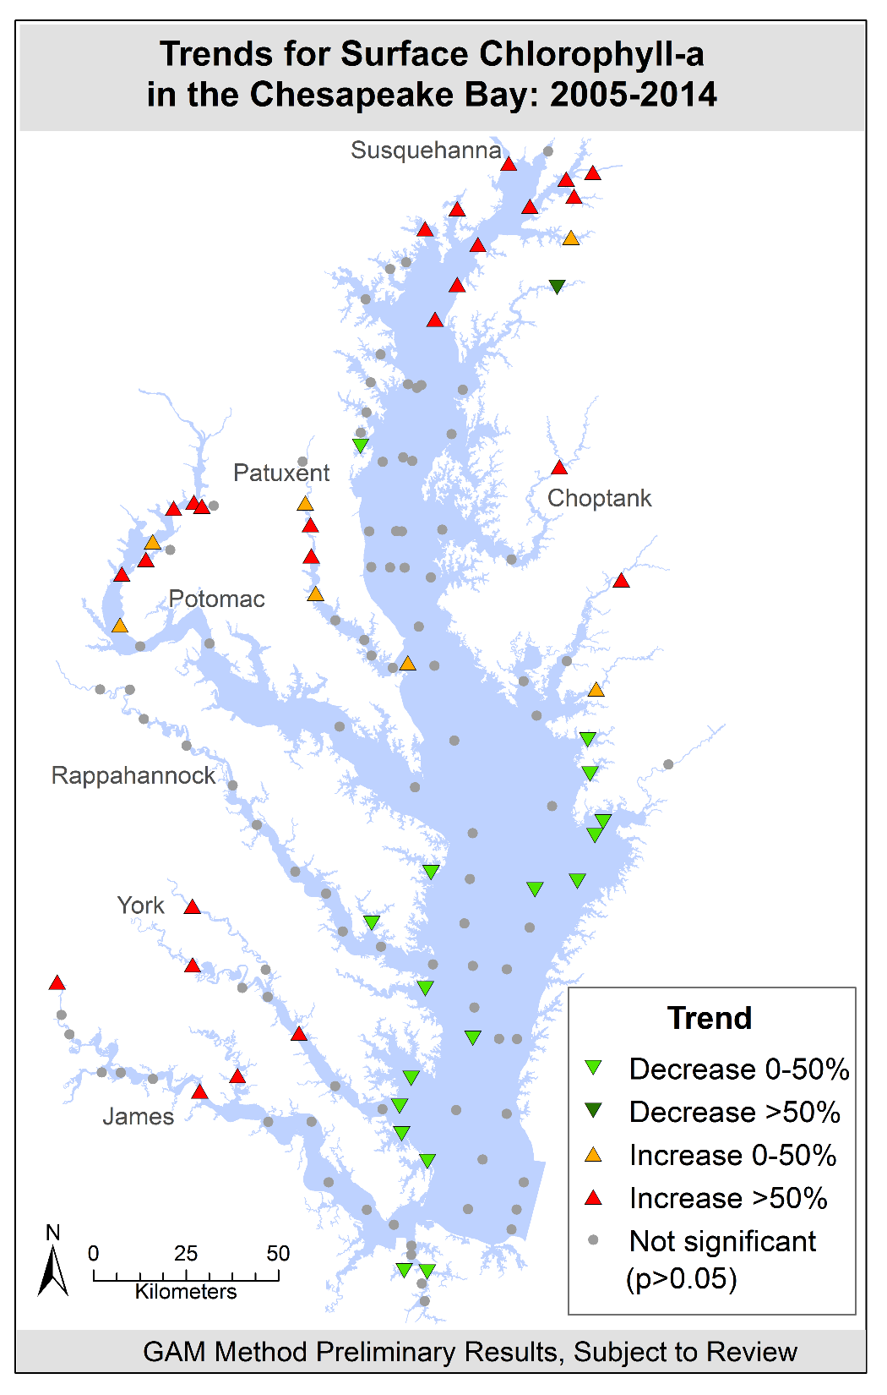

Slide 18
?

Slide 19
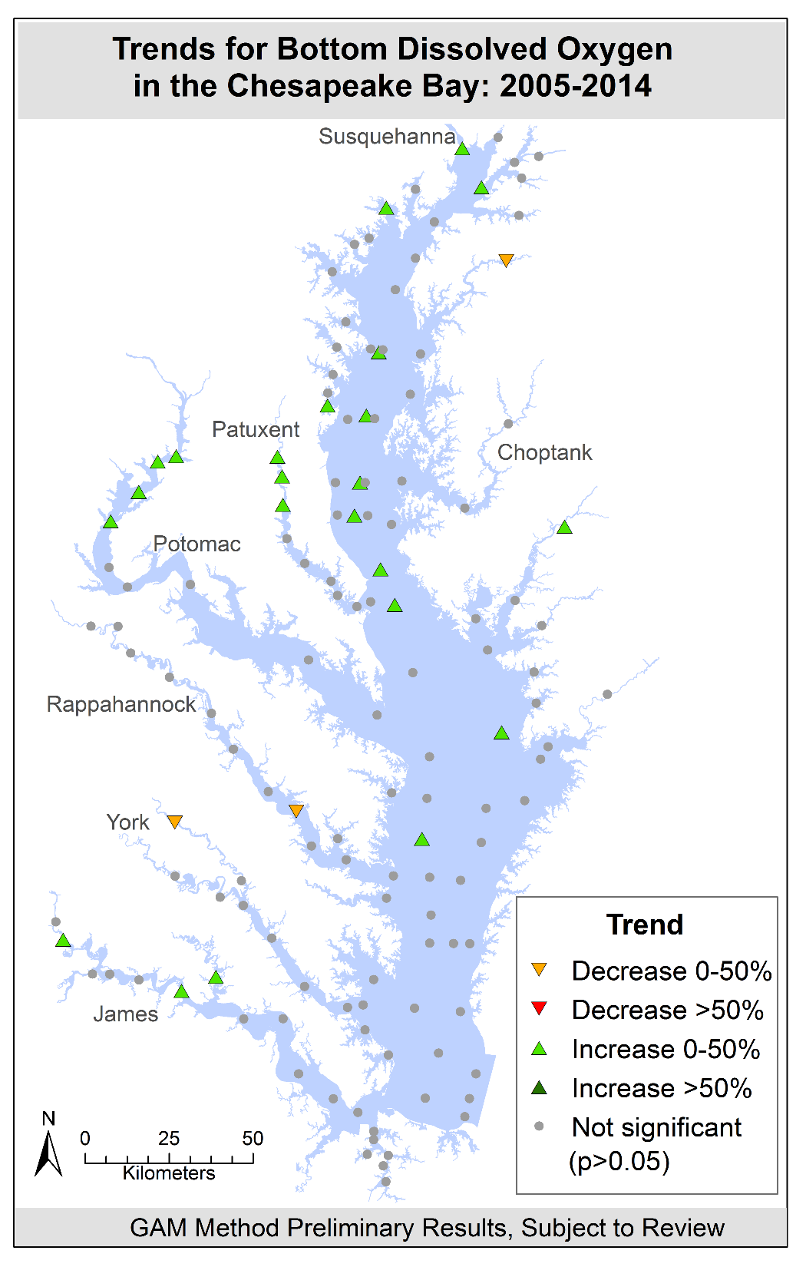

Slide 20
!

Slide 21


Slide 22
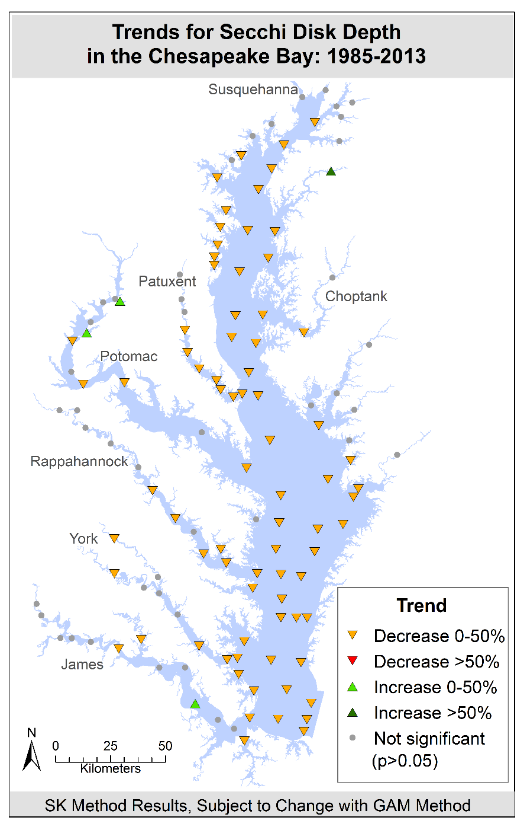

Slide 23
Tidal Water Trends:
Findings and Implications
Bay has a much shorter term memory than once thought
We ARE observing positive tidal water quality responses in the face of a changing climate
We stand to lose this important momentum if we don’t take actions to continue reducing our key sources—ag, stormwater
We must factor in findings from these observed trends into Partnership and jurisdiction-specific decisions on how we get to our 2025 goals

Slide 24
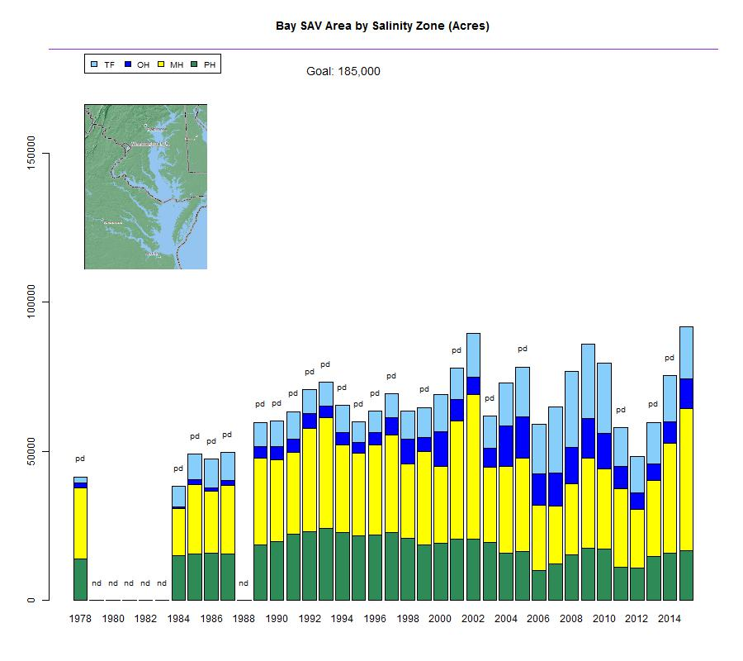
Chesapeake Bay SAV Trends: 1978-2015
3X!

Slide 25
Chesapeake Bay SAV Trends: 1978-2015
… still half way to go

Slide 26
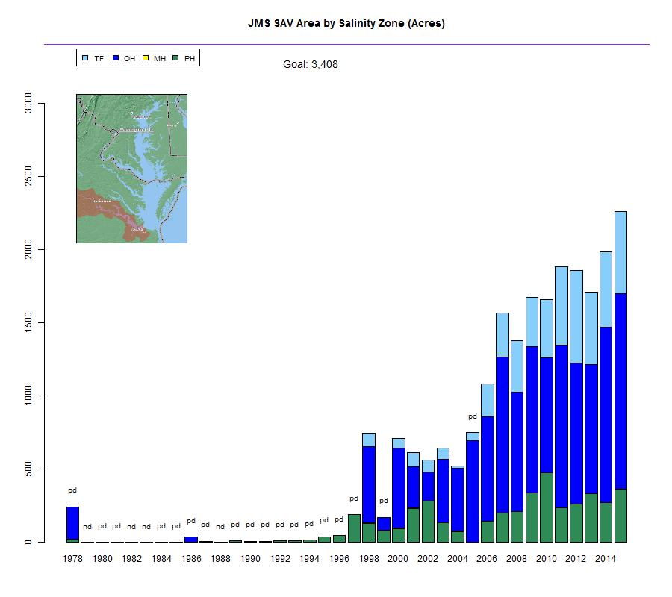
James River SAV Trends: 1978-2015
The Good…

Slide 27
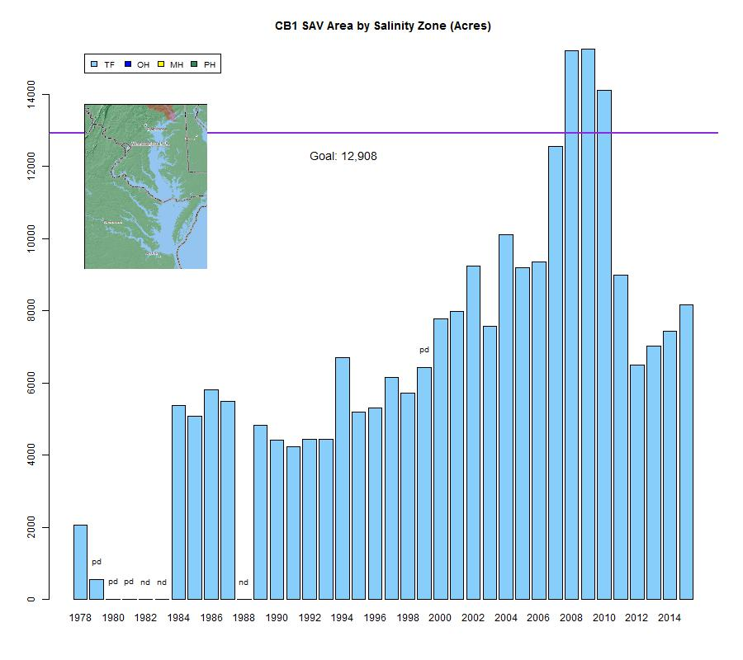
Susquehanna Flats SAV Trends: 1978-2015
The Beautiful…

Slide 28
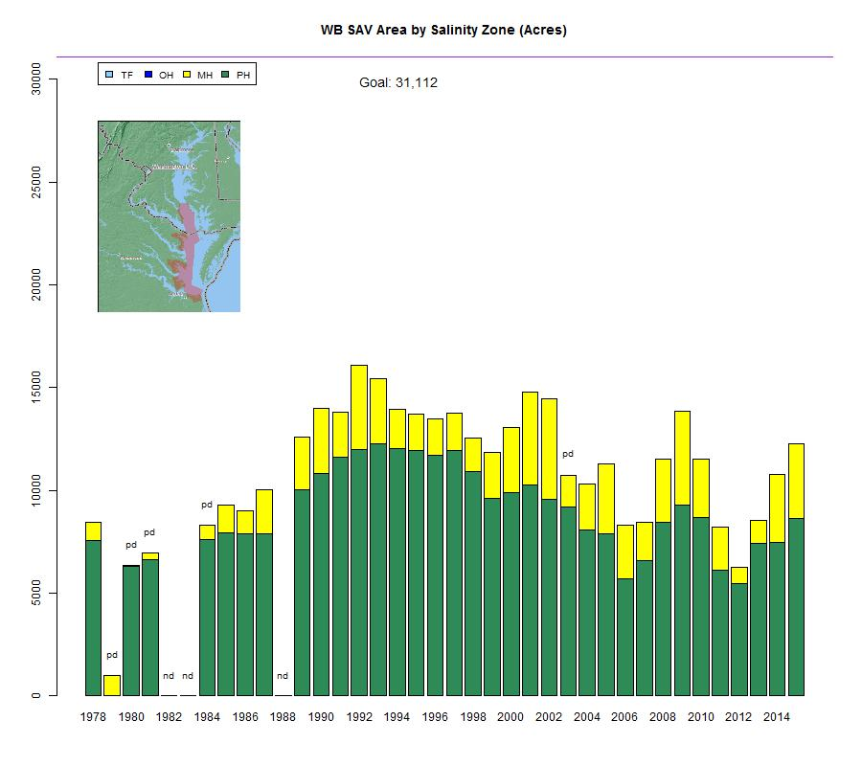
Lower Western Shore SAV Trends: 1978-2015
And the Ugly…

Slide 29
Lower Western Shore SAV Trends: 1978-2015
Eelgrass populations responding to hotter summer temperatures

Slide 30
SAV Trends:
Findings and Implications
From our observed low point in 1984, underwater Bay grasses have almost tripled in total acreage
Grass bed density and species diversity has also increased over the past three decades
But we are only half way to our restoration goal, baywide
We are facing a steep challenge in fully restoring eelgrass to the Bay
Need to understand what additional improvements in water clarity are needed to see the next significant increase in SAV acreages

Slide 31
The Changing Shape of Our Watershed Pollutant Sources

Slide 32
Chesapeake Bay Watershed Nitrogen Loads: 1985-2015
318
242
2015
1985
59% Wastewater
39% Agriculture
2% Forest
Where did the Nitrogen reductions come from?

Slide 33
Percent of Nitrogen Goal Achieved

Slide 34
Nitrogen Load to be Reduced by 2025

Slide 35
Chesapeake Bay Watershed Municipal and Industrial Wastewater Treatment Facilities Discharged Nitrogen Loads: 1985-2015

Slide 36
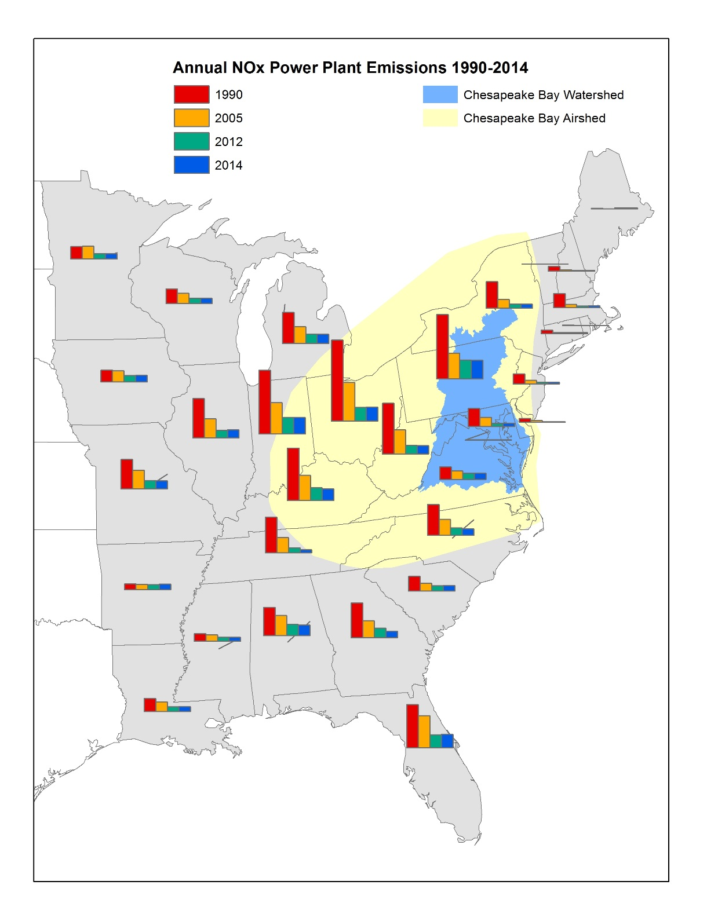
35 million lbs. reduction to Bay: 1985-2015
http://gis.chesapeakebay.net/air
Notes:
Airshed is 570,000 square miles – 9 times larger than the watershed
1/3 of nitrogen pollution comes from air deposition
Between 1985-2015, loads of oxidized nitrogen from atmospheric deposition in the Chesapeake Bay watershed is projected to decrease by about 60%

Slide 37
Chesapeake Bay Watershed Nitrogen Reductions: 2015-2025
242
192
2025
2015
Where will the remaining nitrogen reductions* come from?
71% Agriculture
24% Urban Stormwater
5% Septic Systems
*Based on the jurisdictions’ Phase II WIPs.

Slide 38
Chesapeake Bay Watershed Phosphorus Loads: 1985-2015
25.6
15.4
2015
1985
73% Wastewater
24% Agriculture
2% Urban Stormwater
1% Forest
Where did the phosphorus reductions come from?

Slide 39
Percent of Phosphorus Goal Achieved

Slide 40
Chesapeake Bay Watershed Phosphorus Reductions: 2015-2025
15.4
14.5
2015
2025
Where will the remaining phosphorus reductions* come from?
64% Agriculture
36% Urban Stormwater
*Based on the jurisdictions’ Phase II WIPs.

Slide 41
Pollutant Source Sector Implications
Phase II WIPs
Phase III WIPs
2025 Nitrogen Goal
Agriculture
Urban Stormwater
?
Septic Systems

Slide 42
Resulting Policy Challenges

Slide 43
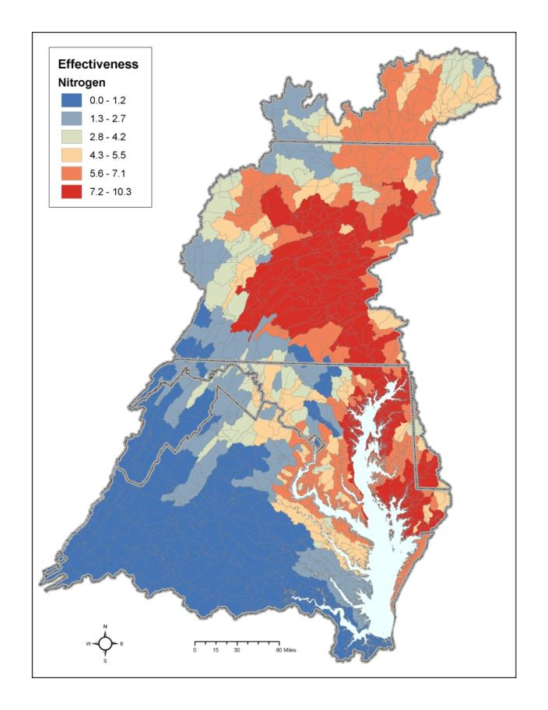
Where Load Reductions Occur Matters

Slide 44
Pennsylvania Nitrogen Loads and Goals: 1985-2025

Slide 45
Pennsylvania Nitrogen Loads and Goals: 1985-2025
11 million lbs.
34 million lbs.

Slide 46
Pennsylvania Nitrogen Loads and Goals: 1985-2025

Slide 47
Pennsylvania’s Source Sector Challenges
Needs to reduce a total of 34 million lbs by 2025
Responsible for 69 percent of remaining basinwide nitrogen load reductions by 2025
Agriculture will likely be responsible for more than 80 percent of these nitrogen reductions by 2025
The technical assistance/compliance infrastructure, cost share funding are not in place to deliver on these needed reductions

Slide 48
Summary of Challenges
River input loads flattening out, increasing in the past decade
Wastewater, air deposition close to tapped out
Agriculture being asked for most of the remaining reductions
States’ urban stormwater reduction goals being scaled back and/or to be achieved sometime post 2025

Slide 49
Summary of Challenges
Pennsylvania agriculture on the hook for a significant portion of all the remaining reductions
MD, VA currently depending on ‘over-reductions’ of wastewater treatment facility loads to counter under-reductions in agriculture and urban stormwater sectors
In MD and VA, where the load reductions occur matters to full restoration of Bay regional and local water quality
Phosphorus saturated soils, nitrogen groundwater lags hinder timely water quality responses and need to be factored in

Slide 50
Refinements and Advancements of the Partnership’s Phase 6 Modeling Tools

Slide 51
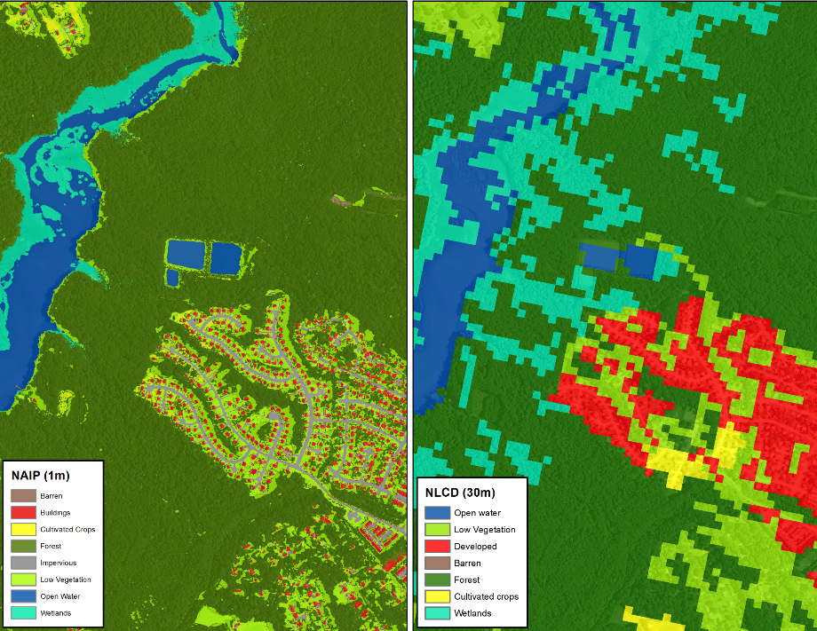
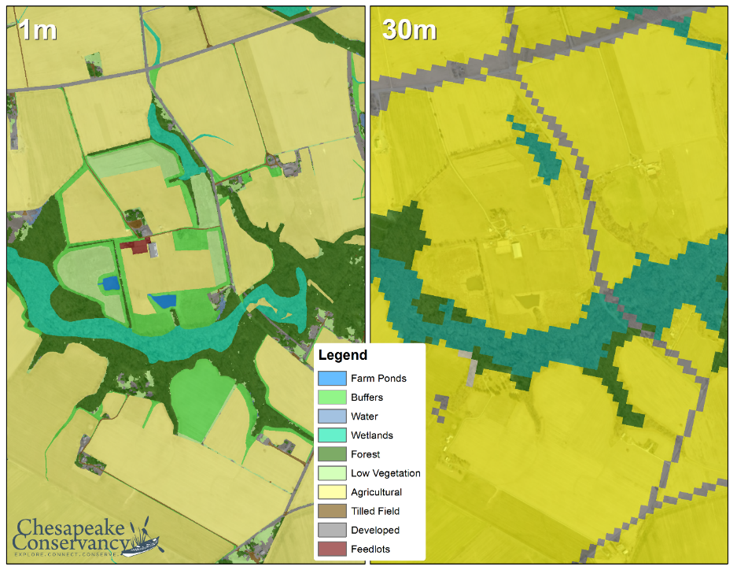
Chesapeake Bay Watershed Land Cover Data
Phase 5
Phase 6
Urban/Suburban Settings
Rural Settings

Slide 52
Phase 6 Land Use Production Schedule
September 30: Complete initial production of Phase 6 land use datasets for all counties in the watershed and disseminate for local review
October 31: All local reviews of the Phase 6 land use datasets are complete
November 4: All responses to reviewer comments are complete
December 2: Phase 6 land use (1985 – 2014), delivered to the Partnership’s Watershed Modeling Team

Slide 53
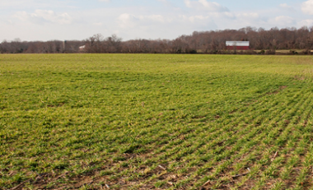
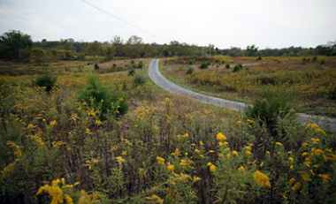
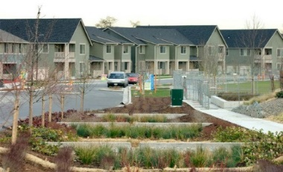
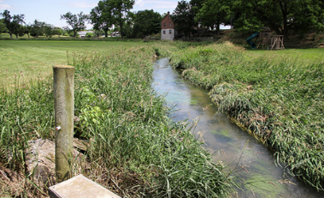
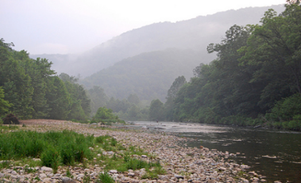
Simplified an Extremely Complex Model So Even Verna Can Understand It!
Phase 6 Watershed Model Structure
Average Load + Inputs * Sensitivity
Land Use Acres
BMPs
Land to Water
Stream Delivery
River Delivery
*
*
*
Direct Loads
*
*

Slide 54
Finalizing the Partnership’s Phase 6 Modeling Tools for Management Application
“…improve accuracy, transparency, and confidence”
Data inputs (e.g., BMP efficiencies) due: September 30, 2016
Phase 6 land use dataset due: December 1, 2016
STAC peer review of the all the modeling tools: summer – winter 2016
Release of the Beta 4 (near final) version of the Phase 6 tools: January 2017
Partnership’s fatal flaw review of the modeling tools: March – April 2017
Finalization of the Phase 6 modeling tools: June 2017 (release of draft Phase II WIP Planning Targets)

Slide 55
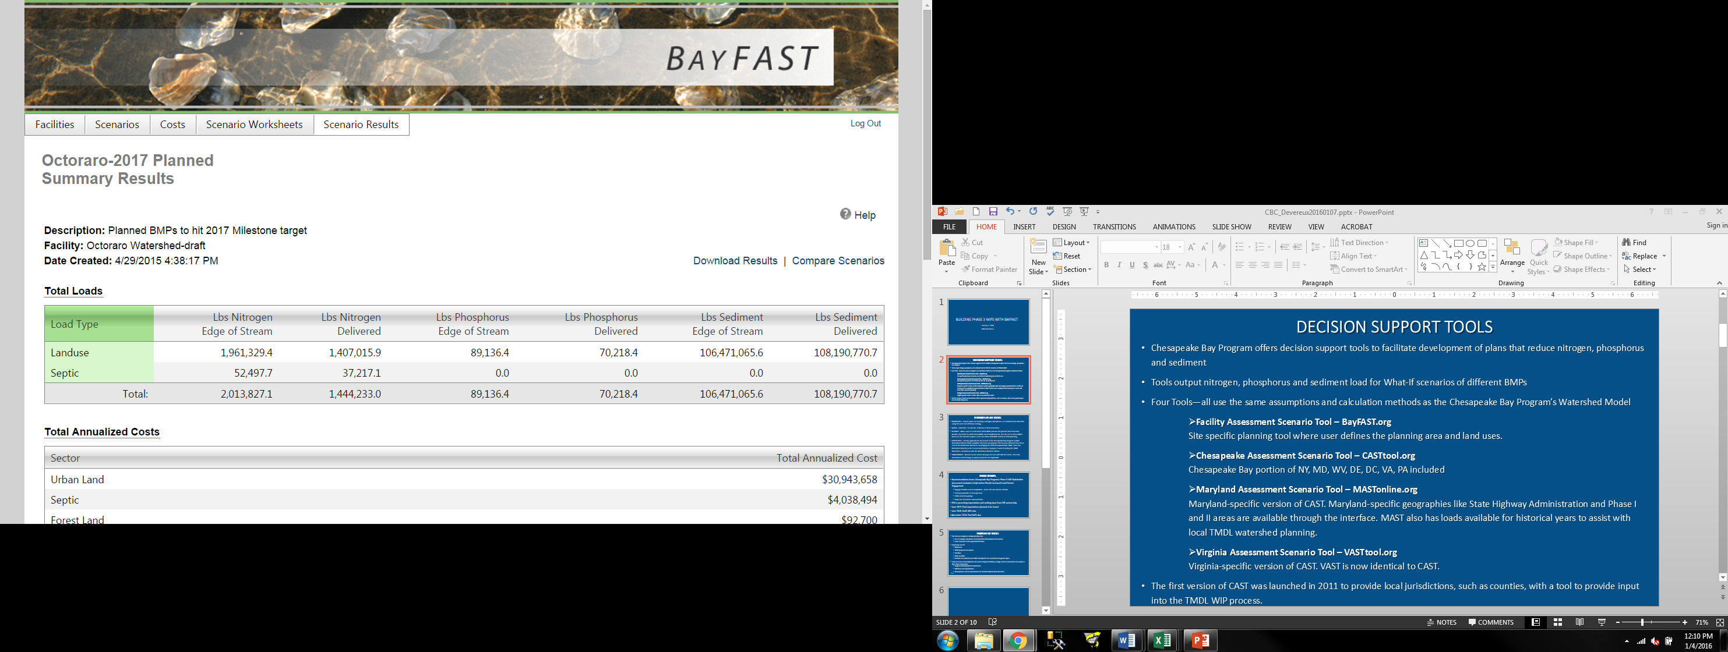
Web Accessible Tools for Local Partners

Slide 56
Hint: Even Charlie can be trained to use the CAST and BayFast Tools!

Slide 57
And We are Heading Towards 400+ Unique BMPs with Pollutant Reduction Efficiencies and Associated Capital and Maintenance Costs…

Slide 58
Over 380 BMPs Available for Tracking, Reporting and Crediting by the Partners
State-Specific Practice Name for NEIEN Reporting | Bay Program Practice Name
Land Reclamation, Abandoned Mined Land | Abandoned Mine Reclamation
Advanced Grey Infrastructure Nutrient Discovery Program | Advanced Grey Infrastructure Nutrient Discovery Program
Alternative Crop/Switchgrass RI | Alternative Crops
Alternative Crops | Alternative Crops
Animal Waste Management Systems (All Types) | Animal Waste Management System
Dry Waste Storage Structure RI | Animal Waste Management System
Solid/Liquid Waste Separation Facility | Animal Waste Management System
Waste Control Facilities | Animal Waste Management System
Waste Control Facility | Animal Waste Management System
Waste Storage Facility | Animal Waste Management System
Waste Storage Pond | Animal Waste Management System
Waste Storage Structure | Animal Waste Management System
Waste Treatment - Beef | Animal Waste Management System
Waste Treatment - Dairy | Animal Waste Management System
Waste Treatment - Horse | Animal Waste Management System
Waste Treatment - Poultry | Animal Waste Management System
Waste Treatment - Swine | Animal Waste Management System
Waste Treatment - Turkey | Animal Waste Management System
Waste Treatment Lagoon | Animal Waste Management System
Animal Trails and Walkways | Barnyard Runoff Control
Barnyard Clean Water Diversion RI | Barnyard Runoff Control
Barnyard Runoff Controls | Barnyard Runoff Control
Barnyard Runoff Management | Barnyard Runoff Control
Roof runoff management | Barnyard Runoff Control
Roof Runoff Structure | Barnyard Runoff Control
Stormwater Runoff Control | Barnyard Runoff Control
Wastewater Treatment Strip | Barnyard Runoff Control
Bioretention | Bioretention/raingardens - A/B soils, no underdrain
Biofiltration | Bioretention/raingardens - A/B soils, underdrain

Slide 59
State-Specific Practice Name for NEIEN Reporting | Bay Program Practice Name
Green Parking Lot | Bioretention/raingardens - A/B soils, underdrain
Rain Garden | Bioretention/raingardens - A/B soils, underdrain
Green Roofs | Bioretention/raingardens - C/D soils, underdrain
Bioswale | Bioswale
Dry Swale | Bioswale
Commodity Cover Crop- Early | Commodity Cover Crop Early Other Wheat
Cover Crops - Harvestable | Commodity Cover Crop Early Other Wheat
Commodity Cover Crop- Standard | Commodity Cover Crop Standard Other Wheat
Harvestable Cover Crop | Commodity Cover Crop Standard Other Wheat
Conservation Tillage | Conservation Tillage - Additional Acres
Residue and Tillage Management, Mulch Till | Conservation Tillage - Additional Acres
Residue and Tillage Management, No-Till/Strip Till/Direct Seed | Conservation Tillage - Additional Acres
Residue and Tillage Management, Ridge Till | Conservation Tillage - Additional Acres
Residue Management -Direct Seed | Conservation Tillage - Additional Acres
Residue Management, Mulch Till | Conservation Tillage - Additional Acres
Residue Management, No-Till/Strip Till | Conservation Tillage - Additional Acres
Residue Management, Ridge Till | Conservation Tillage - Additional Acres
Residue Management, Seasonal | Conservation Tillage - Additional Acres
High Residue Tillage Management | Continuous, High Residue, Minimum Soil Disturbance Tillage Management
Cover Crops- Early Planting | Cover Crop Early Arial Barley
Cover Crops - Early Planted Rye | Cover Crop Early Other Rye
Cover Crops - Early Planting | Cover Crop Early Other Wheat
Cover Crop | Cover Crop Late Other Wheat
Cover Crops - Wheat | Cover Crop Late Other Wheat
Plant an annual grass-type cover crop that will scavenge residual nitrogen | Cover Crop Late Other Wheat
Cover Crops - Rye | Cover Crop Late-Planting Other Rye
Cover Crops | Cover Crop Standard Other Barley
Cover Crops | Cover Crop Late Other Wheat
Cover Crops | Cover Crop Early Arial Rye

Slide 60
State-Specific Practice Name for NEIEN Reporting | Bay Program Practice Name
Cover Crops | Cover Crop Standard Other Rye
Cover Crops | Commodity Cover Crop Early-Planting Aerial Corn Barley
Cover Crops | Commodity Cover Crop Early-Planting Aerial Soy Barley
Cover Crops | Cover Crop Early Arial Barley
Cover Crops | Cover Crop Early-Planting Aerial Soy Barley
Cover Crops | Commodity Cover Crop Early-Planting Other Barley
Cover Crops | Cover Crop Early-Planting Other Barley
Cover Crops | Commodity Cover Crop Standard-Planting Other Barley
Cover Crops | Winter Hardy Brassica, Early, Aerial
Cover Crops | Winter Hardy Brassica, Early, Drilled
Cover Crops | Winter Hardy Brassica, Early, Other
Cover Crops | Commodity Cover Crop Early Arial Wheat
Cover Crops | Annual Legume + Grass, Early, Aerial
Cover Crops | Commodity Cover Crop Early Other Wheat
Cover Crops | Annual Legume + Grass, Early, Drilled
Cover Crops | Annual Legume + Grass, Early, Other
Cover Crops | Commodity Cover Crop Late Other Wheat
Cover Crops | Annual Legume + Grass, Normal, Other
Cover Crops | Commodity Cover Crop Standard Other Wheat
Cover Crops | Commodity Cover Crop Early Arial Rye
Cover Crops | Commodity Cover Crop Early Drilled Barley
Cover Crops | Commodity Cover Crop Early Drilled Wheat
Cover Crops | Commodity Cover Crop Early Other Rye
Cover Crops | Commodity Cover Crop Late-Planting Drilled Rye
Cover Crops | Commodity Cover Crop Late-Planting Drilled Wheat
Cover Crops | Commodity Cover Crop Late-Planting Other Rye
Cover Crops | Commodity Cover Crop Standard-Planting Drilled Barley
Cover Crops | Commodity Cover Crop Standard-Planting Drilled Wheat
Cover Crops | Commodity Cover Crop Standard Other Rye

Slide 61
State-Specific Practice Name for NEIEN Reporting | Bay Program Practice Name
Cover Crops | Commodity Cover Crop Late-Planting Drilled Rye
Cover Crops | Commodity Cover Crop Late-Planting Drilled Wheat
Cover Crops | Commodity Cover Crop Late-Planting Other Rye
Cover Crops | Commodity Cover Crop Standard-Planting Drilled Barley
Cover Crops | Commodity Cover Crop Standard-Planting Drilled Wheat
Cover Crops | Commodity Cover Crop Standard Other Rye
Cover Crops | Annual Legume, Early, Aerial
Cover Crops | Triticale, Early, Aerial
Cover Crops | Cover Crop Early Arial Wheat
Cover Crops | Cover Crop Early-Planting Drilled Barley
Cover Crops | Triticale, Early, Drilled
Cover Crops | Cover Crop Early Drilled Wheat
Cover Crops | Annual Legume, Early, Other
Cover Crops | Winter Killed Oats, Early, Other
Cover Crops | Cover Crop Early Other Rye
Cover Crops | Triticale, Early, Other
Cover Crops | Cover Crop Early Other Wheat
Cover Crops | Cover Crop Late Drilled Rye
Cover Crops | Triticale, Late, Drilled
Cover Crops | Cover Crop Late-Planting Drilled Wheat
Cover Crops | Cover Crop Late-Planting Other Rye
Cover Crops | Cover Crop Standard Drilled Barley
Cover Crops | Annual Legume, Normal, Drilled
Cover Crops | Cover Crop Standard Drilled Rye
Cover Crops | Annual Ryegrass, Normal, Drilled
Cover Crops | Cover Crop Standard Other Wheat
Cover Crops | Annual Ryegrass, Early, Aerial
Cover Crops | Annual Ryegrass, Early, Drilled
Cover Crops | Annual Ryegrass, Early, Other

Slide 62
State-Specific Practice Name for NEIEN Reporting | Bay Program Practice Name
Cover Crops | Annual Ryegrass, Normal, Other
Cover Crops | Winter Hardy Oats, Early, Aerial
Cover Crops | Winter Hardy Oats, Early, Drilled
Cover Crops | Winter Hardy Oats, Early, Other
Cover Crops | Winter Hardy Oats, Normal, Other
Cover Crops | Winter Hardy Oats, Normal, Drilled
Cover Crops | Triticale, Late, Other
Cover Crops | Triticale, Normal, Other
Cover Crops | Triticale, Normal, Drilled
Cover Crops | Commodity Cover Crop Early-Planting Aerial Soy Rye
Cover Crops | Cover Crop Early-Planting Aerial Soy Rye
Cover Crops | Commodity Cover Crop Early-Planting Aerial Soy Wheat
Cover Crops | Cover Crop Early-Planting Aerial Soy Wheat
Cover Crops | Forage Radish, Early, Drilled
Cover Crops | Forage Radish, Early, Other
Cover Crops | Forage Radish, Early, Aerial, After Soy
Cover Crops | Forage Radish, Early, Aerial
Cover Crops | Forage Radish + Grass , Early, Drilled
Cover Crops | Forage Radish + Grass, Early, Other
Cover Crops | Forage Radish + Grass, Early, Aerial, After Soy
Cover Crops | Forage Radish + Grass, Early, Aerial
Cover Crops | Annual Legume, Early, Drilled
Cover Crops | Annual Legume, Early, Aerial, After Soy
Cover Crops | Annual Legume, Normal, Other
Cover Crops | Annual Legume + Grass, Early, Aerial, After Soy
Cover Crops | Annual Legume + Grass, Normal, Drilled
Cover Crops | Triticale, Early, Aerial, After Soy
Cover Crops | Annual Ryegrass, Early, Aerial, After Soy
Cover Crops | Winter Hardy Oats, Early, Aerial, After Soy

Slide 63
State-Specific Practice Name for NEIEN Reporting | Bay Program Practice Name
Cover Crops | Winter Killed Oats, Early, Drilled
Cover Crops | Winter Killed Oats, Early, Aerial, After Soy
Cover Crops | Winter Killed Oats, Early, Aerial
Cover Crops | Winter Hardy Brassica, Early, Aerial, After Soy
Cover Crops | Forage Radish + Grass, Normal, Drilled
Cover Crops | Forage Radish + Grass, Normal, Other
Cover Crops | Commodity Cover Crop Standard Drilled Rye
Cover Crops | Cover Crop Standard Drilled Wheat
Feed Management | Dairy Precision Feeding and/or Forage Management
Decision Agriculture | Decision Agriculture Efficiency Version
D&G Road - Surface Aggragate and Rasied Roadbed | Dirt & Gravel Road Erosion & Sediment Control - Driving Surface Aggregate + Raising the Roadbed
D&G Road - Surface Aggregate and Raised Roadbed | Dirt & Gravel Road Erosion & Sediment Control - Driving Surface Aggregate + Raising the Roadbed
D&G Road - Outlets Only | Dirt & Gravel Road Erosion & Sediment Control - Outlets only
D&G Road - E&S Control and Outlets | Dirt & Gravel Road Erosion & Sediment Control - with Outlets
Regenerative Stormwater Conveyance | Dry Channel Regenerative Storm Water Conveyance
Dry Detention Ponds | Dry Detention Ponds and Hydrodynamic Structures
Dry Detention Ponds & Hydrodynamic Structures | Dry Detention Ponds and Hydrodynamic Structures
Dry Extended Detention Ponds | Dry Extended Detention Ponds
Micropool Extended Detention | Dry Extended Detention Ponds
Enhanced Nutrient Management | Enhanced Nutrient Application Management Efficiency Version
Erosion & Sediment Control | Erosion and Sediment Control Level 1
Erosion and Sediment Control Level 1 | Erosion and Sediment Control Level 1
Erosion and Sediment Control Level 2 | Erosion and Sediment Control Level 2
Erosion and Sediment Control Level 3 | Erosion and Sediment Control Level 3
CREP Riparian Forest Buffer | Forest Buffers
Extending riparian forest buffers for water quality protection and wildlife habitat | Forest Buffers
Forest Buffer on Watercourse RI | Forest Buffers
Forest Buffers | Forest Buffers
Riparian Forest Buffer | Forest Buffers

Slide 64
Goes on for 8 more slides…and the Partnership still has 15 active BMP expert panels working right now!

Slide 65
…and We are Working on Building Optimization Functionality and Ultimately Co-Benefits Ecosystem Services into these Tools

Slide 66
Preview of Midpoint Assessment Profiles of Bay Watershed Jurisdictions

Slide 67
Midpoint Assessment Profiles
Provide partners and stakeholders with full access to a comprehensive summary of midpoint assessment findings
Monitoring trends-based findings
In-depth analysis of implementation progress
Programmatic capacity gaps and needs
Remaining challenges to be addressed

Slide 68
Phase III WIP Expectations

Slide 69
Overall Objective: Meeting the 2025 nutrient and sediment goals; improving local water quality
Optimize pollutant load reducing practices between 2018-2025
Develop comprehensive local and federal engagement strategies
Ensure new loads are offset
Adjustments to Planning Targets
Jurisdiction-specific expectations
Placeholders for Conowingo, climate change, and local area targets

Slide 70
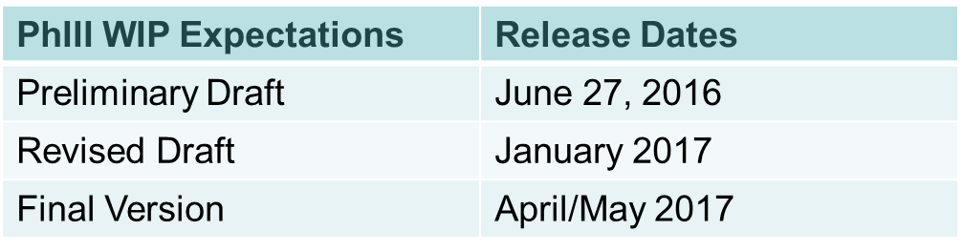
What specific elements would CAC like to see included in the Phase III WIP expectations document?
What role would CAC like to have in the jurisdictions’ development of their Phase III WIPs?

Slide 71
Local Area Targets

Slide 72
Purpose of the Local Area Targets Task Force
Why local area targets?
Raise awareness of local partners’ contribution toward achieving the Bay TMDL and WIPs
Refinements to Phase 6 modeling tools can support targets at a more local scale
Task Force charged to develop recommendations as to whether:
Local area targets should be established; and if so
Options for how those targets could best be expressed in the jurisdictions
Based on Task Force discussions, preliminary options include:
Percentage and quantification of BMP implementation goals
Programmatic Goals (e.g., post-construction performance standards)
Numeric nutrients and sediment reduction goals
Bottom Line: Flexibility is key!!

Slide 73
Task Force Recommendations | Approval Dates
Preliminary Recommendations | October – December 2016
Partnership Webinar | February 2017
Final Recommendations | March – May 2017
What concerns do you have and are likely to hear from your state and local partners on the development of local area targets?
What are your thoughts on how local area targets could best be expressed?

Slide 74
Broader Midpoint Assessment Communications

Slide 75
Engaging Local Stakeholders in the Midpoint Assessment & Phase III WIPs
Meetings with each of the seven Bay jurisdictions, Chesapeake Bay Commission to understand their perspectives and positions on key Midpoint Assessment priorities.
Reach out key local partners to ensure they are informed about the Midpoint Assessment and involved in the development of (1) the jurisdictions’ Phase III WIP; (2) the Phase III Planning Targets; and (3) local area planning targets.
Local partners for this engagement include (but are not limited to):
Regional partners: MWCOG, SRBC, ICPRB
Riverkeepers and Waterkeepers
State municipal authority associations
State farm bureaus
Counties, townships, municipalities
Conservation districts
Watershed organizations

Slide 76
Who are the critical audiences that need to be engaged in the Midpoint Assessment and the Phase III WIPs?
What do you see as your role in the Midpoint Assessment and the Phase III WIPs, and how would you like to stay engaged in these issues?

Slide 77

Rich Batiuk
Associate Director for Science
U.S. EPA Chesapeake Bay Program Office
410-267-5731 Work
443-223-7823 Mobile
batiuk.richard@epa.gov
Lucinda Power
Implementation and Evaluation Team Leader
U.S. EPA Chesapeake Bay Program Office
410-267-5722 Work
power.lucinda@epa.gov
www.chesapeakebay.net
www.epa.gov/chesapeakebaytmdl

