Slide 1
Local Government Advisory Committee Updates
March 21, 2018
Carin Bisland, Associate Director
Chesapeake Bay Program Office
www.chesapeakebay.net
www.chespeakeprogress.com

Slide 2

2018-2019
CBP PRIORITIES

Slide 3

Phase III Watershed Implementation Plans
Timeline
Conowingo Watershed Implementation Plan
Climate Change
Growth in pollution load
Local Area Goals
BMP Verification

Slide 4
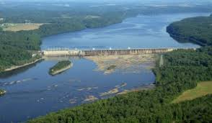
Conowingo Watershed Implementation Plan
Notes:
Needed because of the additional load caused by the build up of the sediment behind the dam i.e. no longer storing nutrients and sediment
WIP with effective basins to deal with extra pounds caused by the dam being full
Steering Committee
Proposal for funding

Slide 5
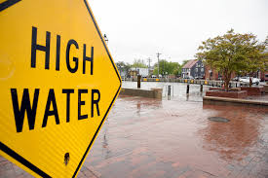
Factoring Climate Change Considerations into the Phase III Watershed Implementation Plans
Notes:
3 part process

Slide 6
1.
Incorporate Climate Change in the Phase III WIPs
Include a narrative strategy in the Phase III WIPs that describes the state and local jurisdictions’ current action plans and strategies to address climate change and commit to adopting climate change targets by 2021, employing the Partnership’s suite of models that factor in climate change and other relevant local information. Acknowledging the challenges that lie ahead, reference the preliminary modeling estimates attributable to climate change by 2025 to be roughly an additional 9 million pounds of nitrogen and 0.5 million pounds of phosphorus.

Slide 7
2.
Understand the Science
By refining the climate modeling and assessment framework, continue to sharpen the understanding of the science, the impacts of climate change, and any research gaps and needs.
Develop an estimate of pollutant load changes (nitrogen, phosphorus, and sediment) due to 2025 climate change conditions.
Develop a better understanding of BMP responses, including new, enhanced and resilient BMPs, to better address climate change conditions such as increased storm intensity.
In March 2021, the Partnership will consider results of updated methods, techniques, and studies and refine estimated loads due to climate change for each jurisdiction.
In September 2021 jurisdictions will account for additional nutrient and sediment pollutant loads due to 2025 climate change conditions in a Phase III WIP addendum and/or 2-year milestones beginning in 2022.

Slide 8
3.
Incorporate into Milestones
Starting with the 2022-2023 milestones, the Partnership will determine how climate change will impact the BMPs included in the WIPs and address these vulnerabilities in the two-year milestones.

Slide 9
PSC Policy Decisions: Accounting for Growth in Pollution Load
Approved the Water Quality Goal Implementation Team’s recommended use of 2025 projected conditions (based on the current zoning scenario) to account for growth in the development and implementation of the jurisdictions’ Phase III WIPs and two-year milestones

Slide 10
PSC Policy Decisions: Accounting for Growth
Approved the Water Quality Goal Implementation Team’s proposed approach to continued Partnership accounting for growth into the future by:
  Updating the Partnership’s projection of future growth every two years
  Factoring these updated future projections into next round of the jurisdictions’ two-year milestones
  Factoring in future (every 4 years) updates to the Partnership’s high resolution land use/cover data across the entire watershed
  Ensuring local partner review of the future growth forecasts with each 2-year update

Slide 11

BMP Verification

Slide 12

What is BMP Verification?
“Process through which agency partners ensure practices, treatments and technologies resulting in reductions of nitrogen, phosphorus and sediment pollutant loads are implemented and operating correctly.”

Slide 13
BMP no longer present/functional removed from database
OR
BMP
installed,
verified, and reported by Jurisdiction
BMP verified/
upgraded with new technology
Initial Inspection
BMP gains efficiency
Data quality assurance/ validation
BMP lifespan ends – re-verify
BMP Performance
BMP nears end of life span
Follow-up Checks
BMP fully functional
BMP performance metrics collected
Notes:
Step 1: “Is the BMP There?”
The first part of the life cycle is the initial inspection upon the installation of the BMP, meant to answer the question, “Is the BMP there?” Following the initial inspection and reporting of the data, quality assurance and validation of the data ensures that the data was collected, compiled and submitted correctly, and that issues of double counting and the clean-up of historical BMP data have been addressed.
Step 2: “Is the BMP still operating correctly?”
The second part of the life cycle is completion of follow-up checks, carried out at the appropriate frequency to ensure that the BMP is operating correctly throughout the lifespan of that practice.
Step 3: “Systematic Data Collection”
The third part of the life cycle is performance outcomes. This stage is focused on the systematic collection of data that will be used to ensure that the BMPs are working as expected, while also allowing the partnership to adapt approaches to the future installation and maintenance of the practices, and to help further refine their pollutant reduction efficiencies.

Slide 14
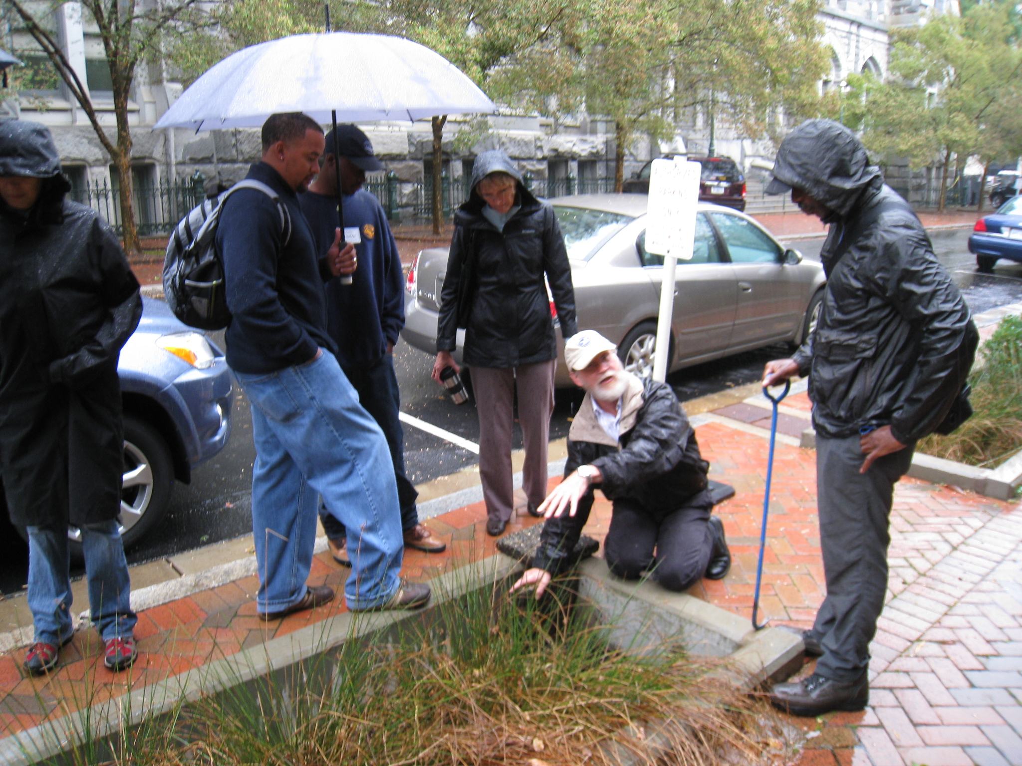
When Would it Start?
“Only Verified Practices may be Credited After the Initial Two Year Ramp-up Period. Starting with the 2018 annual progress reporting cycle, those reported practices, treatments or technologies for which documentation of verification has not been provided through each jurisdictions’ NEIEN-based report systems may not be credited for nitrogen, phosphorus or sediment pollutant load reductions for that year.”
https://www.chesapeakebay.net/what/programs/bmp_introduction_to_bmp_verification/bmp_additional_resources

Slide 15

HOW

Slide 16
EPA Strategic Plan

Slide 17
FY 2017 – 2019 CBP Budget and Funding Levels
  FY 2017 Operating Budget - $73 Million for CBP
  FY 2018 PresBud - $0 Funding for CBP and all EPA Geo Programs
  FY 2018 Continuing Resolution – Through March 23, 2018
  FY 2018 – House Bill: CBP @ $60 Million; Senate Bill: CBP @ $73 Million
  FY 2019 PresBud - $7.3 Million for CBP; 0 FTE; $30 Million for Great Lakes

Slide 18

FY 18 Federal Budget
Notes:
CR ends March 23
House $60 million, Senate $73 million

Slide 19
FY 17 Budget Highlights
EPA Budget -
  Funds
    $5 million for Implementation
    $6 million for Small Watershed Grants
    $6 million for Innovative Nutrient and Sediment Reduction Grants
    ACB Grant for LGAC Support
  Staffing
    Reggie Parrish
  Other federal and state funds

Slide 20

FY 2019 CBP PresBud CBP Language
“…Chesapeake Bay. These watersheds require coordination and collaboration among numerous States, Tribes, and local governments. In the case of the Great Lakes, international coordination with Canada is also necessary. Effective coordination and collaboration among these stakeholders relies on accurate and continuous data.
The Budget provides funds to support basin-wide monitoring in these watersheds, which would assist decision-making on health and economic issues including harmful algal blooms and invasive species management. The Budget also supports cooperative federalism by building State and local capacity to conduct monitoring, while recognizing that the primary responsibility for local ecosystem restoration rests with States and local groups.”

Slide 21
Document: Fiscal Year 2019 President’s Budget
“The Budget funds programs to measure and assess the health of the Great Lakes and Chesapeake Bay. These watersheds require coordination and collaboration among numerous States, Tribes, and local governments…
“The Budget also supports cooperative federalism by building State and local capacity to conduct monitoring, while recognizing that the primary responsibility for local ecosystem restoration rests with States and local groups.”
Document: Justification of Appropriation Estimates for the Committee on Appropriations
Geographic Program: Chesapeake Bay (Dollars in Thousands)
 | FY 2017 Actuals | FY 2018 Annualized CR | FY 2019 Pres Budget | FY 2019 Pres Budget v. FY 2018 Annualized CR
Environmental Program & Management | $66,773.5 | $72,504.0 | $7,300.0 | -$65,204.0
Total Budget Authority | $66,773.5 | $72,504.0 | $7,300.0 | -$65,204.0
Total Workyears | 37.3 | 39.9 | 0.0 | -39.9

Slide 22
Document: Justification of Appropriation Estimates for the Committee on Appropriations
FY 2019 Activities and Performance Plan:
In FY 2019, EPA is requesting $7.3 million for support of state and local collection of water quality monitoring data and coordination of science, research, and modeling. Work in this program directly supports Goal 1/Objective 1.2, Provide Clean and Safe Water in EPA's FY 2018 - 2022 Strategic Plan.
The $7.3 million requested in FY 2019 would support the following activities:
• Water quality monitoring ($5.2 million). This funding would leverage
between $10-$12 million in combined federal, state, and local funds.
  Tidal and non-tidal monitoring ($4.8 million).
  Submerged Aquatic Vegetation (SAV) monitoring ($400 thousand).
• Provide facilitation to build capacity at the state level ($2.1 million).
  Coordinate modeling, decision support services, data collection, analysis, storage, and access;
  Support information dissemination and transparency; and
  Provide consistency and efficiency in communications and data management.

Slide 23
Federal Data
Table 1– Federal Agency Totals¹
(Budget authority in thousands) | FY 2015 Operating Level | FY 2016 Operating Level | FY 2017 Operating Level | FY 2018 President’s Budget
Department of Agriculture | 156,287 | 160,661 | 163,321 | 145,822
Department of Defense (non-Army Corps) | 41,842 | 70,722 | 79,520 | 55,194
Department of Commerce | 16,071 | 16,345 | 17,248 | 9,527
Department of Homeland Security | 0 | 0 | 1,087 | 0
Department of the Interior | 41,120 | 41,097 | 37,492 | 24,178
Department of Transportation² | 0 | 0 | 0 | 0
Environmental Protection Agency | 185,786 | 196,077 | 204,443 | 110,119
Army Corps of Engineers | 22,792 | 55,848 | 66,306 | 39,608
Total, All Agencies | 463,898 | 540,750 | 569,417 | 382,861
¹ In all tables, funding amounts are rounded to the nearest thousand. Rounding errors may result.
²Though DOT is a member of the Chesapeake Bay Federal Leadership Committee and conducts environmental-related activities in the Chesapeake Bay watershed, none meet the definitional limits of this crosscut.

Slide 25
State Program Spending
Funding levels reported in millions of dollars.
 | FY 2015 Operating Level | FY 2016 Operating Level | FY 2017 Operating Level | FY 2018 Budgeted
Delaware | $0.8 | $0.8 | $0.8 | $0.8
District of Columbia | $39.6 | $49.6 | $63.3 | $45
Maryland | $871.4 | $990.2 | $989.6 | $1.209.3
New York | $6.7 | $9.5 | $7.3 | $8.7
Pennsylvania | $86.5 | $51.1 | $88.6 | $37
Virginia | $226.2 | $227.7 | $228.1 | $204.7
West Virginia | $42.3 | $86.1 | $35.7 | $9.4
Total (All Jurisdictions) | $1,273.5 | $1,415 | $1,413.4 | $1,514.9

Slide 27
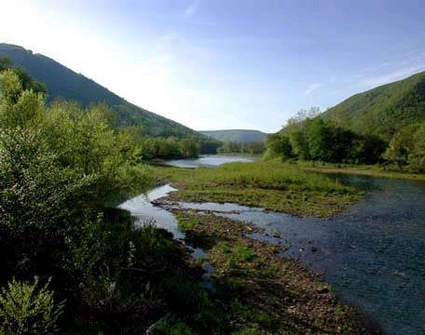
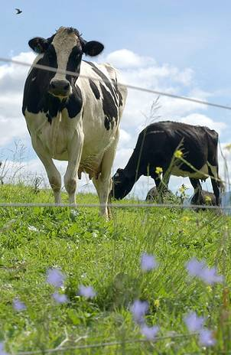


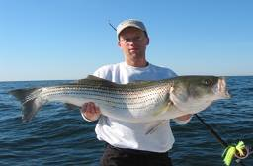
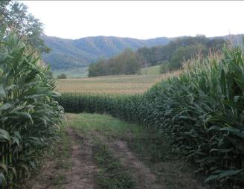


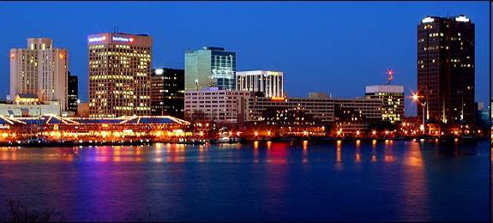
Questions?
27

