Slide 1
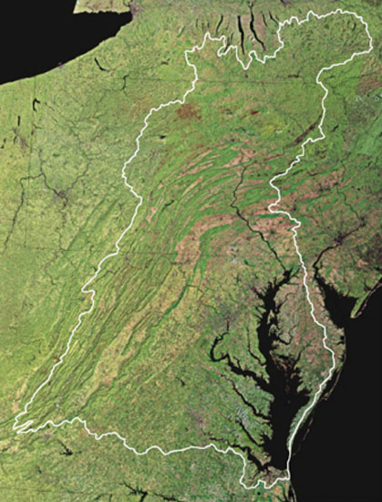
Verifying Our Pollutant Reduction Practices Have Been Put in Place and are Functioning
Chesapeake Bay Program Partnership’s
Citizens Advisory Committee
February 23, 2018
Rich Batiuk, Associate Director for Science, Analysis and Implementation
Chesapeake Bay Program Office
U.S. Environmental Protection Agency
Annapolis, Maryland

Slide 2
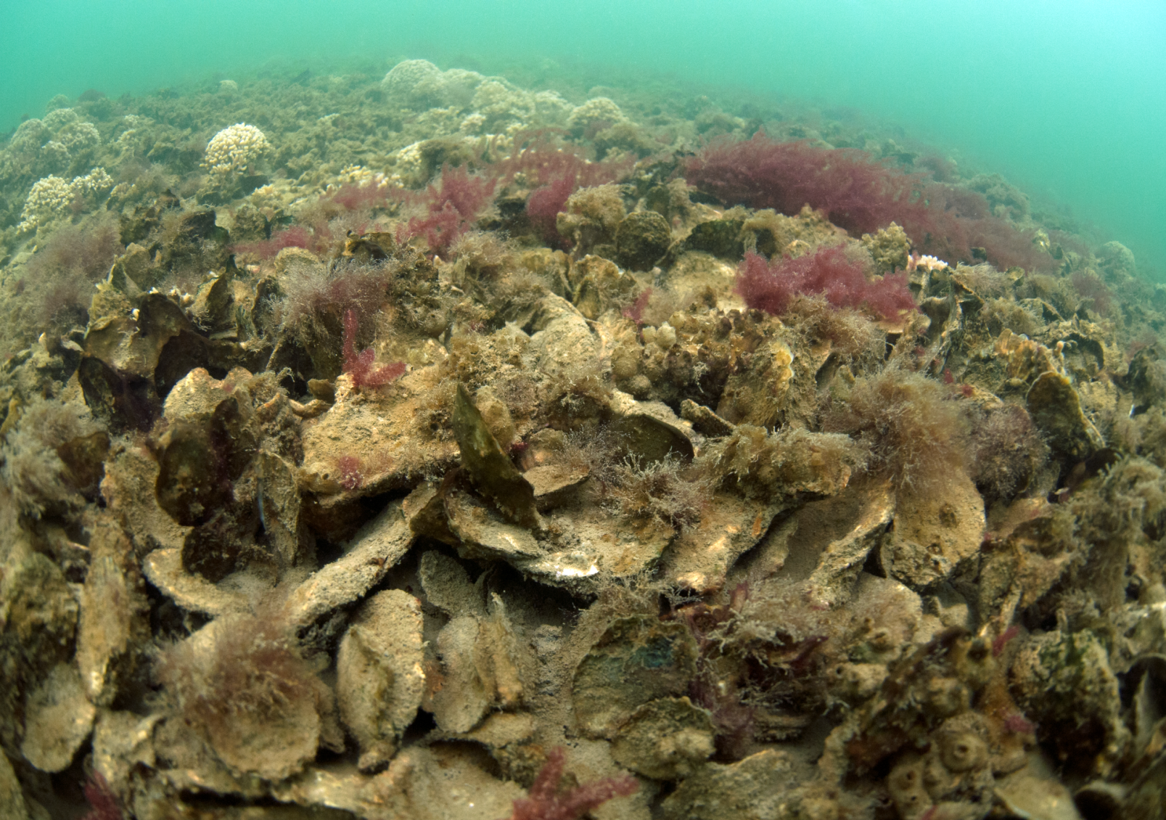

Slide 3
+ over 400 other unique practices approved by the Partnership for tracking, verification and reporting!

Slide 4
Hundreds More BMPs

Slide 5
“Process through which agency partners ensure practices, treatments and technologies resulting in reductions of nitrogen, phosphorus and sediment pollutant loads are implemented and operating correctly.”

Slide 6
“are implemented and operating correctly”

Slide 7
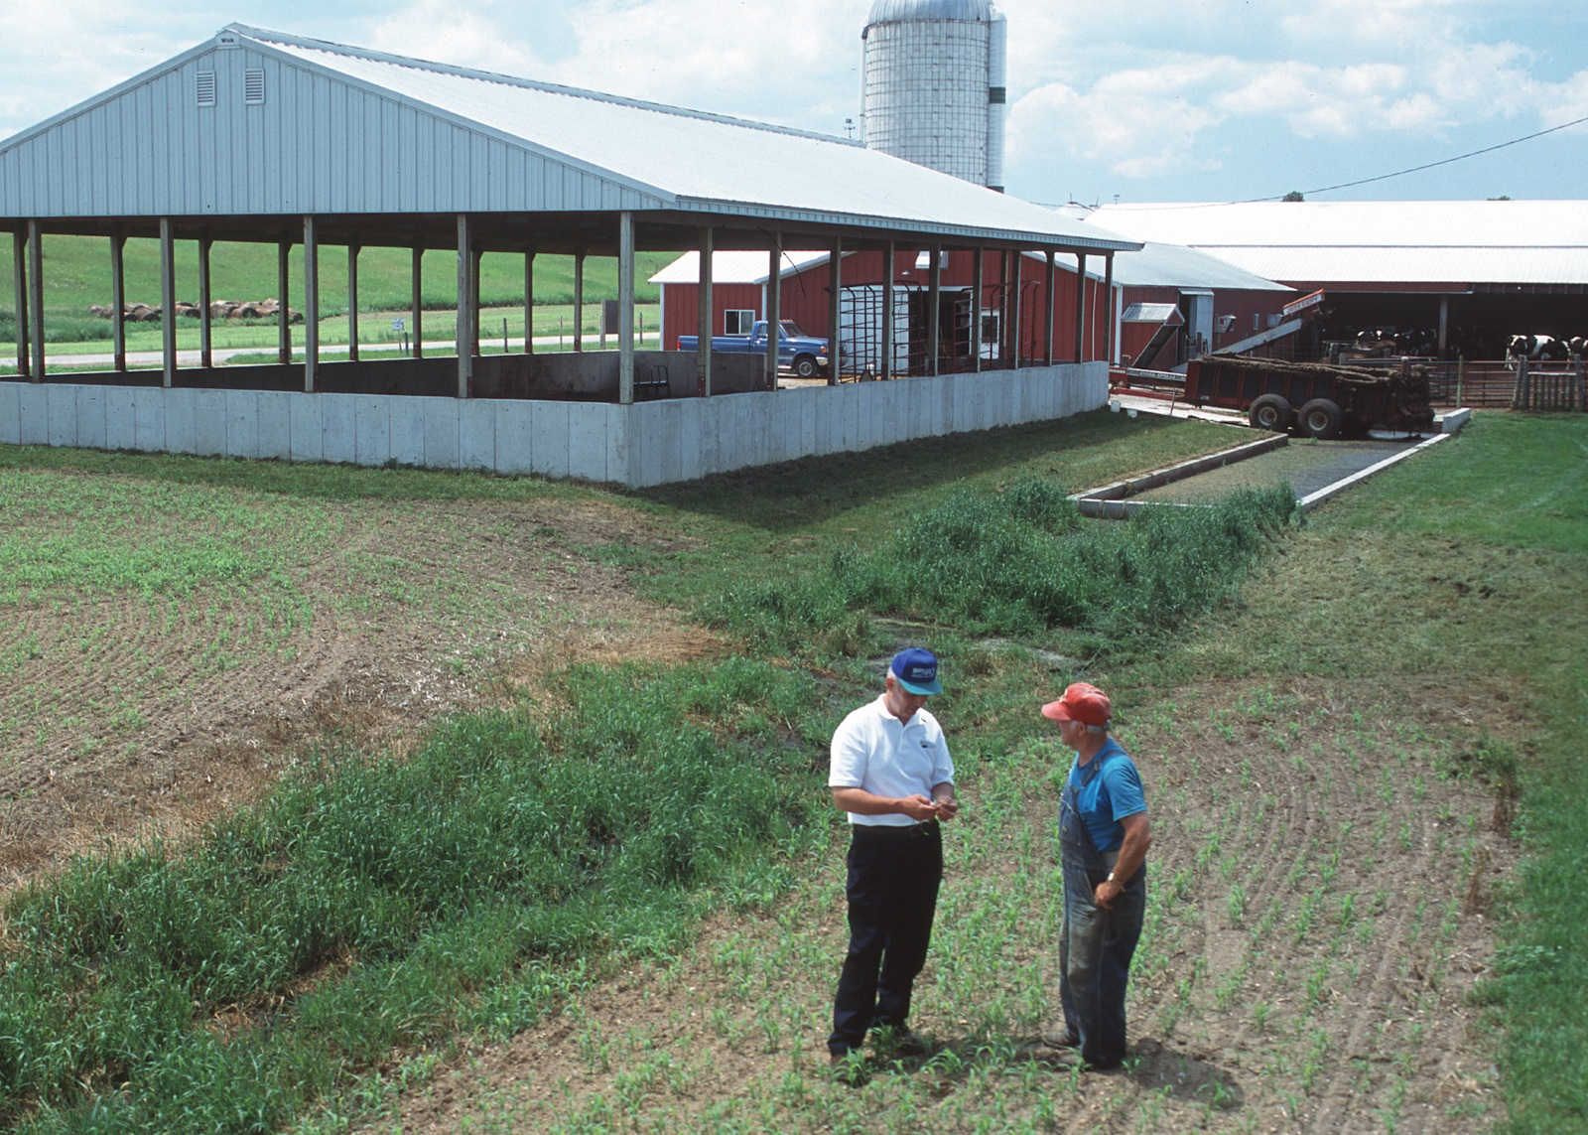
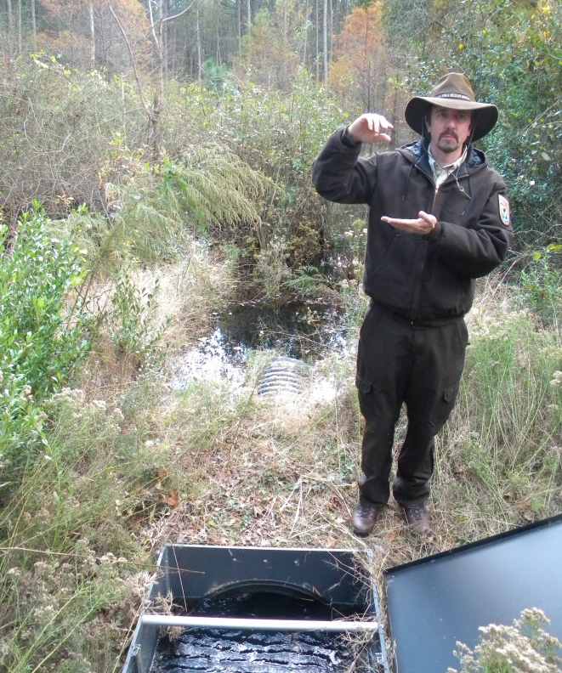
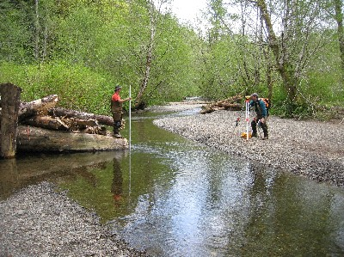
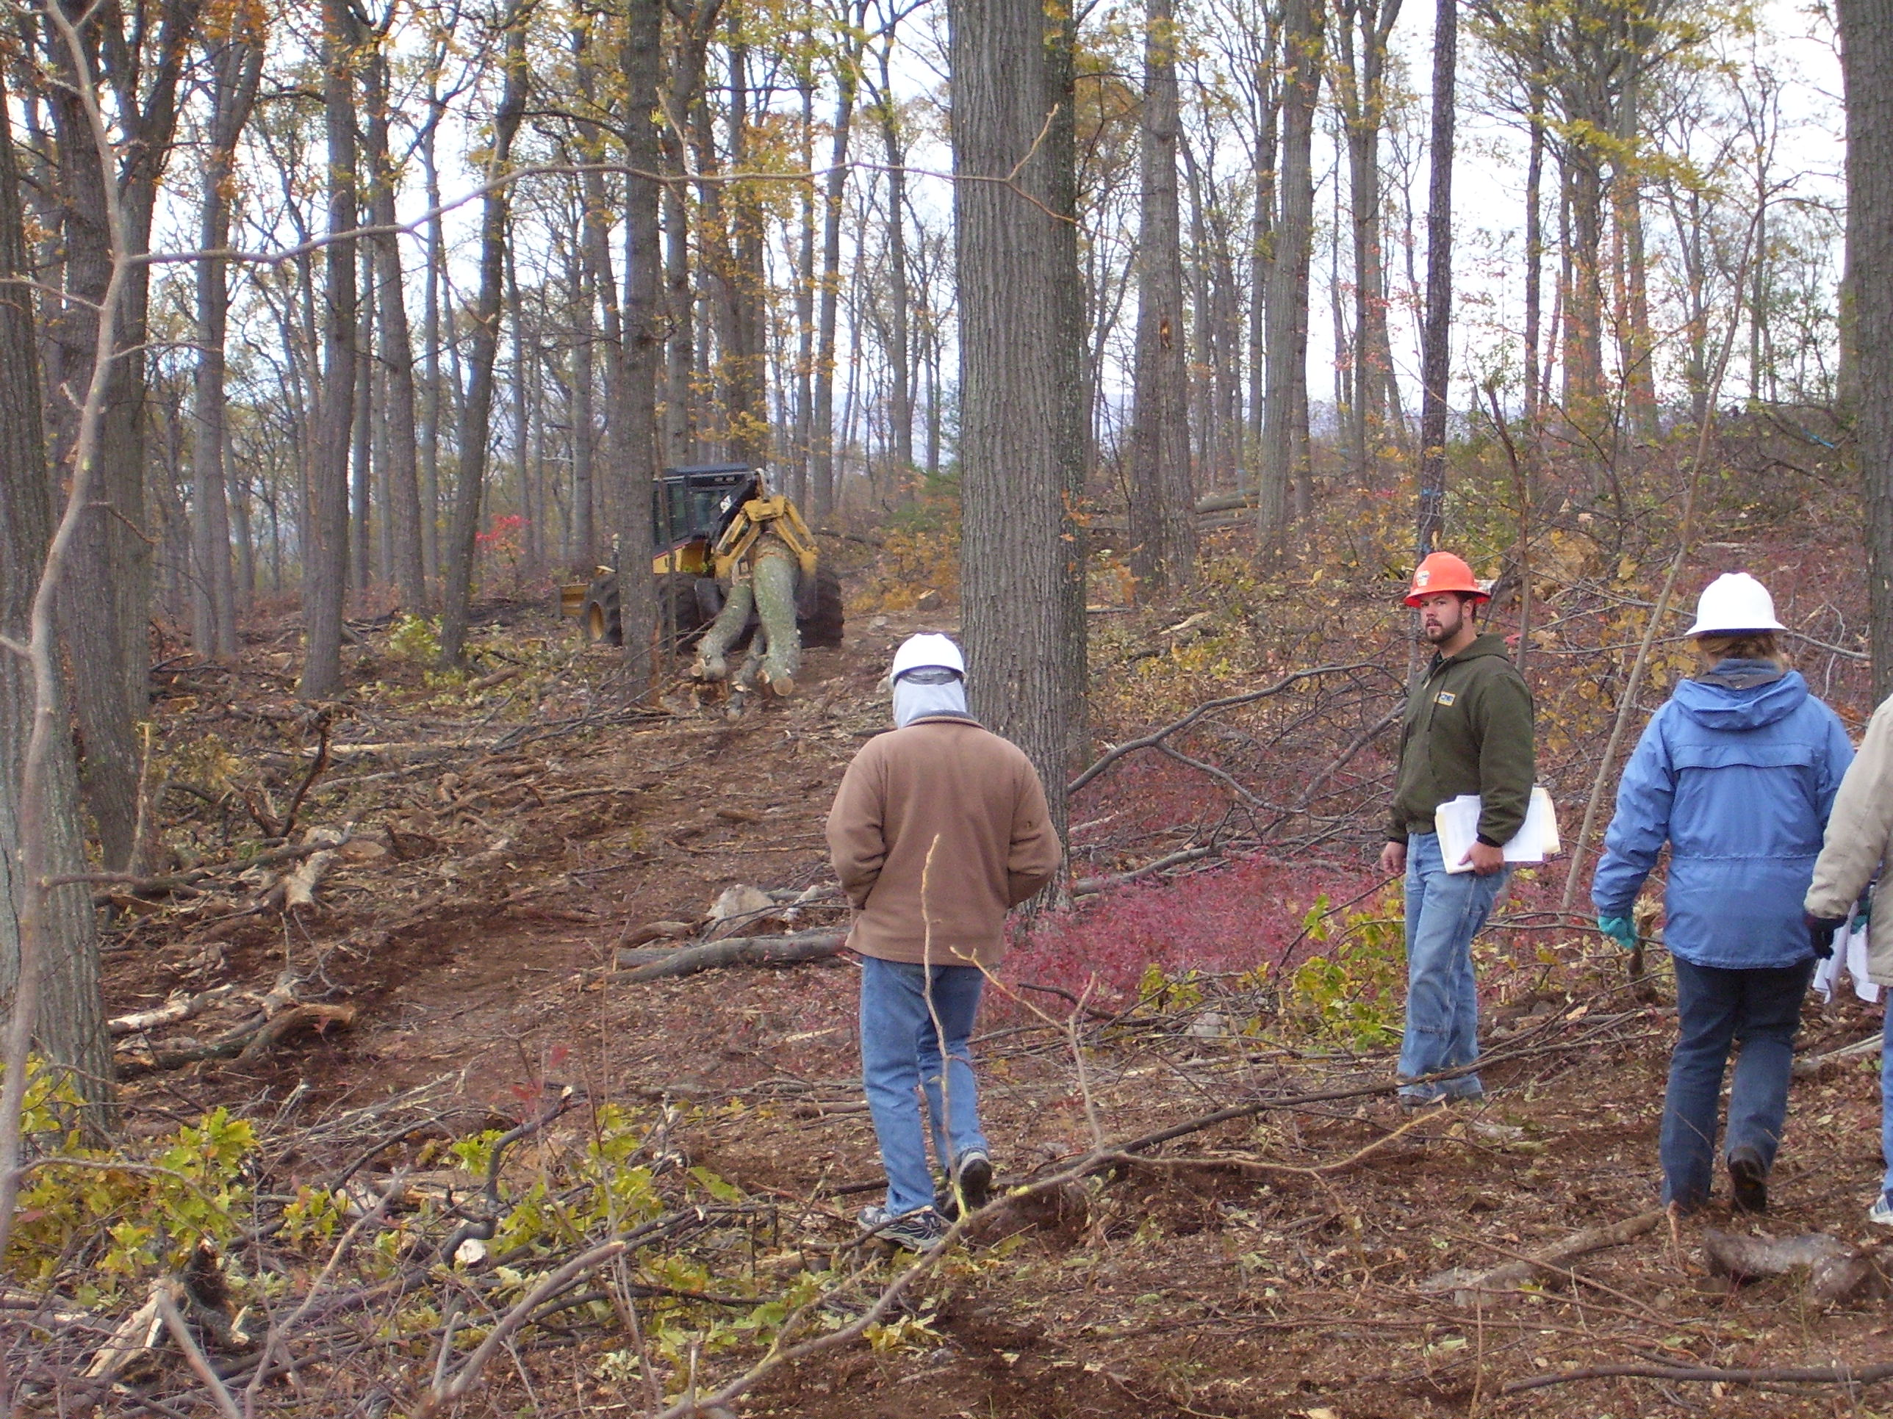
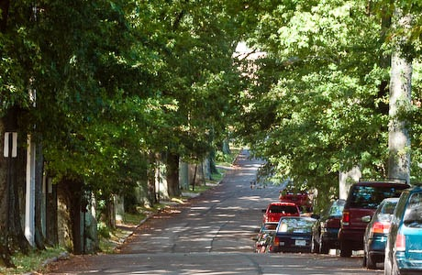
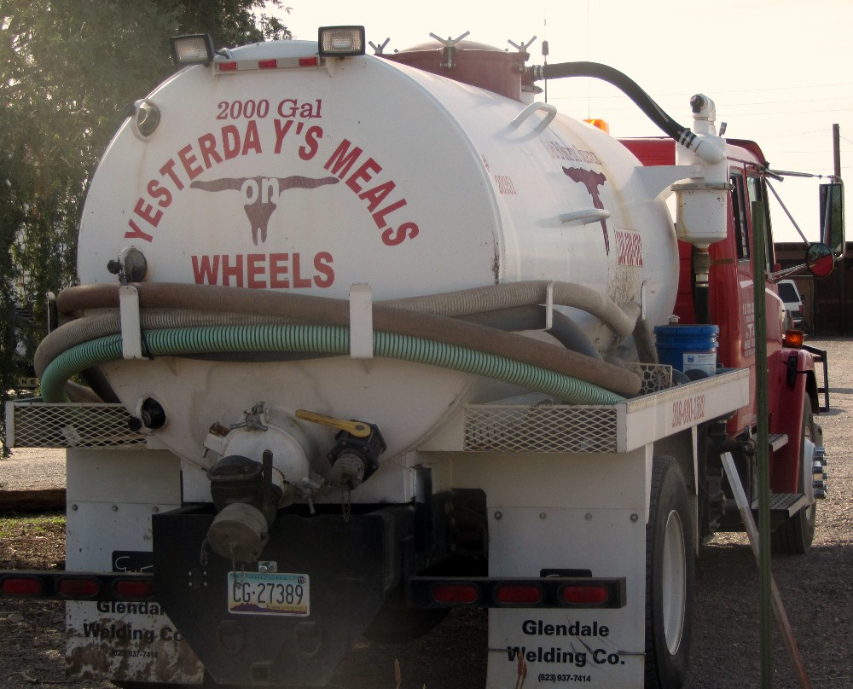
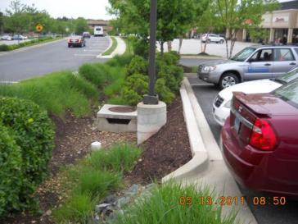
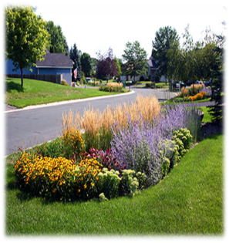
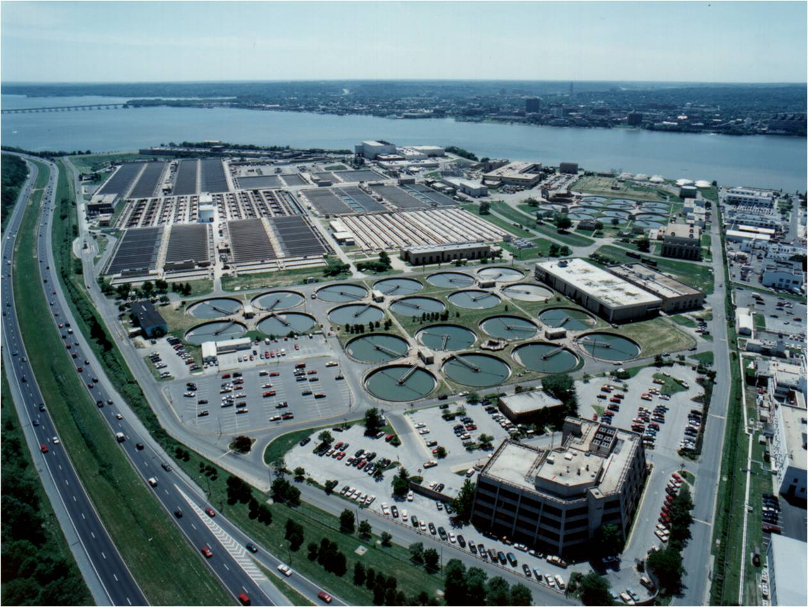
Who?

Slide 8
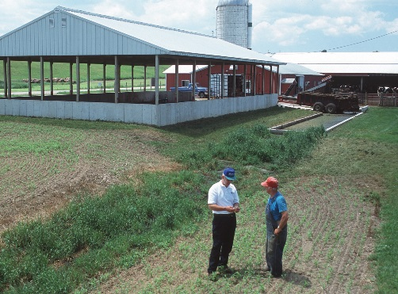



What?
Strengthening Verification of Best Management Practices Implemented in the Chesapeake Bay Watershed: A Basinwide Framework
Report and Documentation from the Chesapeake Bay Program Water Quality Goal Implementation Team’s BMP Verification Committee
October 2014

Slide 9
How?
BMP no longer present/functional removed from database
OR
BMP
installed,
verified, and reported by Jurisdiction
BMP verified/
upgraded with new technology
Initial Inspection
BMP gains efficiency
Data quality assurance/ validation
BMP Verification
Life Cycle
BMP lifespan ends – re-verify
BMP Performance
BMP nears end of life span
Follow-up Checks
BMP fully functional
BMP performance metrics collected

Slide 10
How?
Illustration of Diversity of Verification Approaches Tailored to Reflect Practices
Sector | Inspected | Frequency | Timing | Method | Inspector | Data Recorded | Scale
Stormwater | All | Statistics | <1 year | Monitoring | Independent | Water quality data | Site
 | Percentage | Targeting | 1-3 yrs | Visual | Regulator | Meets Specs | Subwatershed
 | Subsample | Law | 3-5 yrs | Aerial | Non-Regulator | Visual functioning | County
 | Targeted | Funding | >5 yrs | Phone Survey | Self | Location | State
Agriculture | All | Statistics | <1 year | Monitoring | Independent | Water quality data | Site
 | Percentage | Targeting | 1-3 yrs | Visual | Regulator | Meets Specs | Subwatershed
 | Subsample | Law | 3-5 yrs | Aerial | Non-Regulator | Visual functioning | County
 | Targeted | Funding | >5 yrs | Phone Survey | Self | Location | State
Forestry | All | Statistics | <1 year | Monitoring | Independent | Water quality data | Site
 | Percentage | Targeting | 1-3 yrs | Visual | Regulator | Meets Specs | Subwatershed
 | Subsample | Law | 3-5 yrs | Aerial | Non-Regulator | Visual functioning | County
 | Targeted | Funding | >5 yrs | Phone Survey | Self | Location | State

Slide 11
Table B-3. Jurisdictional Agriculture Verification Protocol Design Table: Visual Assessment BMPs—Single Year Chesapeake Bay Program Agriculture Workgroup
A. BMP Priority | B. Data Grouping | C. BMP Type | D. Initial Inspection |  |  |  | E. Follow-up Check |  |  | F. Lifespan/ | G. Data QA, Recording & Reporting
 |  |  | (Is the BMP there?) |  |  |  | (Is the BMP still there?) |  |  | Sunset
 |  |  | Method | Frequency | Who inspects | Documentation | Follow-up Inspection | Statistical Sub-sample | Response if Problem | (Is the BMP no longer there?)
High / Low | Visual Assessment: Single Year | Non-Cost Shared BMPs | On-Site Visual Assessment (Limited Statistical Sampling) | 100% of All Tracked & Reported BMPs | Trained and certified technical agency/NGO field staff or engineers | BMPs meet appropriate government and/or CBP practice standards | Single Year | 10% / 5% QA of All Tracked & Reported BMPs (within the year) | Bring into compliance within one year or less, or remove from reported BMPs | Single Year | Document inspections/follow-up checks, prevent double counting, and QA reported data
High / Low | Visual Assessment: Single Year | Cost-Shared Programs | On-Site Visual Assessment Only | 100% of All Tracked & Reported BMPs | Trained and certified technical agency/NGO field staff or engineers | BMPs meet appropriate government and/or CBP practice standards | Single Year | 10% / 5% QA of All Active Contractual BMPs (within the year) | Bring into compliance within one year or less, or remove from reported BMPs | Single Year | Document inspections/follow-up checks, prevent double counting, and QA reported data
High / Low | Visual Assessment: Single Year | Permit-Issuing Programs | On-Site Visual Assessment Only | 100% of All Tracked & Reported BMPs | Trained and certified technical agency field staff or engineers | BMPs meet the appropriate government and/or CBP practice standards | Single Year | 20% Annually of All Active Permits | Bring into compliance within one year or less, or remove from reported BMPs | Single Year | Document inspections/follow-up checks, prevent double counting, and QA reported data
EXAMPLE BMP | Visual Assessment: Single Year | Cost-Shared Programs: Traditional Cover Crop- Early Drilled Rye | On-Site Visual Assessment: Cover Crop Establishment | 100% of All Active Contracts | County Conservation District USDA-NRCS Certified Field Technician | Cost-Share Program BMP Certification Form | On-Site Visual Assessment: Cover Crop Termination | 10% QA of All Active Contractual BMPs | Cost-Share Program Contract Compliance Policy | Contract Year | Cost-Share Program Documentation / 10% QAQC Compliance Checks by State Agency / Tracking & Reporting Protocol

Slide 12
Practice Life Spans Translated into Credit Durations
Sector | Practice | Credit Duration
Urban Stormwater | E&S Control | 1 year
 | Stormwater Retrofits | 10 years
 | New PCSM Practices | 10 years
 | Homeowner BMPs | 5 years
 | Street Cleaning | 1 year
Agriculture | Nutrient Management BMPs | 1 year
 | Conservation Plan/SCWQ BMPs | Varies depending upon Practice (1 year to 15 years)
 | Cover Crop | 1 year
 | Conservation Tillage | 1 year
 | Manure Transport | 1 year
 | Roof Runoff Structure- NRCS 558 | 10 years
 | Barnyard Clean Water Diversion – RI-16 | 5 years

Slide 13
When?
“Only Verified Practices may be Credited After the Initial Two Year Ramp-up Period. Starting with the 2018 annual progress reporting cycle, those reported practices, treatments or technologies for which documentation of verification has not been provided through each jurisdictions’ NEIEN-based report systems may not be credited for nitrogen, phosphorus or sediment pollutant load reductions for that year.”

Slide 14
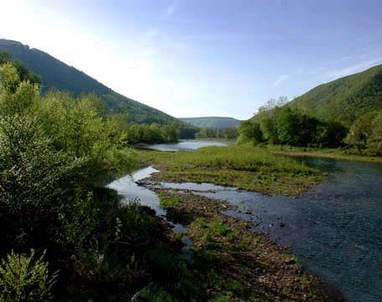
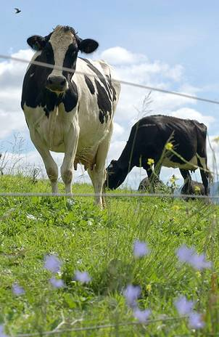



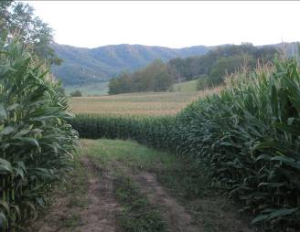



Questions?
14

Slide 15

Rich Batiuk
Associate Director for Science
U.S. EPA Chesapeake Bay Program Office
410-267-5731 Work
443-223-7823 Mobile
batiuk.richard@epa.gov
www.chesapeakebay.net
www.epa.gov/chesapeakebaytmdl

