Slide 1
Chesapeake Bay Program Communications and Outreach
Citizens’ Advisory Committee – May 2021

Slide 2
Vision Statement
By communicating the work of the Chesapeake Bay Program and its partners, the Communications Office will better inform, engage and inspire our stakeholders and the interested public to protect and restore the Chesapeake Bay watershed.

Slide 3

Outreach on two scales: Fish Consumption Advisory and Virtual Webinars
Caitlyn Johnstone, Communications and Outreach Specialist

Slide 4
Intimate and Specific: CBP Fish Consumption Advisory Project
Goal Implementation Team (GIT) funding is provided by the CBP to tackle complex projects and forward action on goals and outcomes throughout the Chesapeake Bay watershed.
Toxic Contaminants Workgroup.
Diversity Workgroup.
Tetra Tech (contractor)
Environmental Protection Agency (EPA)
D.C. Department of Energy & Environment (DOEE)
Chesapeake Research Consortium (CRC)
VA Department of Environmental Quality (DEQ)
National Park Service (NPS)
CBP Communications Office.
Communications assisted Toxic Contaminants Workgroup GIT funded project effort
Notes:
A partnership answer to a complicated problem—GIT funded projects at the Chesapeake Bay Program offer a unique opportunity for experts to bring their skills to a project. In the case of FCA, we had a collaboration of scientific, legislative, research, engagement, and communications expertise. Before we can get into the details of this project…

Slide 5
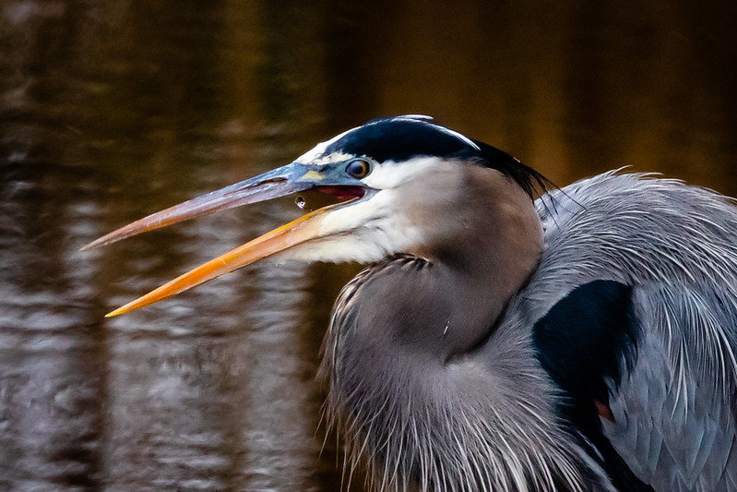
Fish Consumption Advisories
Mercury in the watershed
Polychlorinated biphenyls (PCBs) in urban waterways
Who is at risk?
Environmental and food chain movement
Chemical concentration in fish
Fish size
Fish behavior
Fish lesions
Does a contaminated fish look sick?
Advisories by state and region
Notes:
Contaminants: Contaminants interact with living creatures in different ways. Mercury, which most people think of with fish contaminants and is indeed present in most fish, can accumulate in the muscle. PCBs, manmade chemicals prevalent in urban waterways, concentrate in the fat and the skin of a fish. This means that there are ways to prepare a fish that make it safer, but more on that later.
PCBs cause developmental and neurological issues in humans. The contaminants move up the food chain, with smaller fish being eaten by larger fish and increasing the concentration of PCBs in the bigger fish. Children are at greater risk than adults.
Appearance of contaminated fish: Lesions can occur on fish from a variety of causes and diseases, and are readily visible and understood to indicate a sick fish. Fish contaminated with PCBs will not necessarily look sick—they are more like a person with high cholesterol or undiagnosed early-stage cancer. From the outside you can’t easily tell, but the danger is there. A healthy-looking fish can have contaminant levels that are too high for human consumption.
Differences in fish and advisories: Different fish species have different swimming and eating habits, so different species accumulate more PCBs than others. For example, a bottom feeder or a fish predator will have different levels of contamination than a fish that eats insects near the water’s surface.
While fish species differ, so do bodies of water and the level of contaminants in them. Two rivers in neighboring states or counties, or even within the same county, could have different concentrations of contaminants, which means a fish considered safe in one area may not be safe in another.

Slide 6
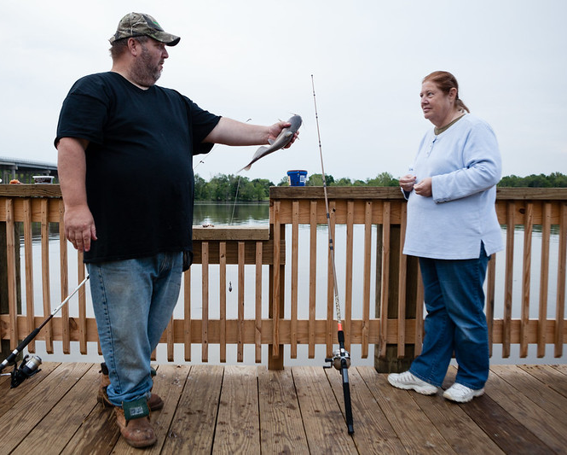
Factors practical and social
Ineffective advisories
Notes:
What I do is help our science be communicated in an effective way by considering the human factor in our scientific efforts.
Fish consumption advisories are listed for every region at waterways and online, but the creation of an advisory does not immediately translate to a change in fish consumption behaviors in the population. FCAs are not being followed, and are therefore ineffective.
This project was started to find out why. An initial literature review of multiple research studies found people are not following fish consumption advisories due to practical and social factors.
In photo: Rodney Hunter, left, of Fredericksburg, Va., asks Ann Morse if she wants to kiss a blue catfish they caught while fishing off the end of the Port Royal Landing in Caroline County, Va., on May 9, 2016. The new 200-foot pier also features a soft launch for paddlers and was funded by grants from the National Park Service, Friends of the Rappahannock, the Chesapeake Conservancy, and other organizations. (Photo by Will Parson/Chesapeake Bay Program)

Slide 7
Compliance Considerations
Practical
Information is not reaching the correct audiences.
Fishing licenses.
Water’s edge anglers.
Inaccessibility
Technical language.
Jargon.
Language barriers.
Social
Perception and behavior.
Delayed onset of symptoms.
Fish appear healthy.
Distrust of messenger.
Cultural emphasis on fish consumption.
Sharing practice.
Cooking styles.
Notes:
What is actually affecting the implementation of all that science information? People are affected, so in addition to science factors your need to look at people factors.
Advisory effectiveness hinges on:
Information in the advisory
How that information is delivered
Practical considerations involve technical and logistical elements that prevent information from reaching the correct audience.
▪ FCAs on licenses: Anglers with licenses often fish for the enjoyment and practice catch and release. Those most at risk for eating contaminated fish are often subsistence fishermen that might not have a license.
▪ FCAs at water’s edge: Anglers catching the fish are often not the ones eating the fish. We’ve been getting the fish contamination side of advisories correct, but we’re missing the human consumption side of advisories.
▪ Technical scientific language or language barriers make advisories inaccessible. Many subsistence anglers don’t speak English, or speak English as a second language. By only posting advisories in one language we are failing to inform a large group of people that are at high risk for eating contaminated fish.
Social factors include perception of advisories and behavior.
▪ Delayed onset: When people eat contaminated fish, they don’t immediately get sick like they do with food poisoning. As people start to develop neurological issues, developmental issues and cancer, they don’t associate those problems with the fish in their diet.
▪ Distrust of message and deliverer: Current FCAs are seen as government-driven and authoritative rather than driven by public health and safety. The perceived message is currently, “govt says no,” of an authority overstepping and telling you what to do, when it should be, “please come fish, but do so safely for you and your family’s health.”
▪ It is important to have an understanding of the culture. Is sharing fish with family or neighbors popular in the culture? Your audience for FCAs may not be those fishing at the water. How is the fish being cooked? Whole frying a fish is a very popular (and let’s be honest, delicious) preparation method, but it also melts the fat onto the flesh. Whole frying a fish is one of the most dangerous ways to prepare a contaminated fish.

Slide 8
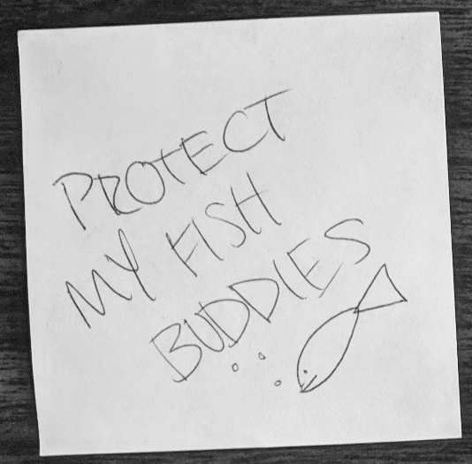
Infographic changes and community feedback overall feel
Notes:
Some of the feedback just made us smile

Slide 9
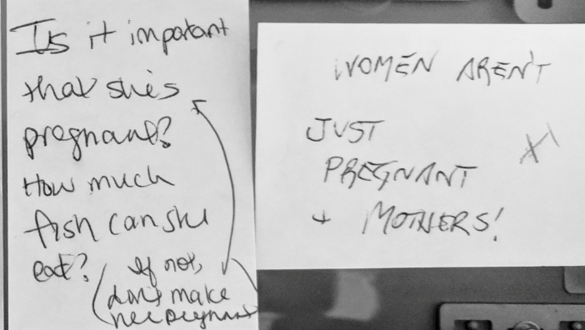
Infographic changes and community feedback appropriate audience
Notes:
When doing outreach, make sure you’re addressing the appropriate audience. No one is going to like everything. But are you reaching the audience you’re addressing? Is it making a difference there? That’s what counts, and that’s what matters.
But remember that you cannot please everyone.
These post-its: The team also received feedback at the Chesapeake Watershed Forum in West Virginia. The population attending the event were mostly environmental professionals and young people. The feedback at this event was very different. Several people questioned the significance of showing the woman in the infographic as pregnant. The plus signs are in a different color ink, indicating others are “liking” and seconding that message.
The decision was made to show the woman in the image pregnant because developing fetuses are at significant risk of harm from contaminated fish, therefore expectant mothers must be particularly mindful of their fish consumption.
● It is important to consider implicit bias when reviewing comments. The comments, and the vehemence displayed in the firm pressure placed on the pen, imply that at this particular event, there is an assumption that pregnancy is seen as a degrading or shameful way to portray women, or that if one is pregnant, that that is her whole identity. Idealism can sometimes outweigh science, even in the environmental field.
You will receive different feedback from different audiences, which could influence your design. Therefore, be sure that you are engaging with the target community for that feedback. It is their behavior you are trying to influence, so it is their feedback that matters.

Slide 10
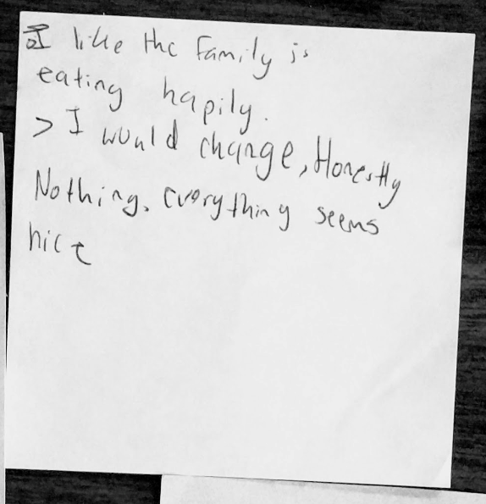
Infographic changes and community feedback Making decisions with community feedback
Notes:
When the team creating materials does not reflect the target population you are trying to reach, different priorities can become important considerations. The team solicited feedback throughout the process, which greatly helped with the design. Community feedback can be found in the user guide appendix on the Toxic Contaminants Workgroup FCA project page on www.chesapeakebay.net.
The team took large versions of the draft posters—in both English and Spanish—to the 2017 Festival del Rio Anacostia at Bladensburg Waterfront Park in partnership with a free fishing event from Anacostia Riverkeepers.
We provided markers, post-its, and written open-ended feedback questions such as “what do you like about this poster?” “what don’t you like?” “what message do you get from the poster?” “what would you change about it?”
This particular post-it and others like it was instrumental in design discussion around panel 4, “Enjoy fish safely.” Scientists on the team understandably wanted the focus solely on health issues and to lose the busy image—just keep the portion sizes and the frequency calendar.
However, this campaign is about reaching the audience and changing behavior. Much of the feedback showed that the community liked the poster, and was therefore receptive to the message, precisely because of the family portrayed. . If the team had not received community feedback, they might have eliminated the elements that the target audience found appealing.
Having this feedback from the community, rather than guessing at what they would want or need, also saved time and money by limiting back-and-forth discussion during design meetings.

Slide 11
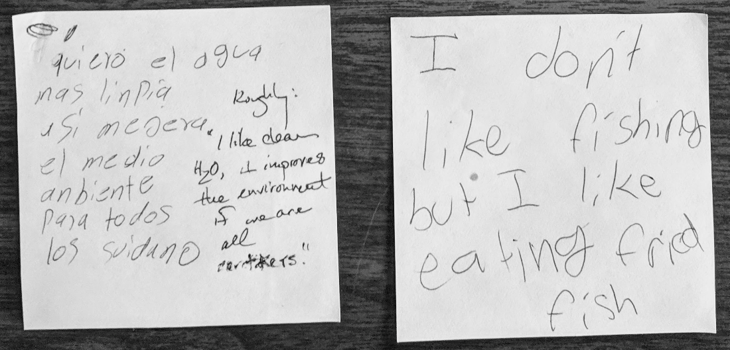
Infographic changes and community feedback ties of science and culture
Notes:
Further evidence that the act of eating itself is tied into social considerations like culture, enjoyment, community. Again the type of fish described here is one of the most dangerous ways to eat a contaminated fish, as frying allows the melted, contaminated fat to coat the fillet being consumed. A project like this, which involves science, the environment, food, people, and community, must be approached holistically.

Slide 12
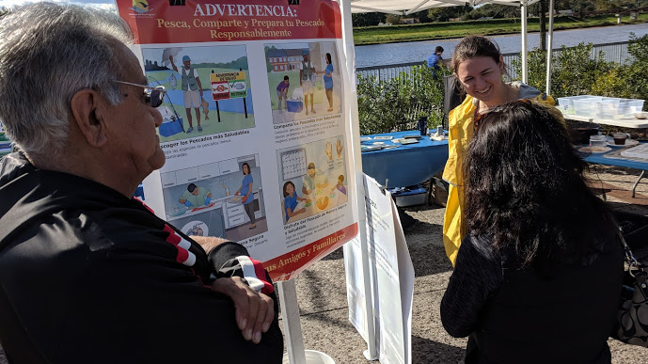
Completed Infographic engages target audience
Notes:
Chesapeake Bay Program staffer Michelle Williams talks about the FCA infographic with festival attendees, Festival del Rio 2018.

Slide 13

User Guide--Contents
Intended use of document
Background
Key points
Placement and promotion
Guidance for individual panel usage
Pilot Study results
Tips for Success
Tips to Encourage Behavior Change
Managing and Customizing Files
Appendices
Notes:
The infographics are designed to be used anywhere there are fish consumption advisories, but the particular pilot project conducted by the Chesapeake Bay Program will not work for every audience. The user guide that accompanies the graphic is designed to help organizations create engagement campaigns that will work for their unique situation and audience.
Find background, technical resources, key points, tips for success, and guidance for the use of individual panels for specific audiences and locations.

Slide 14
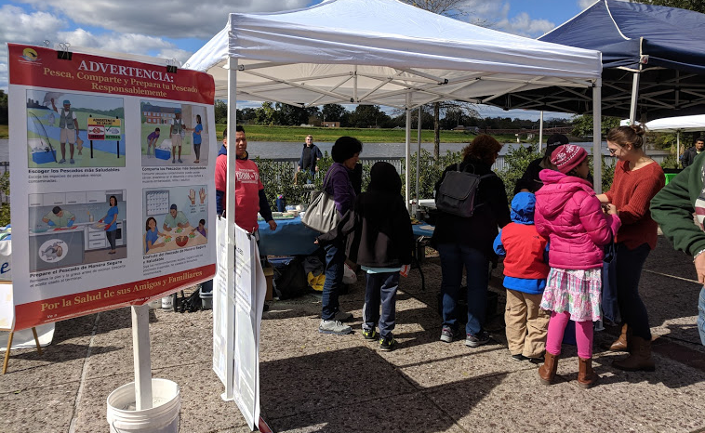
Pilot study
Notes:
Large poster-sized versions of the infographic in both English and Spanish were on display at the cooking demonstration.

Slide 15
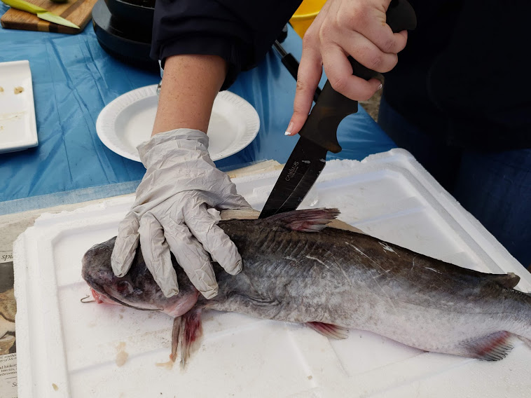
Pilot study
Notes:
Filleting is the safest preparation, but not many are familiar with the process. Beginning the demonstration with a whole fish and filleting in real time removed that barrier of unfamiliarity.

Slide 16
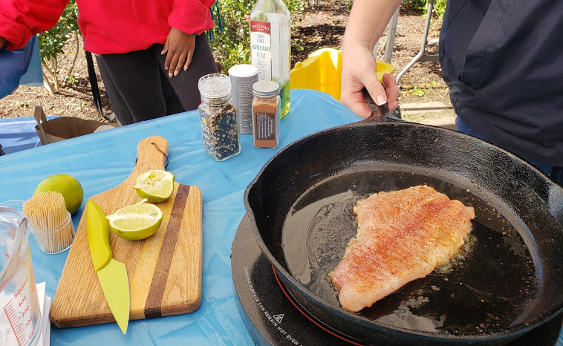
Pilot study
Notes:
The smell of cooking fish and the promise of a sample kept festival-goers engaged and interested in the talk.

Slide 17
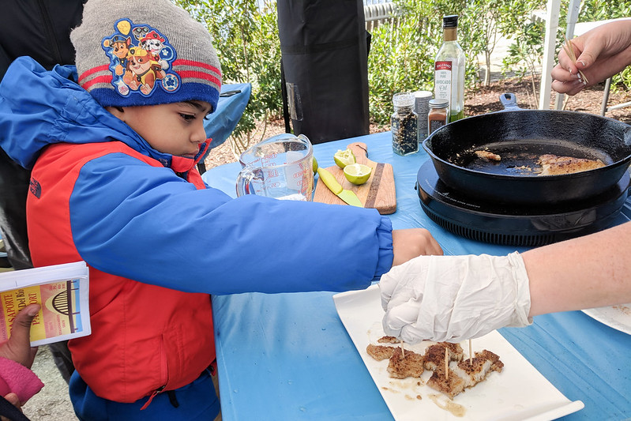
Pilot study
Notes:
Feeding people is one of the surest ways to engage and create a friendly atmosphere, and reaching the young a successful way of nudging behavior. This little guy returned to the table 4 or 5 times throughout the day to enjoy the samples of safely prepared catfish.

Slide 18
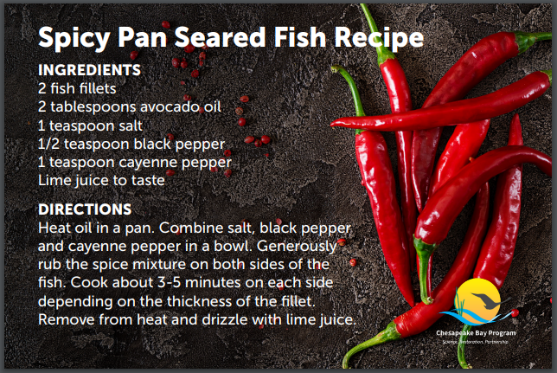
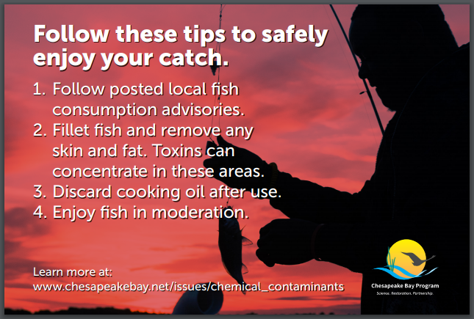
Choosing to engage
Notes:
Recipe cards, which were printed on glossy cardstock and available on the table in both English and Spanish, were not given out to passerby. Rather, attendees had to choose to take it from the table (which they did after tasting the fish, wanting to take home the recipe). This arrangement offered a greater chance that the information would be kept rather than discarded with so many other free festival flyers. The number of cards taken also gave presenters a way to figuratively straw-poll the level of audience interest.
One side featured the recipe they had just sampled. The reverse featured tips for safe fish consumption and a website link to learn more.

Slide 19
Outreach and Updates
Public facing materials on bay.net
Festival del Rio Anacostia
Toxic Contaminants Workgroup presentation
Diversity Workgroup presentation
Management Board presentation
Communications Workgroup presentation
Bay Journal coverage
2020 Pandemic pivoting: video
Riviera Tapas partnership
2021 usage and growth
Notes:
Lasting relationships: The pilot cooking and filleting demonstration was so popular that Festival del Rio planners requested its return for the 2019 festival. Because of this project, Chesapeake Bay Program now has a robust, lasting relationship with the festival and the organizations involved. Chesapeake Bay Program communications and outreach specialist Caitlyn Johnstone now serves as a member of the standing festival planning team. CBP remains a yearly sponsor and participant at the festival.
Pandemic innovation:
Health and safety concerns during the 2020-2021 Covid-19 pandemic necessitated a change in tactic. CBP developed a partnership with a local Latino chef, Hugo Bonilla of Riviera Tapas, to produce two public service videos on fish consumption and healthy eating in the autumn of 2020. The first, presented in English with Spanish subtitles, is a joint video between Riviera Tapas and CBP. The second, completely in Spanish, features chef Bonilla directly addressing the community about healthy fish consumption.
At the request of the restaurant, the full-size poster English version of the infographic is now on display in the dining room of Riviera Tapas in Riverdale, Md. Contact cards for CBP outreach and communications are available at the restaurant bar for curious patrons.
Publicly available materials:
Toxic Contaminants Workgroup public materials(videos, links, user guide, project resources): https://www.chesapeakebay.net/who/group/toxic_contaminants_workgroup
How to cook a healthier fish video: https://vimeo.com/471107206
Bay Journal coverage: https://www.bayjournal.com/news/fisheries/new-recipefish-consumption-advisory-substitutes-safety-for-scare/article_5ab7a1e2-28d1- 11eb-a0fc-0b25fedd6eac.html
CBP article: A cocktail of contaminants in Chesapeake waters https://www.chesapeakebay.net/news/blog/a_cocktail_of_contaminants_in_chesapeake_waters
Fish consumption advisory infographic user guide: https://www.chesapeakebay.net/channel_files/32171/fca_user_guide_december _2020.pdf

Slide 20
Engaging on a larger scale: 2021 CBP Virtual Public Forums
Free forum series hosted by Chesapeake Bay Program Communications Office.
Zoom webinars featuring speakers, videos, and Q&A with the public.
Live cast to CBP Facebook.
Advertised across CBP social media channels.
Themes related to wider CBP calendar.
Engagement opportunities open to all workgroups and partnership organizations.
Communications team project engaging multiple science areas and reaching larger audiences
Notes:
A partnership answer to a complicated problem—GIT funded projects at the Chesapeake Bay Program offer a unique opportunity for experts to bring their skills to a project. In the case of FCA, we had a collaboration of scientific, legislative, research, engagement, and communications expertise. Before we can get into the details of this project…

Slide 21
Engaging on a larger scale: 2021 CBP Virtual Public Forums
February: Media relations
April: Native plants and pollinators
May: Wetlands of the watershed
June: Recreation in the region
July: Blue crabs
August: Green infrastructure
September: Underwater grasses
October: Trees in Chesapeake restoration
If you have work or expertise you would like to showcase on these future themes, contact Caitlyn Johnstone at cjohnstone@chesapeakebay.net.
Notes:
A partnership answer to a complicated problem—GIT funded projects at the Chesapeake Bay Program offer a unique opportunity for experts to bring their skills to a project. In the case of FCA, we had a collaboration of scientific, legislative, research, engagement, and communications expertise. Before we can get into the details of this project…

Slide 22

Virtual Public Forum: April
Chesapeake Bay Program
Alliance for the Chesapeake Bay
Bay Land Design

Slide 23
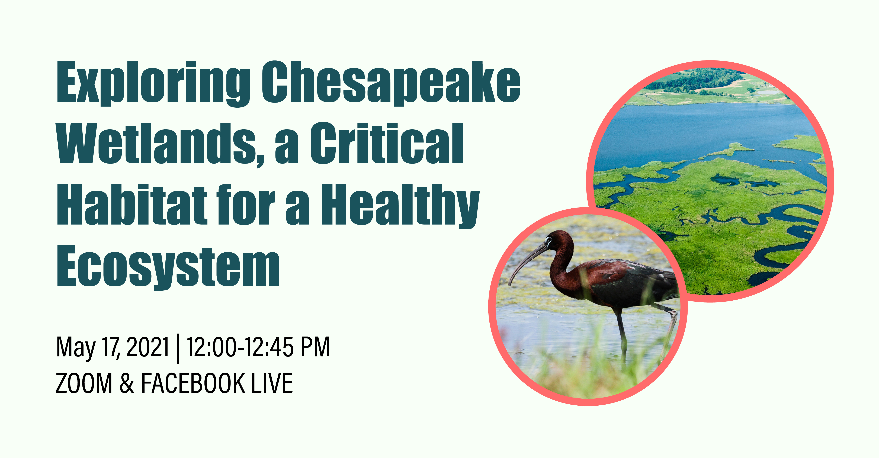
Virtual Public Forum: May
Virginia Institute of Marine Science
The Nature Conservancy
Department of Defense

Slide 24
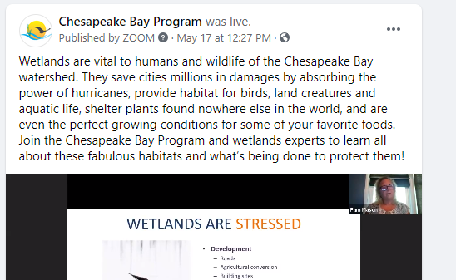
Live Cast to CBP Facebook

Slide 25
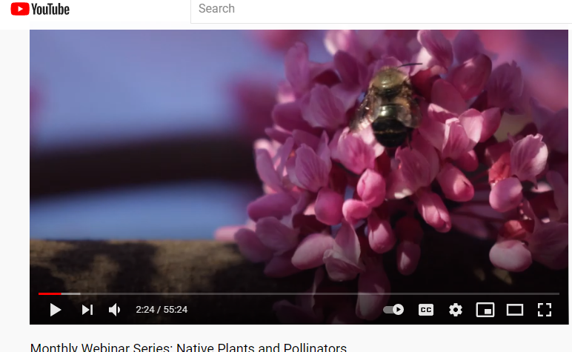
Published on CBP YouTube Channel

Slide 26
What can you do?
Alert networks to resources, events and campaigns
https://www.chesapeakebay.net/who/group/toxic_contaminants_workgroup
https://www.chesapeakebay.net/who/group/communications_workgroup
Help Caitlyn build connections! cjohnstone@chesapeakebay.net
Notes:
Share these resources with other organizations!
Reach out to the GIT project team with any questions or connections.

Slide 27

Chesapeake Bay Program Communications Office
Rachel Felver, Communications Director

Slide 28
Mission Statement
Tell the story of the Chesapeake Bay watershed by communicating and supporting the policy, science, data and restoration activities of the Chesapeake Bay Program and its partners through media outreach, web—and—print—based products, high-quality multimedia, and established and consistent brand, targeted messaging, educational resources and collaboration and engagement with diverse audiences and stakeholders across the watershed.

Slide 29

Who is the Communications Office?
Marisa Baldine, Communications Staffer
Staffs the partnership-wide Communications Workgroup.
Contributes regularly to the CBP blog.
Manages our three newsletters—Bay Brief, Bay News and Chesapeake Currents.
Runs our Twitter account.
Assists with graphic and social media design.

Slide 30
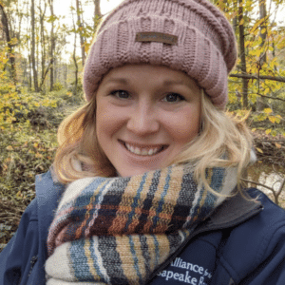
Who is the Communications Office?
Caitlyn Johnstone, Communications and Outreach Specialist
Coordinates our role in any external events or exhibit requests.
Supports efforts to connect with diverse and underserved audiences throughout the watershed.
Member of the Diversity Steering Committee and our Local Engagement Action Team, actively making connections between local audiences and CBP outcomes.
Liaison with workgroups and our Science and Technical Advisory Committee; responsible for many of our blogs that seek to communicate scientific reports produced by the partnership.
Provides guidance in message creation to reach different audiences across the watershed.

Slide 31

Who is the Communications Office?
Will Parson, Multimedia Manager
Produce photography, video and writing that supports CBP’s mission.
Visual editor for projects and provide guidance on photo and video requests.
Manage Instagram, Vimeo and YouTube accounts.
Promote and manage comprehensive multimedia archive.

Slide 32
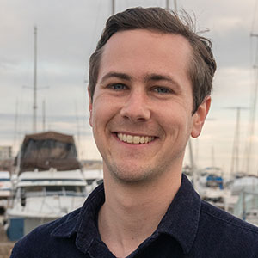
Who is the Communications Office?
Jake Solyst, Web Content Specialist
Manages overall editorial calendar and strategy.
Responsible for content on our flagship website—chesapeakebay.net.
Manages overall social media strategy.
Runs our Facebook page.
Responds to FAQs and comments from the public.
Assists in graphic design.

Slide 33
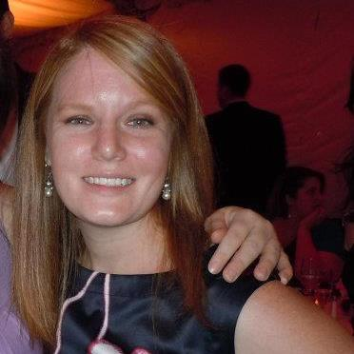
Who is the Communications Office?
Rachel Felver, Communications Director
Point of contact for partnership media relations.
Responsible for setting the strategic direction of CBP communications.
Coordinate partnership-wide Communications Workgroup.
Provide communications and behavior change expertise across the partnership.
Prepare communications strategies for CBP projects and programs.
Coordinate annual Chesapeake Executive Council meeting.

Slide 34
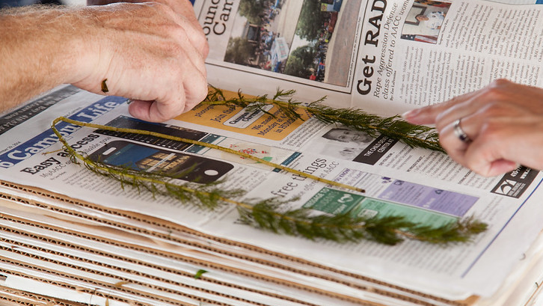
Recap…How can we help you?

Slide 35
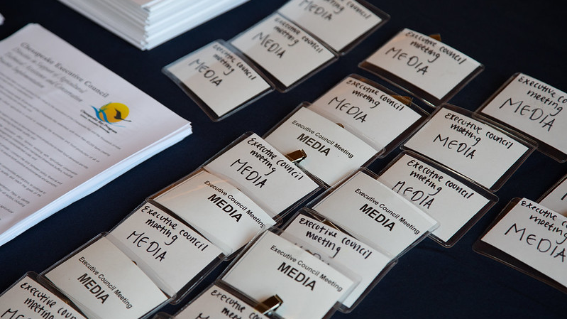
Media Relations
Write press releases.
Connect with reporters.
Facilitate media calls.
Issue media advisories.
Provide media toolkits (talking points, videos, photos, social media content, web content, blogs).

Slide 36
Provide expertise
Communications strategy
Outreach
Editing
Behavior change
Engagement

Slide 37
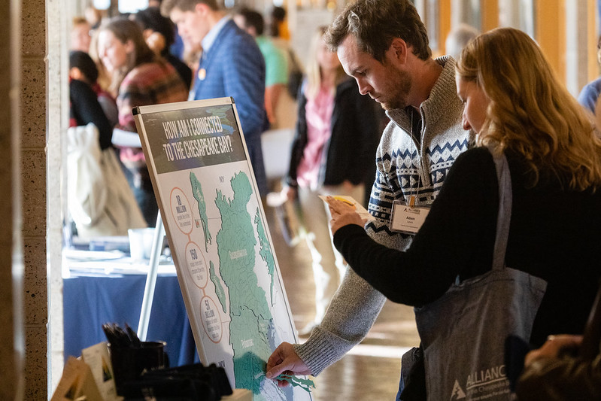
Promotions
Social media
Facebook
Instagram
Twitter
Newsletters
Bay News: Daily round-up of headlines and blogs from around the watershed.
Bay Brief: Weekly newsletter of jobs, internships, events, conferences and funding opportunities.
Chesapeake Currents: Monthly newsletter of CBP-produced news.
Blogs
Events and exhibits

Slide 38
How can you help us?
Message testing
Networking
Provide feedback

Slide 39
Questions?
Rachel Felver, Communications Director
Alliance for the Chesapeake Bay
rfelver@chesapeakebay.net
Caitlyn Johnstone, Communications and Outreach Specialist
Alliance for the Chesapeake Bay
cjohnstone@chesapeakebay.net

