Slide 1
Mid Atlantic Environmental
Literacy Workgroup Meeting
November 14, 2014

Slide 2

Since last we met…

Slide 3
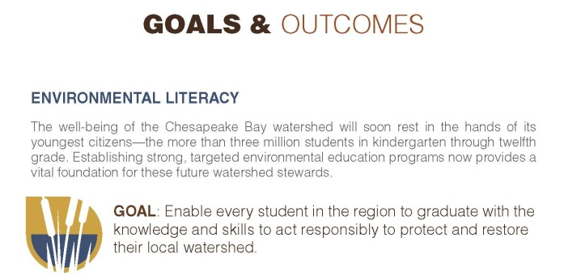

Slide 4
Student Outcome
Continually increase students’ age-appropriate understanding of the watershed through participation in teacher-supported, meaningful watershed educational experiences and rigorous, inquiry-based instruction, with a target of at least one meaningful watershed educational experience in elementary, middle and high school depending on available resources.

Slide 5
Sustainable Schools Outcome
Continually increase the number of schools in the region that reduce the impact of their buildings and grounds on their local watershed, environment and human health through best practices, including student-led protection and restoration projects.

Slide 6
What are Sustainable Schools?
U.S. Green Ribbon Schools
  Pillar 1: Reduced Environmental Impact and Costs
  Pillar 2: Improved Health and Wellness
  Pillar 3: Effective Environmental and Sustainability Education

Slide 7
EL Planning Outcome
Each participating Bay jurisdiction should develop a comprehensive and systemic approach to environmental literacy for all students in the region that includes policies, practices and voluntary metrics that support the environmental literacy Goals and Outcomes of this Agreement.

Slide 8
Management Strategies
Outline the actions needed to accomplish each Outcome as well as monitoring, assessing and reporting progress and coordinating actions among partners and stakeholders
2 year strategies
Management Strategies should describe:
  how local governments, nonprofit and private partners will be engaged;
  where actions, tools or technical support are needed to empower local governments and others to do their part;
  and what steps will be taken to facilitate greater local participation in achieving the Outcome.
Due within one year of Agreement signing

Slide 9
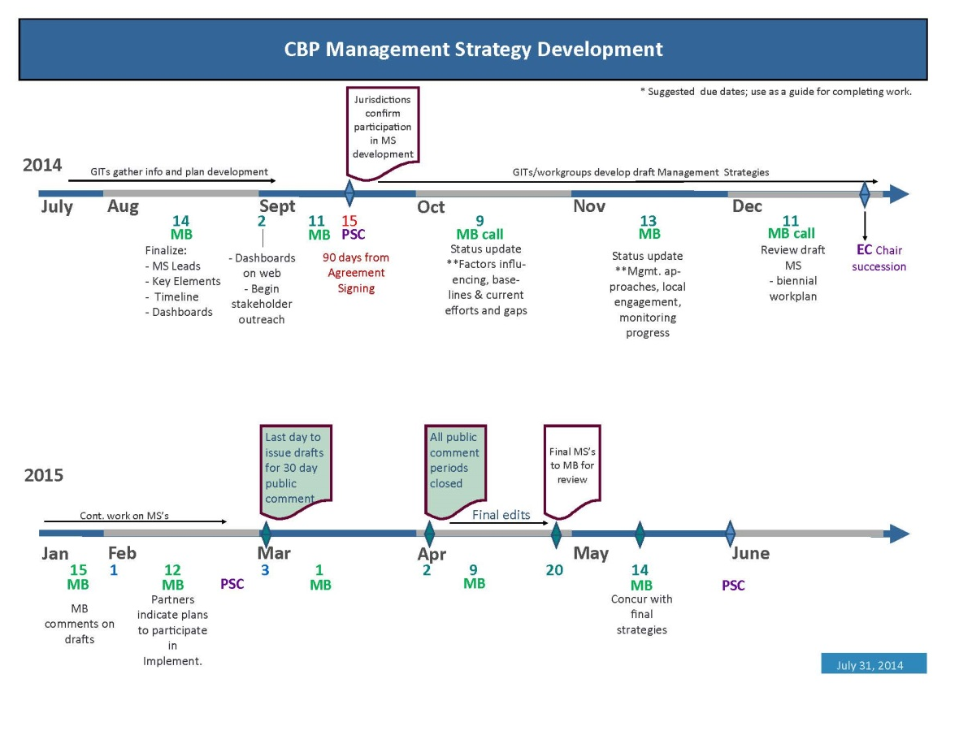

Slide 10
Recent work
Updated MWEE definition
Created and pilot tested Environmental Literacy Tracking Tool (“ELIT”)
Sustainable Schools Workshop (Oct 1-2)
  Individuals identified by state leads
  Drafted actions for sustainable school mgmt. strategy
Leadership workshop (Oct 27-28)
  Refined actions for all outcomes
  Identify specific actions for CBP

Slide 11
Regional Priorities
Student Outcome
Develop Teacher Guide and promotional materials to MWEEs with state specific content, and model programs
Develop targeted communication and outreach strategy to promote MWEE’s and Sustainable schools by jurisdiction
Add after school programs supporting MWEE’s and Sustainable schools to BayBackpack
Scholarships for post-secondary course work
Sustainable Schools Outcome
Provide funding for sustainable schools technical assistance
Support tracking of school building level sustainable practices
Focus future regional summit on sustainable schools
Consider development of Best practices for school certification programs
Develop and promote sustainable schools models/guidance – school grounds for learning
Support state/local level environmental literacy planning activities
Define sustainable schools for ELIT

Slide 12
Regional Priorities continued
Environmental Literacy Planning Outcome
Convene education leadership with Bay leadership to bring focus to E-Lit goals
Build a science and environment network
Incorporate state level priorities into available funding to support EL goal and outcomes (e.g. “block grants”)
Support implementation of the ELIT at the LEA level within each state (e.g. template presentation for administrators to assist with data collection)
Where needed initiate meeting with key leaders to advance EL goal and outcomes

Slide 13
Today’s Focus
Review MWEE update and ELIT Tool
Discuss each EL outcome, corresponding state actions, and how CBP can support at a regional level
Clarify next steps in management strategy development

