Slide 1
MWEE 101 Course
Underpins a consistent understanding
Supports extensive PD across the watershed (and beyond!)
Creates opportunities for enhanced dialogue and more field time during PD workshops

Slide 2
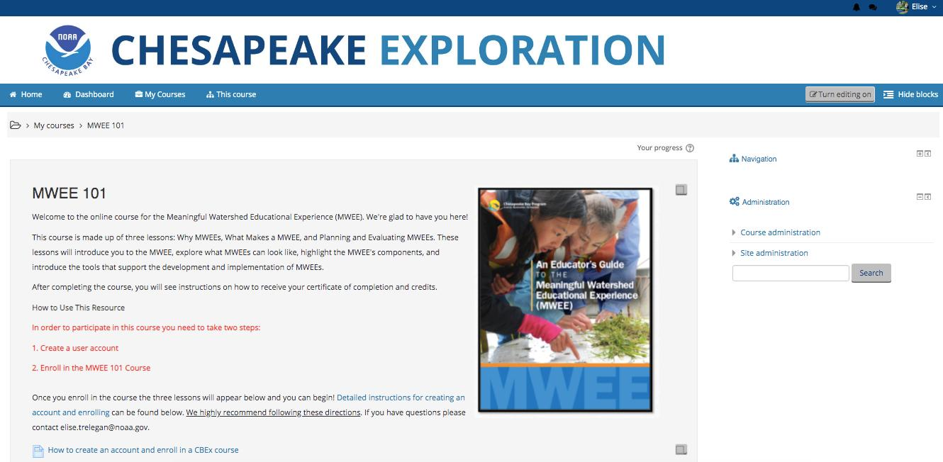

Slide 3
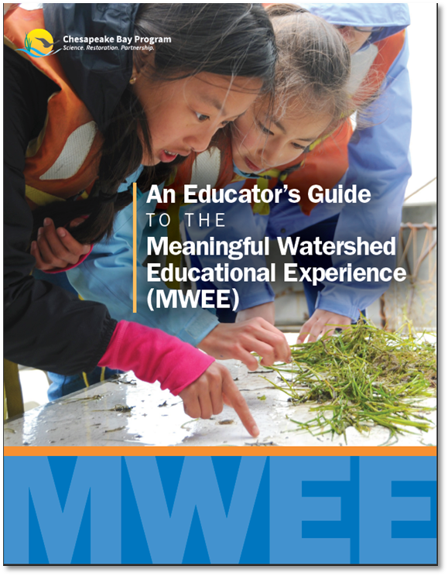
Lesson 1: Why MWEEs
Scholarship
CBP
Lesson 2: What Makes a MWEE
Essential Elements
Supporting Practices
Case Studies
Completed Tools
Think Cloud
Lesson 3: Planning & Evaluating a MWEE
Case Studies
ELMS
Audit Tool

Slide 4
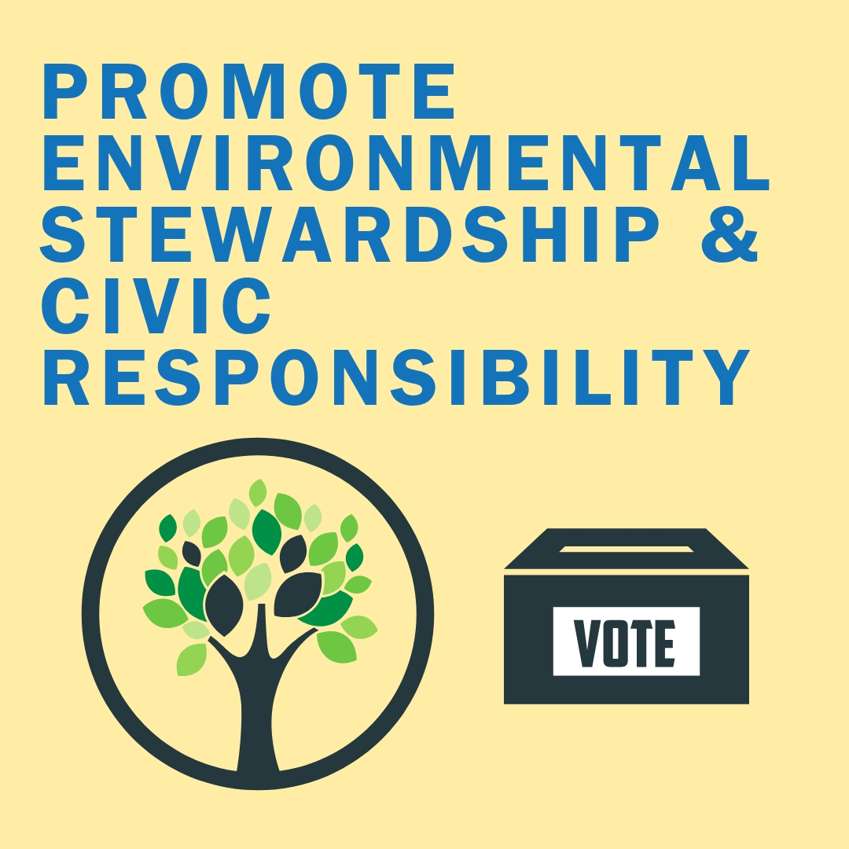

Chesapeake Bay Agreement
Scholarship
Project-based Learning
Place-based Learning
Best Practices for EE
Lesson 1
Why MWEEs

Slide 5
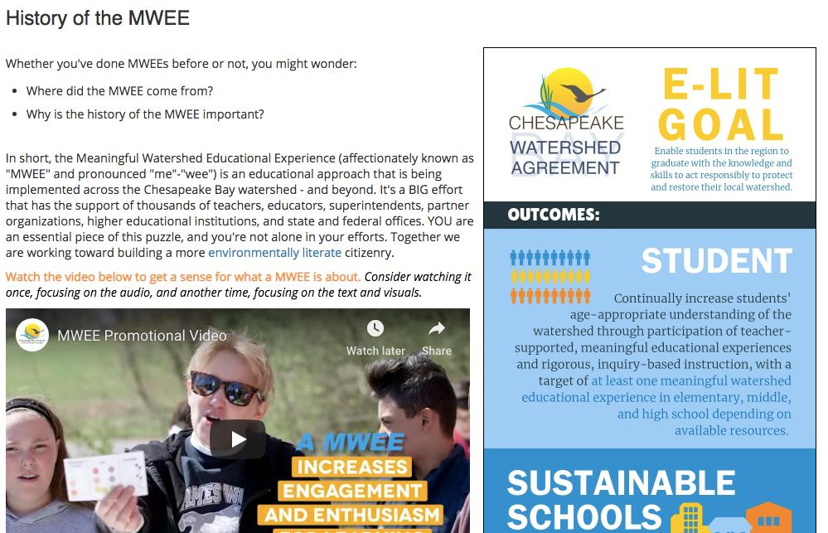

Slide 6
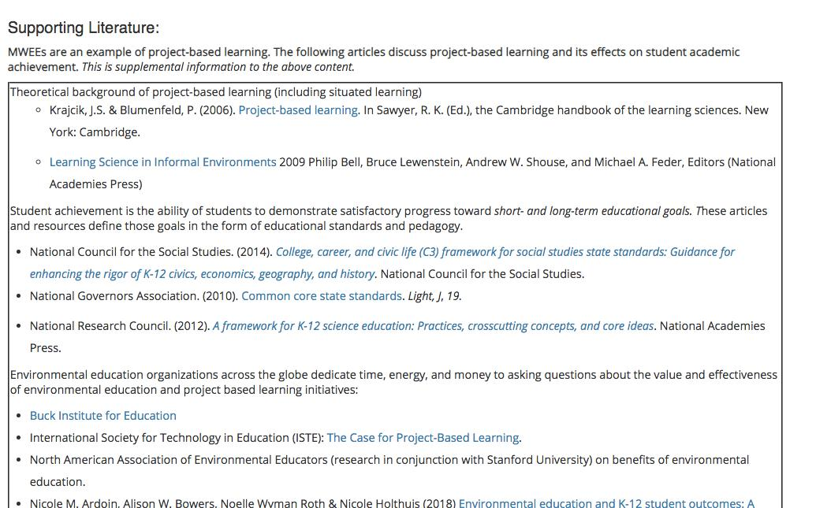

Slide 7
Essential Elements
Supporting Practices
Case Studies
Completed Tools
Think Cloud
Lesson 2
What Makes a MWEE

Slide 8
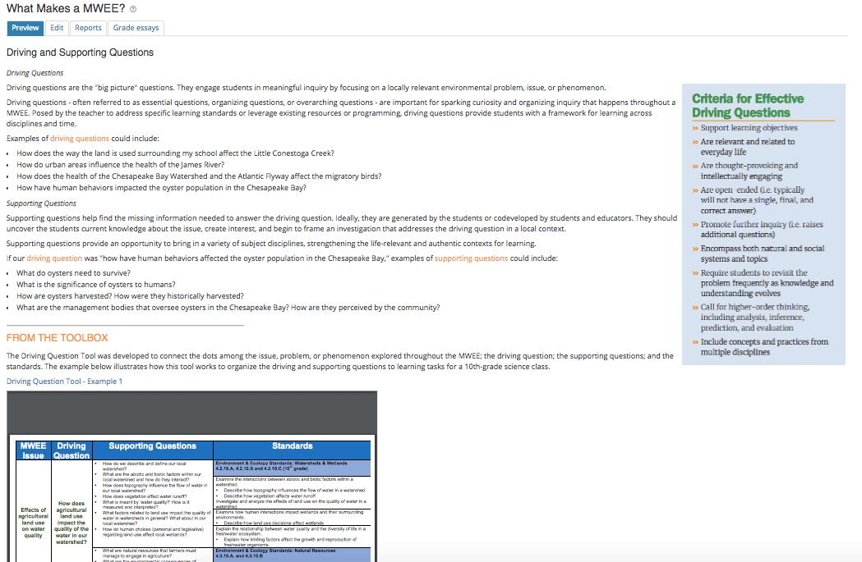

Slide 9
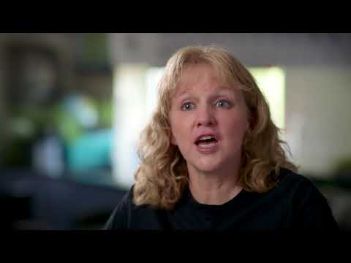

Slide 10
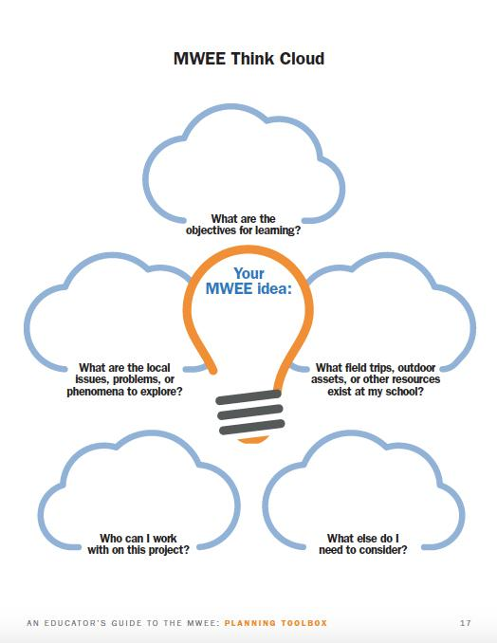
After following the case studies and developing an understanding around the essential elements and supporting practices...

Slide 11
Case Studies
ELMs
Audit Tool
Lesson 3
Planning + Evaluating MWEEs

Slide 12
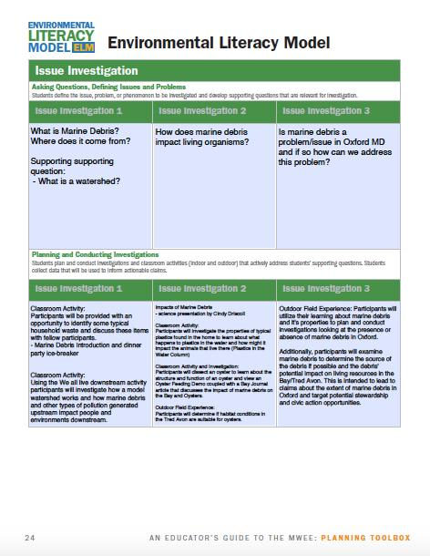
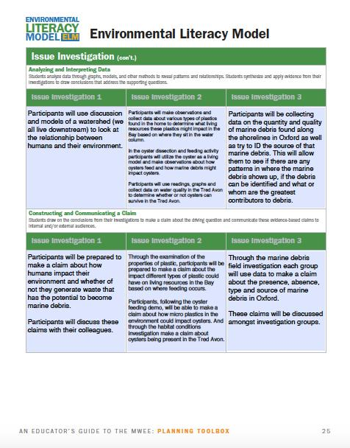

Slide 13
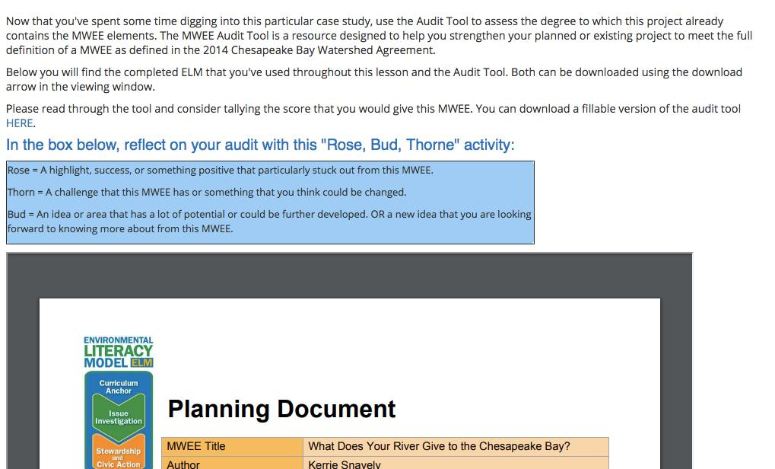

Slide 14
MWEEs in Maryland
Lessons
Maryland Policy / Standards
Curriculum Anchor
Issue Investigation
Stewardship + Civic Action
[
Reflect on experience
Explore new resources
Engage with a PRACTICAL example
Apply the associated tool / ELM page for your planning

Slide 15
What’s New In the MWEE Guide?
Tools / Environmental Literacy Model
Action Projects → Stewardship & Civic Action
Youth Voice Callout Box

Slide 16
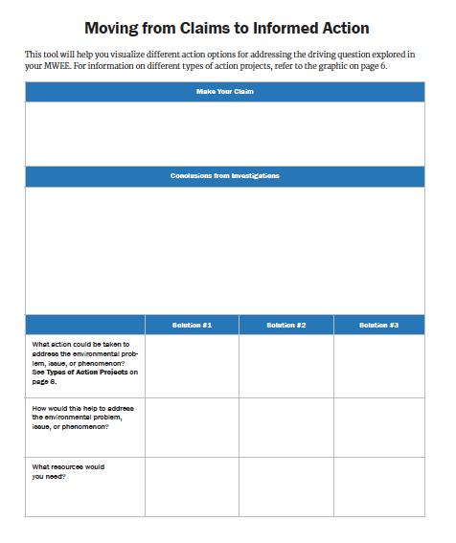

Slide 17
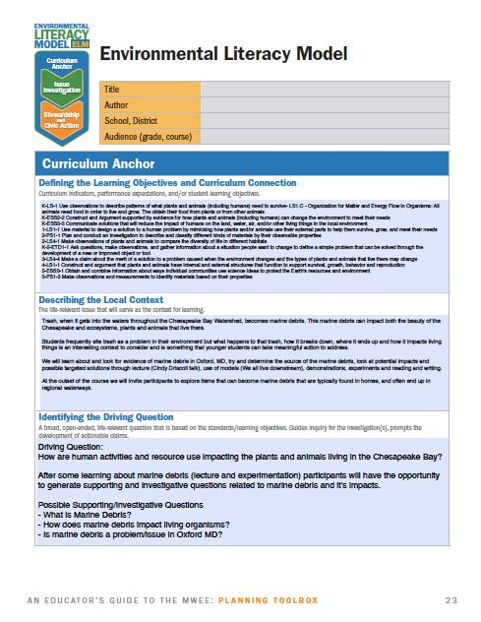
Same!

Slide 18
New!

Slide 19
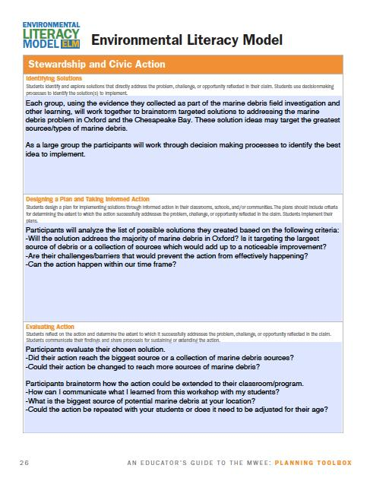
Updated Language

Slide 20
Access the Tools
MWEE 101
http://bit.ly/MWEECourse
Updated MWEE Guide / Toolbox http://baybackpack.com

