Slide 1

CBP Cooperative Agreement
Objective 3: BMP Opportunities,
Prioritization, and Reporting
Katie Walker
Geospatial Analyst
kwalker@chesapeakeconservancy.org

Slide 2
CBP Cooperative Agreement
Objective 1: Land Cover and Land Use
  Partnering with University of Vermont
Objective 2: Hydrology & Ditches
  Partnering with UMBC
Objective 3: BMP Mapping & Tracking
  Partnering with Chesapeake Commons and Drexel University
Objective 4: General Geospatial Support
Notes:
Objective 1: rsoobitsky@chesapeakeconservancy.org
Objective 2: dsaavedra@chesapeakeconservancy.org
Objective 3: lking@chesapeakeconservancy.org
Objective 4: jleizear@chesapeakeconservancy.org

Slide 3


Vision and Mission
Vision:
To gather a basin-wide understanding of where opportunities for restoration exist that can inform WIP planning and provide data-driven decision making.
Mission:
Leverage high-resolution datasets and innovative methods to create a blueprint for restoration strategies throughout the watershed
Integrate this blueprint into a comprehensive tool for planning and reporting that is accessible by and useful to stakeholders and practitioners alike
Provide capabilities for analysis and reporting on identified practices

Slide 4
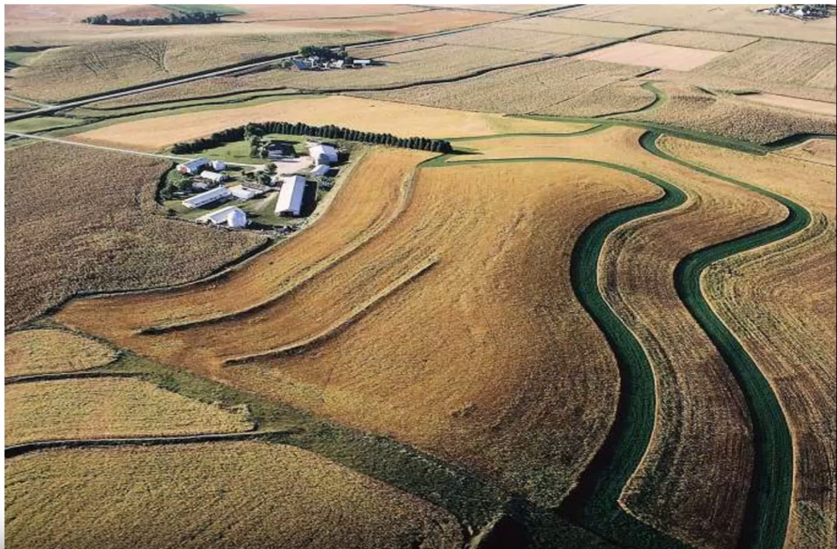
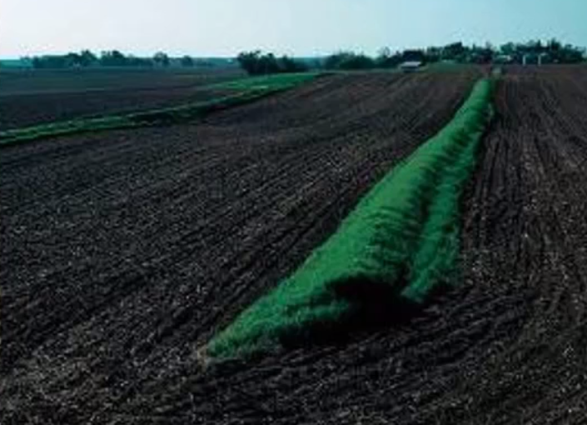
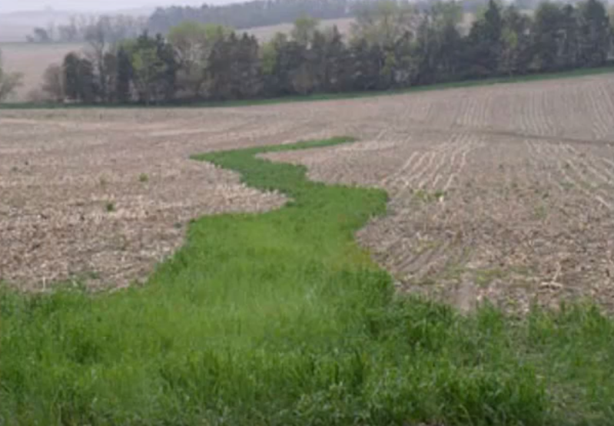
Research into Chesapeake BMPs
Water and Sediment Control Basins
Grassed Waterways
Contour Buffer Strips

Slide 5
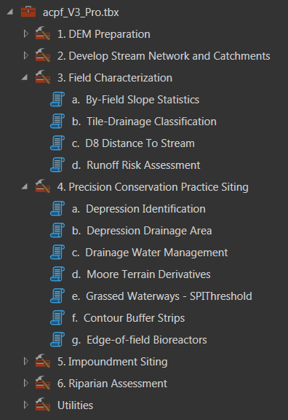
BMP Identification & Mapping
ACPF: Agricultural Conservation Planning Framework (USDA)

Slide 6
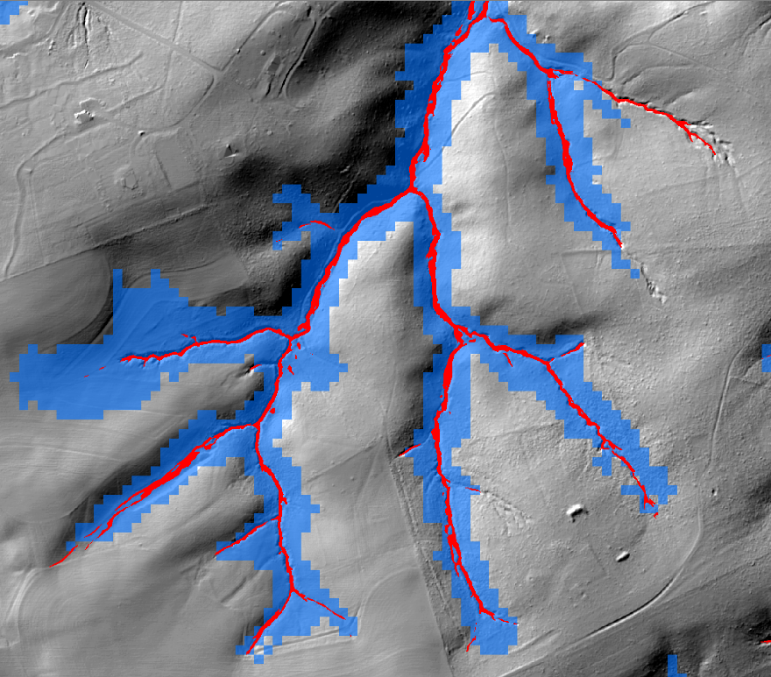
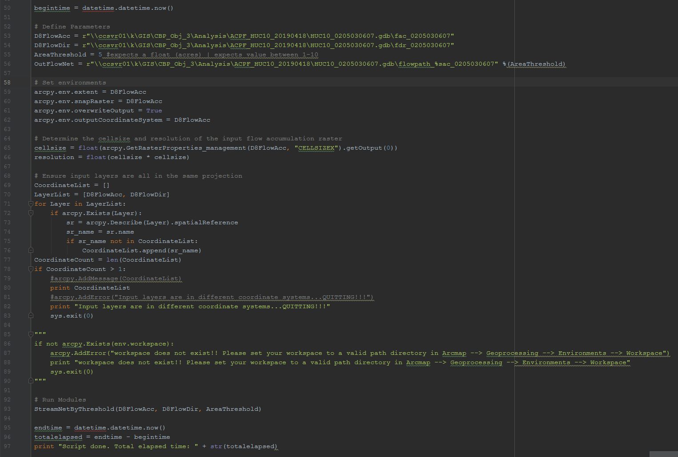
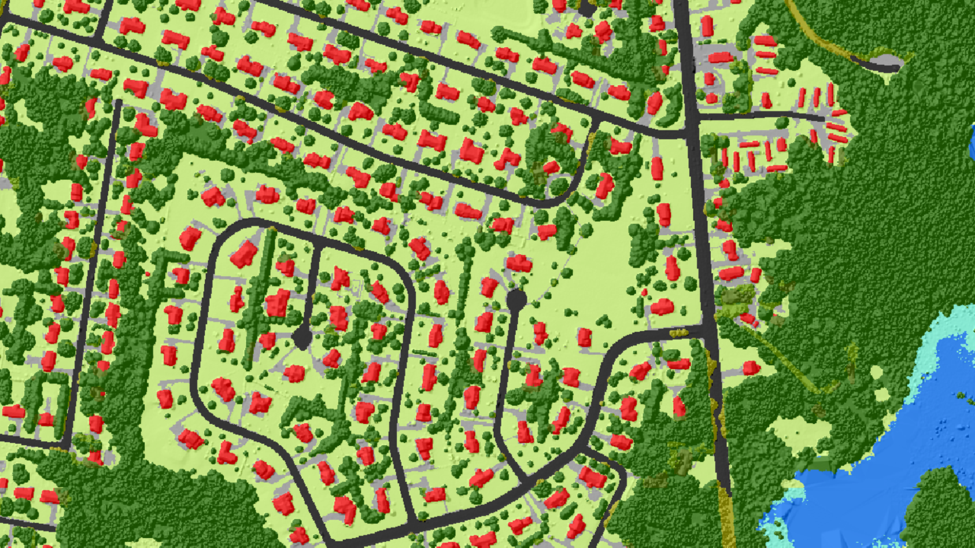
BMP Identification & Mapping
Integrating high-resolution datasets into the framework…

Slide 7
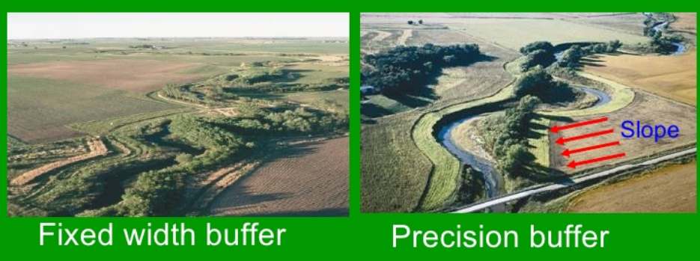
R&D for new methods…
Variable Riparian Buffer Width vs Fixed Width
Fares, Hawaii Water Quality Conference, March 24-25 2008
  35 ft or 100 ft common in this region
  Research shows fixed width buffers aren’t reflective of natural landscape
  Variable width riparian buffers:
    Using datasets to delineate where riparian areas “should be” on the landscape, restoring those areas

Slide 8
Variable Buffer Delineation
AgBuffer Builder
LiDAR – change in slope
Cost-Distance Analysis from pollution risk raster
Hydrologic Function
  Bank-full depth
  Floodplain from stream gauge data (50 year)
    RBDM – Riparian Buffer Delineation Model (v 5.2) [USDA FS]

Slide 9
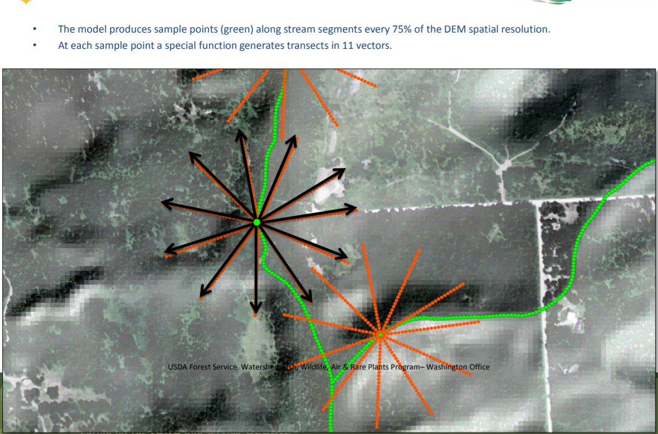
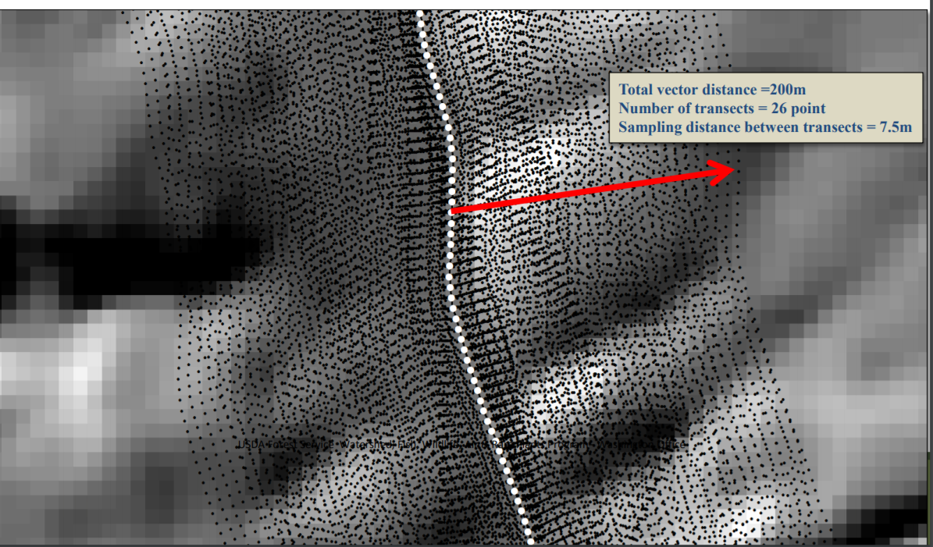
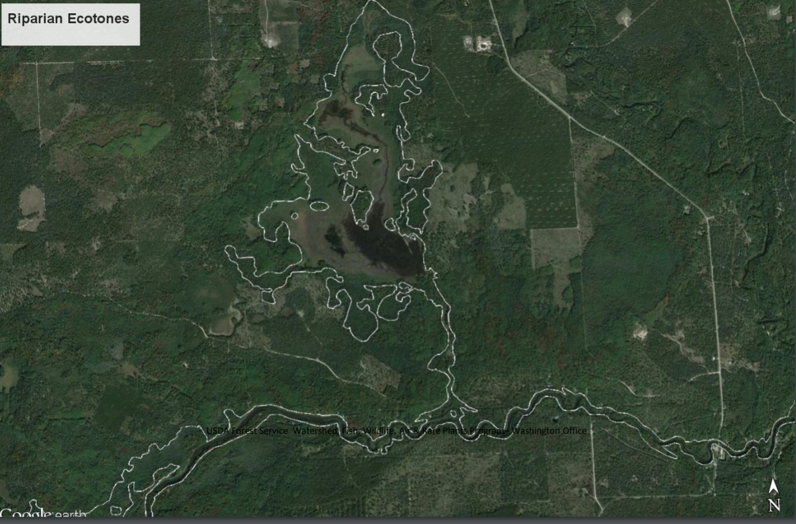
Variable Buffer Delineation

Slide 10
Feedback and Questions
We are seeking feedback for this work. If you have time to reach out, we’d love to hear from you!
Interested in being a part of our advisory committee? Contact us!
Katie Walker | Geospatial Analyst
Chesapeake Conservancy
kwalker@chesapeakeconservancy.org
(443) 482-9013
Louis Keddell | Senior Project Manager
Chesapeake Conservancy
lkeddell@chesapeakeconservancy.org
(443) 482-9016

