Slide 1
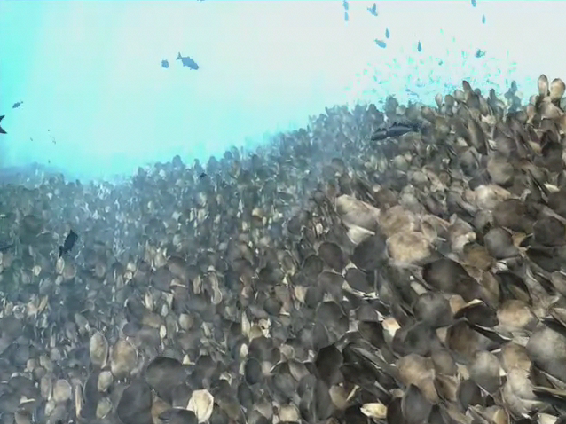


Chesapeake Atlantis Model Predicting the Cumulative Effects of Multiple Simultaneous Stressors
Tom Ihde, ERT, Inc.
for the NOAA Chesapeake Bay Office
Habitat GIT, 14 October, 2015

Slide 2
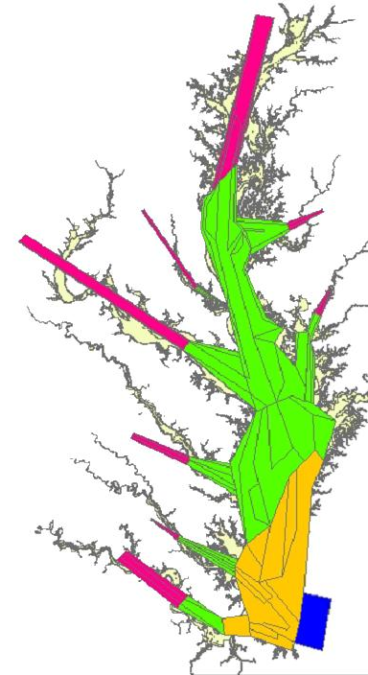
NOAA Chesapeake Bay Office – Ecosystem Modeling Team
The Chesapeake Atlantis Model (CAM)
A Whole Ecosystem Modeling Approach
Incorporating:
Biological environment
Primary production
Trophic interactions
Recruitment relationships
Age structure
Size structure
Life History
Fisheries
Multiple sectors
Gears
Seasons
Spatially explicit
Physical environment
Geology
Chemistry
Circulation & currents
Temperature
Salinity
Water clarity (TSS)
Climate variability
Nutrient Inputs
Currency is Nitrogen
Oxygen
Silica
3 Detrital forms
Bacteria-mediated recycling
Developing and Applying Tools For Ecosystem-Based Fisheries Management
Notes:
Spatial
Salt, heat, and water pushed by ROMS model (Regional Ocean Modeling System)
Nutrient – driven; based on output of CBP’s Watershed Model
Habitat – biomass, area, & 3-D structure providing refuge to prey
Designed to capture/ model multiple, simultaneous stressors to simulate non-intuitive, non-linear, cumulative effects of the combination of stressors & changes in system
Tool to integrate all available information and put it on a level playing field
Atlantis is designed with saltwater geochemistry; consequently, the dynamic model only includes brackish water . However, upstream (freshwater) nutrient information is fed into the model with input from EPA’s Watershed Model, so the effects of upstream management efforts are also be incorporated

Slide 3
The Chesapeake Atlantis Model
Design

Slide 4
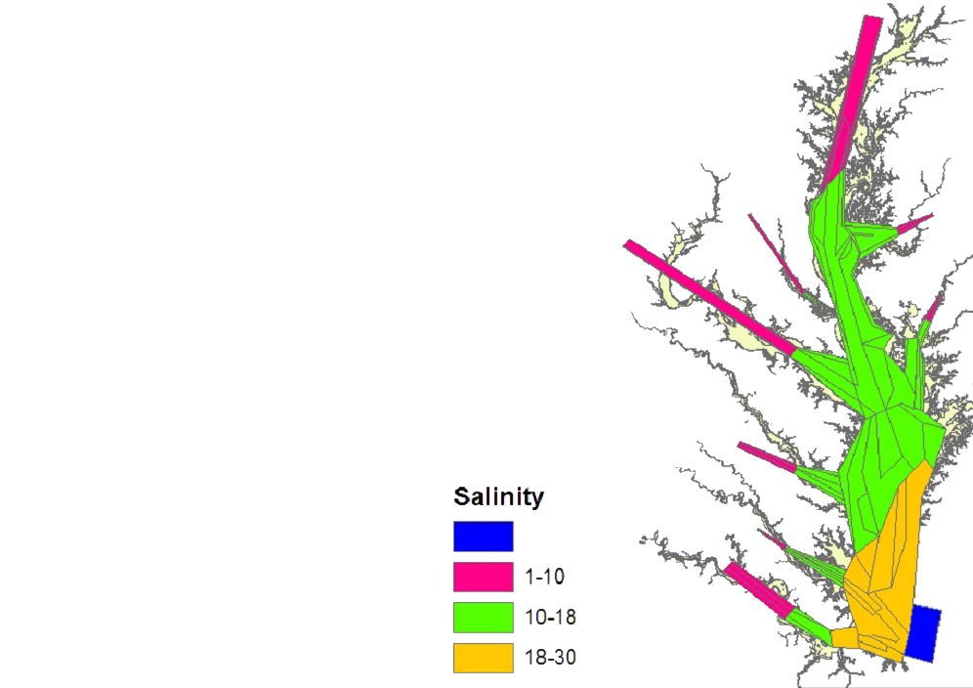
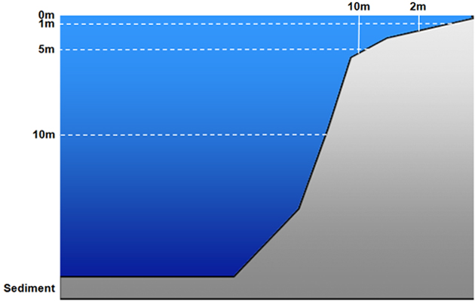
CAM Design: 3-Dimensional Box Model:

Slide 5
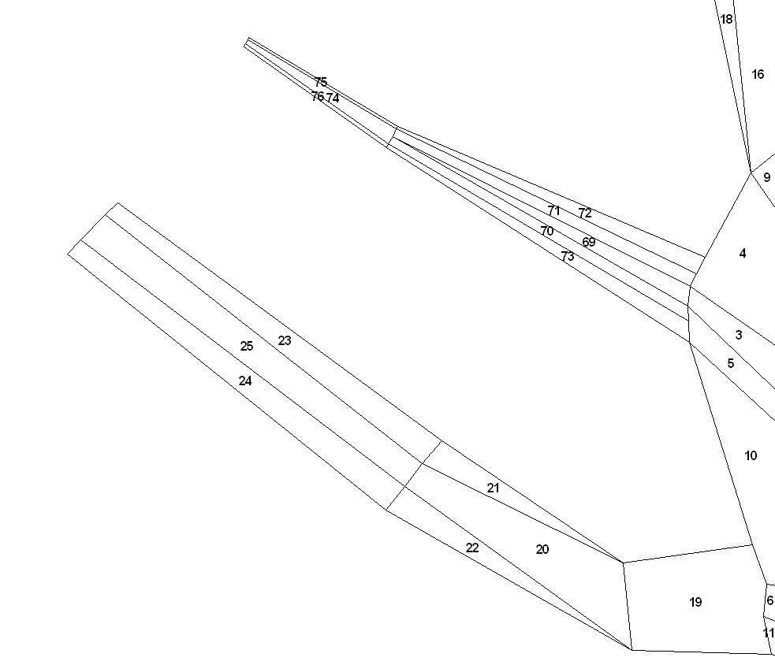
NOAA Chesapeake Bay Office – Ecosystem Modeling Team
CAM: River Box Structure
Notes:
Tribs all have deeper channel with very shallow, narrow boxes that allow for conditions favorable for marsh grasses or SAV to predominate
This structure can accommodate changes in development or water treatment plants, etc.

Slide 6
Ecological Groups: Federal fisheries, Forage, Protected, Habitat
Finfish
- Alosines (Amer.Shad, Hickory Shad, Alewife & Herring)
- Atlantic Croaker
- Bay anchovy
- Black drum
- Bluefish
- Butterfish, harvestfish (“Jellivores”)
- Catfish
- Gizzard shad
- Littoral forage fish: silversides, mummichog
- Menhaden
- Striped bass
- Summer flounder
- Other flatfish (hogchoker, tonguefish, window pane, winter flounder)
- Panfish:
Euryhaline: Spot, silver perch; FW to 10ppt: yellow perch, bluegill
- Reef assoc. fish: spadefish, tautog, black seabass, toadfish
- Spotted hake, lizard fish, northern searobin
- Weakfish
- White perch
Elasmobranchs
- Cownose ray
- Dogfish, smooth
- Dogfish, spiny
- Sandbar shark
Birds
- Bald Eagle
- Piscivorous birds (osprey, great blue heron, brown pelican, cormorant)
- Benthic predators (diving ducks)
- Herbivorous seabirds (mallard, redhead, Canada goose, & swans)
Mammals
- Bottlenose dolphin
Reptiles
- Diamond-back Terrapin
- Seaturtles
Invertebrates
- Benthic feeders: (B-IBI “CO”+”IN”) …,
- Benthic predators: (B-IBI “P”) …,
- Benthic suspension feeders: (B-IBI “SU”)
- Blue crab YOY
- Blue crab adult
- Brief squid
- Macoma clams: (B-IBI)
- Meiofauna: copepods, nematodes, …,
- Oysters
Primary Producers
- Benthic microalgae (“microphytobenthos” benthic diatoms, benthic cyanobacteria,
& flagellates)
- “Grasses:”
SAV – type varies with salinity
- Marsh grass
- Phytoplankton – Large: diatoms & silicoflagellates (2-200um)
- Phytoplankton – Small: nannoplankton, ultraplankton,
aka “picoplankton” or “picoalgae” (0.2-2um),
cyanobacteria included (2um)
- Dinoflagellates (mixotrophs) (5-2,000um)
ZooPlankton
- Ctenophores
- Sea nettles
- Microzooplankton (.02-.2mm): rotifers, ciliates, copepod nauplii
- Mesozooplankton (.2-20mm): copepods, etc.
Detritus
- Carrion
- Carrion (sediment)
- Labile
- Labile (sediment)
- Refractory
- Refractory (sediment)
Bacteria (.2-2 um [.002 mm] - feed microzooplankton food chain)
- Benthic Bacteria (sediment)
- Pelagic Bacteria: (free-living)
Images courtesy of ian.umces.edu/imagelibrary/

Slide 7
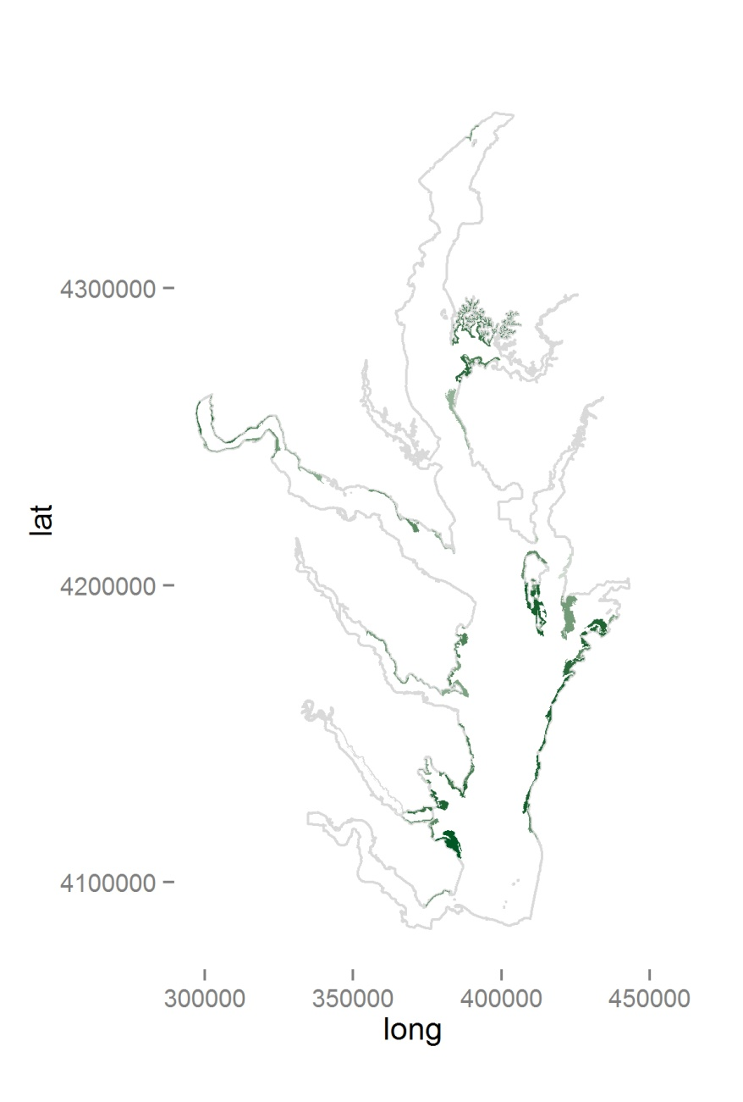
Marsh Modeled in CAM
The Chesapeake Atlantis Model
Application

Slide 8
Habitat Scenario Assumptions
50% loss of Marsh
(area & biomass)
Due to multiple, interacting factors:
shoreline armoring
subsidence
sea level rise
50% loss of Seagrass
Notes:
Biogenic habitat groups
Marsh loss – not completely arbitrary; Chosen with input from Habitat specialists as “realistic” scale of loss
Marsh [accretion] can not keep up with losses, shallowest areas around most of Bay, so losses are expected to be substantial
Generally for modeling with a complex model like Atlantis, a large change also helpful, so the signal that we see is easier to recognize as being caused by the factor, and not some 2ndary, tertiary, or higher level change

Slide 9
Water Column Habitat Assumptions
“TMDL” = Total Maximum Daily Loads of Nitrogen & turbidity – full attainment:
Nitrogen
- 25% reduction
Turbidity (total suspended solids)
- 20% reduction

Slide 10
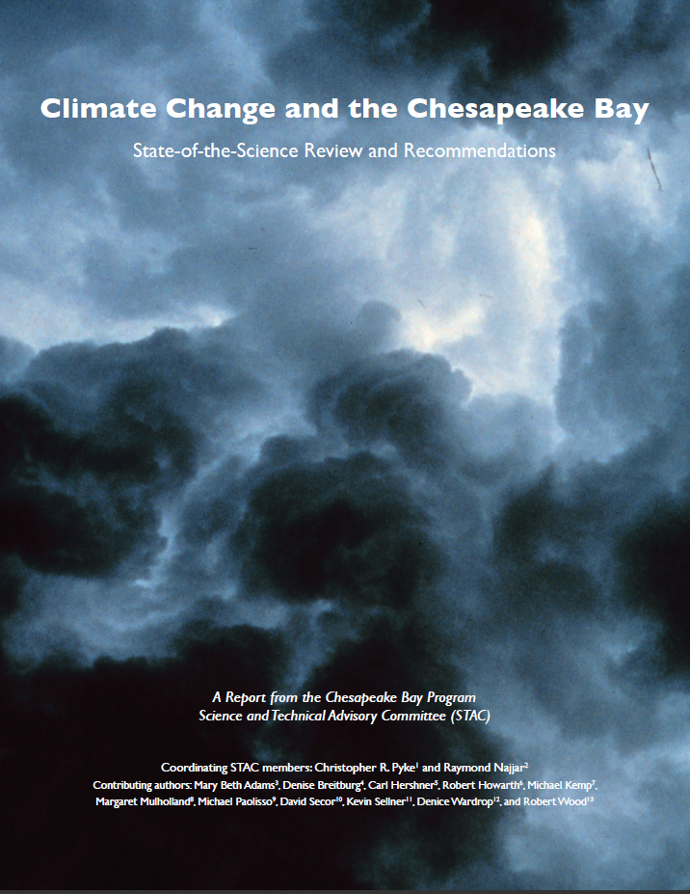
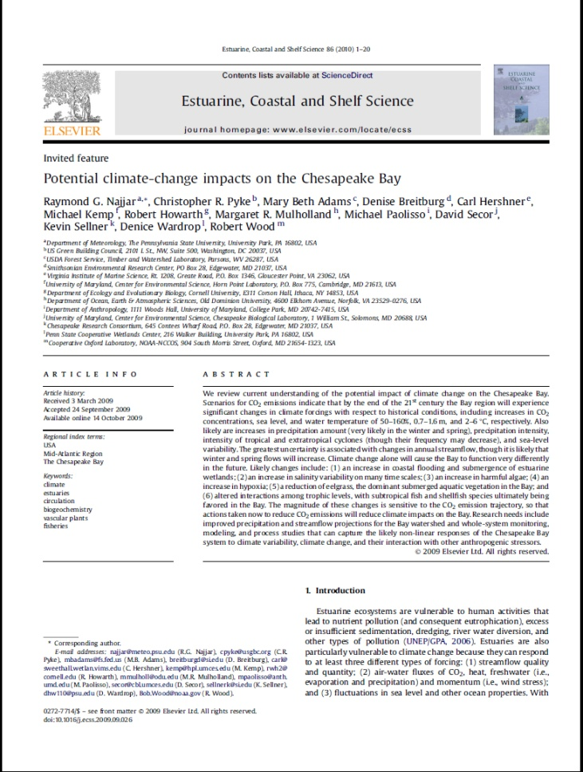
Climate Change Assumptions
Najjar et al. (2010); IPCC AR4 (2007)
50 years from now:
Increased water temperature (1.5°C)
Salinity (+/- 2 ppt)
Notes:
Climate Change scenarios based on STAC (Scientific and Technical Advisory Committee, Chesapeake Bay Program) Review
– which, in turn, was based on IPCC (Fourth Assessment Report of the Intergovernmental Panel on Climate Change, AR4, 2007) report,
and a lit review,
- numbers are specific (AR4 downscaled) to the Chesapeake Bay

Slide 11
Sensitivity To Climate Change
Selected Group Effects of Interest to Management
Temp Increase with
Marsh Loss,
SAV Loss,
& TMDL
BA
SF
FF
Z
W
BC
Z – Zooplankton
SB
AM
BA – Bay Anchovy
W – Worms (and other
benthic invert. prey)
Temp Increase
with Marsh Loss
& SAV Loss
FF
BC – Blue Crab
BA
SF
Z
BC
W
SB
AM
AM – Atlantic Menhaden
SB – Striped Bass
SF – Summer Flounder
Temperature
Increase (1.5C)
BA
SF
FF
Z
W
BC
FF – All Finfish
SB
AM
Scenarios
TMDL
W
FF
AM
SF
BA
BC
Z
SB
SF
FF
SAV Loss
BC
BA
W
Z
AM
SB
Marsh Loss
BA
SF
FF
W
BC
Z
AM
SB
-15
-15
-15
-15
-15
-15
-10
-10
-10
-10
-10
-10
-5
-5
-5
-5
-5
-5
0
0
0
0
0
0
5
5
5
5
5
5
10
10
10
10
10
10
Percentage Change
Notes:
Orientate to plot axes
-------------------------------------
Little variability predicted under Marsh loss, SAV loss, and TMDL scenarios; little consistency between these scenarios
Temp+ => much greater variability / effect of system change; consistent for all scenarios that include Temp+
Interactions also important – and expected to be very non-linear/ multiplicative, not additive

Slide 12
Summary
Temperature increase produces relatively strong effects on production compared to losses of marsh, SAV, or the TMDL water quality improvements
Modeling other stressors without expected temperature increase could be misleading
Reasonable trends can be predicted modeling a single stressor if you happen to choose the dominant stressor
Risk is relatively large for some important Chesapeake managed fish (~10 % loss in production)
12
Notes:
Use of Atlantis – puts stressors (and groups and other factors) on the same “playing field” / same scale, so magnitude/ importance can be compared

Slide 13
Next steps…
Test sensitivities, explore current hypotheses: pred-prey; DO; shifts in state of system
Verify trends with other models where possible
Add other effects of climate change:
- allow movement preferences for changing climate conditions (temperature, salinity)
- shifts in timing of migration & spawning
Acidification effects

Slide 14



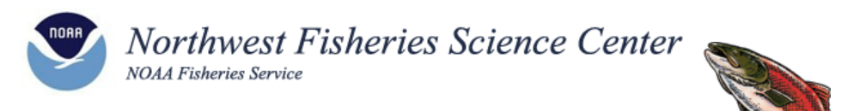

Thanks to:
Marine and Atmospheric Research
14

Slide 15
Extra Slides
15

Slide 16
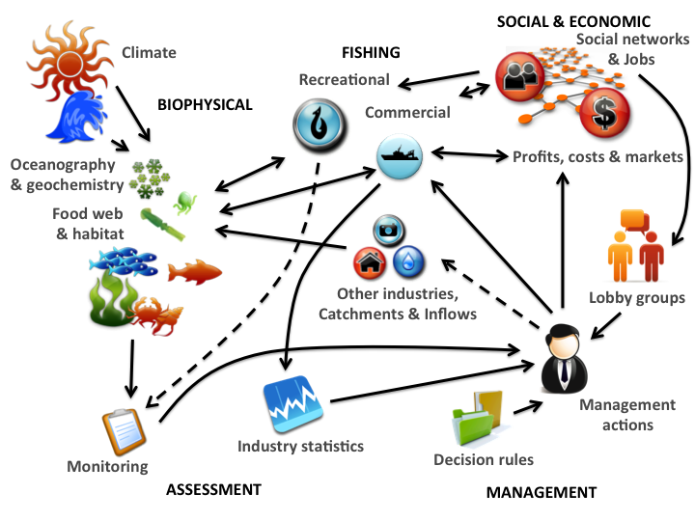
Notes:
Model review
> Beth Fulton’s image – Author of Atlantis
> capabilities
> Design makes Atlantis ideal to apply in systems where multiple important stresses (or system changes) are taking place to get a better handle on predicting the cumulative effects of simultaneous stressors, & to identify non-intuitive change that might otherwise not be predicted from modeling single-dimensional change
> Chesapeake needs -- fish production effects of:
- Habitat loss
- Physical effects: climate change, SLR, TMDL, etc.
- Management choices (ID unintended consequences)

Slide 17
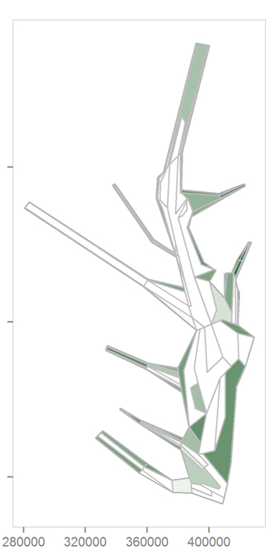
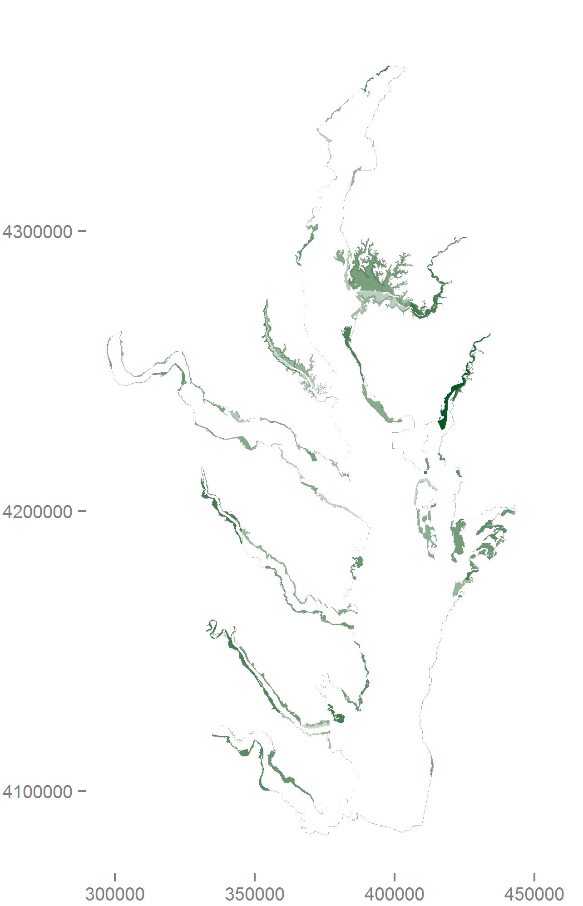
Habitat: SAV Modeled in CAM

Slide 18
Habitat: Marsh Modeled in CAM

Slide 19
Outline
Stressors / system changes:
Habitat loss:
- Marsh, SAV
Water column factors:
- Nitrogen & Total Suspended Solids
Climate forcing:
- Temperature increase
Simulation results
Next Steps

Slide 20
Sensitivity To Climate Change
Selected Group Effects of Interest to Management
Zooplankton
15
Key Forage
(vert & invert)
10
Bay Anchovy
5
0
-
Current
5
-
MA Loss
10
All Finfish
Worms, etc.
SAV Loss
-
15
TMDL
-
20
Temp+
Temp+, MA-, SAV-
Temp+, MA-, SAV-, TMDL
Summer
Flounder
Blue Crab
Striped Bass
Menhaden
Notes:
Same information, plotted differently

Slide 21
Does modeling a single stressor produce similar results as modeling multiple stressors together?
It depends:
Yes, if happen to choose the dominant stressor
No, if choose the wrong stressor
Potentially ‘no’ when modeling multiple stressors of similar importance
21

Slide 22
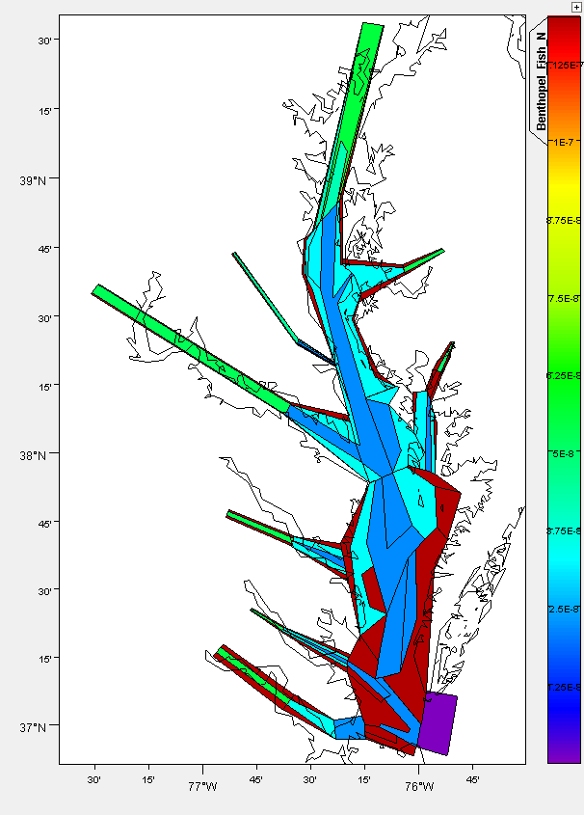
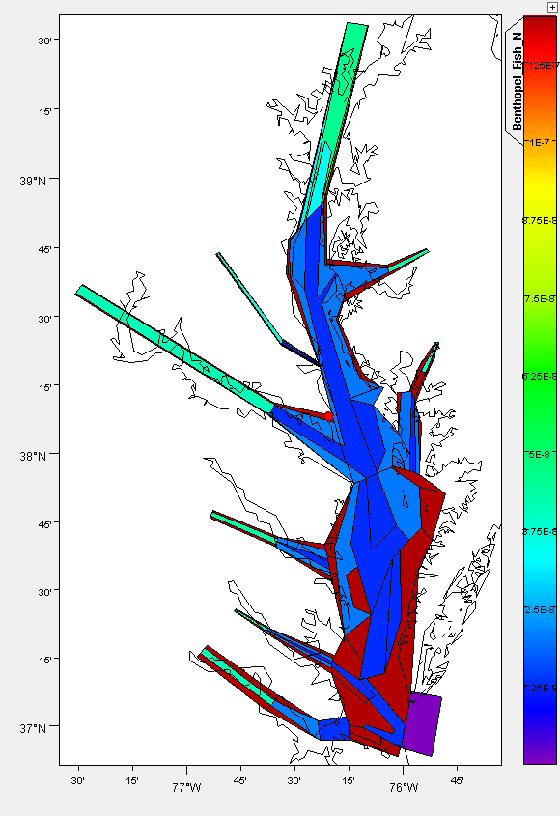
Striped Bass
Temperature increase
& Habitat Loss
Current Conditions
Notes:
Another example of kinds of plots/info we can provide
- orientation:
-> share same color scheme, red – dk blue - purple (absent)
Image - Integrates cumulative effects of multiple stressors of importance; in this case: Temp+, SAV loss, Marsh loss
biomass is result of:
o prey availability
o predators
o migration timing
o physical forcing &
o typically fishing
> 50 groups can produce similar plots in any point in time (of interest)

Slide 23
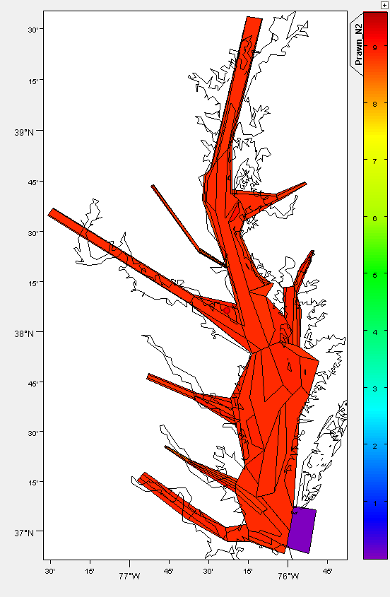
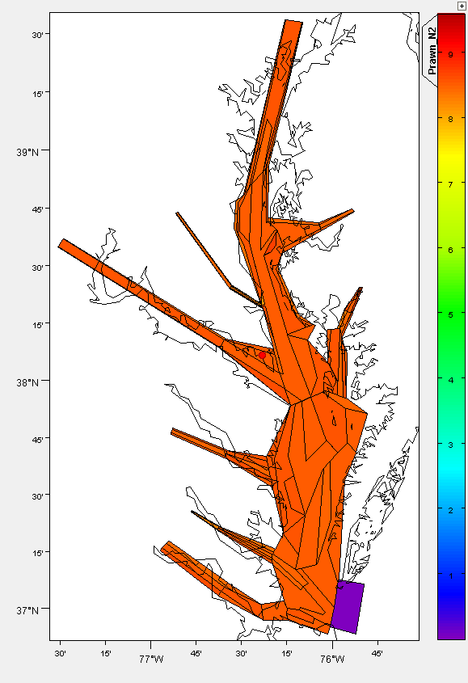
Blue Crab
Temperature increase
& Habitat Loss
Current Conditions

Slide 24
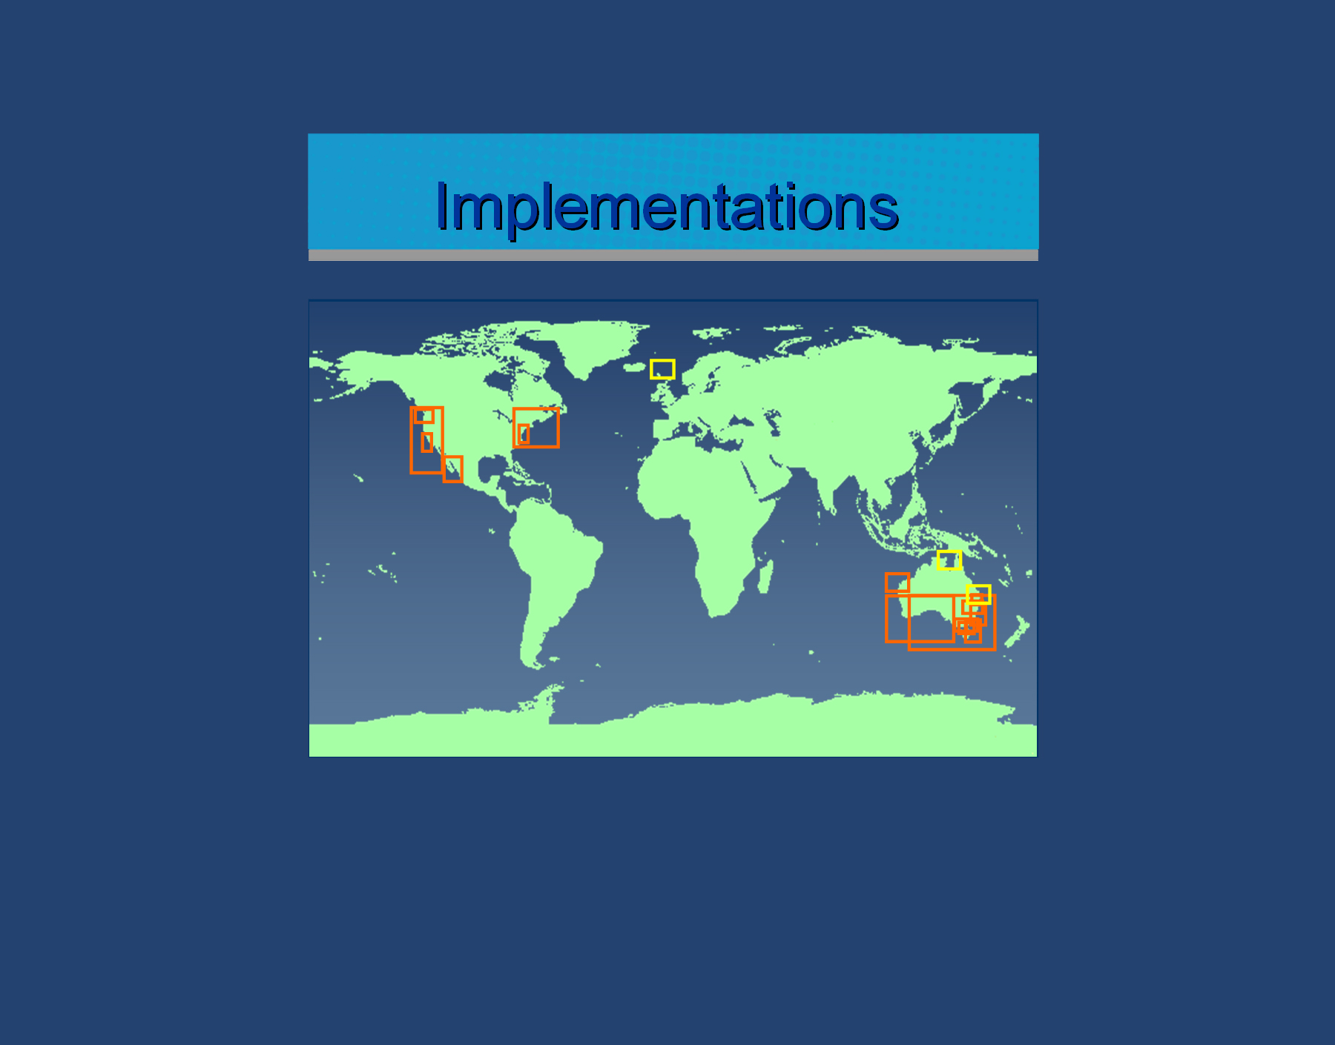
NOAA Chesapeake Bay Office – Ecosystem Modeling Team
Sustainability of fisheries in context of climate change:
Evaluate
economic
pressures
Effort allocation
Gear choice
IEA
MPA planning
in E.S. context
ITQ’s/
“catch shares”
Evaluate
ecological
indicators
Eutrophication most critical
A few key species
capture the major
ecosystem impacts
Ecosystem models identify
impacts single-species
models miss
Developing and Applying Tools For Ecosystem-Based Fisheries Management
Notes:
What are listed here are a selection of Atlantis results that have already succeeded in helping inform management decisions. Though not all specifically habitat concerns, habitat is explicitly modeled, just like fishery populations. In the CAM, not only are oysters & seagrass modeled as specific groups, but the effects these key Bay habitats have on other populations and on the physical environment are modeled as well. These specific examples were included here because they are all related to similar management concerns of the Chesapeake Bay.
In Australia’s Port Phillip Bay, (the first application of Atlantis, where it was developed), program author Elizabeth Fulton concluded from her dissertation work that eutrophication effects have greater impact on fish populations than does the fishing industry, thus, is more critical to implement changes to improve (prioritization). She also found that the major dynamics of the trophic ecology of the system could be captured with a few key species (though most of these were not top predators, so management attention needs to be expanded to include key members of lower trophic levels).
In the Northeast of the US, NOAA’s NorthEast Fishery Science Center has an Atlantis model for the Northeast Atlantic. Their model has been instructive in comparing the effects of different gear choices on the environment and also for comparing effects of different fishing sectors.
Off the West Coast, NOAA’s NorthWest Fishery Science Center has an Atlantis model for the California Current system. That model has been instructive for managers in the design of the system of coastal Marine Protected Areas, evaluation of the application of “catch shares” and in the development and testing of ecosystem/ecological indicators for management use.

