Slide 1
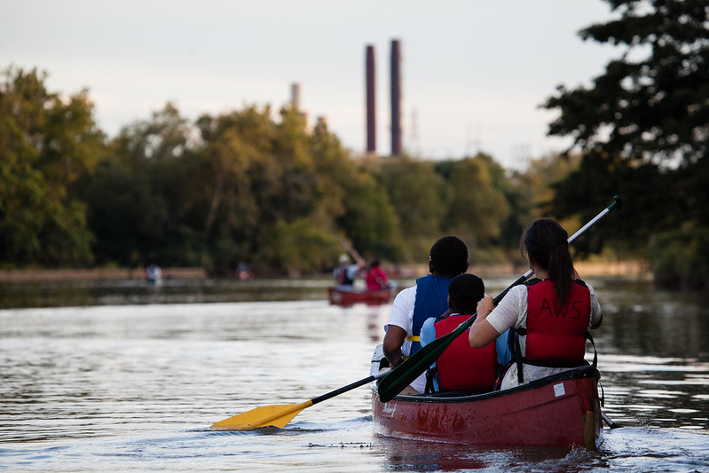
Chesapeake Bay Governance
Distinct Roles of the Partnership and Program Office Explained
Kristin Saunders, Cross Program Coordinator, UMCES
May 19, 2021 CAC Presentation

Slide 2
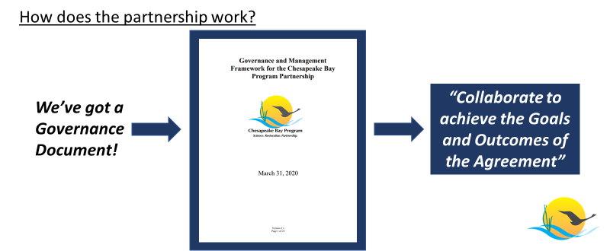
https://www.chesapeakebay.net/documents/CBP_Governance_Document_version_3.1_%28updated_03.31.2020%29.pdf

Slide 3
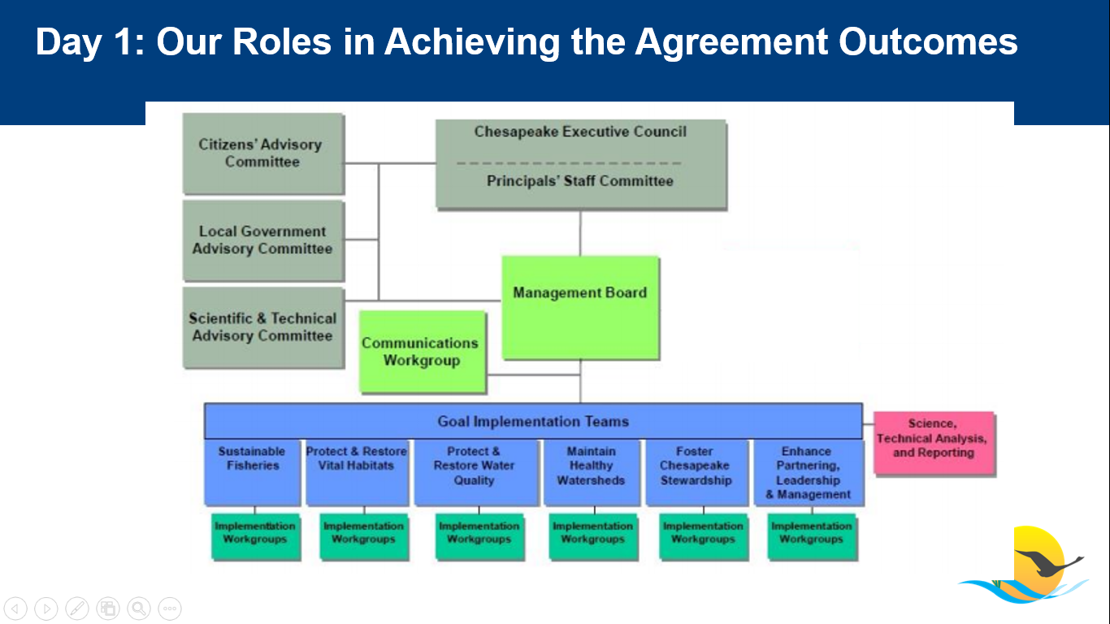

Slide 4
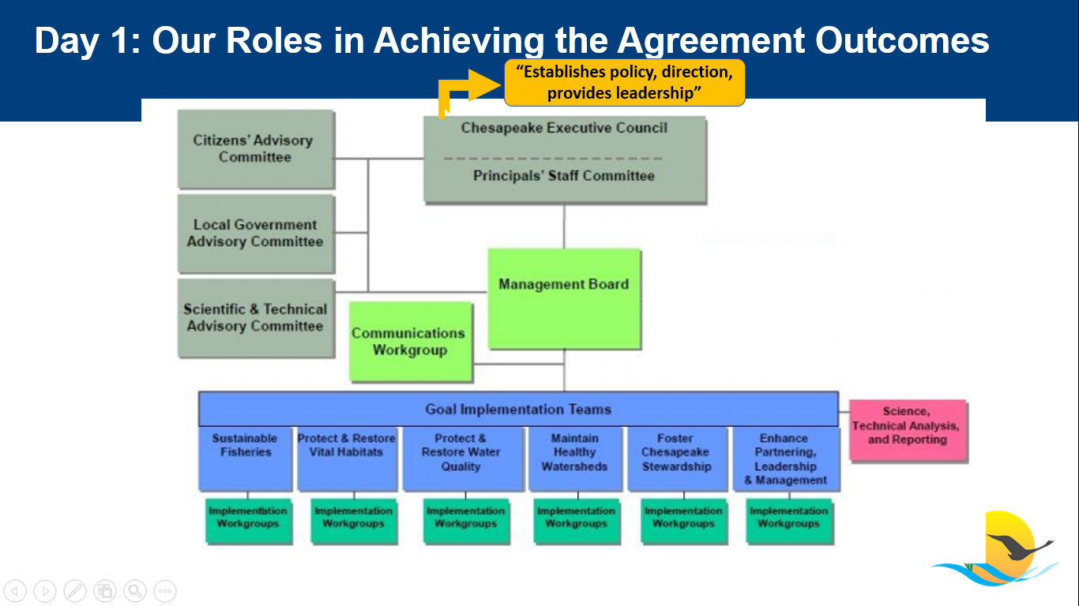

Slide 5
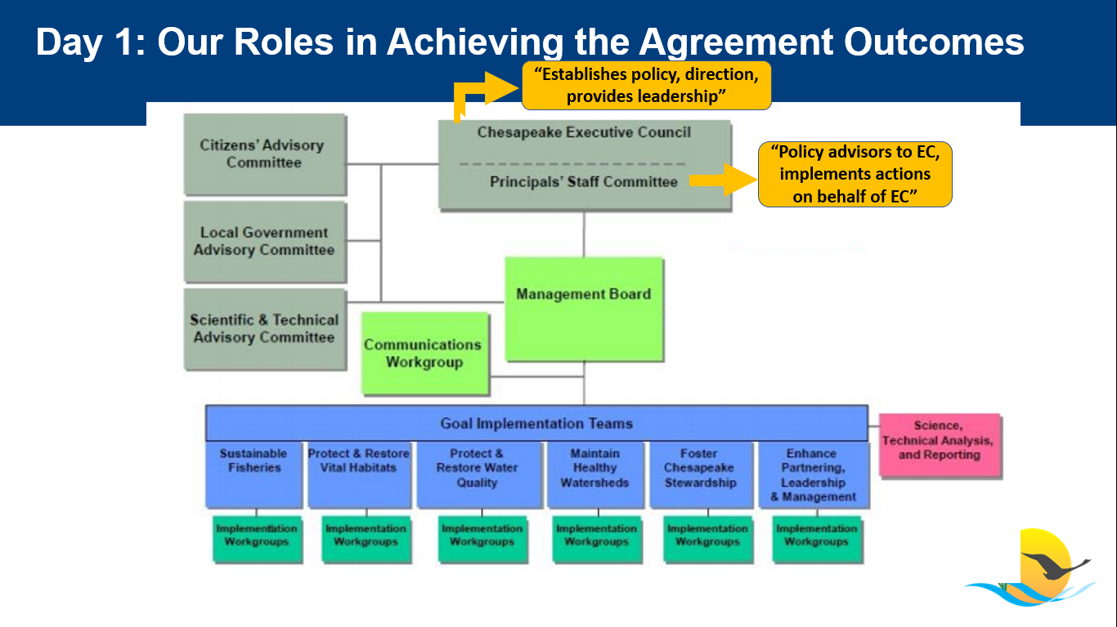

Slide 6
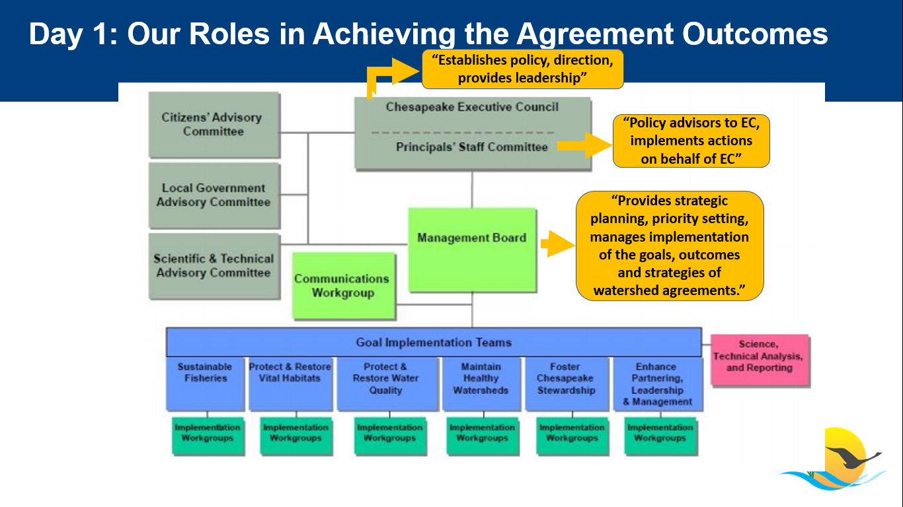

Slide 7
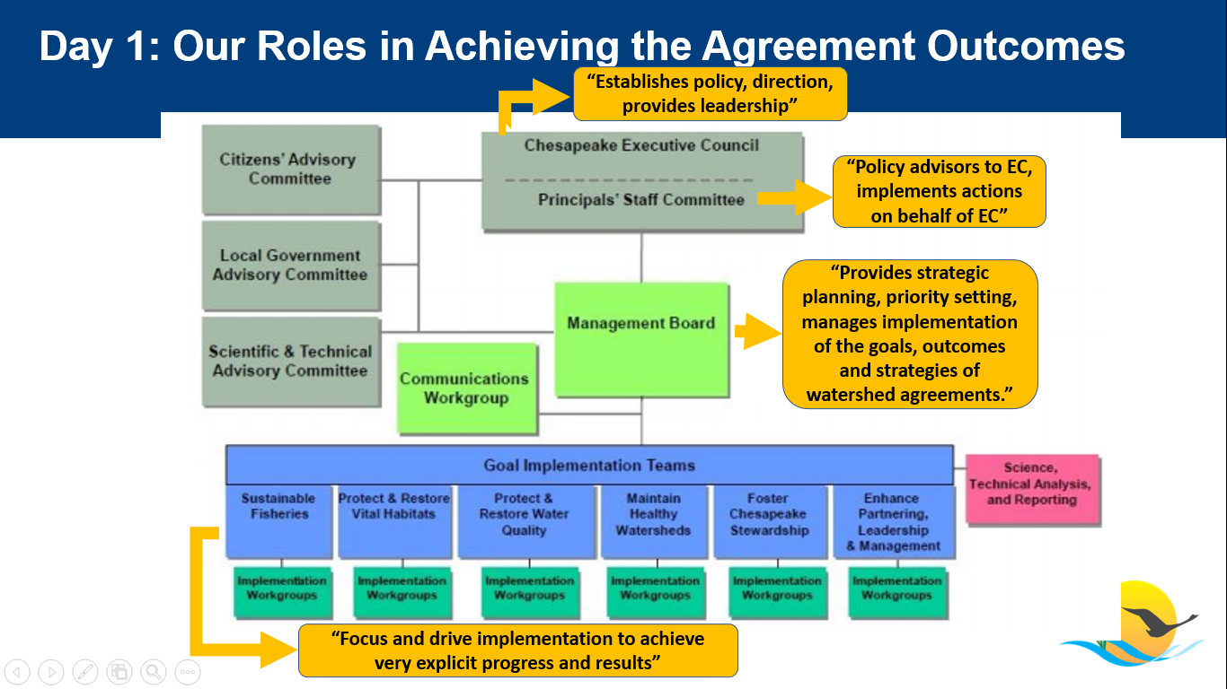

Slide 8
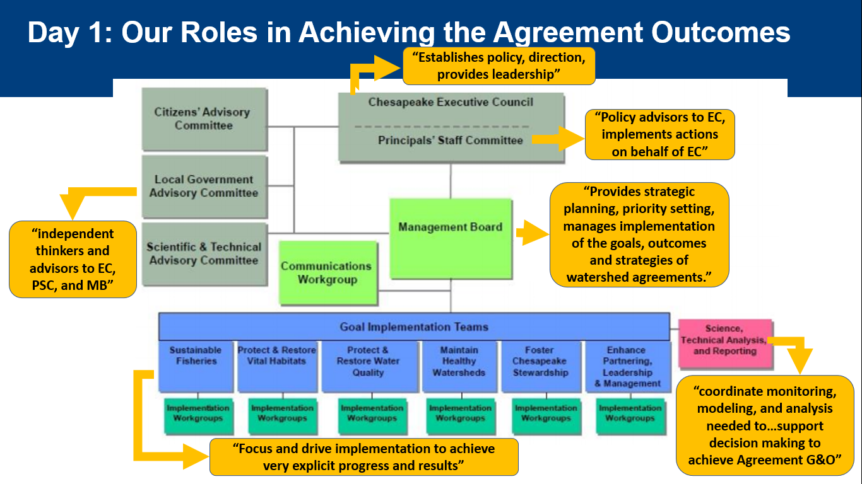

Slide 9
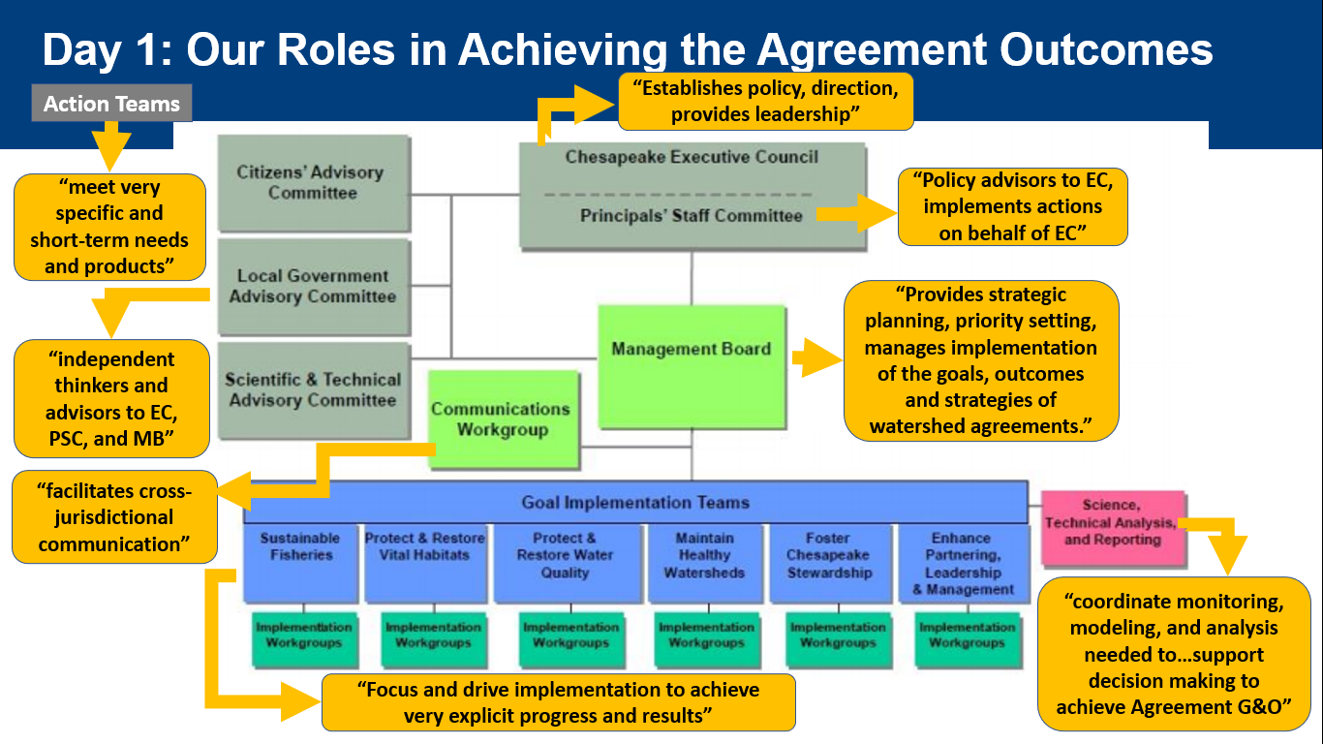

Slide 10
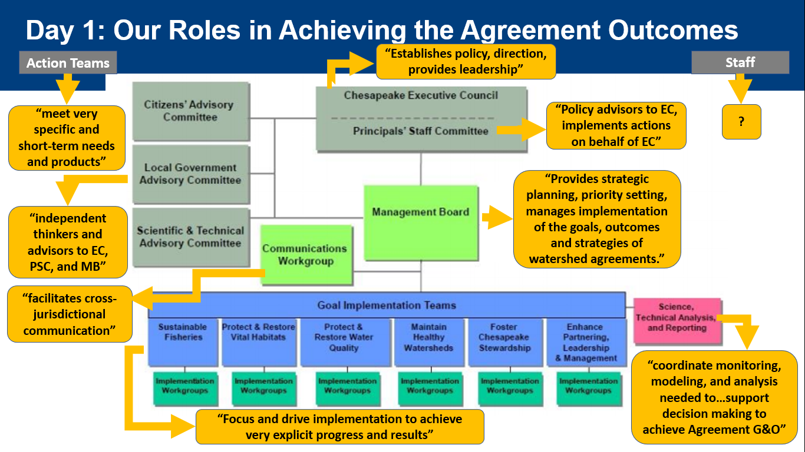
Notes:
Combined 800+ people
State, federal, non-governmental, academic and local levels

Slide 11
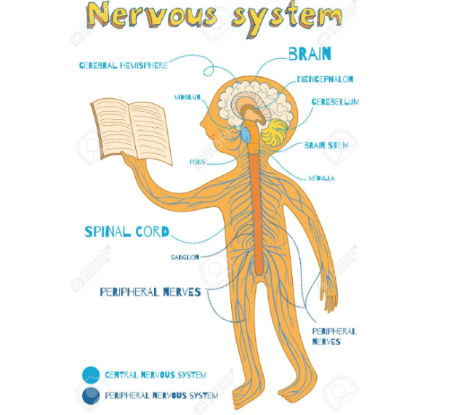
Notes:
I like to think of the Bay Program Office as the central nervous system for restoration

Slide 12
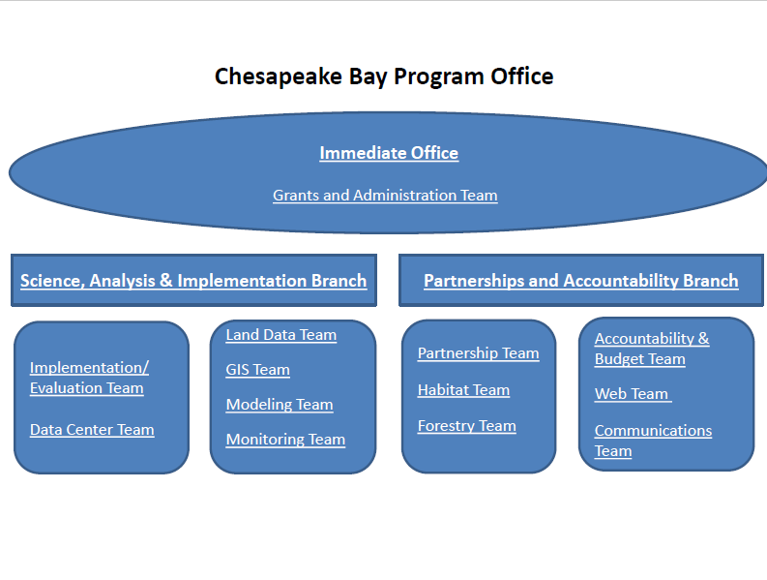
Notes:
Approximately 100 people
Backbone of the restoration effort – I think of it as a neural network that integrates and informs the partnership
We move information and money
Synthesize scientific information, staff meetings, provide the frameworks for reporting, documentation, accountability and learning
Facilitate, collaborate and orchestrate the work of the group for collective impact

Slide 13
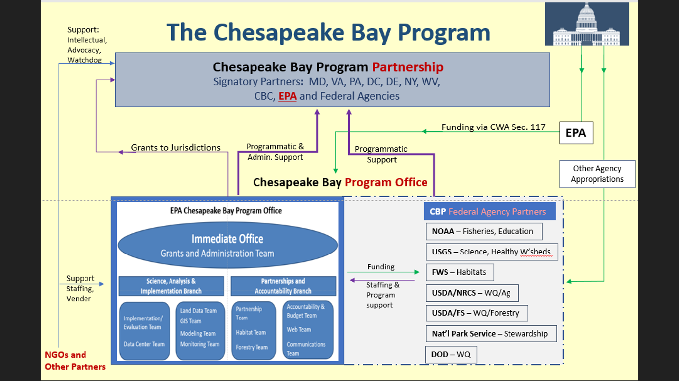
Notes:
Symbiosis – this shows how the two entities come together

Slide 14
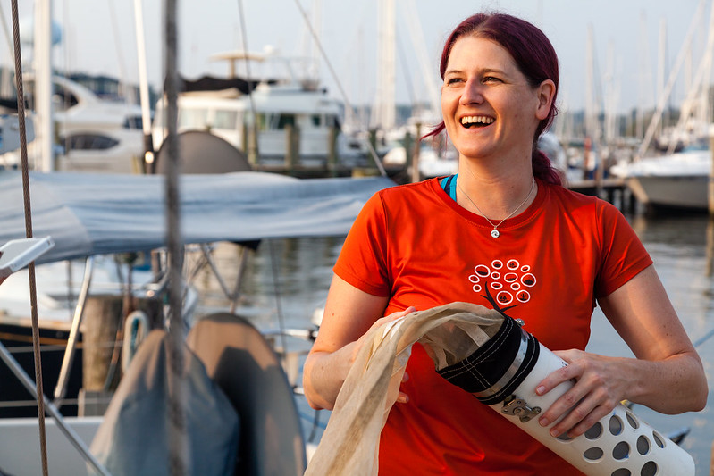
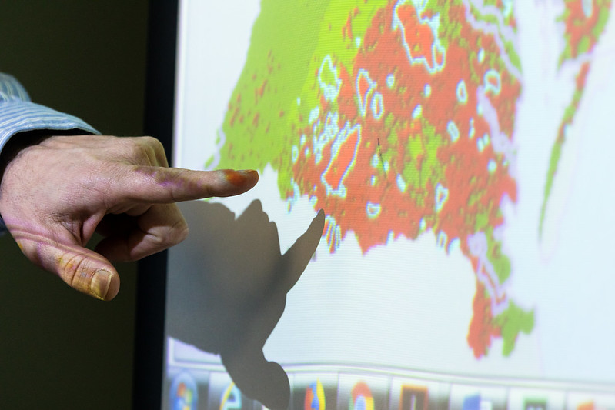
Easy Reminder of the Difference
Partnership: Boots on the ground
Program Office: Wo(man) in the chair
Notes:
Spiderman reference to “guy in the chair” who becomes the guide integrating information while seeing the big picture
Explain the local engagement strategy development as an example

Slide 15
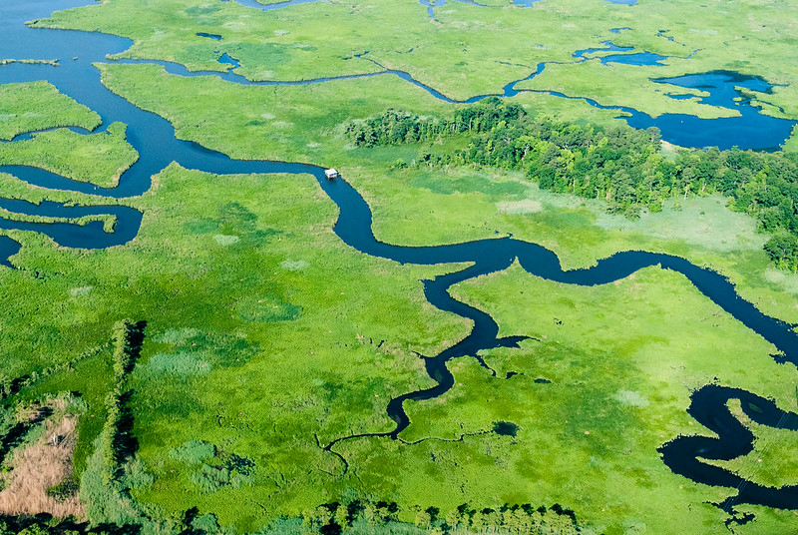
QUESTIONS?
Contact: Kristin Saunders ksaunders@umces.edu

