Slide 1
Preliminary Chesapeake Bay Diversity Profile: 2016 Results, Highlights and Next Steps
Chesapeake Bay Program Office and Alliance for the Chesapeake Bay
CBP Diversity Workgroup Meeting
November 2, 2016

Slide 2
Diversity Management Strategy and Workplan
“Identify stakeholder groups that are not currently represented in the leadership, decision making and implementation of conservation and restoration activities, and create meaningful opportunities and programs to recruit and engage them in the partnership’s efforts.” – Diversity Outcome
“Explore the use of organizational demographic profile tools (e.g. Guidestar and D5) for the Bay Program jurisdictions, agencies, partners and other NGOs in the Bay watershed to report on diversity representation within their organizations.” – Diversity Management Strategy
“Establish a baseline of the level of diversity in the CBP (staff, boards, programs and initiatives aimed at increasing internal diversity).” – Diversity Workplan

Slide 3
Process and timeline
The Alliance for the Chesapeake Bay conducted the profiles on behalf of the Chesapeake Bay Program
The Program was sent to the Principal Staff Committee, Management Board, Advisory Committees, GITs, and workgroup members.
May: Develop simple survey monkey instrument
Mid July: Follow-up emails from CBP leadership
Fall 2016 Post results on CBP website – Press release and web story
Early June: Email from Al Todd to CBP membership
90 days to complete the profile
September 2016: Present results to Management Board
June 23, 2016
Profile Created via Survey Monkey

Slide 4

About the Diversity Profile
Generated simple online demographic profile tool
11 Simple questions
Voluntary and Anonymous
“Self-Identify” responses
Includes questions on management roles due to outcome language

Slide 5
Summary and demographic responses highlights
Profile sent to approximately 750 CBP staff and partners
374 total respondents
49.8% response rate
31.45% of respondents worked for state government
48.26% of respondents reside in Maryland
Notes:
750 is an approximation*

Slide 6
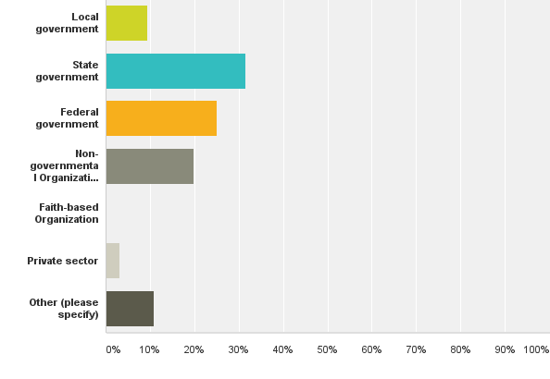
What type of organization do you currently work for?
9.4% (35)
31.5% (117)
Answered: 372 Skipped: 2
25% (93)
19.9% (74)
0.3% (1)
3.2% (12)
10.8% (40)

Slide 7
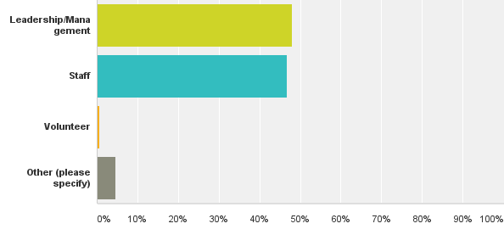
Within your organization, what is your role? Please choose one.
Answered: 366 Skipped: 8
48.1% (176)
46.7% (171)
0.6% (2)
4.6% (17)

Slide 8
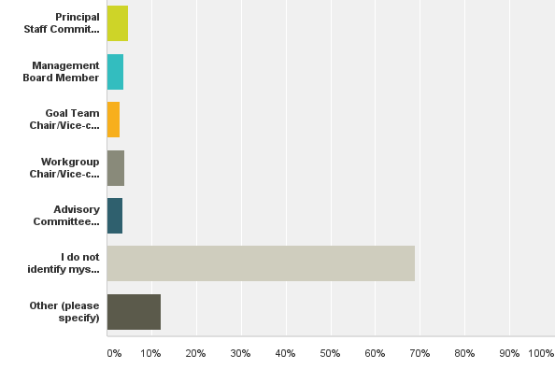
Do you identify yourself as a member of CBP leadership? Choose one. If multiple roles, please list in other.
4.8% (18)
3.8% (14)
Answered: 372 Skipped: 2
2.9% (11)
4% (15)
3.5% (13)
68.8% (256)
12.1% (45)

Slide 9
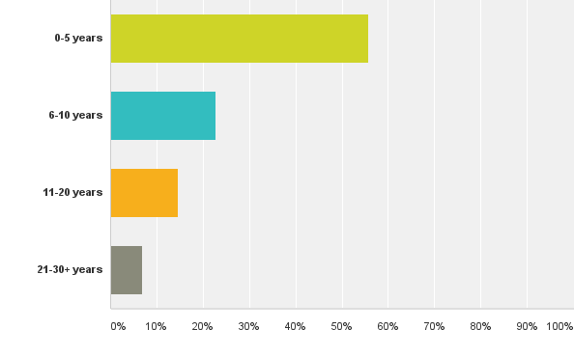
How long have you been participating in the CBP organization?
55.7% (207)
Answered: 372 Skipped: 2
22.9% (85)
14.5% (54)
7% (26)

Slide 10
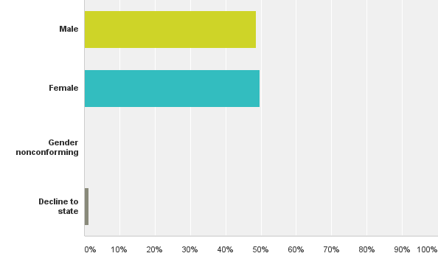
What is your gender?
48.7% (181)
Answered: 372 Skipped: 2
49.7% (185)
0.3% (1)
1.3% (5)

Slide 11
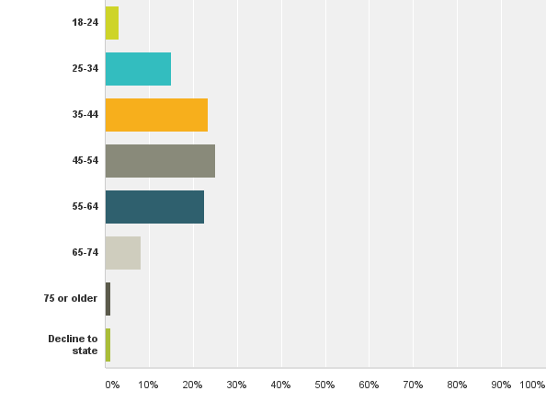
What is your age?
3% (12)
15.1% (56)
Answered: 372 Skipped: 2
23.4% (87)
25% (93)
22.6% (84)
8.1% (30)
1.3% (5)
1.3% (5)

Slide 12
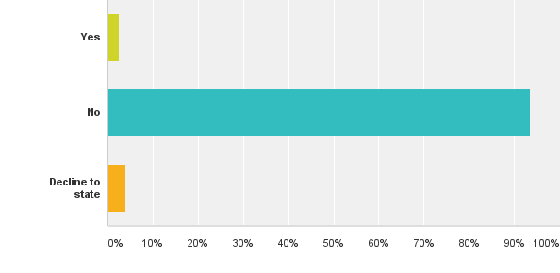
Do you identify as a member of the Lesbian, Gay, Bisexual, Transgender or Gender Nonconforming community?
Answered: 371 Skipped: 3
2.4% (9)
93.5% (347)
4% (15)

Slide 13
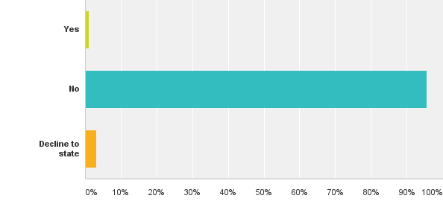
Do you identify as a person who is disabled?
Answered: 373 Skipped: 1
1.1% (4)
95.7% (357)
3.22% (12)

Slide 14
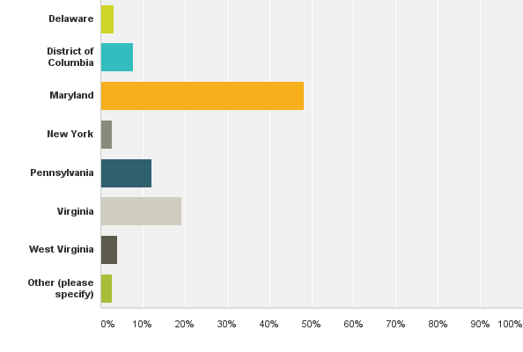
What Chesapeake watershed jurisdiction do you live in?
3.2% (12)
7.8% (29)
Answered: 373 Skipped: 1
48.3% (180)
2.7% (10)
12.1% (45)
19.3% (72)
4% (15)
2.7% (10)

Slide 15
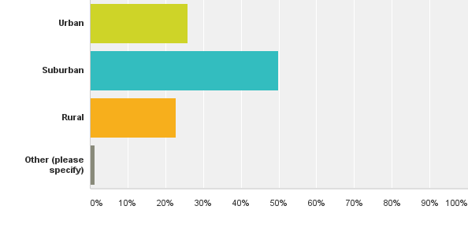
What landscape do you currently reside in?
Answered: 374 Skipped: 0
25.9% (97)
50% (187)
22.7% (85)
1.3% (5)

Slide 16
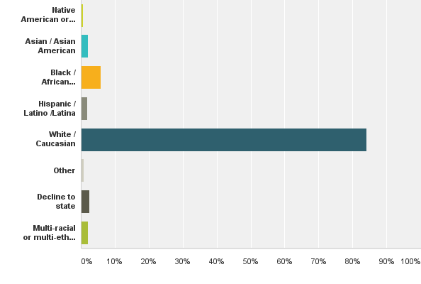
Which category(s) best describe you?
0.5% (2)
2.1% (8)
Answered: 373 Skipped: 1
5.9% (22)
1.9% (7)
84.2% (314)
0.8% (3)
2.4% (9)
2.1% (8)

Slide 17
Answer Choices | Responses (%) | Responses #
Native America or Alaskan Native | 0.54% | 2
Asian / Asian American | 2.14% | 8
Black / African American | 5.90% | 22
Hispanic / Latino / Latina | 1.88% | 7
White / Caucasian | 84.18% | 314
Other | 0.80% | 3
Decline to state | 2.41% | 9
Multi-racial or multi ethnic (please specify) | 2.14% | 8

Slide 18
Data Analysis
Initial focus on ethnic diversity because from the results of the profile tool, it was identified as a major gap.
All analysis is preliminary
Will continue to consult with diversity workgroup, MB, STAR, indicators workgroup, Green 2.0, etc.
Notes:
we chose to focus on ethnic groups because Green 2.0 AND it was identified as a major gap as the result of this profile tool. Not just that we’re following what Green 2.0 is doing.

Slide 19
Sample approach for data analysis
CBP profiles revealed 50 non-caucasion respondents: 13.4%
Out of the 50 non-caucasions, only 12 held leadership positions: 3%
CBP profile further revealed 314 white/caucasion respondents: 84%
Out of the 314 white respondents, 100 identified themselves as CBP leadership: 31.8%
A preliminary analysis of the 50 non-white responses out of the 374 total responses follows
Notes:
After talking with Green 2.0, we thought it would be best to begin our focus with ethnic diversity

Slide 20
(26%)

Slide 21
Preliminary data analysis of 50 non-white respondents
http://www.cpehr.com/blog-1/promoting-diversity-in-the-workplace

Slide 22
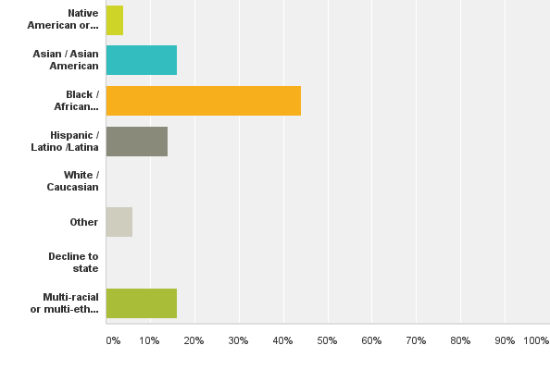
Which ethnic category(s) best describe you?
4% (2)
16% (8)
44% (22)
14% (7)
0% (0)
6% (3)
0% (0)
16% (8)

Slide 23
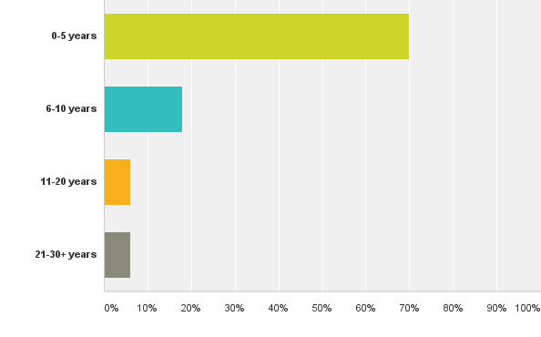
How long have you been participating in the CBP organization?
70% (35)
18% (9)
6% (3)
6% (3)

Slide 24
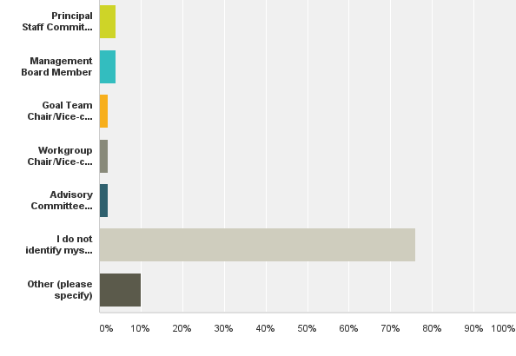
Do you identify yourself as a member of CBP leadership? Choose one. If multiple roles, please list in other.
4% (2)
4% (2)
2% (1)
2% (1)
2% (1)
76% (38)
10% (5)

Slide 25
Questions going forward
Have the terms used in the Outcome been appropriately defined? (Word to replace minority)
What pieces of information do we need to adaptively manage our work? What metric or information would be most meaningful to our workgroup?
Does the proposed indicator address the Diversity Outcome in the 2014 Chesapeake Bay Watershed Agreement?
Is the indicator long term, taking into account possible future changes? Can the Partnership show trends over time using this proposed indicator? (Retention, diversity among leadership, etc.)
Is there a threshold or reference value against which the proposed indicator can be compared, so that users can assess the significance of the values associated with it? (e.q. 36% of nationwide people of color caucus)
Once we decide on an indicator(s), do we want to set a specific Program diversity “goal” for 2025?

Slide 26
Next Steps
Have a Diversity Profile Poster at Watershed Forum
Discuss profile findings with Diversity Workgroup at November Meeting
Make Diversity Profile results widely available – (Late Fall)
Establish Diversity Indicators for Bay Barometer and Chesapeake Progress (December)
Web Story on ChesapeakeBay.net (Mid-December)

Slide 27


Questions?
Jim Edward - edward.james@epa.gov
Al Todd - Atodd@allianceforthebay.org

