Slide 1

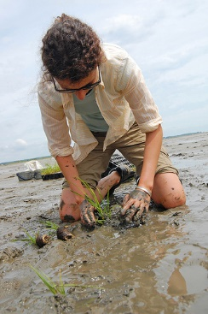
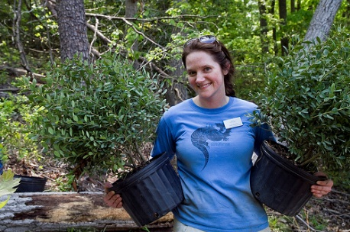
Photos Courtesy Chesapeake Bay Program
Chesapeake Bay
Stewardship Indicator
Notes:
Kacey

Slide 2
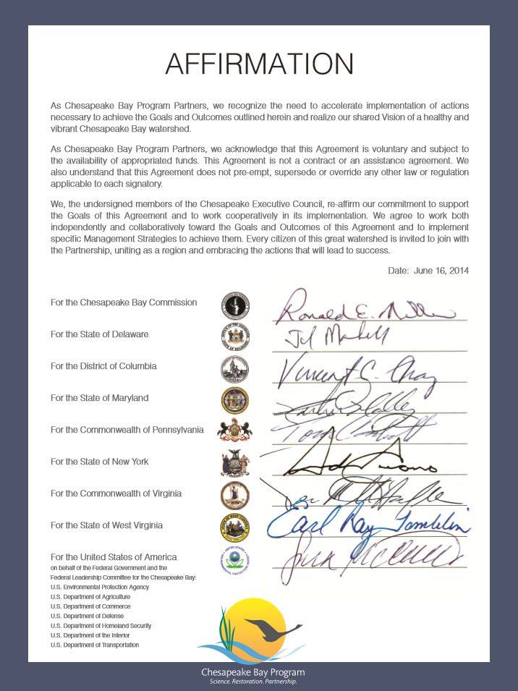
Chesapeake Bay Watershed Agreement
10 broad goals for Bay restoration
https://www.chesapeakebay.net/what/what_guides_us/watershed_agreement

Slide 3

Stewardship Outcome
“Increase the number and diversity of trained and mobilized citizen volunteers with the knowledge and skills needed to enhance the health of their local watersheds.”
Notes:
Kacey

Slide 4
Citizen Stewardship Framework
Increasing citizen actions for watershed health
Community Leaders/ Champions
Mobilize/Increase
Volunteerism/ Collective Community Action
Knowledge & skills
Individual Citizen Actions
and Behaviors
Increasingly Environmentally Literate Population (Elit Goal)
Notes:
Kacey

Slide 5

Why Measure Stewardship?
  Track progress in engaging the public
  Design social marketing campaigns for BMP adoption and behavior change
  Improve strategic communications to build public support for Bay restoration work
  Prioritize investments in citizen-led action
  Improve local decision-making
Notes:
Kacey

Slide 6
Stewardship Behavior
Criteria
Involves individual decision-making
Is repetitive and can be tracked over time
Can be broadly adopted
  Not just by experts
  Not pre-emergent
Has an impact on water health
And/or will engage the public
Notes:
Kacey

Slide 7
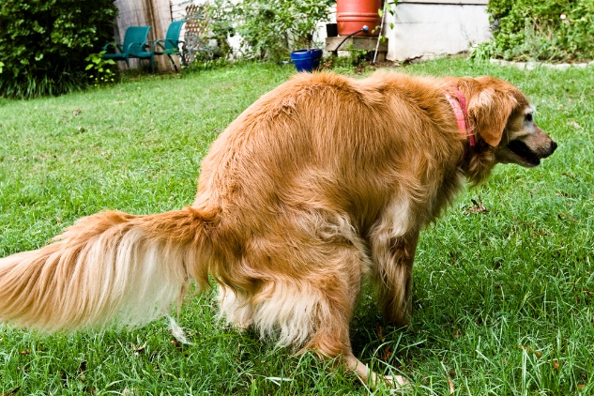
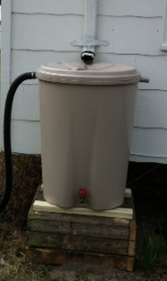
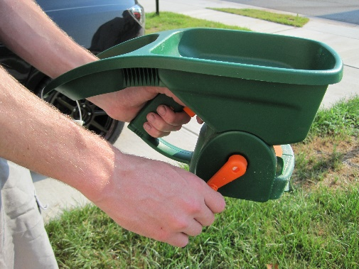
Measured Behaviors
Pet waste (2: on property/off property)
Leaves/Lawn clippings (2)
Litter (2: drop/pick-up)
Fats, grease/Medicines down the drain (2)
Fertilizer use/keep off hard surfaces (2)
Pesticide/Herbicide use (2)
Conservation landscaping
Rain garden installation
Septic system
Tree planting
Downspout redirect
Rain barrel/Connected, emptied (2)
Water conservation
Notes:
Kacey

Slide 8
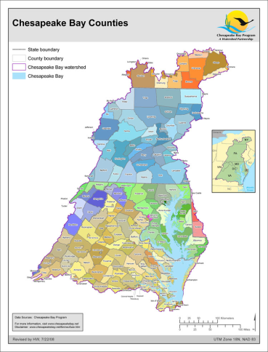
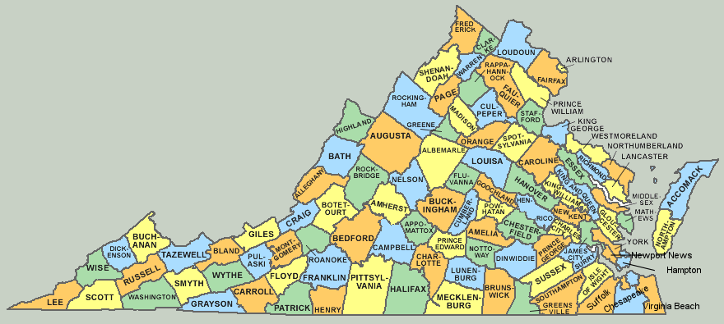
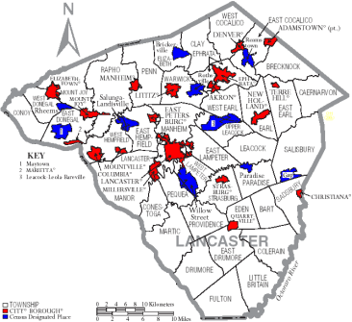
What This Survey Tool Can Do
Measure and track Stewardship progress.
Inform smart behavior selection for practitioners.
Segment data by major jurisdiction, demographic.
Be a resource for other Bay Program priorities: Access, Diversity.
Notes:
Kacey

Slide 9
What This Survey Tool is Not
The citizen stewardship index will NOT verify implementation of behaviors or practices per Bay Program protocols. Other tools like the Smart Tracker exist for this purpose.
It will NOT answer why questions.
It will NOT measure public policy preferences.
It will not measure perceptions and attitudes, except those that directly drive stewardship behavior.
Notes:
Kacey

Slide 10
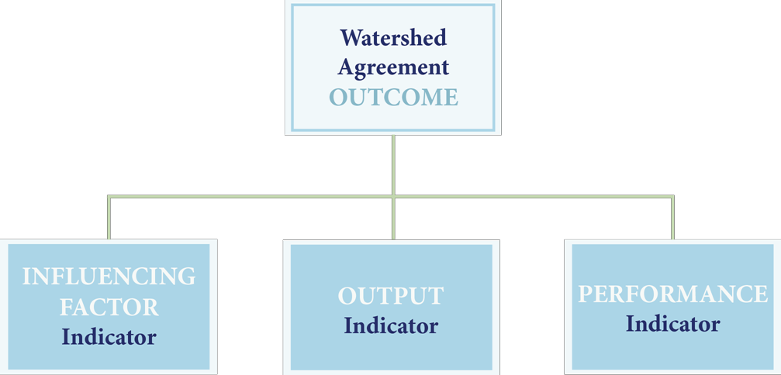
Chesapeake Bay Program Indicators Framework
Approved November 2015 Management Board Meeting
Information Support
Three information types are needed to support adaptive management and communication needs.
Influencing Factors – What KEY influencing factors are impacting the achievement of an outcome?
Outputs – Are we doing what we said we would do in our work plans and management strategies?
Performance – Are we achieving the outcome?

Slide 11
Citizen Stewardship Indicator
Survey Content
Stewardship Behaviors: Personal Actions
Volunteering: Collective Actions
Civic Engagement: Advocating
Likelihood to Take Personal Actions
Likelihood to Volunteer and Advocate
Individual Engagement: Motivating Attitudes

Slide 12
Citizen Stewardship Indicator
Sampling Methodology
 | 2017 Baseline
 | All states statistically significant N=5,212
VA | 1,001 (±3.1%)
MD | 1,005 (±3.1%)
PA | 1,003 (±3.1%)
DC | 801 (±3.5%)
WV | 600 (±4.0%)
NY | 400 (±4.9%)
DE | 402 (±4.9%)
Fielded March – May 2017
13-minute interview
Wireless and Landline
Spanish language interviewing
Notes:
Steve

Slide 13
If people work together, water pollution around here can be fixed.
Level of Agreement
Citizen Stewardship Indicator: 2017 Final Baywide Data
86% agree

Slide 14
My actions contribute to water pollution where I live.
Level of Agreement
Citizen Stewardship Indicator: 2017 Final Baywide Data
35% agree

Slide 15
Strong federal and state action is needed to help clean up the Chesapeake Bay.
Level of Agreement
Citizen Stewardship Indicator: 2017 Final Baywide Data
76% agree
*Numbers may not always appear to add correctly due to rounding.

Slide 16
Citizen Stewardship Indicator: 2017 Final Baywide Data
There is convenient access to the water for boating, fishing, or swimming near where I live.
Level of Agreement
69% agree*
*Numbers may not always appear to add correctly due to rounding.
Notes:
You can note that we are able to look for relationships between access to the water and higher levels of stewardship. Though we have not looked deeply yet, there are early indications that we can validate that relationship.

Slide 17
Citizen Stewardship Indicator: 2017 Final Baywide Data
There is convenient access to the water for boating, fishing, or swimming near where I live.
Level of Agreement
Notes:
Diversity implication: People of color far out-perform Whites on dog waste; White residents of the watershed are the least likely subgroup to pick up after their pet.

Slide 18
Citizen Stewardship Indicator: 2017 Final Baywide Data
Frequency of Kayaking, Canoeing, Boating, Fishing, or Crabbing
Notes:
Diversity implication: White people have much more contact with the water. For people of color, we can see a link in the survey data between this finding and lack of access to the water.

Slide 19
Volunteerism
Citizen Stewardship Indicator: 2017 Final Baywide Data

Slide 20
Individual Behavior
Measurement
Notes:
Kacey

Slide 21
Positive Behaviors: Higher Tier
Citizen Stewardship Indicator: 2017 Final Baywide Data
Desired = Always/Very Frequently/Yes Sometimes

Slide 22
Positive Behaviors: Lower Tier
Citizen Stewardship Indicator: 2017 Final Baywide Data
Desired = Always/Very Frequently/Yes Sometimes

Slide 23
Negative Behaviors
Citizen Stewardship Indicator: 2017 Final Baywide Data
Desired = Never/No, or Seldom

Slide 24
Segmentation Opportunities
Jurisdiction
Age
Educational attainment
Health status (self-assessed)
Household size, presence of children
Home ownership
Housing type
Community size
Agriculture
Religious affiliation, worship frequency
Race/ethnicity
Household income
Gender

Slide 25
Focus Behavior: Picking up Dog Waste
Citizen Stewardship Indicator: 2017 Final Baywide Data
For each of the following things, please tell me if you never, seldom, sometimes,
usually, or always do it.
Pick up your dog’s waste and dispose of it in the trash when you are…
…On your own property.
…Off your property.

Slide 26
Focus Behavior: Picking up Dog Waste
Citizen Stewardship Indicator: 2017 Final Baywide Data
For each of the following things, please tell me if you never, seldom, sometimes,
usually, or always do it.
Pick up your dog’s waste and dispose of it in the trash when you are…
…On your own property.

Slide 27
Citizen Stewardship Indicator: 2017 Final Baywide Data
Picking up Dog Waste (Aggregated On & Off Property)
(Asked of those with a dog):
“For the next few things, please tell me if you never, seldom, sometimes, frequently, or very frequently do it.…Pick up your dog’s waste and dispose of it in the trash when you are…on your own property/off your property.”
(If seldom or never): “Looking forward over the next year or so, how likely are you to do each of these things using the scale very likely, somewhat likely, or not likely?
…Pick up your dog’s waste and dispose of it in the trash while you are…on your own property/off your property.”

Slide 28
Focus Behavior: Picking up Dog Waste
“Very Likely” to Begin Picking Up
Citizen Stewardship Indicator: 2017 Final Baywide Data
Looking forward over the next year or so, how likely are you to do each of these things using the scale very likely, somewhat likely, or not likely?
Pick up your dog’s waste and dispose of it in the trash when you are…
…On your own property.

Slide 29
Citizen Stewardship Indicator: 2017 Final Baywide Data
Septic System Inspected or Pumped Out
(Asked of those with a septic system):
“In the last several years, have you…Had your septic system inspected or pumped out?”
(If no or not sure): “Looking forward over the next year or so, how likely are you to do each of these things using the scale very likely, somewhat likely, or not likely?
…Have your septic system inspected or pumped out.”

Slide 30
Citizen Stewardship Indicator: 2017 Final Baywide Data
Tree Planting
(Asked of all):
“In the last several years, have you…Planted a tree?”
(If no or not sure): “Looking forward over the next year or so, how likely are you to do each of these things using the scale very likely, somewhat likely, or not likely?
…Plant a tree.”

Slide 31
Behaviors More Susceptible to Change
Asked Only of Those Not Taking the Desired Action Today
Citizen Stewardship Indicator: 2017 Final Baywide Data
Looking forward over the next year or so, how likely are you to do each of these things using the scale
(rotate high to low/low to high): [very likely, somewhat likely, (or) not likely]?

Slide 32
Behaviors Less Susceptible to Change
Asked Only of Those Not Taking the Desired Action Today
Citizen Stewardship Indicator: 2017 Final Baywide Data
Looking forward over the next year or so, how likely are you to do each of these things using the scale
(rotate high to low/low to high): [very likely, somewhat likely, (or) not likely]?

Slide 33
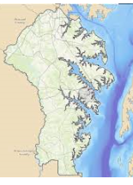
Behaviors Susceptible to Change
Asked Only of Those Not Taking the Desired Action Today
Citizen Stewardship Indicator: Anne Arundel County
Looking forward over the next year or so, how likely are you to do each of these things using the scale
(rotate high to low/low to high): [very likely, somewhat likely, (or) not likely]?

Slide 34
Stewardship Score:
Performance Indicator
Individual Behavior¹ | 38
Volunteerism² | 23
Civic Engagement³ | 19
Rollup | 24
Bay-wide, based on 2017 Baseline data to date
¹19 behaviors, weighted for water impact and % of population that could perform each behavior
²Volunteered, given money for water restoration, or aware of a group in their local community
³Spoken out on behalf of an environmental cause

Slide 35
Choosing the Right Behavior to Influence
  Behavior Weighting:
  Impact of the Behavior on Water Quality
  x
  Inverse of the Penetration (Level of Adoption) in the Community
  x
  Likelihood the Public will Adopt the Behavior
Notes:
Steve/Kacey

Slide 36
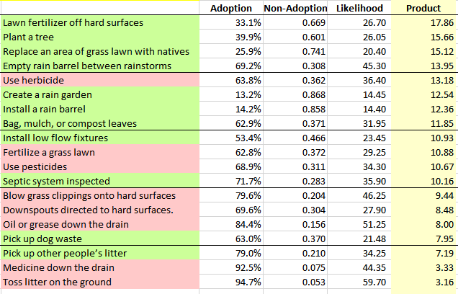
Citizen Stewardship Indicator: 2017 Final Baywide Data
Adoption = Percentage of the population performing a positive behavior
(at least sometimes) or not performing a negative behavior (seldom or never)
Notes:
Steve/Kacey

Slide 37
Resistant
16%
Credit: Nancy R. Lee, University of Washington & Puget Sound Partnership
Adapted from Everett Rogers, Jay Kassirer, Mike Rothschild, Dave Ward, Kristen Cooley

Slide 38
Traditional Public Education
Websites
Brochures
Community meetings
Compulsory Actions
Regulations
Fees & Fines
Legal action
Credit: Nancy R. Lee, University of Washington & Puget Sound Partnership
Adapted from Everett Rogers, Jay Kassirer, Mike Rothschild, Dave Ward, Kristen Cooley

Slide 39
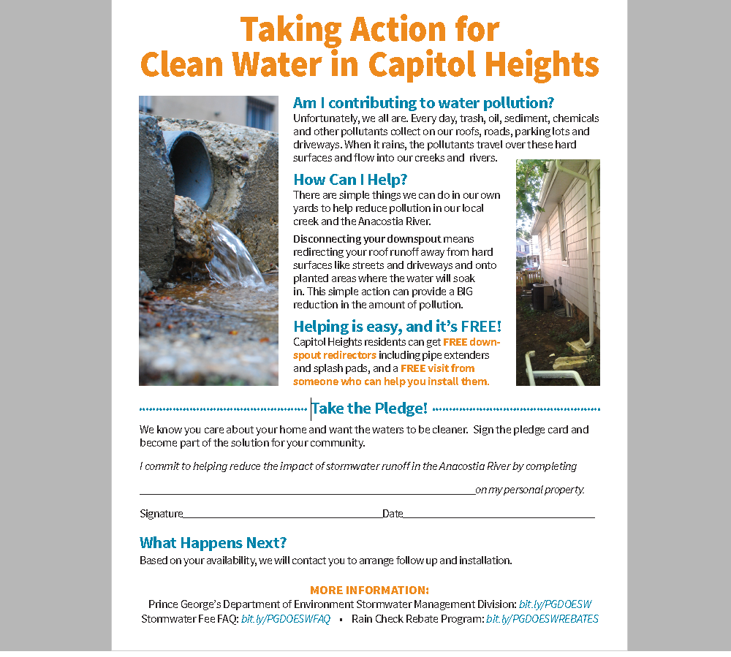
Example Tool: Pledge
“Free Upgrade”
A/B Test:
Flooding
Water quality
50% of homes visited signed the pledge

Slide 40
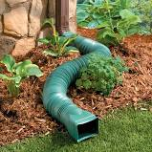

Outcome:
50% of homes signed the pledge.
24% followed through.

Slide 41
Recommendations: Behavior Adoption
Behaviors that have a significant positive impact on clean water are less commonly adopted than behaviors that have a comparatively minor impact on clean water. Recommendations:
  Target key audiences based on prioritization from Index
  Increase use of social science tools, such as social diffusion and social normative messaging
  Increase effective behavior change campaign design and sharing through regional forums
  Regional common branding across jurisdictions
Notes:
Kacey

Slide 42
Recommendations: Behavior Adoption
Behavior Weighting must be completed with impact data
Recommendations:
  The behavior weighting formula will inform behavior change campaign efforts
  Behaviors can be selected based on impact, likelihood, and penetration rate
Notes:
Kacey

Slide 43
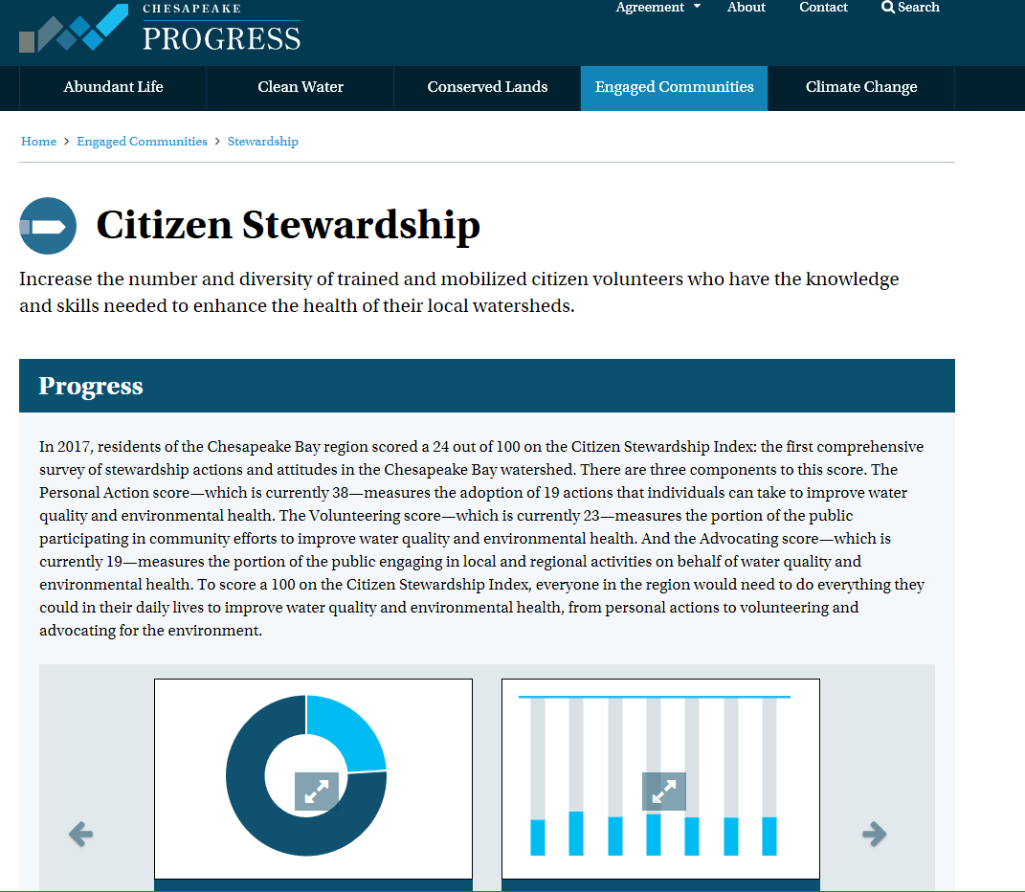

Slide 44
Additional Recommendations
Only 32% of public can name an organization in their area that is cleaning and protecting the natural environment.
Less than half of people actively get involved in their community and of those a very small percentage are involved related to environmental issues.
Recommendations:
  Trainings to create informed communications campaigns that target audiences
  Innovate new ways to connect people with opportunities in their community - concept test new volunteerism program models
Notes:
Kacey

Slide 45
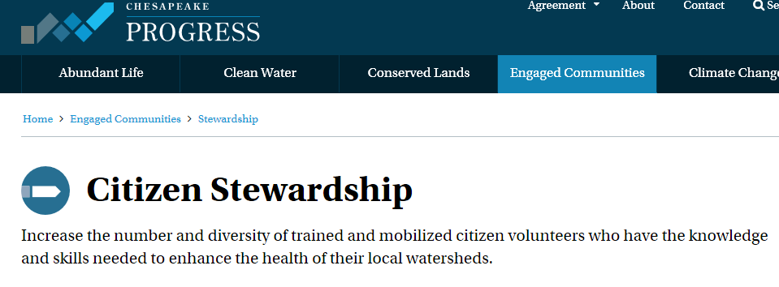
Stewardship Indicator Accessibility
Overview of data access methods:
Methodology document
Raw data
On-line Public Dashboard – In process
  Segment data
  Create correlations
  Customize reports
Notes:
Kacey

Slide 46
Photos Courtesy Chesapeake Bay Program
Chesapeake Bay
Stewardship Indicator
Notes:
Kacey

