Slide 1

2015 Fall Water Clarity
and Water Clarity Assessment Results 2004-2014
Presentation for the CBP SAV Workgroup
March 31, 2016
Mark Trice
Program Chief, Water Quality Informatics
Maryland Department of Natural Resources
October 12, 2015 NASA
MODIS TERRA image

Slide 2
Citizen and Newspaper Reports of Extremely Clear Waters

Slide 3
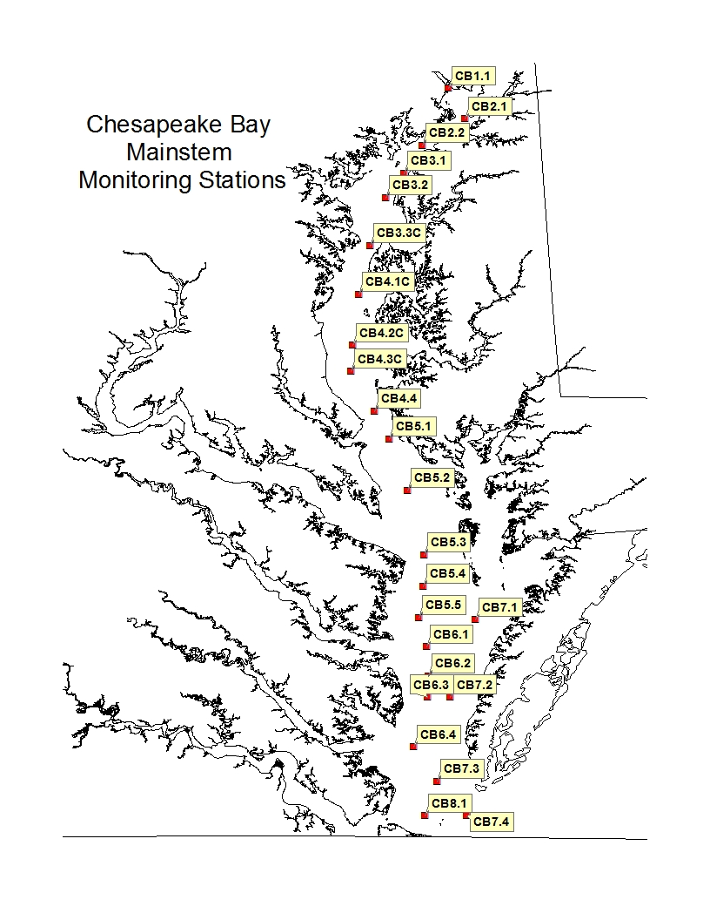
Stations visited by boat
once or twice monthly
Water Quality Profiles
Sediment, Chl, Nutrients
analyzed at laboratories

Slide 4
Susq. Bay Bridge PAX MD/VA Rapp. York Mouth

Slide 5
Susq. Bay Bridge PAX MD/VA Rapp. York Mouth

Slide 6
Susq. Bay Bridge PAX MD/VA Rapp. York Mouth

Slide 7
Susq. Bay Bridge PAX MD/VA Rapp. York Mouth

Slide 8
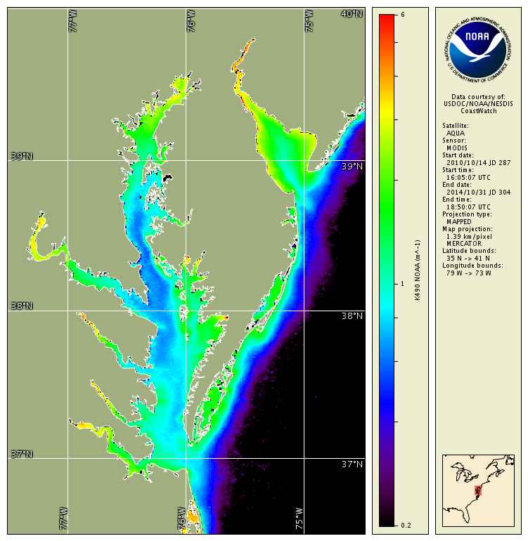
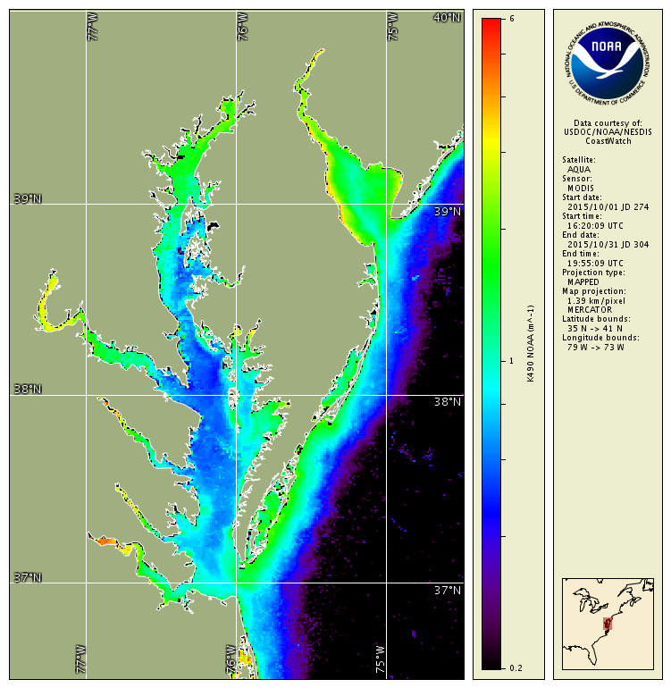
Satellite Turbidity (Clarity): October
high values more turbid, low values more clear
October monthly climatology: 2010-2014
October monthly average: 2015
October 2015 is clearer than average October of previous 5 years
(climatology excludes Oct 2011 due to remaining high sediment from Tropical Storm Lee)
Slide from Ron Vogel, NOAA NESDIS

Slide 9
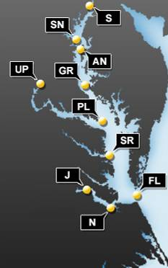

CBIBS Nov. 2015 Turbidity Results
Increase turbidity
Decrease turbidity (“clearer”)
Inconclusive results
Slide from Katie Kirk, NOAA CBPO
Notes:
UP 2015 was not statistically different than any other year
GR was lower than 2014 (high noise) and not different from 2012
SN much higher in 2015, which dropped after a WQM swap, so this was due to noise
S & J showed higher than majority of previous years and was lower than others.
J was lower than 2 years that showed high noise – otherwise highest in 2015.
S was lower than 2012 but higher than 2008, statistically, but majority of non-statistically different years, higher in 2015.

Slide 10
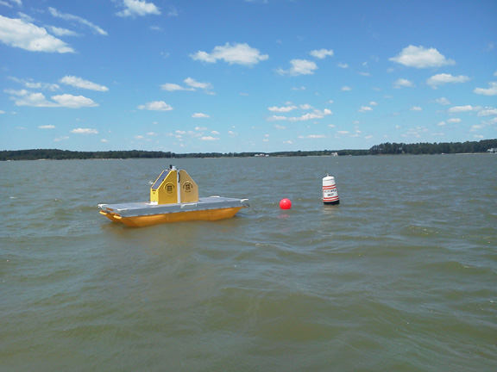
Maryland DNR Continuous Monitoring Data
and the Choptank River Complex
Continuous Monitoring (ConMon)
Readings every 15 minutes
Dissolved Oxygen, Turbidity, Chl,
ph, salinity, water temperature
Most sites deployed for 3 years
Some sentinel sites exist
Vertical Profiler
Water column profile every hour
Same parameters as ConMon
Readings at every half meter
Deployed in Harris Creek for past
4 years
Maintenance on each is performed every
two weeks, and calibration samples are
taken at those times.
Vertical Profiler, Harris Creek

Slide 11

Summary of MD DNR Tidal Choptank River Water Quality Data
DNR Harris Creek Sites
Upstream (0.3m off bottom)
(Sept 13-Jan14; Apr14 – Dec14; Apr15)
Downstream (0.3m off bottom)
(Sept 13-Jan14; Apr14 – Dec14; Apr15)
Wtemp, salin, cond, chl, turb, pH, depth every 15 minutes
Biweekly profiles, nutrients, chl, sediment, & alkalinity
Vertical Profiler (Depths 1,2,3,4,4+)
June 26, 2012 - January 22, 2013
April 30, 2013 - December 19, 2013
March 27, 2014 - December 16, 2014
Wtemp, salin, cond, chl, turb, pH, every hour
Biweekly profiles, nutrients, chl, sediment, & alkalinity
DNR Long-Term Sites (1985-Present)
EE2.1; ET5.2; ET5.1
Monthly WQ profiles; Sediment, Nutrient, Chl samples at
surface & depth
DNR ConMon Sites (~Apr-Oct 2006-08)
Ganey’s Wharf; Jamaica Pt.; Horn Pt.
Mulberry Pt.
1-meter below surface;
Wtemp, salin, cond, chl, turb, pH, every 15 minutes
Bi-weekly profiles, surface nutrients, chl, sediment
DNR Choptank Dataflow (Apr-Oct 2006-08)
Monthly cruises throughout extent of river and creeks with
a four second sample rate of surface waters. 10 calibration
sites with profiles, nutrient, sediment, chl samples
Other Efforts
Horn Pt. Hatchery ConMon
http://www.umces.edu/hpl/choptank-river-horn-point
(wtemp, cond, chl, salin.)
Green Eyes Chop River Bridge ConMon (?)
NOAA site 8571892 (Met, Water Level, Wtemp)
Gooses Reef (Surface/Bottom WQ; Met)
ET5.1
Ganey’s Wharf
ConMon
Harris Cr.
Vertical Profiler
Mulberry Pt.
ConMon
Harris Cr.
Up & Downstream
Bottom ConMon
Dataflow
Cruises
Jamaica Pt
ConMon
EE2.1
Horn Pt. ConMon
Horn Pt. Hatchery
ET5.2

Slide 14
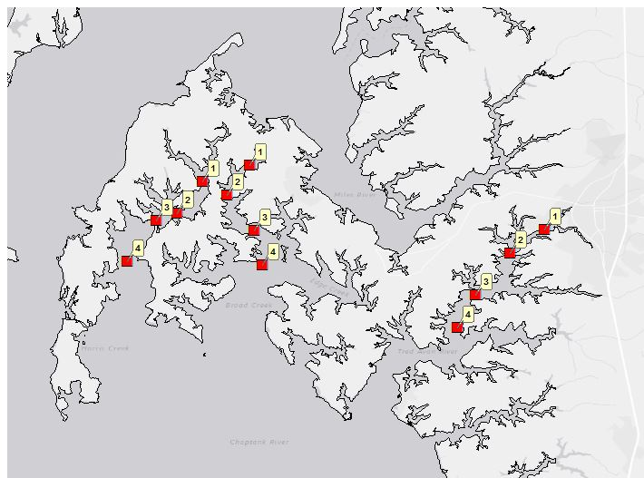

Slide 17
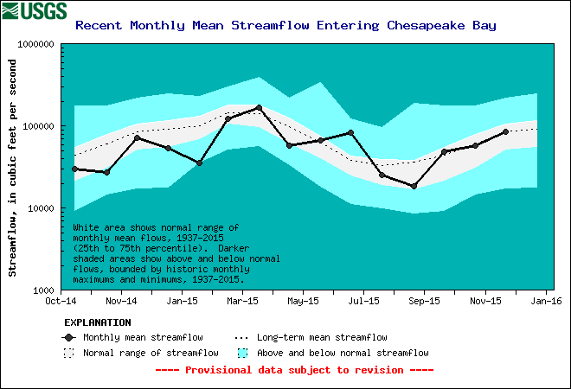
Flow Mostly Average or Below Average for 2015

Slide 18
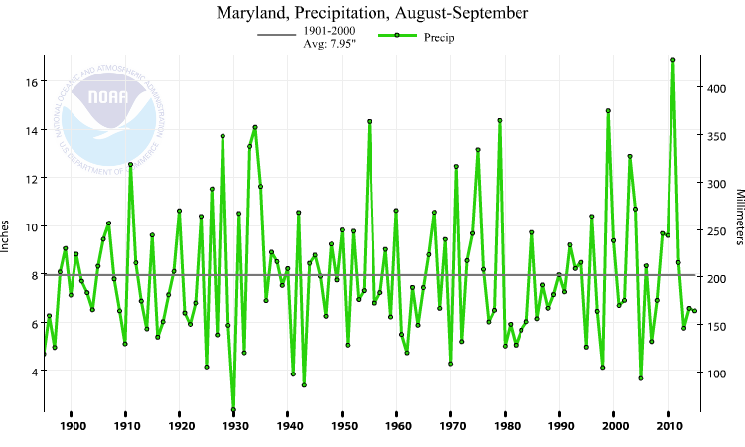

Slide 19
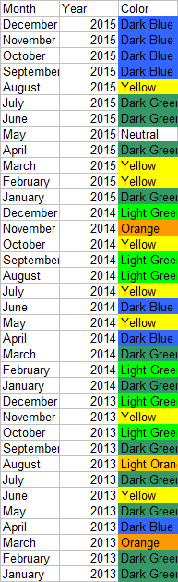
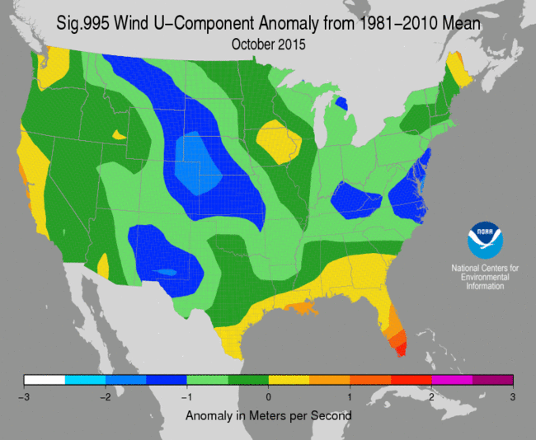
Recent Wind Anomalies

Slide 20
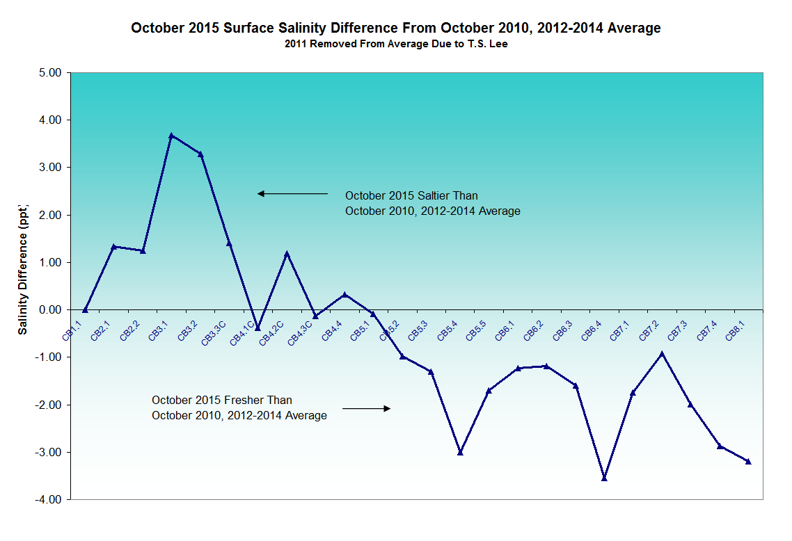
Maryland tributary stations (WT/ET) on average 1ppt greater than previous 4 years

Slide 21
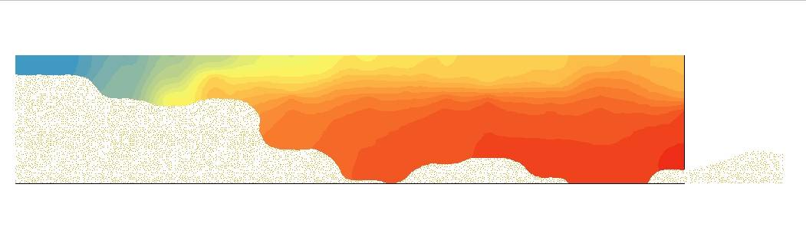
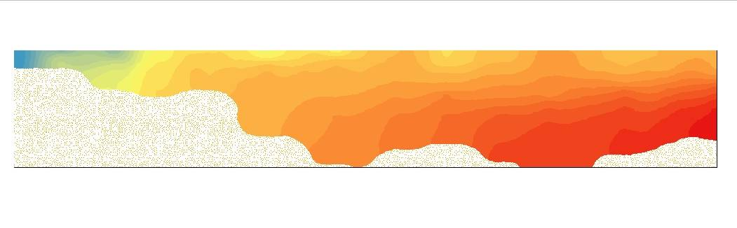
Salinity Along the Mainstem Channel of MD Chesapeake Bay
Salinity (ppt)
Mid-September 2015
Bottom
0
33
no
data
Depth (meters)
Early October 2015
0
33
Susq. Flats
Patapsco
Bay Bridge
Choptank
PAX
MD/VA

Slide 22
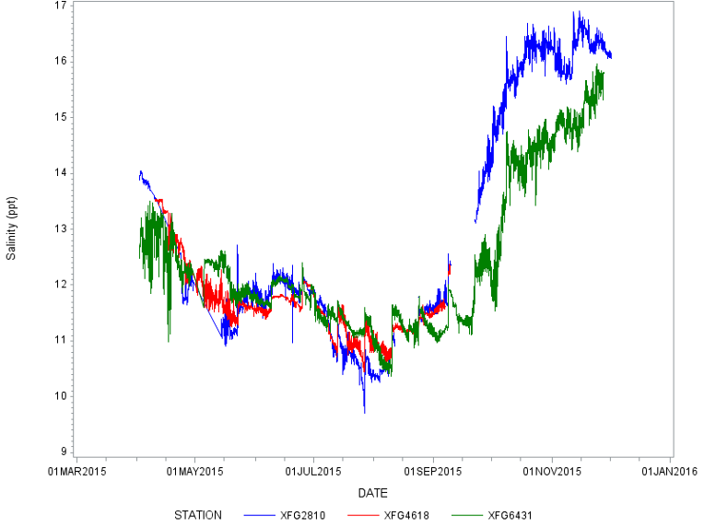
Harris Creek sites

Slide 24
Reports of Abundant Submerged Aquatic Vegetation in 2015
Numerous inquiries from citizens regarding channel clogging from ‘nuisance’ SAV
Biologists reporting increases in SAV
Grasses found in some places where they have not been found before
MD DNR Biologist, Mark Lewandowski
Photo by: Barbara Haddock Taylor, Baltimore Sun
A Baltimore Sun 2015 Picture of the Year

Slide 25
Water Clarity Acres Assessment

Slide 26
Upper Bay Zone of SAV (2004 – 2014)
Pass SAV Goal
Passed WQ Acres
Within 10% of SAV Goal
Within 25% of SAV Goal
Within <25% of SAV Goal
Failed WQ Acres
Zero Goal or No Grow Zone

Slide 27
Middle Bay Zone of SAV (2004 – 2014)

Slide 28
Maryland SAV and Clarity Assessments 2004 - 2014
Segments Passing
Water Clarity Acres
Segments Passing
SAV Goal in Any Year
NANMH – very small goal
RHDMH – segment oddity
FSBMH – small goal
WICMH – very small goal
MANMH2 – small goal
BIGMH2 – small goal
GUNOH1 – close to goal
POTOH1_MD – close to goal
PAXOH
PAXTF
POTTF_MD
C&DOH_MD
CB1TF1
CB1TF2
NORTF
ELKOH1
ELKOH2
BOHOH
CB2OH
SASOH1
SASOH2
BSHOH
GUNOH2
MATTF
24 OUT OF 58 MD SEGMENTS THAT HAVE SAV GOALS
PASSED (8 SEGMENTS HAD ZERO OR NGV)
PISTF could have passed water clarity acres, but upriver is too shallow for sampling.
MIDOH had a possibility of passing but sampling was not complete.
Many segments fail the water quality acres goal because of insufficient habitat to assess.

Slide 29
