Slide 1
ChesapeakeProgress
Research Results
Partnering and Leadership Goal Team Meeting June 3, 2015
Notes:
I’m pleased to be here today to talk about our re-designed ChesapeakeStat, and the directions we’re heading to develop a suite of web products to improve information-sharing and decision-making at the Bay Program.
A year and a half ago, as the Watershed Agreement evolved, we realized we needed a tool that would help us track progress toward the new goals and outcomes. We hypothesized that our core audience for this site would be oversight groups - those groups that hold us accountable for making progress - and considered the information they needed about our work.

Slide 2
Our progress toward the Watershed Agreement is measured by accurate, up-to-date and accessible information on environmental health, habitat restoration and funding.
Notes:
We’ve just finished conducting an additional round of research into ChesapeakeProgress. We know it will be a web tool; we know it will serve oversight groups (Public, Internal, Federal); and we know it will include information about environmental health, habitat restoration and funding to help these groups track our progress toward the Watershed Agreement.
Members of these oversight groups have discussed their needs with us in small groups and in one-on-one interviews, and we have come to an understanding of what users need.
While there was some variability, there were common themes across our user groups.

Slide 3
Specifically tracking progress toward…
goals
outcomes
management strategies, and
funding
…of the Watershed Agreement
Notes:
Our research shows that users want a high-level understanding of Bay health and a deeper understanding of how the Chesapeake Bay Program is doing in its efforts to reach the goals of the Watershed Agreement.

Slide 4
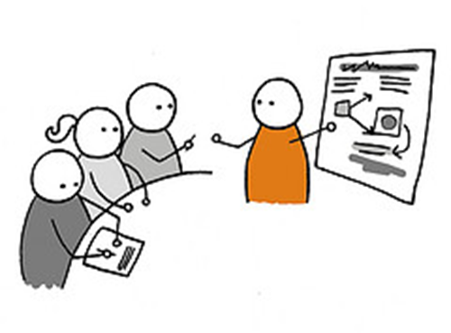
Oversight Groups: Public, Internal, Federal

Slide 5
Users need…
A high-level understanding of Bay health
A deeper understanding of how we are doing in our work to reach the goals of the Watershed Agreement
Notes:
Our research shows that users want a high-level understanding of Bay health and a deeper understanding of how the Chesapeake Bay Program is doing in its efforts to reach the goals of the Watershed Agreement.

Slide 6
Users need…
The who, what, when, where and why
The connections between areas of our work
Notes:
Users want the who, what, when, where and why of our goals, outcomes and management strategies, and have asked that our site connect the dots between different areas of our work to show how they relate to and impact one another.

Slide 7
Users need…
Clear, concise and shareable content
Statistical and spatial representations of progress, bolstered with data that tell a story
Notes:
Users want clear, concise and sharable content, and have asked for statistical and spatial representations of our progress that are bolstered with data that tell a story.

Slide 8
Additionally…
Funding: high-level data spent on federal and state projects
Show, don’t tell
Keep it simple focusing on the big picture.
Notes:
Users want clear, concise and sharable content, and have asked for statistical and spatial representations of our progress that are bolstered with data that tell a story.

Slide 9
Additionally…
Funding: high-level data spent on federal and state projects
Show, don’t tell
Keep it simple focusing on the big picture.
Notes:
Users want clear, concise and sharable content, and have asked for statistical and spatial representations of our progress that are bolstered with data that tell a story.

Slide 10
Next Steps
Content Strategy (under development)
Site Architecture (under development)
Design
Development
Notes:
I’m pleased to be here today to talk about our re-designed ChesapeakeStat, and the directions we’re heading to develop a suite of web products to improve information-sharing and decision-making at the Bay Program.
A year and a half ago, as the Watershed Agreement evolved, we realized we needed a tool that would help us track progress toward the new goals and outcomes. We hypothesized that our core audience for this site would be oversight groups - those groups that hold us accountable for making progress - and considered the information they needed about our work.

Slide 11

ChesapeakeStat.com Vetter.Doreen@epa.gov

