Slide 1

Assessing Citizen Stewardship

Slide 2
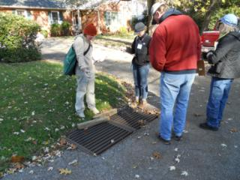
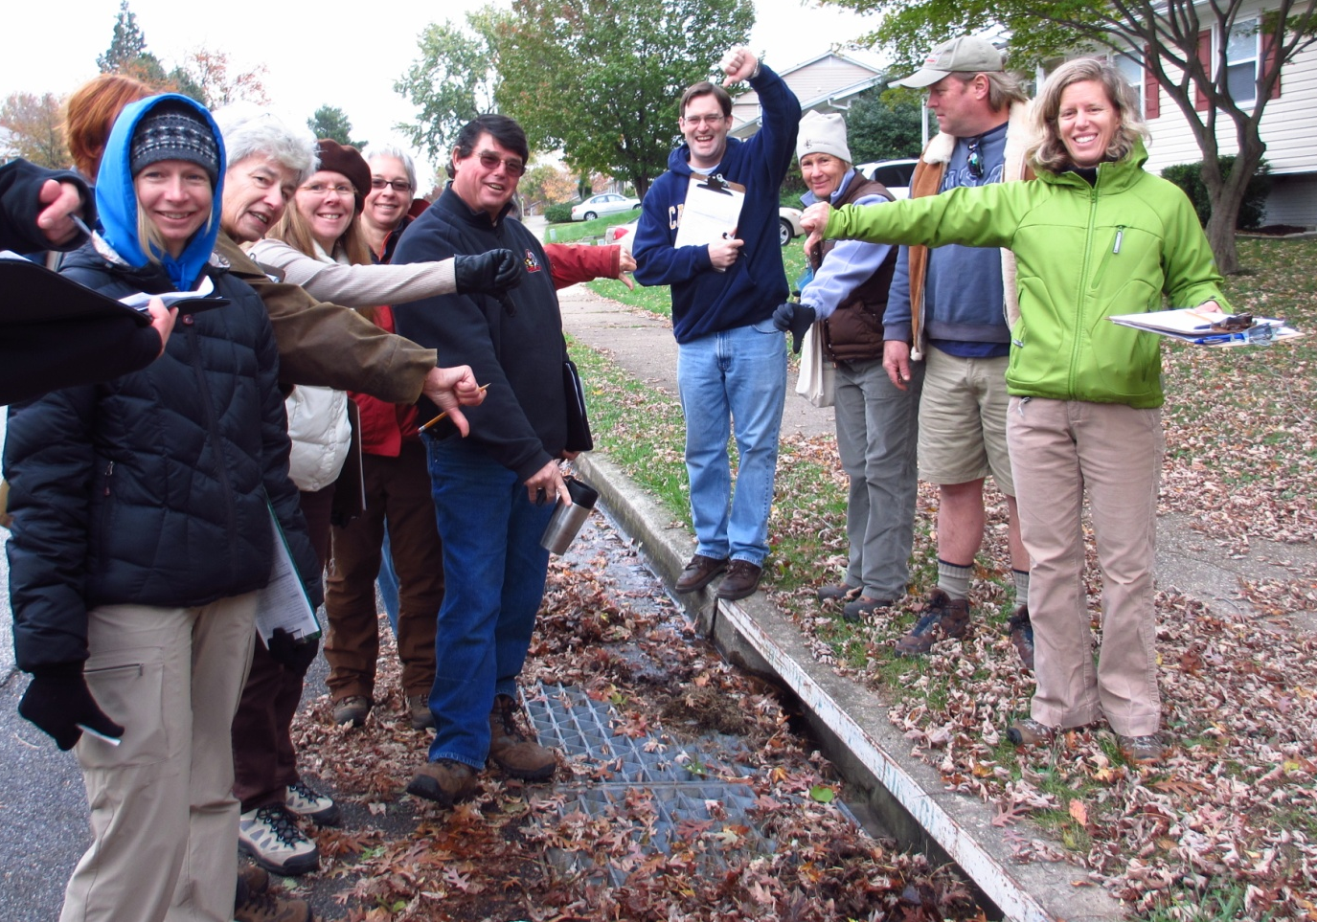
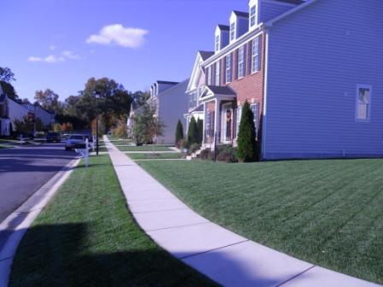
What do Master Watershed Stewards do? Assess Their Community

Slide 3
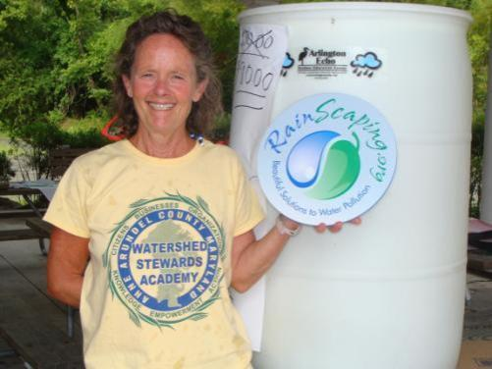
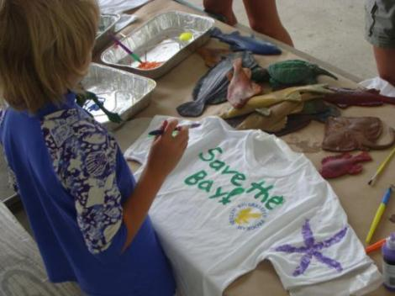
What do Master Watershed Stewards do?
Educate and Engage their Community
Over 97 presentations and outreach events were held, reaching over 9,000 people

Slide 4

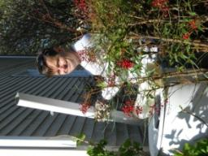
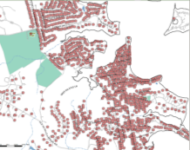
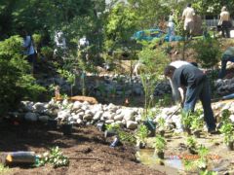
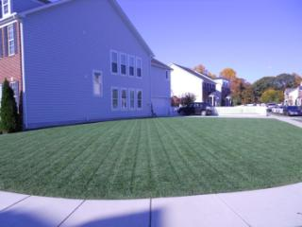
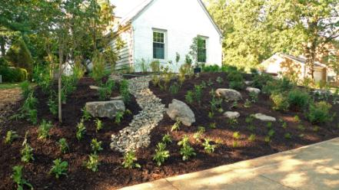
What do Master Watershed Stewards do?
Coordinate Action
Reduce Pollutants
RainScape

Slide 5
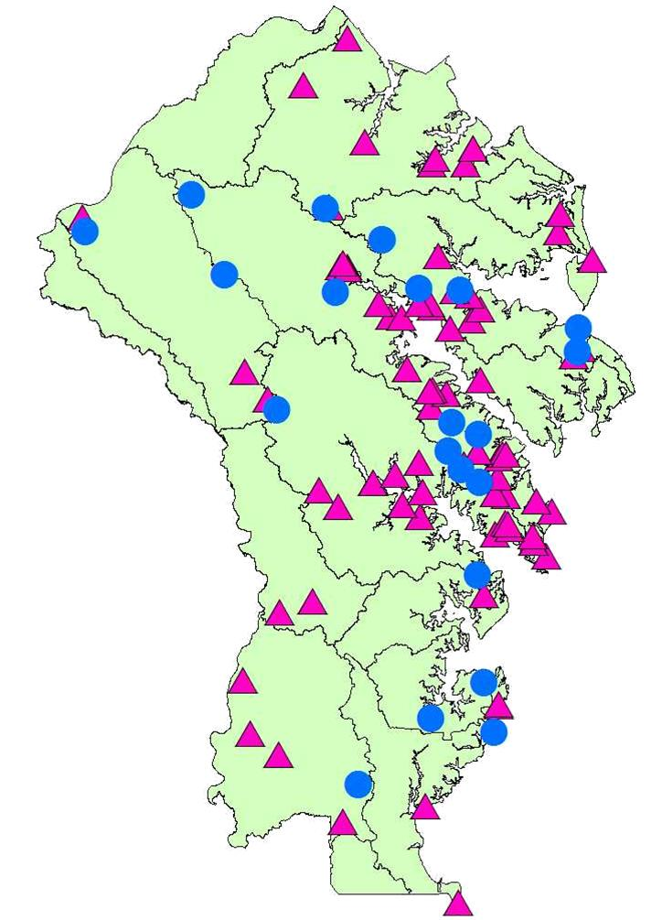
Master Watershed Steward Distribution
Certified Stewards
13o Certified Stewards
Steward Candidates
45 Steward Candidates

Slide 6
Evaluation Criteria Driven by Funders
In 2013, Stewards:
Installed over 400,000 sf of RainScaping Restoration
Planted over 5,000 native plants and trees
Installed 87 rain barrels
Gave 3,500 hours to coordinate restoration action and educate their communities
Stewards reached almost 10,000 people with community relevant outreach and education.

Slide 7
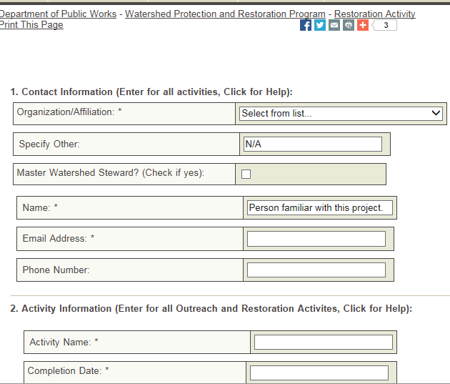
How do we Track Steward Work ?

Slide 8
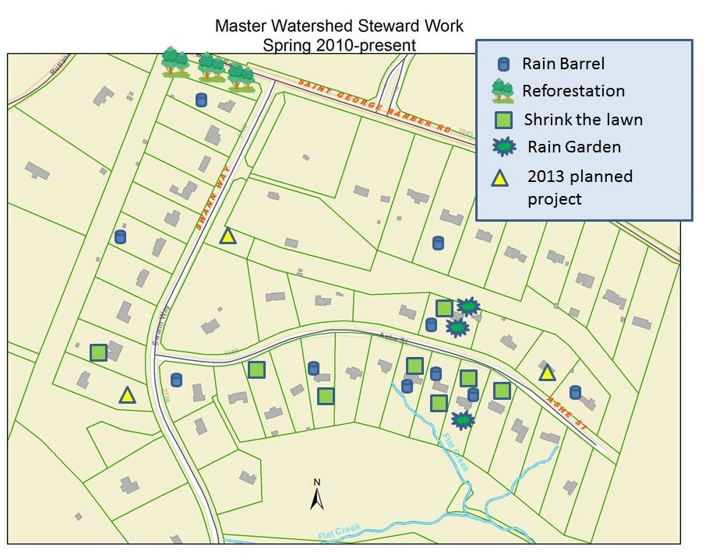
Because Gravley has a Master Watershed Steward…
· 23 % of the homes have installed rain barrels.
· 19 % have “shrunk their lawn”.
· Gravley is home to 4 rain gardens.
· The community has planted over 100 trees, including a 1/3 acre reforestation area and over 50 backyard buffer trees.
· A Forestry Stewardship plan is being created for the entire community.
· 3 projects are planned for later this year.

Slide 9
Other Interesting Data
In 2013, Stewards:
Steward and Community Volunteer Hours $191,468
In Kind Services $54,733
Community Matching CASH $66,947
Steward Solicited Grants $148,445
Total Value of Community Match $461,593

Slide 10

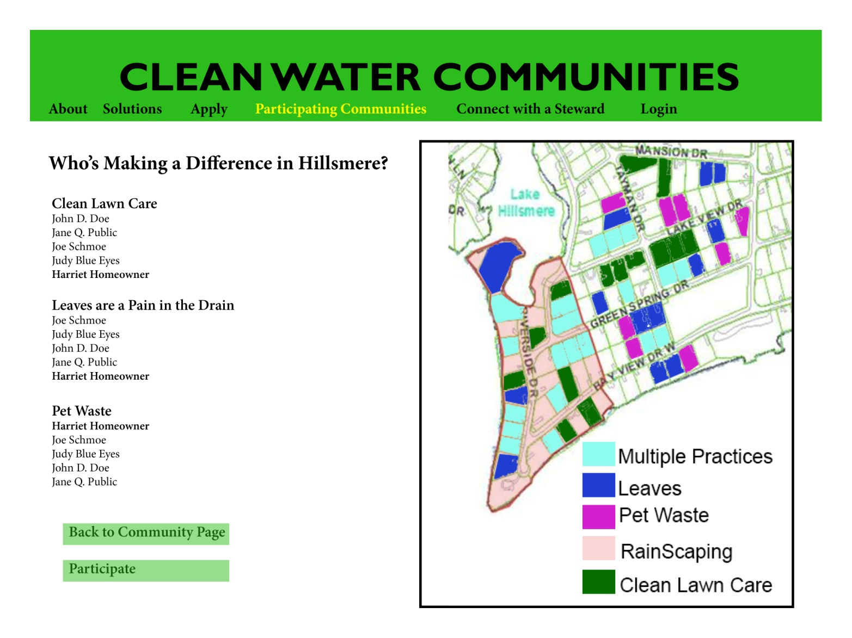
Engage your community in REAL pollution reducing BEHAVIOR CHANGE!

Slide 11
Challenges and Needs
Its difficult to get people to report on things they are not required to report on.
Privacy concerns.
Need guidance on behavior change metrics.
Balance of ROBUST and PRACTICAL – We need a system that is simple enough so you can get a wide range of people reporting, and robust enough to be a real measure of success.
Make it easy for people – multiple ways to report.

