Slide 1
Citizen Stewardship Index
ChesapeakeProgress Charts
October 18, 2017

Slide 2
ChesapeakeProgress is designed to help oversight groups track our progress toward the Chesapeake Bay Watershed Agreement, understand what impacts our work and determine how this work is funded.
Notes:
ChesapeakeProgress is designed to help oversight groups track our progress toward the Chesapeake Bay Watershed Agreement, understand what impacts our work and determine how this work is funded.

Slide 3
Our Goal: To visually depict progress toward increasing the number and diversity of trained and mobilized citizen volunteers who have the knowledge and skills needed to enhance the health of their local watersheds.

Slide 4
The Citizen Stewardship Team believes the following 12 charts will accomplish this goal.

Slide 5
1
A donut chart that depicts the 2017 Citizen Stewardship Index score.

Slide 6
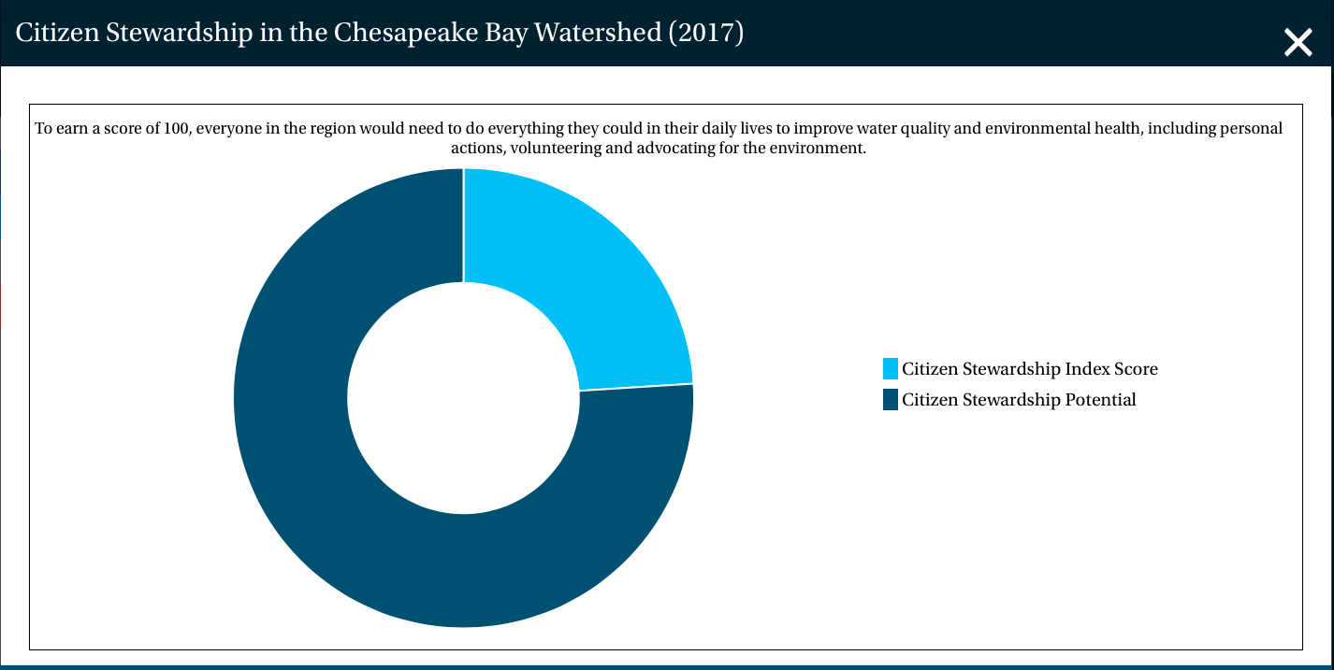
Draft Data

Slide 7
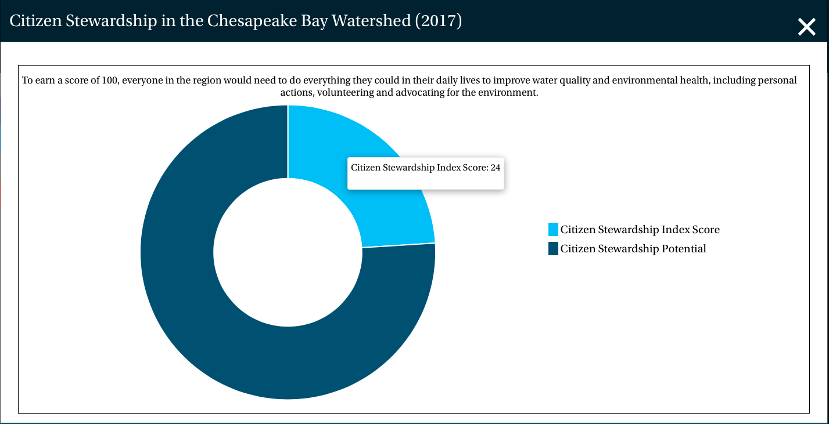
All charts are interactive and allow users to hover over a segment to display the value.

Slide 8
2
A bar chart that depicts the three components of the Citizen Stewardship Index score.
Needed clarification from Data Provider: Are each of these scores on a one-to-100 scale?

Slide 9
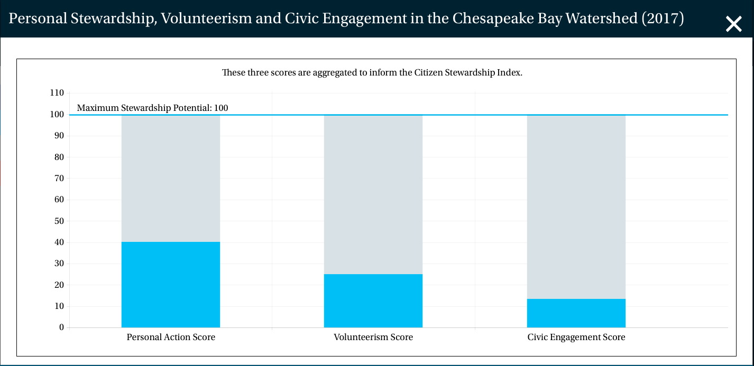
Draft Data

Slide 10
3-6
A series of bar charts that depict the most adopted actions; least adopted actions; most likely to be adopted actions; and least likely to be adopted actions.
We don’t have this data, but we do have a mock-up of the bars that will appear in the “most adopted” and “least adopted” action charts.

Slide 11
A Stewardship Action
Percentage of residents who have taken an action.
Percentage of residents who are likely to take an action.
Percentage of residents who could adopt an action.
Percentage of residents who are unable to adopt an action.

Slide 12
7
A donut chart that depicts the percentage of residents who reported volunteering their time for a charitable organization and those who reported volunteering their time for an environmental organization.
Needed clarification from Data Provider: Are the environmental volunteers a subset of or separate from the general volunteers?

Slide 13
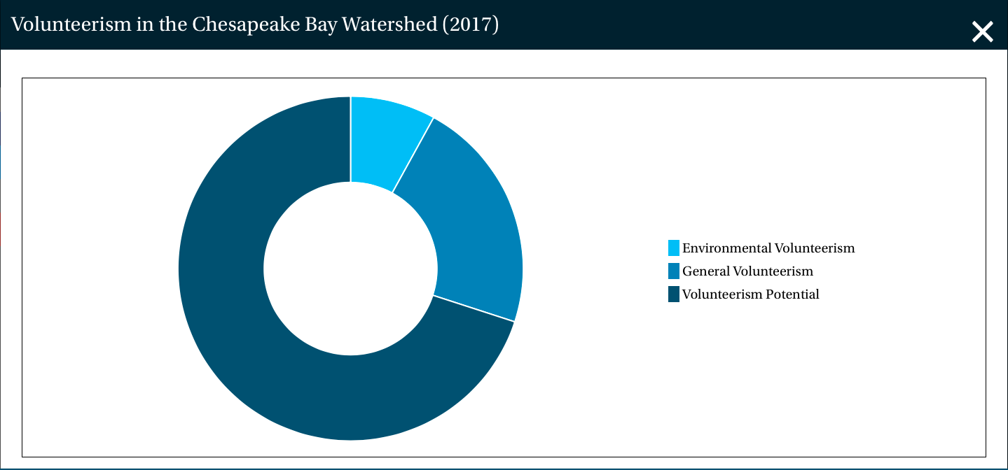
Mock Data

Slide 14
8
A donut chart that depicts the percentage of residents who reported getting personally involved in an important issue and those who reported getting personally involved for an environmental issue.
Needed clarification from Data Provider: Are the environmentally engaged a subset of or separate from the generally engaged?

Slide 15

Mock Data

Slide 16
9
A donut chart that depicts the percentage of residents who reported being able to think of at least one group in their community working to clean up and protect local waters.

Slide 17
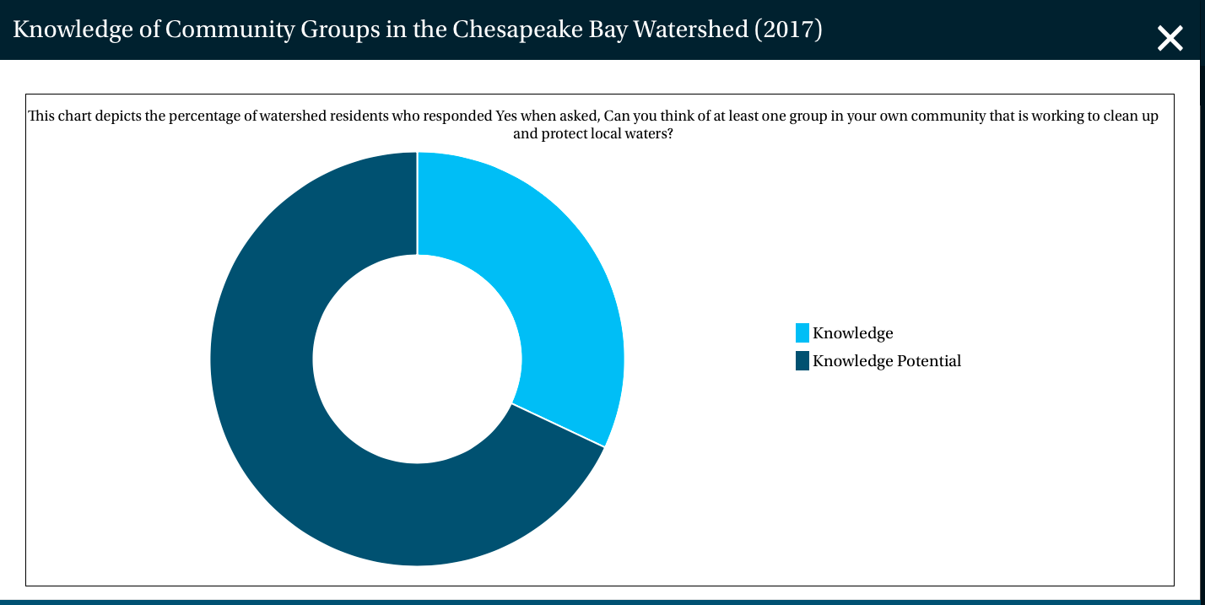
Draft Data

Slide 18
10
A bar chart that depicts the three components of the Factors Influencing indicator.
Needed clarification from Data Provider: Are each of these scores on a one-to-100 scale?

Slide 19
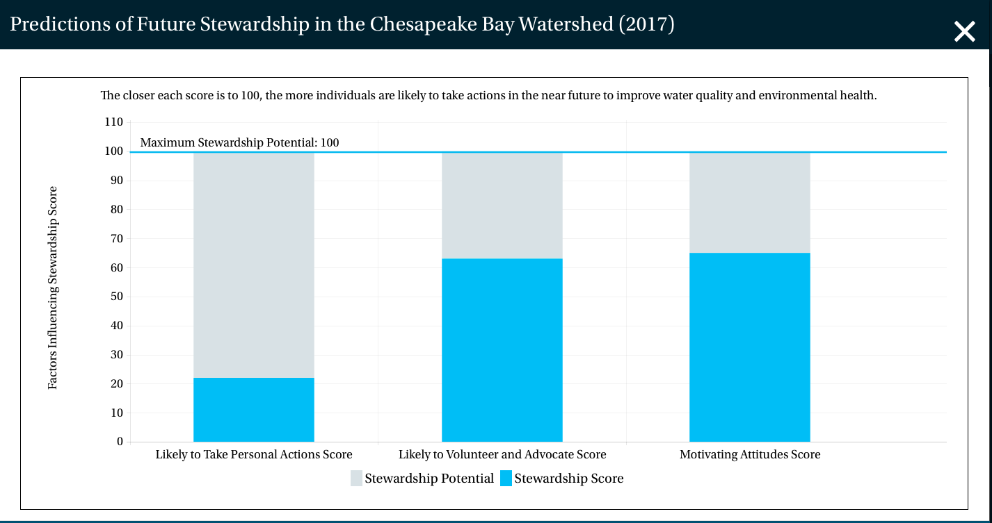
Draft Data

Slide 20
11
A bar chart that depicts responses to the following statements that measure Individual Engagement:
My actions contribute to water pollution where I live.
Polluted water affects me personally.
I want to do more to help make local creeks, rivers and lakes healthier.
I know some things I can do to help reduce water pollution where I live.
The water near where I live is healthy and safe for boating, fishing or swimming.

Slide 21
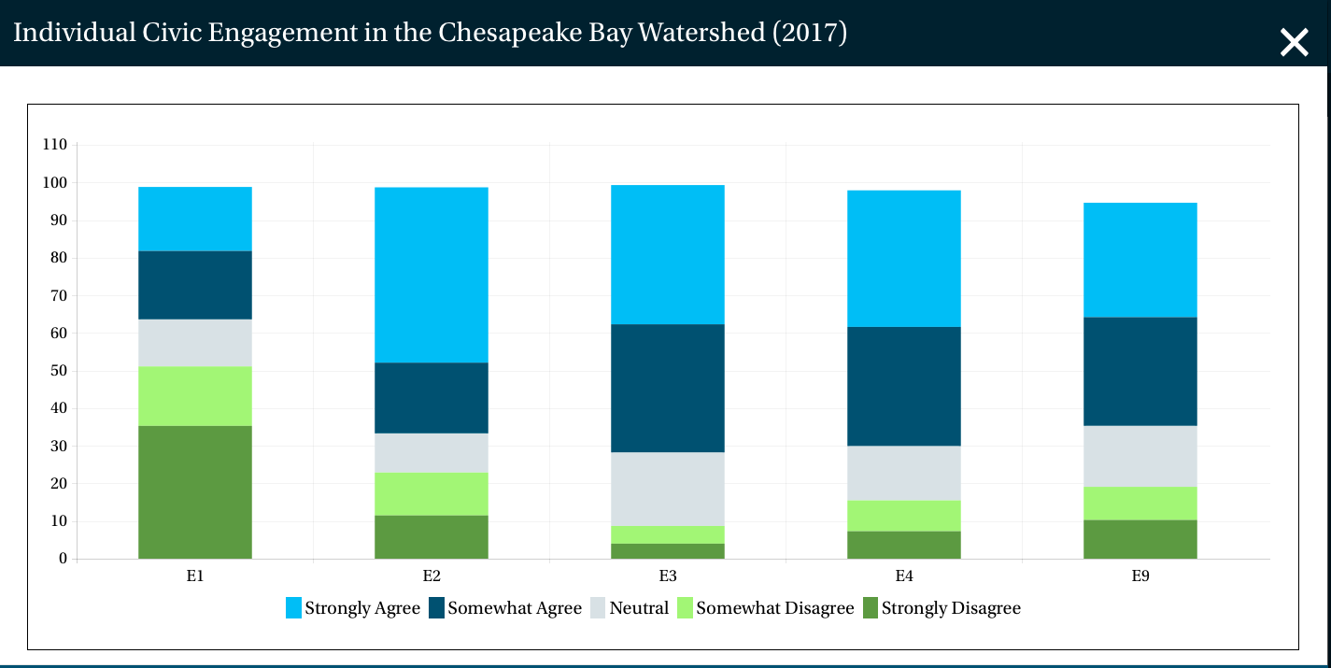
Draft Data
Note: Web Content Strategist will discuss X-axis issue with Web Team.

Slide 22
12
A bar chart that depicts the roll-up Index score for each jurisdiction.

Slide 23
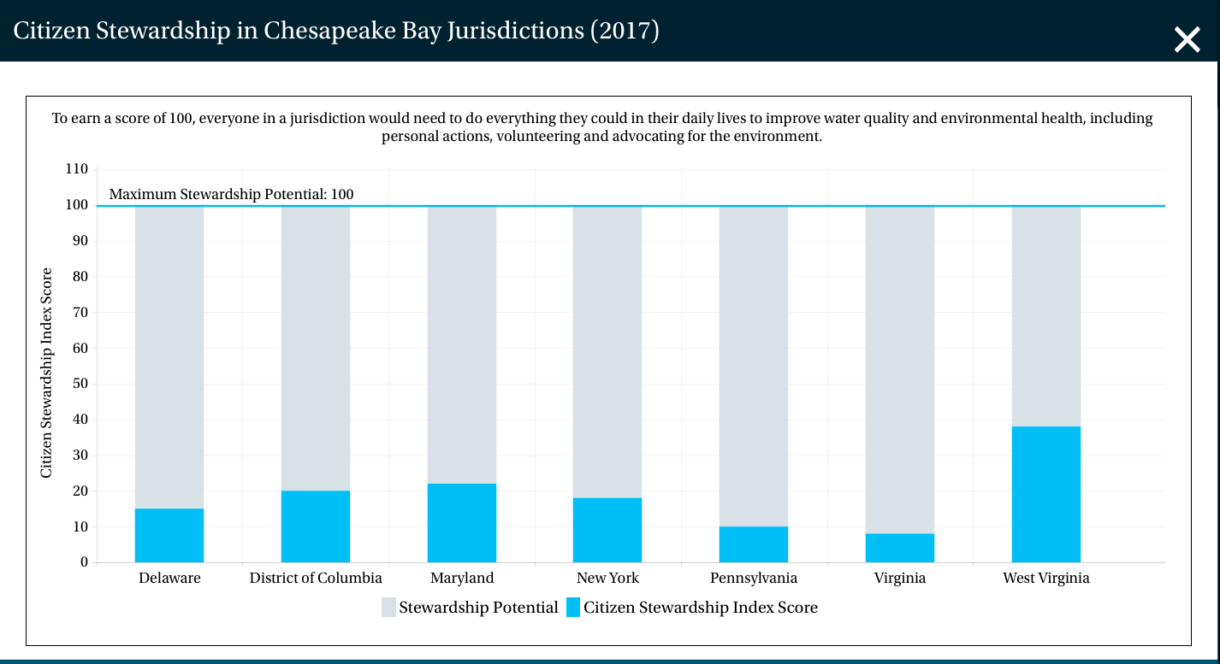
Mock Data

Slide 24
Thanks!

