Slide 1
Climate Workgroup Actions & Climate Change and the TMDL
Mark Bennett
USGS / Climate Resiliency Workgroup
Citizens Advisory Committee – 02/26/21

Slide 2
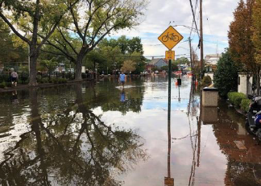
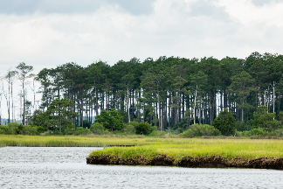
Through the Chesapeake Bay Watershed Agreement, the Chesapeake Bay Program has committed to…
Goal: Climate Resiliency
Outcome: Monitoring & Assessment
Continually monitor and assess the trends and likely impacts of changing climatic and sea level conditions on the Chesapeake Bay ecosystem, including the effectiveness of restoration and protection policies, programs and projects.
Outcome: Adaptation
Continually pursue, design, and construct restoration and protection projects to enhance the resiliency of Bay and aquatic ecosystems from the impacts of coastal erosion, coastal flooding, more intense and more frequent storms and sea-level rise.
NOAA
Will Parson/CBP
Notes:
Connections – emphasize how does monitoring and assessment connect with informing adaptation strategies
INSTRUCTIONS:
Add the title of your goal and the language of your outcome from the 2014 Agreement (copy and paste).
Add a relevant photo (if it all fits).
If desired, talking points could include more contextual information, e.g. the importance of the outcome and the historic trends that led to the establishment of the specific target.

Slide 3
What is our Expected and Actual Progress?
2015-2017
2018-2020
2021-2023
Main Focus:
Monitoring & Assessment
Adaptation
Climate Indicator Implementation Plan
TMDL climate model/sea level rise considerations
Initial CBP climate smart decision framework conversations
Physical climate indicators
Cross-goal climate indicator framework
Climate Mapping Repository
Initial BMP resilience assessment - stormwater
Climate indicators – connect with impacts
BMP resilience assessment (ag, urban, tidal natural)
Data/model synthesis – support adaptation targeting
Local engagement - climate resilience scorecard
Financing strategies
Notes:
Note: 2015-2020 - Main focus of actions was on Monitoring and Assessment; 2021-2023 -Working towards a main focus of adaptation using knowledge gained from Monitoring & Assessment. Work plans include actions for both outcomes, but the main focus varies based on what is needed and resources.
INSTRUCTIONS: Copy and paste the graph or chart you used to answer narrative analysis question #2. The editable graph from the Narrative Analysis template has been included here for your reference.
FROM NARRATIVE ANALYSIS (FOR YOUR REFERENCE ONLY):
“2. Regardless of how successful your short-term progress has been over the past two years, indicate whether we are making progress at a rate that is necessary to achieve the outcome you are working toward.
Use the editable graph or your own chart to illustrate your progress. Explain any gap(s) between our actual progress and our anticipated trajectory.”

Slide 4
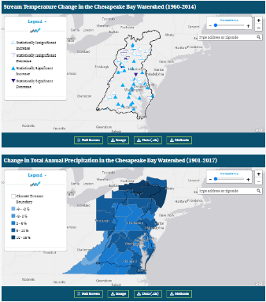
Successes and Challenges
Monitoring and Assessment: Climate Indicators
Successes:
Climate change indicators on Chesapeake Progress:
Avg. Air Temp Increase
Change in High Temp Extremes
Stream Temp Change
Total Annual Precip Change
River Flood Frequency
River Flood Magnitude
Relative Sea Level Rise
Red = updates not available
https://www.chesapeakeprogress.com/climate-change/climate-monitoring-and-assessment
Notes:
INSTRUCTIONS: This slide should briefly summarize your answer to narrative analysis question #1.
FROM NARRATIVE ANALYSIS (FOR YOUR REFERENCE ONLY):
“1. Examine your red/yellow/green analysis of your management actions. What lessons have you learned over the past two years of implementation?
Summarize what you have learned about what worked and what didn’t. For example, have you identified additional factors to consider or filled an information gap?”

Slide 5
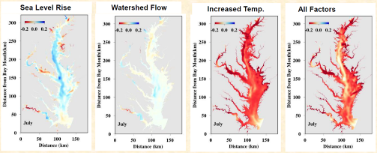
Successes and Challenges
Monitoring and Assessment: TMDL Climate Model
Bottom Dissolved Oxygen Change (mg/L)
(1995-2025)
Successes:
STAC Climate Change Modeling 2.0
Sea level rise TMDL climate model scenario
Image: CBP Modeling Team
Notes:
INSTRUCTIONS: This slide should briefly summarize your answer to narrative analysis question #1.
FROM NARRATIVE ANALYSIS (FOR YOUR REFERENCE ONLY):
“1. Examine your red/yellow/green analysis of your management actions. What lessons have you learned over the past two years of implementation?
Summarize what you have learned about what worked and what didn’t. For example, have you identified additional factors to consider or filled an information gap?”

Slide 6
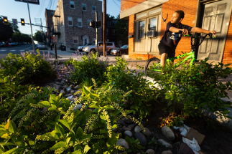
Successes and Challenges
Adaptation: Design and Function of BMPs under a new climate reality
Successes:
BMP efficiencies related to PSC Request – Revision of Intensity Duration Frequency Curves for stormwater (GIT-funded project)
Notes:
INSTRUCTIONS: This slide should briefly summarize your answer to narrative analysis question #1.
FROM NARRATIVE ANALYSIS (FOR YOUR REFERENCE ONLY):
“1. Examine your red/yellow/green analysis of your management actions. What lessons have you learned over the past two years of implementation?
Summarize what you have learned about what worked and what didn’t. For example, have you identified additional factors to consider or filled an information gap?”

Slide 7
Successes and Challenges
Adaptation:
Climate Smart Tool
Successes:
Held meeting to understand lessons learned and challenges for GITs to use
Incorporated climate resilience considerations through other means – collaborative GIT-funding projects, Forums (LGAC Flood Forum)
Notes:
INSTRUCTIONS: This slide should briefly summarize your answer to narrative analysis question #1.
FROM NARRATIVE ANALYSIS (FOR YOUR REFERENCE ONLY):
“1. Examine your red/yellow/green analysis of your management actions. What lessons have you learned over the past two years of implementation?
Summarize what you have learned about what worked and what didn’t. For example, have you identified additional factors to consider or filled an information gap?”

Slide 8
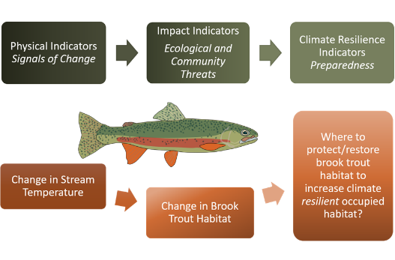
On the Horizon
Monitoring and Assessment: Climate Indicators
Developing Cross-Goal Climate Indicator Framework
Connects physical impacts with ecological and community impacts
Could better inform climate resilience actions related to achieving Chesapeake Bay Watershed Agreement outcomes
Climate & Healthy Watersheds Collaboration
Image Credit: Nora Jackson, Healthy Watersheds
Jane Hawkey, Integration and Application Network, University of Maryland Center for Environmental Science (ian.umces.edu/imagelibrary/)
Notes:
INSTRUCTIONS: This slide should briefly summarize your answer to narrative analysis question #1.
FROM NARRATIVE ANALYSIS (FOR YOUR REFERENCE ONLY):
“1. Examine your red/yellow/green analysis of your management actions. What lessons have you learned over the past two years of implementation?
Summarize what you have learned about what worked and what didn’t. For example, have you identified additional factors to consider or filled an information gap?”

Slide 9
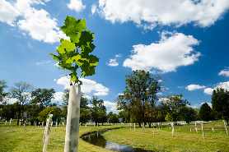
On the Horizon
Adaptation:
BMP climate resilience assessments
Chesapeake Stormwater Network – climate vulnerability analysis of urban stormwater BMPs
STAC-funded climate science synthesis project (Virginia Tech) – assessing urban, ag, and natural BMPs
NOAA-EPA Inter-Agency Agreement Funding (Virginia Tech) – assessing climate change impacts to tidal water BMPs with habitat/fish co-benefits
Results will help inform a research agenda
Notes:
INSTRUCTIONS: This slide should briefly summarize your answer to narrative analysis question #3.
FROM NARRATIVE ANALYSIS (FOR YOUR REFERENCE ONLY):
“3. What scientific, fiscal and policy-related developments will influence your work over the next two years?
This may include information learned at the previous biennial SRS meeting or more specific information about your outcome such as an increase or decrease in funding, new programs that address gaps, and new scientific data or research. Describe how these developments are likely to impact your recommended measure(s) of progress, the factors you believe impact your ability to succeed, and newly created or filled gaps. These changes should be reflected in the first three columns of your revised logic and action plan after your quarterly progress meeting.”

Slide 10
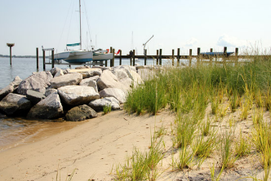
On the Horizon
Adaptation:
Assist localities with design plans for adaptation projects
FY19 GIT-Funded project, “Targeted Local Outreach for Green Infrastructure in Vulnerable Areas” (Lead: Habitat GIT; Support from CRWG)
Consulting with finance experts on investment strategies for adaptation projects
Notes:
INSTRUCTIONS: This slide should briefly summarize your answer to narrative analysis question #3.
FROM NARRATIVE ANALYSIS (FOR YOUR REFERENCE ONLY):
“3. What scientific, fiscal and policy-related developments will influence your work over the next two years?
This may include information learned at the previous biennial SRS meeting or more specific information about your outcome such as an increase or decrease in funding, new programs that address gaps, and new scientific data or research. Describe how these developments are likely to impact your recommended measure(s) of progress, the factors you believe impact your ability to succeed, and newly created or filled gaps. These changes should be reflected in the first three columns of your revised logic and action plan after your quarterly progress meeting.”

Slide 11
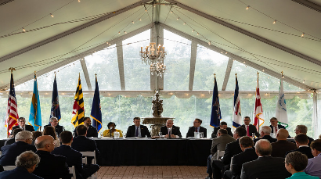
On the Horizon
Local Engagement:
FY19 GIT-funded project, “Bay-Wide Climate Resilience Scorecard for Watershed Communities” (Lead: CRWG; May 2020 – Nov 2021)
Conversation starter with localities to identify climate resilience actions that can be taken
Connect local priorities with program needs
Track progress in climate resilience efforts
Notes:
From Breck: (Ppl liked it when we included the risks
or benefits in our WQSAM outcome presentation)
INSTRUCTIONS: This slide should briefly summarize your answer to narrative analysis question #3.
FROM NARRATIVE ANALYSIS (FOR YOUR REFERENCE ONLY):
“3. What scientific, fiscal and policy-related developments will influence your work over the next two years?
This may include information learned at the previous biennial SRS meeting or more specific information about your outcome such as an increase or decrease in funding, new programs that address gaps, and new scientific data or research. Describe how these developments are likely to impact your recommended measure(s) of progress, the factors you believe impact your ability to succeed, and newly created or filled gaps. These changes should be reflected in the first three columns of your revised logic and action plan after your quarterly progress meeting.”

Slide 12
PSC Charge to the Climate Change Action Team
Communicate an EC position that confirms and reinforces the current science-based understanding that climate change is causing severe detrimental impacts on the Chesapeake Bay and its watershed – communities and natural resources - and urgent attention is warranted.
Update the EC position on climate change by modifying the existing language of the 2014 Chesapeake Bay Watershed Agreement or preparing a new EC Directive.

Slide 13
Other Chesapeake Region Climate Impacts
Flooding
Shoreline erosion
Wetland loss
Habitat changes
Increased stream temperatures
Species changes
Drought effects on water supply
…

Slide 14
Climate Workgroup Actions & Climate Change and the TMDL
Mark Bennett
USGS / Climate Resiliency Workgroup
Citizens Advisory Committee – 02/26/21

Slide 15
CBP Climate Work Plan
2018
Scientific Workshop from CBP’s Scientific and Technical Advisory Committee
2019
CBP’s Modeling Workgroup oversees changes to data and models to improve estimates of climate effects
2020
CBP’s policy workgroups decide how to allocate additional effort necessary to counteract the effects of climate change
2021
Climate change considerations will be implemented into the 2022-2023 WIP milestones.
Preliminary work
Notes:
See Attachment 1 in your materials
Arrow indicates where we are today
Circle show a key deliverable, the revised assessment.

Slide 16
changes in CO₂

Slide 17

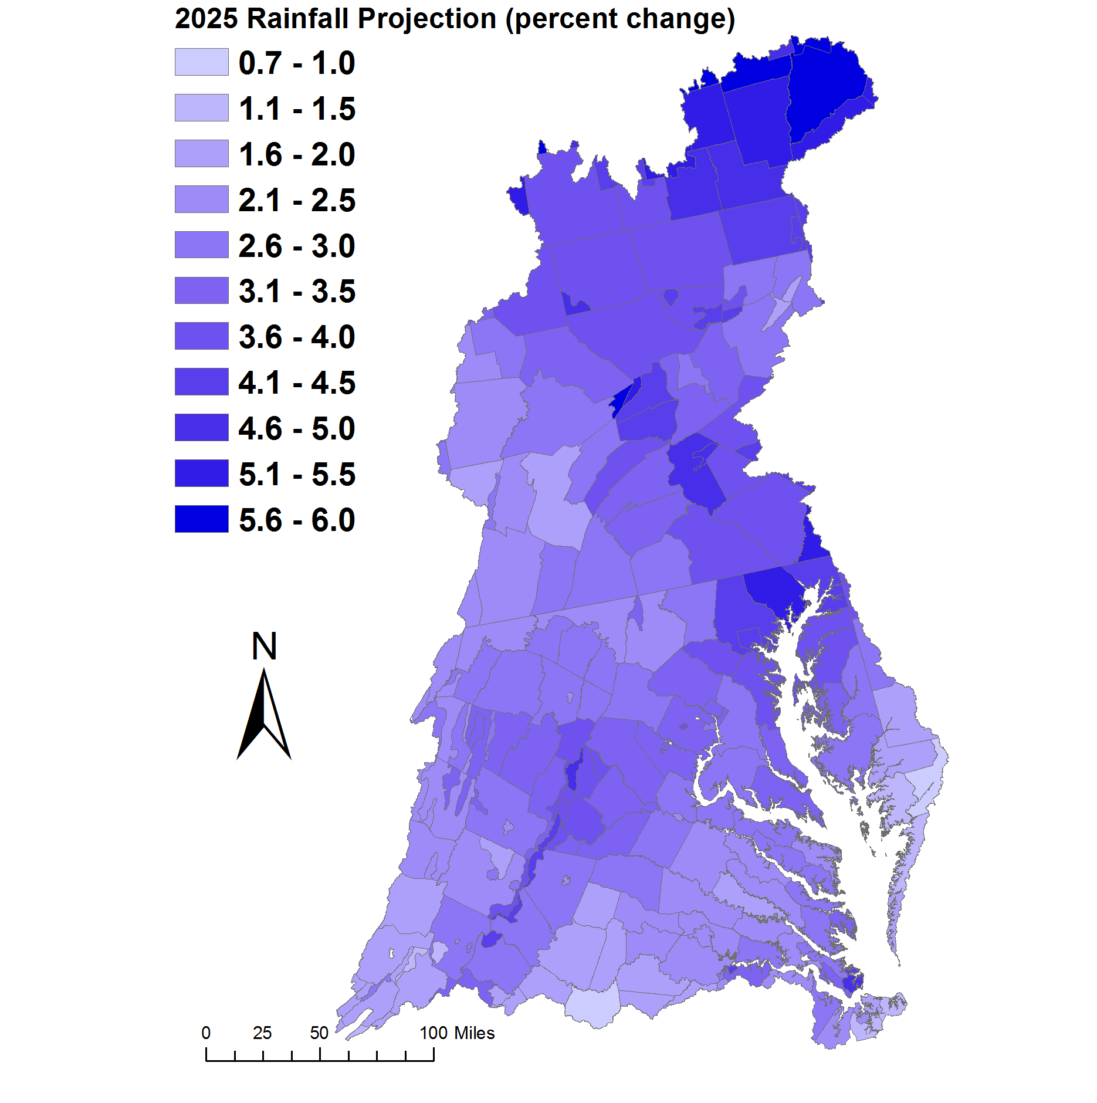
Chesapeake Bay Program
Science, Restoration, Partnership
Assessment of Influence of 2025 Climate Change in the Watershed
Projections of rainfall increase using trend in 88-years of annual PRISM^{[1]} data
Change in Rainfall Volume 2021-2030 vs. 1991-2000
Major Basins | PRISM Trend
Youghiogheny River | 2.1%
Patuxent River Basin | 3.3%
Western Shore | 4.1%
Rappahannock River Basin | 3.2%
York River Basin | 2.6%
Eastern Shore | 2.5%
James River Basin | 2.2%
Potomac River Basin | 2.8%
Susquehanna River Basin | 3.7%
Chesapeake Bay Watershed | 3.1%
[1] Parameter-elevation Relationships on Independent Slopes Model

Slide 18
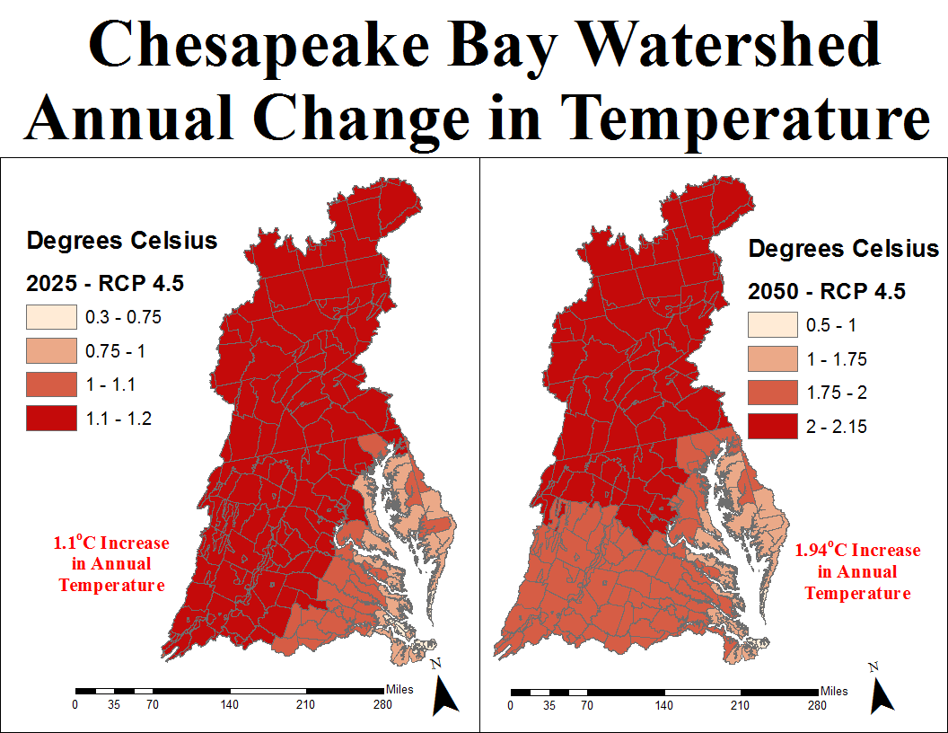
Chesapeake Bay Program
Science, Restoration, Partnership
Notes:
Note that the change is in degrees Celsius, it’s kind of a lot

Slide 19
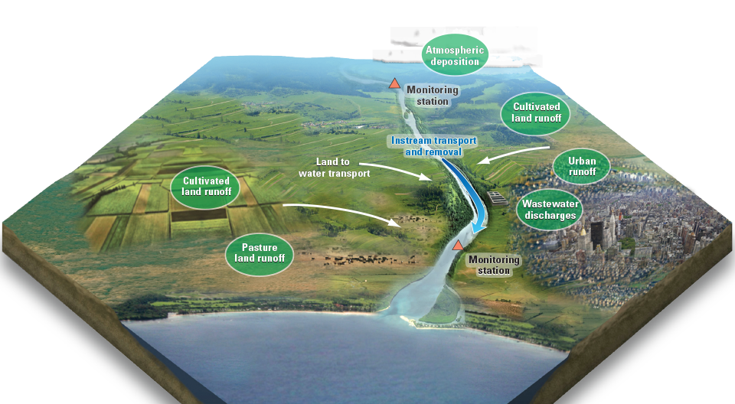



Increased Precipitation
Increased Precipitation Intensity
Increased Temperature
Sea Level Rise
Increased Flow
Increased Water Temperature
Increased Nutrients

Slide 20
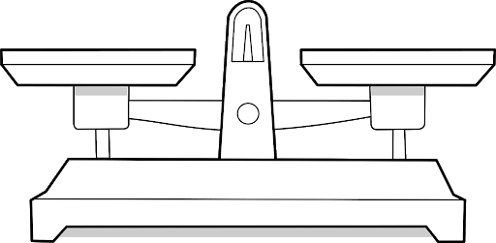
Balance of effects – Science Question
Increased Precipitation
Increased Air Temperature
Increased Precipitation Intensity
Sea Level Rise
Increased Water Temperature
Increased Flow
Increased Nutrients
Higher oxygen
Lower oxygen
CBP studied 21 different effects producing an overall lower level of oxygen

Slide 21
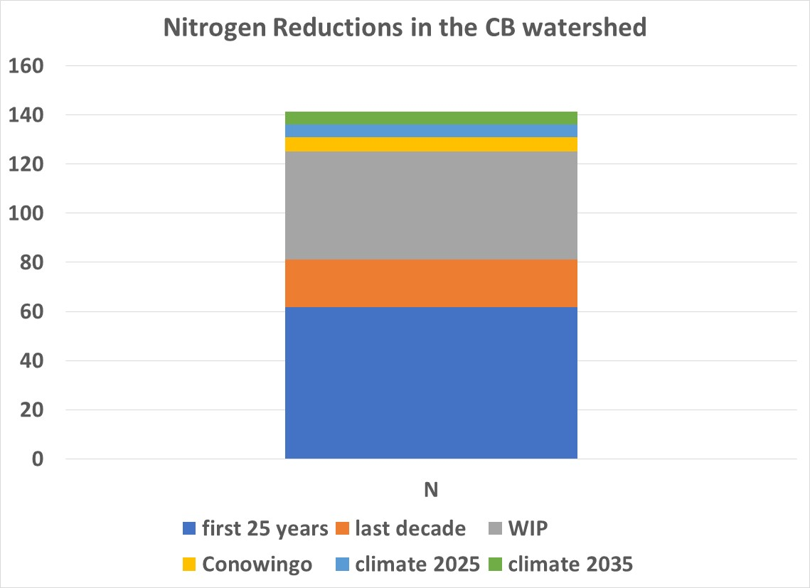
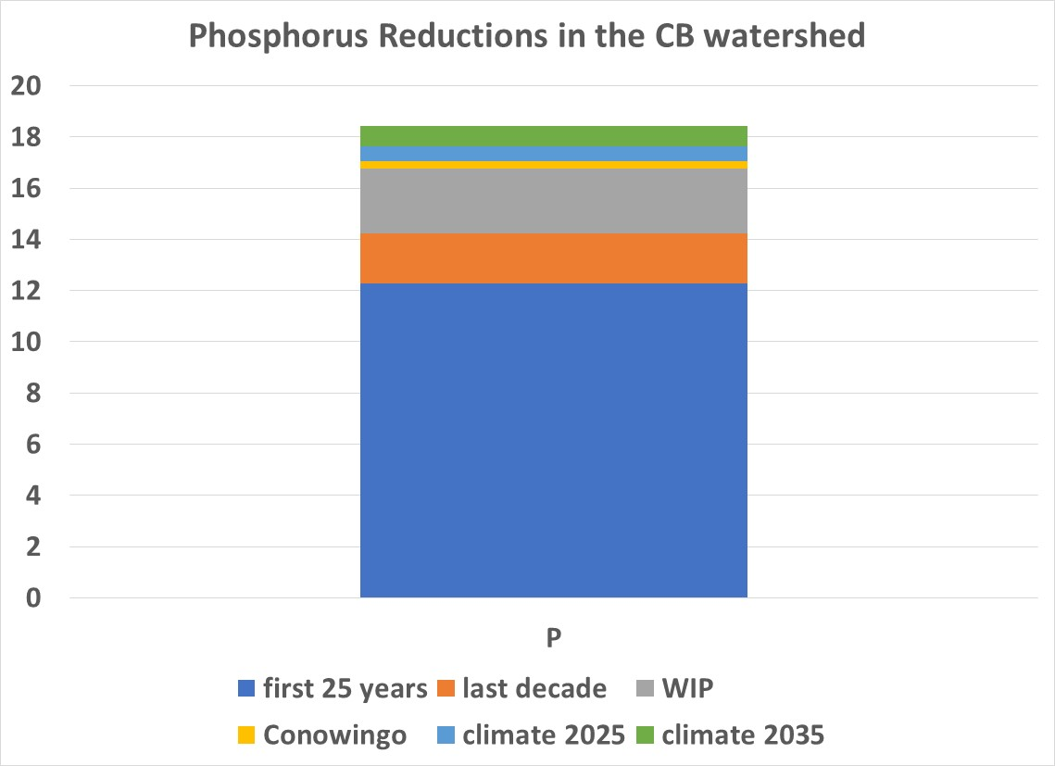
Climate effects in perspective
Modeled load reductions from CAST-2019 (current version of the CBP watershed model)

Slide 22

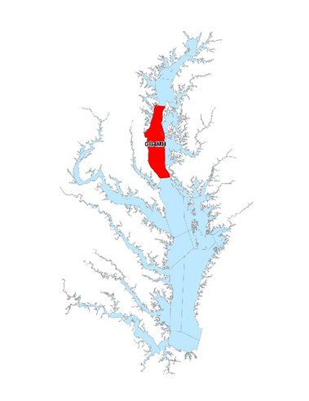
△Achievement of Deep Channel DO Water Quality Standard
Achievement of Deep Channel DO water quality standard (1mg/l instantaneous minimum) expressed
as an incremental increase over the PSC agreed to 2025 planning targets
2025
2035
2045
2055
Deep Water More Affected
Load reductions return to same average state

Slide 23
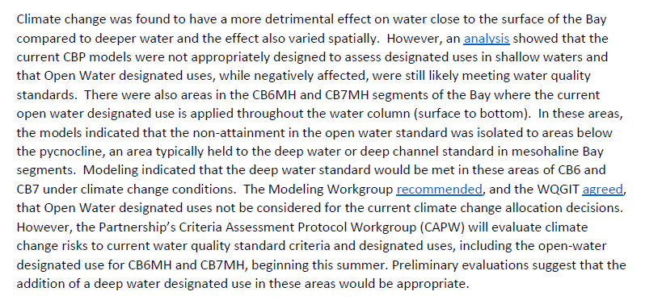
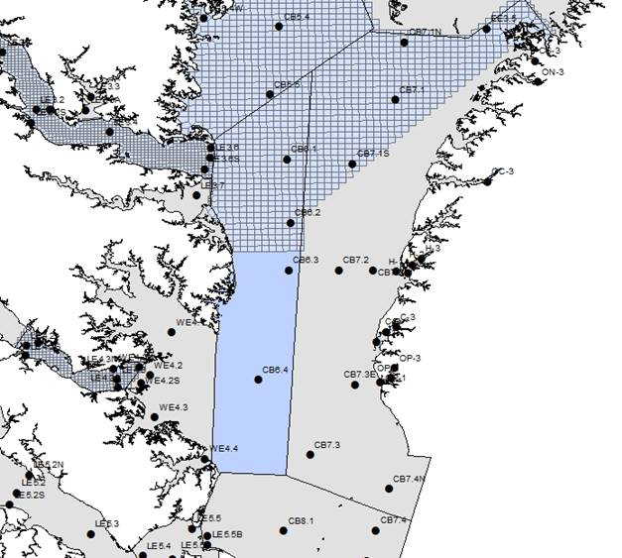
Open Water
Open water is an important use for living resources and modeling showed future non-attainment in CB6MH and CB7MH
… However
The partnership decided not to drive allocations with CB6MH and CB7MH open water
Relatively insensitive to load reductions
No other Mainstem Open Water violations through 2055
Uncertainty over boundary of open water
The Criteria Assessment Protocol Workgroup began to address these issues at their 8/19/20 meeting.

