Slide 1
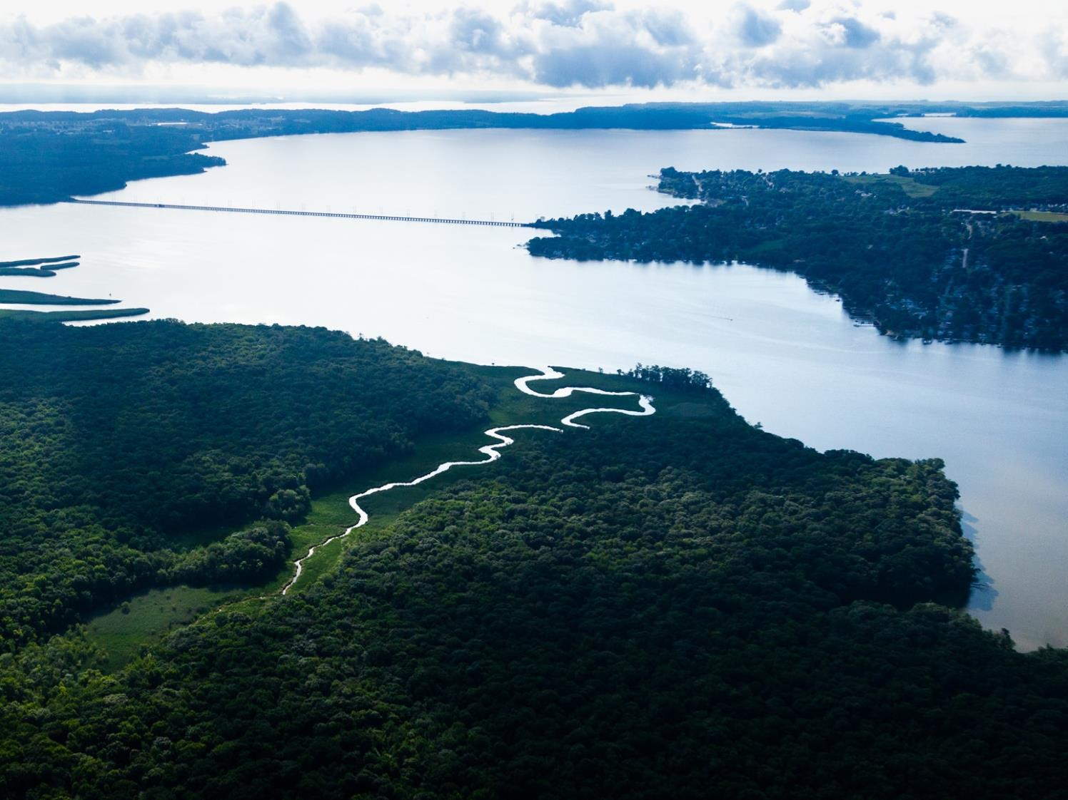

Liz Chudoba
Program Manager, Alliance for the Chesapeake Bay
lchudoba@allianceforthebay.org
Photo courtesy of the Chesapeake Bay Program
Notes:
Anne:

Slide 2
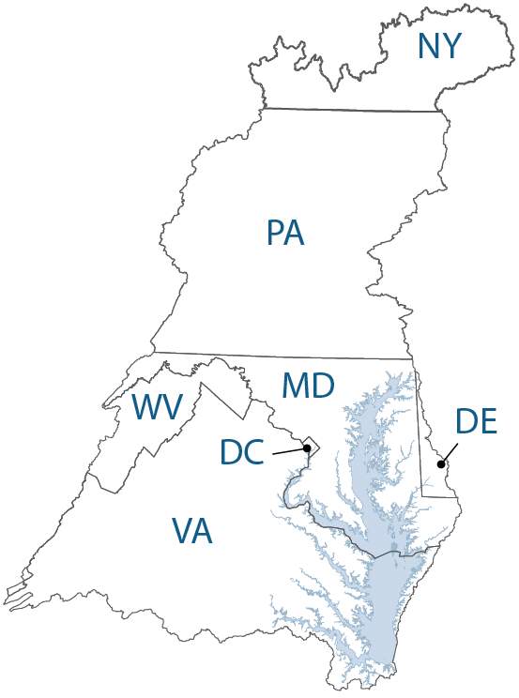





Chesapeake Monitoring Cooperative
A partnership that aims to provide technical, logistical, and outreach support for the integration of volunteer-based and nontraditional water quality and benthic macroinvertebrate monitoring data into the Chesapeake Bay Program (CBP) partnership.
CMC development team
partners & service providers
Participating
Jurisdictions
Cooperative Agreement
Notes:
The Chesapeake Monitoring Cooperative is a group of leading organizations that provide technical, programmatic, and outreach support for the integration of water quality and macroinvertebrate monitoring data into the Chesapeake Bay Program partnership.
The Chesapeake Monitoring Cooperative was set up through a cooperative agreement between the Chesapeake Bay Program and the Alliance for the Chesapeake Bay in 2015.
Define non-traditional and benthic macroinvertebrate

Slide 3
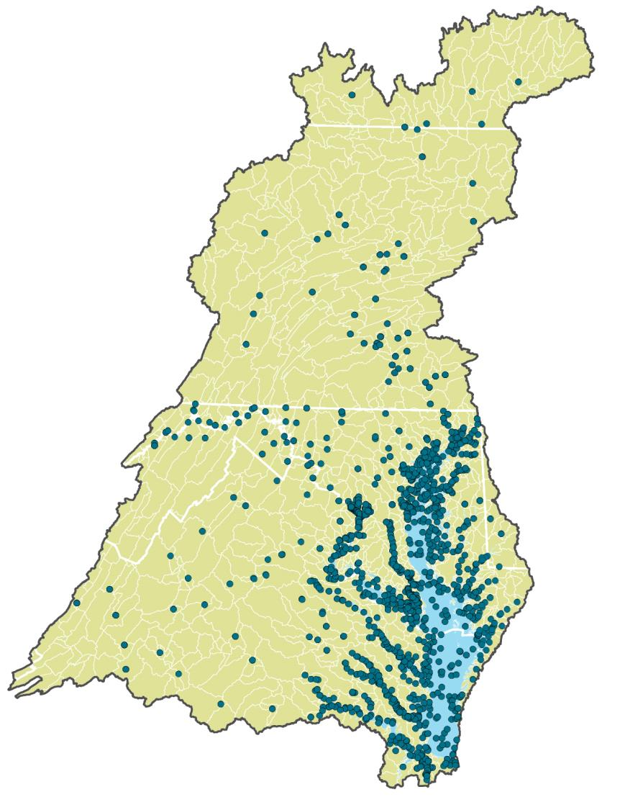
Chesapeake Bay Program Monitoring Sites
Notes:
First we can look at what traditional monitoring already exists…
The Chesapeake Bay Program Partnership’s Long-term water quality monitoring program has supported the assessment of Bay health, reinforced science-driven management, and led to understanding ecosystem response to natural and anthropogenic drivers. However, looking at this map you can see that this network, cannot monitor everywhere, all the time, and sometimes relies on one monitoring site to represent a large area of the watershed.
Then, where do you think volunteer and non-traditional data could fill in?

Slide 4
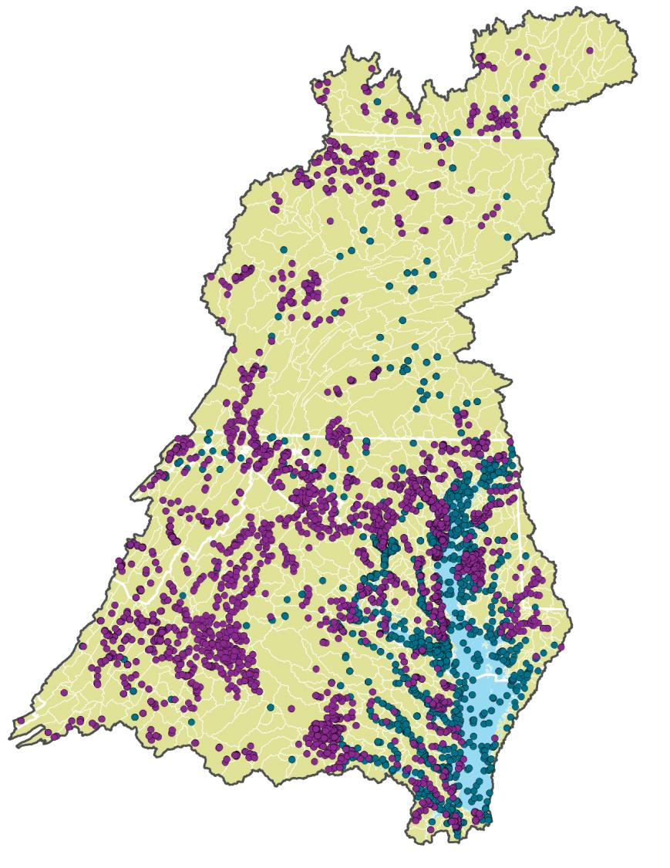
Chesapeake Bay Program Monitoring Sites
Plus Chesapeake Bay Volunteer and Nontraditional Monitoring Sites
Notes:
If you look at this map of monitoring groups that participated in our census this past spring you can see the possibilities of adding a significant amount of data to the monitoring network. Look how dense some of those monitoring points are, these groups are achieving spatial coverage that traditional monitoring can only day dream about.
The non-traditional monitoring groups at the purple points on the map represent a large array of data collectors. On this map we have volunteers of a home owner association collecting bacteria data on the streams in their community to encourage safe disposal of horse manure. There are paid RiverKeepers who go out weekly on their tributary and collect samples with the same rigor as the CBP. And there is a research university tracking stream health recovery from acid rain in the Blue Ridge headwaters.
All this data is of value and when we know of what quality it is, the uses for it can be applied in innumerable ways. One of which could be for the CBP to do their assessment work.

Slide 5
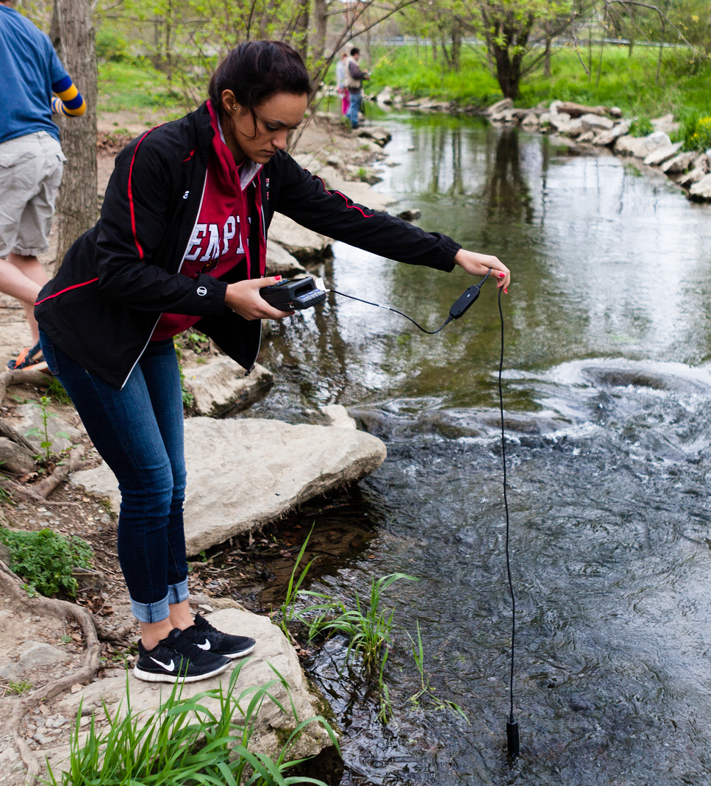
Needs of the Chesapeake monitoring community
Quality Assurance
Comparability
Technical Support
Share Data
Collaboration
Photos courtesy of the Chesapeake Bay Program
Photo courtesy of the Chesapeake Bay Program
Notes:
There are needs of the Chesapeake monitoring community that must to be met.
Available, consistent and comparable field and lab methodologies
A quality assurance program
Technical support and resources for volunteer and non-traditional monitoring groups
A central hub to share volunteer and non-traditional data in the Bay watershed that is user friendly and accessible to monitors and data users
Collaboration and communication between state and federal environmental agencies and the diverse monitoring groups that will make up the cooperative

Slide 6
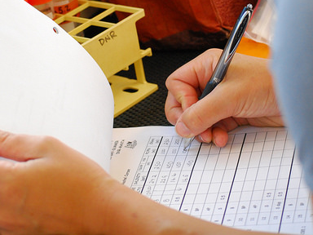
Technical Support Resources
Quality Assurance Project Plans – Tier 1 & 2
Standard Operating Procedures (SOPs) – Tier 1 & 2
User-friendly Methods Manuals
Indicator Fact Sheets
Prioritization Report: How volunteer and nontraditional monitoring can help fill data gaps in the Chesapeake Bay Watershed
Let’s take a quick look!
Photos courtesy of the Chesapeake Bay Program
Notes:
The past two years have been spent by the CMC team laying the foundation for a comprehensive monitoring program throughout the Bay Watershed.

Slide 7
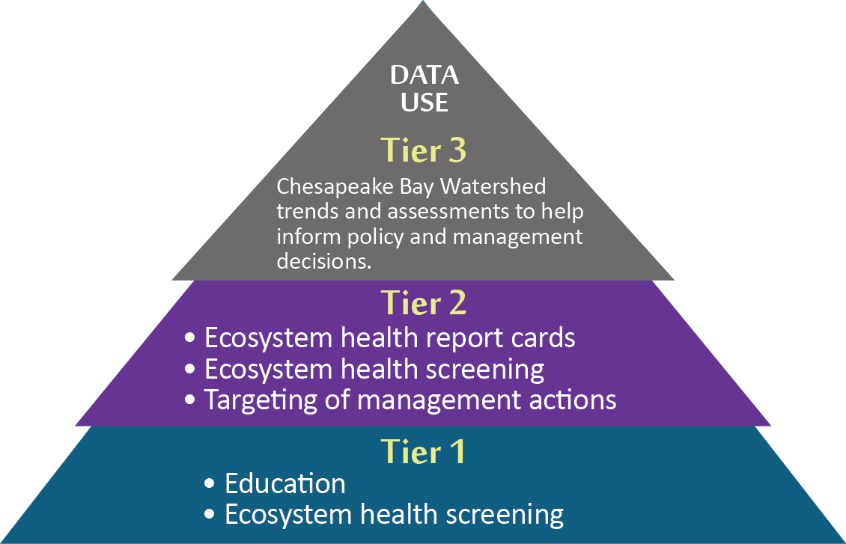
Tiered Framework
Increasing QA standards
Time | Rigor | Expense $$
Notes:
The purpose of the tiered framework is to classify data of know quality collected within the CMC partners.
New Groups – Tiered framework used to guide their equipment and methodology selection based on how they would like to use their data.
Existing Groups – current SOPs and quality assurance procedures are reviewed by CMC team to designate a tier.

Slide 8
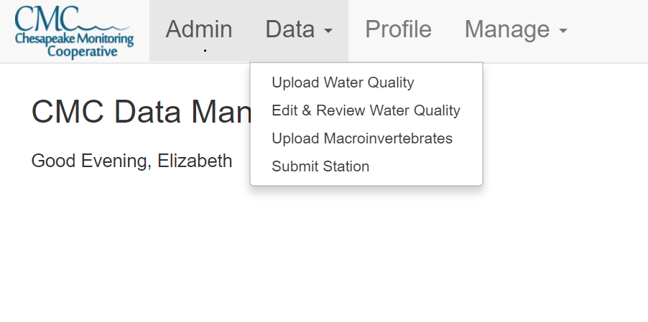
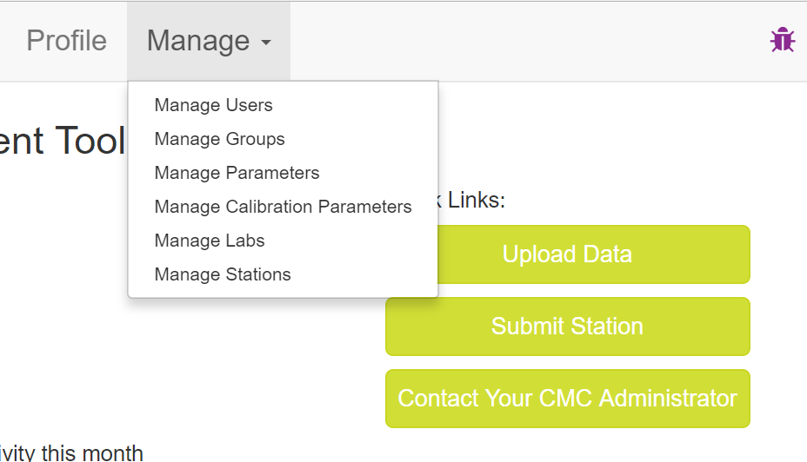
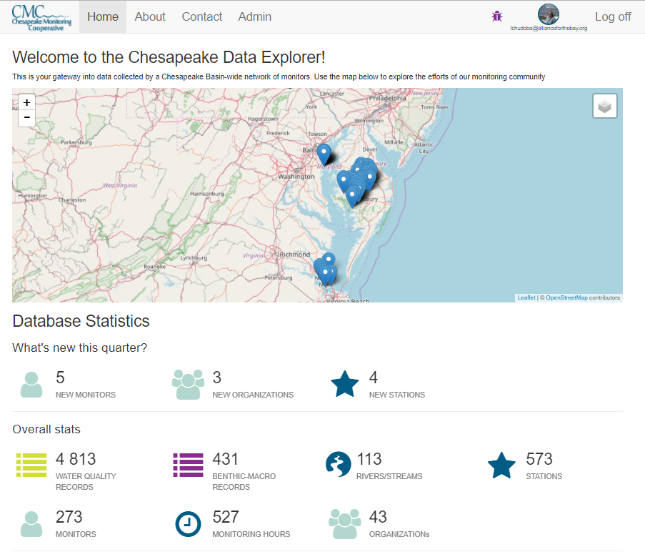
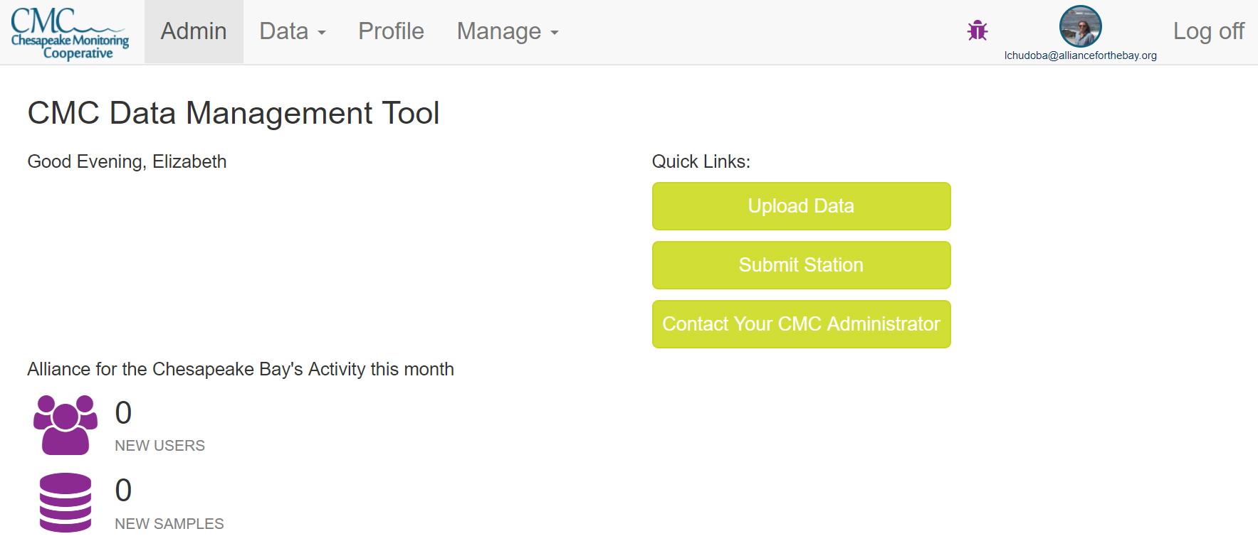
Chesapeake Data Explorer
Notes:
Lea

Slide 9
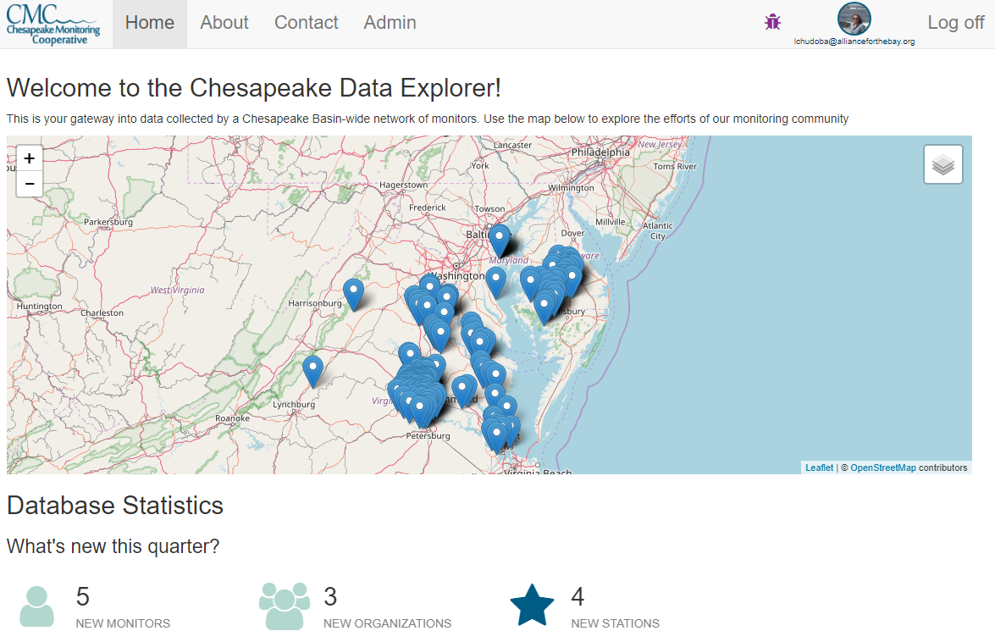
Data Usage Public
Notes:
Public – the front end of the Chesapeake Data explorer is set to be developed in early 2018 and will

Slide 10
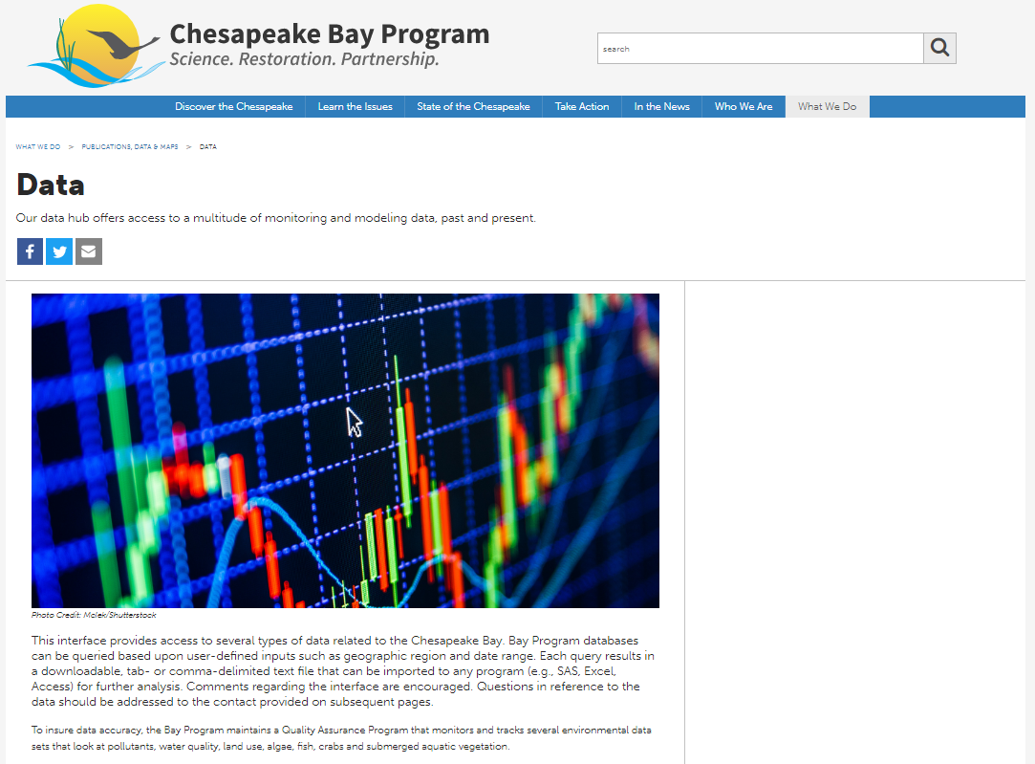
Data Usage EPA Chesapeake Bay Program
Notes:
Our database developers and the Data Center at the Bay program are currently working to create a seemless transition between our database and the Bay Programs CEDR database.

Slide 11
Steps to become a CMC Partner
Fill out the Application for Assistance
Connect with a CMC Service Provider
On Boarding (technical services)
Enter data into the Chesapeake Data Explorer

Slide 12
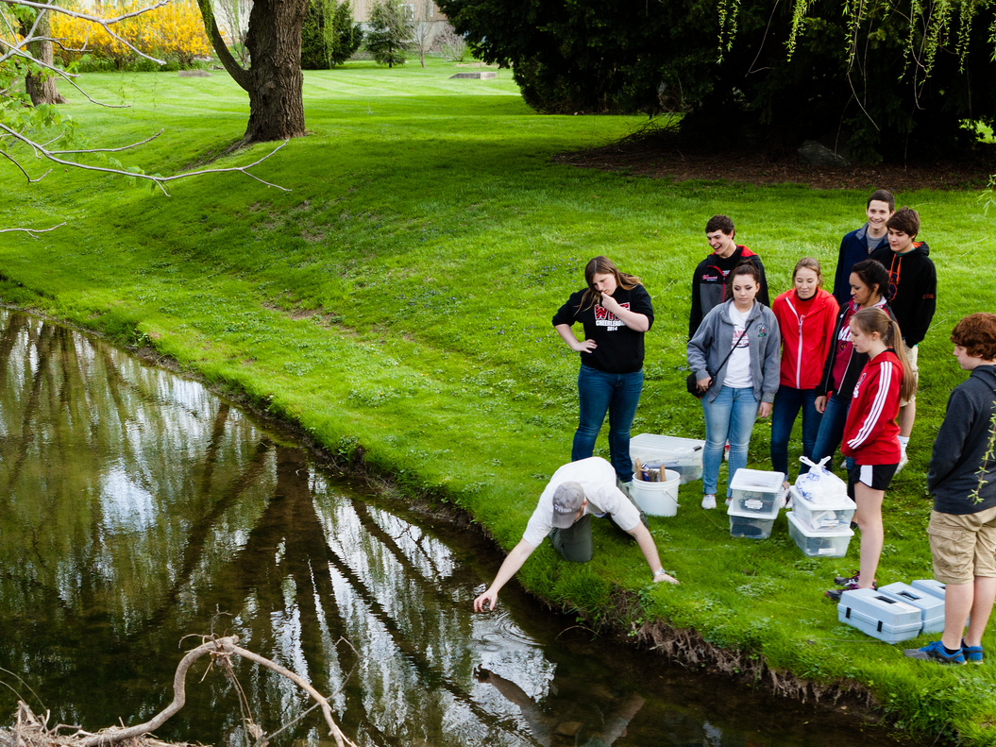
Technical Support Services
Study Design Workshops
Water Quality and Benthic Macroinvertebrate Monitoring Trainings, Certifications, and Re-certs
Benthic Macroinvertebrate Order Level Identification
Equipment and Equipment Suggestions
QA trouble shooting
Data Interpretation and Report Card Workshops
Data Verification & Quality Control
Support for Data Cleaning and Data Uploads
Photos courtesy of the Chesapeake Bay Program
Notes:
Different services are being offered to new vs existing groups.
Study Design Workshop – offered to new groups wanting to start a monitoring program. This workshop goes over how to set up a new monitoring program in order to answer a specific question, from site selection to parameter selection and methods.
Trainings – we offer trainings to new groups and existing groups wanting to add or modify their program.
Equipment and equipment selection – offered to new groups and existing groups wanting to add to or modify their program.
QA Troubleshooting – for any group
Data interpretation and report card workshops – for all groups

Slide 13
Outreach and Engagement
PA Watersheds Conference
MD Streams Roundtable
VA Water Monitoring Council
Data to Decisions 2.0 Workshop
Mid-Atlantic Water Monitoring Conference
Chesapeake Bay Foundation’s Environmental Education Conference
National Monitoring Conference
Maryland Water Monitoring Conference
Notes:
Goal to reach at least 300 people…accomplished but we are still going with a continued goal of 50 people per year.

Slide 14
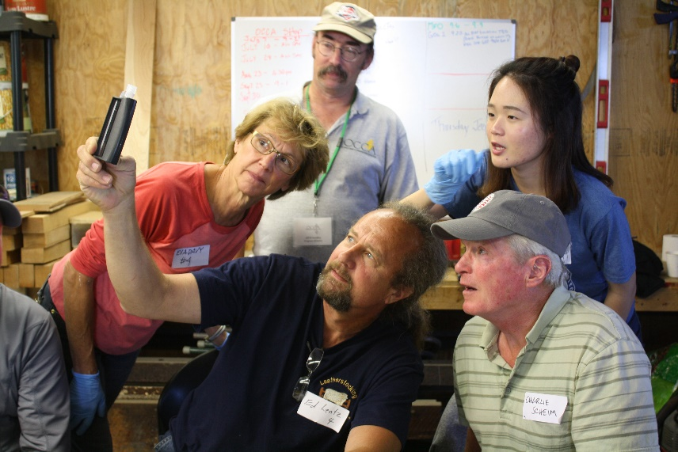
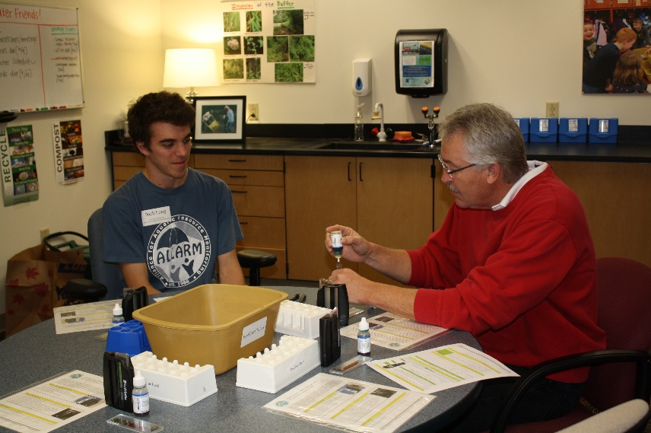
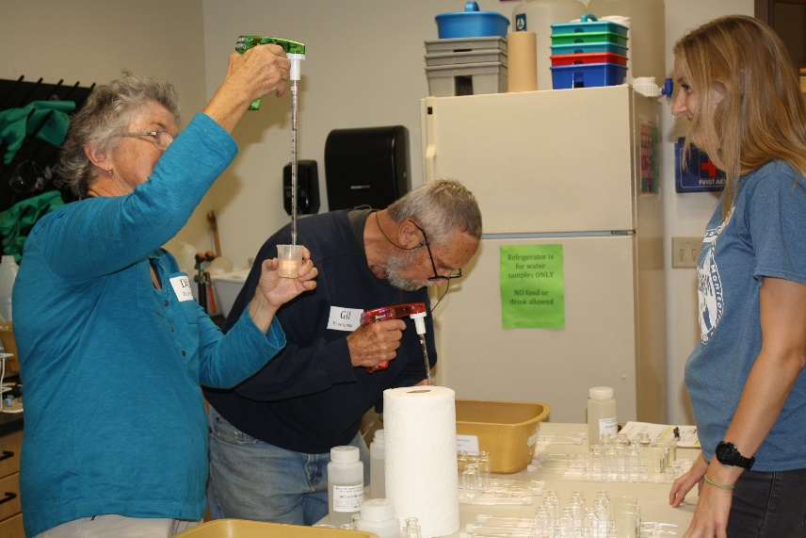
Where we are now
Study Design Workshops
6 completed
Water Quality Monitoring Training
11 completed
Macroinvertebrate Training
11 completed
Data Interpretation Workshops
To begin in 2018
Notes:
T1 and T2 groups – currently working with 18 groups.
Goal is to complete 50 training sessions by 2021, with yearly goals of 6 trainings per year.
Data interpretation workshops are currently being developed. The draft workshop outline was submitted in June, the final methods and tools for data interpretation are on track to be completed by December 31, 2017. Workshops will begin in 2018.

Slide 15
Where we are now
Tier III Groups
Nanticoke watershed alliance is the first approved Tier III Group.
BlueWater Baltimore is next in line.
Next up, South River Federation, West/Rhode Riverkeeper and possibly MDE shellfish sampling.
Notes:
Nanticoke is the first approved T3 group for field parameters. They are also collecting nutrient samples but their lab is not a certified lab, so cannot be considered T3.
Blue Water Baltimore is just waiting on a finishing up a few action items to get their Audit completed and approved.
All Tidal groups – next step is to think about this process in Non-Tidal.

Slide 16
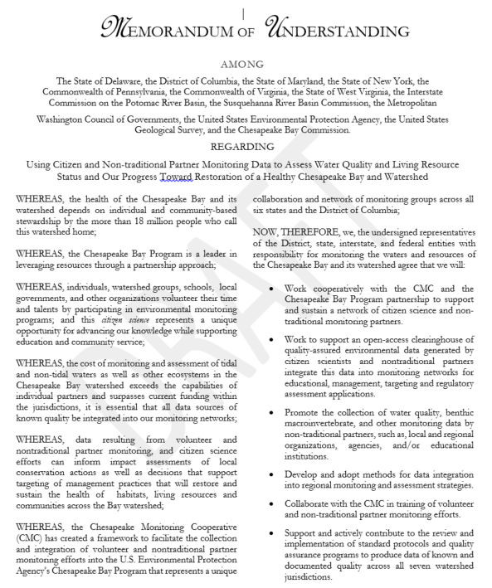
Coming Up
Memorandum of Understanding
Purpose is to forge a deeper understanding of and commitment to the use of citizen-based and other non-tradition partners’ monitoring data in individual partners and shared partnership decision making.
Notes:
Develop a Memorandum of Understanding (MOU), to be ultimately approved and signed at the state secretary level, structured after the 2004 Chesapeake Bay watershed monitoring network MOU. Provide a process that allows review of the MOU within the Partnership’s management structure, building greater understanding of and commitment to the use of monitoring data of known quality that is collected through citizen-based and other non-traditional partners and supporting’ decision- making on Bay and watershed restoration and protection.
Present a concept paper to the CBP Integrated Monitoring Networks Workgroup (July 19) followed by the Data Integrity Workgroup (August) and then STAR (September)
Consult with Carin Bisland and Kristin Saunders to develop a strategy to effectively navigate the CBP management structure to get the necessary level of support (September)
Present the concept paper to the CBP GIT coordinators and staffers to gauge their respective GIT’s interest in getting more directly involved in its development, review and approval ( (October-December)
Brief the Partnership’s advisory committees (Fall/winter quarterly meetings)
Meet with CBP signatories to discuss the MOU and identify concerns and refine the MOU (December 2017-Janury 2018)
Get on the agenda for the Management Board (February 2018)
Present the draft MOU and larger context and importance to the Partnership to the Principals’ Staff Committee and seek approval to circulate for final approval and signatures (Spring 2018)

Slide 17
Coming Up
Memorandum of Understanding
Tiered Framework
Use of non-traditional data and the Chesapeake Data Explorer
Standardized QAPPs and monitoring protocols
Training
Notes:
Develop a Memorandum of Understanding (MOU), to be ultimately approved and signed at the state secretary level, structured after the 2004 Chesapeake Bay watershed monitoring network MOU. Provide a process that allows review of the MOU within the Partnership’s management structure, building greater understanding of and commitment to the use of monitoring data of known quality that is collected through citizen-based and other non-traditional partners and supporting’ decision- making on Bay and watershed restoration and protection.
Present a concept paper to the CBP Integrated Monitoring Networks Workgroup (July 19) followed by the Data Integrity Workgroup (August) and then STAR (September)
Consult with Carin Bisland and Kristin Saunders to develop a strategy to effectively navigate the CBP management structure to get the necessary level of support (September)
Present the concept paper to the CBP GIT coordinators and staffers to gauge their respective GIT’s interest in getting more directly involved in its development, review and approval ( (October-December)
Brief the Partnership’s advisory committees (Fall/winter quarterly meetings)
Meet with CBP signatories to discuss the MOU and identify concerns and refine the MOU (December 2017-Janury 2018)
Get on the agenda for the Management Board (February 2018)
Present the draft MOU and larger context and importance to the Partnership to the Principals’ Staff Committee and seek approval to circulate for final approval and signatures (Spring 2018)

Slide 18
Coming up: Working with Local Governments
MS4 Permit Goals:
Education and outreach
Detection of illicit discharges
Monitoring Goals:
Lab services (WWTP)
Funding for equipment
What are the needs of local governments?
How can monitoring meet those needs?
Notes:
City of Richmond example.

Slide 19
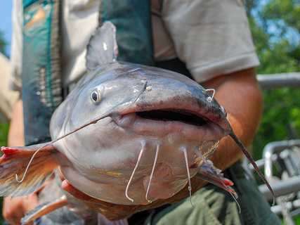
Questions?
Credit: Chesapeake Bay Program

