Slide 1
Benthic Monitoring to fill in gaps in the Stream Health Indicator
In partnership with the Chesapeake Monitoring Cooperative monitoring network

Slide 2
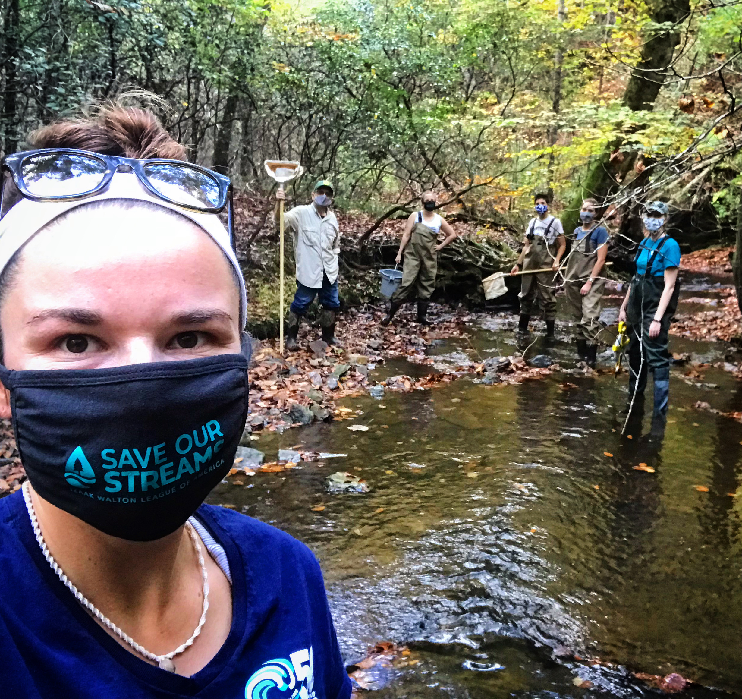
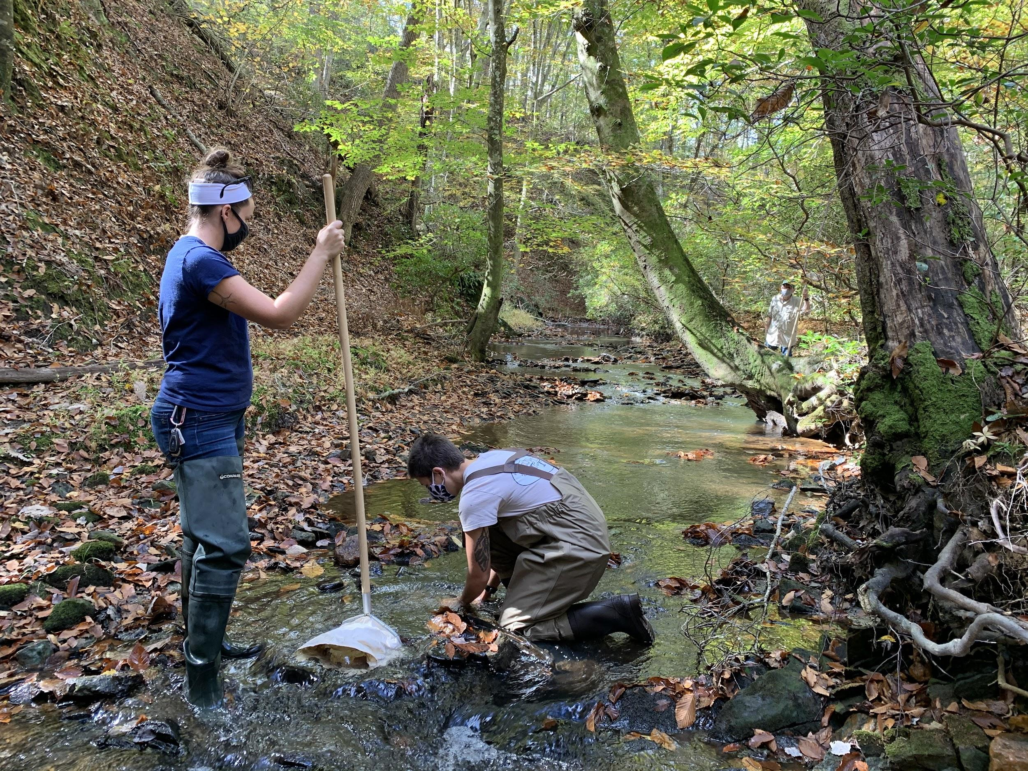
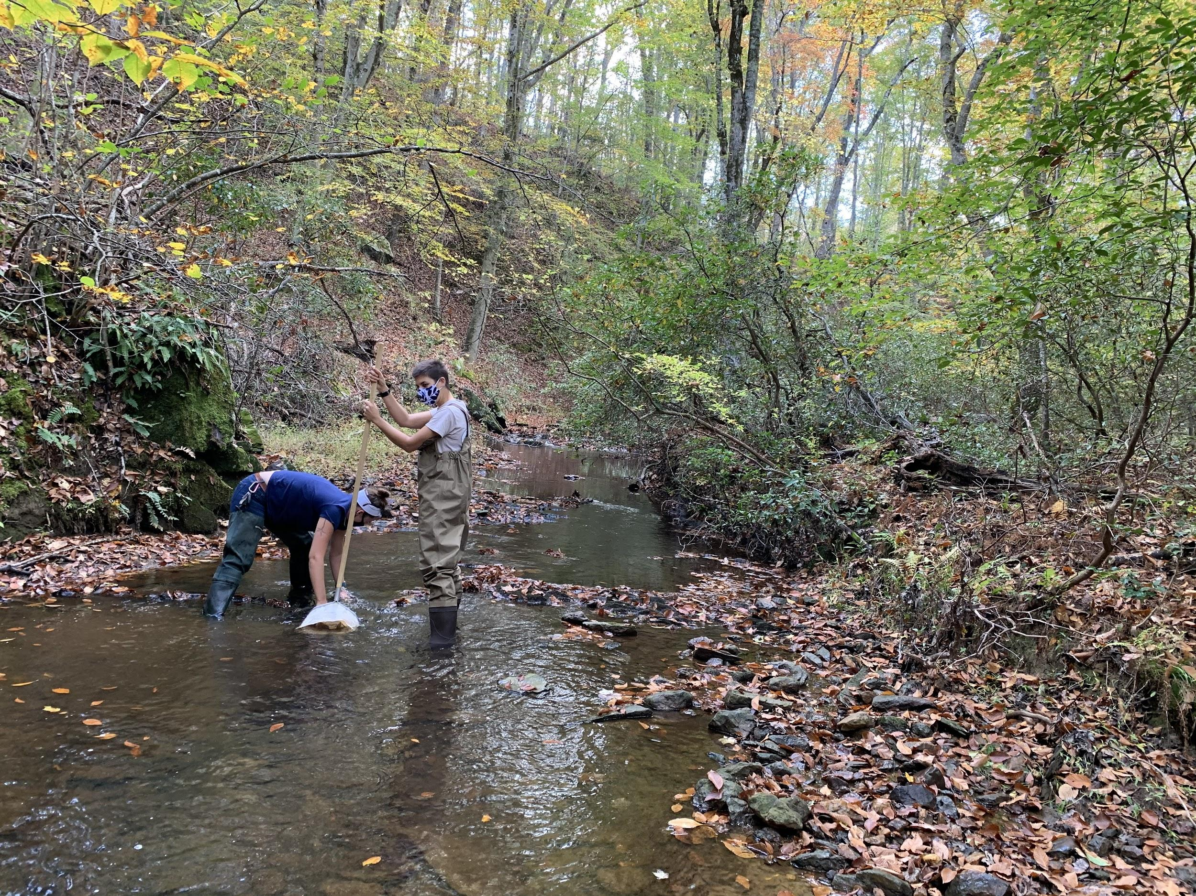
Background
Objective: Fill in HUC12 gaps in benthic data for the Stream Health indicator
Protocol: Collect benthic samples analyzed to family level by Wheeling Lab.
Worked with Claire, EPA Wheeling Lab and referenced Streamwaders, PADEP and DEQ protocols to create a volunteer accessible protocol.
Goal: Collect 100 samples to be processed by Wheeling lab in next 3-5 years with the CMC team and trained volunteers in undersampled rocky bottom (non-tidal) streams.
Approximately 10 samples in 2021
Ask Today: Help us prioritize watersheds/sites to sample

Slide 3
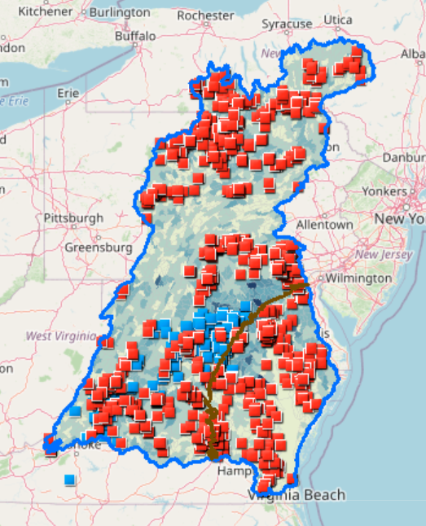
Prioritization
HUC12 watershed that have:
0 samples (white) or 0-5 samples (light blue)
Current or historic benthic or chemical CMC monitoring sites
Focus on CMC project team staff locations - Richmond, Gaithersburg, Carlisle
Are there any other considerations to prioritize HUC12 watersheds?
Land use
https://chesbay.maps.arcgis.com/apps/webappviewer/index.html?id=5deb49aee21e4878918c5ddc1236269b

