Slide 1
Conowingo Dam
Date

Slide 2
What is the Conowingo Dam
Hydroelectric generating station
One of three dams on the lower Susquehanna River
Began operations in 1928
Owned and operated by Exelon Corporation
Impounded water formed the Conowingo Reservoir
Notes:
Hydroelectic dams do not require any fuel source to run. The dams rely on the force of water to sustain electricity production.
Conowingo dam is located on the lower Susquehanna River approximately 10 miles upstream from the mouth of the Chesapeake Bay in the Town of Conowingo, Maryland.
The Susquehanna River delivers an average of 25 billion gallons of fresh water into the Chesapeake Bay each day.
The dam has captured sediment and nutrient pollution carried downstream by the Susquehanna River for 90 years.

Slide 3
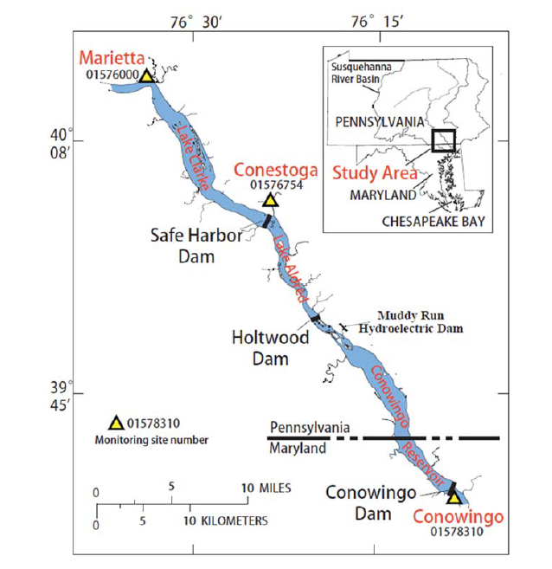
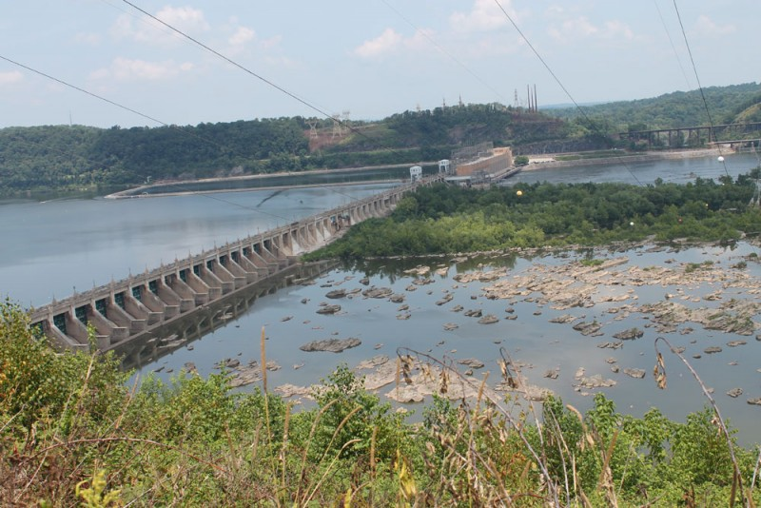
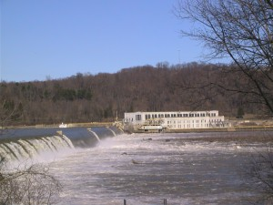
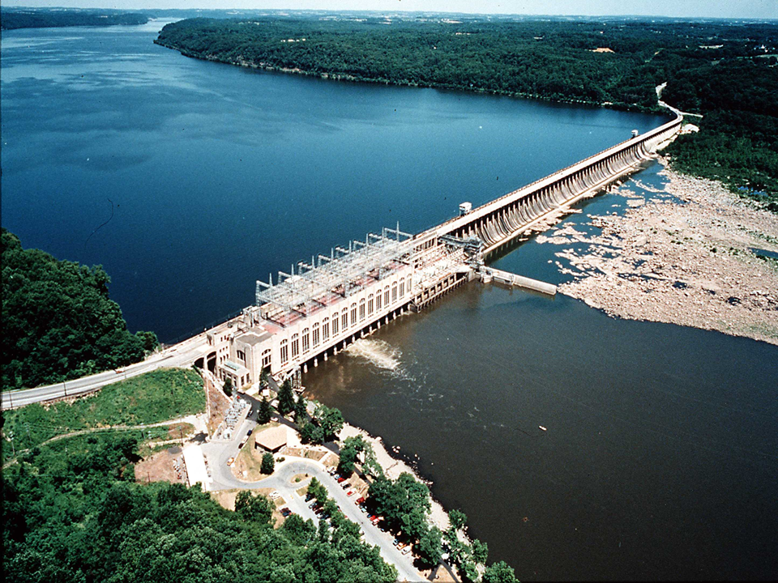
Lower Susquehanna River Reservoirs
Safe Harbor (Constructed 1931)
Safe Harbor (Constructed 1931)
Holtwood (Constructed 1910)
Conowingo (Constructed 1928)
Notes:
The Safe Harbor, Holtwood and Conowingo dams are located along the Susquehanna River. The Safe Harbor and Holtwood dams are located in Pennsylvania and the Conowingo dam, as mentioned, is located in Maryland.

Slide 4
Conowingo Reservoir Serves Many Purposes
Drinking water supply for Baltimore, MD
Cooling water for a nuclear generating station
“Pollution gate” that captures sediment and nutrient pollution before it can enter the Chesapeake Bay
Notes:
Serves as a “pollution gate” by trapping sediments and nutrients that runoff from the river (including agricultural, suburban, stormwater and urban runoff) and preventing them from entering the Chesapeake Bay.
At this time, the storage capacity of the dam is estimated to be trapping as much as 2% of nitrogen, 45% of phosphorus and 70% of sediment flowing downstream.

Slide 5
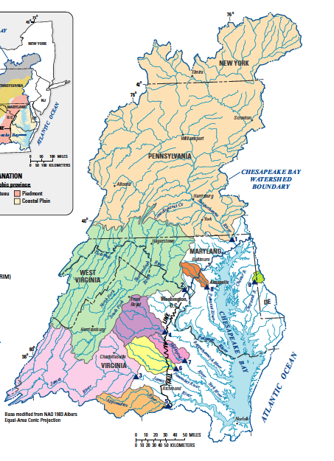
Susquehanna River Has a Major Influence on Chesapeake Bay Water Quality
Susquehanna watershed
50% of freshwater flow into the Bay
Picks up agricultural, suburban, stormwater and urban runoff along its journey.
Influences Bay water quality well into Virginia’s portion of the Bay
Potomac watershed
Notes:
The Susquehanna River begins in upstate New York and flows through Pennsylvania into Maryland.
The Susquehanna River contributes one-half of the freshwater flowing into the Chesapeake Bay.
The Susquehanna River, beginning in upstate New York, picks up agricultural, suburban, stormwater and urban runoff as it flows through Pennsylvania into Maryland.
Over the years, the phosphorus and sediment trapped by the Dam have built up to the point where the storage capacity of the reservoir behind the Dam is almost full.

Slide 6
Why is the Conowingo Reservoir Reaching Capacity?
Overtime, sediment and nutrients in the reservoir have built up to near capacity
Susquehanna River carries sediment and nutrients downstream
Sediment settles out of fast-moving river flows when Susquehanna reaches the reservoir
At total capacity, dam’s storage will be half-full with sediment
Notes:
Overtime, the sediment in the reservoir has built up to where it is losing its storing capacity.
The storage capacity of both the Holtwood and Safe Harbor dams reached capacity several decades ago.
The fast-moving Susquehanna Rivers carries sediment and attached nutrients as it flows downstream.
The river enters the reservoir where the flow slows dramatically allowing the sediment to drop out of suspension and settle to the bottom of the reservoir.
When the storage capacity is met, the sediments and nutrients currently being trapped will instead flow downstream and into the Bay.
When at total capacity, the Dam’s storage will be half-full with sediment.

Slide 7
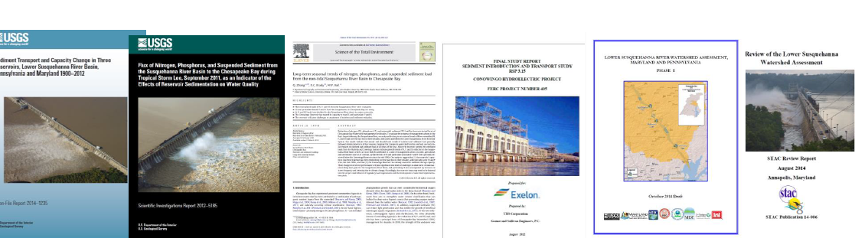
What’s the Problem?
Since the Bay TMDL was established in 2010, new models, monitoring data and research have indicated conditions have changed
Recent publications indicate the reservoir’s sediment-trapping capability has declined substantially
Trapping efficiency was observed under many flow conditions, including during storm flows
Notes:
Since the Bay TMDL was established in 2010, new models, monitoring data and research have indicated conditions have changed.
Recent publications from the USGS and Johns Hopkins University indicate that the reservoir’s sediment trapping performance has declined substantially since around 2000.
Trapping efficiency was observed under many flow conditions, including during storm flows.
A 1997 USGS report estimated that the dam has accumulated, at that time, 174 million tons of sediment; 670,000 tons of nitrogen; and 130,000 tons of phosphorus.
In 2015, USGS reported that the dam had reached 92% capacity.
U.S. Geological Survey (USGS) (2012, 2014, 2015)
U.S. Army Corps of Engineers (2015)
Johns Hopkins University (2013, 2015, 2016)
CBP Scientific and Technical Advisory Committee (2014, 2016)
Enhanced Monitoring and Modeling funded by Exelon and conducted by Gomez and Sullivan, University of Maryland and USGS (2014-2016)

Slide 8
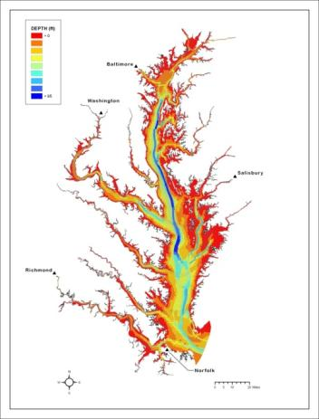
New Models, Monitoring and Research Since 2011 Indicate Conditions Have Changed
Chesapeake Bay Modeling Tools
Improved inputs into the watershed model
Chesapeake Bay modeling tools used to evaluate attainment of state water quality criteria.
Refinements to sediment-nutrient interactions
Recent monitoring data
Chesapeake Bay Water Quality and Sediment Transport Model
Notes:
The newest version of the suite of Chesapeake Bay modeling tools is known as Phase 6. Its simplified structure makes it easier to use.
The Phase 6 Suite of Modeling Tools includes expanded and improved data about:
• The sources and amount of nutrients entering the water; •
The latest, cutting-edge high-resolution land cover data from satellites; and
• New and updated information about the efficiencies of pollution-reducing best management practices.

Slide 9
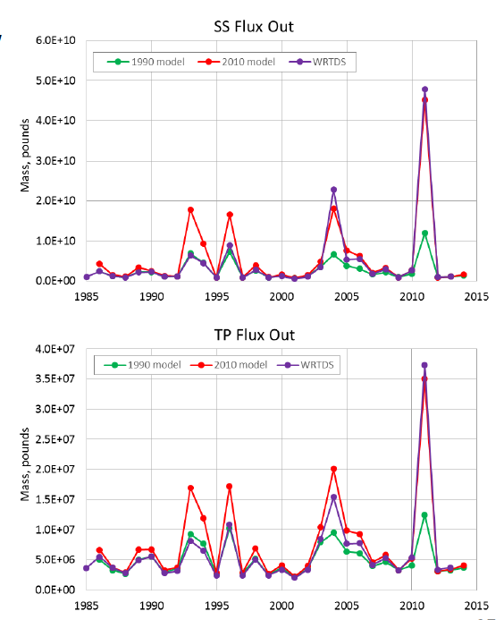
New Models, Monitoring and Research Since 2011 Indicate Conditions Have Changed (cont.)
New Phase 6 model captures reservoir behavior under various flow and infill conditions
The model also more explicitly represents the tendencies of nitrogen and phosphorus released by the sediments associated with the dam
TMDL Critical flow period
Notes:
The Phase 6 Suite of Modeling Tools can also simulate the environmental impacts of population growth, climate change and sediment build-up behind the Conowingo Dam (on the Susquehanna River in Maryland), which helps decision makers explore options for addressing these factors.

Slide 10
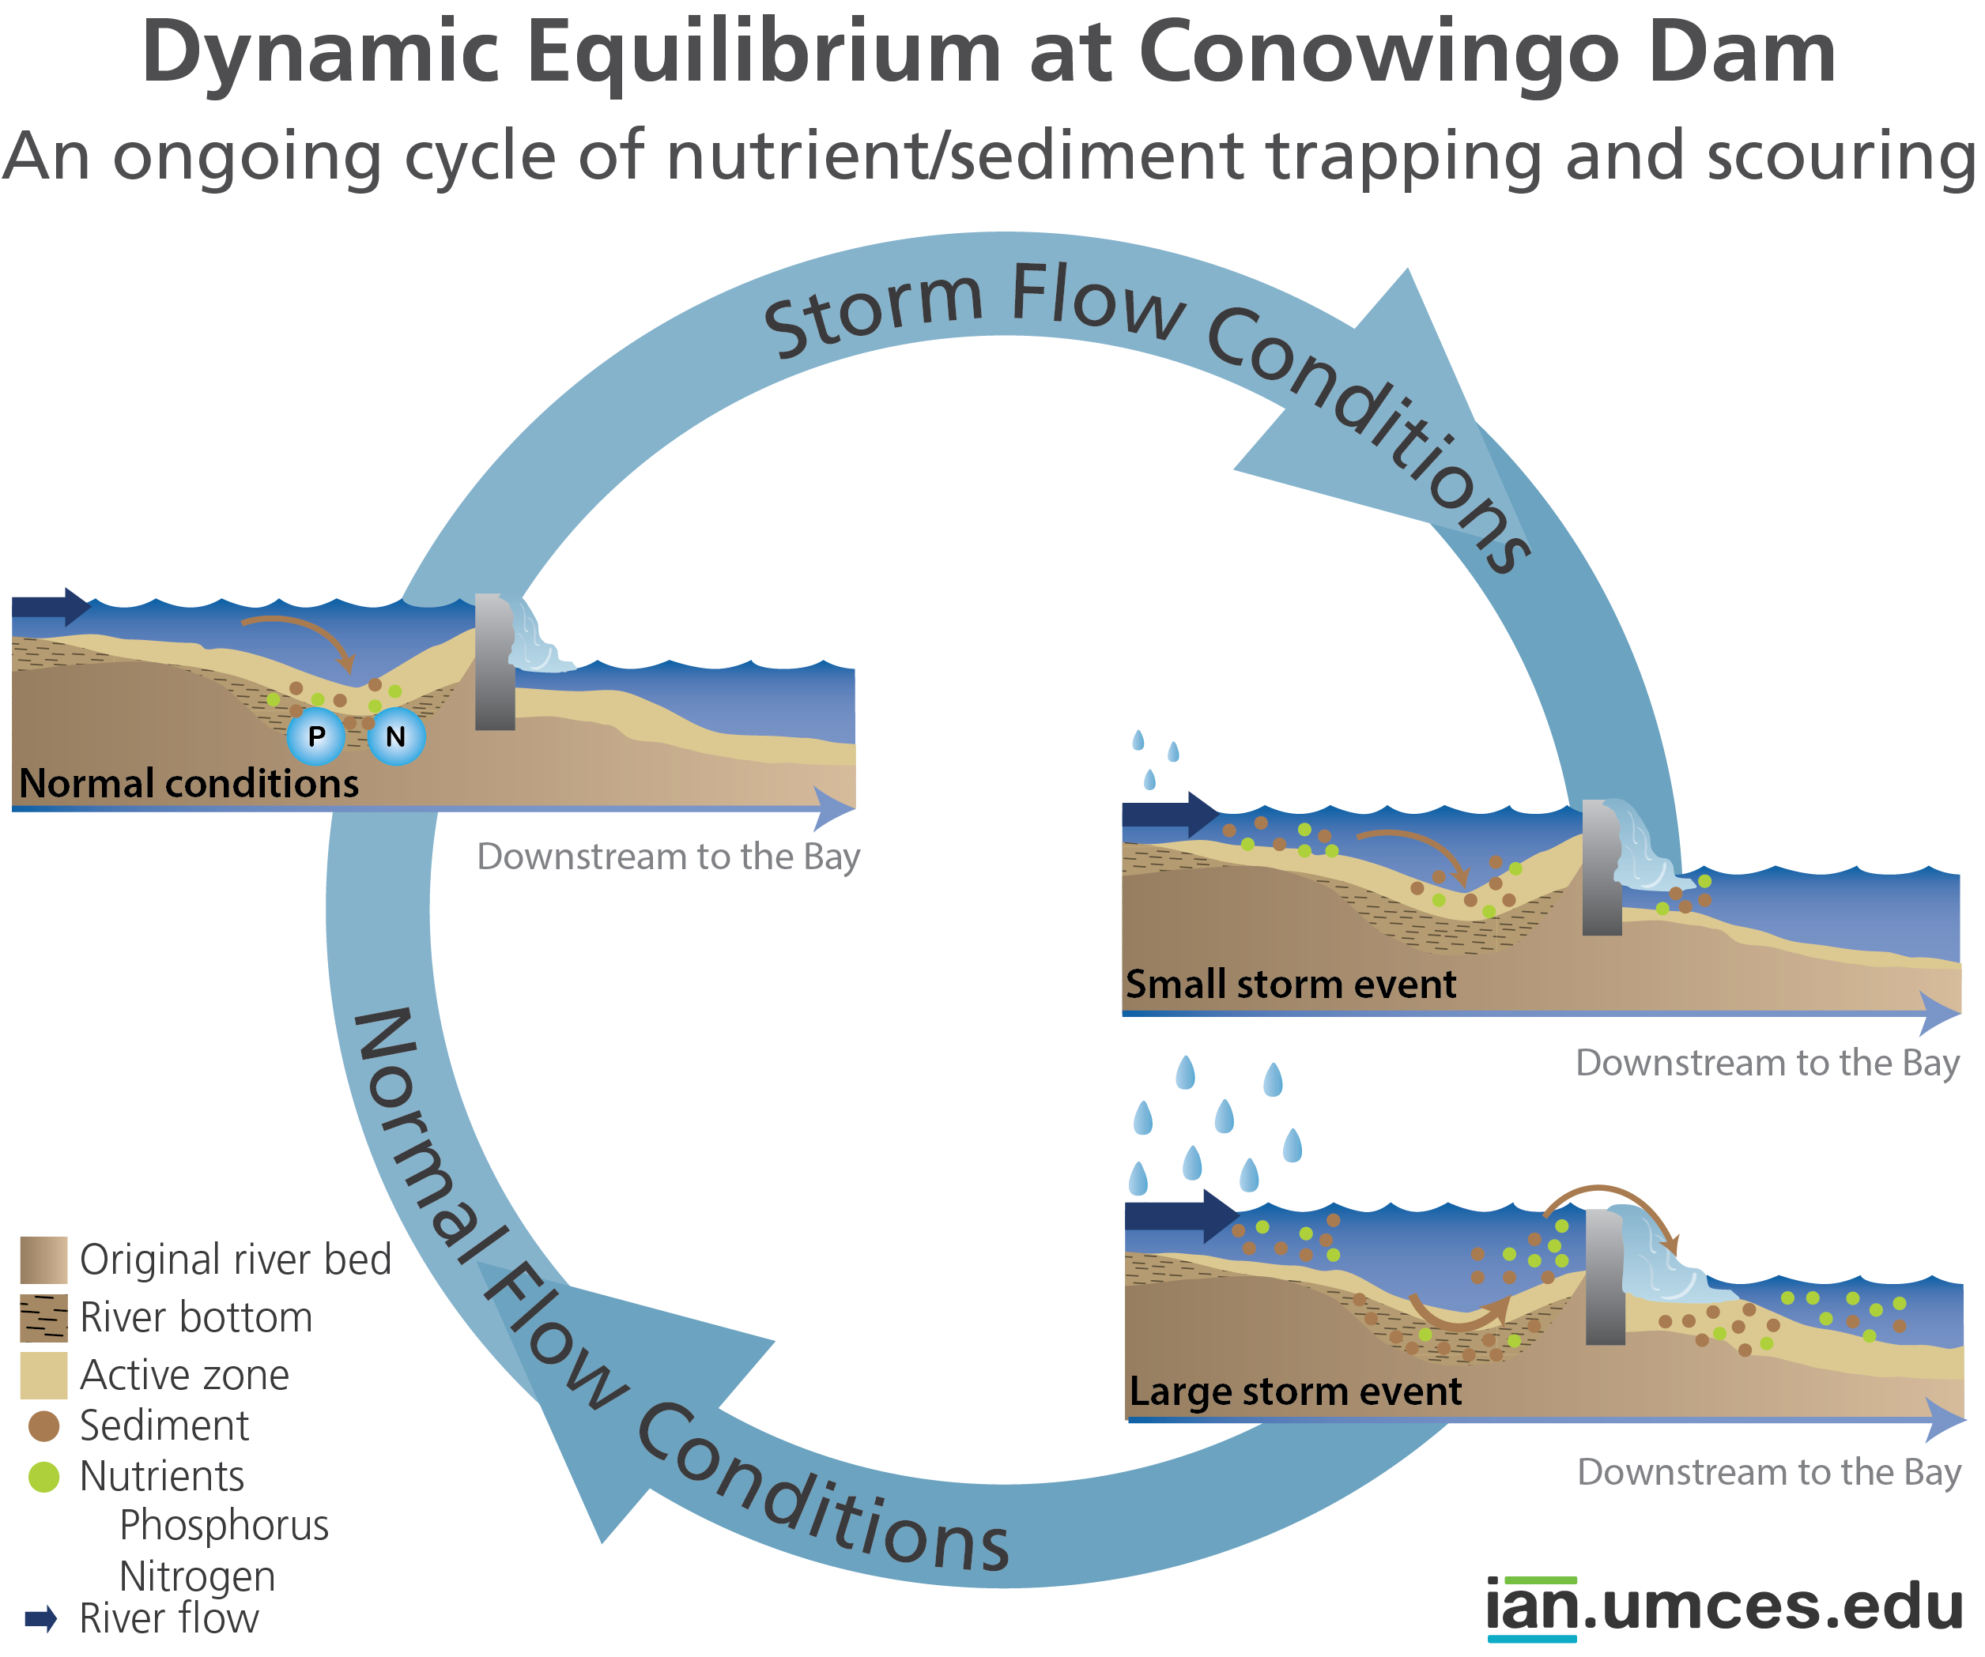
What are the Consequences?
Large of amounts of sediments and attached nutrients enter the Bay, which is unhealthy for water quality and detrimental to aquatic habitats
Loss of trapping capacity
Threat of large storms and severe floods (Hurricane Agnes, Tropical Storm Lee)
Cyclic process
Notes:
Although the loss of trapping capacity will have the biggest impact on sediment, the nutrients entering the Susquehanna River upstream that attach to sediment flowing downstream will have a larger impact on the water quality of the Bay.
Sediment entering the Bay is unhealthy to water quality by clouding the water, clogging navigation channels, blocking sunlight from reaching aquatic habitats, and smothering bottom habitats. Nutrients attached to the sediment are released into the Bay, feeding the growth of algal blooms that die off and deplete oxygen necessary for aquatic life.
During large storms or severe floods, such as in 1972 with Hurricane Agnes or in 2011 with Tropical Storm Lee, the high flow of water from the Susquehanna scours sediment and attached nutrients from within the reservoir and carries it over the dam and into the Chesapeake Bay.
Storms create some storage in the reservoir in the short-term, but eventually the cycle is repeated.

Slide 11
How Does This Affect the Chesapeake Bay Cleanup Goals?
2010 - Original Bay cleanup goals were developed based on unchanging conditions in the reservoir and steady climate conditions
2011 - Additional studies indicated conditions have changed
2017 - Midpoint Assessment determined the need for new sediment and nutrient load reduction goals
Notes:
TMDLs developed in 2010 were based on modeling that assumed unchanging condition and steady climate conditions beginning in 1990 and continuing through 2025.
Additional studies have indicated that the reservoir’s trapping efficiency has declined substantially.
As part of the midpoint assessment, the Chesapeake Bay Program partners assessed the trapping capacity of the Conowingo and other dams in the watershed. They determined the need to establish and implement new sediment and nutrient load reduction goals to assist in restoring the health of the Chesapeake Bay.

Slide 12
Several Possible Solutions are Under Consideration
Sediment flowing downstream has decreased
Dredging (pros/cons)
Bypassing
Changing operations
Reducing upstream nutrient and sediment loads through Bay TMDLs and supporting WIPs
Notes:
The sediment flowing downstream has greatly decreased over the past several years, thanks in part to lower-than-average rainfall and better soil management practices.
The sediment trapped behind the dam contains not only sand and soil, but significant amounts of other materials including coal, toxic metals, PCBs and the list goes on.
Sediment is extremely small and hard to catch in the water.
Sediment transported for disposal (filled with these pollutants) could leach into soil and water.
The dredged sediment could be turned into a marketable product (e.g., construction materials).
Bypassing or changing operations could minimize sediment deposition, but would be expensive.
Although managing sediment behind the dam is possible, researchers have found that reducing upstream nutrient and sediment pollution would be more beneficial to the Bay overall and more cost effective.

Slide 13
Next steps (cont.)
Principals’ Staff Committee (PSC) agreed to the development and implementation of a separate WIP for Conowingo Dam
PSC agreed to pool resources in areas with the most impact on Chesapeake Bay water quality
Independent third party will facilitate development and implementation of the Conowingo WIP
Collaboration of the partners
Notes:
In order to account for the increased pollution as a result of Conowingo Dam reaching capacity, the Principals’ Staff Committee agreed to develop a separate Conowingo Dam planning target, with its own WIP.
The Committee agreed to pool resources in areas determined to have the most impact on Bay water quality.
A representative from every partner will work together to develop the WIP, which will include the determination of a fund manager; assignment of specific jurisdictions load reduction responsibilities; and working with EPA and other federal partners on federal funding allocations.
The WIP will take into account a number of items including local government and public engagement strategies, the identification of specific reduction practices, timeline, funding sources, determination of any gaps and how to address them.

