Slide 1


Local Planning Process…
Citizen Advisory Committee
May 23, 2018

Slide 2
Objectives – The Phase 3 WIP Story
What and Why
Planning Targets, Local Goals
Progress
Why is this Important?
Where – By County
Who (This Means Us) and When
Action items, Measurable outputs and outcomes, timelines
Milestones, Progress Reporting, Indicators
Other
How
Local Planning Goal Workgroup Toolbox
Watershed Agreement Outcomes and Indicators
Bay Program and SRBC Resources and Modeling Tools

Slide 3
How do we determine “local”?
Source:
Matt Johnston, University of Maryland
Step 1: Convert any Chesapeake Bay “diet” into a local PA stream diet.
CBP Model has estimates of nutrient and sediment delivery from the field to local streams through large rivers and to the Bay.
Pounds of pollutant delivered to the Bay can be expressed as pounds delivered to local streams using these factors.
If 73.18 M lbs of Nitrogen delivered to the Bay is PA’s Chesapeake Bay “diet”, that number is equivalent to 108.06 M lbs of Nitrogen delivered to local streams.
111.06 M Lbs
(Local Streams)
73.18 M Lbs
(Bay)

Slide 4
Step 2: Choose a geography to split up the diet.
Small watershed – Swatara Creek (122)
County – Berks (43)
Sub-basin – Lower Susquehanna River (6)
River basin – Susquehanna River (3)
Source:
Matt Johnston, University of Maryland
Land-River Segments (LRSEG) - 505
Rivers - 122
Counties - 42
Sub-Basins - 6

Slide 5
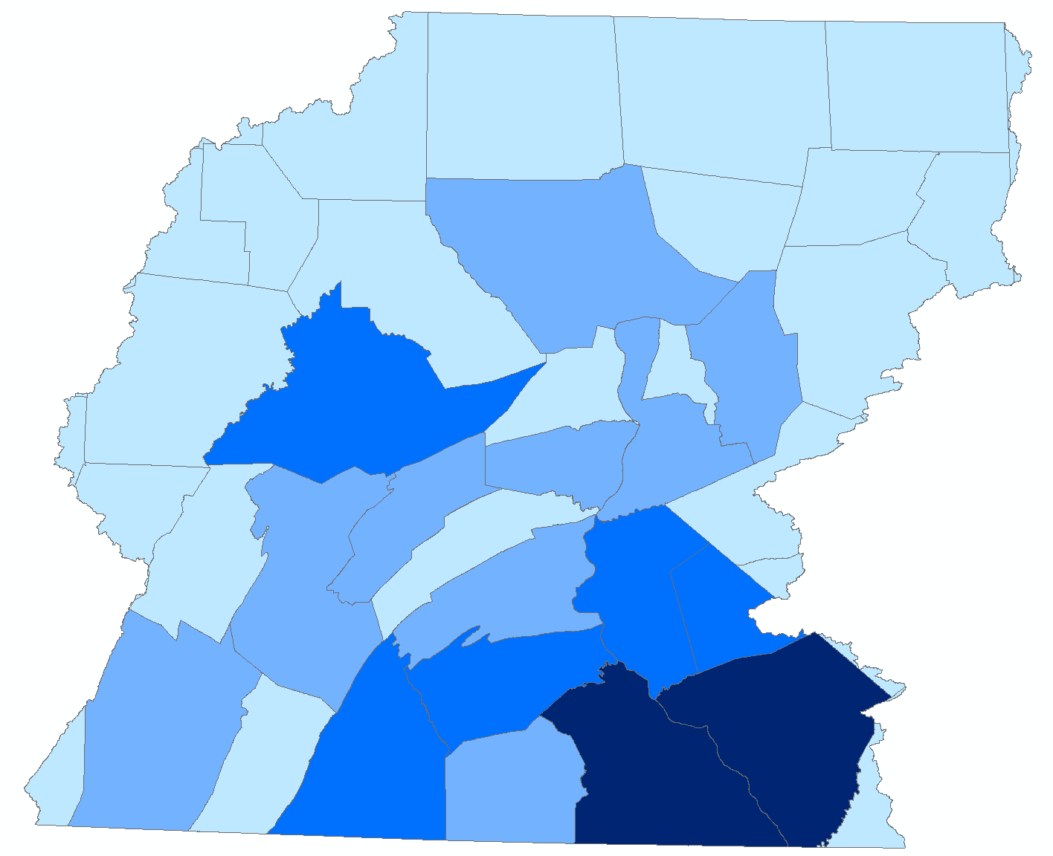
Where Should Efforts be Targeted?
Source:
Matt Johnston, University of Maryland
Tier 1 - First 25% of Reductions
Tier 2 - Second 25% of Reductions
Tier 3 - Third 25% of Reductions
Tier 4 - Last 25% of Reductions

Slide 6
Source:
Matt Johnston, University of Maryland
Loads Already Reduced as of 2016.
Reduction Needed from 2016.
Controllable Load that does NOT Need to be Reduced.
Loads that are Uncontrollable
Tier 4 (Final 25% of Reductions)
Purpose of the Phase III WIP is to describe programs and policies that will eliminate the green bar in each county (or geography of choice).
Tier 3 (Third 25% of Reductions)
Tier 2 (Second 25% of Reductions)
Tier 1 (First 25% of Reductions)

Slide 7
Tier 2 (Second 25% of Reductions)
Tier 1 (First 25% of Reductions)

Slide 8
Existing Programs/Enhancements -- PROPOSED
Permitting, Compliance and Enforcement Initiatives
Agriculture-
Manure Management
Act 38
Agriculture Erosion and Sediment Control
Stormwater-
MS4s and PRPs
Refinements in Next Permit Cycle
Non-MS4 Communities
Wastewater-
Existing Permit Caps
Non-Significant Facilities
ENR at Significant Facilities
Septics
Connections to Treatment Facilities
Nutrient Treatment on on-lot Systems
Technical/Financial Assistance and Outreach
Agriculture –
Soil Health (PA in the Balance)
Expanded Nutrient Management
Manure Treatment, Storage and Transportation
Riparian Ecosystems
Stormwater-
“Trees and Pollinators”
Stream Restoration
Forestry (Sector Growth)
Riparian/Forest Buffers
Protected Lands/Land Conservation
Agriculture and Forest
Tree Canopy

Slide 9
Level of Effort – Conceptual Framework
Potential progress with new and existing state agency programs
+
Local Initiatives
Progress from 1985 through 2016
Permitting, Compliance and Enforcement Initiatives
Technical and Financial Assistance and Outreach Initiatives
Reductions Already Made
Customized Partnership by County
Hypothetical journey to a county goal (nitrogen)

Slide 10
Pennsylvania – Nonpoint Source Opportunities
Agriculture
33,000 Farms, < 400 CAFOs or CAOs with a NPDES Permit
All must comply with Manure Management and Agriculture Erosion and Control Plan Regulations
Nitrogen Loading from Lancaster = Delaware + West Virginia + DC = New York = 21% of needed reduction for Pennsylvania
Urban Stormwater
Nearly 75% of developed acres are outside of an MS4 or combined sewer system area.
Existing Permitting and Compliance Programs cover very little of the urban sector’s contribution
Wastewater
Met the required 2017 reduction goals 3 years early at a cost of $1.4 billion
Are on track to meet the 2025 goals without further enhancements
Notes:
There is a new focus in Pennsylvania on accomplishing local water quality and other local environmental restoration goals through the planning efforts of the Phase 3 WIP. There is very little low hanging fruit, so to speak, in Pennsylvania, since very little of our loads come from a source covered by a permit that can easily be established, monitored and enforced.
Wastewater was successful because:
Collaborative effort, enforceable goals were established and put into permits where compliance is easily measured and penalties taken accordingly.
Once goals were set, everyone was on board, it just becomes a matter of money … $1.4 billion to be exact.
We can do the same for nonpoint source:
Collaboration and partnerships are hard, but can be accomplished with established goals.
Once the goals are set, where is the money and resources going to come from?

Slide 12
Bay Program “Stacking” Efforts
Brook Trout
Climate Resiliency
Fish Habitat
Forest Buffers
Healthy Watersheds
Protected Lands
Public Access
Stream Health
Submerged Aquatic Vegetation
Toxic Contaminants
Tree Canopy
Wetlands

Slide 13
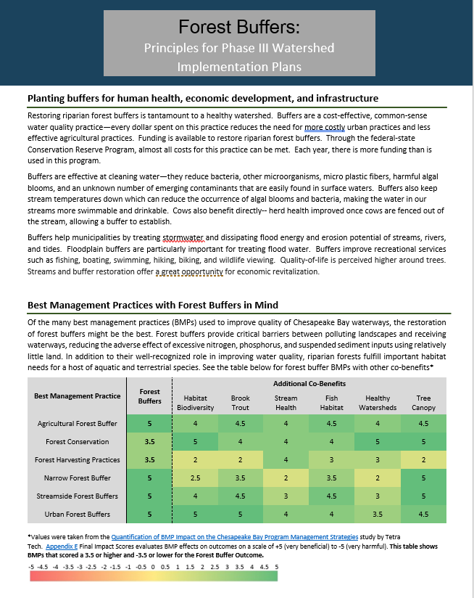
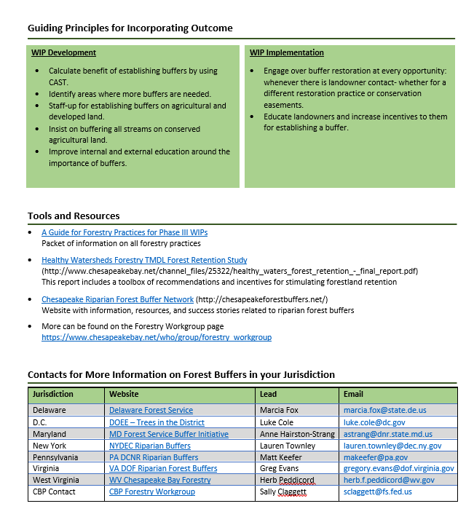
Templates

Slide 14

Countywide Plan Development -- Steps
Convene Countywide Action Team Members
Identify Water Quality and Other Goals
Identify Local Resources
Select and Report Actions
Implement Actions

Slide 15
Countywide Plan Development – Resources
Support Team
DEP Staff Person from Chesapeake Bay Office
Member of Technical Support Team
Members, as needed, of the Steering Committee Workgroups
County Planning Toolbox
County Specific Data
List of Resources and Contacts
Community Outreach Tools
Templates for Use in Completing the Action Plan

Slide 16
Countywide Plan Development – Series of Meetings
May –
Convening – Local Leaders Define Members and Process
June –
Background and Information Gathering
Identify Local Initiatives to Add
July/August –
Define action steps and potential reductions
Define Local Priorities
Refine Scoping Scenarios
Identify existing and needed resources
September –
Draft Action Plan for Submittal to DEP by October
Implementation Team Meetings
Follow Up Meetings as Needed as the Action Plan is Implemented

Slide 17
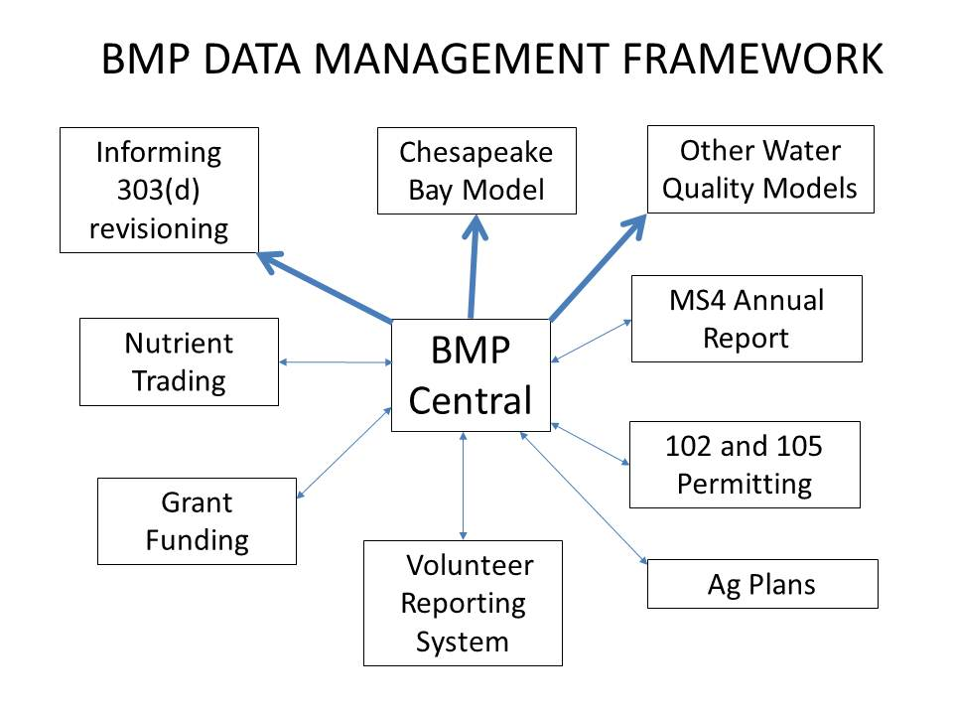


Milestones and Progress (Outputs)
BMP Verification Plan
Tracking and Reporting
Indicators of Progress
“PA Barometer”

Slide 18
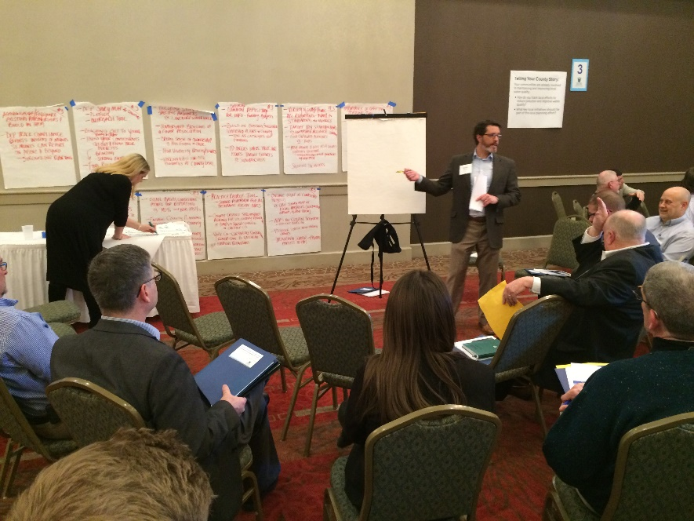
Local Engagement --
Developing a toolbox for county stakeholders to use in determining locally how they will meet their goal
Informed by sector-based work groups
April 10 – Local Planning Process Kickoff
Countywide Planning Goals – May through October
Pilot Process in 3 to 4 counties
Continued public engagement and input
Fact Sheets, Program Updates, Website
Forums, Regional Meetings – May through October 2018
Public Review and Comment Period on Draft WIP Plan – March 2019
Final Phase 3 WIP – June 2019

Slide 19
Contact Information:
Veronica Kasi
vbkasi@pa.gov
717-772-4053
DEP Chesapeake Bay Program Website:
http://www.dep.pa.gov/ChesapeakeBay
Phase 3 WIP Website:
www.dep.pa.gov/chesapeakebay/phase3

