Slide 1
Diversity Indicators
Measuring Community Outreach and Engagement
Crystal Zhao
June 25, 2021

Slide 2

National Estuary Programs do not (yet) track diversity
Nearly all 28 NEPs identify DEIJ and/or diverse stakeholder engagement as priorities, but none track how successfully DEIJ is being incorporated in community outreach and engagement.
Source: EPA
Notes:
Some have identified the need to develop diversity indicators but have not yet done so
Some track community engagement without DEIJ considerations
But restricted to underrepresented communities.

Slide 3
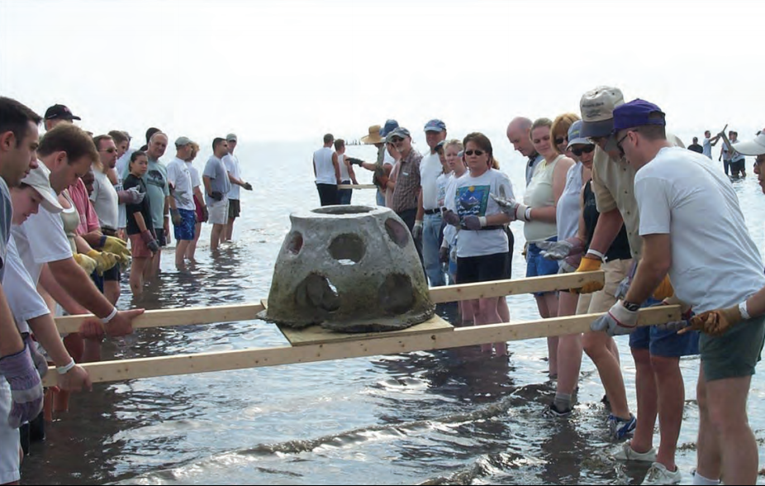
Some measures of community engagement may be applicable
Amount of community grants awarded (Casco Bay)
Number of staff that have participated in educational outreach (Coastal and Heartland)
Measuring participation at outreach events (Partnership for the Delaware)
Focus groups and surveys to evaluate perceived effectiveness of outreach/engagement (Partnership for the Delaware)
Source: Sarasota Bay Estuary Program

Slide 4
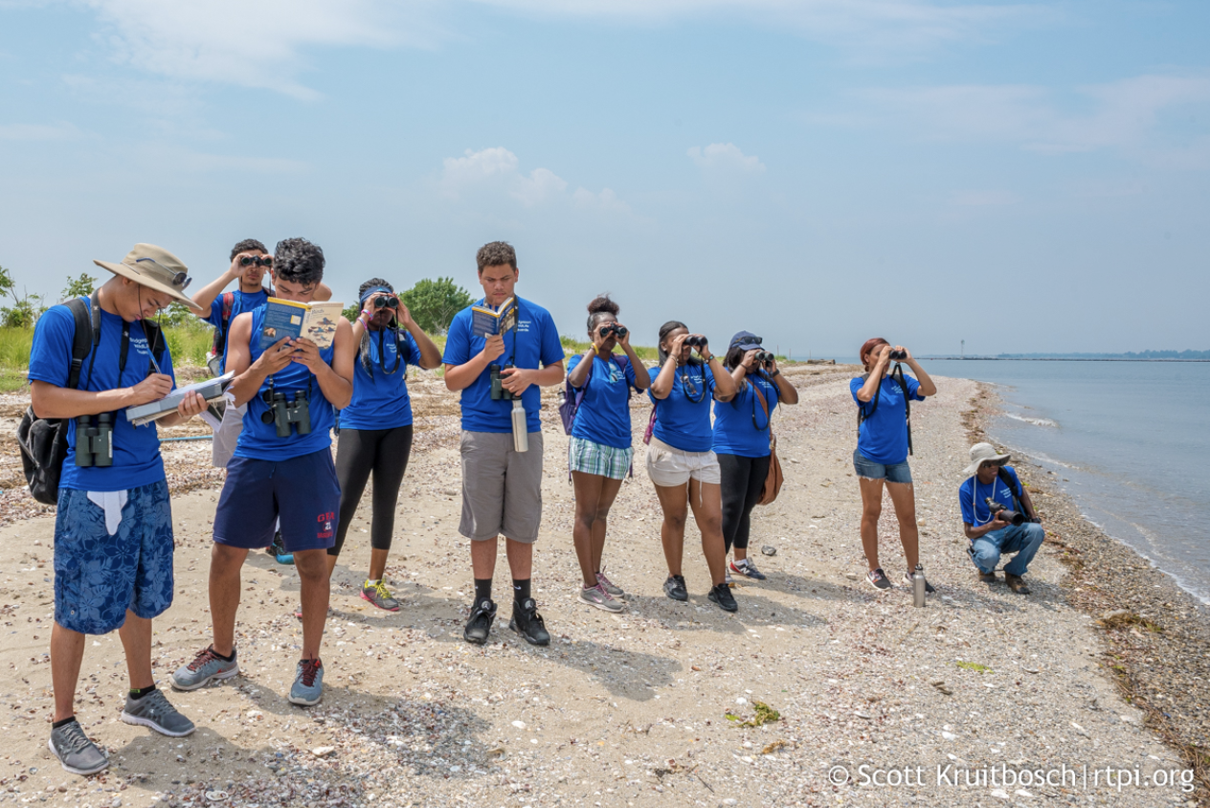
Some NEPs plan to develop community engagement and diversity indicators
Number of perceived barriers to participation among target audiences (based off Long Island Sound EJ outcome)
Source: Long Island Sound Study

Slide 5

Academic literature offers no ready-made diversity and community engagement indicator
Many indicators described in academic literature are ill-suited to measuring diversity and community engagement in the unique context of the Bay Program.
Source: Chesapeake Bay Program
Notes:
Research on effect of having more diverse stakeholders, not so much on how to measure diversity.
Eder 2018, trust measurement, social network inquiry.

Slide 6
Takeaways from scholarly findings
Questionnaire surveying is an established method of measuring existing stakeholder satisfaction (Li 2013)
Several studies reject purely quantitative measures of community engagement (Pearce 2007, Hart 2010, Napoli 2019)
Measuring the behavior/activity of participants can be a proxy for measuring number of participants (Schlemer 2008)
Principles of effective community engagement can be measures of engagement success (Wagner 2013)
Tracking number of projects that solicit public review is an established method of measuring community engagement in science research (Eder 2018)
Given the opportunity, communities articulate the value of engagement with external programs/institutions, and those values can sometimes be measured (O'Connor 2008, Franz 2014)
Notes:
Scope 11 external meeting, toward an understanding of what communities what out of their relationship with the Bay Program

Slide 7
References
Eder, M., Evans, E., Funes, M. (2018) Defining and Measuring Community Engagement and Community-Engaged Research: CTSA Institutional Practices. Prog Community Health Partnership 12(2). 10.1353/cpr.2018.0034
Franz, N. K. (2014) Measuring and Articulating the Value of Community Engagement: Lessons Learned from 100 Years of Cooperative Extension Work. Education Publications, 7. http://lib.dr.iastate.edu/edu_pubs/7
Hart, A., Northmore, S. (2010) Auditing and Evaluating University–Community Engagement: Lessons from a UK Case Study. Higher Education Quarterly, 65(1). https://doi.org/10.1111/j.1468-2273.2010.00466.x
Li, T. H. Y., Ng, S. T., Skitmore, M. (2012). Evaluating stakeholder satisfaction during public participation in major infrastructure and construction projects: A fuzzy approach. Automation in Construction, 29, 123-125. https://doi.org/10.1016/j.autcon.2012.09.007
Napoli, I. D., Dolce, P., & Arcidiacono, C. (2019) Community Trust: A Social Indicator Related to Community Engagement. Social Indicators Research, 145. https://doi.org/10.1007/s11205-019-02114-y
O’Connor, M., Spangenberg, J. H. (2007) A methodology for CSR reporting: assuring a representative diversity of indicators across stakeholders, scales, sites and performance issues. Journal of Cleaner Production 16(13). https://doi.org/10.1016/j.jclepro.2007.08.005
Pearce, J. & Pearson, M. (2007) The Ivory Tower and Beyond: Bradford University at the Heart of its Communities. https://talloiresnetwork.tufts.edu/wp-content/uploads/REAP_Report_Bradford_U.pdf
Schlemer, L., Oliver, J., Chen, K. (2008) Work in Progress: Outreach Assessment: Measuring Engagement. Cal Poly, San Luis Obispo Publications. https://digitalcommons.calpoly.edu/cgi/viewcontent.cgi?referer=https://scholar.google.com/&httpsredir=1&article=1088&context=ime_fac
Wagner, J. (2013) Measuring Performance of Public Engagement in Transportation Planning: Three Best Principles. Journal of the Transportation Research Board. https://doi.org/10.3141/2397-05

