Slide 1
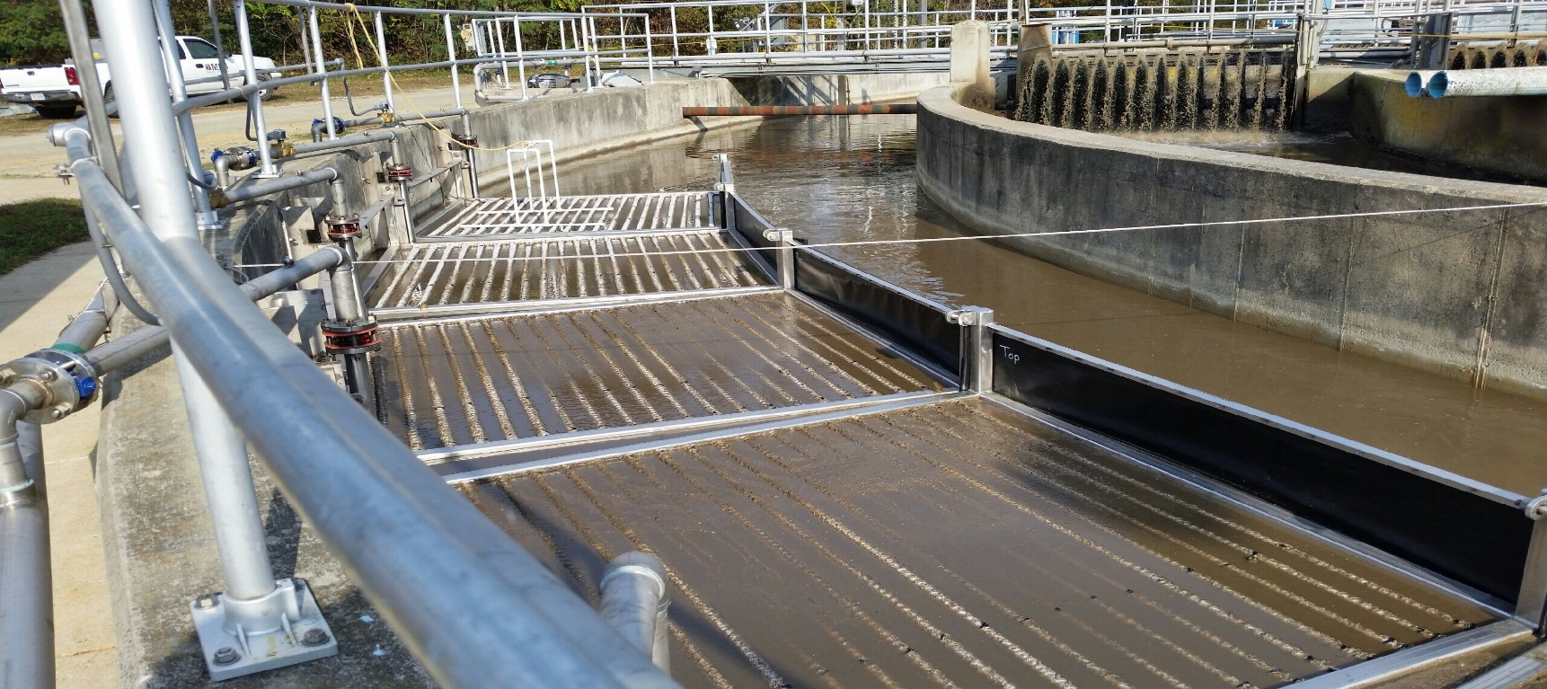
KING GEORGE COUNTY SERVICE AUTHORITY
DAHLGREN WWTP
NUTRIENT UPGRADE PROJECT

Slide 2
Christopher F. Thomas, P.E.
General Manager
King George County Service Authority
Civil Engineering Degree, Clemson University
Registered Professional Engineer in Virginia & Oklahoma

Slide 3
Why Did We Do This?
Compliance
Compliance
Compliance
Compliance with the Chesapeake Bay Preservation Act
Consent Order to Comply

Slide 4
What We Did
Reviewed and evaluated all available technologies with regards to our current operational situation
Selected Entex “Webitat” IFAS technology
Conducted real time parallel pilot testing of the selected option
Chose to pilot and install in a pre-anoxic configuration for various cost saving measures.
KGCSA was the first to utilize this technology in this configuration

Slide 5
Before Construction

Slide 6
After Construction

Slide 7
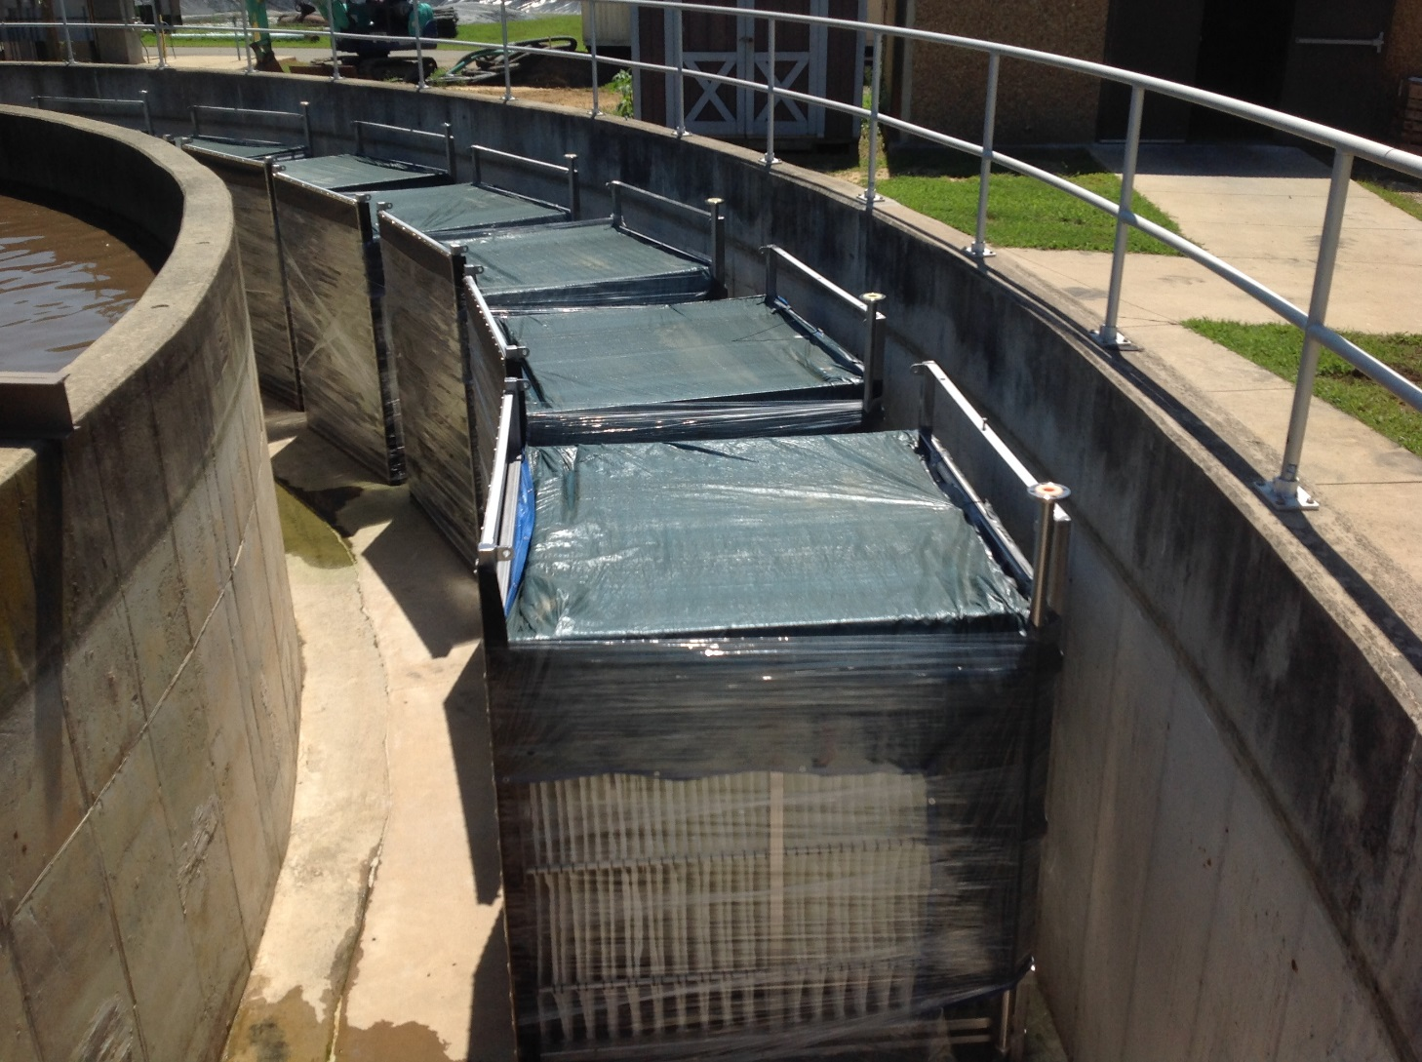
Entex IFAS Units In Place

Slide 8
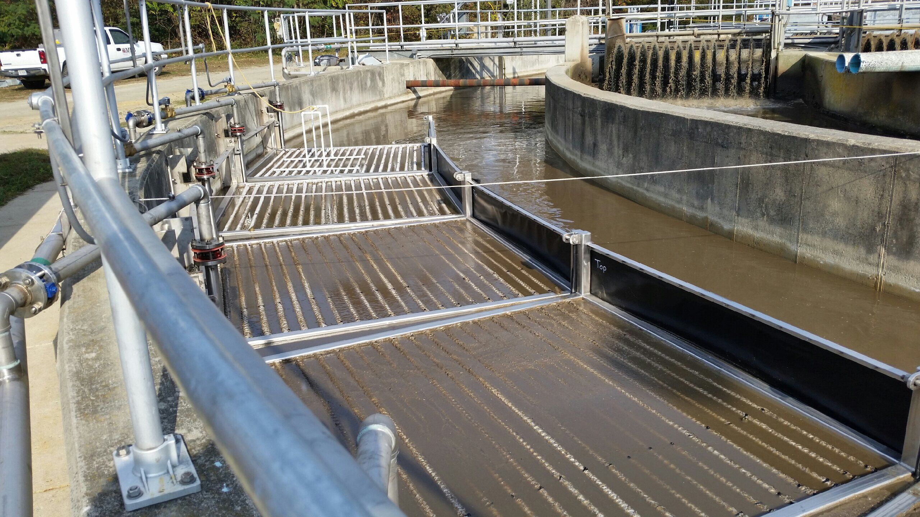
Entex IFAS Units In Use

Slide 9
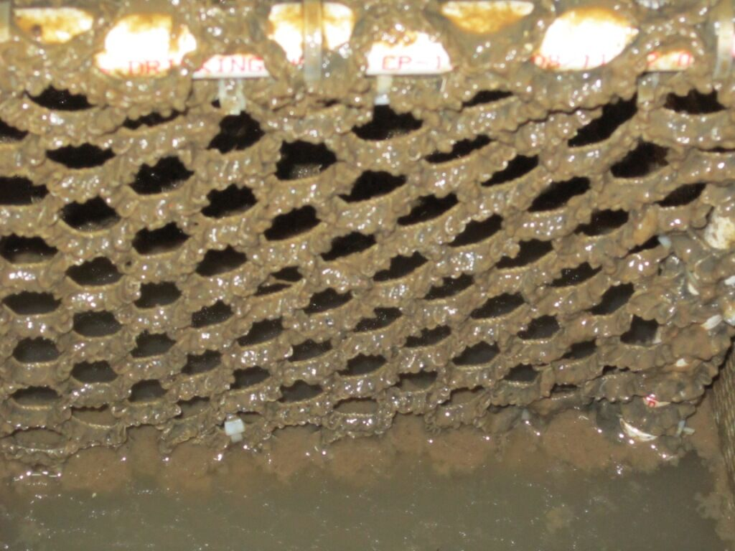
Closer View of IFAS Media

Slide 10
Benefits of Decision
Reduced construction footprint which allows for future expansion capacity while saving significant construction costs
Reduced operational costs from lower Supplemental Carbon feed rates
Allows for early detection of denitrification problems
Ease of maintenance and IFAS Unit Replacement
Flexible operation allows for pinpointing our effluent removal efficiencies while minimizing operational costs

Slide 11
Results of Decision
Successfully and Consistently removed Total Nitrogen and Total Phosphorus below 3.0 mg/L and 0.3 mg/L, respectively.
These are the most stringent permit limits to date.
Consistently achieve 90% to 98% removal efficiency of all organic nitrogen

Slide 12
Validation of Decision

