Slide 1

Landuse
Fairfax County, Virginia
Watershed Management Plans

Slide 2
Scope of task
Develop countywide land use/ land cover GIS data layers useful for plan development
Watershed characterization (i.e. maps, data analysis)
Pollution & Hydrologic modeling
Key requirements:
A layer containing a land use mix for both existing and future conditions
Key parameter for modeling water quality
A layer containing Impervious values (connected & disconnected) for both conditions
Key parameter for modeling water quantity

Slide 3
Available digital data
Tax Administration real estate records
Each record contained a unique code for each parcel:
Existing land use
Zoned land use
Adopted land use comprehensive plan
Polygons containing planned land use information
Twenty-two different planned land use categories
Parcel data
Polygons contained a unique ID for each parcel
Included vacant & underutilized parcels
Planimetric data (1997 aerial photography)
Codes > 200 types

Slide 4
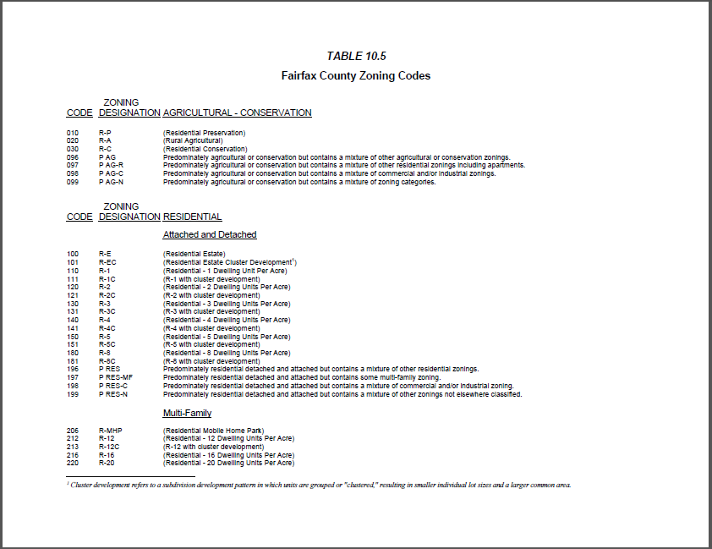
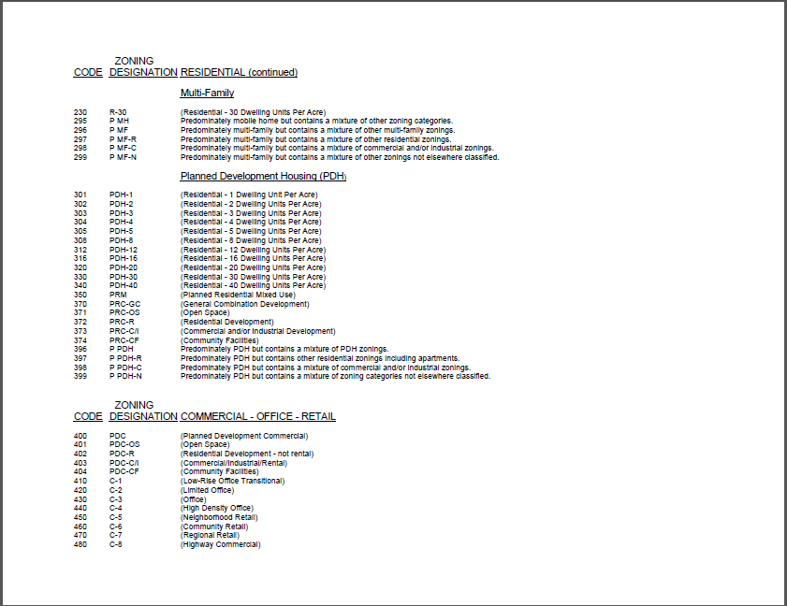
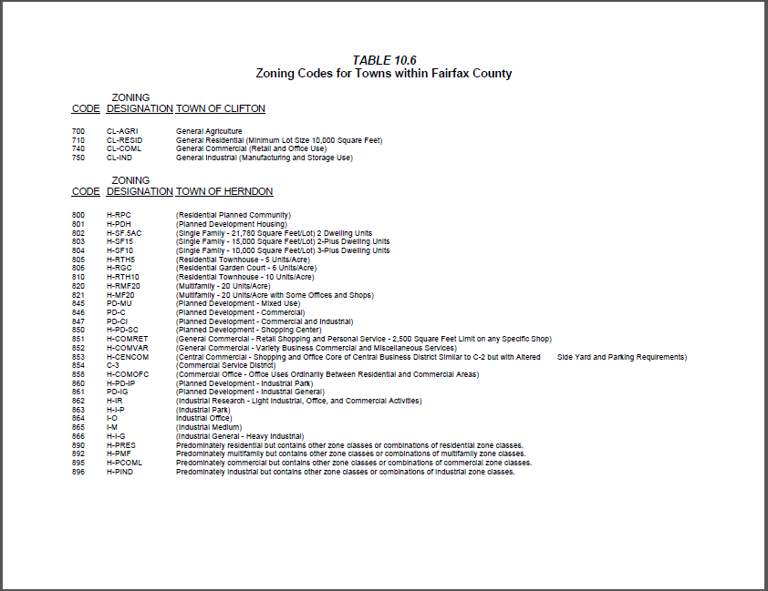
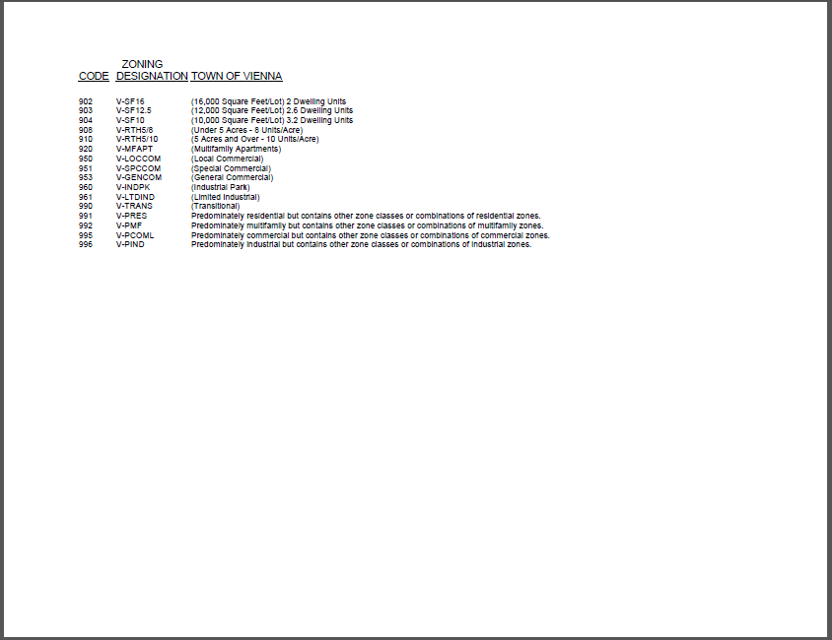
Consolidation
The need to simplify (i.e. group) land use types through consolidation was evident
200 different codes (included embedded towns)
Code numbering convention facilitated consolidation

Slide 5
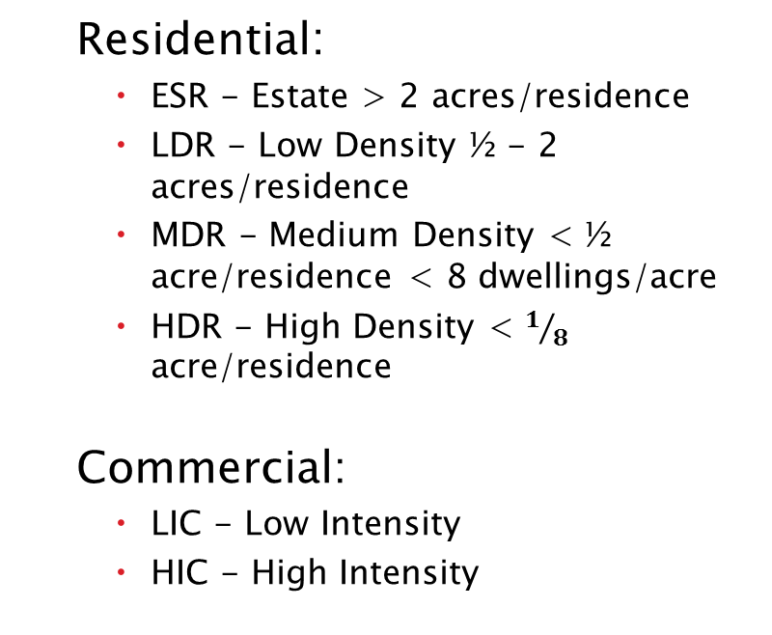
Consolidation
Grouped existing, zoned & planned land use types into 11 categories:
Residential:
ESR - Estate > 2 acres/residence
LDR - Low Density ½ - 2 acres/residence
MDR - Medium Density < ½ acre/residence < 8 dwellings/acre
HDR - High Density < $1/8$ acre/residence
Commercial:
LIC - Low Intensity
HIC - High Intensity
Miscellaneous:
OS - Open Space
GC - Golf Course
INT - Institutional:
Government/Universities
IND - Industrial
Airports
Railways
Transportation:
TRANS - Road rights-of-way

Slide 6
Creating landuse layer - a GIS exercise
Existing conditions:
Each real estate record was assigned a category for existing, zoned & planned land use
Joined the tabular tax record data to the parcel layer polygons
Included category: TRANS landuse
Areas outside of the parcel boundaries = ROW
Included category: WATER land cover
Planimetric data of the stream network, lakes

Slide 7
Creating landuse layer - a GIS exercise
Future conditions:
Intersected comprehensive plan coverage with the parcel layer
Most parcels were already built-out
Vacant & underutilized parcels
Compared zoned vs. planned land use
Where different, chose classification that yielded the greatest density

Slide 8
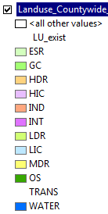
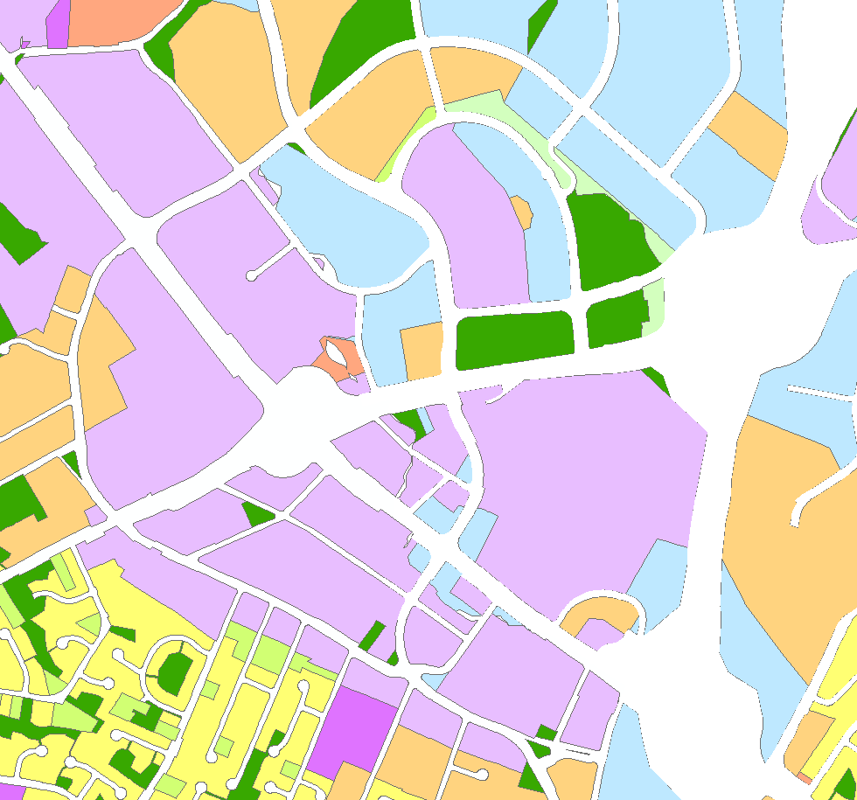
Creating landuse layer - a GIS exercise
Existing conditions - Tysons Corner

Slide 9
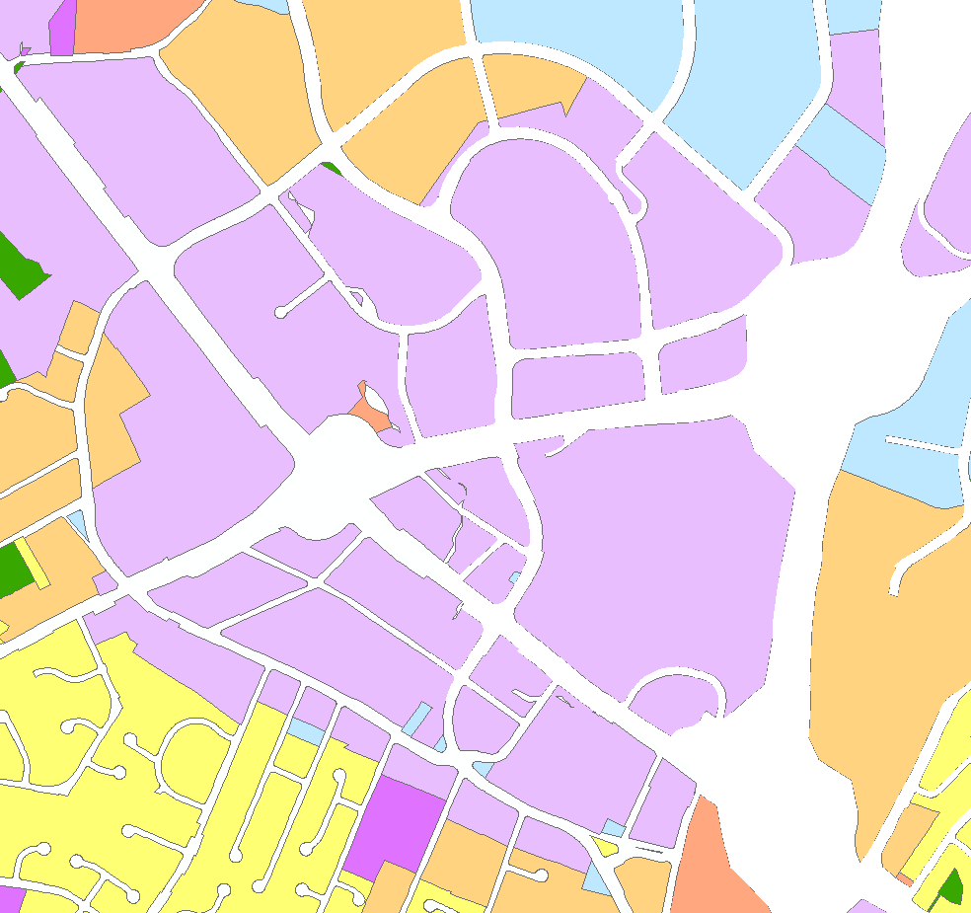
Creating landuse layer - a GIS exercise
Future conditions - Tysons Corner
future

Slide 10
Estimating imperviousness values
Used planimetric data
Features were assigned a corresponding % imperviousness
Buildings, roads, parking lots & sidewalks/trails – 100%
Parking lots, unpaved – 50%
Areas outside planimetric features – 0%
Feature types sampled to estimate the typical DCIA/NDCIA split
Roads, parking lots – 100% DCIA
Sidewalks/trails – 85% DCIA, 15% NDCIA
Buildings – DCIA varied by type
Commercial - 100%
Industrial - 95%
Multi-Family Residential - 90%
Single Family Residential - 50%

Slide 11
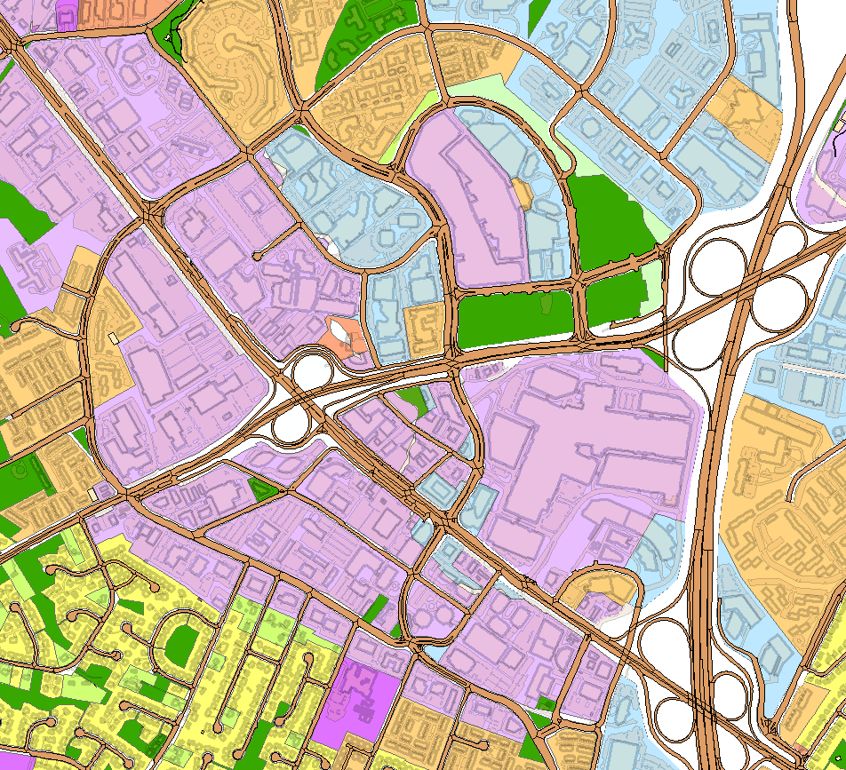
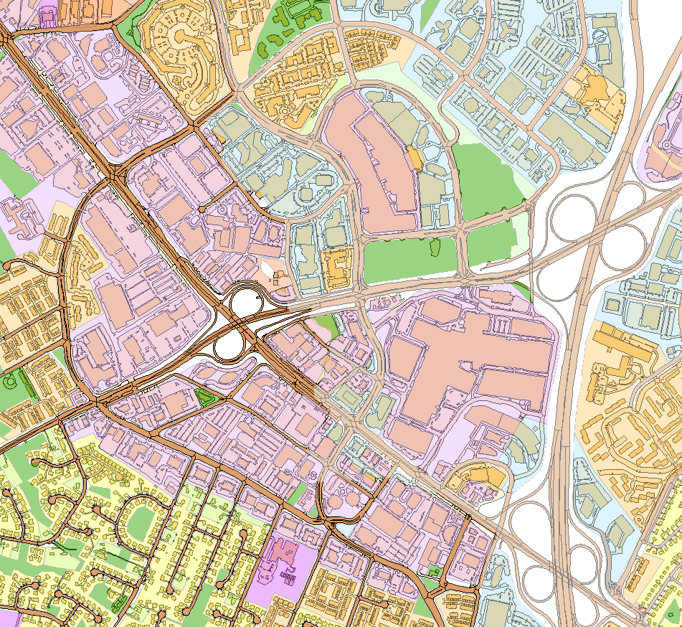
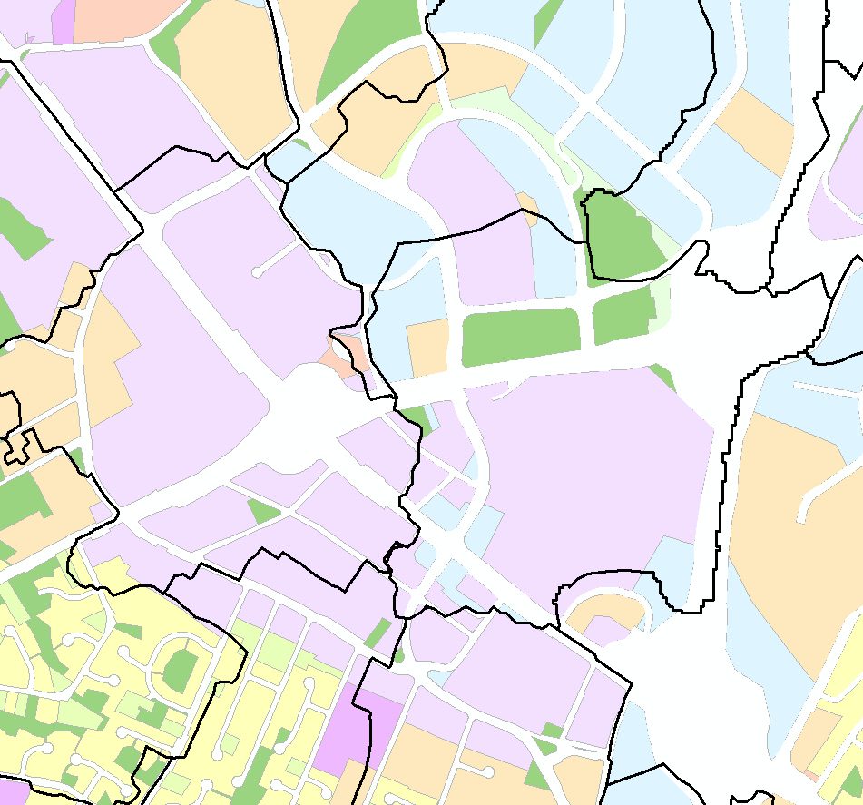
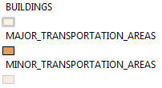
Estimating imperviousness values
Planimetrics - Tysons Corner

Slide 12
Estimating imperviousness values
Estimating exist & future condition imperviousness values by land use:
Sampled planimetric data in areas representative for each land use category
Average % imperviousness was calculated for each land use category
Assigned % DCIA/NDCIA to each category based on appropriate feature types
DCIA & NDCIA values were aggregated to a “subbasin” level
Polygons were created for modeling purposes
Typically 300-500 acres in size
Over 1800 polygons

Slide 13
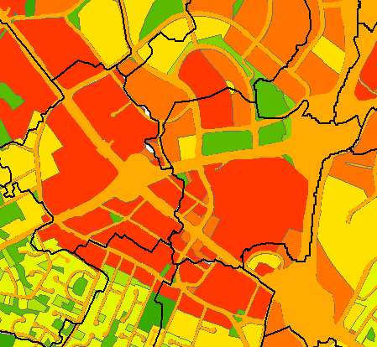
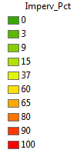
Estimating imperviousness values
Existing % Imperv by Land use - Tysons Corner

Slide 14
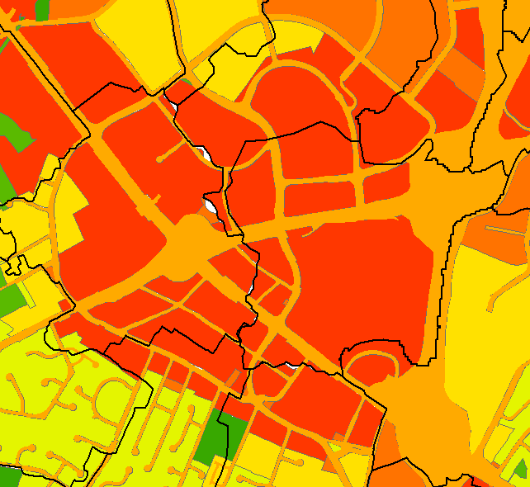
Estimating imperviousness values
Future % Imperv by Land use - Tysons Corner

Slide 15
Conclusion/Challenges
The LU/LC methodology Fairfax County implemented for its watershed planning effort worked well at the local scale & could be a method used to help standardize urbanized LU/LC categories across the bay watershed.
Many smaller jurisdictions have less readily available data, however; many larger urban areas maintain data similar to Fairfax (i.e. comp plan, tax/parcel information & planimetrics) which could be used with this methodology.

Slide 16

Questions?

