Slide 1
The Law-borist
Enforcing the District of Columbia’s Municipal Tree Law

Slide 2
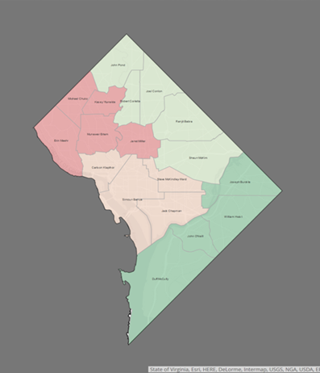
Urban Forestry Division,
Washington D.C.
20 arborists, 4 teams
District Department of Transportation (DDOT)
675,000 people
150,000 street trees
61 sq. mi.

Slide 3
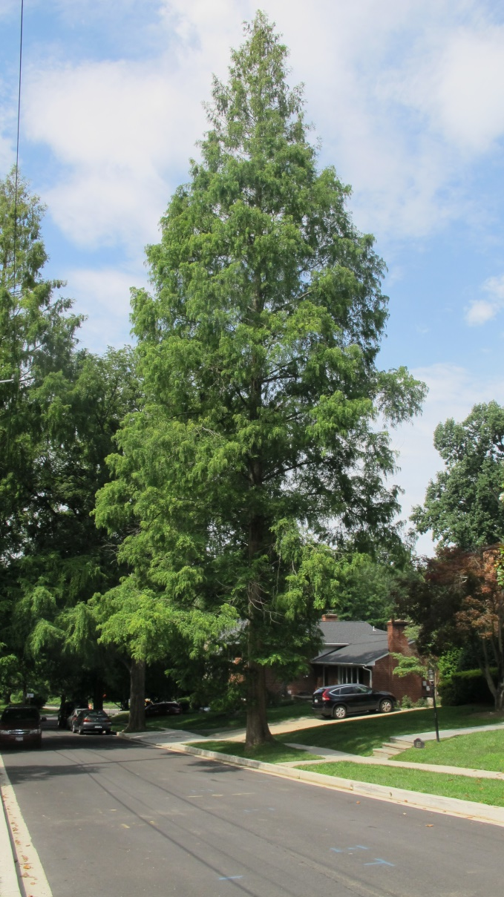
D.C.: The City of Trees
40% Canopy Goal by 2032
Plant 8,000 Trees a Year
Issue Tree Removal Permits

Slide 4

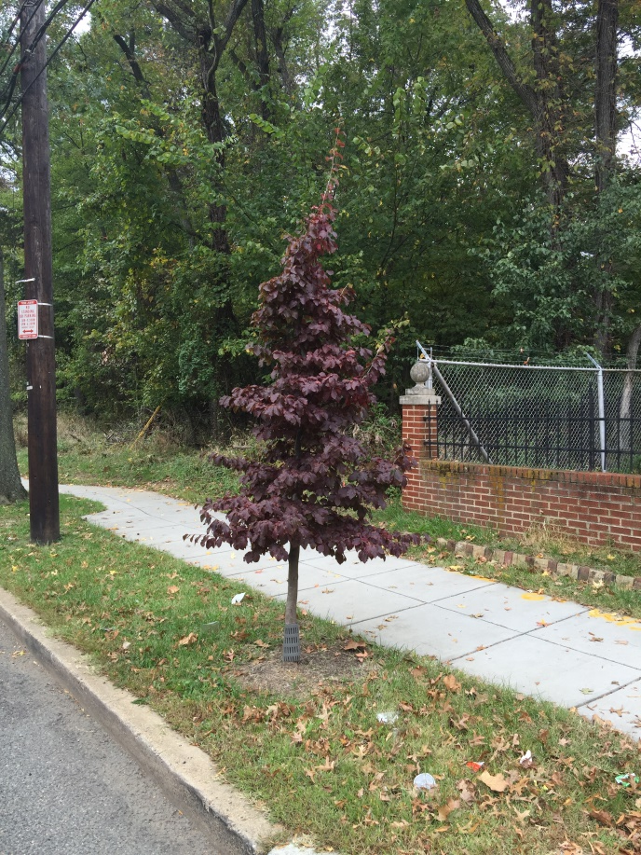
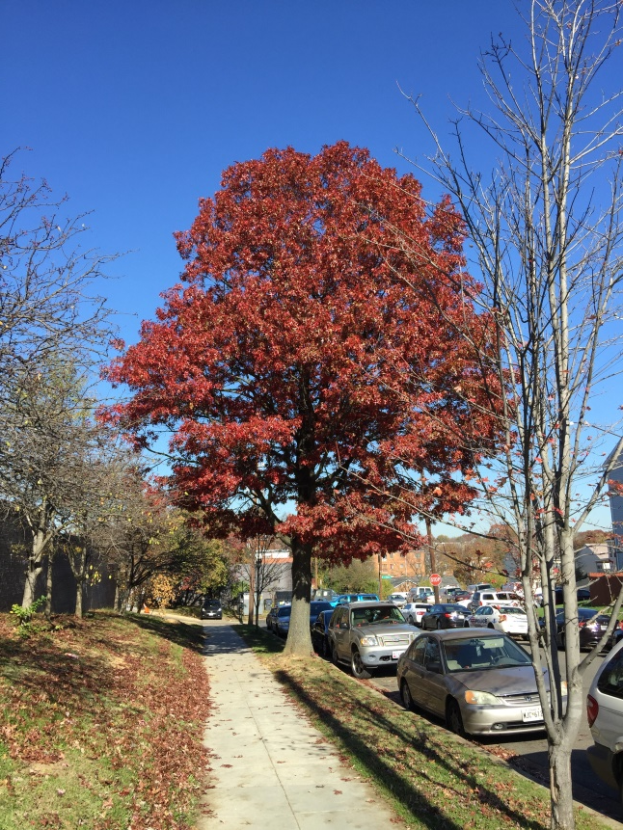
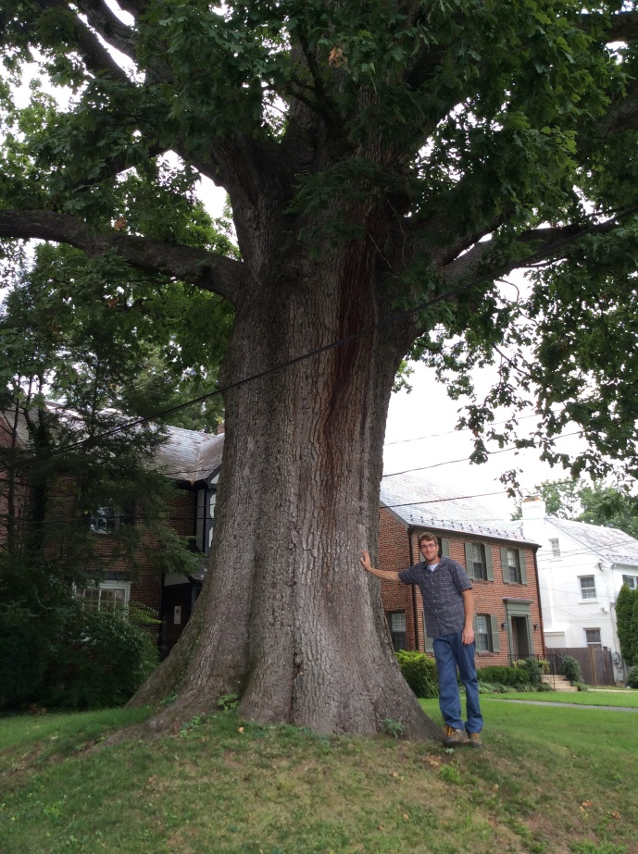
Urban Forest Preservation Act of 2002 (plus 2016 Amendment)
Undersized < 44”
44” < Special > 100”
100” < Heritage Trees

Slide 5
Urban Forest Preservation Act of 2002 (plus 2016 Amendment)
$55 per inch of circumference to remove non-hazardous trees.
$300 per inch of circumference fine for illegal removals.
Trees measured at 4.5 feet above the ground

Slide 6
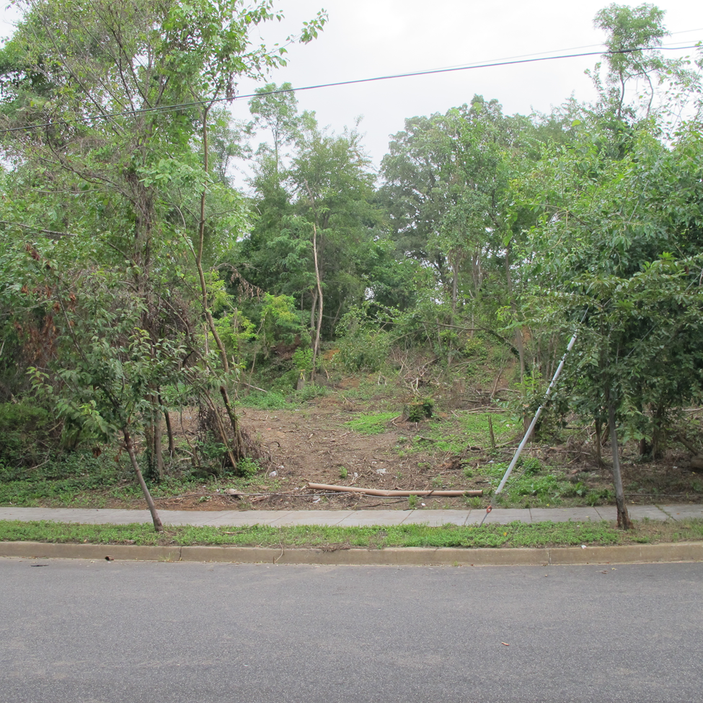
Case Study #1: The Gainesville Case

Slide 7
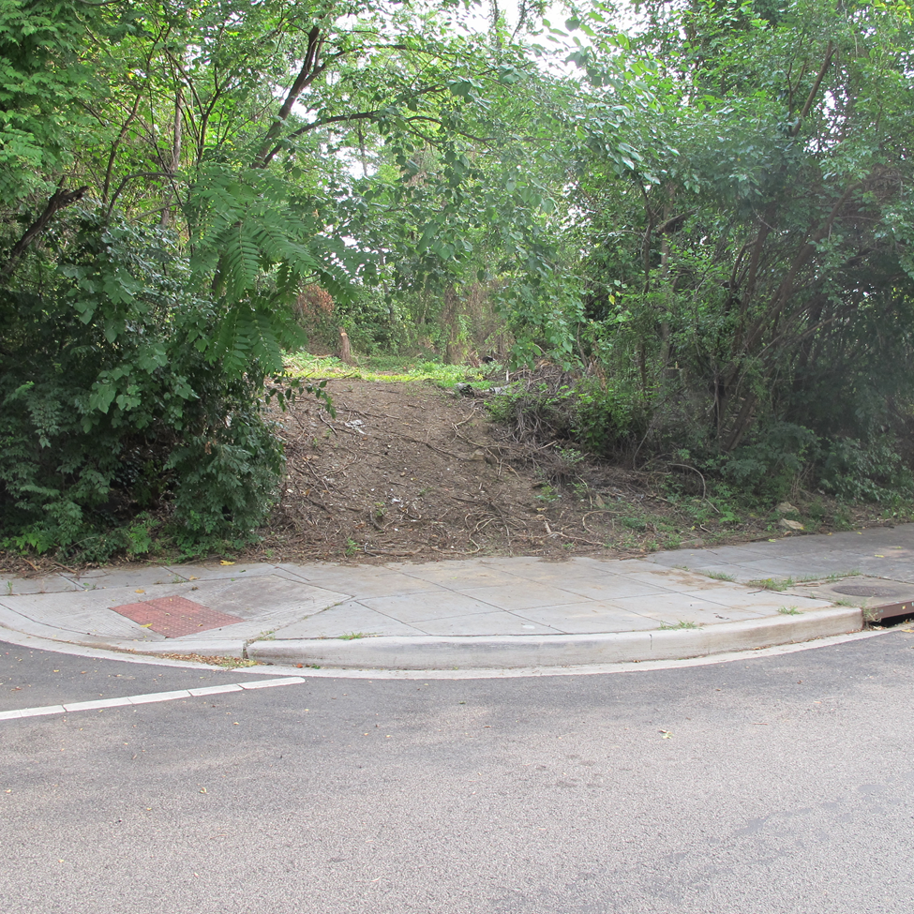

Slide 8
Burden of Proof
Civil Trial
  Preponderance of the Evidence
    Was the respondent more likely than not to have committed the infraction?
Criminal Trial
  Beyond a Reasonable Doubt
    Is there a reasonable doubt the defendant committed the crime?

Slide 9
Burden of Proof
Civil Trial
  Preponderance of the Evidence
    Was the respondent more likely than not to have committed the infraction?
Criminal Trial
  Beyond a Reasonable Doubt
    Is there a reasonable doubt the defendant committed the crime?

Slide 10
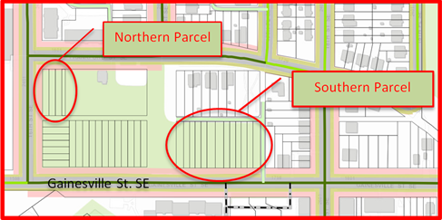
Two Parcels

Slide 11
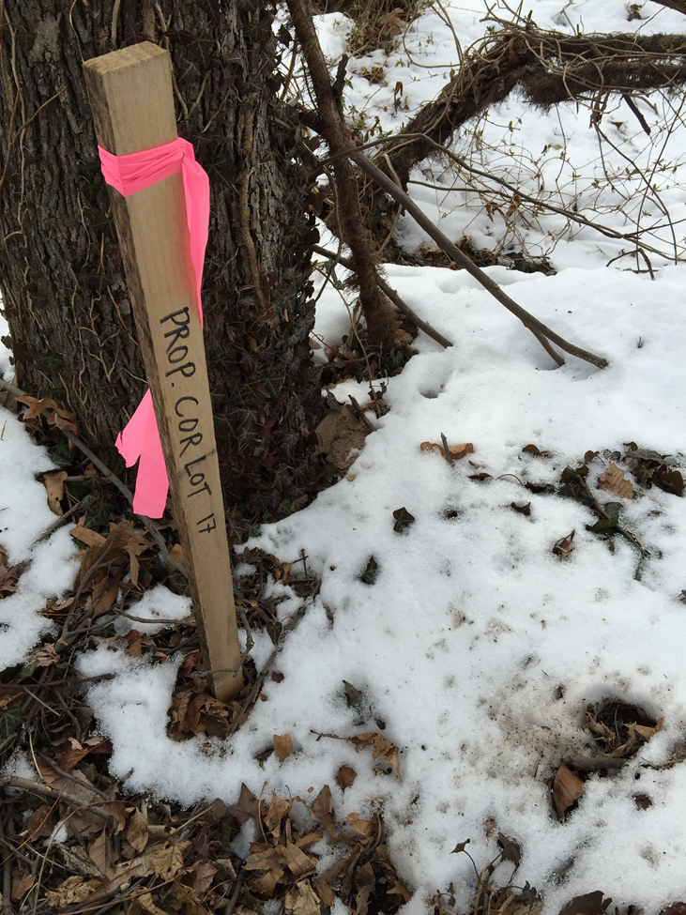
Property Boundary Staked

Slide 12
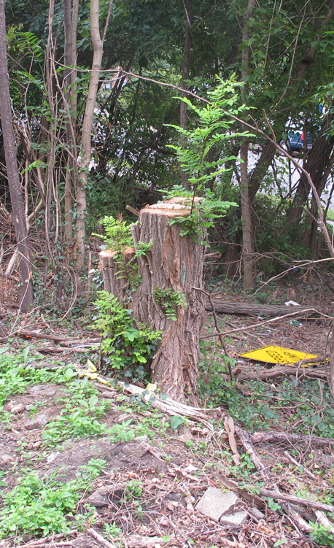
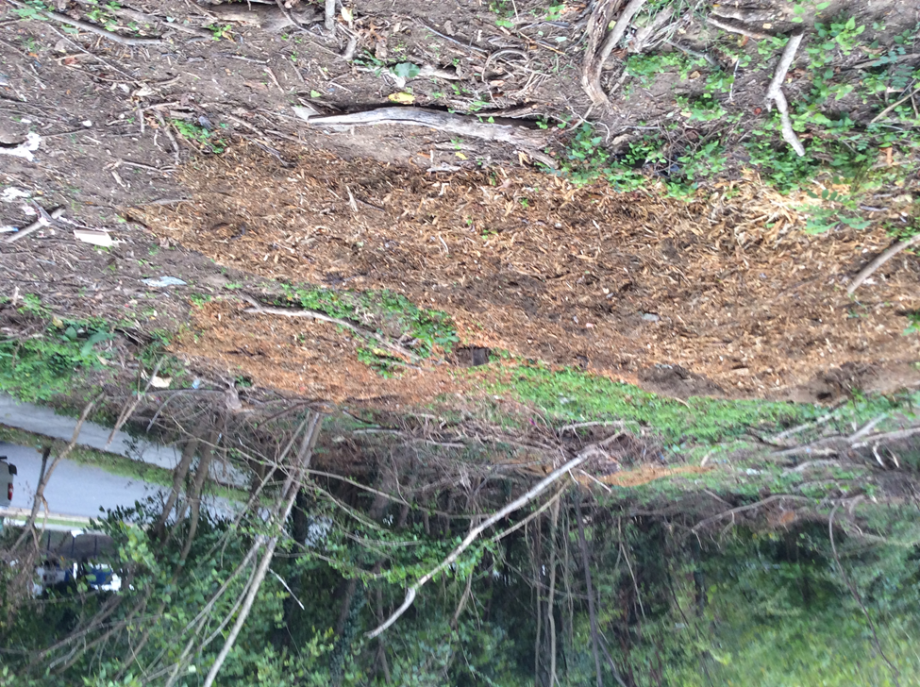
Stump Grinding

Slide 13
Burden of Proof
Civil Trial
  Preponderance of the Evidence
    Was the respondent more likely than not to have committed the infraction?
Criminal Trial
  Beyond a Reasonable Doubt
    Is there a reasonable doubt the defendant committed the crime?

Slide 14
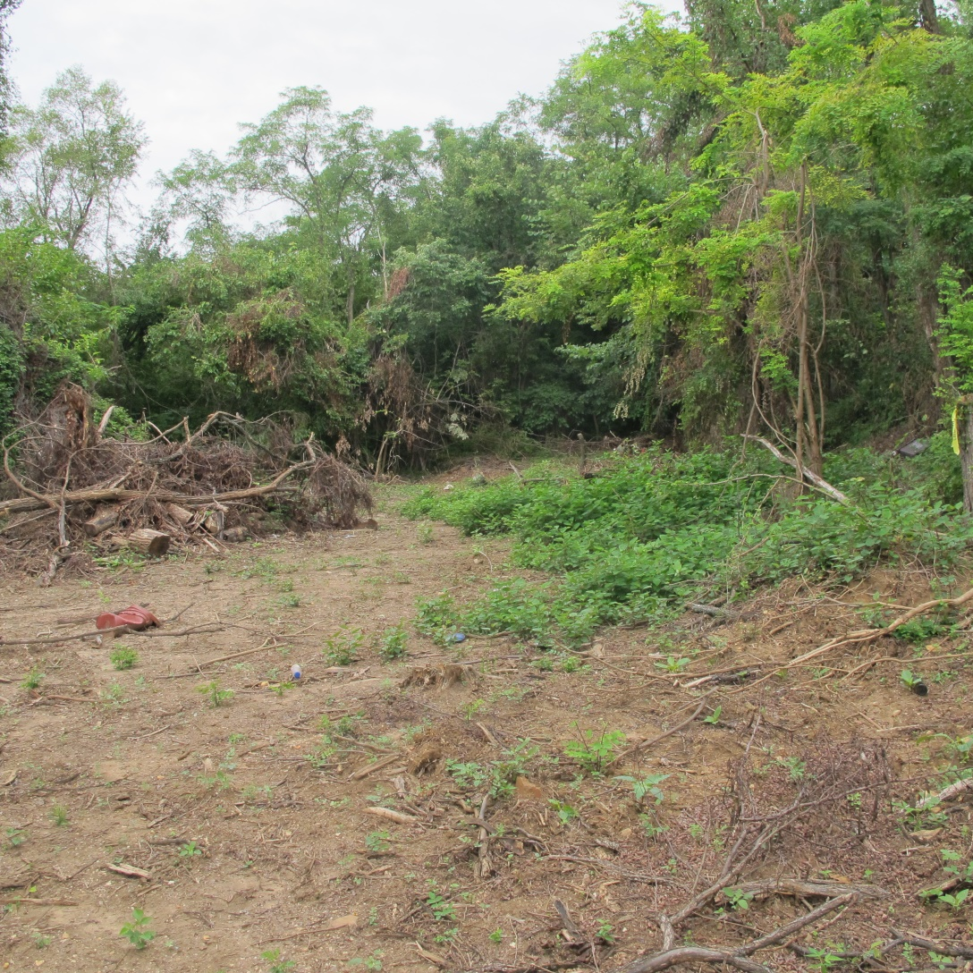
What do we measure???

Slide 15
What information do we have?
Stump D
Stump H
Species
Total tree height, using LIDAR

Slide 16
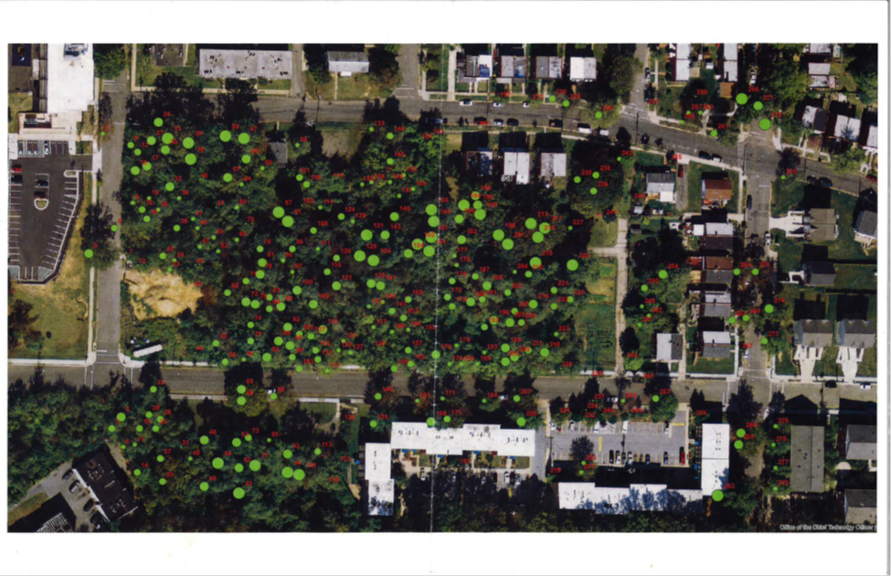
Measuring TH with LIDAR

Slide 17
ORMEROD EQUATION:* D^2/DBH^2 = [(TH – H) / (TH – 4.5)]^2b1
Where . . .
  D = the measured diameter
  H = height of the measured diameter
  TH = total height of the tree (obtained from LIDAR data)
  DBH = diameter at breast height
  b1 = species-specific co-efficient developed by USFS
  *Martin, A. Jeff. “Taper and Volume Equations for Selected Appalachian Hardwood Species.” United States Department of Agriculture. 1981.

Slide 18
In Excel . . .
Solve for DBH
=SQRT(D^2/((TH-H)/TH-4.5))^(2*b1)

Slide 19
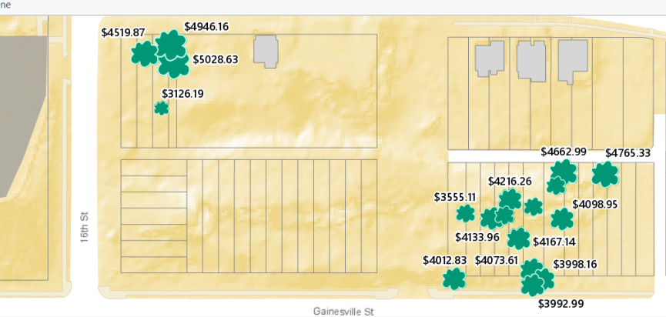
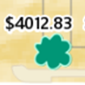
Tree Fines

Slide 20
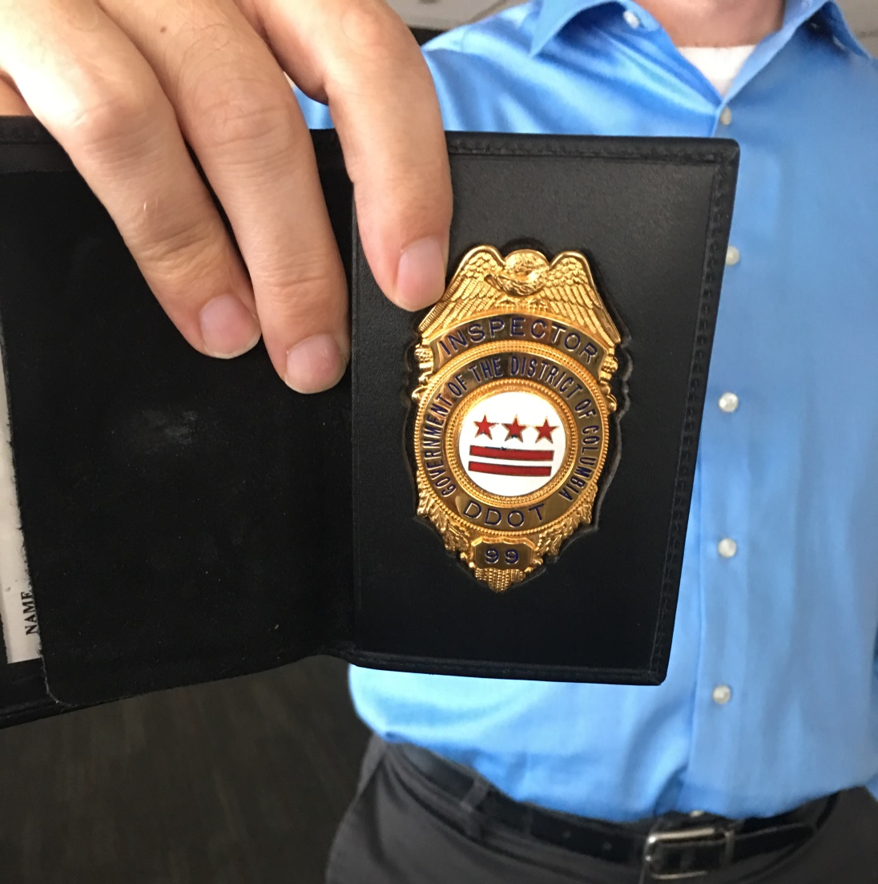
Total Fine: $114,740.07

Slide 21
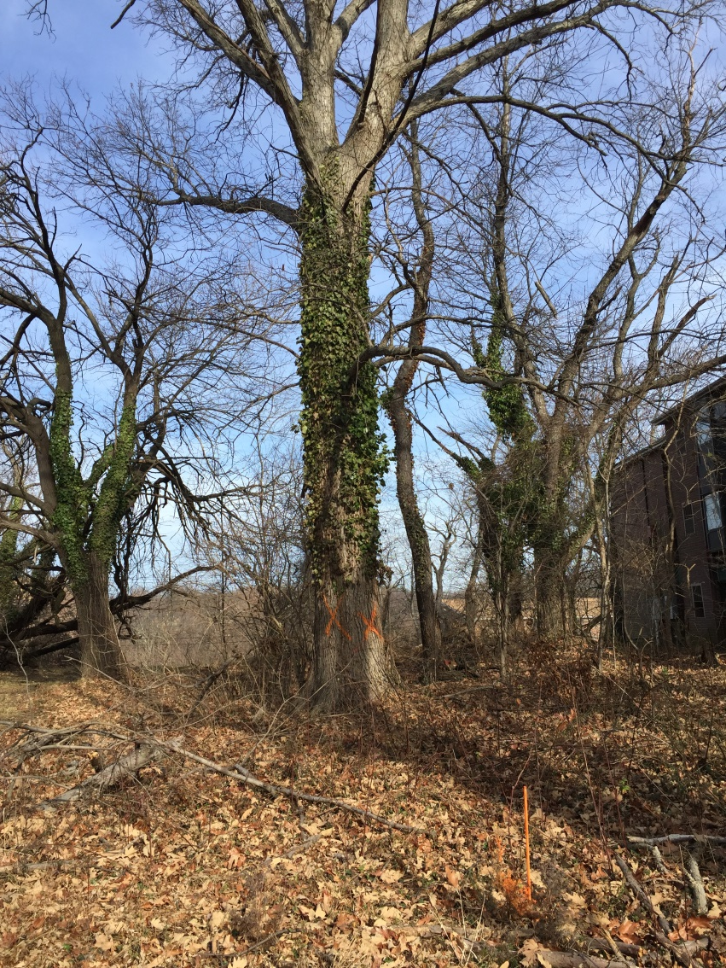
Case Study #2: The Robinson Case

Slide 22
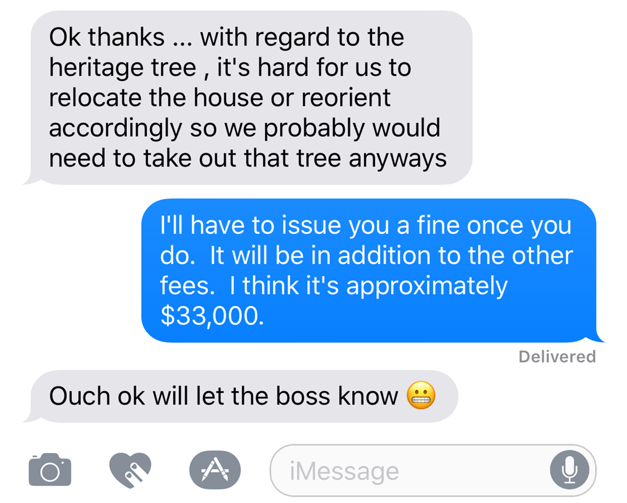
Evidence

Slide 23

Ouch Emoji

Slide 24
Judges Can Suspend Fines . . .
(1) Past Compliance
(2) Past Good Faith Attempts to Comply with Applicable Laws and Regulations
(3) Respondent Correct the Infraction by a Date Certain

Slide 25
Best Case
“Respondent has accepted responsibility . . .”
“Respondent was properly permitted and paid the fees . . . for the Special Trees . . .”
“. . . This Heritage Tree is barely over the threshold to qualify as a Heritage Tree . . .”

Slide 26
Best Case
“Respondent has accepted responsibility . . .”
“Respondent was properly permitted and paid the fees . . . for the Special Trees . . .”
“. . . This Heritage Tree is barely over the threshold to qualify as a Heritage Tree . . .”
$31,197 → $18,000

Slide 27
Fine Reductions
2014-DDOT-U100115
  $21,823.00 → $5,000
  “. . . a first-time offense . . .”
2014-DDOT-U100066
  $8,765.00 → $3,067.75
  “. . . Respondent acted in good faith by applying for the permit . . .”

Slide 28
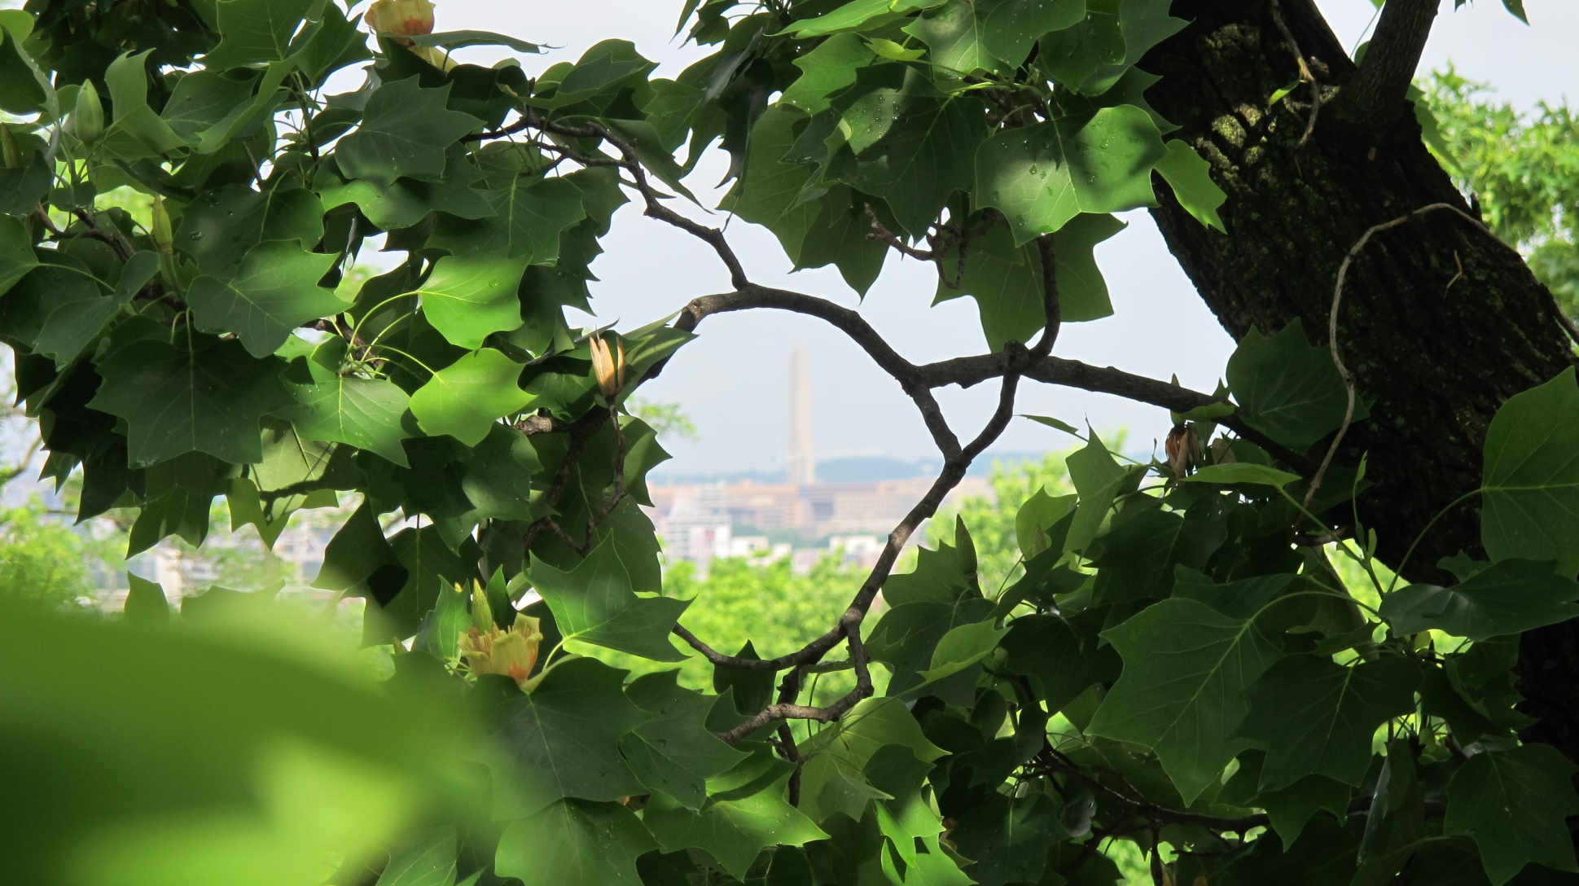
Canopy = 38.5%

Slide 29

Contact
John O’Neill
Urban Forester, Ward 8 District of Columbia Government
john.oneill@dc.gov
(202) 527- 5633

