Slide 1
Innovations in Infrastructure Funding at DC Water
District of Columbia Water and Sewer Authority
George S. Hawkins, General Manager
Presentation for:
Chesapeake Bay Local Government Advisory Committee
Financing Stormwater Programs/Pay for Success
Maureen M. Holman
Sustainability Chief
October 6, 2017

Slide 2
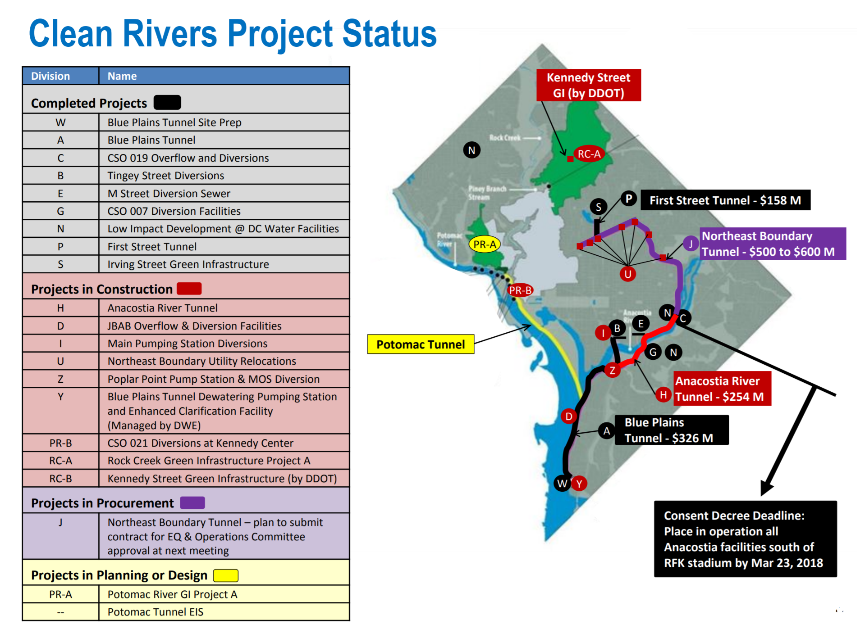

Slide 3
Environmental Impact Bond (EIB)
Innovations in Infrastructure Funding at DC Water

Slide 4
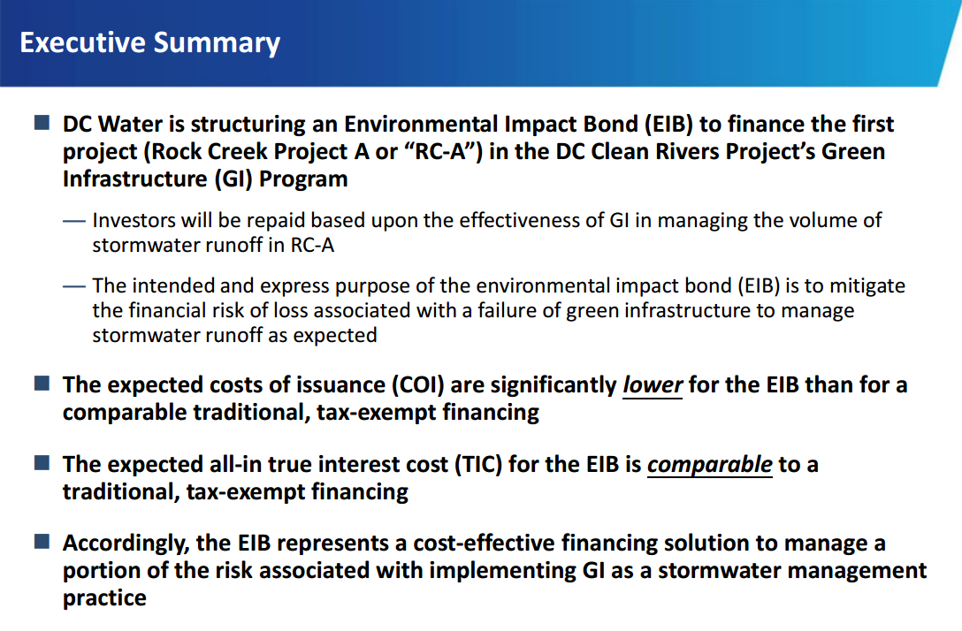

Environmental Impact Bonds
Notes:
Program Evaluation
- DC Water is conducting a rigorous, three-step program evaluation of the effectiveness of green infrastructure in managing stormwater runoff:
o Step 1 - Pre-construction monitoring to measure the existing stormwater runoff without green infrastructure.
o Step 2 - With results from the pre-construction monitoring and DC Water’s green infrastructure design plan for RC-A, DC Water established outcome ranges
predicting the expected reduction in stormwater runoff. An independent engineering firm selected by the investors confirmed these ranges.
o Step 3 - Post-construction monitoring to measure the actual stormwater runoff with green infrastructure.
- By comparing the actual stormwater runoff to the existing stormwater runoff, DC Water will calculate the effectiveness of green infrastructure in Rock Creek Project A as measured by the percentage reduction in stormwater runoff and determine the associated Performance Tier, which may trigger a contingent payment on the EIB.
- An independent validator will confirm the results of the analysis and Performance Tier.
Performance Tier, Outcome Ranges and Contingent Payment
- Depending on the effectiveness of GI, a contingent payment may be due at the mandatory tender date:
Perf. Tier Outcome Ranges Contingent Payment
1 Runoff Reduction > 41.3% DC Water will make an Outcome Payment to Investors of $3.3 million.
2 18.6% <= Runoff Reduction <= 41.3% No contingent payment due.
3 Runoff Reduction < 18.6% Investors will make Risk Share Payment to DC Water of $3.3 million.
- The Outcome Ranges reflect the expectation that a successful project will result in Performance Tier 2 with no contingent payment due by either party.
- If green infrastructure outperforms expectations and the stormwater runoff reduction is greater than 41.3%, then DC Water will make an additional Outcome Payment to the investors for sharing its risk in the Project.

Slide 5
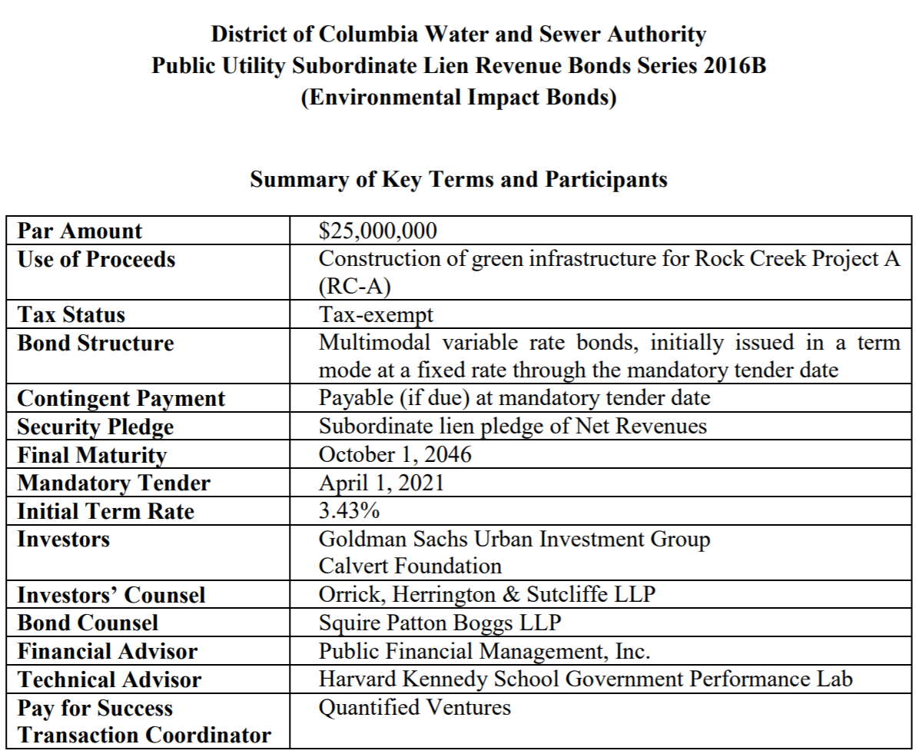
Environmental Impact Bonds
Notes:
Program Evaluation
- DC Water is conducting a rigorous, three-step program evaluation of the effectiveness of green infrastructure in managing stormwater runoff:
o Step 1 - Pre-construction monitoring to measure the existing stormwater runoff without green infrastructure.
o Step 2 - With results from the pre-construction monitoring and DC Water’s green infrastructure design plan for RC-A, DC Water established outcome ranges
predicting the expected reduction in stormwater runoff. An independent engineering firm selected by the investors confirmed these ranges.
o Step 3 - Post-construction monitoring to measure the actual stormwater runoff with green infrastructure.
- By comparing the actual stormwater runoff to the existing stormwater runoff, DC Water will calculate the effectiveness of green infrastructure in Rock Creek Project A as measured by the percentage reduction in stormwater runoff and determine the associated Performance Tier, which may trigger a contingent payment on the EIB.
- An independent validator will confirm the results of the analysis and Performance Tier.
Performance Tier, Outcome Ranges and Contingent Payment
- Depending on the effectiveness of GI, a contingent payment may be due at the mandatory tender date:
Perf. Tier Outcome Ranges Contingent Payment
1 Runoff Reduction > 41.3% DC Water will make an Outcome Payment to Investors of $3.3 million.
2 18.6% <= Runoff Reduction <= 41.3% No contingent payment due.
3 Runoff Reduction < 18.6% Investors will make Risk Share Payment to DC Water of $3.3 million.
- The Outcome Ranges reflect the expectation that a successful project will result in Performance Tier 2 with no contingent payment due by either party.
- If green infrastructure outperforms expectations and the stormwater runoff reduction is greater than 41.3%, then DC Water will make an additional Outcome Payment to the investors for sharing its risk in the Project.

Slide 6
Environmental Impact Bonds
Program Evaluation
DC Water is conducting a rigorous, three-step program evaluation of the effectiveness of green infrastructure in managing stormwater runoff:
Step 1 - Pre-construction monitoring to measure the existing stormwater runoff without green infrastructure.
Step 2 - With results from the pre-construction monitoring and DC Water’s green infrastructure design plan for RC-A, DC Water established outcome ranges predicting the expected reduction in stormwater runoff. An independent engineering firm selected by the investors confirmed these ranges.
Step 3 - Post-construction monitoring to measure the actual stormwater runoff with green infrastructure.
Notes:
Program Evaluation
- DC Water is conducting a rigorous, three-step program evaluation of the effectiveness of green infrastructure in managing stormwater runoff:
o Step 1 - Pre-construction monitoring to measure the existing stormwater runoff without green infrastructure.
o Step 2 - With results from the pre-construction monitoring and DC Water’s green infrastructure design plan for RC-A, DC Water established outcome ranges
predicting the expected reduction in stormwater runoff. An independent engineering firm selected by the investors confirmed these ranges.
o Step 3 - Post-construction monitoring to measure the actual stormwater runoff with green infrastructure.
- By comparing the actual stormwater runoff to the existing stormwater runoff, DC Water will calculate the effectiveness of green infrastructure in Rock Creek Project A as measured by the percentage reduction in stormwater runoff and determine the associated Performance Tier, which may trigger a contingent payment on the EIB.
- An independent validator will confirm the results of the analysis and Performance Tier.
Performance Tier, Outcome Ranges and Contingent Payment
- Depending on the effectiveness of GI, a contingent payment may be due at the mandatory tender date:
Perf. Tier Outcome Ranges Contingent Payment
1 Runoff Reduction > 41.3% DC Water will make an Outcome Payment to Investors of $3.3 million.
2 18.6% <= Runoff Reduction <= 41.3% No contingent payment due.
3 Runoff Reduction < 18.6% Investors will make Risk Share Payment to DC Water of $3.3 million.
- The Outcome Ranges reflect the expectation that a successful project will result in Performance Tier 2 with no contingent payment due by either party.
- If green infrastructure outperforms expectations and the stormwater runoff reduction is greater than 41.3%, then DC Water will make an additional Outcome Payment to the investors for sharing its risk in the Project.

Slide 7
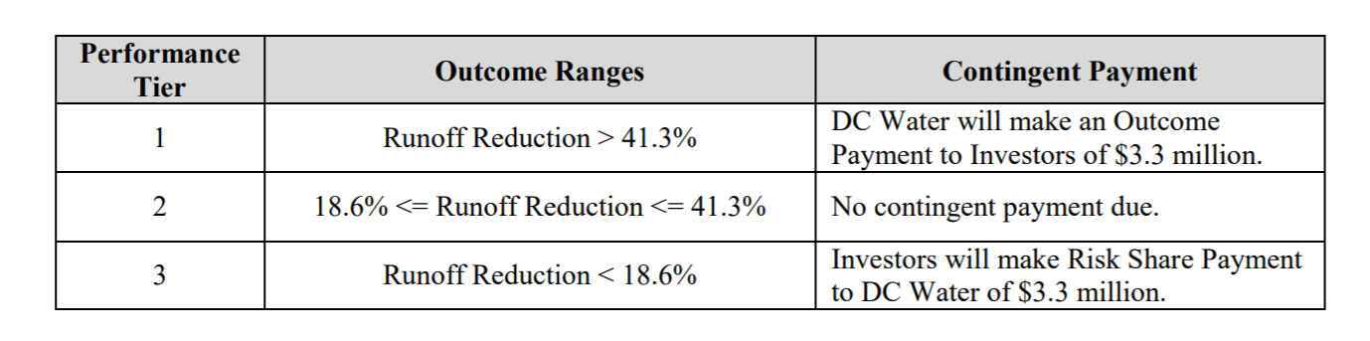
Environmental Impact Bonds
Paying for Success
By comparing the actual stormwater runoff to the existing stormwater runoff, DC Water will calculate the effectiveness of green infrastructure in Rock Creek Project A as measured by the percentage reduction in stormwater runoff and determine the associated Performance Tier, which may trigger a contingent payment on the EIB.
Notes:
Program Evaluation
- DC Water is conducting a rigorous, three-step program evaluation of the effectiveness of green infrastructure in managing stormwater runoff:
o Step 1 - Pre-construction monitoring to measure the existing stormwater runoff without green infrastructure.
o Step 2 - With results from the pre-construction monitoring and DC Water’s green infrastructure design plan for RC-A, DC Water established outcome ranges
predicting the expected reduction in stormwater runoff. An independent engineering firm selected by the investors confirmed these ranges.
o Step 3 - Post-construction monitoring to measure the actual stormwater runoff with green infrastructure.
- By comparing the actual stormwater runoff to the existing stormwater runoff, DC Water will calculate the effectiveness of green infrastructure in Rock Creek Project A as measured by the percentage reduction in stormwater runoff and determine the associated Performance Tier, which may trigger a contingent payment on the EIB.
- An independent validator will confirm the results of the analysis and Performance Tier.
Performance Tier, Outcome Ranges and Contingent Payment
- Depending on the effectiveness of GI, a contingent payment may be due at the mandatory tender date:
Perf. Tier Outcome Ranges Contingent Payment
1 Runoff Reduction > 41.3% DC Water will make an Outcome Payment to Investors of $3.3 million.
2 18.6% <= Runoff Reduction <= 41.3% No contingent payment due.
3 Runoff Reduction < 18.6% Investors will make Risk Share Payment to DC Water of $3.3 million.
- The Outcome Ranges reflect the expectation that a successful project will result in Performance Tier 2 with no contingent payment due by either party.
- If green infrastructure outperforms expectations and the stormwater runoff reduction is greater than 41.3%, then DC Water will make an additional Outcome Payment to the investors for sharing its risk in the Project.

Slide 8
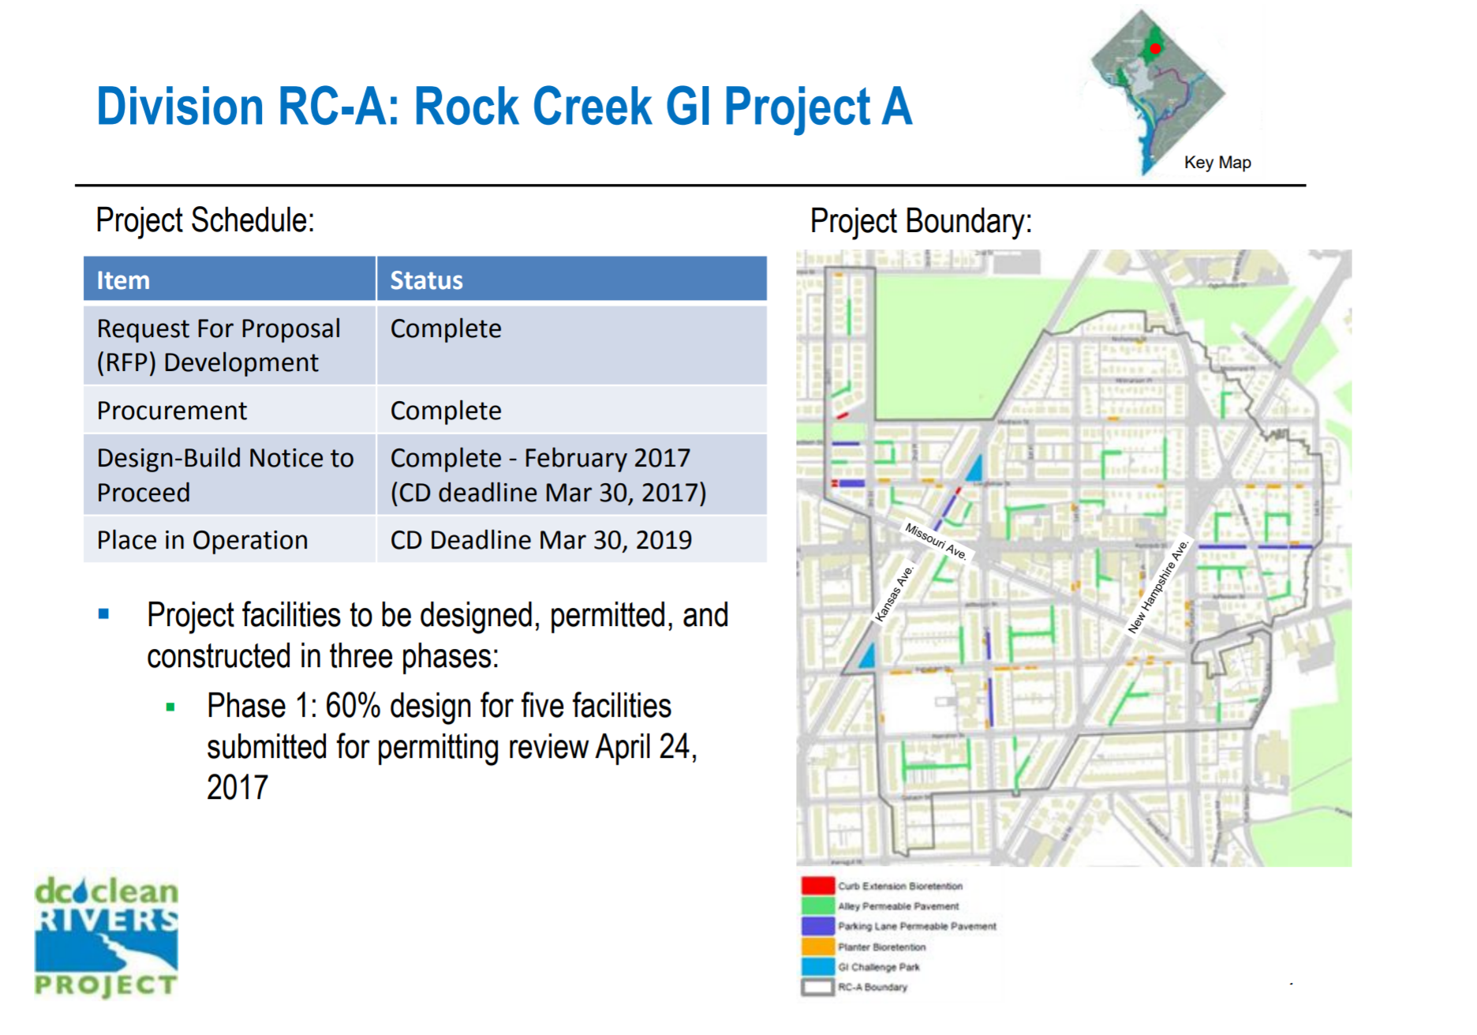

Slide 9

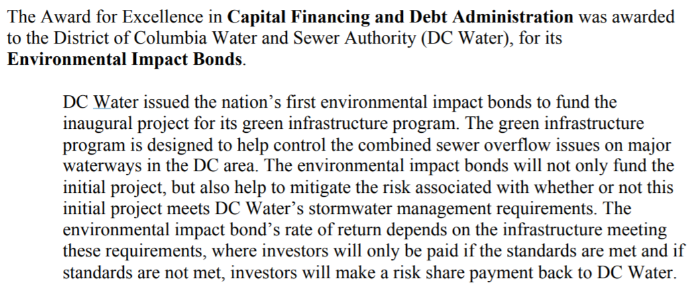
Environmental Impact Bonds
Recognition within the World of Finance

Slide 10
Green Century Bonds
Innovations in Infrastructure Funding at DC Water
Notes:
Bank of America claims its $500 million, three-year green bond, issued in November 2013, was the first U.S. corporate green bond ever. It helped fund LED streetlights in Oakland and Los Angeles. American municipal green bonds are a tad older. In June 2013, Massachusetts sold $100 million in bonds to help clean its rivers, improve wastewater management, boost clean energy and more. (Massachusetts sold another $350 million in bonds last week.) There’s little doubt that a more robust market for green bonds would make it easier for local governments and city agencies to finance infrastructure projects like these that until now have relied on conventional bonds or politically risky tax hikes.

Slide 11
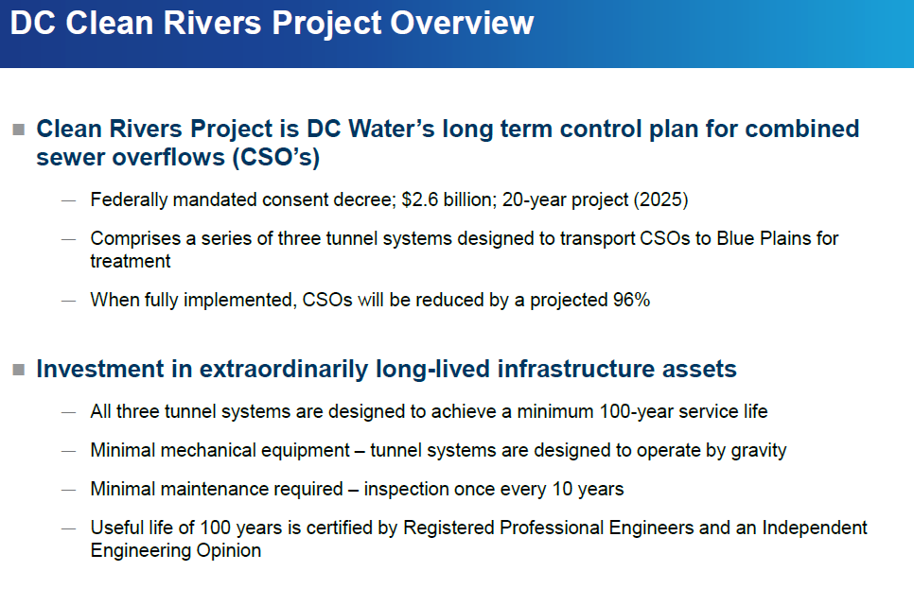
Green Century Bonds
Notes:
"The responsibility of a Chief Financial Officer is to secure the funding necessary to undertake the work of the enterprise," said DC Water CFO Mark Kim. "We also need to formulate a financing strategy that both matches the lifespan of our assets with their funding stream and that presents an equitable charge to our ratepayers. We developed this innovative approach to achieve all these goals."
The key reasons DC Water chose to issue century bonds included:
- Asset-Liability Matching: century bonds permit the Authority to match its long-lived assets and liabilities on its balance sheet.
- Intergenerational Equity and Fairness: century bonds spread the costs of the project more affordably and fairly to those who will benefit over the next 100 years.
- Committed, Long-Term, Low-Cost Capital: century bonds allow DC Water to take advantage of historically low interest rates and to lock-in funding costs for a very long-lived asset.

Slide 12
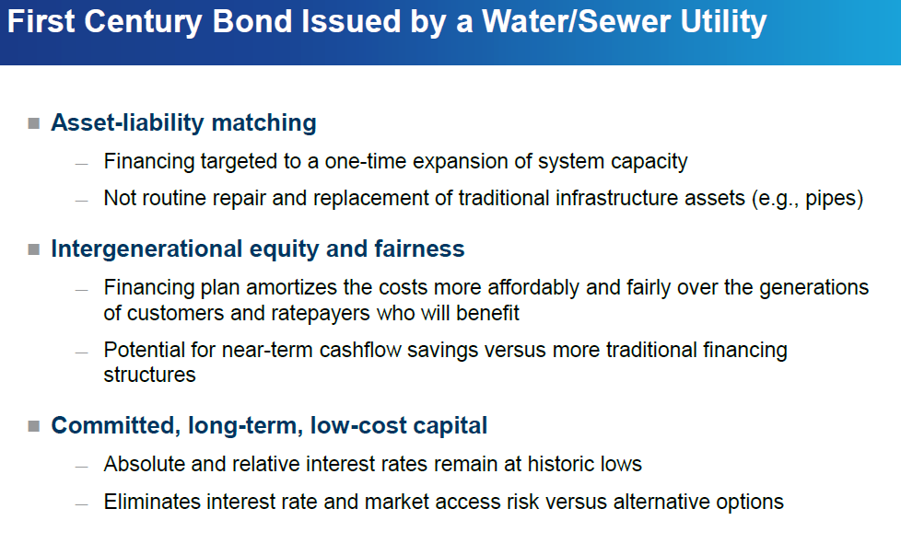
Green Century Bonds
Notes:
100 years is the longest maturity we’ve seen in the green bonds market by quite some way. Typically, DC Water have issued 30-35 year municipal bonds but they thought a century bond would better match the life of the tunnel system … which is expected to last one 100 years. DC Water also noted that a 100 year bond means repayment of project costs will be spread across all the generations that benefit. They call it “intergenerational equity and fairness”. Perhaps just as importantly, the bond allows DC Water to lock in historically low interest rates.
This bond marks a big step for the US green bond market – it’s the first that has had and independent review, or “second opinion”, on the green credentials of the bond. It was done by Vigeo. A second opinion is essential to comply with the Green Bond Principles as well as the Climate Bonds Standard.
The proceeds will be used to construct a tunnel to transport stormwater and sewage to a wastewater treatment plant and reduce sewage overflows to waterways.
Sewage system overflows are becoming more common as climate change increases rainfall intensity in many cities with older systems – for example, 30% of the US sewage system dates back to the 19th century. We need to see a lot of these infrastructure adaptation projects.

Slide 13
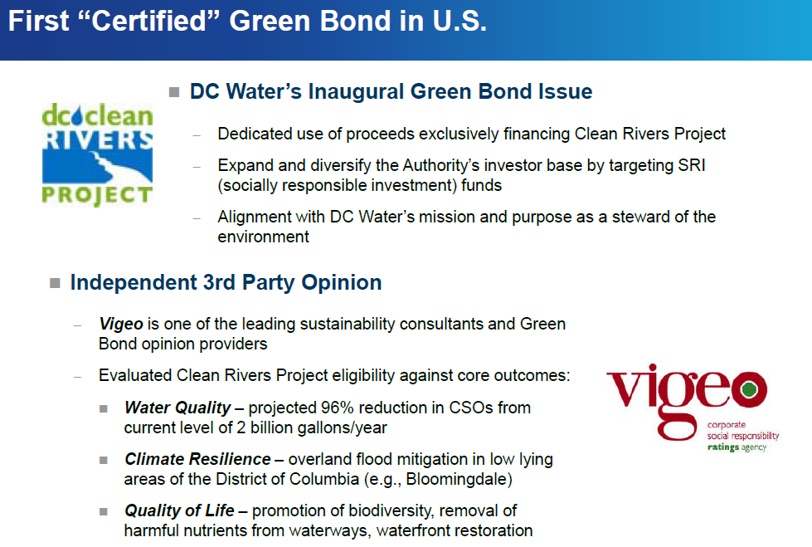
Green Century Bonds
Notes:
Sustainable Accounting Standards Board.. Infrastructure Standards under development, to be released March 2016
Hello Maureen,
Thank you for joining the Infrastructure Industry Working Group! For those of you who were able to join the webinar this morning, thank you for your engagement and excellent questions. Your thoughtful input is critical to our process.
- Electric Utilities: 100 participants
- Gas Utilities: 30 participants
- Water Utilities: 40 participants
- Waste Management: 50 participants
- Engineering & Construction Services: 70 participants
- Home Builders: 20 participants
- Real Estate, Dev. & Inv. Trusts: 110 participants
- Real Estate Services: 30 participants

Slide 14
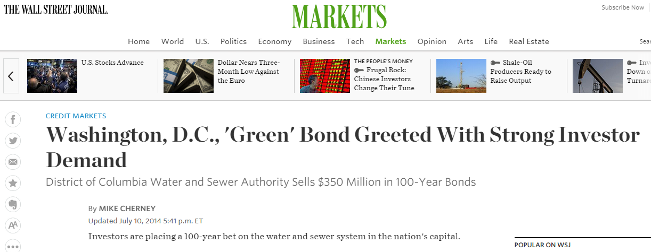
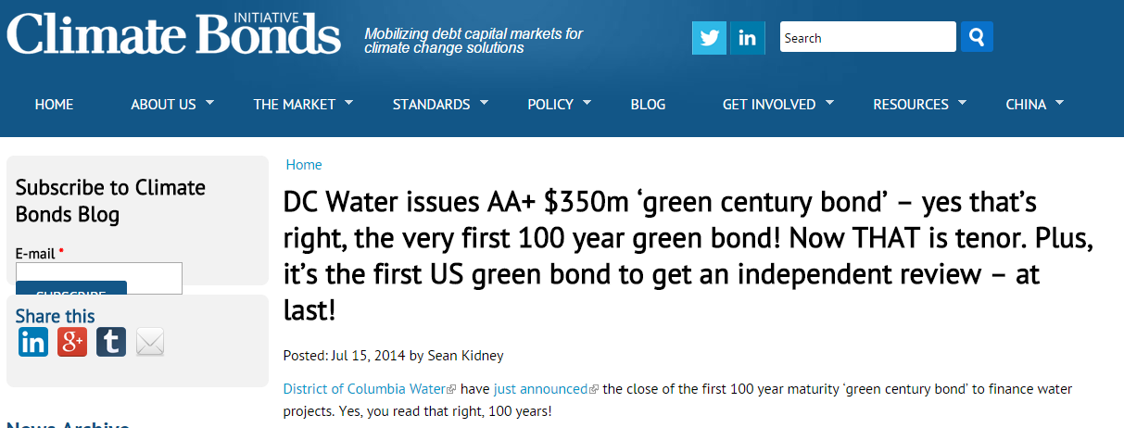
Green Century Bonds
National Recognition in the Press

Slide 15
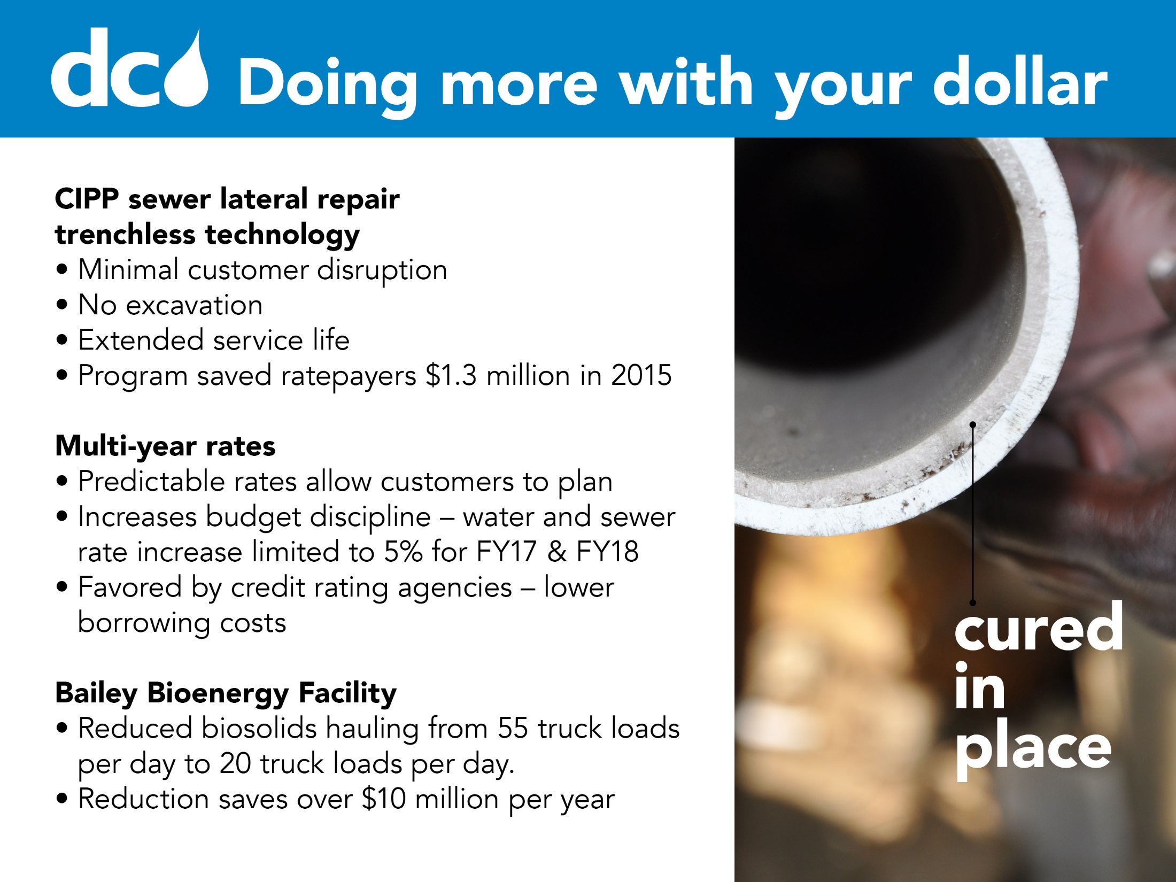
Notes:
Financial Sustainability and Innovation
DC Water has recently been upgraded to a AAA bond rating – an accomplishment that is largely due to the efforts by our CFO and Finance team to be more creative and efficient in financing our operations – such as the issuance of Green Century Bonds.
In July, 2014, DC Water issued $350 million in taxable, green century bonds, marking several firsts for the Authority and the municipal sector. The 100-year final maturity represents the first municipal century bond issued by a water/wastewater utility in the United States. It also represents DC Water’s inaugural green bond issue and the first "certified" green bond in the US debt capital markets with an independent second party sustainability opinion.
The key reasons DC Water chose to issue century bonds included:
- Asset-Liability Matching: century bonds permit the Authority to match its long-lived assets and liabilities on its balance sheet.
- Intergenerational Equity and Fairness: century bonds spread the costs of the project more affordably and fairly to those who will benefit over the next 100 years.
- Committed, Long-Term, Low-Cost Capital: century bonds allow DC Water to take advantage of historically low interest rates and to lock-in funding costs for a very long-lived asset.

Slide 16
Q & A for more information please contact:
Maureen M. Holman, Sustainability Chief maureen.holman@dcwater.com
Innovations in Infrastructure Funding at DC Water

