Slide 1
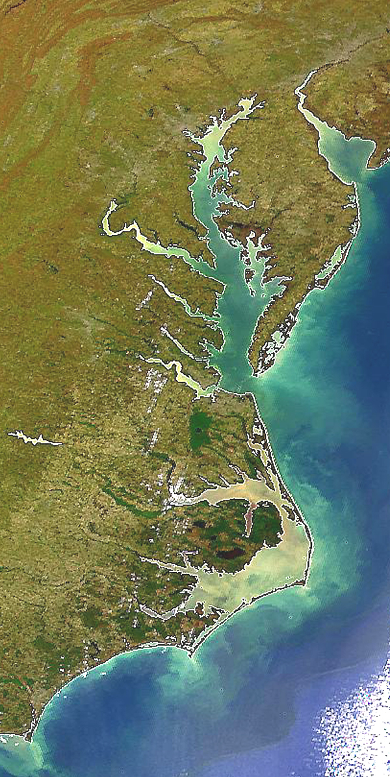

Jurisdiction Profile
District of Columbia

Slide 2
DC Draft Phase III WIP Planning Targets + Reference Loads
Nitrogen Load
 | No-Action (M lbs) | E3 (M lbs) | 2013 Progress (M lbs) | Phase II WIP (reference) (M lbs) | Draft Phase III WIP Planning Target (M lbs)
DC Potomac | 9.39 | 1.63 | 1.75 | 2.43 | 2.43
Phosphorus Load
 | No-Action (M lbs) | E3 (M lbs) | 2013 Progress (M lbs) | Phase II WIP (reference) (M lbs) | Draft Phase III WIP Planning Target (M lbs)
DC Potomac | 1.562 | 0.060 | 0.062 | 0.143 | 0.130

Slide 3
DC Nitrogen – Phase 6 Level Of Effort
(NoAction:E3 Reference)

Slide 4
DC Phosphorus – Phase 6 Level Of Effort
(NoAction:E3 Reference)

Slide 5
DC Nitrogen – Phase 6 Loads and Target
Where did the
reductions come from?
1985
2013
Draft Phase III WIP
Planning Target

Slide 6
DC Phosphorus – Phase 6 Loads and Target
Where did the
reductions come from?
1985
2013
Draft Phase III WIP
Planning Target

Slide 7
DC Nitrogen – Phase 6 Scenario Loads and Draft Target

Slide 8
DC Phosphorus – Phase 6 Scenario Loads and Draft Target

Slide 9
Nitrogen – Phase 6 Relative Effectiveness
Effect of Nitrogen Load Reduction on WQ Standard Attainment
A = Above Fall Line B = Below Fall Line

Slide 10
Phosphorus – Phase 6 Relative Effectiveness
Effect of Phosphorus Load Reduction on WQ Standard Attainment
A = Above Fall Line B = Below Fall Line

Slide 11
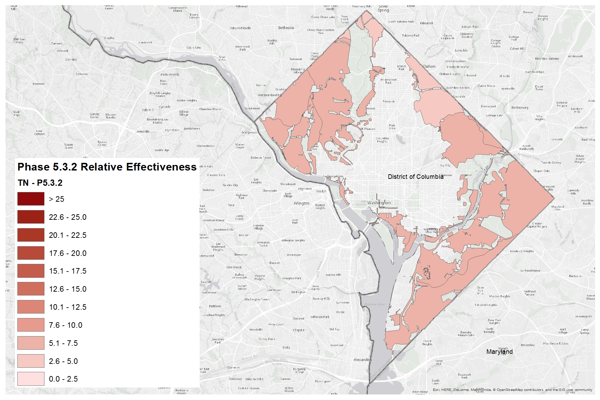
Nitrogen Relative Effectiveness
Phase 5.3.2

Slide 12
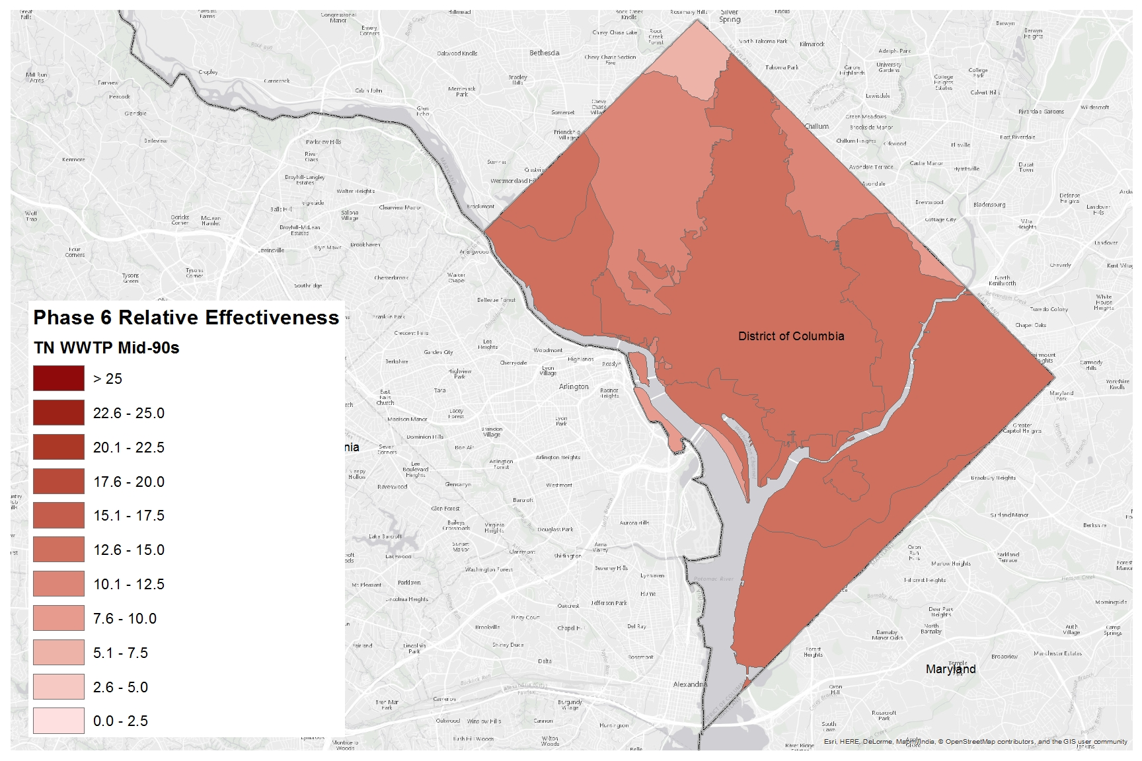
Nitrogen Relative Effectiveness
Phase 6, WWTP, Mid-90s

Slide 13
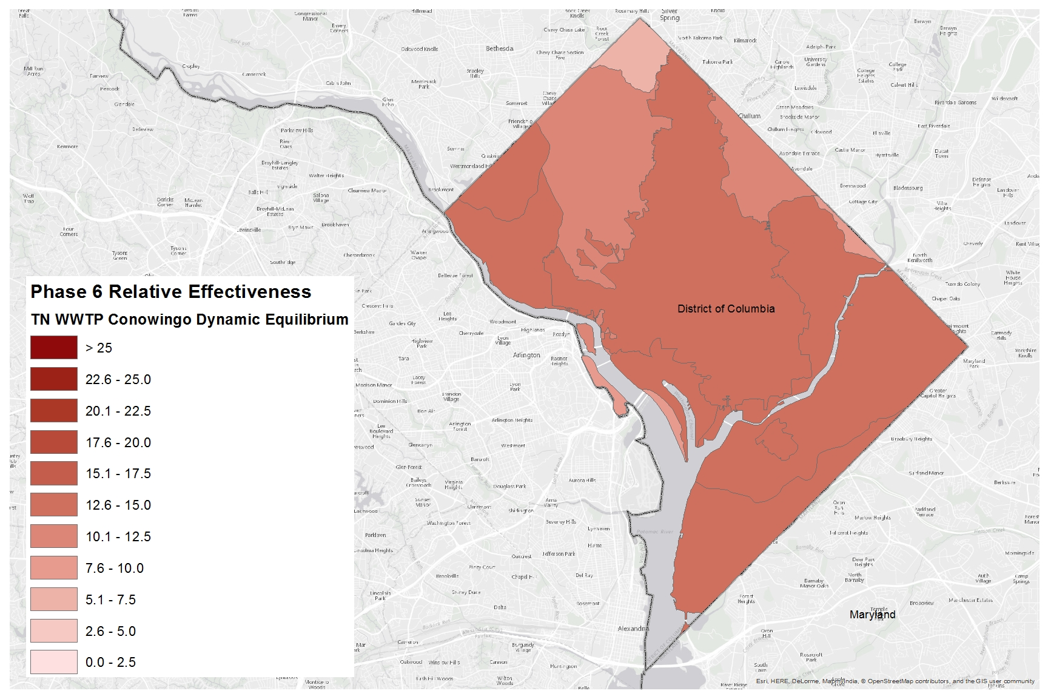
Nitrogen Relative Effectiveness
Phase 6, WWTP, Conowingo Dynamic Equilibrium

Slide 14
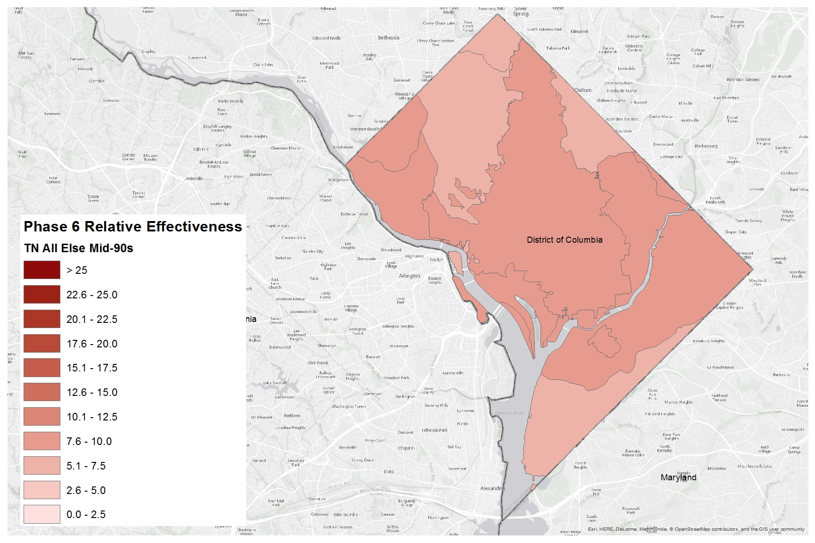
Nitrogen Relative Effectiveness
Phase 6, All Else, Mid-90s

Slide 15
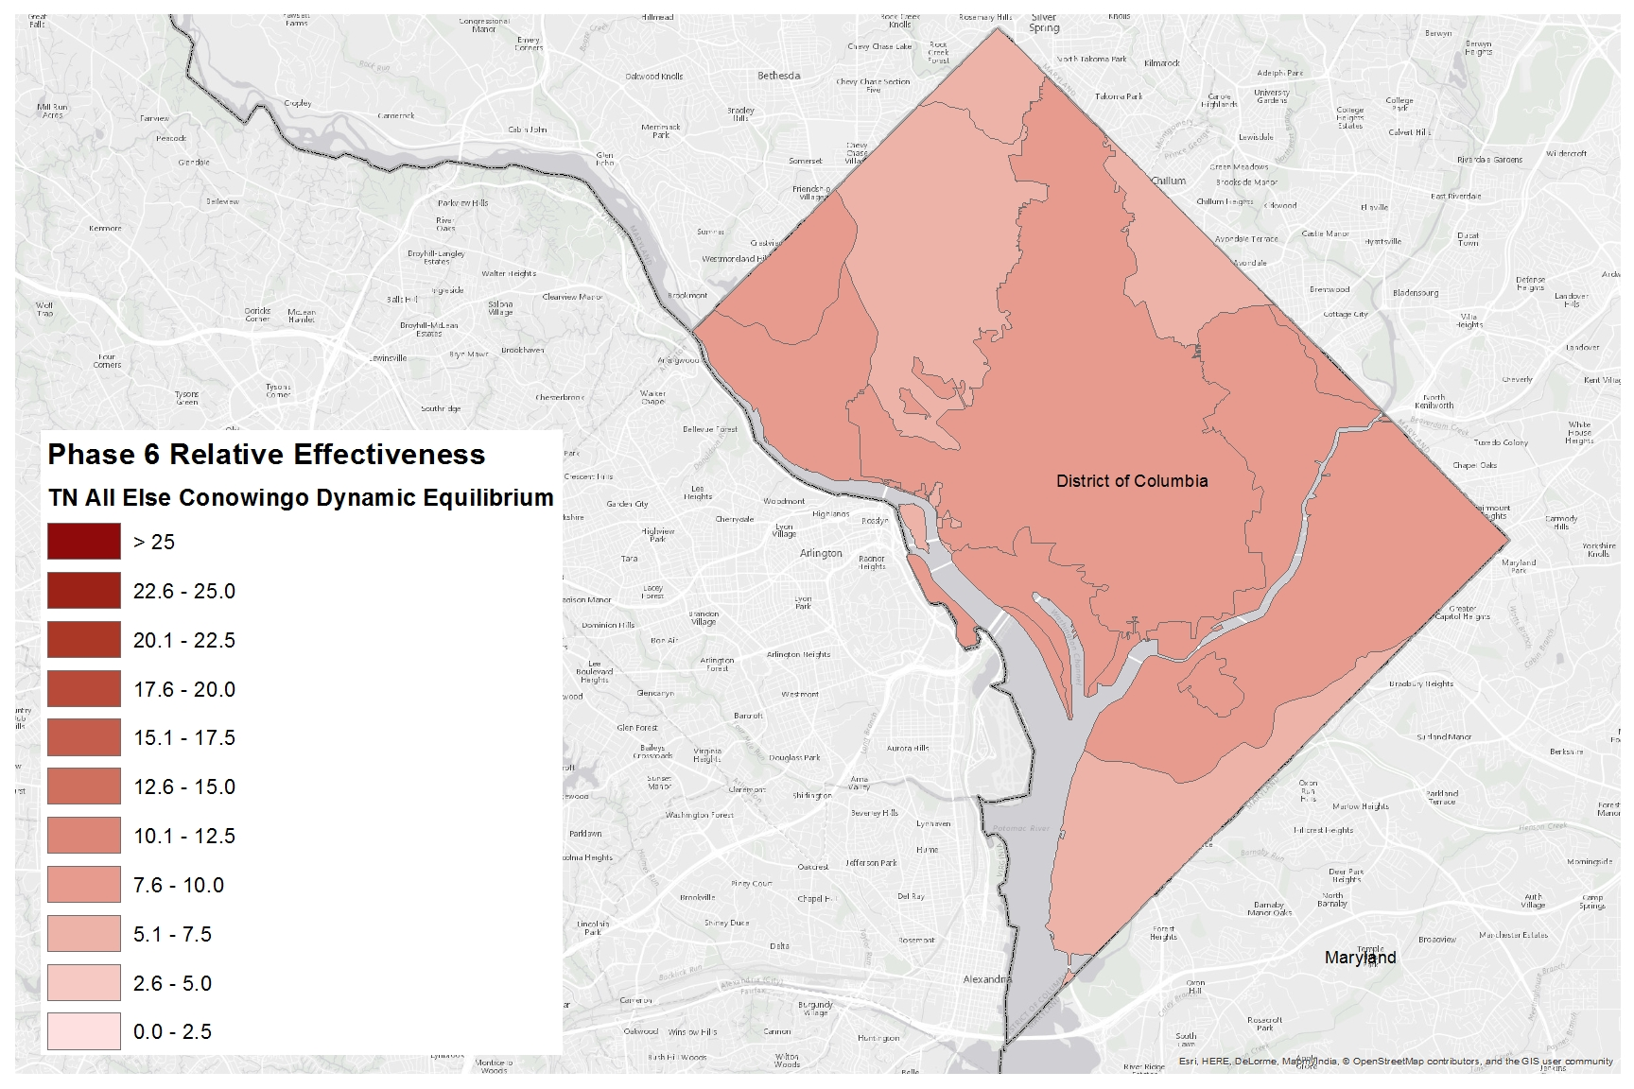
Nitrogen Relative Effectiveness
Phase 6, All Else, Conowingo Dynamic Equilibrium

Slide 16
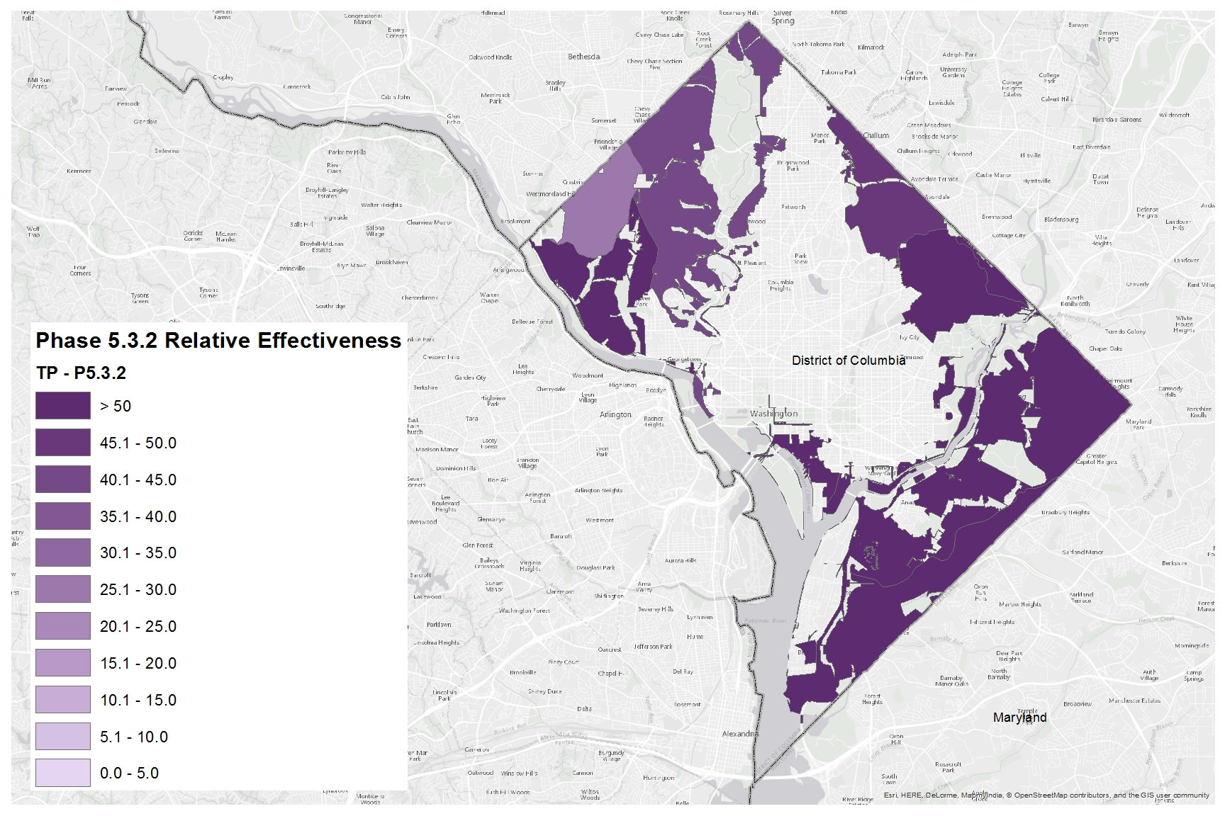
Phosphorus Relative Effectiveness
Phase 5.3.2

Slide 17
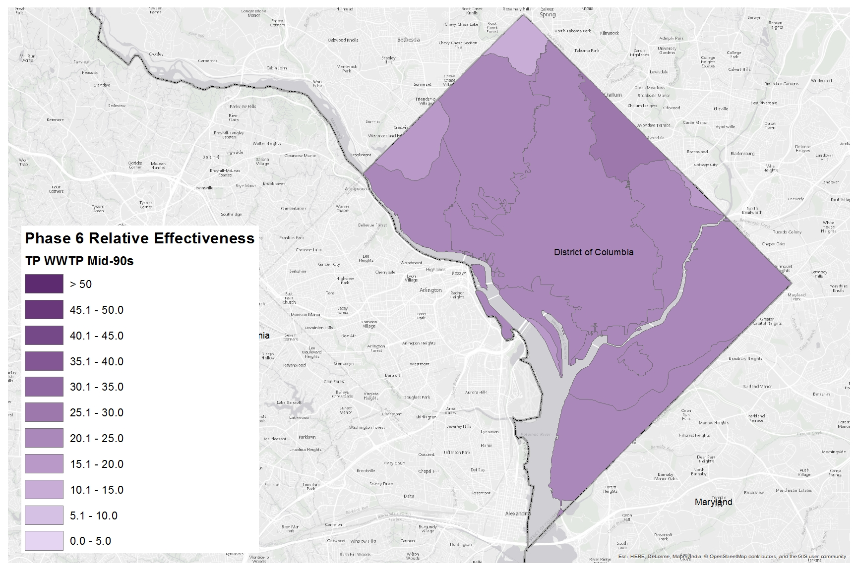
Phosphorus Relative Effectiveness
Phase 6, WWTP, Mid-90s

Slide 18
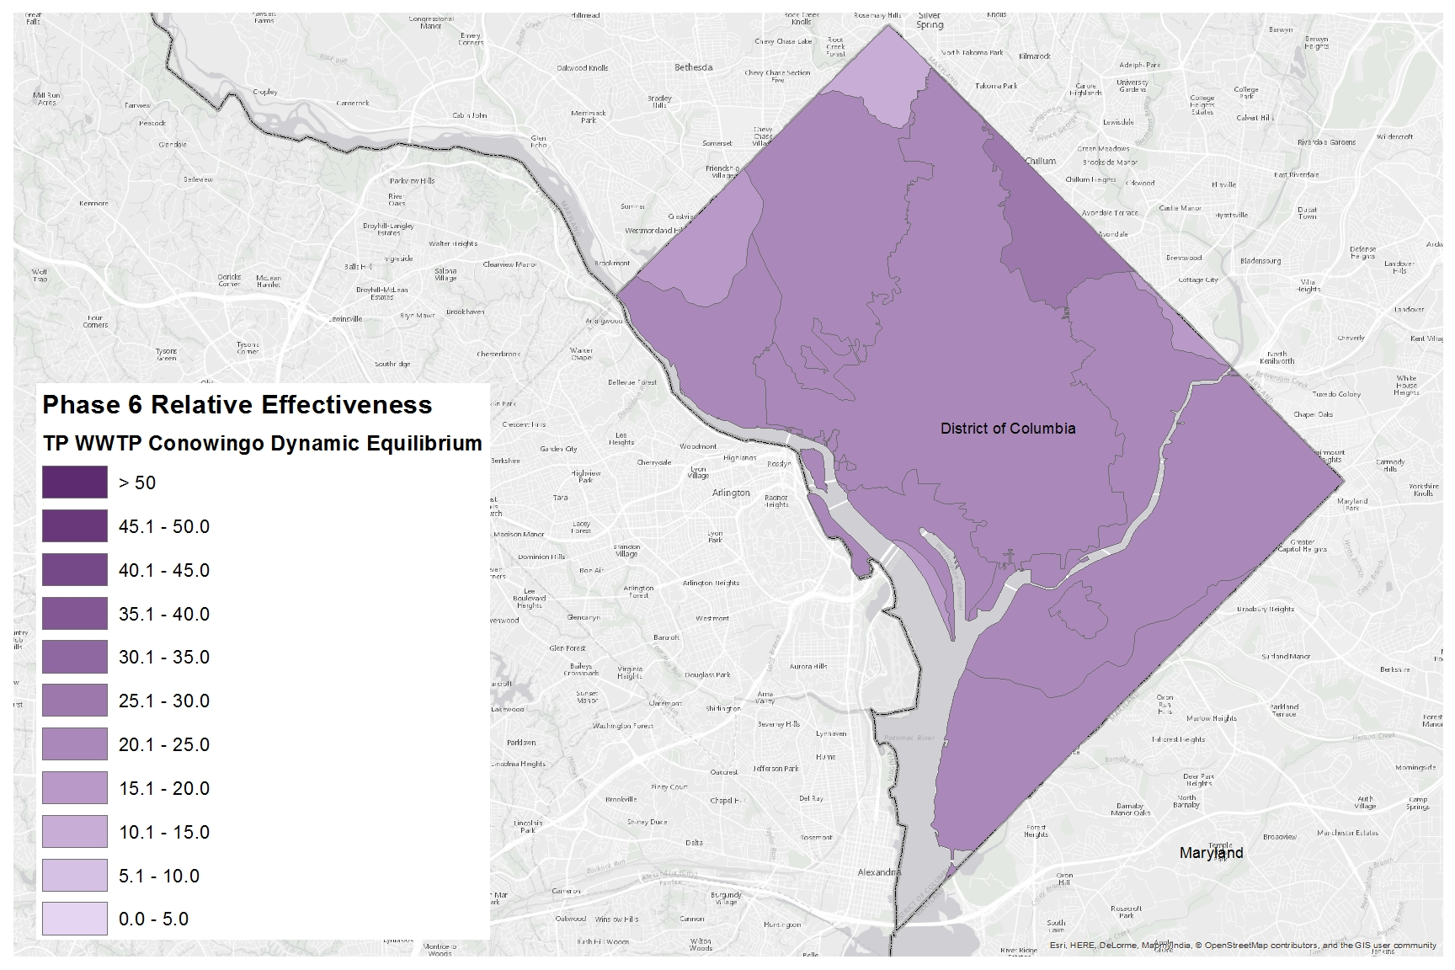
Phosphorus Relative Effectiveness
Phase 6, WWTP, Conowingo Dynamic Equilibrium

Slide 19
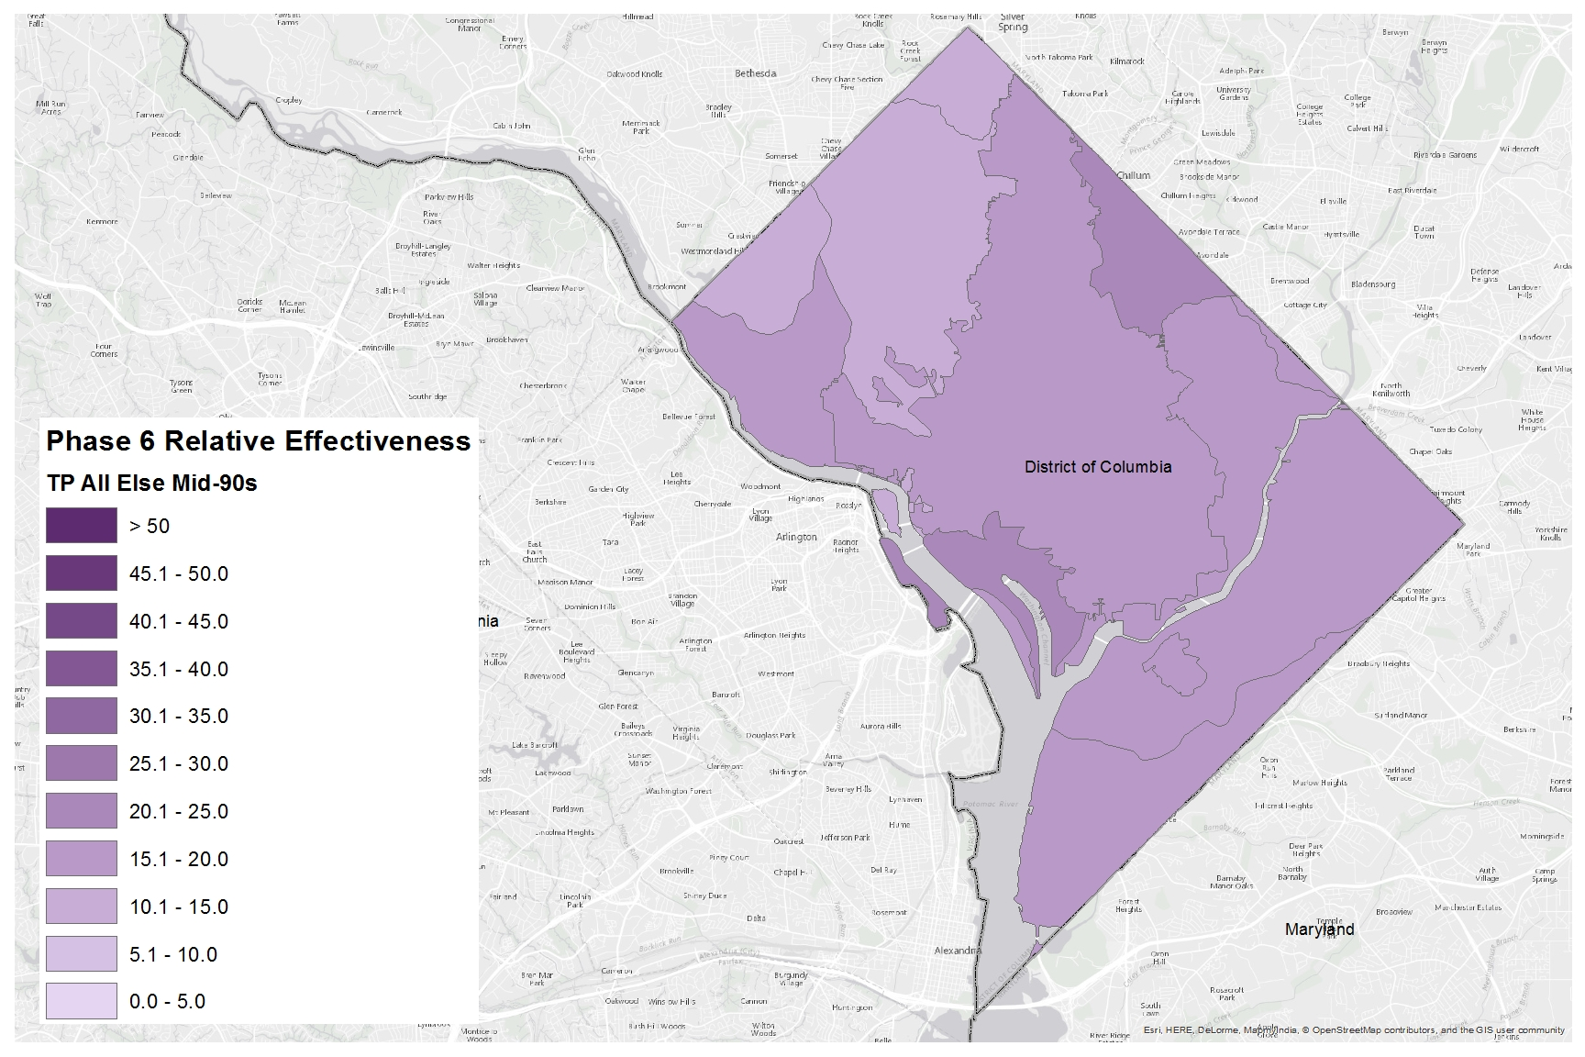
Phosphorus Relative Effectiveness
Phase 6, All Else, Mid-90s

Slide 20
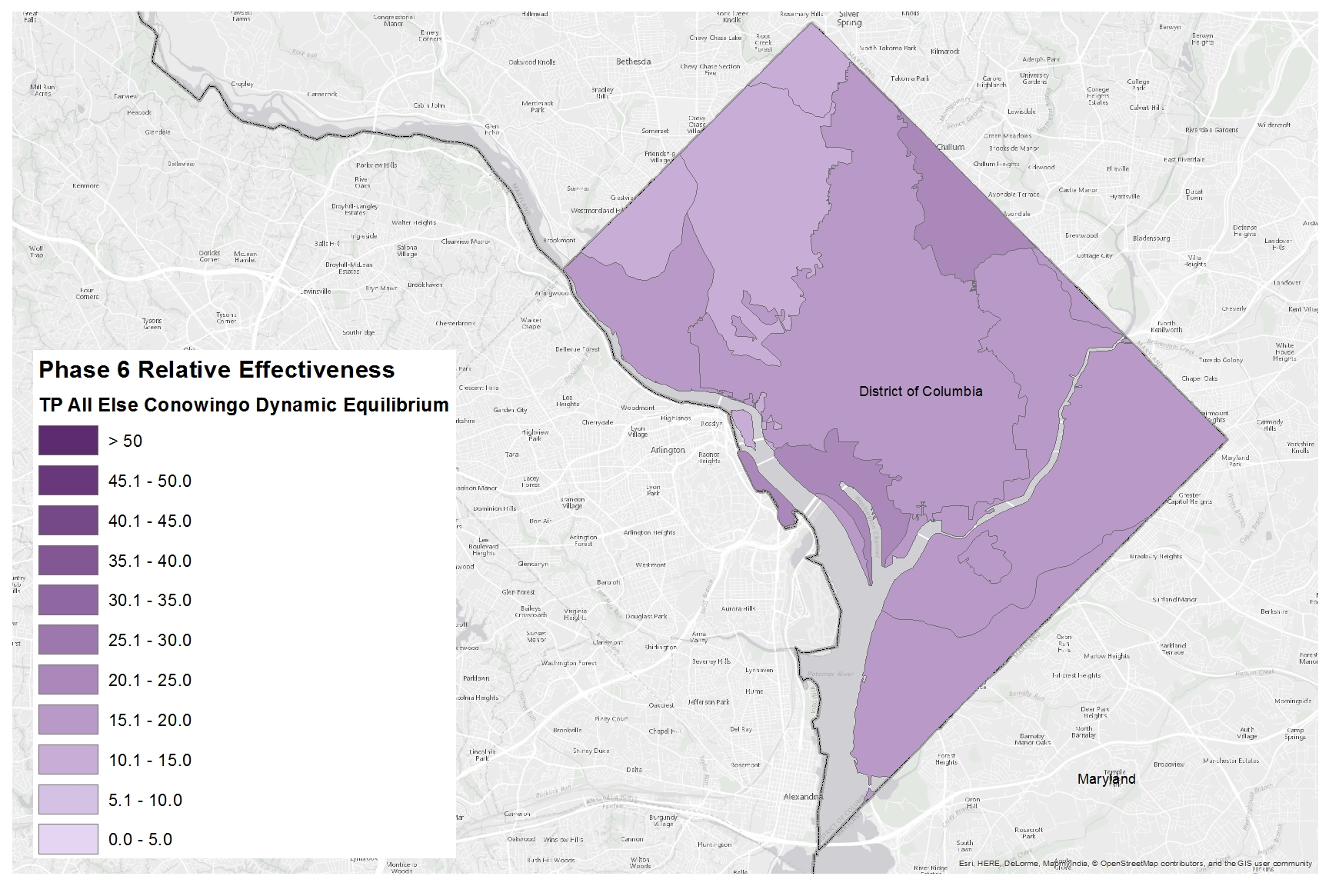
Phosphorus Relative Effectiveness
Phase 6, All Else, Conowingo Dynamic Equilibrium

