Slide 1
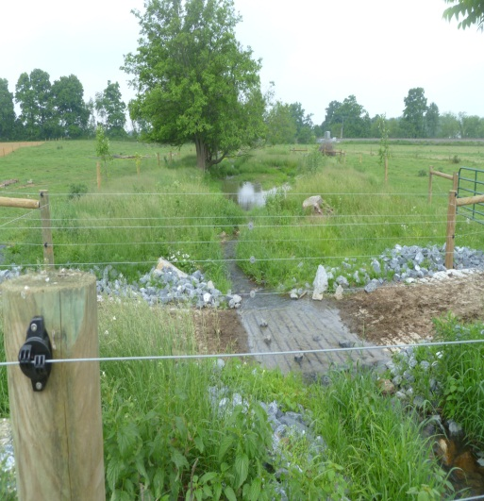
Farm Bill Update

Slide 2
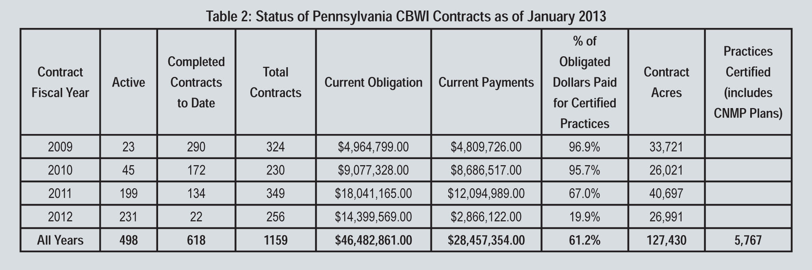
Last farm bill: a lot accomplished on working lands

Slide 3
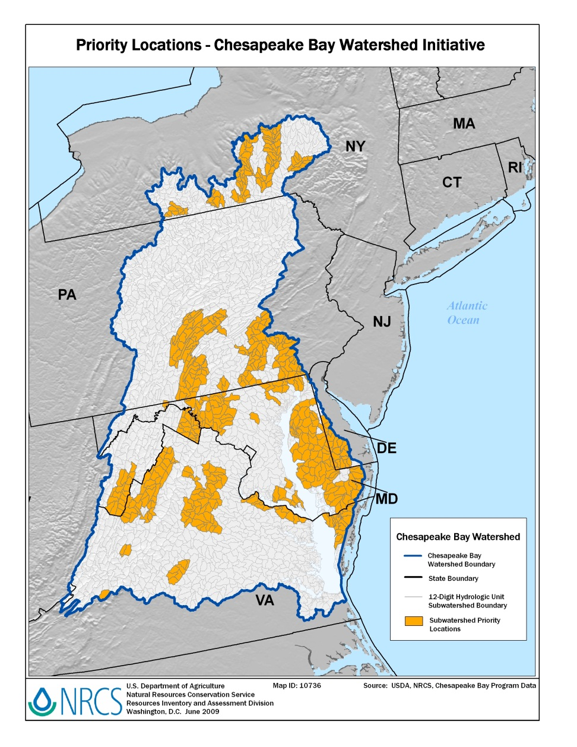
WHAT’S AFTER THE CHESAPEAKE BAY WATERSHED INITIATIVE?

Slide 4
The Regional Conservation Partnership Program (RCPP):
Consolidates four existing conservation programs: the Agricultural Water Enhancement Program (AWEP); the Chesapeake Bay watershed program (CBWP); the Cooperative Conservation Partnership Initiative (CCPI); and the Great Lakes Basin Program for Soil Erosion and Sediment Control (GLBP).
Is designed to deliver projects that improve soil quality, water quantity and quality, or wildlife habitat in a specific area or region. The consolidated program identifies projects at the state, regional and national levels that cover specific geographic areas.
Allows geographic and resource-specific targeting at scales as small as a sub-watershed level or as broad as a multi-state region like the Chesapeake, Great Lakes, or Mississippi river basin.

Slide 5
PROGRAM FUNDING
The program has mandatory funding of $100 million in no-year funds from 2013 through 2017. This funding would be obligated much as the CBWP funding is currently – applying the funding in RCPP project or CCA areas through covered programs.
In addition, the program reserves up to eight percent (the House mark includes six percent) of program funds or acres in each of the covered programs (i.e, EQIP, CSP and ACEP). The latter mechanism is similar to the process under the CCPI program, and like CCPI, any funds not obligated under the RCPP by April 1 are swept for use under the original covered program.

Slide 6
NATIONAL FUND ALLOCATION: COMPARISON BETWEEN HOUSE AND SENATE
Allocates annual funding to three funding pools:
40 percent of the funding for national projects (House: 50 percent)
25 percent of the funding for State level projects (administered by the state conservationist) (House: same)
35 percent of the funding for Critical Conservation Areas (CCA) (House: 25 percent).
Enables producers to enter into contracts either through a partner in partnership project areas, or directly with NRCS either in a partnership project area or in a CCA.

Slide 7
WATER QUALITY FOCUS: ALIGNMENT WITH BAY
Critical Conservation Areas
includes multiple States with significant agriculture production;
is covered by an existing regional, State, bi-national, or multistate agreement or plan with established objectives, goals and workplans and is adopted by a Federal, State, or regional authority;
has water quality concerns;
has water quantity concerns; or
is subject to regulatory requirements that could reduce the economic scope of agricultural operations within the area.

Slide 8
CRITICAL CONSERVATION AREAS
Up to six designated areas
Partners include governmental organizations like state or local governments, multistate water resource agencies or authorities, and Indian tribes; groups of producers like agricultural or silvicultural producer associations or farmer cooperatives; institutions of higher education like land-grant universities; and other organizations with a history of working cooperatively with producers to address local conservation priorities or critical watershed-scale natural resource concerns.
Partners are required to provide a significant contribution to the cost of the scope of the project. No funds can be used to pay administrative expenses of partners.
The Senate bill refers to multistate water resource authorities as eligible to enter into alternative funding arrangements as described below, but they are not explicitly listed in the definition of “eligible partner.” The House includes “an entity that is a water district, irrigation district, rural water district or association, or other organization with specific water delivery authority to producers on agricultural land” in the definition of “eligible partner.”

Slide 9
How DO WE BRING MONEY INTO THE BAY WATERSHED?
Gives higher priority to partnership applications that:
Assist producers with meeting or avoiding the need for a natural resource regulatory requirement;
Significantly leverage non-Federal resources and coordinate with other local, State, regional or national efforts;
Deliver high percentages of applied conservation to address conservation priorities or local, State, regional or national conservation initiatives; or
Provide innovation in conservation methods and delivery, including outcome-based performance measures and methods.

Slide 10
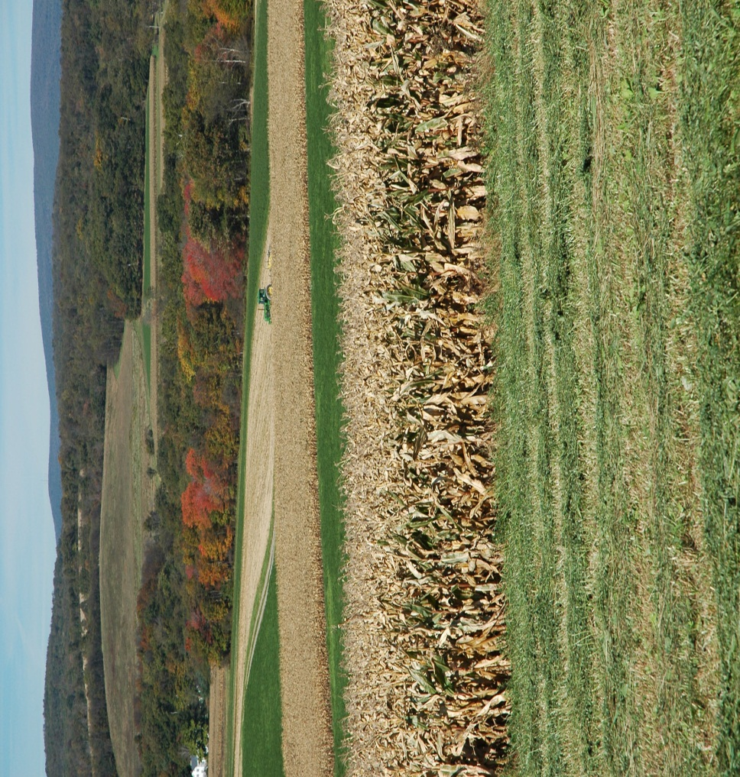
PROGRAM PARTICIPATION
Producers may participate in the program by entering into contracts with NRCS through a covered program, if:
they are in an area covered by a partnership project, or
they are in a designated CCA.

Slide 11
ReGionAL CONSERVATION PARTNERSHIPS
Agreements are entered into at either the national or state level following a competition:
Assisting producers to meet or avoid a natural resource regulatory requirement;
Leveraging non-federal financial and technical resources and coordinating with other conservation efforts;
Delivering high percentages of applied conservation to address conservation priorities;
Providing innovation in conservation methods or delivery, including outcome-based measures;
Having a high percentage of producers in the areas covered by the agreement; and
Other priorities as determined important to achieving the purposes of the program.
Achieve results within five years. Partner is to provide a close-out report on results.
The partner is authorized, at the request of a producer, to represent the producer in applying for NRCS assistance. A partner must provide a significant portion of the overall cost of the scope of the project.

Slide 12
ASSISTANCE TO PRODUCERS AND PAYMENTS
Operates using program authority and funds or acres from three covered programs:
Agricultural Conservation Easement Program (ACEP)
Environmental Quality Incentives Program (EQIP)
Conservation Stewardship Program (CSP)

Slide 13
ASSISTANCE TO PRODUCERS AND PAYMENTS
Contracts under the program can provide financial and technical assistance to:
producers participating in a project with a partner
producers that fit within the scope of a project with a partner, but who seek to implement an eligible activity independent of the partner, or
producers that are within a CCA designated by USDA.
A producer within a critical conservation area may also be within a designated project area as well, since a partner agreement area can be included in a CCA.
For example, if the Chesapeake Bay watershed were designated as a CCA for water quality, a partner group could apply to address nutrient runoff in an area within the watershed. A producer in the area could apply through the partner; apply directly to NRCS under the scope of the project; or directly to NRCS under the critical conservation area designation. Conceivably, some producers could be covered under multiple partnership projects addressing different conservation needs, as well as being located within a designated CCA.

