Slide 1
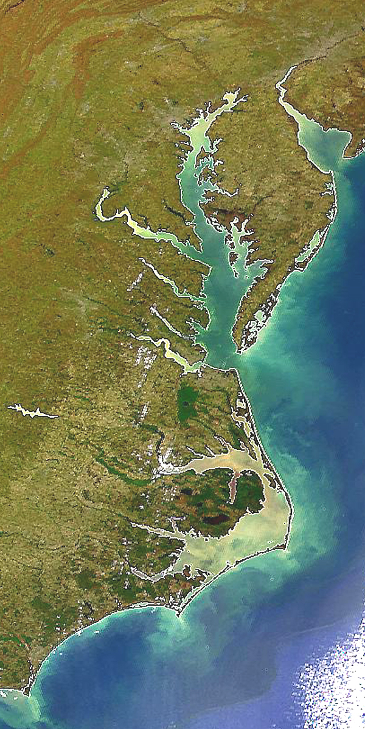

State Profile
Delaware

Slide 2
DE Draft Phase III WIP Planning Targets + Reference Loads
Nitrogen Load
 | No-Action (M lbs) | E3 (M lbs) | 2013 Progress (M lbs) | Phase II WIP (reference) (M lbs) | Draft Phase III WIP Planning Target (M lbs)
DE Eastern Shore | 8.60 | 2.42 | 6.59 | 4.11 | 4.59
Phosphorus Load
 | No-Action (M lbs) | E3 (M lbs) | 2013 Progress (M lbs) | Phase II WIP (reference) (M lbs) | Draft Phase III WIP Planning Target (M lbs)
DE Eastern Shore | 0.207 | 0.064 | 0.115 | 0.086 | 0.120

Slide 3
DE Nitrogen Loads-Goals, Phase 5.3.2

Slide 4
DE Nitrogen Loads-Goals, Phase 6

Slide 5
DE Nitrogen Change in Level of Effort

Slide 6
DE Phosphorus Loads-Goals, Phase 5.3.2

Slide 7
DE Phosphorus Loads-Goals, Phase 6

Slide 8
DE Phosphorus Change in Level of Effort

Slide 9
DE Nitrogen – Phase 6 Level Of Effort
(NoAction:E3 Reference)

Slide 10
DE Phosphorus – Phase 6 Level Of Effort
(NoAction:E3 Reference)

Slide 11
DE Nitrogen – Phase 6 Loads and Target
Where did the
reductions come from?
1985
2013
Draft Phase III WIP
Planning Target

Slide 12
DE Phosphorus – Phase 6 Loads and Target
Where did the
reductions come from?
1985
2013
Draft Phase III WIP
Planning Target

Slide 13
DE Nitrogen – Phase 6 Scenario Loads and Draft Target

Slide 14
DE Phosphorus – Phase 6 Scenario Loads and Draft Target

Slide 15
Nitrogen – Phase 6 Relative Effectiveness
Effect of Nitrogen Load Reduction on WQ Standard Attainment
A = Above Fall Line B = Below Fall Line

Slide 16
Phosphorus – Phase 6 Relative Effectiveness
Effect of Phosphorus Load Reduction on WQ Standard Attainment
A = Above Fall Line B = Below Fall Line

Slide 17
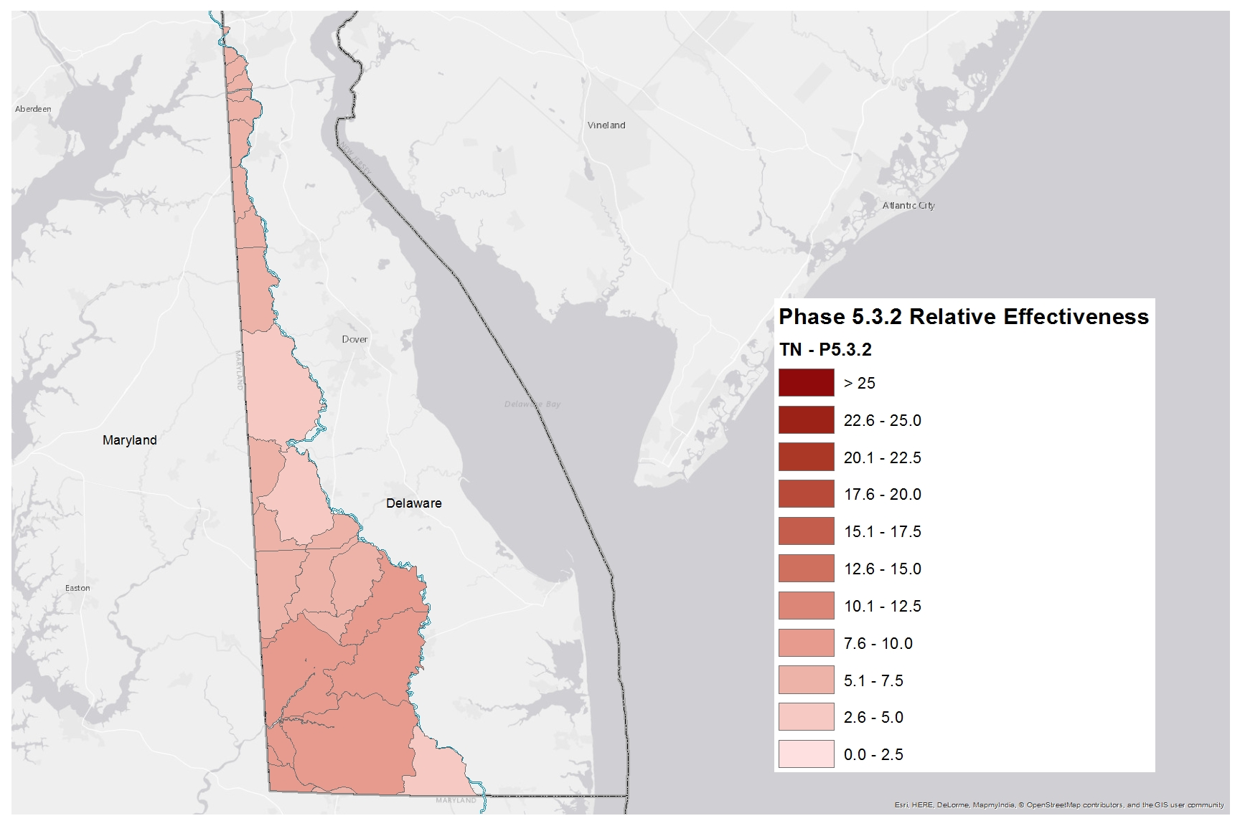
Nitrogen Relative Effectiveness
Phase 5.3.2

Slide 18
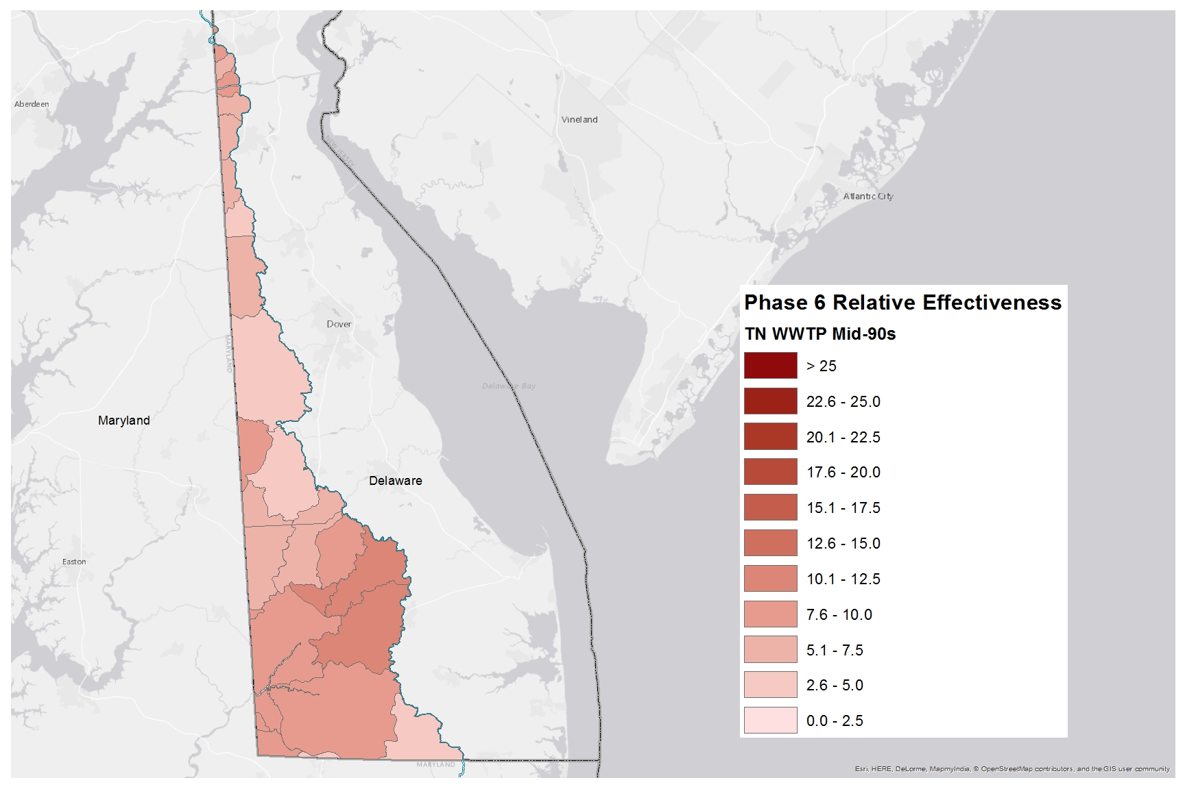
Nitrogen Relative Effectiveness
Phase 6, WWTP, Mid-90s

Slide 19
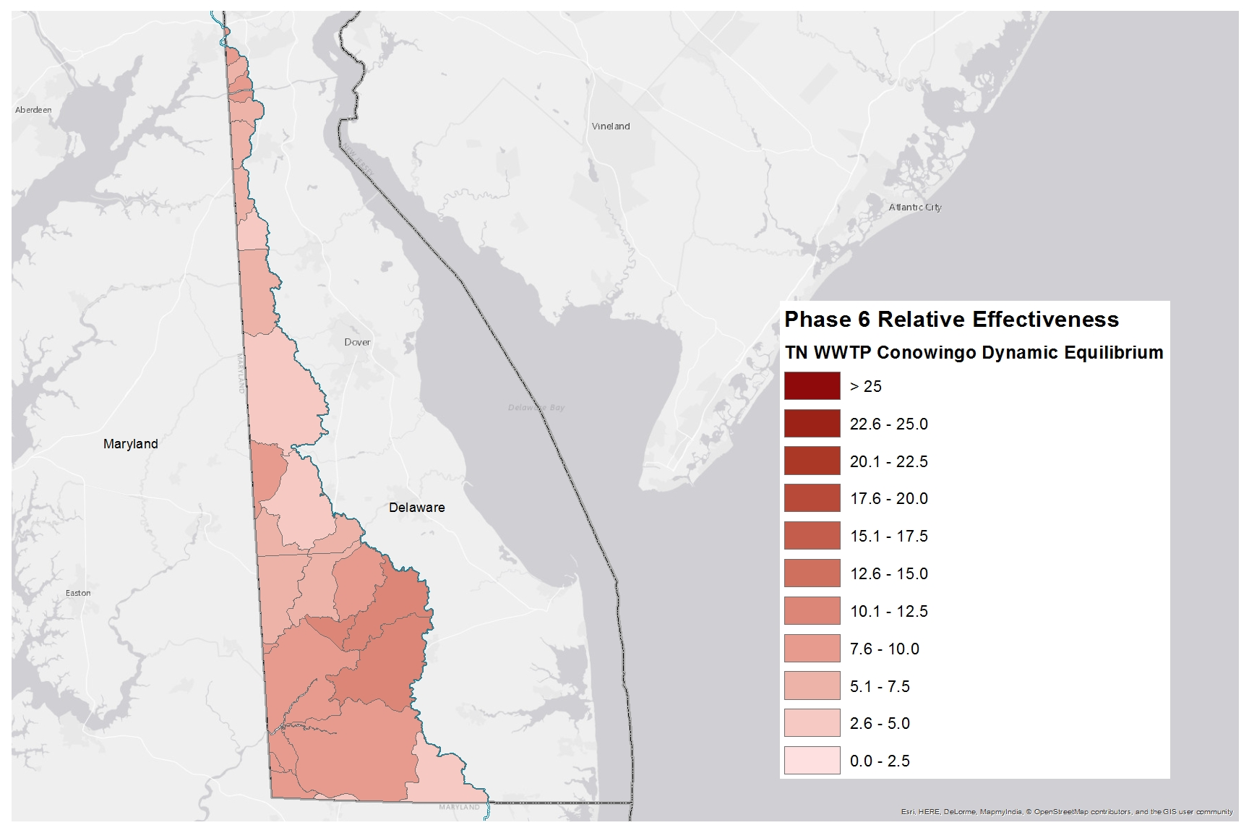
Nitrogen Relative Effectiveness
Phase 6, WWTP, Conowingo Dynamic Equilibrium

Slide 20
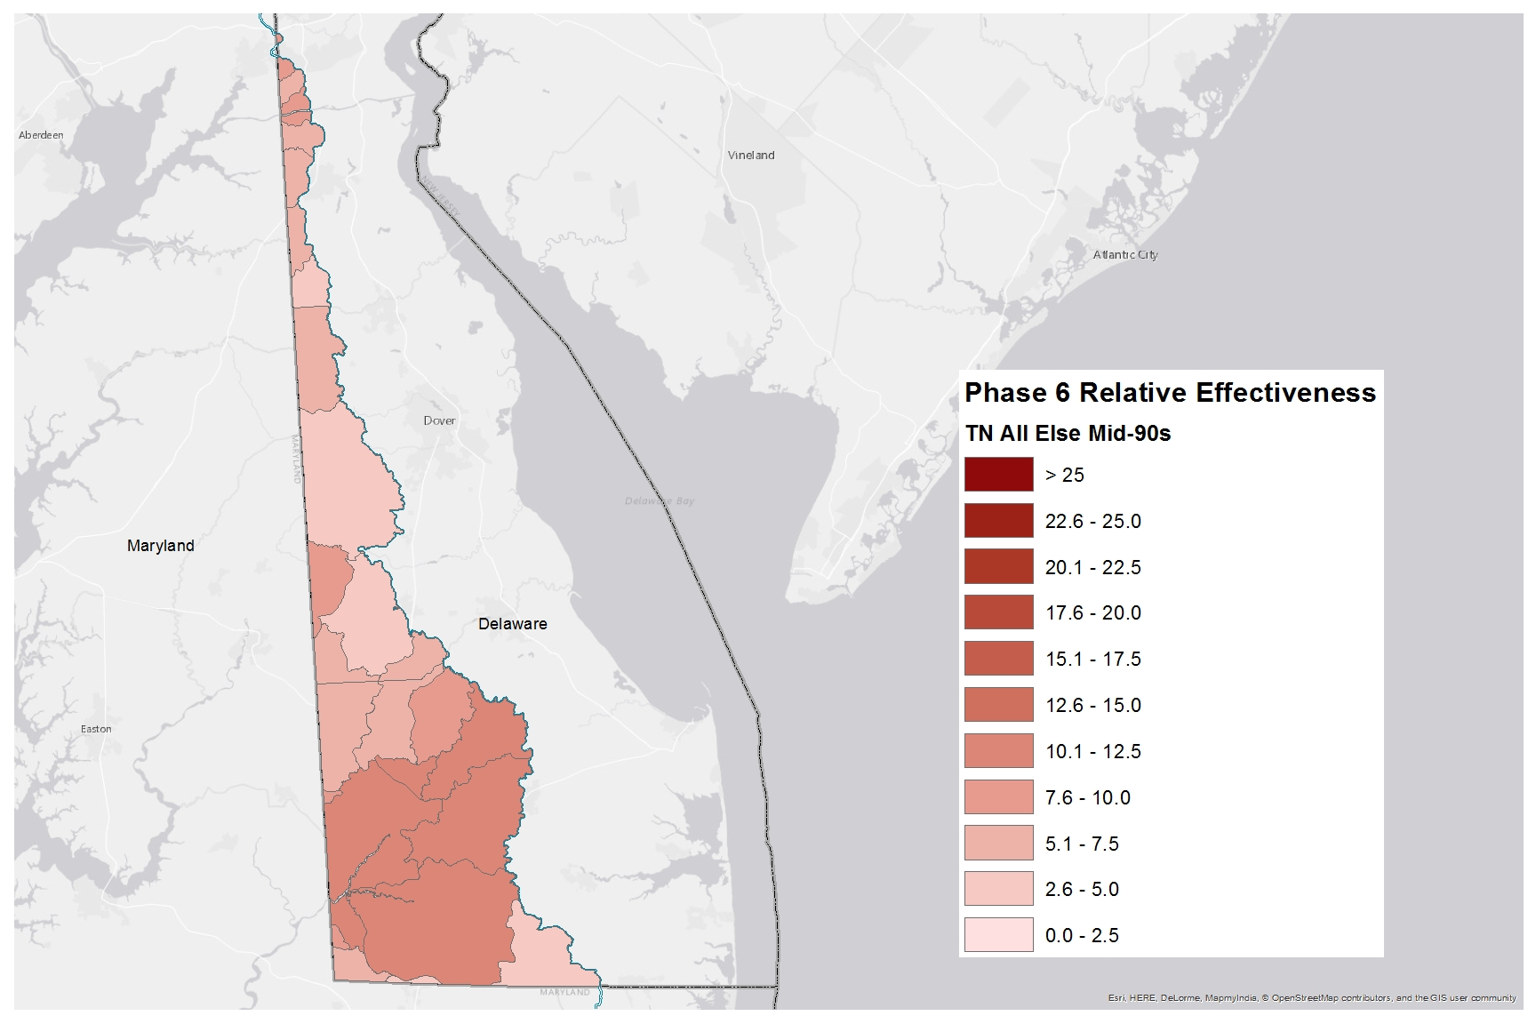
Nitrogen Relative Effectiveness
Phase 6, All Else, Mid-90s

Slide 21
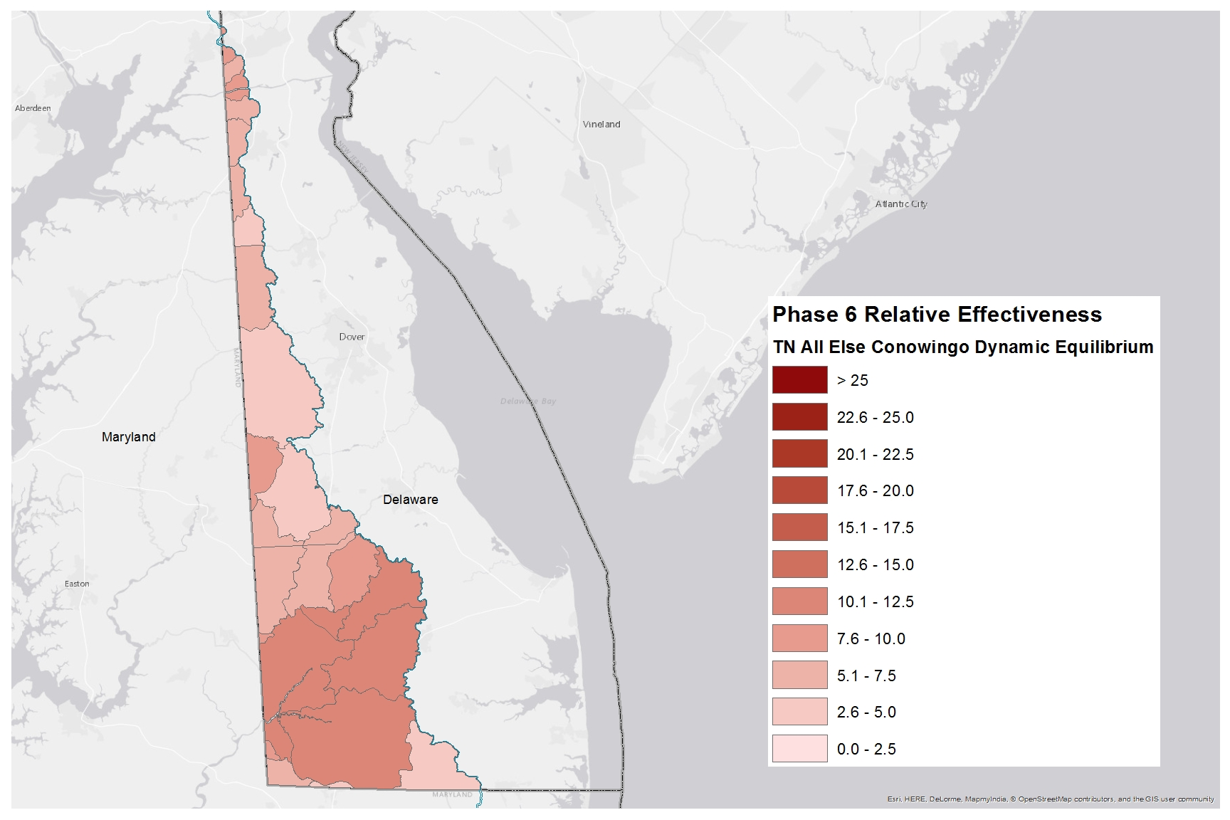
Nitrogen Relative Effectiveness
Phase 6, All Else, Conowingo Dynamic Equilibrium

Slide 22
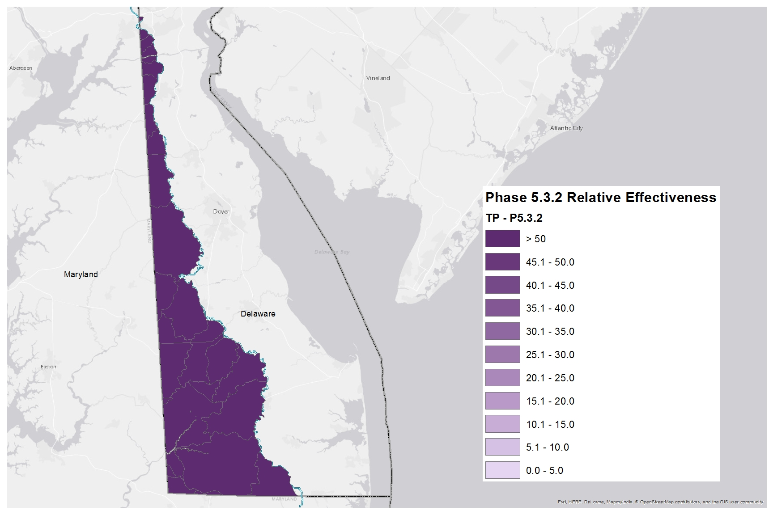
Phosphorus Relative Effectiveness
Phase 5.3.2

Slide 23
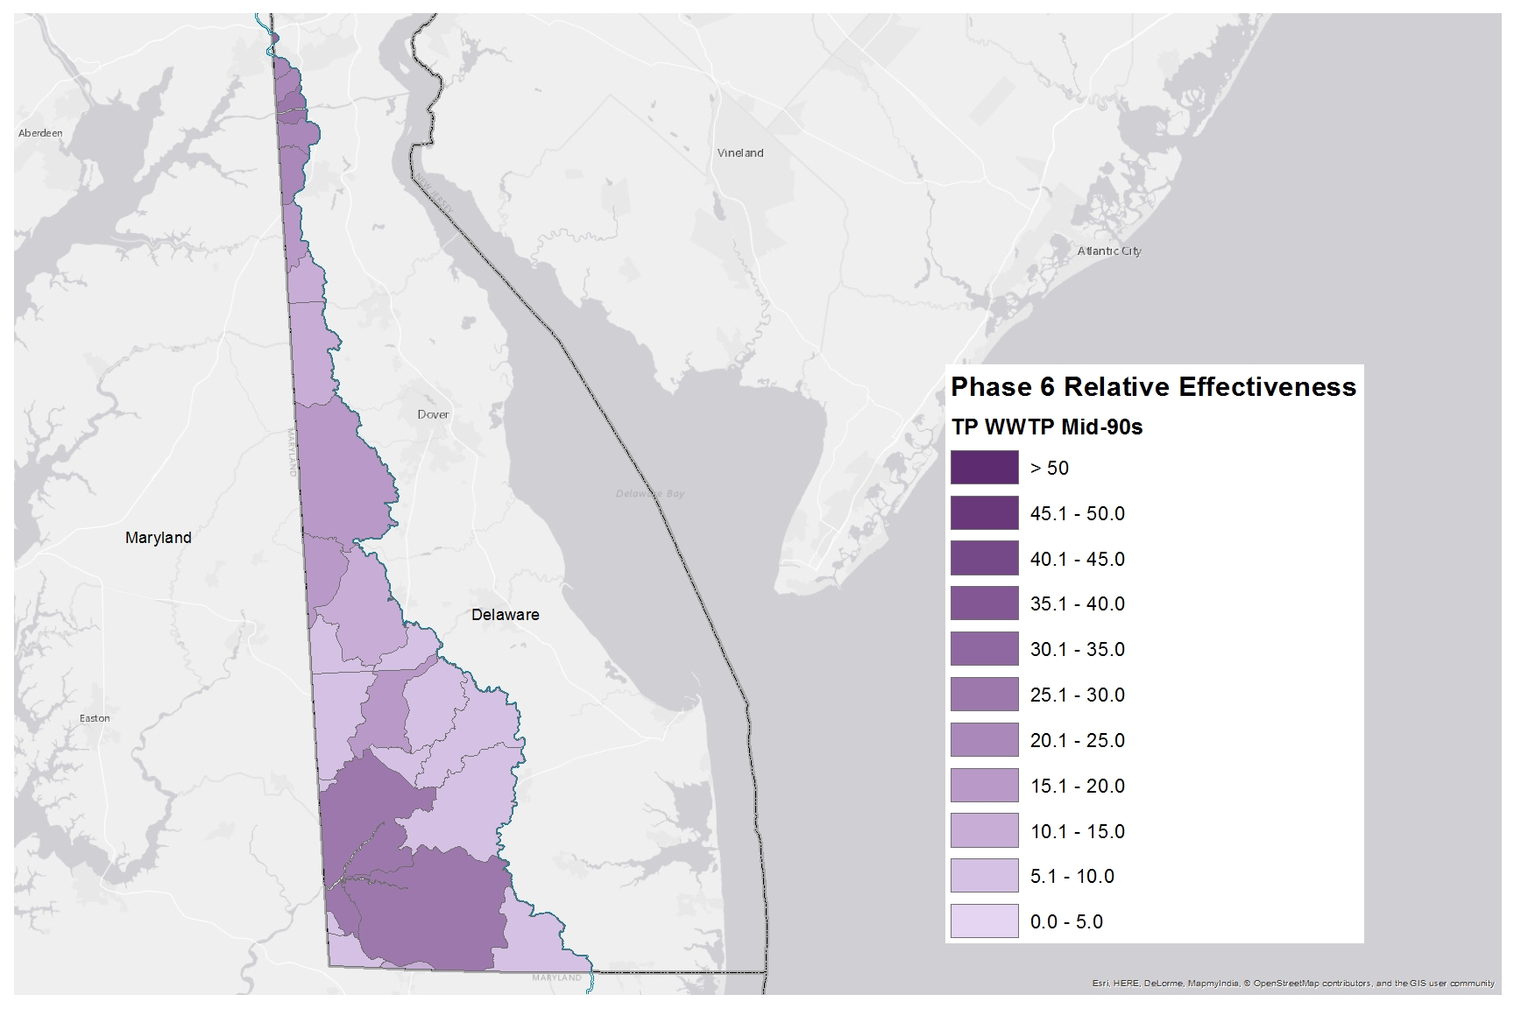
Phosphorus Relative Effectiveness
Phase 6, WWTP, Mid-90s

Slide 24
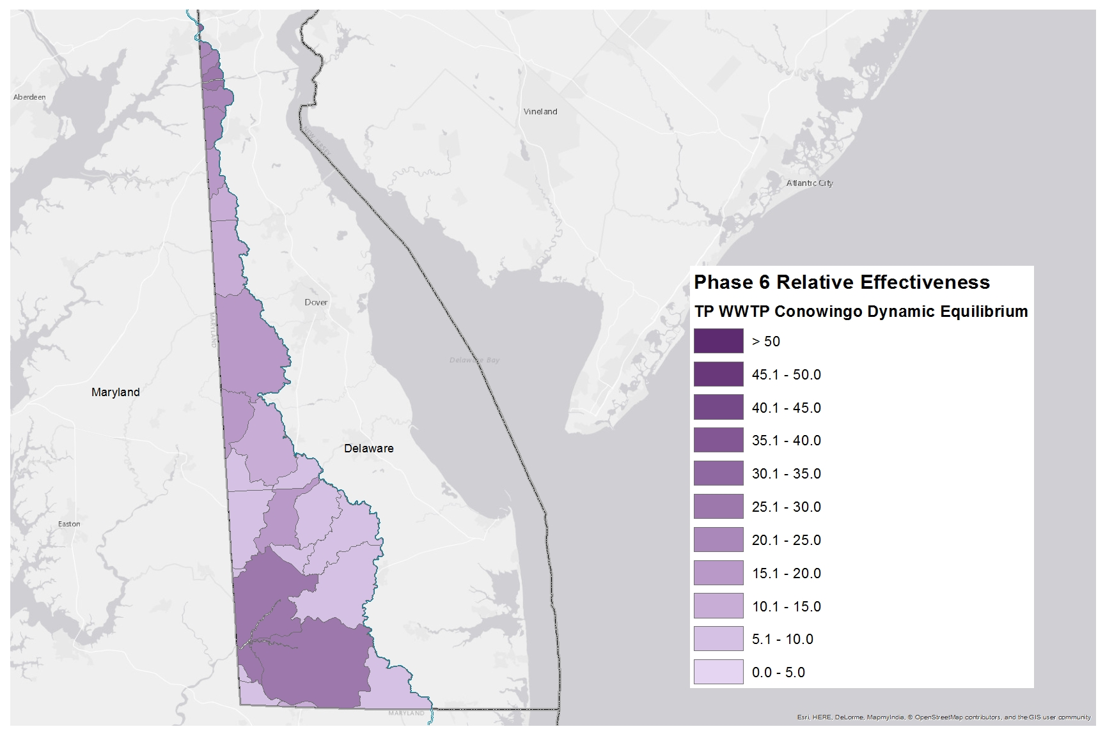
Phosphorus Relative Effectiveness
Phase 6, WWTP, Conowingo Dynamic Equilibrium

Slide 25
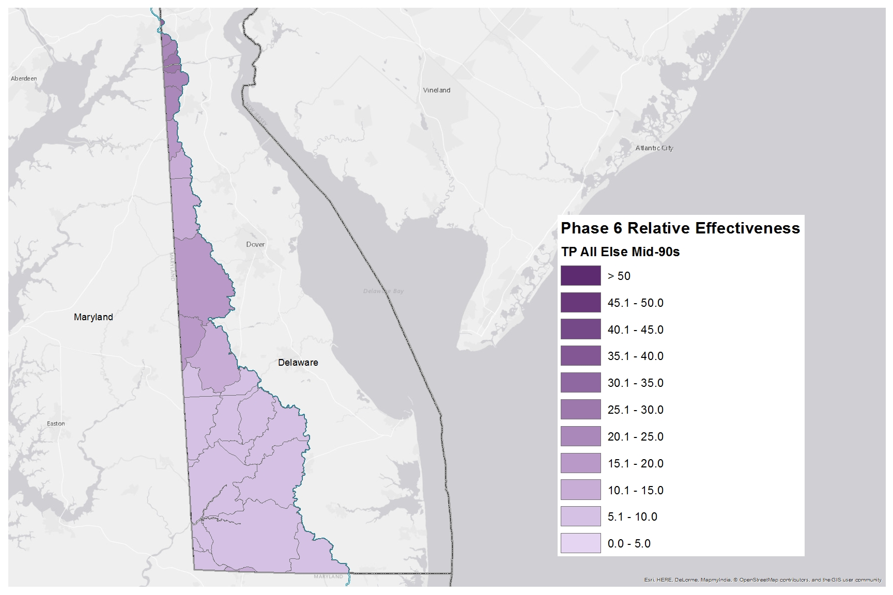
Phosphorus Relative Effectiveness
Phase 6, All Else, Mid-90s

Slide 26
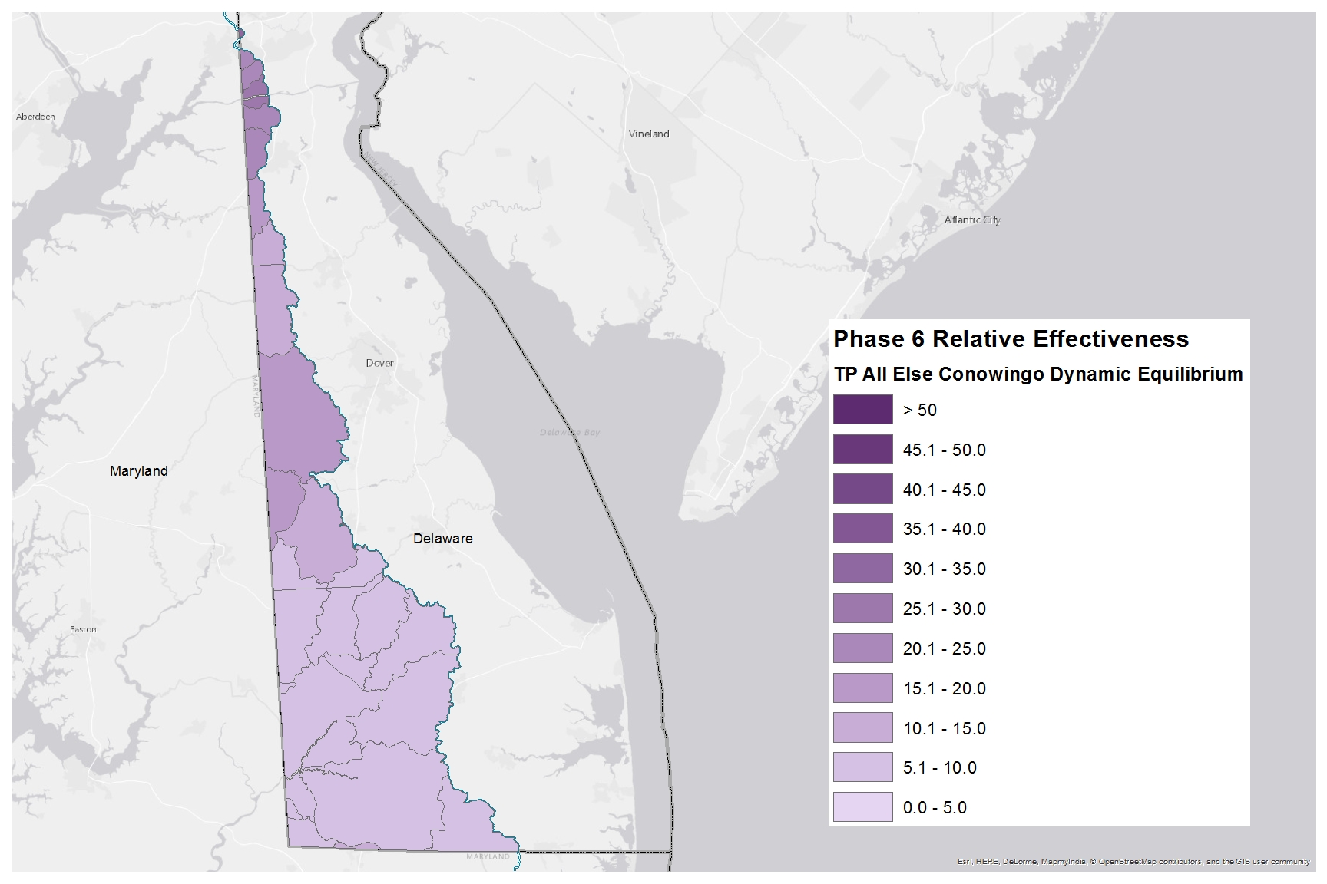
Phosphorus Relative Effectiveness
Phase 6, All Else, Conowingo Dynamic Equilibrium

