Slide 1


Diversity Workgroup Announcements
July 2022

Slide 2


Chesapeake Bay Diversity, Equity, Inclusion, and Justice Coordination Grant
DOEE seeks eligible entities to field a person(s) who will facilitate and coordinate the implementation of key elements of the Chesapeake Bay Program Diversity, Equity, Inclusion and Justice Implementation Plan. Approximately $150,000 is available. An applicant should be knowledgeable about DEIJ and Environmental Justice program management; DEIJ -related issues, concepts, practice, and principles; and multi-jurisdictional, regional, collaborative partnerships. Applications are due Friday, July 22, 2022. To learn more about this grant opportunity, FAQs, and how to apply, visit: https://doee.dc.gov/release/notice-request-applicants-cbp-diversity-equity-inclusion-and-justice-coordination-grant
Informational Webinar: The second informational webinar/conference call and opportunity for question and answers will be held on Thursday, July 7, 2022, 12:00 pm. Please see meeting information below. Attendance is not required.
Webex access>>
Meeting number: 2313 069 4460
Password: dSuPViaB643
Join by phone
+1-202-860-2110, Access code: 2313 069 4460”
Questions: For questions, please email 2022DEIJ.grants@dc.gov

Slide 3
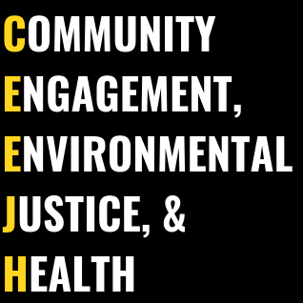


UMD EJ Symposium — Community Engagement, Environmental Justice & Health (ceejh.center)

Slide 4

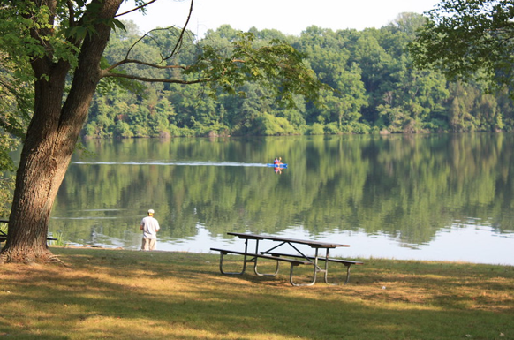
Montgomery Parks will be having a Latino Conservation Week Kick-Off Fiesta on July 16th, and we are looking for environmental organizations to table and help spread their message to the Latino community in Montgomery County, as well as asking them to spread the word about the event. We want it to be as accessible as possible and have partnered with Montgomery County DOT to provide free shuttles to the park from 2 metro stations. Event Logistics: Saturday, July 16th, 2022 Wheaton Regional Park- 2000 Shore field Road, Wheaton, Maryland 20902 5:00 pm -8:00 pm - Zumba 6-7pm, food trucks, lawn games, environmental activities, organization tables 8:00 pm - 10:00pm - Montgomery County Department of Environment Climate Stories screening, Disney's Encanto Transportation Logistics: FREE 3 buses will run every 20-25 minutes to shuttle from Wheaton Metro to Wheaton Regional Park from 4:30pm - 11:30pm 3 buses running every 20-25 minutes to shuttle from Glenmont Metro to Wheaton Regional Park from 4:30pm - 11:30pm
Montgomery Parks will be having a Latino Conservation Week Kick-Off Fiesta

Slide 5




The NASA GLOBE Observer team is planning a party and you are invited! GLOBE Observer Connection, Conversation, Celebration (GO C3) will be the first virtual gathering of volunteers who participate in The GLOBE Program through the GLOBE Observer app. Anyone may register to attend this free online event (please feel free to share this invitation). The event will take place on 26 July 2022 from 7-9 p.m. ET (6-8 CT, 5-7 MT, 4-6 PT). GO C3 will feature presentations from volunteers from all around the world, updates from the GLOBE Observer team, and interactive conversations with scientists and other volunteers. Learn more and register: https://go.nasa.gov/3NATpsu

Slide 6
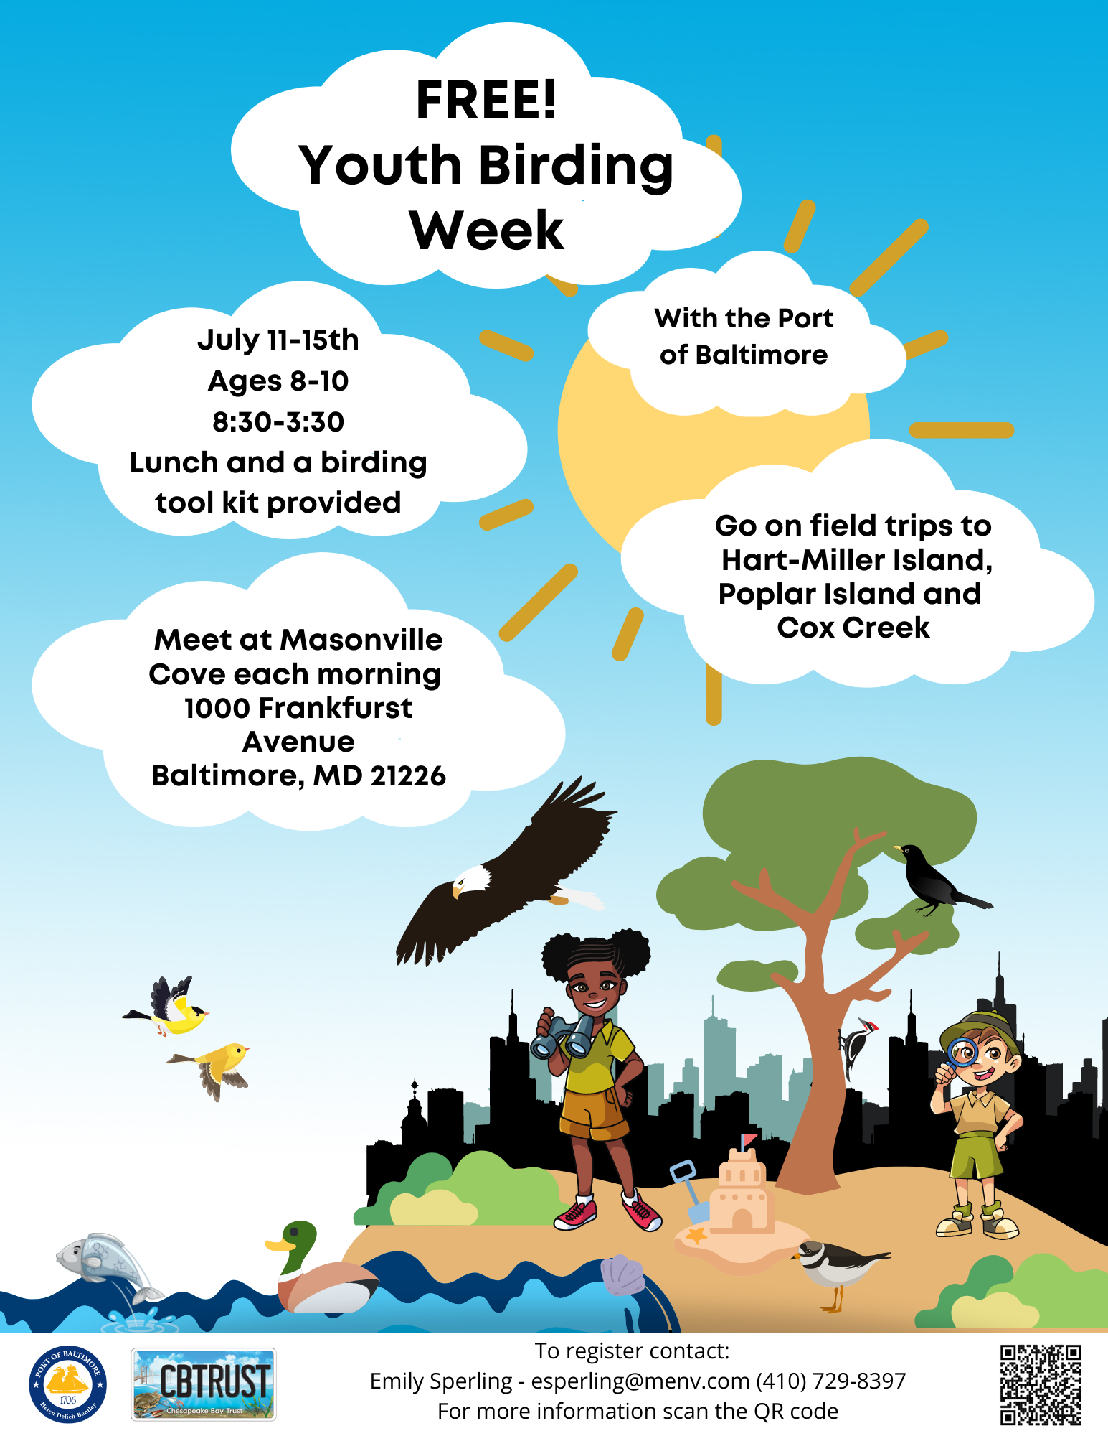

Slide 7

NORTHERN NECK SOIL & WATER CONSERVATION DISTRICT ANNOUNCES PERMANENT, FULL-TIME EMPLOYMENT OPPORTUNITY: MARKETING & OUTREACH SPECIALIST WARSAW, VA - The Northern Neck Soil & Water Conservation District (NNSWCD), a political subdivision of the Commonwealth of Virginia, is seeking a permanent, full-time Marketing & Outreach Specialist. This individual will assist in fulfilling the NNSWCD’s mission of promoting the stewardship of natural resources through leadership, education, and technical assistance within Lancaster, Northumberland, Richmond, and Westmoreland Counties. The Marketing & Outreach Specialist shall have a degree or extensive experience in advertising, education, marketing, or public relations with a demonstrated history of professionalism and proficiency in graphics design software.
The job responsibilities include, but are not limited to:
Expanding community outreach programs inclusive of diverse populations;
Marketing the availability of NNSWCD programs and accomplishments;
A complete Job Description and fillable NNSWCD Employment Application are available at: www.nnswcd.org/employment.
Permanent, full-time with maximum 40 hours/week.
Salary Range: $35,000 - $55,000 based on qualifications, plus excellent benefits including health insurance, VRS, as well as paid leave.
Submit cover letter, resume, and NNSWCD Employment Application by 4:30 PM on August 12, 2022.
Email to: kathy.clarke@nnswcd.org or submit via postal service to:
Northern Neck SWCD
Attn: District Operations Manager
P.O. Box 220
Warsaw, VA 22572

Slide 8

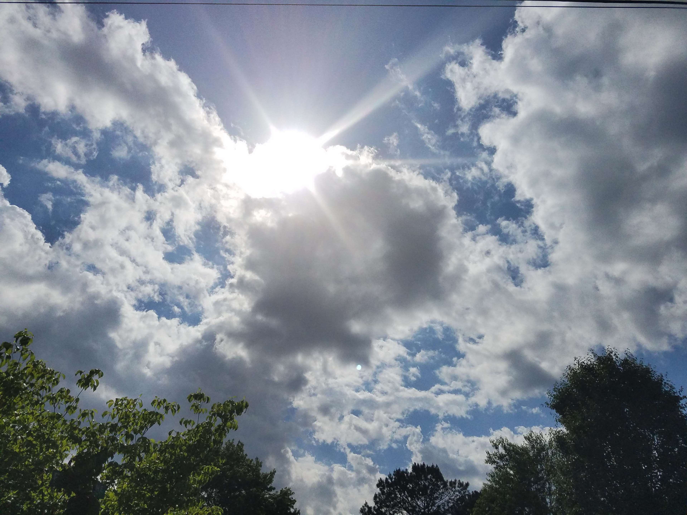
GBA was recently awarded an EPA Environmental Justice grant to build capacity for community stewardship of Farring Baybrook Park and Masonville Cove. The project goal is to support the growth of Friends of FB Park and Friends of Masonville Cove groups.
We are hiring an Environmental Justice Organizer to support this project - please share with people with a passion to strengthen community voices! Feel free to have your referred candidates email me directly.

Slide 9
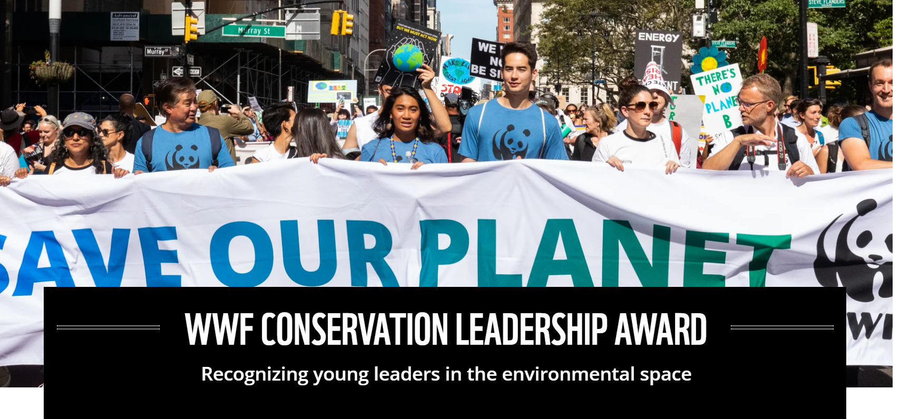
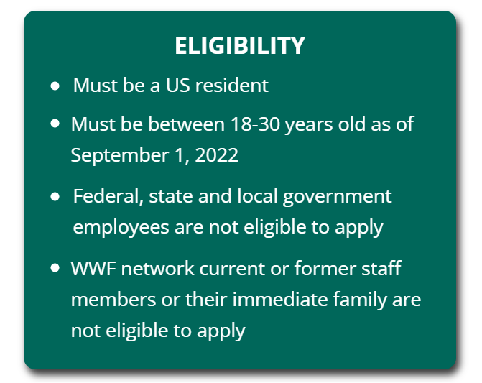

Deadline Sept 1st Apply Here

Slide 10

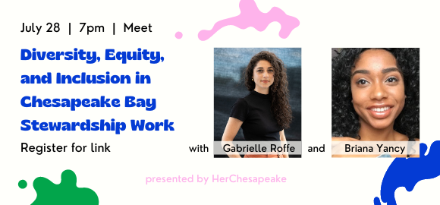
Briana Yancy and Gabrielle Roffe, DEIJ in Chesapeake Bay Restoration and Stewardship Work
Join the virtual conversation on Thursday, July 28 at 7:00pm.
Register through the Google form to get the virtual event link to attend on Google Meet. All attendees must register to join. Registration will stay open through the duration of the event - join when you can!
Virtual Meeting

Slide 11
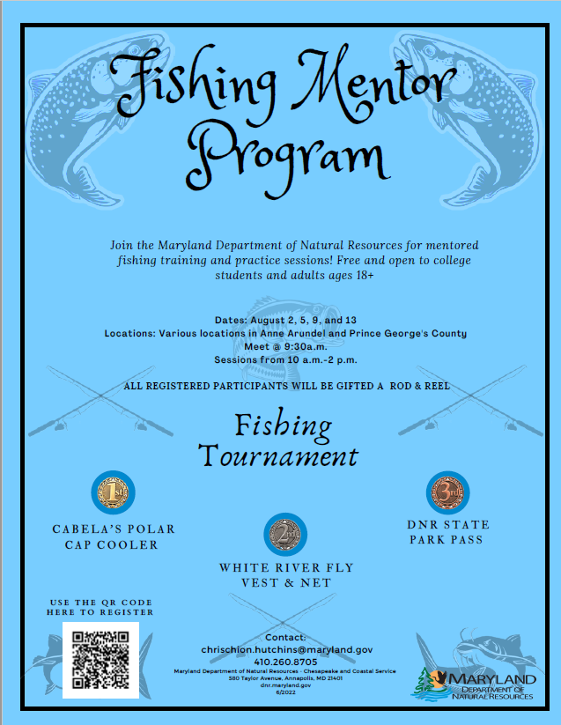

Slide 12
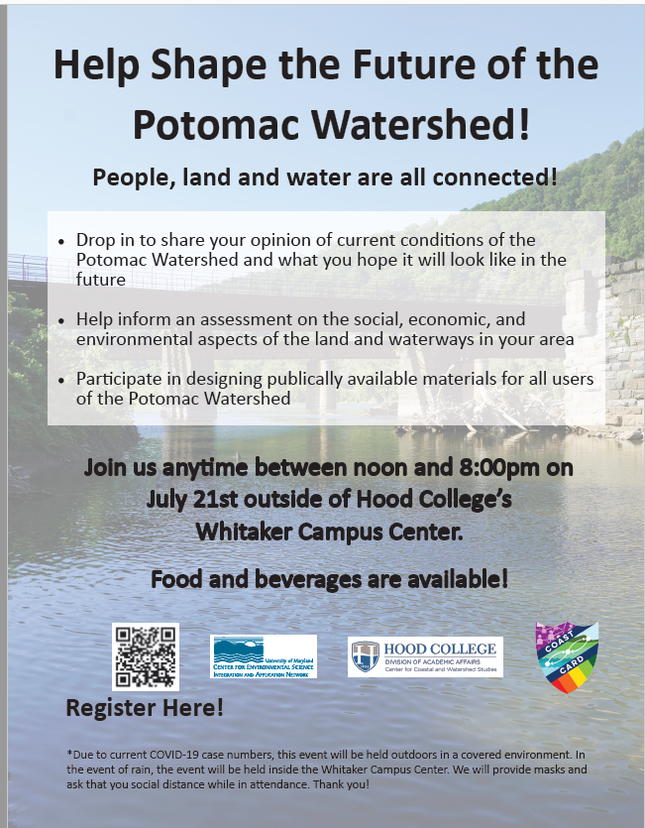

Slide 13

FRI provides integrated resources to frontline communities while bolstering shared knowledge and community rights to healthy, safe, and sustainable environments. FRI is releasing two grant opportunities through a Collective Action Fund at the Tides Foundation. These grants are intended for environmental justice and climate justice organizations serving frontline communities and will assist in building organizational capacity and promoting shared learning.
Recognizing organizations have different needs depending on their longevity, financial capacity, and development journeys, FRI plans to disburse funds via two tracks:
Track 1 - Organizational Strategy Development (four grants up to $150,000 each)
Track 2 - Organizational Capacity Building and Organizational Sustainability (eight grants up to $50,000)
To learn more about the grants please join us on Thursday July 21, at 2 PM ET for a live webinar and Q&A. To register, click here. If you cannot join the webinar, it will be recorded and posted on FRI’s webpage.
Also please feel free to share this grant opportunity with your networks, attached you will find a social media tool kit.

Slide 14

The Foundation for Food & Agriculture Research (FFAR) and the Walton Family Foundation announced a new program, Achieving Conservation through Targeting Information, Outreach and Networking (ACTION) to support innovative research that increases adoption of conservation practices. The program was developed in cooperation with the National Fish and Wildlife Foundation, which can provide additional support for practice implementation costs associated with opportunities developed through awarded projects.
Conservation practices include infield, edge-of-field, and edge-of-stream practices that retain and filter runoff and shallow groundwater. Despite their benefits to soil health, watershed restoration, and climate resiliency, adoption rates remain low, on less than 10% of all US croplands. The ACTION program seeks to increase adoption by strengthening technical service and outreach.
FFAR and the Walton Family Foundation anticipate awarding grants ranging from $200,000 to $500,000 for a total of approximately $1 million to compare and optimize outreach strategies. Projects that support the Edge of Field Roadmap and commit to implementing conservation practices through a partnership with the National Fish and Wildlife Foundation will be prioritized. As the Walton Family Foundation provided matching funds for this program, applicants are not required to secure a match; however, securing additional funds that FFAR can match is encouraged.
Pre-applications for this opportunity are due on August 31, 2022. More information, including details on how to apply, is available on the ACTION program RFA webpage.

Slide 15
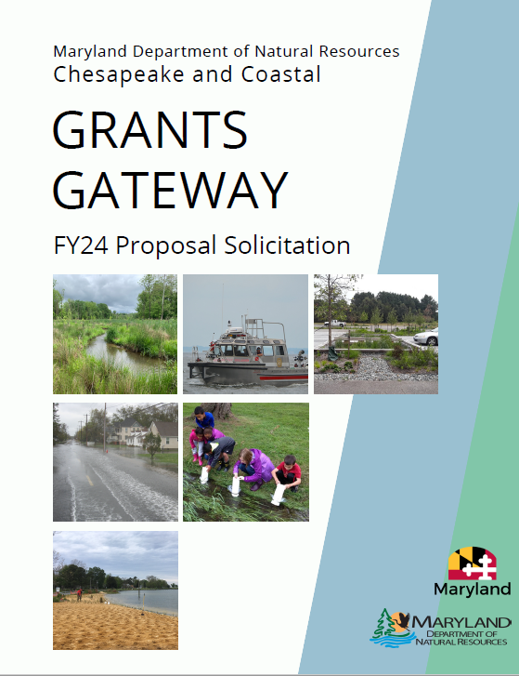
Deadline for Outcome 5 is September 16, 2022
Deadline for all other Outcomes is December 15, 2022
Apply Now: https://dnr.maryland.gov/ccs/Pages/funding/grantsgateway.aspx

