Slide 1
Chesapeake Bay Program
Diversity Workgroup Announcements
March 1, 2022

Slide 2

Today’s Meeting Focus:
Special thank you to the speakers BeKura Shabazz, Alex Smith and Wellington Ashe. Also, to Marisa Baldine, Rachel Felver and Jake Solyst from the Communications Team for their collaboration and support

Slide 3

Please remember jobs, internships and other opportunities will continue to be shared via the Bay Brief. You can still send that information to Briana or send it directly to Marisa Baldine (mbaldine@chesapeakebay.net) 😊

Slide 4
Diversity Workgroup Feedback and Actions
63% of respondents preferred bimonthly meetings that were 2 hours or 90 minutes. ACTION: for the next 6 months, we will schedule bimonthly 90 minute meetings.
0% of respondents preferred in person meetings. ACTION: for the next 6 months, we will schedule virtual meetings.
Respondents were almost evenly split between where they find value in our quarterly meetings: networking, updates about CBP, and training/learning opportunities. ACTION: Provide all 3 opportunities during bimonthly meetings over the next 6 months.
In the open-ended responses, we learned that you would like increased structure with time for learning, working, and networking. For our first bimonthly meeting,

Slide 5

Funding Opportunity - Small Watershed Grants
2022 Small Watershed Grants (SWG) program for projects within the Chesapeake Bay watershed that promote voluntary, community-based efforts to protect and restore the diverse and vital habitats of the Chesapeake Bay and its tributary rivers and streams. Applications are due April 21, 2022.
SWG Implementation (SWG-I) grants of $75,000-$500,000 will be awarded for projects that result in direct, on-the-ground actions to protect and restore water quality, species, and habitats in the Bay watershed
SWG Planning and Technical Assistance (SWG-PTA) grants up to $75,000 will be awarded for projects that enhance local capacity to implement future on-the-ground actions through community-based assessment, planning, design, and other technical assistance-oriented activities.
Non-federal matching funds are encouraged but not required and NFWF anticipates record program funding available.

Slide 6

Collaboration Opportunity
In 2021, the NPS Chesapeake Bay Office hosted the inaugural year of the Chesapeake Youth Initiative in partnership with the NOAA Chesapeake Bay Office and the CBP Education Workgroup.
The Chesapeake Youth Initiative aims to celebrate youth-voice at the Chesapeake Bay Program while supporting youth leaders who are working to influence environmental change in their communities
Help us amplify youth voice in the Chesapeake Bay Program by becoming a Chesapeake Youth Initiative Mentor! As a mentor, you will share your knowledge and expertise with the Youth Ambassadors as they work to implement an action project that benefits their community. Mentors should be knowledgeable about the Chesapeake Bay Watershed Agreement, excited and willing to engage with high school students, and have a career related to the environment. To find out more about participation details and the timeline for mentors, email nortoncolleen88@gmail.com

Slide 7

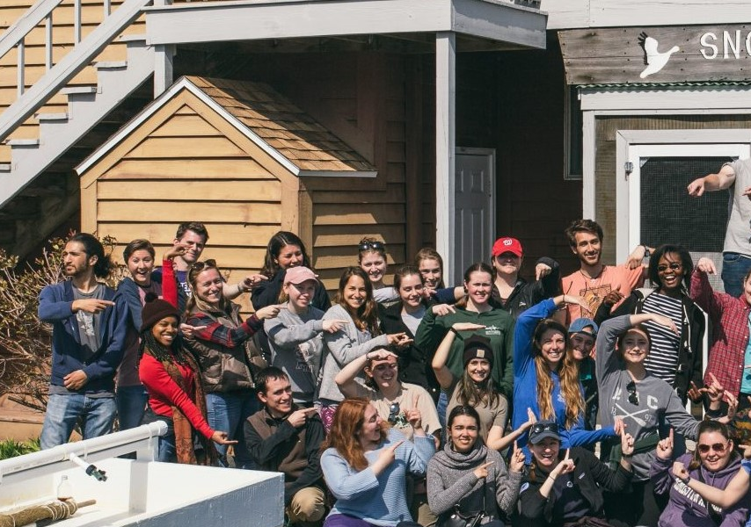
Chesapeake Conservation Corps Member Applications Closing Soon
The Chesapeake Conservation Corps places young adults (ages 18-25) with nonprofit organizations or government agencies to work fulltime in the environmental field for a one-year term of paid service. The Corps provides young professionals with experience, leadership and professional development training, mentorship, and a support network with other young environmentalists. Positions offered by host organizations are in the fields of environmental restoration, community engagement, environmental education, climate change, sustainable agriculture, energy conservation, and forestry.
Application Closes
Application Closes March 3rd https://cbtrust.org/chesapeake-conservation-corps/apply/

Slide 8

Now Hiring: Environmental Protection Specialist
To support the Enforcement Team, manage the Anacostia River Explorers grant program, and support coordination of DOEE’s efforts under the Chesapeake Bay Program.
Visit careers.dc.gov to apply and search for job #16041
Email Kevin Newman (kevin.newman@dc.gov) for more information

Slide 9

How satisfied are you with today’s meeting?
Menti.com
Voting code: 7507 4326
Notes:
https://www.mentimeter.com/s/d1c84fc0288271ce05990721558909c4/71999a86dd6c

