Slide 1
DIVERSITY WORK GROUP ANNOUNCEMENTS
May 17, 2021

Slide 2

EPA ENVIRONMENTAL JUSTICE GRANTEES & STAKEHOLDERS
Register for the Environmental Protection Agency Office of Environmental Justice Grantee workshop.
Registration to the event is required. Use the link below to submit your registration Feel free to forward the registration link to partners.
Register here: https://usepa.zoomgov.com/j/1602525615
Notes:
If you have any questions, feel free to reach out to me.

Slide 3

2022 CHESAPEAKE COMMUNITY RESEARCH SYMPOSIUM
June 6-8, 2022
Register here: https://ccmp2022.chesapeake.org/
Chesapeake Bay Restoration, Resilience, and Reflection: Progress and Future Challenges

Slide 4

NFWF GRANT OPPORTUNITY
National Fish and Wildlife Foundation Request for Proposals: America the Beautiful Challenge
Grant funding opportunity for conservation and restoration projects around the U.S.
Proposals due by Thursday, July 21, 2022
Eligible Applicants: State government agencies and Indian Tribes
Informational webinar on Thursday, May 19 at 2:00PM
Register for the webinar via the link in RFP: https://www.nfwf.org/programs/america-beautiful-challenge/america-beautiful-challenge-2022-request-proposals

Slide 5
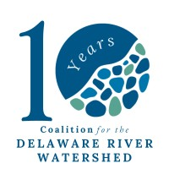
THE COALITION FOR THE DE RIVER WATERSHED COMMUNICATIONS GROUP
Asian American, Native Hawaiian & Pacific Islander Heritage Month Social Media Toolkit
Celebrate and uplift AANHPI communities and their contributions to environmental movements. Include #AANHPIHeritageMonth in your post.
Register for the May Communications Webinar Tool Series
Please join the Coalition for an interactive mini-series about communications tools! Each session is 30 min.
Register here: https://forms.gle/A1Ux9XCWugWtDNcy8

Slide 6

CHESAPEAKE WATERSHED FORUM
The Alliance for the Chesapeake Bay will hold the 17th annual Chesapeake Watershed Forum
Location: National Conservation Training Center (NCTC) in Shepherdstown, WV
Date: November 4 - 6, 2022
Theme: “Nature in Your Neighborhood: Connecting Communities to the Outdoors”
Goals
Showcase local benefits of the broader Chesapeake Bay watershed restoration movement.
Elevate tools, examples, and ideas on how to bridge the gap between local communities and their watersheds.
Consider the ways historic inequities and biases have prohibited certain populations from accessing and
connecting with their local waterways.

Slide 7
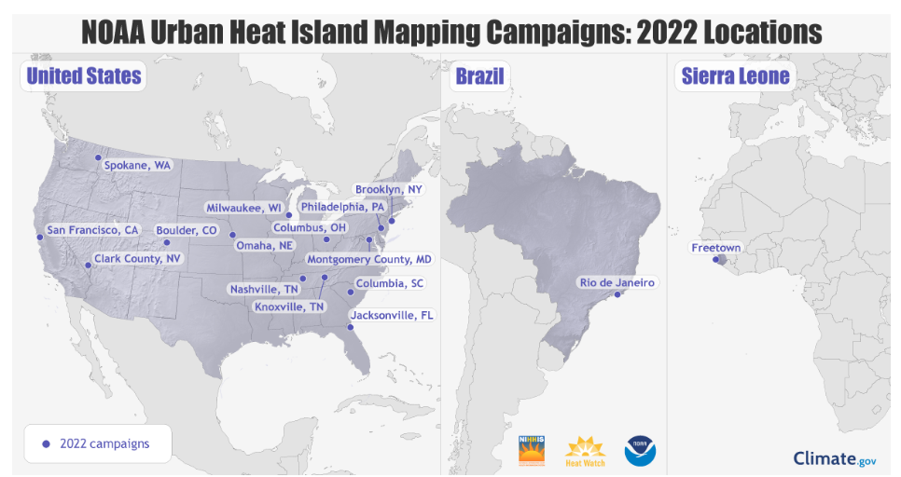
NOAA & COMMUNITIES TO MAP HEAT INEQUITIES IN 14 U.S. CITIES & COUNTIES
Communities will use maps to inform efforts to combat extreme heat
https://www.noaa.gov/news-release/noaa-and-communities-to-map-heat-inequities-in-14-us-cities-and-counties

