Slide 1
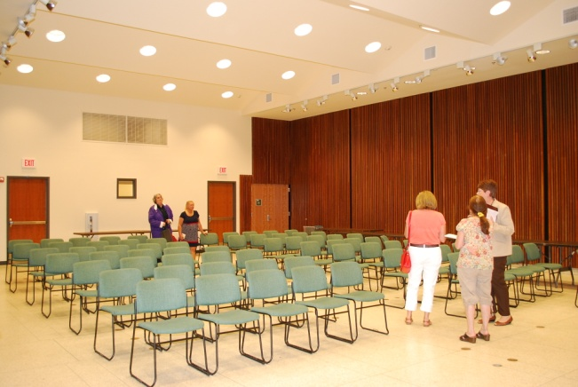
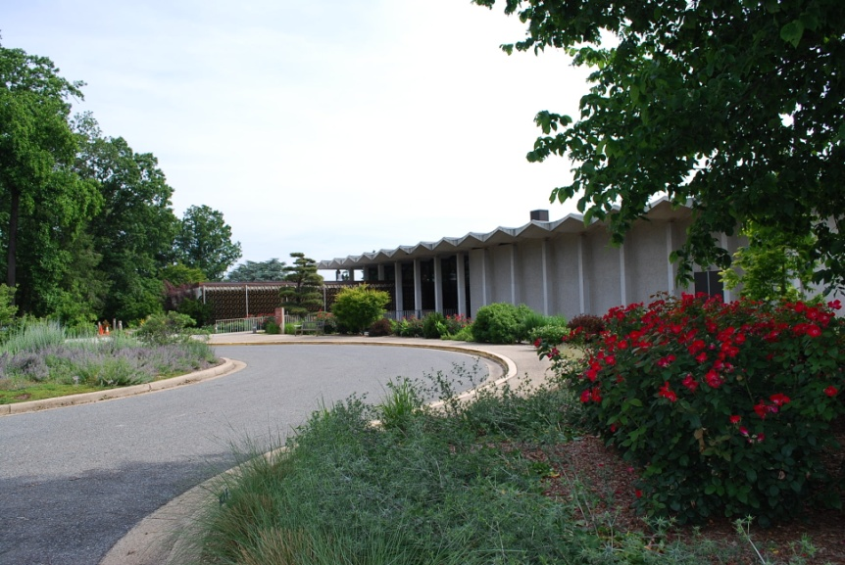
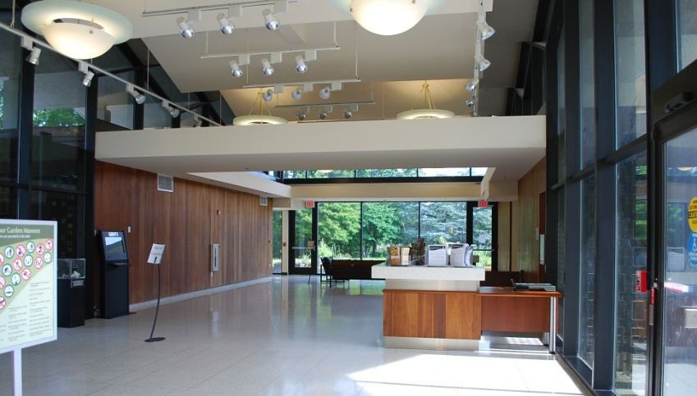
Logistics
Contact: Margaret Enloe 410-267-5740 menloe@chesapeakebay.net
Location & Date
Arboretum Security Contact | Lt Dawn Osborne 703-906-1910
Status
U.S. National Arboretum – Washington DC Dec 12, 2013

Slide 2
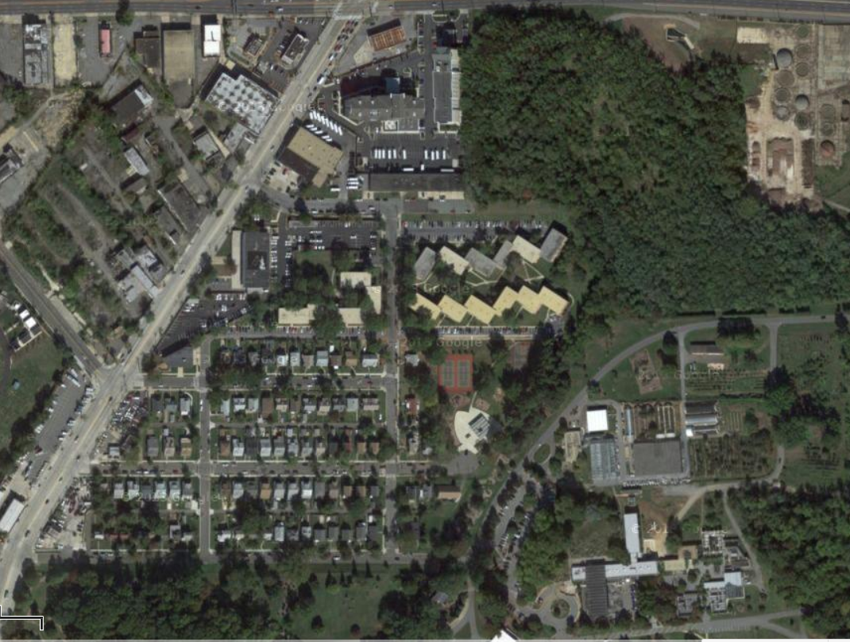
New York Ave
Bladensburg Rd
24th Street NE
Parking
R Street
Big Sign – “Arboretum”
Entrance gate
Visitor Center

Slide 3
Visitors Center layout
Parking
Sidewalk
Entrance
EC Breakfast
Restrooms
Arboretum Offices
Visitors Center Lobby
Circle drive for drop off
Construction Area
kitchen
Press conf.

Slide 4
Logistics
Executive Council Member Confirmation
Confirmed Members
Contact: Margaret Enloe 410-267-5740 menloe@chesapeakebay.net
Availability Confirmed
Unconfirmed Members
CAC Chair
LGAC Chair (Dave Dunmyer)
STAC Chair
DC Vincent Gray, Mayor (EC Chair)
MD Martin O’Malley, Governor
CBC Delegate Maggie McIntosh, Chair
VA Bob McDonnell, Governor
PA Tom Corbett, Governor (Acting Sec. Christopher Abruzzo , DEP)
EPA Gina McCarthy, Administrator (Dep. Admin. Bob Perciasepe, EPA)
DE Jack Markell, Governor (Secs. Kee & O’Mara, DNREC)
WV Earl Ray Tomblin, Governor (Asst. Dir.Teresa Koon, DEP)
NY Andrew Cuomo, Governor (Sec. Jim Tierney, DEC)
USDA Tom Vilsack, Secretary (Dep. Under Sec., Ann Mills, USDA)

Slide 5
Content
EC Agenda
Contact: Margaret Enloe 410-267-5740 menloe@chesapeakebay.net
Status
At a Glance
9:45-10 :00 EC members arrive
10:00-12:10 PRIVATE Breakfast (Agreement focused)
12:15-1:00 News conference

Slide 6
Meeting Agenda - Annotated
9:45-10 EC members arriving, get breakfast and take seats
10-12:10 Private Breakfast
10 – 10:10 Welcome, Agenda, 30yr Reflections – Chair (Mayor Gray, DC)
10:10-10:15 Showing of Video PSA – Margaret Enloe
10:15-11:10 Briefings on draft Chesapeake Watershed Agreement
10:15-10:25 Agreement Overview – Nick DiPasquale
10:25-11:10 Advisory Committee comments on Agreement (10 min + 5 min q&a ea.)
Citizens Advisory Committee (CAC) – John Dawes Scientific, Technical Advisory Committee (STAC) – Kirk Havens Local Government Advisory Committee (LGAC) - David Dunmyer
11:10-12:00 EC Agreement discussion
EC vote on Chair for 2014
12:00-12:10 Press conference prep/group photo – Margaret Enloe
12:05-12:10 Group photo
12:10 Move to press conference – next slide
Notes:
Suggestion to be made to shift times forward/later so that a “stage setting” CBP video can be shown at beginning of meeting. Morning session to end at 12:00.

Slide 7
Meeting Agenda – Annotated (contd)
Press Conference
12:15-1:00
12:15-12:20 Welcome by Arboretum representative
12:20-12:25 Mayor Gray remarks
12:25-12:30 Mayor Gray announces election of new EC Chair
12:30-12:35 Governor O’Malley remarks
12:35-12:40 Governor McDonnell remarks
12:40-1:45 Chair McIntosh Remarks
12:45-1:00 Media Q&A

Slide 8
Logistics / Set up
To patio
Windows to garden
Buffet Breakfast – Menu: TBD
Breakfast (10-12:30 am)
Visitor Center Classroom
Entry from HALL
DC +1 DC MD MD +1
+1 EPA
EPA
PA
PA +1
WV
DE
DE +1
CBC +1
CBC
VA
VA +1
NY
NY +1
USDA
USDA +1
Checklist:
Arboretum to provide:
All tables & chairs needed to:
seat 20 ppl at EC table,
offer buffet
side table for 3ppl
CBP to provide:
Buffet breakfast & beverages for EC
Linens, place settings, etc.
EC Table
Counter for beverages
CAC LGAC STAC CBP Dir.
DiPasquale
Bisland
Enloe
(table w/chairs)
Chairs for AC Coordinators
screen

Slide 9
Logistics / Set up
News Conference 12:30-1:15pm
Visitor Center Conf Room (Open to the Public)
Extra exit
Checklist:
Arboretum to provide:
Wireless internet
Podium
Electricity
Chairs (75)
8ft tables (2) with chairs (5)/table
6ft table (2) - for press regist. & materials
CBP to provide:
Flags
Logo
Sound system
Table Mics (from a.m.)
Mult box
Water pitchers & glasses (10)
Table linens
Name plates
Flags
Flags
USDA DE PA VA CBC
DC MD EPA NY WV
8ft table w/ 5 chairs
and water
2 – mics
Podium w/mic &
Speaker
CBP Logo
&
MULT BOX
8ft table w/ 5 chairs
and water
2 – mics
35 Chairs
~28 Chairs
Aisle
No chairs; t.v. media section
Press
Entry

Slide 10
Communications
Media Plan
Contact: Margaret Enloe
410-267-5740, menloe@chesapeakebay.net
Status
Due Date: Dec 5/9
Components:
Media Advisory – Dec 5(informal) AND Dec 9(formal)
There will be two advance notices to media announcing the EC Meeting. The 1st will be an unofficial notice; the 2nd formal advisory will go out first thing Dec 9. The media advisory will focus on the theme of CBP 30 year history, planning for future, and expected EC Chair announcement. The advisory will include listing of key public figures participating and details on event location and time. Media will be asked to confirm attendance.
Media Outlets
Advisory & E-versions of Media Kit to:
400 media outlets on Communication Office’s comprehensive list of media in the watershed. - 8-10 select pitches/phone calls:
- The Associated Press, The Richmond Times-Dispatch, Virginian Pilot, The Daily Press in Norfolk, The Washington Post, The Baltimore Sun, The Capital in Annapolis, DC radio stations.

Slide 11
Communications
Media Plan
Contact: Margaret Enloe
410-267-5740, menloe@chesapeakebay.net
Components:
News Release & Media “kit” – Dec 12 – 1:00pm
Embargoed copy: Wednesday, December 11
Final copy: Dec. 12 at 1:30pm – at end of EC press event, after new Chair announced.
Messages:
Recognizing CBP Progress and partnership over last 30 years
Planning for the Future of Bay restoration science/efforts
Announcement of new EC Chair
Media Outlets – same as those who rec’d advisory

