Slide 1


Local Government Advisory Committee
John Willingham
Council President
Elizabeth Minor
Mayor
Eden Freeman
City Manager
Kelly Henshaw
City Engineer

Slide 2
About Winchester
Population – 27,543 (2014 estimate)
Size – 9.3 square miles
Council/Manager form of government
Budget – $222,635,993 (FY16 Adopted)
  General Fund - $83,115,000
  Schools - $70,475,993
  Capital Improvements - $15,000,000
Major Employers (1,000-4,999 employees)
  Winchester Medical Center
  Rubbermaid Commercial Products
Major Employers (500-999 employees)
  O’Sullivan Films, Inc.
  Shenandoah University
  National Fruit
  Winchester Public Schools
  City of Winchester

Slide 3
A rich history
1744 – Winchester founded by Col. James Wood
1752 – Received town charter
1758 – George Washington elected to first public office
1808 – Central water system installed, 3rd oldest public water system in U.S.
1862-1864 Civil War – Winchester changed hands approximately 70 times between Union and Confederate
1874 – Town becomes City and independent from County
1895 – Judge John Handley bequeaths funding for JHHS, Library, School for black students and private endowment
1900 – Rouss City Hall built
Notes:
Scranton, PA and Philadelphia, PA are the two older systems.

Slide 4
Mission and Vision
Mission
Vision 2028
To provide a safe, vibrant, sustainable community while striving to constantly improve the quality of life for our citizens and economic partners.
To be a beautiful, vibrant city with a historic downtown, growing economy, great neighborhoods with a range of housing options and easy movement.

Slide 5
Stormwater History
Winchester was classified as a Small MS4 locality as a result of the 2000 census
First MS4 permit cycle began on July 1, 2003
We are currently in our third 5-year permit cycle (Year 3)
As a result of our first permit cycle, the City has a water protection ordinance in place, which addresses water quantity and quality
  Water quality requirements were introduced in 2006
Current programs administered that relate to stormwater include:
  Virginia Erosion & Sediment Control Program
  Virginia Stormwater Management Program
  National Flood Insurance Program
Notes:
MS4 – Municipal Separate Storm Sewer System

Slide 6
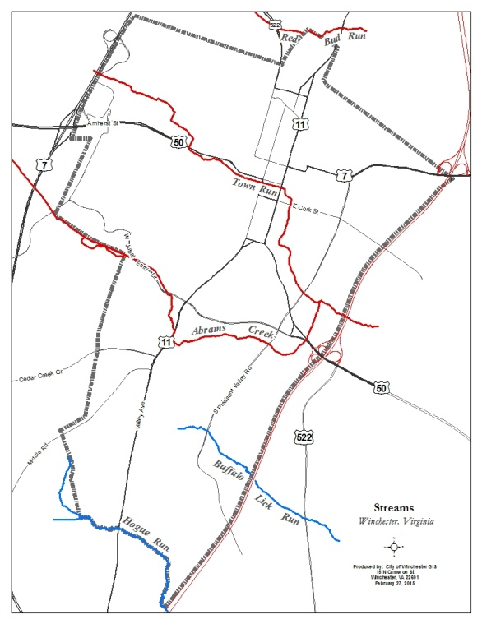
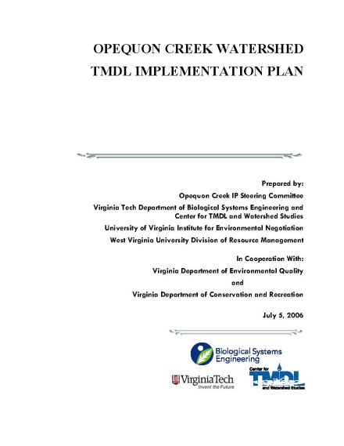
Stormwater History
Land within the City limits drains to five streams
  Three are impaired and are covered under the Opequon Creek Watershed TMDL Implementation Plan that was approved in 2006
    Abrams Creek
    Town Run
    Redbud Run
  Two are not impaired
    Hoge Run
    Buffalo Lick Run
Notes:
MS4 – Municipal Separate Storm Sewer System
TMDL – Total Maximum Daily Load

Slide 7
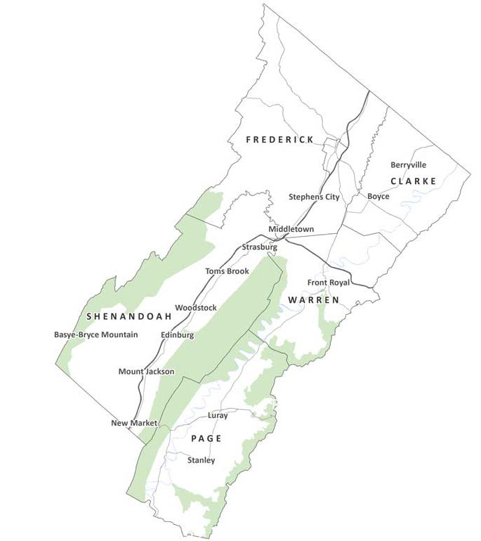
City’s Perspective on Stormwater
We acknowledge that we are part of
both the local and Chesapeake Bay
watersheds and need to do our part
The City is the only MS4 locality
in the Northern Shenandoah Valley,
which presents challenges relating
to compliance, enforcement and
economic development
We feel the new VSMP regulations (effective July 1, 2014) will help to “level the playing field”; however, our MS4 designation holds us accountable and has many more requirements than just the VSMP
Notes:
MS4 – Municipal Separate Storm Sewer System
VSMP – Virginia Stormwater Management Program

Slide 8
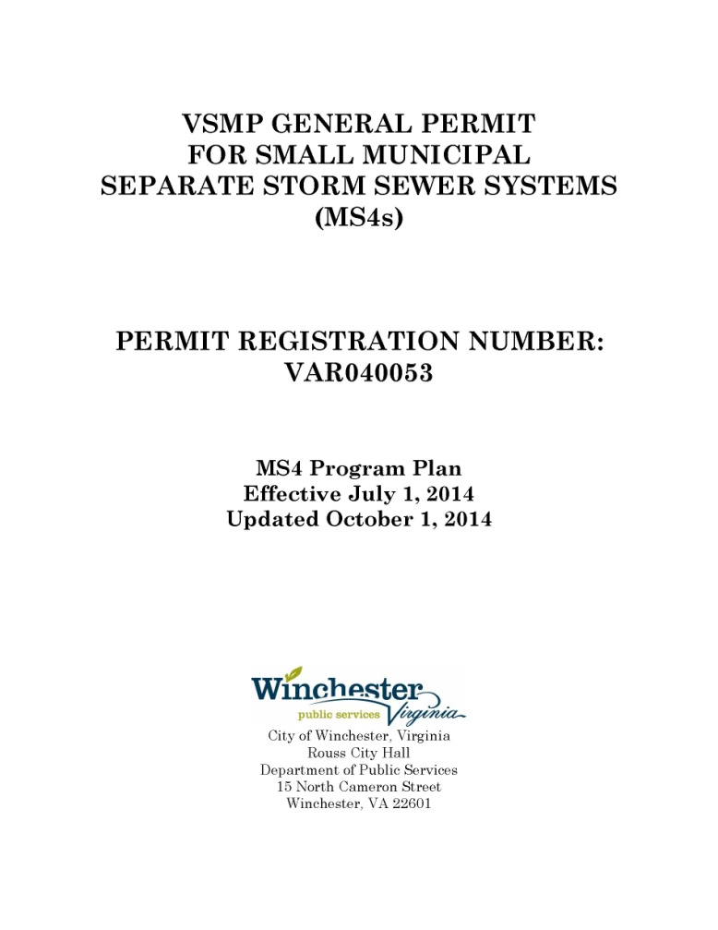
What are we doing?
Planning for numerous
activities and projects that
will be necessary in the
coming years to meet the
increasingly more stringent
stormwater regulations
  This will require significant
  City resources
Staying on top of annual
requirements and
deliverables for the MS4
permit
Notes:
MS4 – Municipal Separate Storm Sewer System

Slide 9


What are we doing?
Continuing to operate our E&SC
program in accordance with DEQ
requirements
Continuing to develop and operate our VSM program in accordance with DEQ requirements
  This is a continuous process since VSMP is a relatively new local program
  The Harrisonburg regional office has been a valuable resource in helping us get the program off the ground
Maintaining our membership
in the NFIP
Notes:
MS4 – Municipal Separate Storm Sewer System
E&SC – Erosion & Sediment Control
DEQ – Department of Environmental Quality
VSM – Virginia Stormwater Management
NFIP – National Flood Insurance Program

Slide 10


What do we need help with?
Additional funding (and staff) to meet
requirements of the new stormwater
regulations and MS4 permit requirements
Clarity and further assistance from DEQ
  Information often isn’t sent out
  in a timely manner (to give
  localities enough time for full
  implementation)
  Many times the local DEQ
  office and Richmond do not
  appear to be on the same
  page (we hear different things
  depending on where the
  information originates)
Notes:
As in many other localities, we do not have City funds to cover all of the needs. Federal and/or state support is needed.

Slide 11
www.winchesterva.gov

