Slide 1
Chesapeake Bay Program Update
Jim Edward, Deputy Director
EPA, Chesapeake Bay Program Office
CAC Meeting
May 18 -19, 2016

Slide 2
Chesapeake Bay Program Updates
Elements of the Chesapeake Bay Accountability and Recovery Act
Independent Evaluator
Budget Reporting
Brief Review of the Environmental Finance Symposium
Brief Highlights of the Executive Order Progress Report
Updates on the Mid Point Assessment
Diversity Demographics Profile

Slide 3
Chesapeake Bay Accountability and Recovery Act (2014)
Independent Evaluator
Chesapeake Bay Crosscut Budget

Slide 4

Independent Evaluator
There shall be an Independent Evaluator for restoration activities in the Chesapeake Bay watershed, who shall review and report on—
(1) restoration activities; and
(2) any related topics that are suggested by the Chesapeake Executive Council.

Slide 5
What needs to be done?
Executive Council may nominate an independent evaluator
Within 30 days the Administrator selects a nominee that demonstrates excellence in
Marine science
Policy evaluation
Other studies relating to complex environmental activities
First report due to Congress in 180 days, every 2 years after
Notes:
(1) IN GENERAL.—Not later than 30 days after the date of submission of nominees by the Chesapeake Executive Council, the Independent Evaluator shall be appointed by the Administrator from among nominees submitted by the Chesapeake Executive Council with the consultation of the scientific community.
(2) NOMINATIONS.—The Chesapeake Executive Council may nominate for consideration as Independent Evaluator a science-based institution of higher education.
(3) REQUIREMENTS.—The Administrator shall only select as Independent Evaluator a nominee that the Administrator determines demonstrates excellence in marine science, policy evaluation, or other studies relating to complex environmental restoration activities.
(c) REPORTS.—Not later than 180 days after the date of appointment and once every 2 years thereafter, the Independent Evaluator shall submit to Congress a report describing the findings and recommendations of reviews conducted under subsection (a).

Slide 6
3 Options Analyzed
Option 1: EPA Science Advisory Board
Convener
Standing Committee
Nominating individuals with expertise to the Committee
Option 2: Awarding a grant to an entity through the EC nomination/Administrator selection
Nominating an institution to act as the Independent Evaluator
Option 3: The National Academy of Science
Convener
Panel
Individuals are selected based on expertise

Slide 7
Key Considerations
Format
Cost to Program
Timeliness
Sustainability
Readiness
Meets Intent of law
Avoids actual or appearance of
conflict of interest

Slide 8
Meeting the Intent of the Law
Nominations for independent evaluator submitted by the EC
Science-based institution of higher education
Administrator appoints IE from among nominees with consultation of the scientific community
Demonstrates excellence in marine science, policy evaluation, or other studies relating to complex environmental restoration activities
Reports not later than 180 days after date of appointment and once every 2 years thereafter

Slide 9
Discussion and Decision
Agree on the selected option
Assign next steps to include
Initial task/charge development
Recommended expertise needed for individual members
Process for nominating members
Bring back to PSC in May for final approval of approach

Slide 10

Budget Accounting
Notes:
Workplans, ChesapeakeProgress, EO accounting, Budget and Finance Workgroup

Slide 11
CBARA Budget Accounting
Definition of “Federal restoration activity” – a program or project carried out with the “express intent to directly* protect, conserve, or restore living resources, habitat, water resources, or water quality in the Chesapeake Bay watershed, including programs or projects that provide financial and technical assistance to promote responsible land use, stewardship, and community engagement in the Chesapeake Bay watershed.”
*Definition of a State restoration activity also includes the word “Or indirectly”

Slide 12
Categories May Include:
physical restoration,
planning,
feasibility studies,
scientific research,
monitoring,
education,
infrastructure development

Slide 13
Interagency Cross-cut Budget
OMB Director, in consultation with the EC, shall submit to Congress a financial report containing:
Proposed federal and estimated state funding to be carried out in the succeeding fiscal year (FY17)
Expenditures for Federal, and to the extent available, State restoration activities for preceding 2 fiscal years, current fiscal year, and succeeding fiscal year (FY 14, 15, 16, 17)

Slide 14
Funding Levels and Timeline
Funding Levels
- For the first 3 years, funding > $300,000
- After that, funding > $100,000
Timeline –
-- In June EPA to send BDR to Federal agencies and jurisdictions on behalf of OMB.
-- Six weeks to review.
-- Report to Congress due Sept. 30, 2016 and each year there after.
Notes:
Working with Federal partners, setting up a meeting with OMB, first task of the new Budget and Finance workgroup

Slide 15
Chesapeake Bay Environmental Finance Symposium University of Maryland April 25-26, 2016
Opening Panel:
Creating Financing Efficiencies and Cost Reductions
Eric Letsinger, Quantified Ventures
Incentivizing Innovation
Paul Carroll, City of Newport, Rhode Island
Influencing the Consumer Marketplace
Perry Raso, Matunuck Oyster Bar, South Kingston, Rhode Island
Integrating Public and Private Capital
Jag Khuman, Maryland Department of the Environment
Mitigating Restoration Investment Risk
Nick Dilks, Ecosystem Investment Partners, Baltimore Maryland
Environmental Markets
Jeremy Sakulsky, Environmental Incentives, South Lake Tahoe, California
Notes:
Working with Federal partners, setting up a meeting with OMB, first task of the new Budget and Finance workgroup

Slide 16
Symposium Themes
Reducing Implementation Costs
Incentivizing Innovation
Creating and Building Consumer Demand
Integrating Public and Private Capital
Mitigating Investment and Implementation Risk
Water Quality Trading and Environmental Markets
Notes:
Working with Federal partners, setting up a meeting with OMB, first task of the new Budget and Finance workgroup

Slide 17
Federal Funding Summary 2011-2016
Approximately $2.84 billion over 6 years
Department/Agency | FY 2011 President’s Budget Request | FY 2012 Operating Levels | FY 2013 Operating Levels | FY 2014 Operating Levels | FY 2015 Operating Levels | FY 2016 Operating Levels
USDA Total | $153,578,000 | $121,488,000 | $135,449,000 | $111,014,000 | $126,725,000 | $133,183,000
Farm Service |  | ($37,081,000) | $34,304,000 | $34,304,000 | $30,200,000 | $34,753,000
NRCS | $149,740,000 | $119,828,000 | $98,000,000 | $75,300,000³ | $94,000,000 | $95,000,000
Office of Chief Economist | $150,000 | $350,000 | $350,000 | $$350,000 | $350,000 | $350,000
USFS | $3,688,000 | $1,310,000 | $2,795,000 | $1,060,000 | $2,175,000 | $3,080,000
U.S. Dept. of Commerce / NOAA | $19,346,250 | $9,208,425 | $10,119,000 | $8,436,442 | $7,202,750 | $8,648,615
DoD Total | $13532,013 | $121,254,616 | $89,106,945 | $118,855,437 | $63,441,667 | $120,766,960
Services | $7,521,000 | $101,169,616 | $71,146,945 | $93,855,437 | $41,841,667 | $70,721,960
USACE | $6,011,013 | $20,085,000⁵ | $17,960,000⁵ | $25,000,000⁷ | $21,600,000 | $50,045,000
DOI Total | $42,817,218 | $23,906,000 | $21,227,233 | $25,758,725 | $30,725,986 | $33,593,000
BLM |  |  |  |  |  | $2,591,000
FWS | $15,161,27 | $10,146,000 | $10,294,000 | $11,553,745 | $11,070,986 | $13,443,000
NPS | $19,169,640 | $6,411,000 | $3,876,233 | $4,515,980 | $8,466,000 | $5,568,000
USGS | $8,486,304 | $7,349,000 | $7,057,000 | $9,689,000 | $11,189,000 | $11,991,000
EPA | $248,873,881 | $184,010,730 | $174,821,744 | $197,504,967 | $206,301,507 | $193,806,590
Total | $486,648,362 | $459,867,771 | $430,723,922 | $461,569,571 | $434,396,910 | $487,041,665

Slide 18
Fiscal Year 2016 Chesapeake Bay Program Funding
Region 2 | $224,000
Region 3 | $69,501,000
Philadelphia | $4,543,259
Annapolis | $64,957,741
Office of Water | $60,000
Office of Enforcement and Compliance Assurance | $675,000
Office of General Counsel | $462,000
Office of Environmental Information | $1,516,000
Office of Administration and Resources Mgmt. | $562,000
Total | $73,000,000

Slide 19
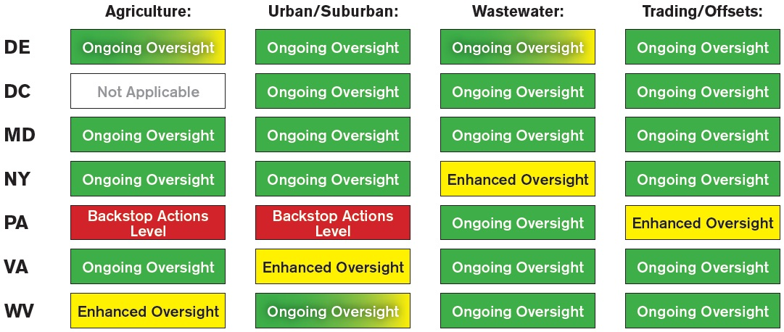
Provide EPA Oversight of 2014 Progress
Enhanced Oversight
* Green fading to yellow indicates potential downgrade at the end of the 2014-2015 milestone period if specific actions aren’t taken.

Slide 20
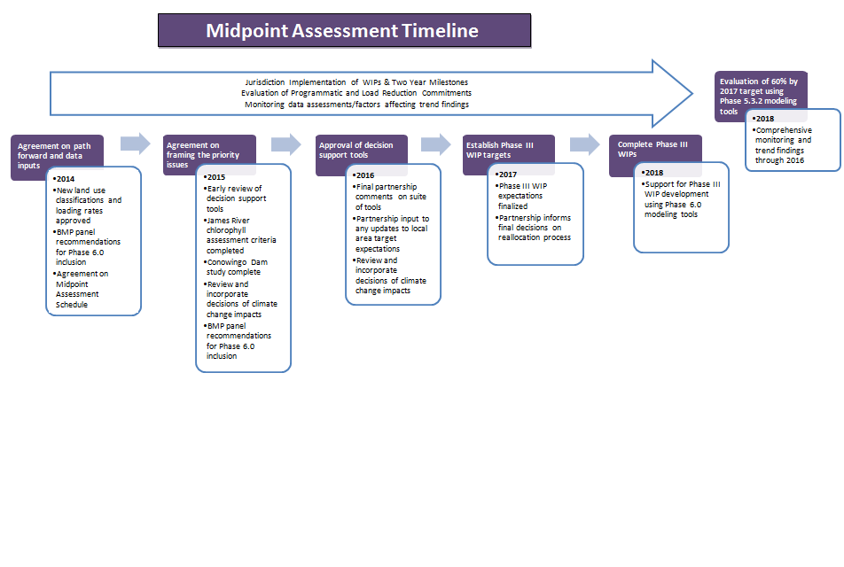
Issues:
Land Use changes
Climate Change
Geographic (James River & Conowingo)
New BMPs

Slide 21
What’s Next for the Midpoint Assessment
Local area targets: Task Force recommendations spring 2017, partnership decisions summer 2017, factor into Phase III WIPs 2018
Phase 6 Models: independent scientific peer reviews spring/summer 2016; continue Partnership reviews 2016-early 2017; management application starting late spring 2017
Conowingo Dam: Partnership decisions on path forward fall 2016; solid understanding of level of nutrients/sediment loads to be offset spring 2017; factor into Phase III WIPs 2018

Slide 22
What’s Next for the Midpoint Assessment
Climate Change: independent scientific peer review summer 2016, partnership decisions on how to factor into WIPs fall 2016-spring 2017, factor into Phase III WIPs 2018
2025 Projections: Partnership discussions about how to address increased load due to growth within the Phase III WIPs fall 2016-spring 2017
Phase III WIP Expectation: share draft with Partners summer 2016; actively seek feedback/input; finalize expectations by summer 2017

Slide 23
What’s Next for the Midpoint Assessment
Implications from Monitoring Trends: initial explanations of long term monitoring trends winter 2016, factor into development of Phase III target loads in 2017 and into Phase III WIPs in 2018
Analysis of Programmatic Capacity: factor into development of Phase III target loads in 2017 and into Phase III WIPs in 2018
Phase III WIP Target Loads: approve suite of Partnership models for management application spring 2017; develop target loads spring-winter 2017; factor into Phase III WIPs 2018

Slide 24
Establishing a Diversity Baseline for the Chesapeake Bay Program
Using a Simple Demographic Profile Tool

Slide 25
Diversity Management Strategy and Workplan
“Identify minority stakeholder groups that are not currently represented in the leadership, decision making and implementation of conservation and restoration activities, and create meaningful opportunities and programs to recruit and engage them in the partnership’s efforts.” – Diversity Outcome
“Explore the use of organizational demographic profile tools (e.g. Guidestar and D5) for the Bay Program jurisdictions, agencies, partners and other NGOs in the Bay watershed to report on diversity representation within their organizations.” – Diversity Management Strategy
“Establish a baseline of the level of diversity in the CBP (staff, boards, programs and initiatives aimed at increasing internal diversity).” – Diversity Workplan
Notes:
The Diversity workgroup’s activities are driven by the diversity management strategy. Workplan actions informed by long time and new partners of the CBP and community members.

Slide 26
Why a demographic profile?
An important aspect of tracking and assessment is to collect baseline data in order to measure progress towards the goal/outcome.
Green 2.0 made a national call to environmental organizations to share their diversity data in order to begin improving diversity at all levels.
Notes:
Mention Green 2.0’s ground breaking report http://www.diversegreen.org/about-us/

Slide 27
CBP Partners who Responded
Chesapeake Bay Trust
Alliance for the Chesapeake Bay
Conservation Fund
National Fish and Wildlife Foundation
Chesapeake Bay Foundation
And more…

Slide 28
Others have begun collecting their own diversity data to establish baselines for diverse attendance and participation in conferences:
Choose Clean Water Coalition Conference
Alliance Chesapeake Bay Watershed Forum
Others?
Notes:
The report found that “Despite increasing racial diversity in the United States, the racial composition in environmental organizations and agencies has not broken the 12% to 16% “green ceiling” that has been in place for decades”.

Slide 29
What is the CBP Diversities Profile?
10 Simple Questions
Voluntary and anonymous
“Self-Identify” responses
Includes questions on management roles due to language in diversity outcome
Notes:
The report found that “Despite increasing racial diversity in the United States, the racial composition in environmental organizations and agencies has not broken the 12% to 16% “green ceiling” that has been in place for decades”.

Slide 30
The Process
The Alliance for the Chesapeake Bay will conduct the profile on behalf of the Chesapeake Bay Program
The profile will be sent to the Principals Staff Committee, Management Board, Advisory Committees, GITs, and workgroup members (using anonymous survey monkey tool).
Encourage Chairs to incorporate in ongoing meeting agendas and make follow-up requests to their members.
Demographic Profile analysis based on participant response.
Notes:
*Pull up the draft profile and mention that these questions where influenced by and adapted from Green 2.0. The profile will be disseminated through Survey Monkey and the data would be collected anonymously.

Slide 31
Timeline
May: Develop simple survey monkey instrument
Early June: Email from Al Todd to CBP membership
30 days to complete the profile
Mid June: Follow-up email from CBP leadership (MB chair, GIT chairs, etc.)
Summer 2016 – Present results to Management Board
September 2016: Post results on CBP website
Press release and web story

Slide 32

Questions?
Jim Edward
edward.james@epa.gov
www.ChesapeakeBay.net

