Slide 1



Maryland’s Ecological Effects of Sea Level Rise Project
Nicole Carlozo, Chesapeake & Coastal Service
May 6, 2020

Slide 2
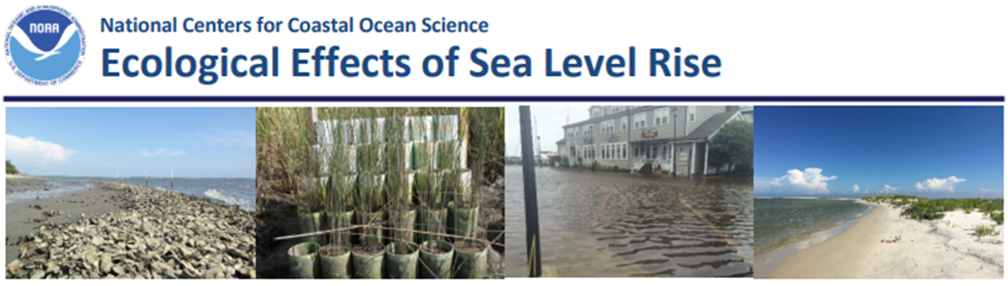
EESLR Overview
Multidisciplinary research program
inform coastal managers of local coastal vulnerability & solutions to mitigate flood risk
Collaborative science model
integrates stakeholder input to ensure relevancy, applicability & value to coastal managers

Slide 3
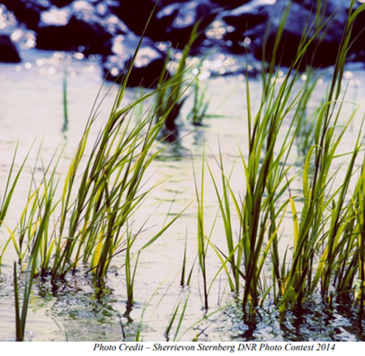
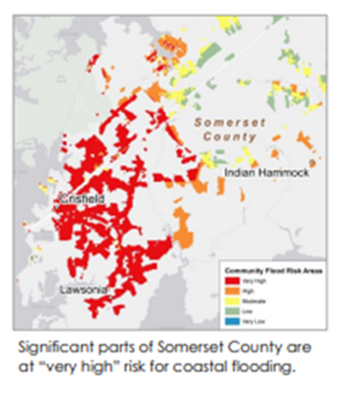
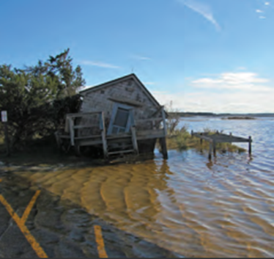
Project Goals
Quantify the benefits of natural & nature-based features (NNBF)
Inform conservation & management under future sea level rise scenarios
Notes:
-Quantify the benefits of natural & nature-based features (NNBF) in Maryland’s Chesapeake & Atlantic Coastal Bays – wave and flood attenuation capacity
-Partners: George Mason University’s Flood Hazards Research Lab, The Nature Conservancy, Management Transition Advisory Group. Builds upon a previous partnership monitoring protection services at Monie Bay and Deal Island, MD.
-Inform conservation and management under future SLR scenarios
-Update decision-making tools (Coastal Resiliency Assessment)
-Advance use of NNBF where feasible, either in place of or in combination with gray infrastructure.
Focus on marshes and seagrass
Connections to Habitat GIT (meeting SAV restoration goals) and CRW (protection capacity of wetlands)

Slide 4
Objectives
Enhance understanding of flood protection capacity & performance of NNBF under extreme & chronic events
Increase understanding of statewide flood protection capacity of NNBF under current conditions & future SLR scenarios
Quantify NNBF benefits for current and future SLR scenarios & integrate into Maryland’s natural resource management
Work with regional, state & local stakeholders to:
Develop conservation & management recommendations to preserve or elevate the protective benefits of NNBF
Enhance resiliency of Maryland’s vulnerable coastal communities
Notes:
Objectives – Focus on first 2 over the next year.

Slide 5
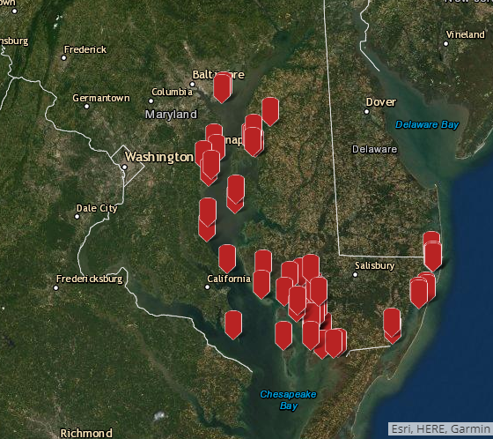
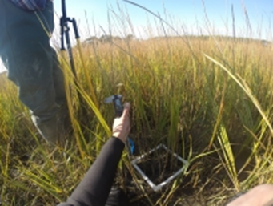
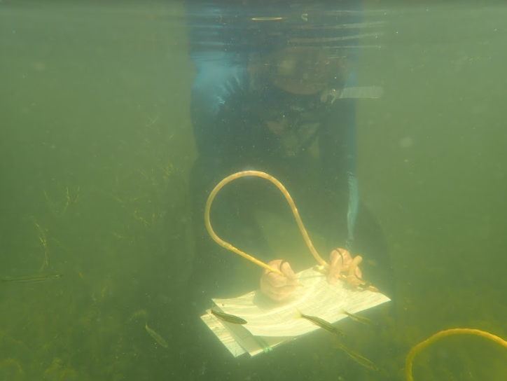
Objective 1
Enhance understanding of flood protection capacity & performance of NNBF under extreme & chronic events
Site Selection
Field-based NNBF and Nearshore Habitat Monitoring
Field-based Hydrodynamic Monitoring

Slide 6
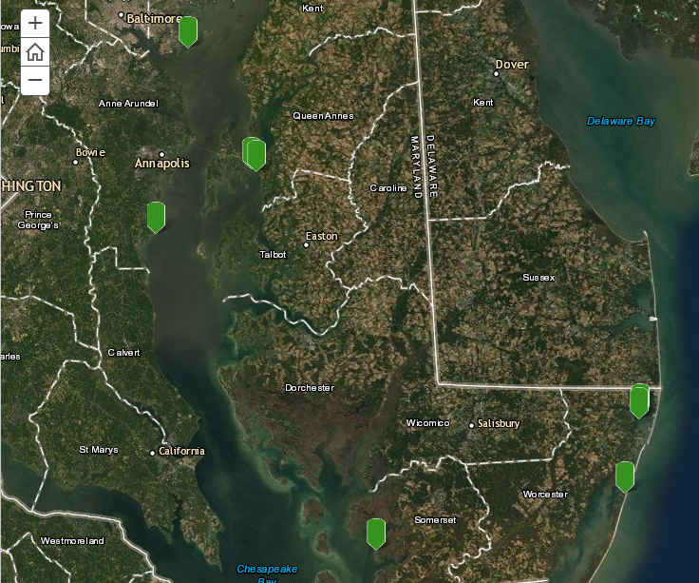
Site Selection
YEAR 1
North Point State Park
Fairmount (private)
Assateague State Park
YEAR 2
Franklin Point State Park
Chesapeake Bay Environmental Center
Isle of Wight WMA
Notes:
https://tnc.maps.arcgis.com/apps/Shortlist/index.html?appid=ee1ff27def2c4b6a9c9d5a4f1b07e230

Slide 7
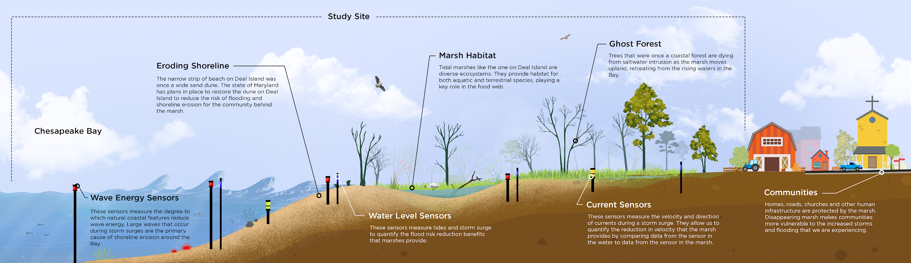
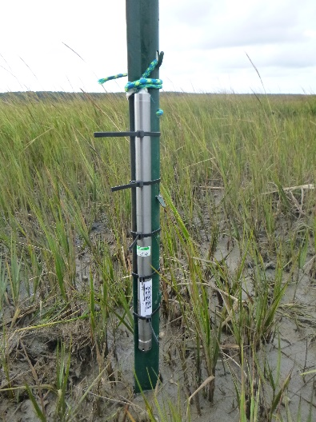
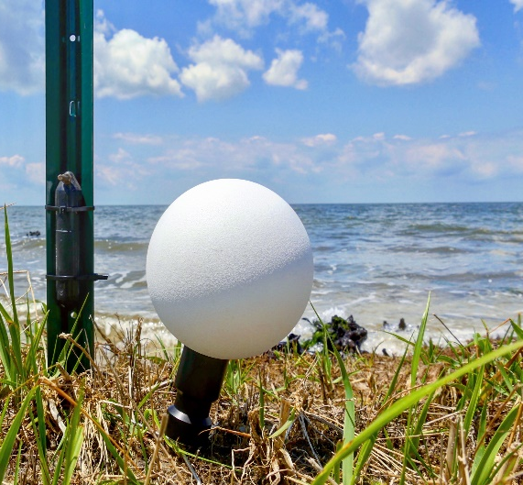
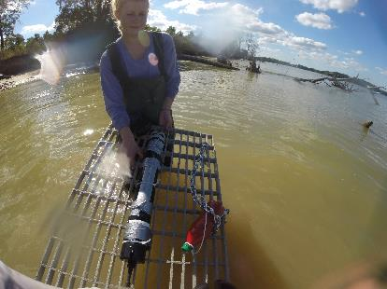
Field Setup
Wave Sensor
Water Level Sensor
Currents Profile (ADCP)
Notes:
-Water Levels, Waves, Currents
-Topo/Bathy, Vegetation
-Address Seasonality and Extreme/chronic events

Slide 8
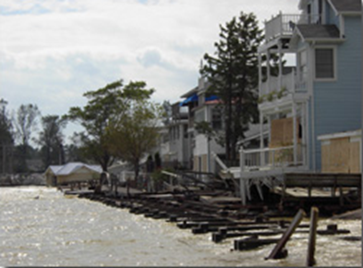
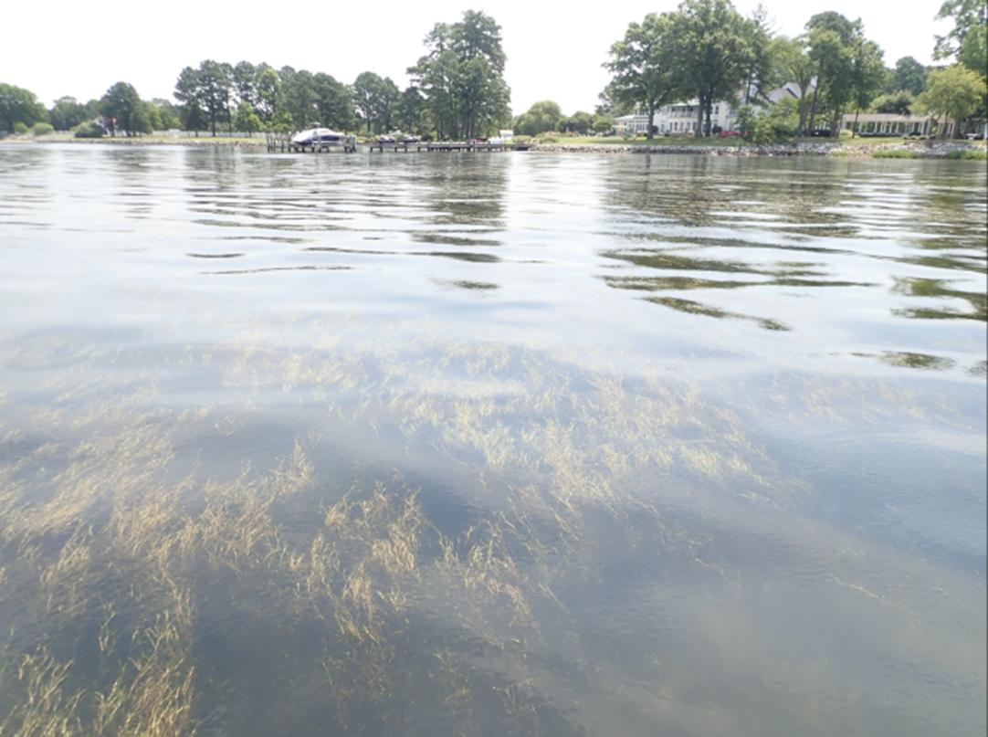
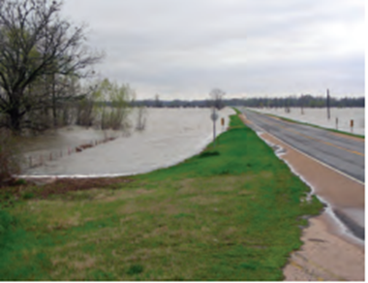
Objective 2
Increase understanding of statewide flood protection capacity of NNBF under current conditions & future SLR scenarios
Evaluate statewide buffering capacity of NNBF
Evaluate SLR Impacts to NNBF
Evaluate Buffering Capacity of NNBF under Future SLR conditions
Notes:
Numerical Models
Sea Levels Affecting Marshes Model (SLAMM)
Numerical Models + SLAMM

Slide 9
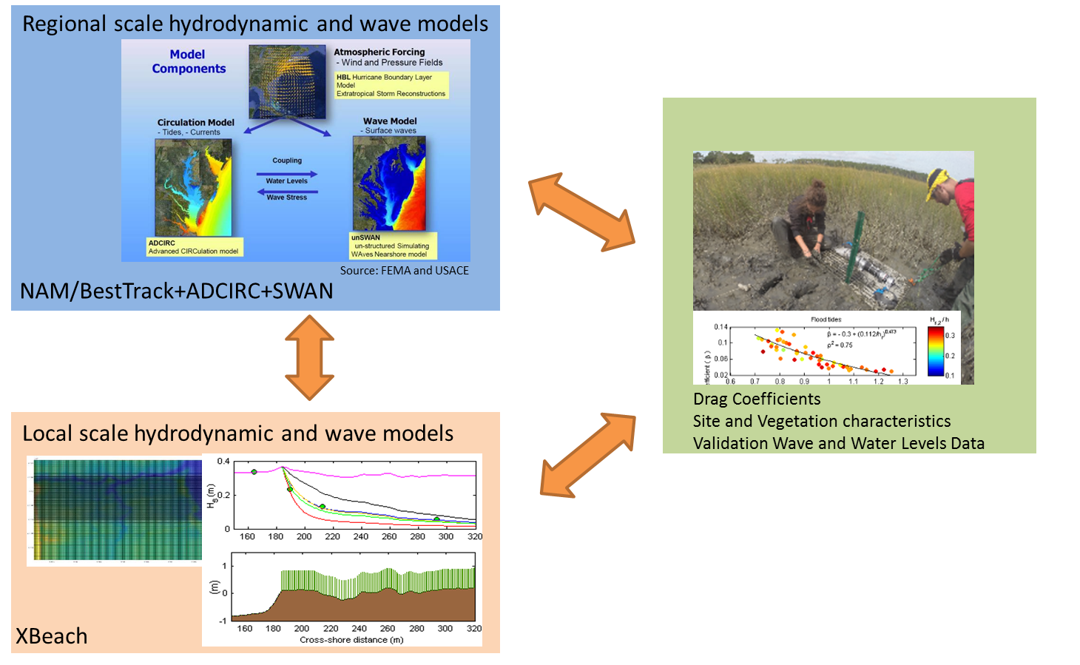
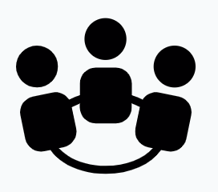
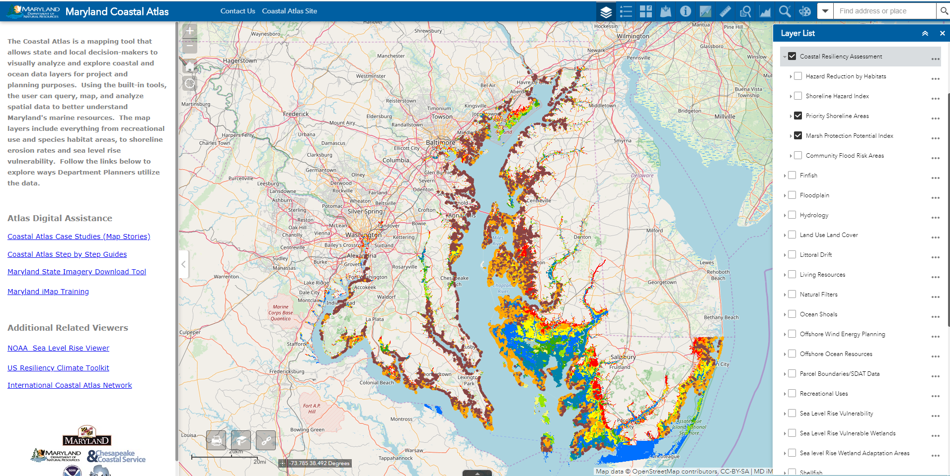
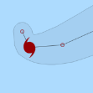
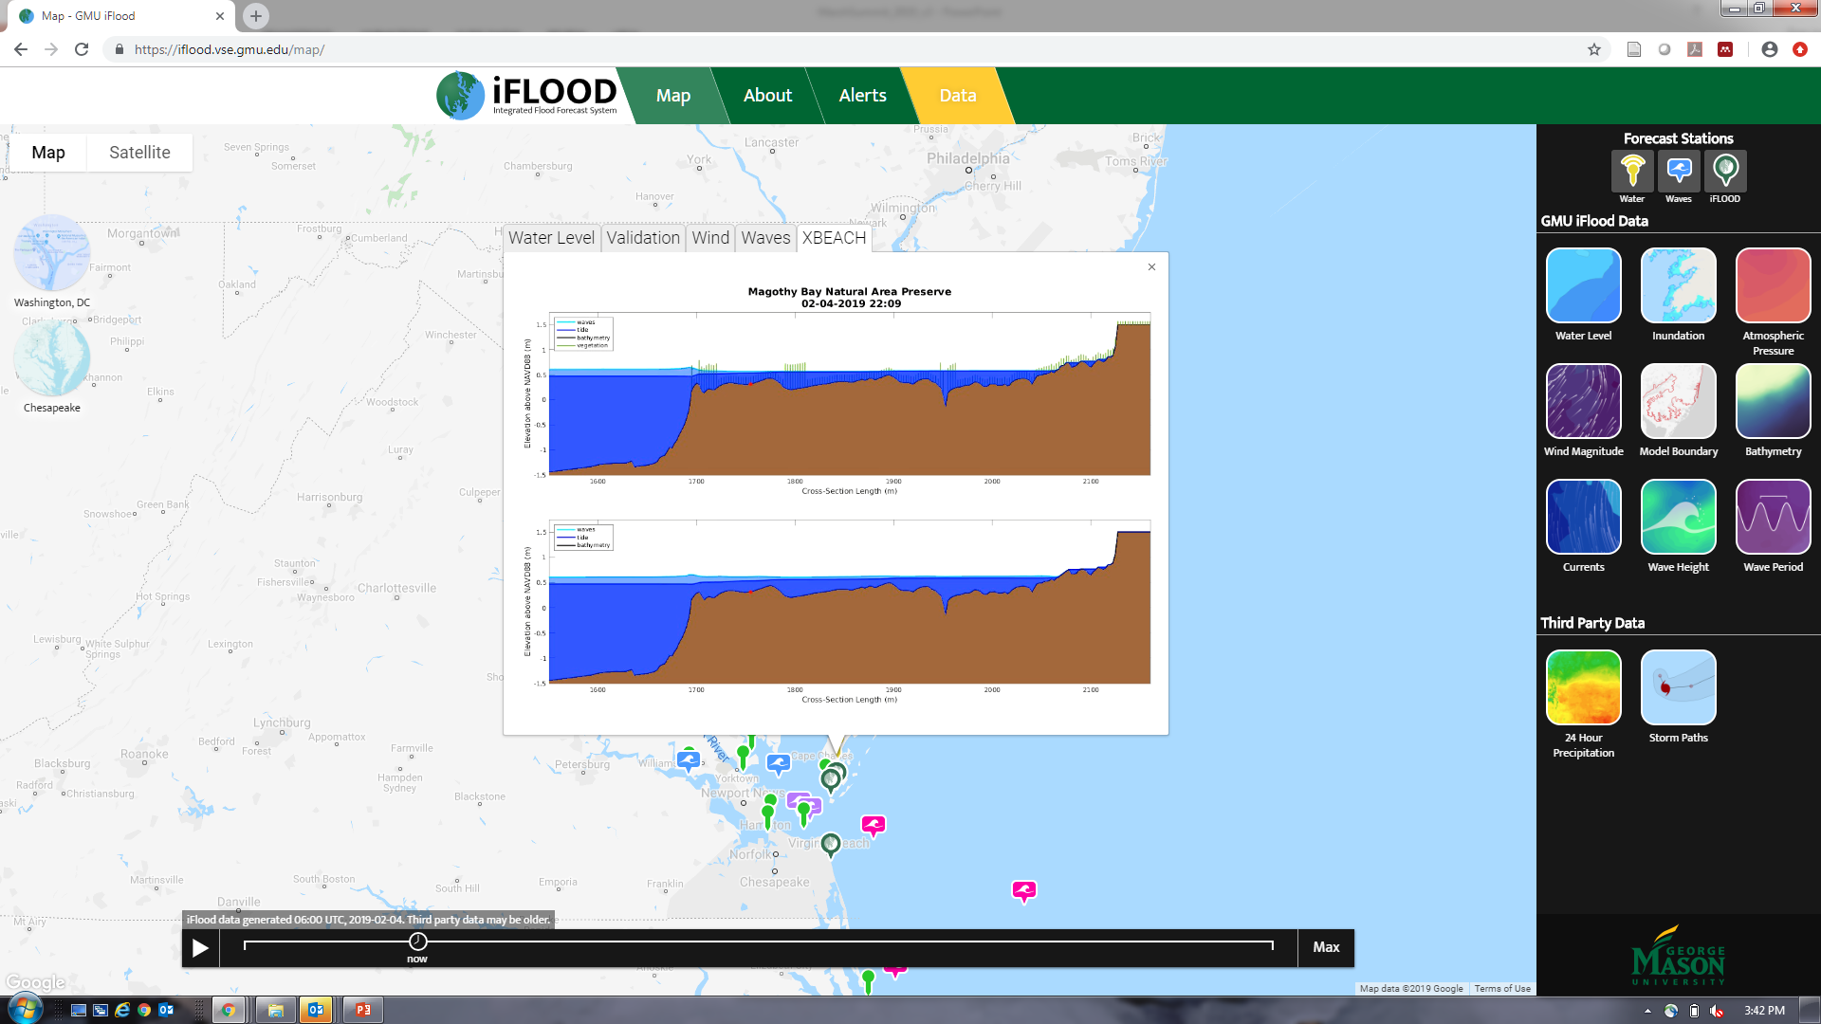
Coastal Flooding Modeling Framework
Scenarios
Costal Flood Hazards Models
State-wide coastal protection information
Sea-level rise
Extreme events
Marsh migration and conservation
Management actions
Scenario-based simulations that compare the benefits of various management actions
Notes:
-ADCIRC + SWAN Regional Hydrodynamic and Wave Models
-XBeach Local Hydrodynamic and Wave Model
-Couple with field-based Drag Coefficients, Site and Vegetation characteristics, Wave and Water Levels Data
-Evaluate statewide buffering capacity of NNBF under various storm conditions, management actions, and SLR scenarios.

Slide 10
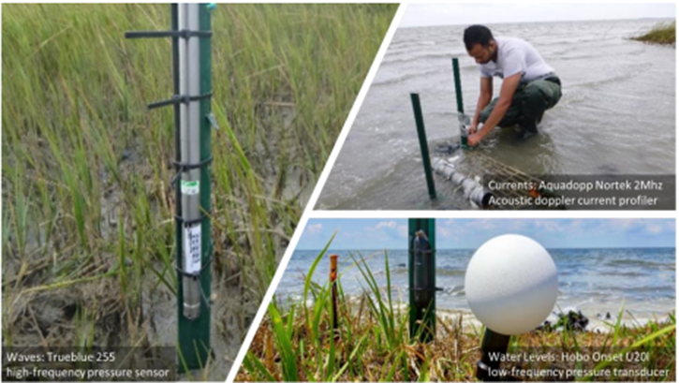
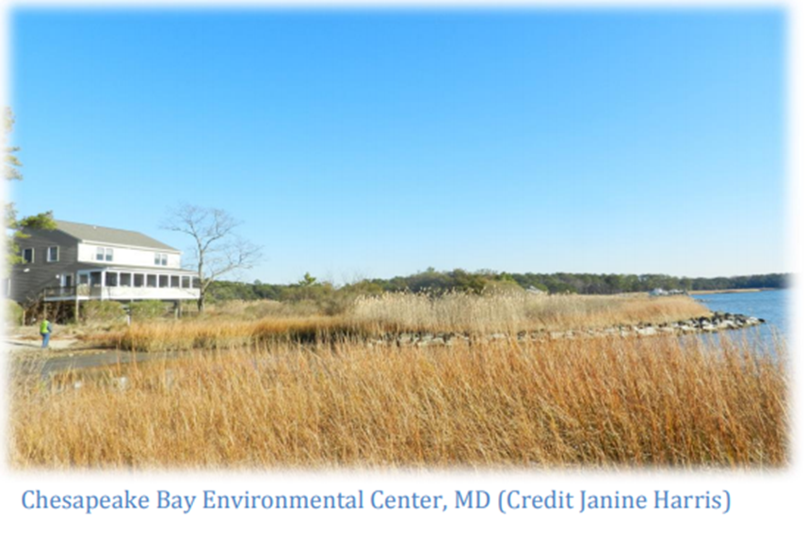
Anticipated Outcomes & Products
Site-level biological & hydrodynamic characterizations
Spatial datasets
Updated statewide conservation & restoration targeting tools
Management recommendations for priority areas as sea levels rise
Communication materials
Notes:
These are the initial expected outcomes and data products but they will be further developed through conversations with the MTAG to ensure that outcomes are useable by stakeholders.

Slide 11
Where are we now?
Notes:
MTAG
Workgroup Formation
Outreach – Where can this project inform other decision-making tools/processes?

Slide 12
Proposed Workgroups
Sea Level Rise (2020) Review state SLR projections and scenarios and make recommendations for SLR projections/scenarios to include within the EESLR project.
Living Shoreline (2020) Discuss options for living shoreline monitoring. Discuss living shoreline types and MTAG priorities. Make recommendations for living shorelines to monitor that would inform management or practitioner decision-making.
Marsh Model (2020-2021) Review SLAMM inputs and outputs for marsh model
SAV Model (2020-2021) Review SLAMM inputs and outputs for SAV model

Slide 13
Proposed Workgroups
Risk Reduction (2021) Inform methods for quantifying risk reduction.
Management Actions (2021) Identify and review proposed management actions for scenario modeling (ex. living shorelines, thin-layer sediment placement, marsh restoration, green vs. gray solutions).
Data Integration (2022) Discuss data integration options for state targeting models. Identify other data integration opportunities. How best can model outputs be integrated into existing decision-making tools? How should data be used? How should data not be used?

Slide 14
Proposed Workgroups
Scenario Modeling/Community Outreach (2022) Identify scenarios of interest (storm events and management strategies) based on focus areas, SLR scenarios, and management actions list. Identify stakeholders and make outreach recommendations. Participate in outreach meetings as is relevant.

Slide 15
Questions?
George Mason University
Celso Ferreira, cferei3@gmu.edu
Maryland Department of Natural Resources
Nicole Carlozo, nicole.carlozo@maryland.gov
Rebecca Golden, rebecca.golden@maryland.gov
Elliott Campbell, elliott.campbell@maryland.gov
The Nature Conservancy
Michelle Canick, mcanick@tnc.org
Jackie Specht, jackie.specht@tnc.org

