Slide 1
Environmental Literacy
3 Draft Indicators | Sustainable Schools, Environmental Literacy Planning, and Student Meaningful Watershed Educational Experiences (MWEEs)
Presentation to the Environmental Literacy Workgroup| 12-15-2016

Slide 2
“Since its formation, the Chesapeake Bay Program has been guided by science-based goals. To assess our progress toward these goals, we track a range of environmental indicators. Accurate data and open assessments ensure our work is transparent and allow our partners, stakeholders and oversight groups to hold us accountable for the work that we do.”
The Evolution Of Accountability At The Chesapeake Bay Program
Chesapeakestat Website
(emphasis added)

Slide 3
We use data and indicators to …
Assess our progress toward the goals of the 2014 Chesapeake Bay Watershed Agreement
Environmental Literacy Goal, with 3 Outcomes:
Environmental Literacy Planning
Student
Sustainable Schools
Via Chesapeake Progress
Make decisions about focus, resources, and effort
Within the Chesapeake Bay Program
Within individual jurisdictions

Slide 4
Indicator Updates are …
Based on data availability.
Managed among Indicators Coordinator, Web Content Specialist, and Workgroup Chair or Coordinator.
Governed by a specific Program-approved process.
Used to tell a story about our progress and our work.

Slide 5
The Chesapeake Bay Watershed Agreement
Environmental Literacy Goal:
Enable students in the region to graduate with the knowledge and skills needed to act responsibly to protect and restore their local watersheds.
Environmental Literacy Outcomes:
Sustainable Schools
Environmental Literacy Planning
Student

Slide 6
Sustainable Schools Outcome
Outcome:
Continually increase the number of schools in the region that reduce the impact of their buildings and grounds on their local watershed, environment and human health through best practices, including student-led protection and restoration projects.
Indicator:
The number of certified sustainable elementary, middle and high schools in the Chesapeake Bay watershed, tracked by jurisdiction.
US Green Ribbon Schools, MD Green Schools, VA Naturally, and Natural Wildlife Federation (NWF) Eco-Schools programs
Baseline: Percentage of certified sustainable schools in the watershed
Change Over Time: Total number (or percentage) of certified sustainable schools in each jurisdiction
Notes:
Indicator: The number of certified sustainable elementary, middle and high schools in the Chesapeake Bay watershed, tracked by jurisdiction.
Representations:
Baseline: Percentage of certified sustainable schools in the watershed (donut chart; light blue: certified sustainable; dark blue: not certified sustainable)
Change Over Time: Total number (or percentage) of certified sustainable schools in each jurisdiction
Data would be presented at the watershed level (i.e., clipped to watershed boundary), but can be available for download at the jurisdiction-wide level.

Slide 7
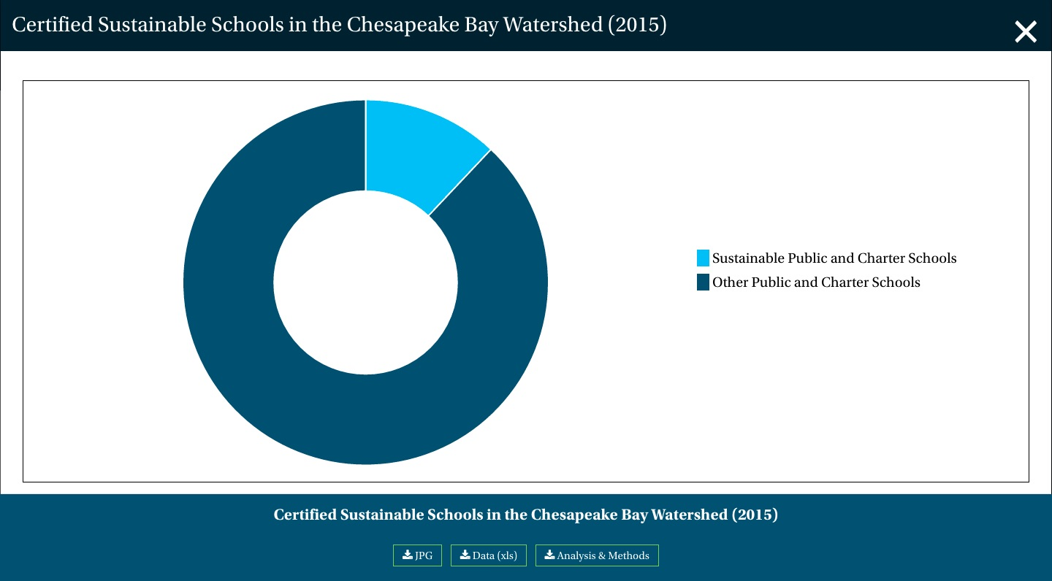
Sustainable Schools Outcome

Slide 8

Indicator on ChesapeakeProgress: Progress Section

Slide 9

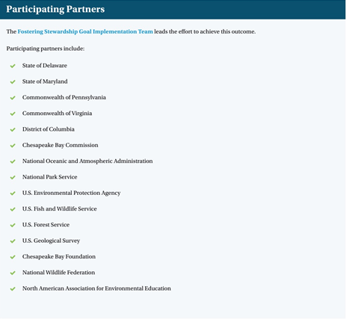
Indicator on ChesapeakeProgress: Supporting Sections

Slide 10
Environmental Literacy Planning Outcome
Outcome:
Each participating Chesapeake Bay jurisdiction should develop a comprehensive and systemic approach to environmental literacy for all students in the region that includes policies, practices and voluntary metrics that support the environmental literacy goals and outcomes of the Watershed Agreement.
Indicator:
The percentage of reporting Local Education Agencies that are “Well” or “Somewhat Prepared” to implement environmental education program(s).
Based on ELIT data
Baseline: Percentage of LEAs in each jurisdiction that are well-prepared, somewhat prepared and not at all prepared to implement environmental education program(s)
Notes:
Indicator: The percentage of reporting Local Education Agencies (LEAs) that are “Well” or “Somewhat Prepared” to implement environmental education program(s).
Based on ELIT data
Representations:
Baseline: The percentage of LEAs in each jurisdiction that are well-prepared, somewhat prepared and not at all prepared to implement environmental education program(s)
How should we depict change over time—still a question
Progress text should explain how data were gathered and interpreted (e.g., questions posed to survey participants; ranking scale; etc.). Data would be presented at the watershed level (i.e., clipped to watershed boundary), but be available for download at the jurisdiction-wide level.

Slide 11
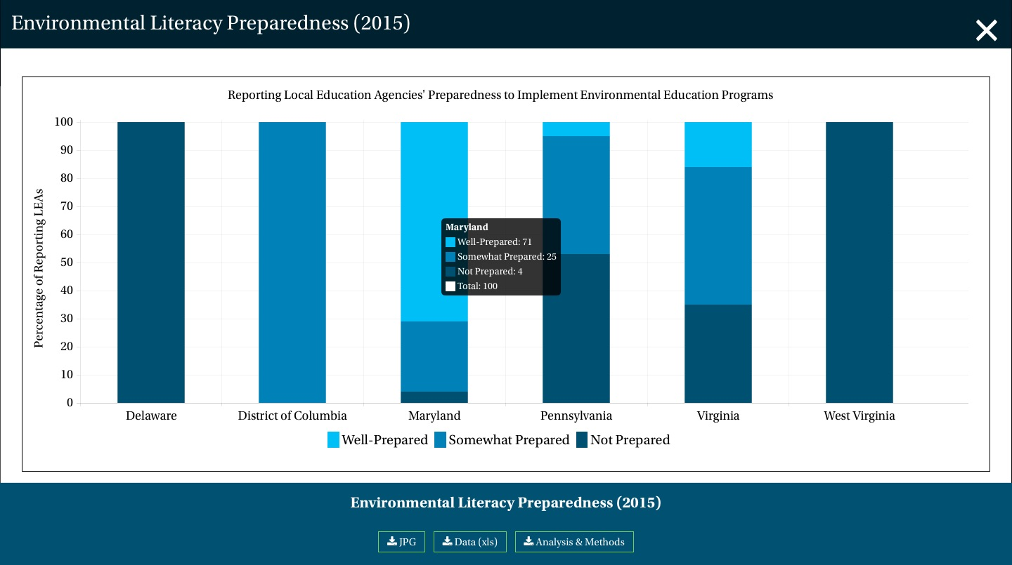
Environmental Literacy Planning Outcome

Slide 12

Indicator on ChesapeakeProgress: Progress Section

Slide 13
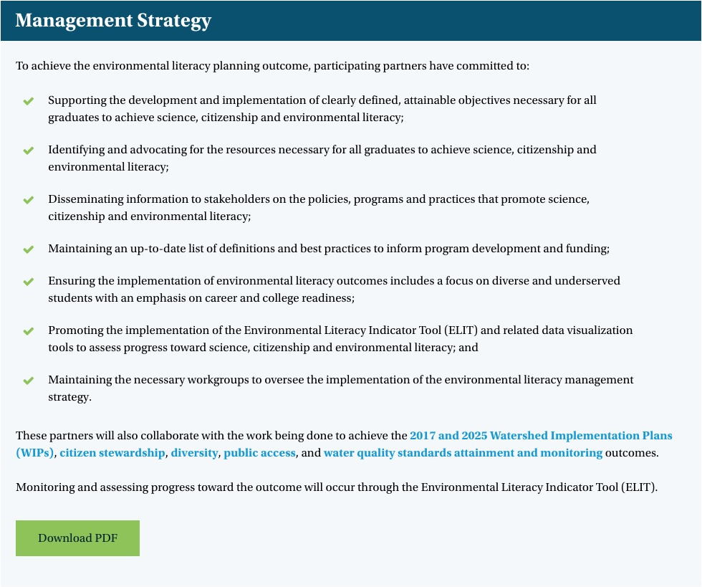
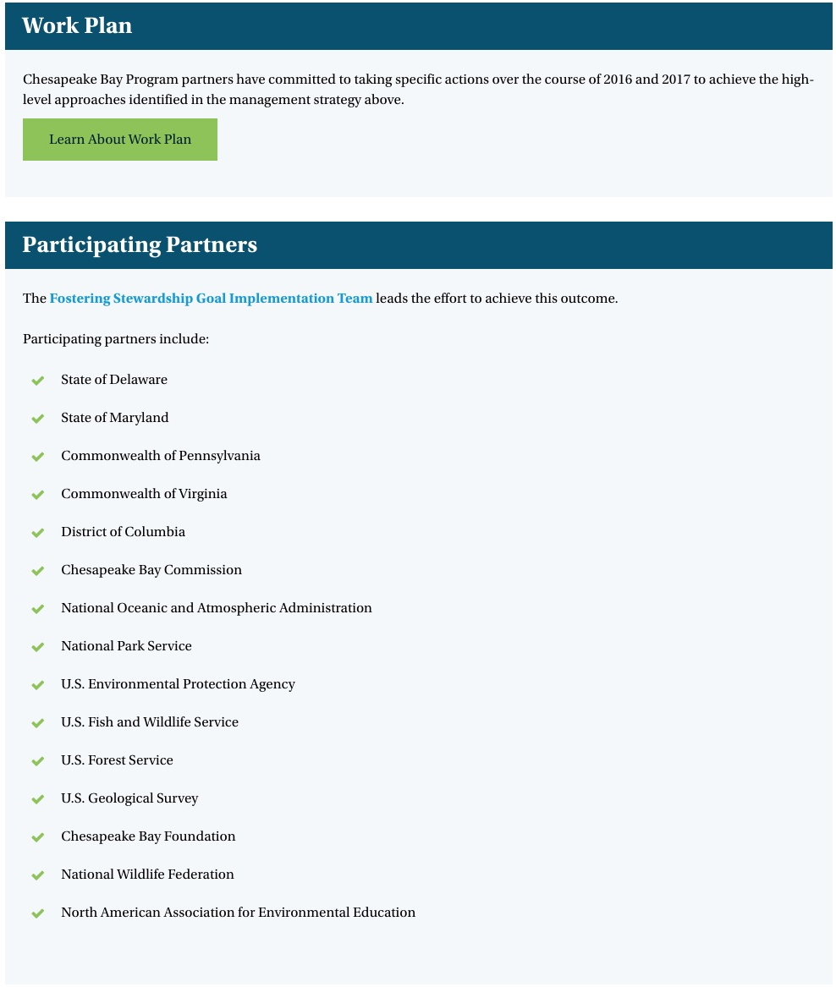
Indicator on ChesapeakeProgress: Supporting Sections

Slide 14
Student Outcome
Outcome:
Continually increase students’ age-appropriate understanding of the watershed through participation in teacher-supported meaningful watershed educational experiences and rigorous, inquiry-based instruction, with a target of at least one meaningful watershed educational experience in elementary, middle and high school depending on available resources.
Indicator:
The number of Local Education Agencies that provide MWEEs.
Based on ELIT data
Baseline: Percentage of LEAs in each jurisdiction that provide system-wide, some or no MWEEs
Notes:
Indicator : The number of Local Education Agencies that provide system-wide MWEEs.
Representation:
Baseline: The percentage of reporting Local Education Agencies that provide system-wide MWEEs, some MWEEs or no MWEEs for at least one grade level in elementary and middle school and one course in high school in each jurisdiction (stacked bar charts for elementary, middle and high schools; light blue: LEAs that offer system-wide MWEEs; medium blue: LEAs that offer some MWEEs; dark blue: LEAs that offer no MWEEs).
How should we depict change over time?
Data would be presented at the watershed level (i.e., clipped to watershed boundary).
We considered as an indicator The number of students enrolled in elementary, middle and high schools that provide system-wide MWEEs.
Representation:
Baseline: The percentage of students enrolled in elementary, middle and high schools that provide system-wide and/or some MWEEs in each jurisdiction
How should we depict change over time? Would be difficult to compare progress over time if one large LEA did not respond, for example.

Slide 15
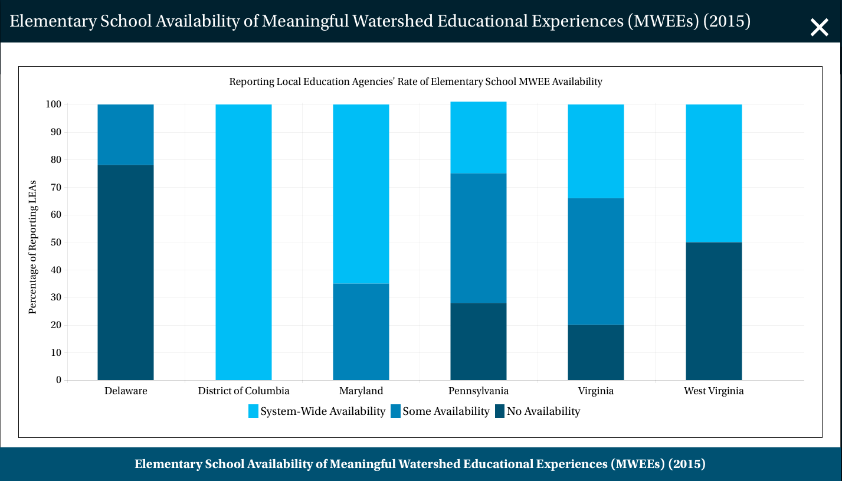
Student – Elementary School MWEEs
One graph for each school level
Rotate in carousel on webpage
Pop-up will appear when hover over bar

Slide 16
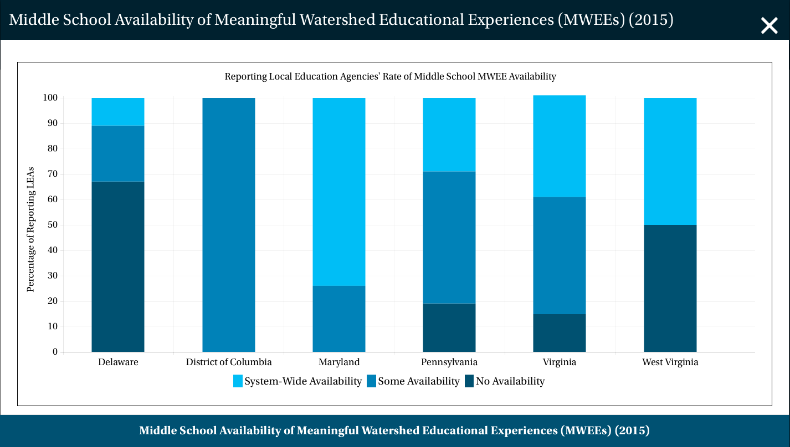
Student – Middle School MWEEs
One graph for each school level
Rotate in carousel on webpage
Pop-up will appear when hover over bar

Slide 17
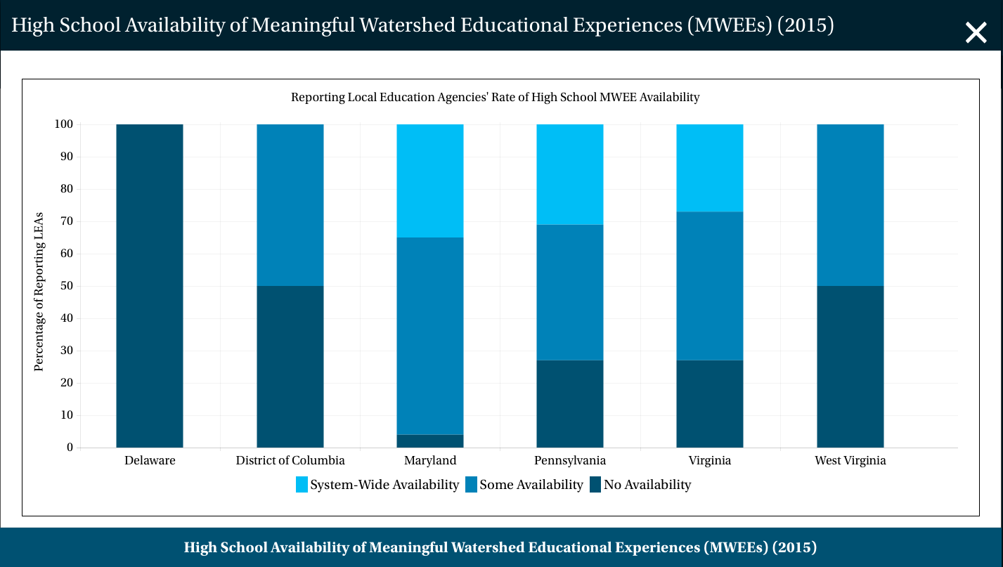
Student – High School MWEEs
One graph for each school level
Rotate in carousel on webpage
Pop-up will appear when hover over bar

Slide 18
In review …
We will add indicators for each of the 3 outcomes under the Environmental Literacy Goal.
Sustainable Schools: percentage of sustainable public and charter schools in the watershed
Environmental Literacy Planning: percentage of LEAs in each jurisdiction that are well, somewhat, or not al all prepared to implement environmental education programs
Student: percentage of LEAs in each jurisdiction providing systemwide, some, or no MWEEs in elementary, middle, and high schools

Slide 19
Thanks! Questions?
Laura Free| free.laura@epa.gov

Slide 21
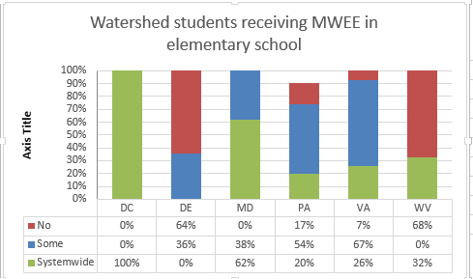
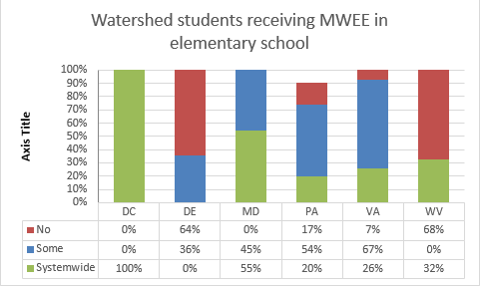
Using % of Students as an Indicator
2015 Results
2015 Results minus Prince George’s MD
Note: Percentage of students is based on enrollment numbers from responding LEAs.
Notes:
Imagine trying to track change over time when the same LEA may not respond to the next survey.
Here are two scenarios: left represents 2015 results, while right was calculated using 2015 results minus Prince George’s County in MD.
Consider the right graph the next iteration of ELIT, in 2017.
MD is showing an almost 10% drop in systemwide MWEEs, and the only thing we changed was Prince George’s County!
For each year, we suggest calculating the number of students that have access to Systemwide MWEEs for each level, but we don’t think that indicator can be used to track change over time.

Slide 22
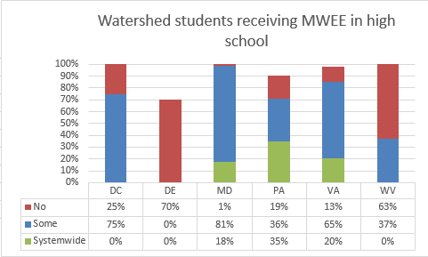
Using % of Students as an Indicator
Gaps occur when LEAs provide enrollment data but no information about MWEEs
Note: Percentage of students is based on enrollment numbers from responding LEAs.

