Slide 1
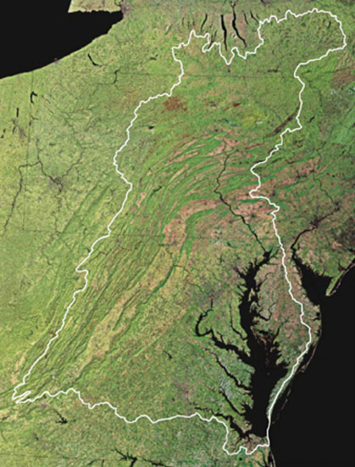
The Chesapeake Bay Program
EO 13508 Action Plan, Progress Report and Milestones
James Edward, Deputy Director
EPA Chesapeake Bay Program Office
CAC meeting, June 1, 2012

Slide 2
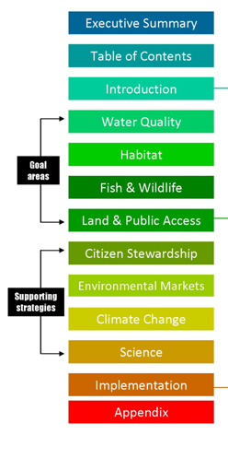
EO 13508 Chesapeake Bay Strategy
May 12, 2010

Slide 3
EO Strategy Goals and Outcomes
RESTORE CLEAN WATER GOAL: Reduce nitrogen, phosphorus, sediment and other pollutants to meet Bay water quality goals for dissolved oxygen, clarity and chlorophyll-a and toxic contaminants.
 | WATER QUALITY OUTCOME: Meet water quality standards for dissolved oxygen, clarity/underwater grasses and chlorophyll-a in the Bay and tidal tributaries by implementing 100 percent of pollution reduction actions for nitrogen, phosphorus and sediment no later than 2025, with 60 percent of segments attaining water quality standards by 2025.
 | STREAM RESTORATION OUTCOME: Improve the health of streams so that 70 percent of sampled streams throughout the Chesapeake watershed rate fair, good or excellent, as measured by the Index of Biotic Integrity, by 2025.
 | AGRICULTURAL CONSERVATION OUTCOME: Work with producers to apply new conservation practices on 4 million acres of agricultural working lands in high-priority watersheds by 2025 to improve water quality in the Chesapeake Bay and its tributaries.
RECOVER HABITAT GOAL: Restore a network of land and water habitats to support priority species and to afford other public benefits, including water quality, recreational uses and scenic value across the watershed.
 | WETLAND RESTORATION OUTCOME: Restore 30,000 acres of tidal and non-tidal wetlands and enhance the function of an additional 150,000 acres of degraded wetlands by 2025.
 | FOREST BUFFER OUTCOME: Restore riparian forest buffers to 63 percent, or 181,440 miles, of the total riparian miles (stream bank and shoreline miles) in the Bay watershed by 2025.
 | FISH PASSAGE OUTCOME: Restore historical fish migratory routes by opening 1,000 additional stream miles by 2025, with restoration success indicated by the presence of river herring, American shad and/or American eel.
SUSTAIN FISH & WILDLIFE GOAL: Sustain healthy populations of fish and wildlife, which contribute to a resilient ecosystem and vibrant economy.
 | OYSTER OUTCOME: Restore native oyster habitat and populations in 20 tributaries out of 35 to 40 candidate tributaries by 2025.
 | BLUE CRAB OUTCOME: Maintain sustainable blue crab interim population target of 200 million adults (1+ years old) in 2011 and develop a new population rebuilding target for 2012-2025.
 | BROOK TROUT OUTCOME: Restore naturally reproducing brook trout populations in headwater streams by improving 58 sub-watersheds from ‘reduced’ classification (10-50 percent of habitat lost) to “healthy” (less than 10 percent of habitat lost) by 2025.
 | BLACK DUCK OUTCOME: Restore a three-year average wintering black duck population in the Chesapeake Bay watershed of 100,000 birds by 2025.
CONSERVE LAND AND INCREASE PUBLIC ACCESS Conserve landscapes to maintain water quality, habitat, sustainable working forests, farms and maritime communities; and cultural, community and indigenous values. It will also expand public access to the Bay and its tributaries through existing and new federal, state, and local parks, refuges, reserves, trails and partner sites.
 | LAND CONSERVATION OUTCOME: Protect an additional 2 million acres of lands throughout the watershed currently identified as high conservation priorities at the federal, state or local level by 2025, including 695,000 acres of forest land of highest value for maintaining water quality.
 | PUBLIC ACCESS OUTCOME: Increase public access to the Bay and its tributaries by adding 300 new public access sites by 2025.

Slide 4
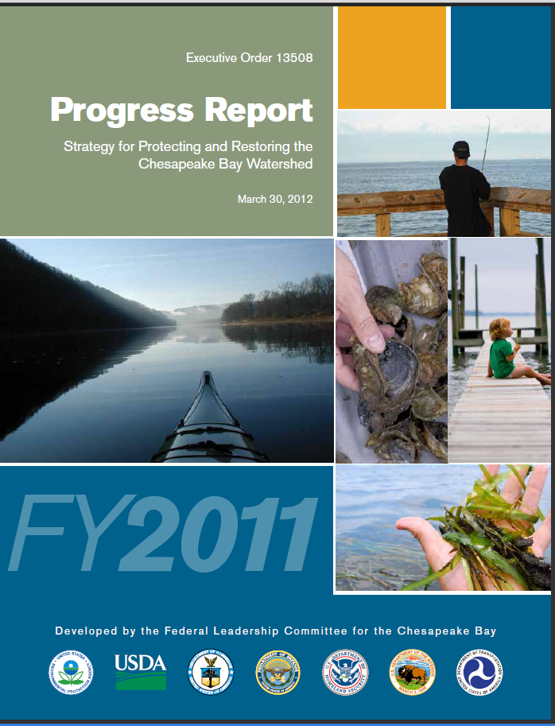
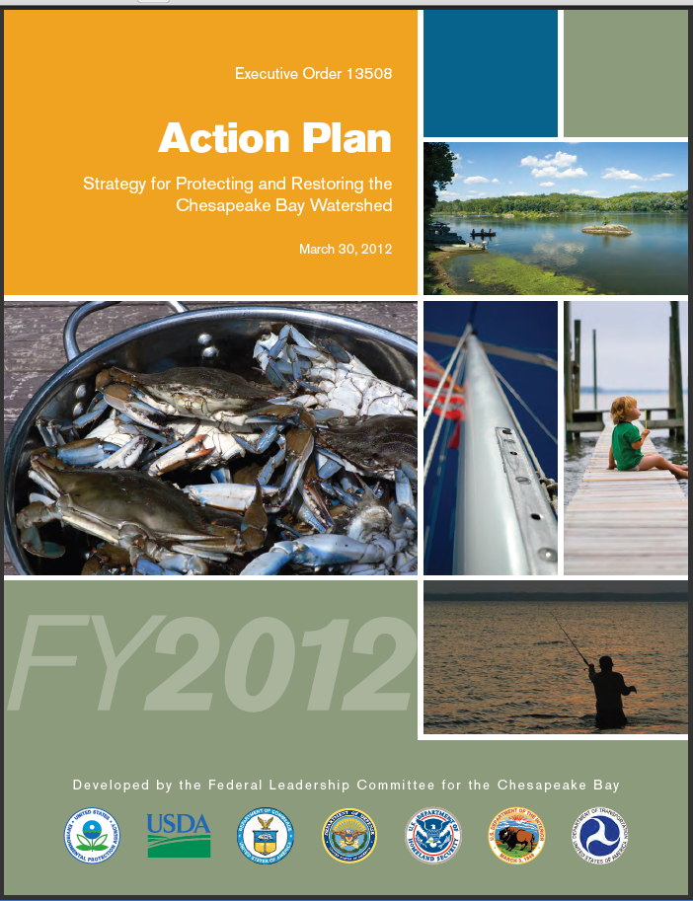
EO FY11 Progress Report & FY12 Action Plan
Released by the FLC March 30, 2012

Slide 5
FY11 Progress Report
First ever EO report on progress
Details the steps federal agencies took toward achieving strategy goals
FY2012 efforts focused on setting a “road map” for the future
Federal agencies also collaborated to eliminate duplication of efforts

Slide 6
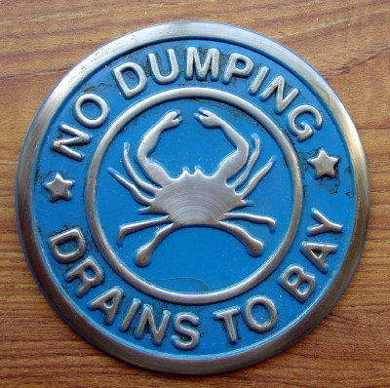
FY11 Progress Report
RESTORE CLEAN WATER
FY2011 Accomplishments:
EPA and its jurisdictional and federal partners focused on implementing the historic Chesapeake Bay Total Maximum Daily Load (TMDL) completed in December 2010. Partners began putting in place controls that achieve 11 percent of the sediment reduction goal, 8 percent of the nitrogen reduction goal and 1 percent of the phosphorus reduction goal. This work is ahead of schedule for all but phosphorus. These local actions—put in place with the help of farmers, home builders, watershed organizations and others—will eventually help meet water quality standards for dissolved oxygen, chlorophyll a and clarity.
The bay jurisdictions drafted Phase II Watershed Implementation Plans designed to show how strategies will be implemented at the local level, which provide roadmaps for reaching required TMDL pollution reductions by 2025. The jurisdictions and the federal partners also developed two-year milestones to ensure all partners keep on an aggressive path to achieving their pollution reduction targets.
EPA, U.S. Geological Survey, and the states expanded the Chesapeake non-tidal water quality network to obtain new monitoring data to better assess progress toward the bay TMDL.
EPA provided more than $20 million to the states and DC in implementation and accountability grants, and $5 million for local innovative and small watershed restoration actions.
USDA/NRCS treated more than 650,000 acres of working lands in priority watersheds with at least one conservation practice and provided technical and financial assistance to agriculture producers.

Slide 7
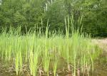
FY11 Progress Report
RECOVER HABITAT
FY2011 Accomplishments:
148 stream miles were opened for fish passage to benefit anadromous and resident species. This exceeded the annual target of 67 stream miles.
Federal and state partners completed the Maryland portion of a fish passage prioritization tool for blockages in Maryland, Virginia and Pennsylvania.
  This tool will accelerate projects that enhance passage of target species and open large stretches of high-quality habitat.

Slide 8
FY11 Progress Report
SUSTAIN FISH & WILDLIFE
FY2011 Accomplishments:
NOAA led the development of oyster restoration performance metrics that, for the first time in the Chesapeake Bay, set criteria for evaluating success of oyster restoration projects at both tributary and reef spatial scales. The metrics will be used to track progress toward the EO goal to restore oysters in 20 tributaries by 2025.
USACE, NOAA and Maryland have also initiated a targeted effort to restore oysters in Harris Creek, a Maryland oyster sanctuary. This collaborative effort serves as a bay-wide model for science-based, large-scale oyster restoration.
The 2011 Chesapeake Bay Blue Crab Stock Assessment was released by NOAA and was used by the states to establish a new adult, female-specific, blue crab abundance target of 215 million female crabs for the bay. The new target will help maintain a sustainable stock of blue crabs and ensure a robust harvest over the long-term.
The Eastern Brook Trout Joint Venture (which includes FWS and USGS) evaluated the health of brook trout in sub-watersheds within the Chesapeake Bay watershed and the FWS Coastal Program initiated 2 brook trout restoration projects in Maryland and Virginia.
Federal, state and nongovernmental partners initiated work to improve a regional black duck habitat model, to assess the quality and spatial arrangement of available black duck habitat in Chesapeake Bay, and to prioritize and target restoration measures. A mid-winter aerial survey was completed, and estimated the 2009-2011 three-year average at 47,269 black ducks in the Chesapeake Bay.

Slide 9
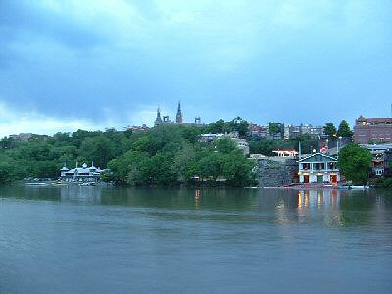
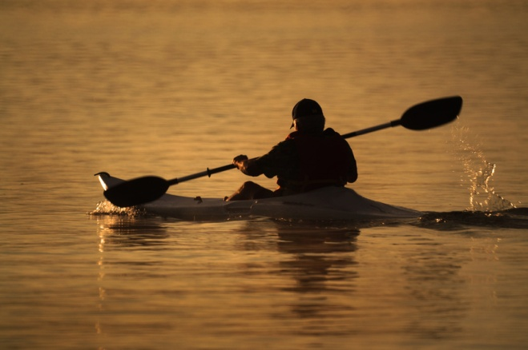
FY11 Progress Report
CONSERVE LAND & INCREASE PUBLIC ACCESS
FY2011 Accomplishments:
USDA/NRCS worked with agricultural producers to enroll over 6,000 acres in programs that place permanent easements on farmland and wetlands. These efforts conserve open space, keep working lands working, and help reduce the flow of nutrients and sediment into the Chesapeake Bay.
The Public Access Planning Team, led by the National Park Service, with representation from federal, state, local and nonprofit partners identified and mapped approximately 1,100 existing public access sites throughout the Chesapeake Bay watershed—the first time the entire watershed was inventoried.
A web-based mapping tool was developed to identify public access gaps and opportunities using input from the public, resulting in more than 300 additional public access site suggestions which will be included in a strategy for expanding public access to be released in Spring of 2012.

Slide 10
FY12 Action Plan
Second Annual EO action plan
Includes a list of tangible efforts federal agencies will tackle to improve the Bay’s health
Some of these initiatives are continuations of projects started the previous year; others are new initiatives

Slide 11
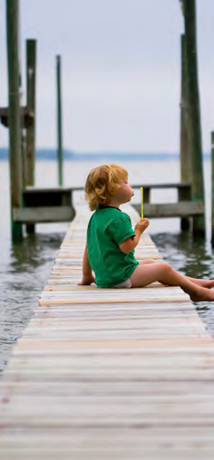
FY12 Action Plan Overview
FY12 Highlights Include:
Continue to provide technical assistance and resources to the Chesapeake Bay jurisdictions for Phase II Watershed Implementation Plans, supporting implementation of the Bay TMDL.
Invest in financial and technical assistance to farmers to help them implement voluntary conservation practices in high-priority watersheds within the Chesapeake watershed.
Prepare a report on toxic contaminants in the bay and watershed to help guide new reduction goals for toxic contaminants in 2013.
Continue oyster reef construction, spat-on-shell planting, and restoration monitoring and evaluation in Harris Creek, Maryland, as a blueprint for additional large-scale sanctuary restoration.
Continue work to establish a watershed-side GIS based land conservation priority system.

Slide 12
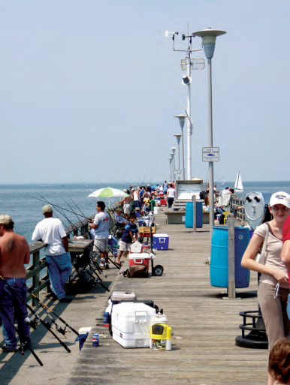
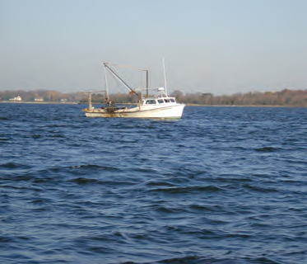
FY12 Action Plan
Examples of Collaborative Actions:
Develop a Chesapeake Conservation Corps Network that will provide a continuum of service opportunities to help engage youth.
Finalize the Elementary and Secondary Environmental Literacy Strategy that addresses goals for students, educators, and school grounds.
Support an economic study on the costs of water quality improvements and the role a nutrient trading program can play in environmental markets in the Bay watershed.
Hold workshops to integrate climate adaption with restoration and conservation techniques at the subwatershed level.
Produce a report summarizing the potential changes in streamflow conditions in the watershed to help assess potential changes in water quality.
Collaborate with state and academic partners to implement adaptive management though ChesapeakeStat and establish the Monitoring Alliance and Data Enterprise.

Slide 13

Funding
Total FY2012 federal funding: $419,632,152 (actual appropriations)
Based on resources that are directly attributable to implementing the EO Strategy by the FLC agencies
FY2012 projections are based on an explicit strategy and a set of actions jointly adopted by all agencies

Slide 14
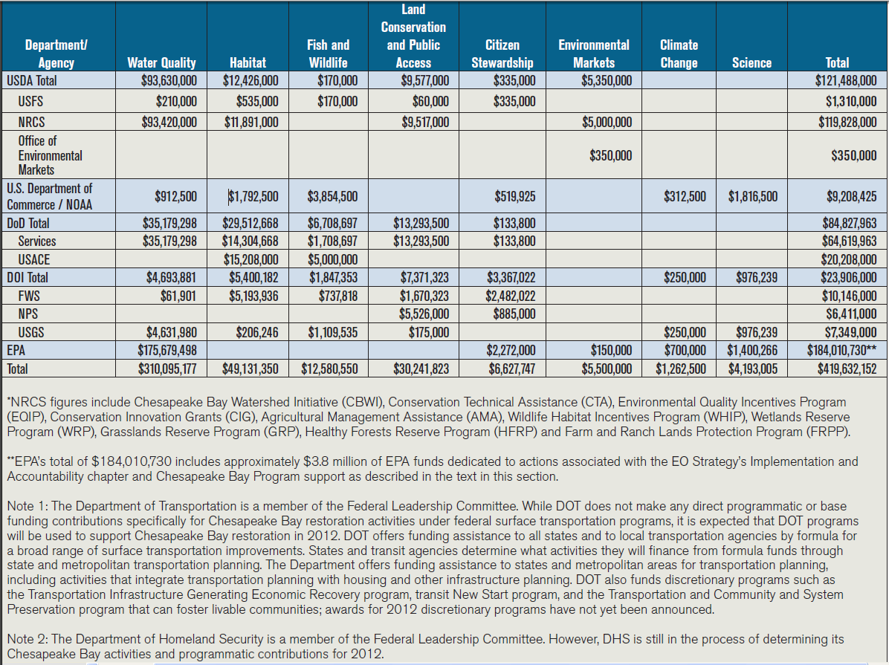
Funding

Slide 15
Outcomes and Milestones for the Four Goal Areas
Two-year milestones for four major goal areas
  Water Quality
  Habitat
  Fish & Wildlife
  Land & Public Access
Water Quality milestones issued with state two-year milestones in January 2012
Other goals in FY12 Action Plan issued March 30, 2012

Slide 16
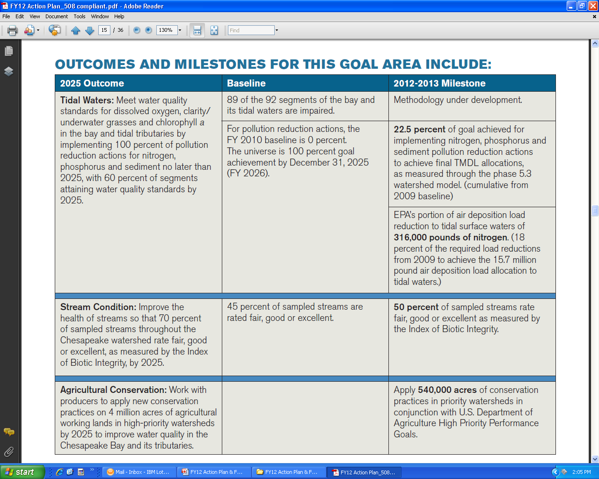
2012-2013 Milestones
Restore Clean Water

Slide 17
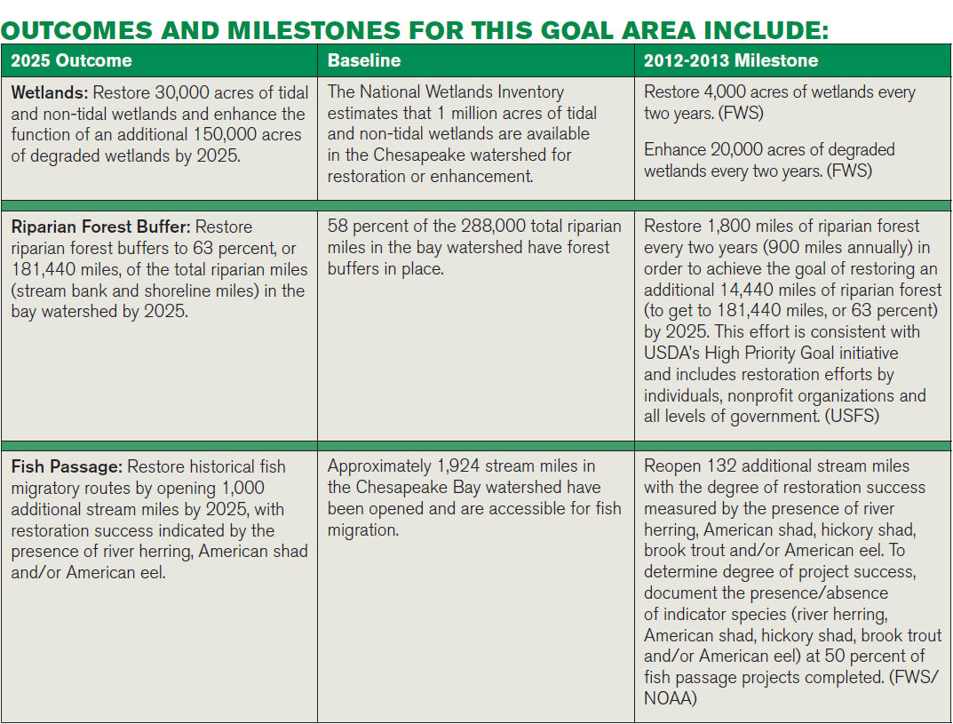
2012-2013 Milestones
Recover Habitat

Slide 18
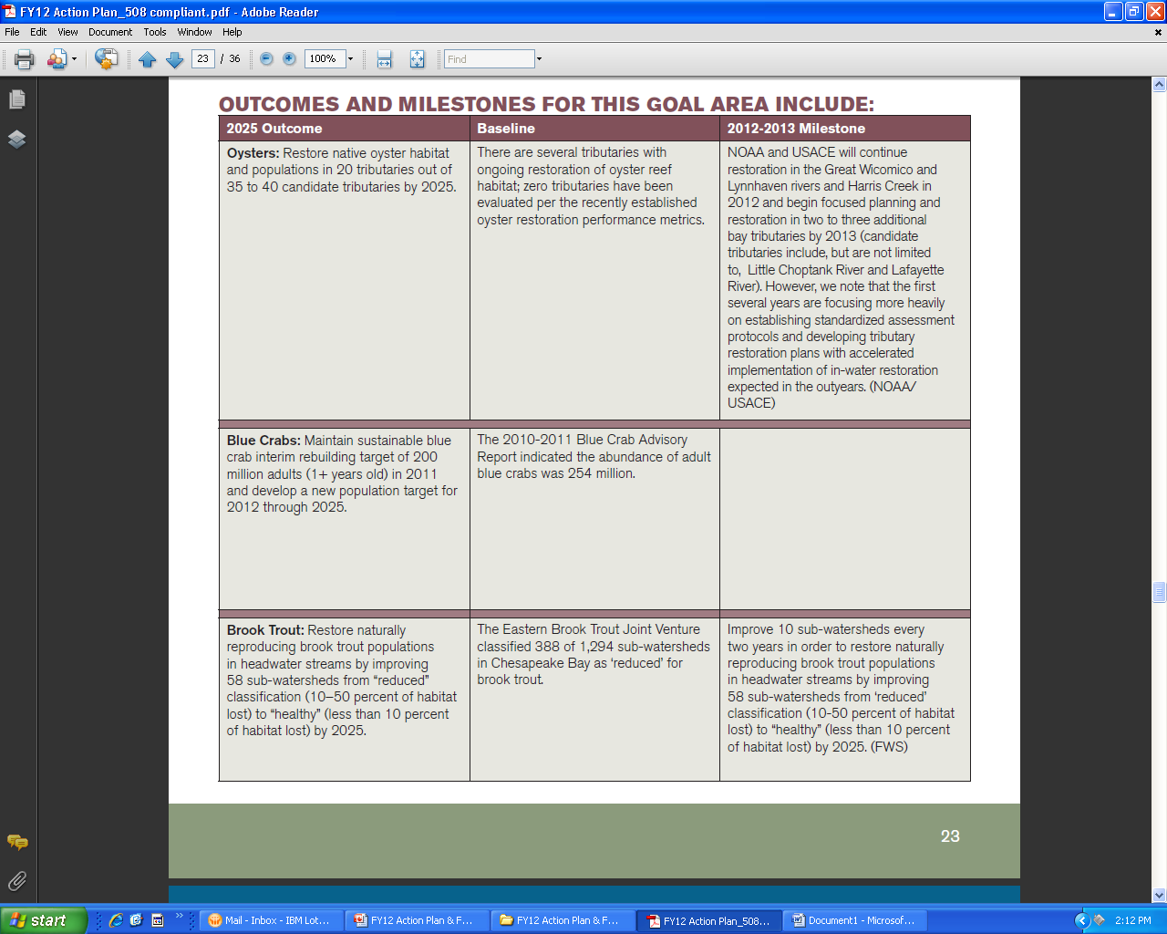
2012-2013 Milestones
Sustain Fish and Wildlife

Slide 19
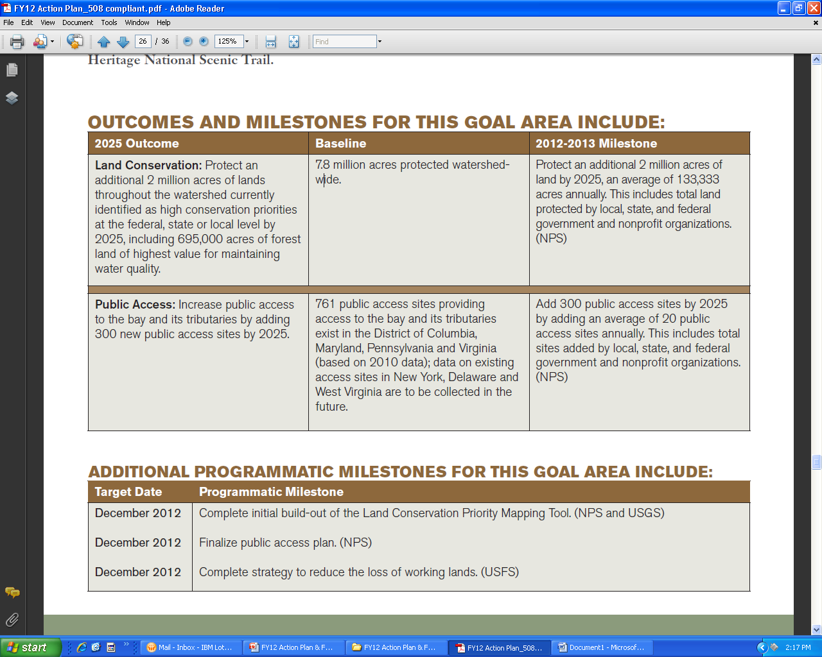
2012-2013 Milestones
Conserve Land and Increase Public Access

Slide 20
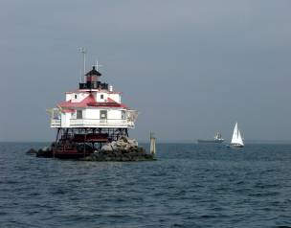
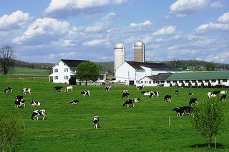
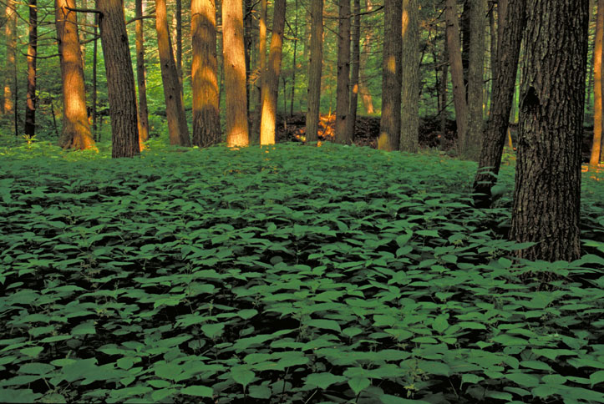
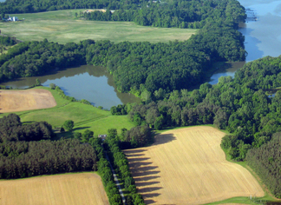
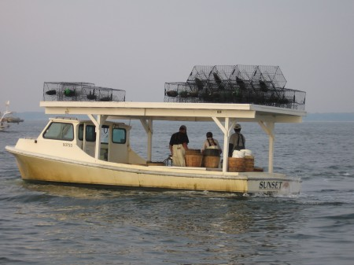
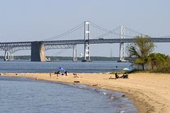
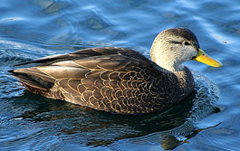
QUESTIONS
http://executiveorder.chesapeakebay.net/

