Slide 1

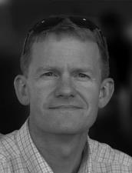

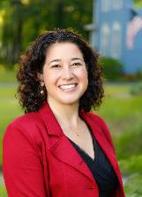
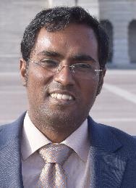



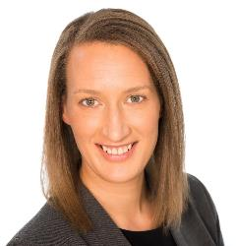
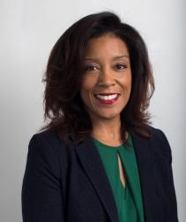








We build policies to deliver spectacular improvements in the speed of environmental progress.
Water Infrastructure
Restoration & Mitigation
Procurement & Finance
Water Quality Partnerships
Technology
Endangered Species

Slide 2
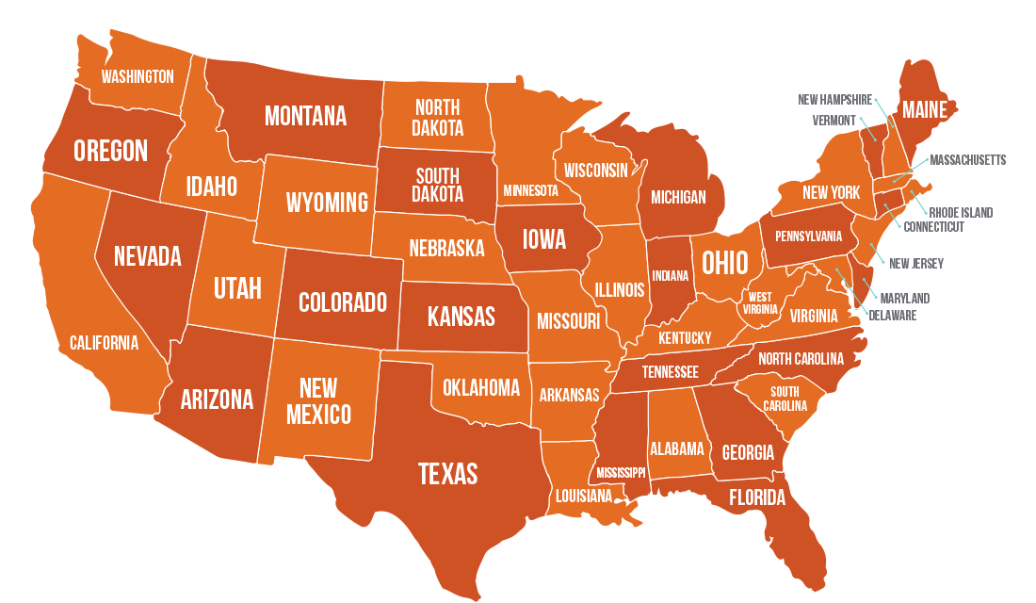
Notes:
Define innovation: give a specific example → the Chesapeake model that quantifies outcomes.

Slide 3
pension funds financing natural solutions
pension funds financing natural solutions
Notes:
Define innovation: give a specific example → the Chesapeake model that quantifies outcomes.

Slide 4
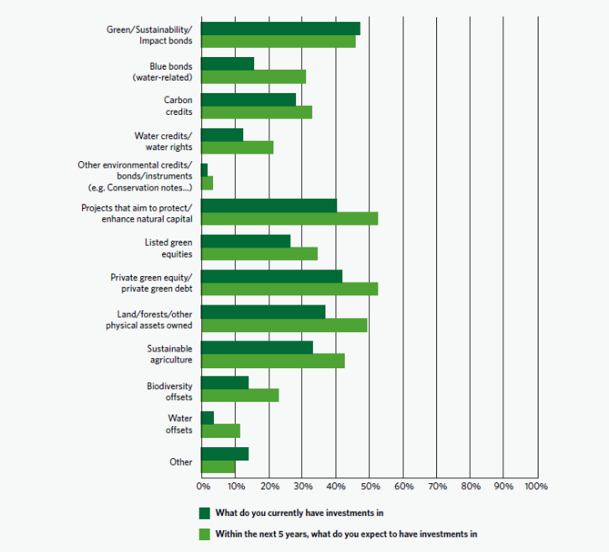
Global Investment
2019 survey of 62 investors with more than $3 trillion in assets invested
(pension funds, Goldman Sachs, Credit Suisse, big banks, institutional investors, etc.)

Slide 5
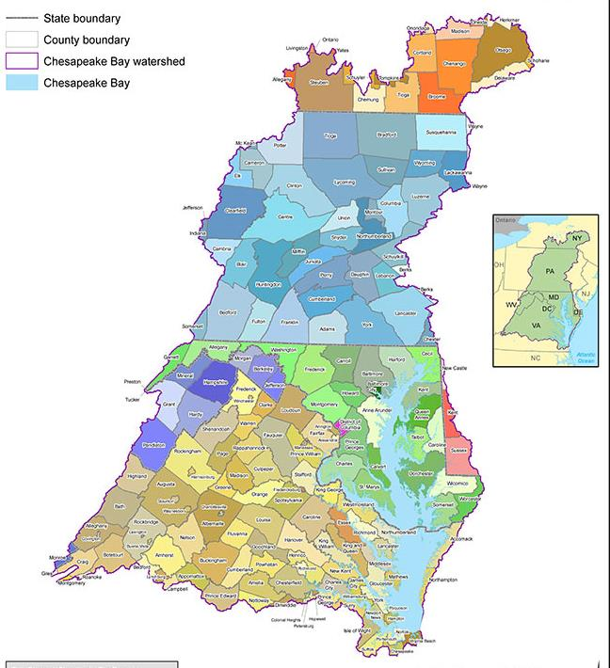
Clean
Finance Innovation Chesapeake Bay
PA (SRF) Revolving Fund Forest Protection
PA Clean Water Procurement Program (leg.)
Delaware Revolving Water Fund
MDOT Advance Stream Credit Procurement
MDOT Smart Ponds
VA DEQ Nonpoint Source Nutrient Trading (160 banks)
VA Wetlands Banking
VA Seagrass Carbon Credits
MD Clean Water Commerce Act
MD Forest Banking
Prince Georges P3 – biggest environmental P3 in US
Anne Arundel Full Delivery Credits
DC Green Bank
DC Stormwater Credit Price Floor
DC Stormwater Retention Credits

Slide 6
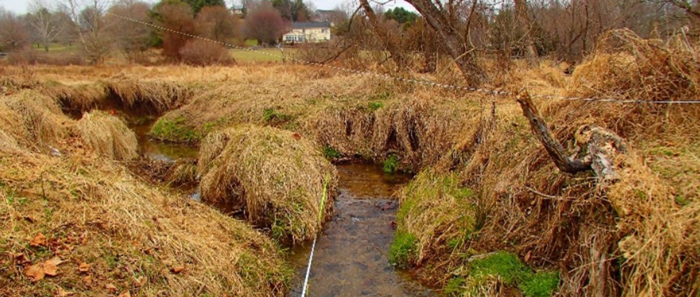

2017: Maryland DOT needed 28 miles of stream restoration, 140 acres of wetland
Developed a Pay for Success/Full Delivery RFP
20 contracts for stream & wetland restoration
80% cost savings compared to earlier projects

Slide 8
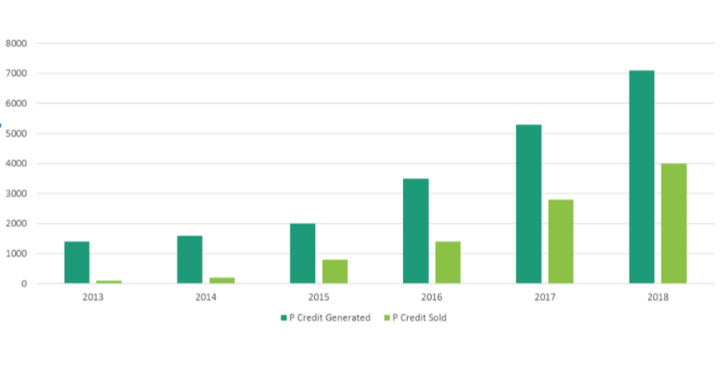
Virginia’s $15 M/year nutrient banking program for new impacts

Slide 9
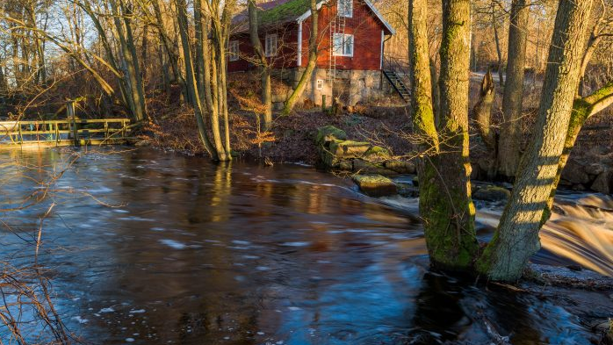
New Study in Baltimore Finds Stream Restorations Increase Home Values 11-15%

Slide 10


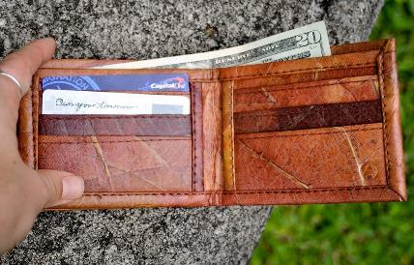

Commodity has value to someone – or be assigned a value
Government behavior – either as a regulator or a buyer – needs to be predictable
Someone must pay back the investor (inc. state)
Currency that requires less than 5-10% of project budget to track
Notes:
Note: someone has to pay for the environmental good or service.
E.g. Municipality, taxpayer, consumer, a regulated/compliance buyer, utility or their ratepayers, etc.

Slide 11
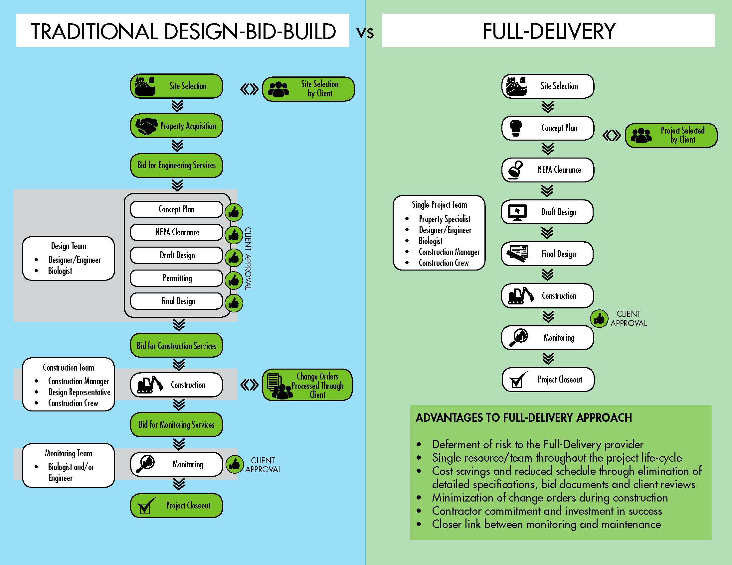

Slide 12
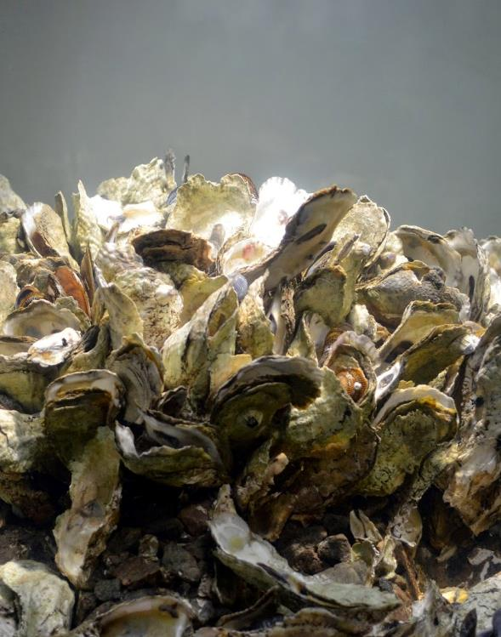
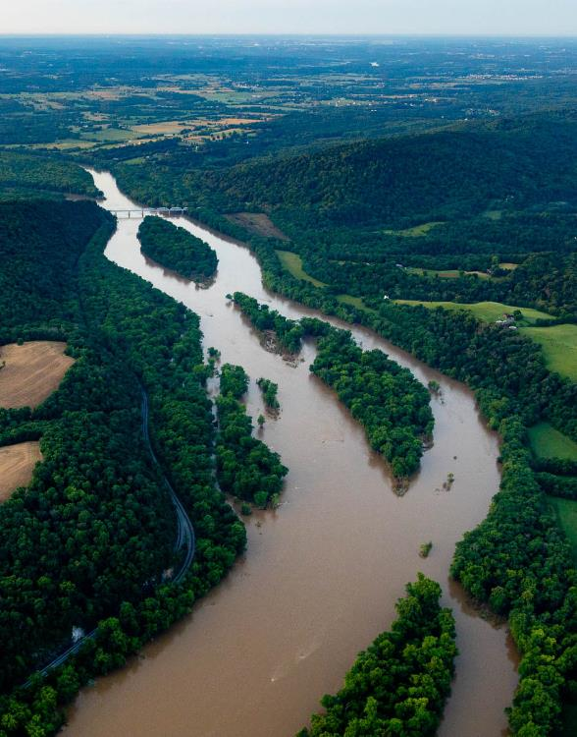
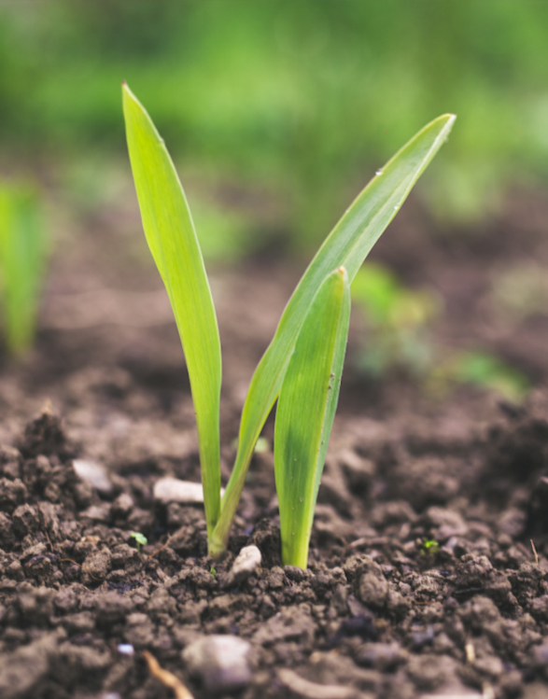

Slide 13
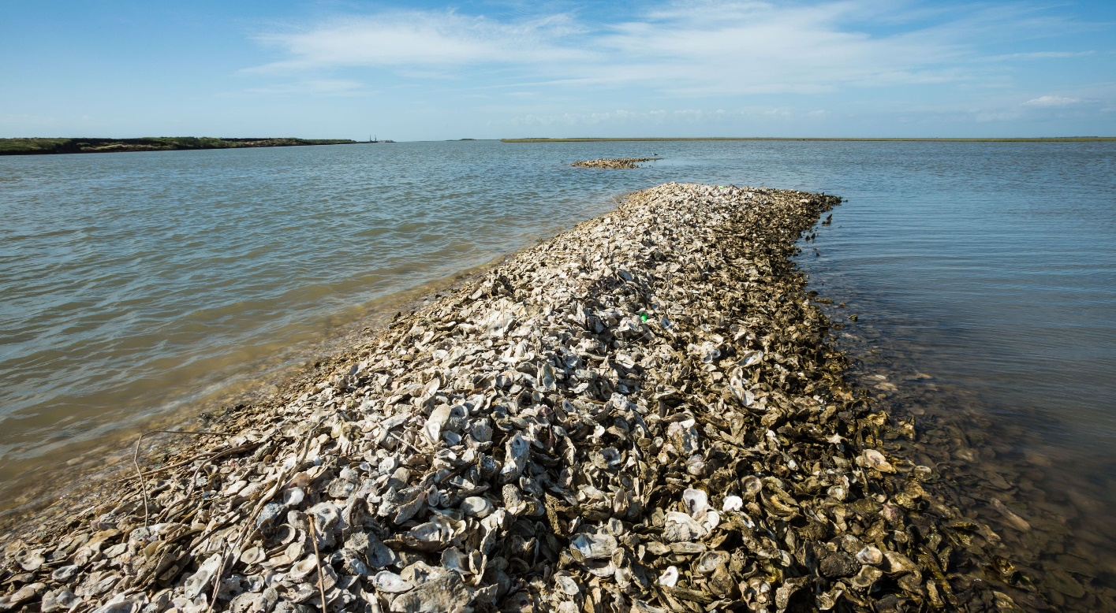
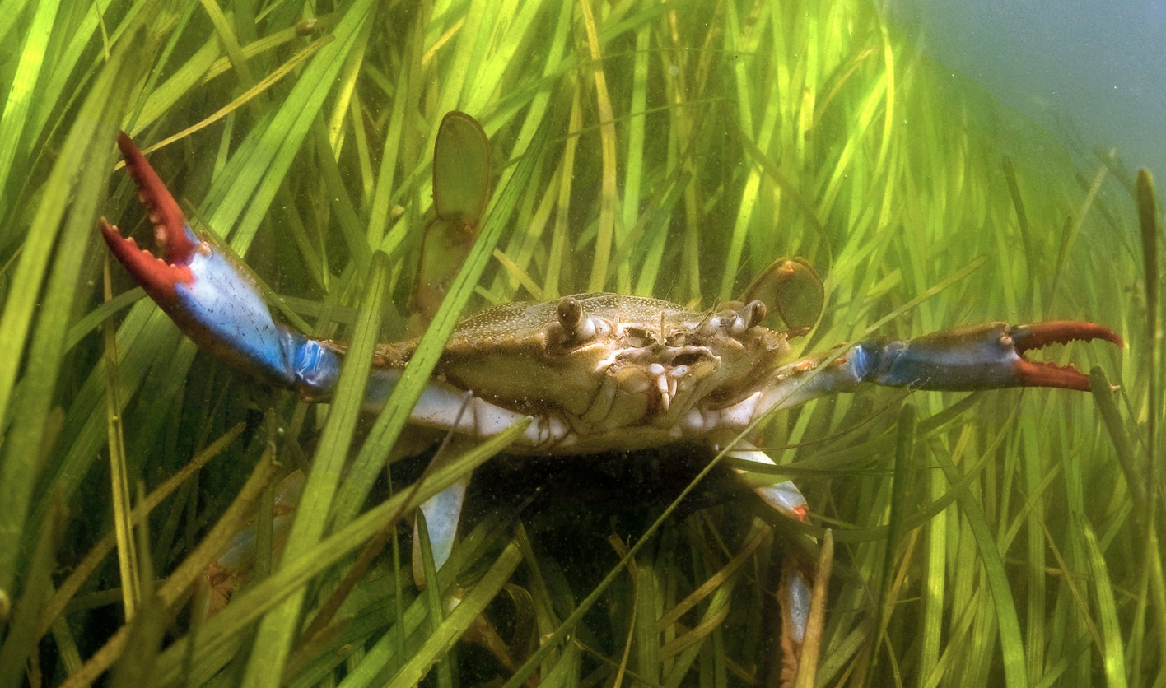
Equal Footing for Green and Blue Infrastructure
Makes green and blue infrastructure as financeable as gray infrastructure
First state law definition of blue infrastructure: “a water-based natural element or engineered element designed to mimic or enhance the function of a natural element that 1) absorbs and filters pollutants, 2) protects communities from flooding or storm surge, 3)reduces erosion, or 4) sequesters carbon
Allows loans for forest conservation , loan guarantees to nonprofits and for profits for green/blue infrastructure, pay for success, or impact bond work.

Slide 14
Create Pay for Success Contracting in Procurement Law
Add “Pay for Success” contract option to MD General Procurement Law.
  A new procurement practice.
  Define ‘environmental outcome’ as a commodity.
Make relevant changes to agency-specific code to incorporate
  DOT environmental projects
  Carbon credit purchases
  Natural resource programs
  Green and blue infrastructure
Notes:
Only use one term, don’t switch between pay for success and performance.

Slide 15
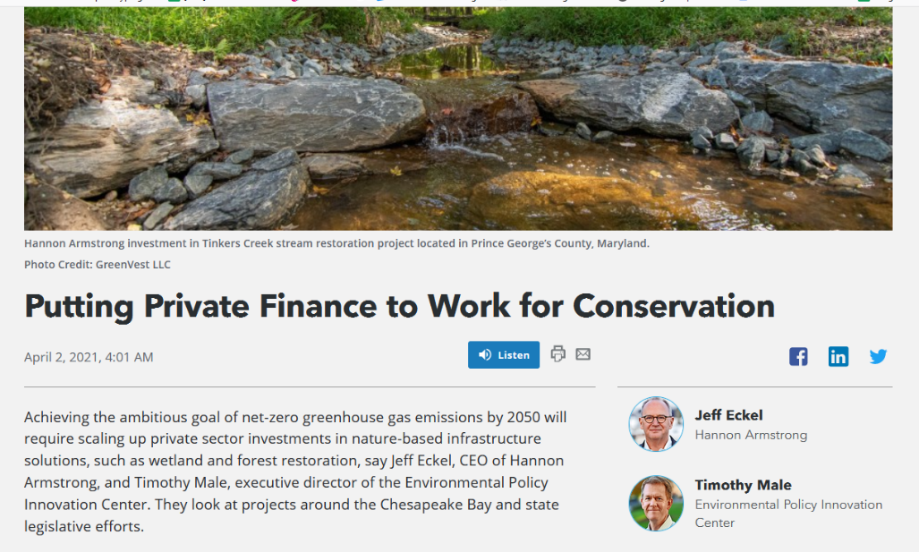
Define Environmental Outcomes as Commodities
“Environmental outcome” means a commodity that is modeled or directly measured as a single, quantifiable, and certified unit of improvement to the environment, including a nutrient or carbon benefit
Defining these as a commodity would pave the way for easier public and private transactions to buy them.
Nitrogen load reduction; Phosphorus load reduction; Climate resiliency; Carbon sequestration; Algal bloom reduction
https://bit.ly/2R88KsI

Slide 16
State Revolving Funds to be Used for Forests
Adjust language to make clear that it supports loans for land conservation, and forest and coastal bay protection and management
Make clear that it can support implementation of agricultural and forestry BMPs
Replicate a funding option used in other states (called ‘sponsorship’) that can expand funding for nonpoint source projects and work by third parties
Expand linked deposit authorization to facilitate banks making loans for things like tree planting
Green (and blue) infrastructure projects get extensive attention and prioritization in both drinking and wastewater programs
Notes:
Edit based on comments from MDE and Liz/Lyme

Slide 17
Carbon Credit Markets
Ensures state easements, contracts and agreements don’t limit landowners’ ability to sell additional carbon in voluntary carbon markets
Encourages a new working group to advise DNR on forest carbon aggregation policies for small private properties
Requires DNR to initiate first forest carbon (and blue carbon) projects within 2 years
Allows state forest restoration to count as buffer or insurance to meet private lands’ carbon protocol requirements
Notes:
Edit based on comments from MDE and Liz/Lyme

Slide 18
Accounting & Permitting
Commission on Green and Blue Infrastructure
  Fix procedural barriers to ecological restoration
  Recommend procedures to simplify state/local permit processes
  Actions to expand private investment
Task Force on Natural Capital Accounting
  Recommendations for local government to add valuations of trees, carbon and other assets to municipal balance sheets
Notes:
Edit based on comments from MDE and Liz/Lyme

Slide 20





