Slide 1
Equity in Environmental Literacy
Tuana Phillips, EPA
Francesca King, CRC

Slide 2
1. What is DEI?
Let’s start with the definitions.

Slide 3
Diversity
“Expanding the diversity of the workforce and participants in restoration and conservation activities means to include a wide range of people of all races, income levels, faiths, genders, ages, sexual orientations and disabilities, along with other diverse groups. For this effort to be successful it will require us to honor the culture, history and social concerns of local populations and communities.”

Slide 4
Equity
Improving equity is to promote justice, impartiality and fairness within the procedures, processes, and distribution of resources by institutions or systems. Tackling equity issues requires recognition of the underlying or root causes of disparities within our society.

Slide 5
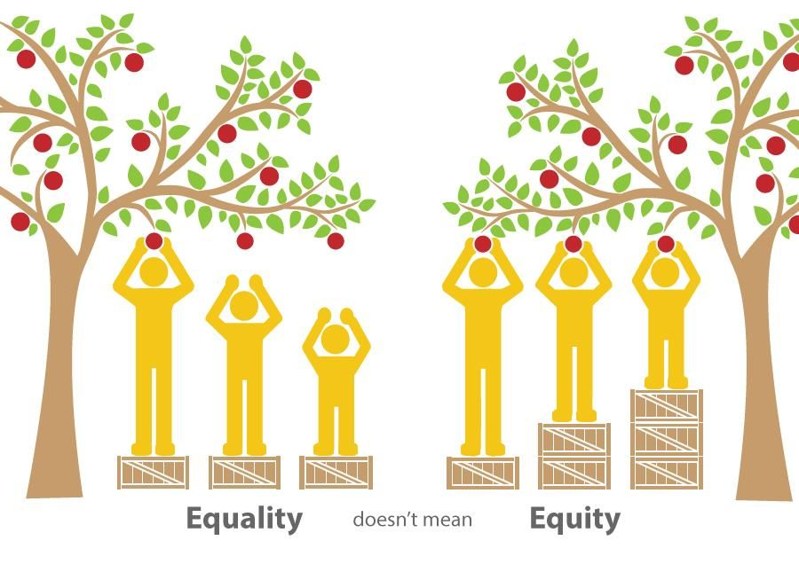

Slide 6
Inclusion
Refers to the degree to which diverse individuals are enabled to participate fully in the decision-making processes within an organization or group. While a truly “inclusive” group is necessarily diverse, a “diverse” group may or may not be “inclusive.”

Slide 7
Justice
Equal access to wealth, opportunities, and privileges within a society. This may mean addressing the present-day impacts of past inequities in order to achieve equity going forward.

Slide 8
2. What is CBP doing?

Slide 9
DEI in the Chesapeake Bay Program Partnership
2014 Chesapeake Bay Agreement
Diversity listed as an Outcome for the first time.
Diversity Workgroup
Jim Edwards, Chair
Tuana Phillips, Coordinator
Francesca King, Staffer
Steering Committee
Membership

Slide 10
Identify minority stakeholder groups that are not currently represented in the leadership, decision making and implementation of current conservation and restoration activities and create meaningful opportunities and programs to recruit and engage them in the Partnership’s efforts. [Diversity Outcome]

Slide 11
36%
35%
13%
Let’s check out the numbers...
People of color make up:
Of the United States
Of the watershed
Of the Partnership

Slide 12

2025 CBP Diversity Indicator Targets
To increase racial and ethnic diversity representation in the partnership from 13% → 25%
Within Leadership: 11% → 15%
Currently 11% of leadership self-identify as non-white
3% of non-white people in the partnership say they hold a leadership position, compared to 27% of white people.

Slide 13
GIT Funded Project: Skeo Solutions, Inc
75% Dissatisfied with diversity among staff
8%
Agreed CBP regularly considers DEI
Cultural Readiness Survey and Focus Groups

Slide 14
Next Phase: DEI Strategy
DEI Strategy coming soon!
Cultural Competency Trainings

Slide 15
2. So how does this relate to environmental literacy?

Slide 16
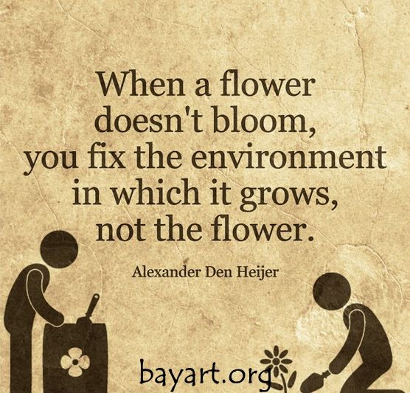

Slide 17
Diversity Workgroup
Communications and Outreach
Begin dialogue to better understand how community issues link to watershed restoration.
RESET Program
Employment and Professional Engagement
C-Stream Internship Program
Share opportunities and address inequities in Green Jobs

Slide 18
Diversity Workgroup
Promote Environmental Justice
Bay Program will partner with funding organizations and grass roots organizations to partner with to organize:
Awareness building
Grant writing training
Capacity building to address restoration projects in areas with diverse and underrepresented populations.
Tracking and Assessment
Create and track new partnerships that help to better identify and target underrepresented and underserved Chesapeake communities.
Use EJ Screening tool as a base for identifying underserved Chesapeake communities.

Slide 19
DEI in Environmental Literacy
Incorporate environmental education development in underserved school systems.
Encourage career-building days in the environmental literacy curriculum of high with a focus on career paths.
Explore partnering with non-profit social service organizations to provide technical training as an alternative to higher education degrees.

Slide 20
Environmental Literacy Policy Work Plan
Management Approach 1: Support school district efforts to embed locally appropriate environmental practices, content, and learning opportunities into curriculum and operations.
Action 1.4: Encourage the development of local networks that include school district(s), environmental education providers, and local community groups to provide in school and out-of-school opportunities to foster youth engagement.
Performance Target: Support the development of local networks to support MWEE design and implementation in underserved areas

Slide 21
Environmental Literacy Policy Work Plan
Management Approach 2: Use available data and information to strategically and equitably focus resources to support school district level environmental literacy planning and implementation.
Action 2.1: Create reports, data visualizations, and progress indicators using data from the Environmental Literacy Indicator Tool and other pertinent information (e.g. socioeconomic, natural resource, etc.) to better inform policy and resource allocation decisions. Performance Target: Work with CBP GIS team to develop maps and information to inform conversations about targeting environmental literacy work.

Slide 22
Think About It!
What are the barriers to achieving equity in environmental education?
What efforts currently exist to address these efforts and how could we support or build on these efforts?

