Slide 1
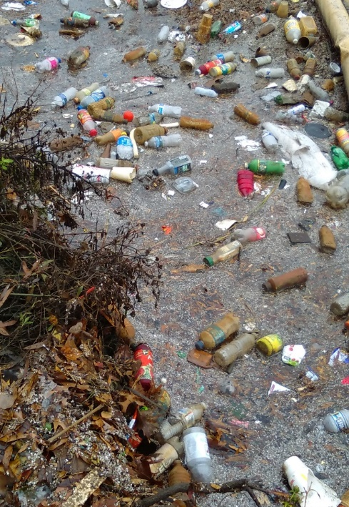
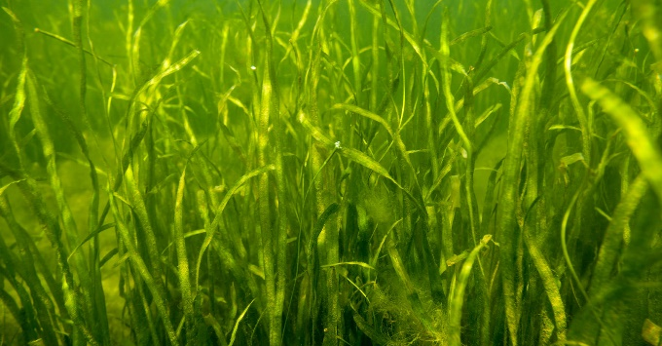
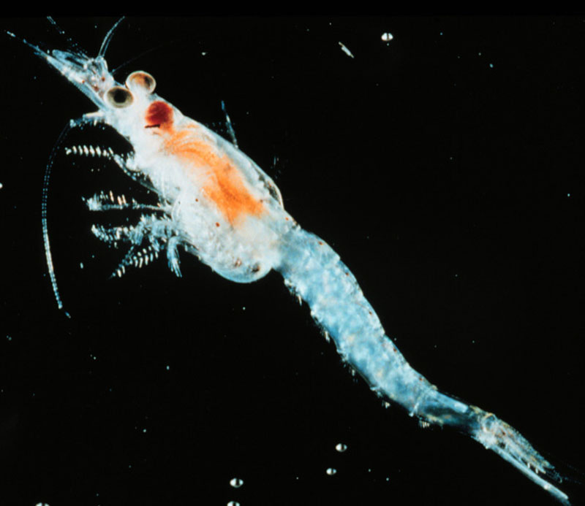
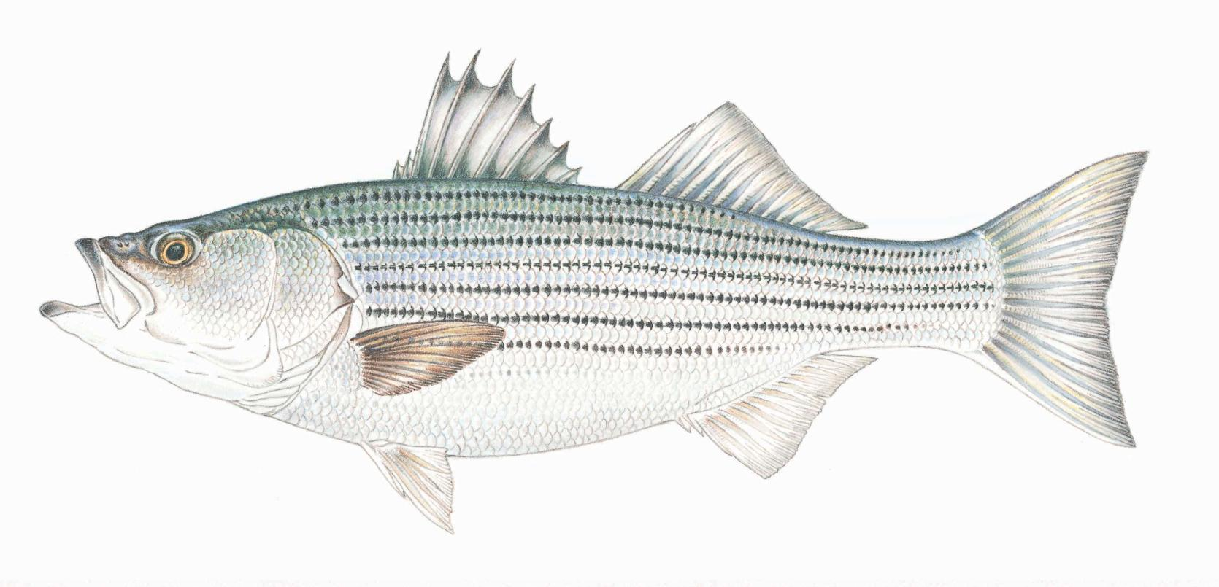
MICROPLASTICS ECOLOGICAL RISK ASSESSMENT: Updates and Gaps
&
Linkages to Chesapeake Bay Program Goals
Bob Murphy, Paige Hobaugh - Tetra Tech Center for Ecological Sciences

Slide 2
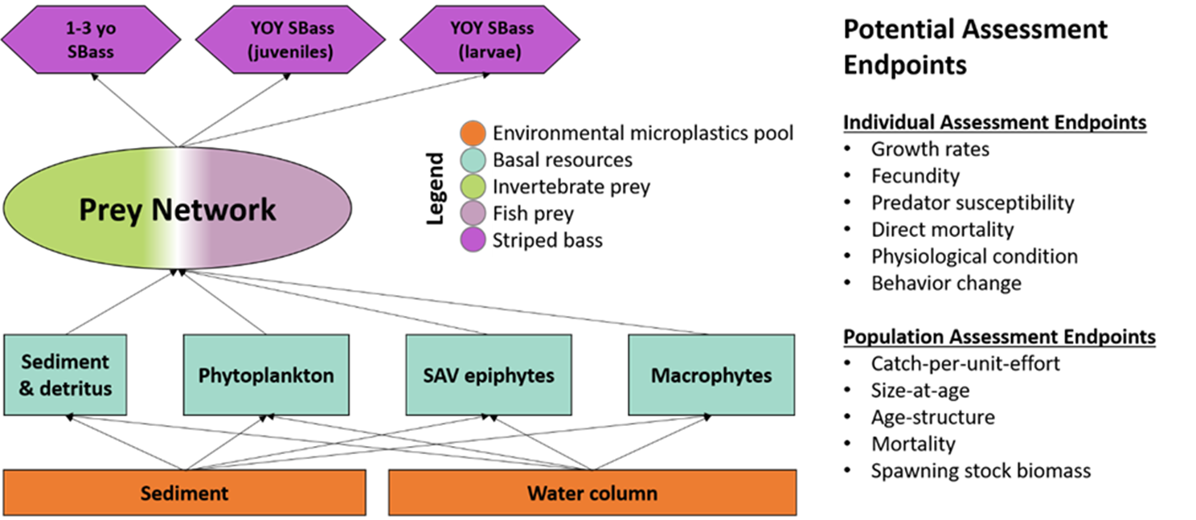
Striped Bass ERA Recap

Slide 3
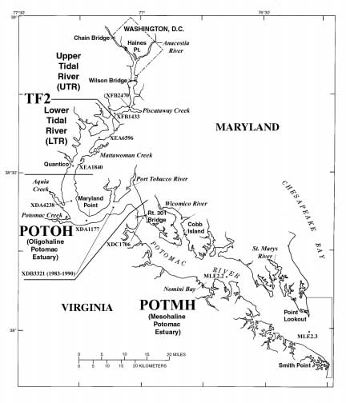
Model Input and Criteria for Inclusion
Potomac River Striped Bass YOY
Literature Review
Potomac River data
Chesapeake Bay/other tributary studies
Other Atlantic Coast
Global

Slide 4
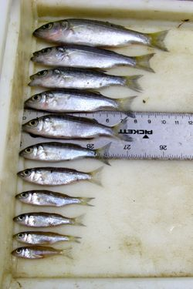
Model Development
Biological endpoints of potential interest
Qualitative food web interactions that could lead to microplastic intake by Striped Bass;
Semi-quantitative food web interaction scenarios for Striped Bass living in different salinity regimes.

Slide 5
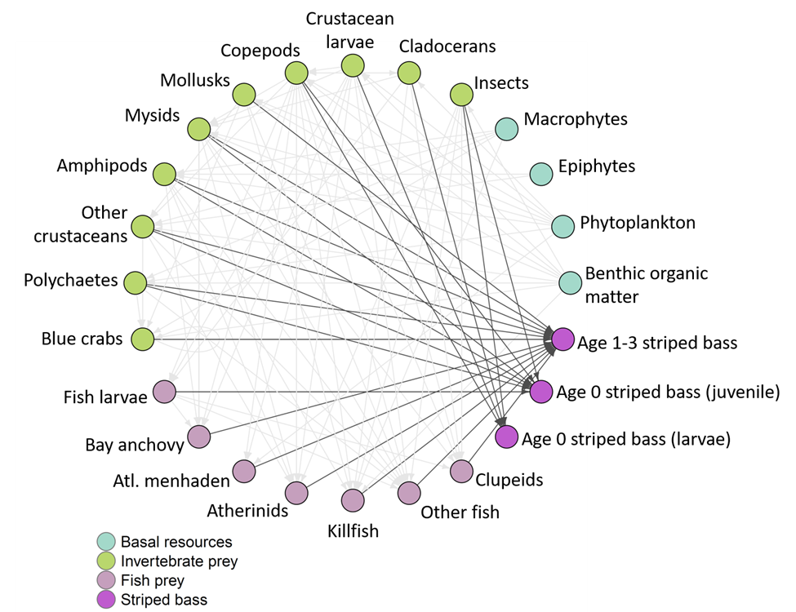
Qualitative food web interactions

Slide 6
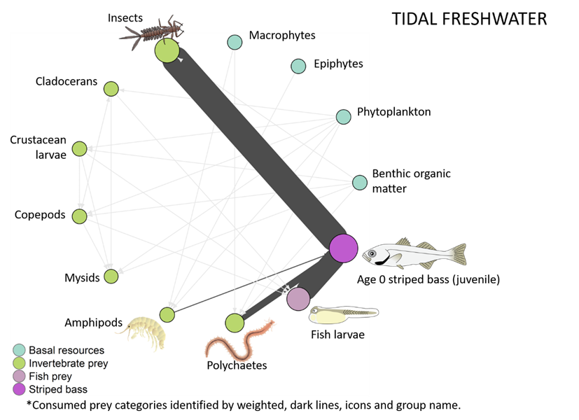
Semi-quantitative food web interaction
Data from Boynton et al 1981

Slide 7
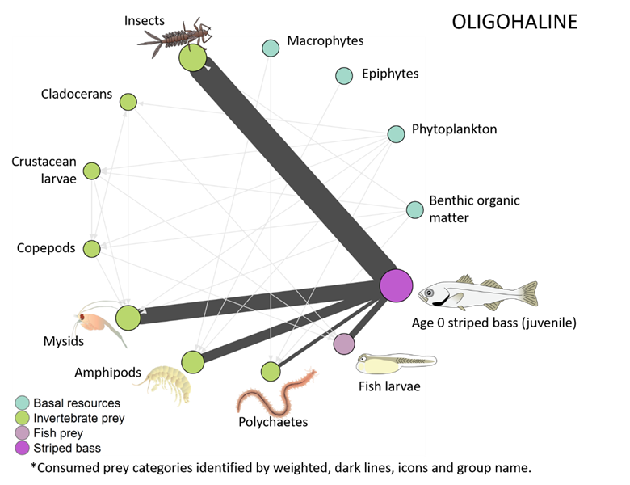
Semi-quantitative food web interaction
Data from Boynton et al 1981

Slide 8
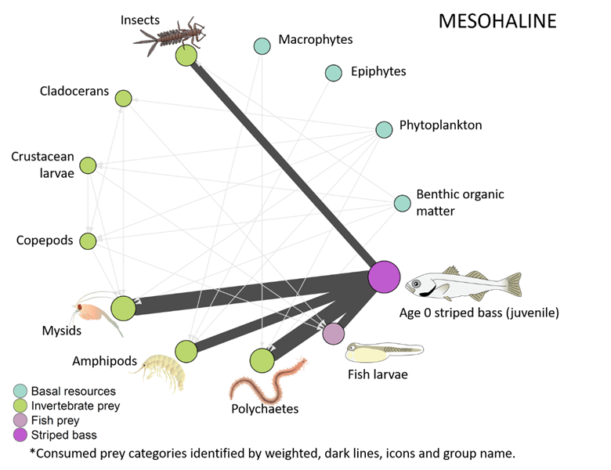
Semi-quantitative food web interaction
Data from Boynton et al 1981

Slide 9
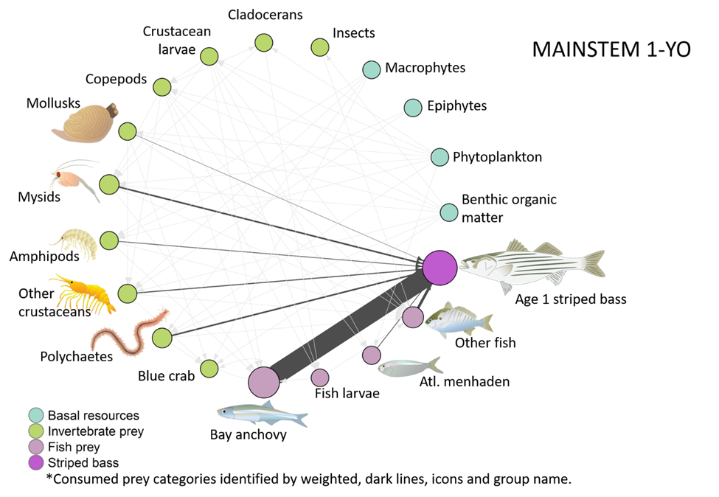
Baywide diet: 1YO
Data from Ihde et al, 2015

Slide 10
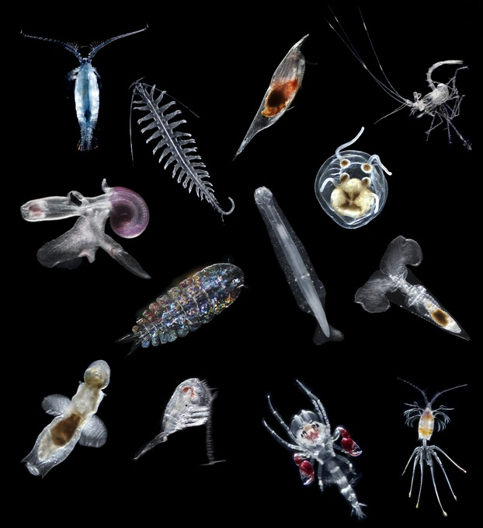
Updating the ERA Model
There is an incomplete understanding of the diet of juvenile and resident sub-adult Striped Bass in the Potomac River;
Potential regime shift in the zooplankton community;
May only be relevant to larval stage;
Ongoing research into contemporary Striped Bass diet

Slide 11
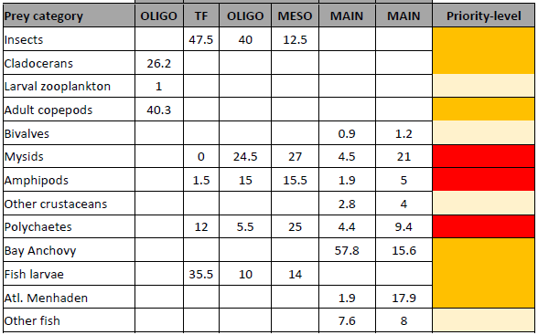
Priority Prey Items

Slide 12
Microplastic pathways
Major Taxa | Confirmed MP presence or consumption? (Y/N) | Location | Citation | Notes
Habitat
Macrophytes (includes SAV and wetlands) | Y | (SAV) Caribbean; UK, Korea; Washington, DC; (wetlands)South Africa; multiple | (Goss et al. 2018, Reynolds and Ryan 2018, Murphy 2019, Townsend et al. 2019, Cozzolino et al. 2020, Huang et al. 2020, Jones et al. 2020) | Macrophytes include a combination of SAV and wetlands given similar roles for microplastic adherence
Epiphytes | Y | Caribbean; | (Goss et al. 2018, Seng et al. 2020) | Found in epiphytes on seagrass
Benthic organic matter | Y | St. Lawrence River; Washington DC; | (Castaneda et al. 2014, Murphy 2020)
Phytoplankton | Y | Laboratory; | (Long et al. 2015, Shiu et al. 2020) | Diatoms; aggregation of cells on MPs
Invertebrate Prey
Insects | Y
Crustacean larvae | Y | Laboratory | (Jemec et al. 2016, Gambardella et al. 2017, Woods et al. 2020) | Lobsters; barnacle nauplii;
Cladocerans | Y | Laboratory | (Martins and Guilhermino 2018, Jaikumar et al. 2019, Woods et al. 2020) | Freshwater regions
Copepods | Y | Laboratory; Pacific Ocean | (Cole et al. 2015, Desforges et al. 2015)
Amphipods | Y | Laboratory | (Jeong et al. 2017, Mateos Cárdenas et al. 2019) | Jeong et al proposed an adverse outcome pathway for microplastic exposure that covers molecular and individual levels.

Slide 13
Focus Areas
Recent research baywide into YOY striped bass has confirmed top prey items¹:
  Americamysis bigelowi (Mysid)
  Cyathura polita (Isopod)
  Apocorophium lacustra (Amphipod)
  Diptera (Insecta)
  Anchoa mitchelli (Bay Anchovy) (Actinopteri)
¹ Ogburn et al, in review

Slide 14
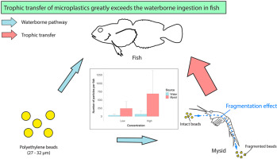
Data Gaps
Mysid shrimp uptake in Chesapeake Bay (laboratory studies, environmental sampling)
Hasegawa, T., and M. Nakaoka. 2021. Trophic transfer of microplastics from mysids to fish greatly exceeds direct ingestion from the water column. Environmental Pollution 273:116468.

Slide 15
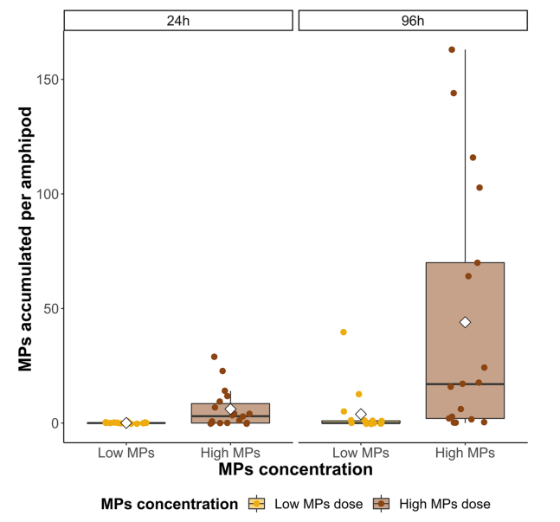
Data Gaps
Amphipod loadings (laboratory, environmental sampling)
Laboratory experiments may not represent environmental loadings
Mateos-Cárdenas, A., J. O’Halloran, F. N. A. M. van Pelt, and M. A. K. Jansen. 2020. Rapid fragmentation of microplastics by the freshwater amphipod Gammarus duebeni (Lillj.). Scientific Reports 10:12799.

Slide 16
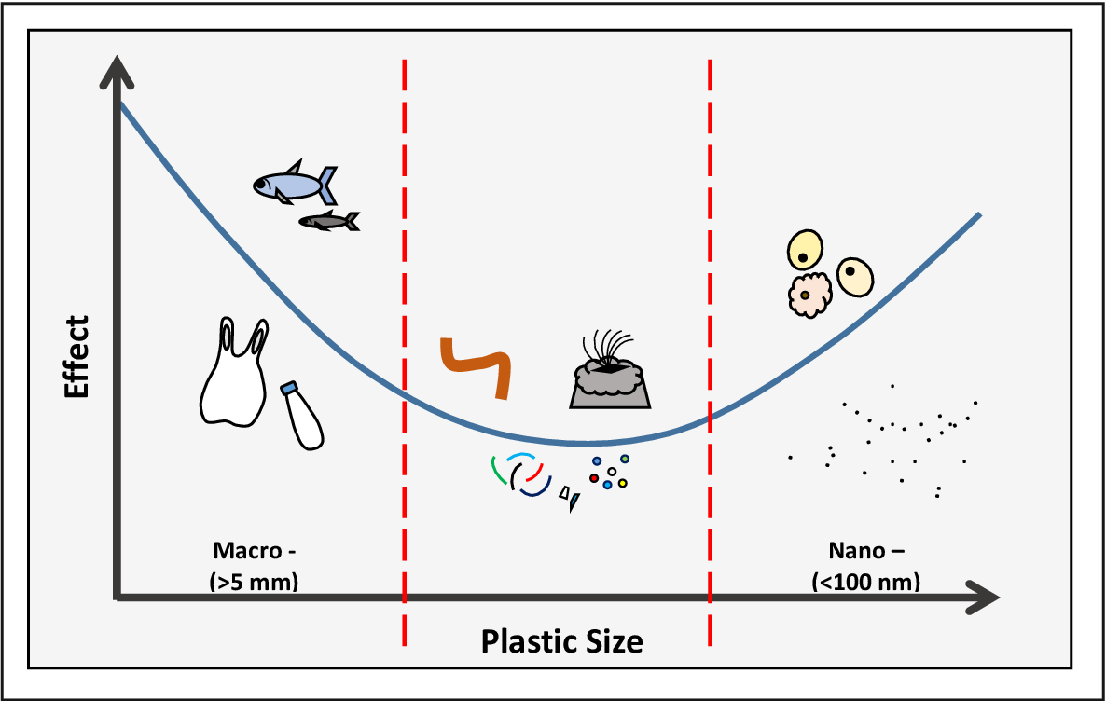
Data Gaps
Polychaetes (Laboratory studies and field sampling)
Pequeno et al (2021) found microplastics in 30 polychaete species in the estuarine waters of Portugal;
MPs in polychaetes averaged the smallest size (fragments much more prevalent than fibers;
Hodgson 2017
Pequeno, J., J. Antunes, V. Dhimmer, F. Bessa, and P. Sobral. 2021. Microplastics in Marine and Estuarine Species From the Coast of Portugal. Frontiers in Environmental Science 9.

Slide 17
Data Gaps
Insects- There is a great deal of literature on microplastic loadings in a variety of insect taxa
Diptera well-represented in current study (Ogburn et al)
Aquatic insects contribute to the degradation of plastic during digestion
Difficulties in fully capturing Insect contribution
    Large number of taxa within
    Restricted by salinity (fresh to oligohaline)
    Terrestrial phase of life history

Slide 18
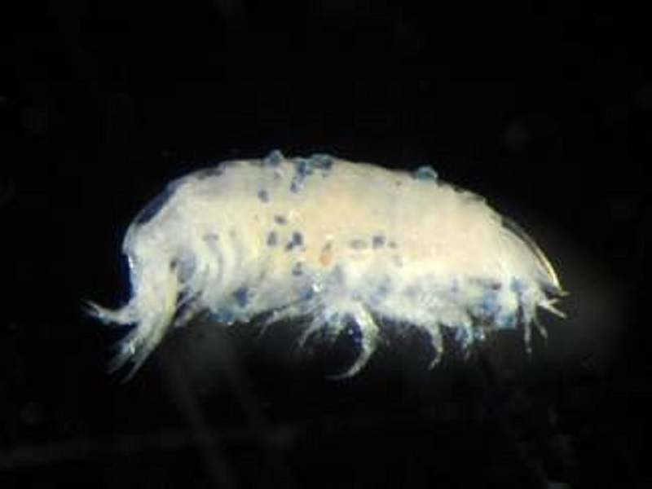
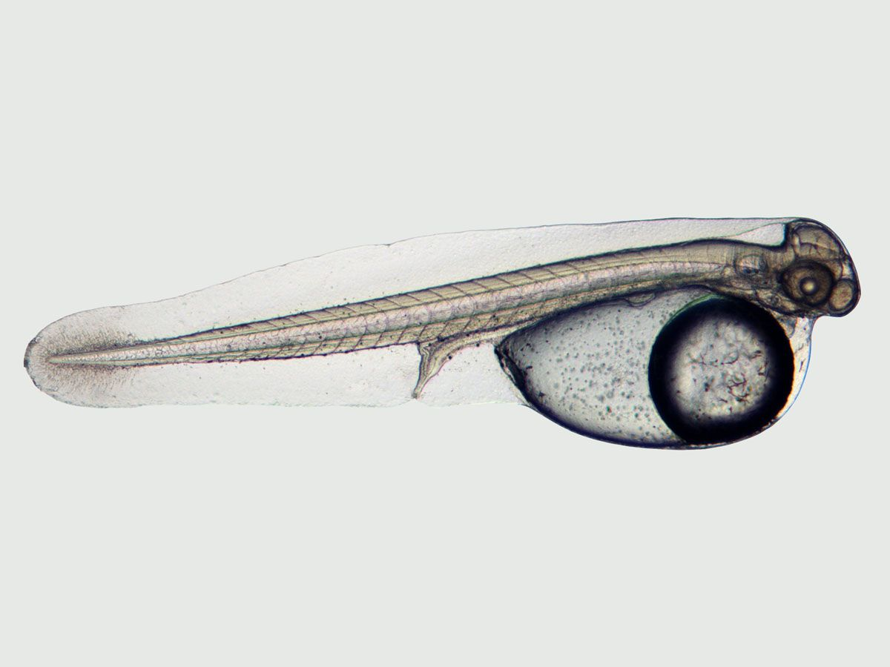
Next Steps
Focus on two taxa, Mysids and Amphipods
  Recommendation on research priorities
  Quantitative analyses bring us closer to quantifying risk

Slide 19
Chesapeake Bay Agreement 2014
&
Plastics

Slide 20
Microplastics and the 31 outcomes
Management Board requested an evaluation of the potentially negative effects of plastic pollution on the Bay Agreement outcomes
12 of 31 outcomes may be impacted by plastic pollution
Most affected by plastic pollution are the living resources goal related outcomes
  SAV, Fish Habitat
  Forage Fish, Oysters, Blue Crabs
Notes:
The purpose of the PPAT is to reduce the presence and impacts of plastic pollution on the Chesapeake Bay and its watershed – one exercise in accomplishing this was to evaluate the potentially negative effects of plastic pollution on the Bay Agreement outcomes.
Tetra Tech reviewed each Bay Agreement outcome and determined, based on available science and knowledge, whether the effects of plastic pollution could inhibit the outcome being met.
As highlighted in the MP science strategy, MP have known negative effects on fisheries related outcomes including blue crab abundance, oysters, and forage fish due to larval/juvenile loss of fitness via update (by which they’re subject to predation).

Slide 21
Forage Fish
Larval/juveniles-Loss of fitness via uptake (subject to predation)
Potential for exposure (resulting in physiological, neurological effects) to chemical pollutants, bioaccumulative contaminants, pathogens via microplastic makeup and adsorption

Slide 22
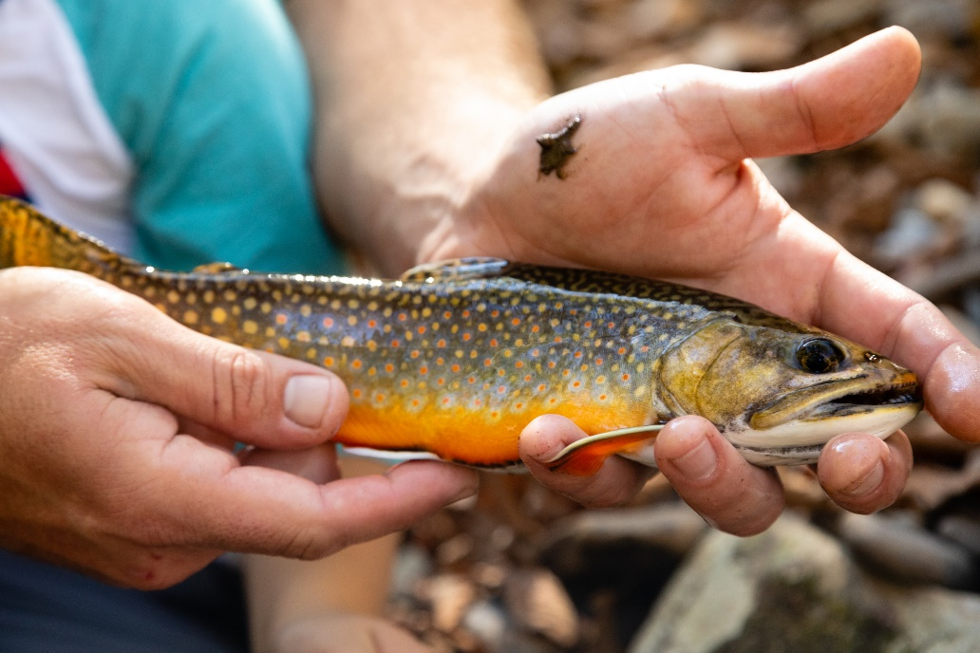
Brook Trout
Potential for larval/juveniles-Loss of fitness via uptake (subject to predation)
Potential for exposure (resulting in physiological, neurological effects) to chemical contaminants, pathogens via microplastic makeup and adsorption
Notes:
The brook trout outcome is also at risk due to freshwater streams also being MP sinks. Brook trout populations face the potential for larval/juvenile loss of fitness via uptake (by which they’re subject to predation) and the potential exposure to contaminants and pathogens via microplastic makeup and absorption of these contaminants. It may be difficult to sustain reproducing brook trout populations in freshwater streams with significant MP pollution.

Slide 23
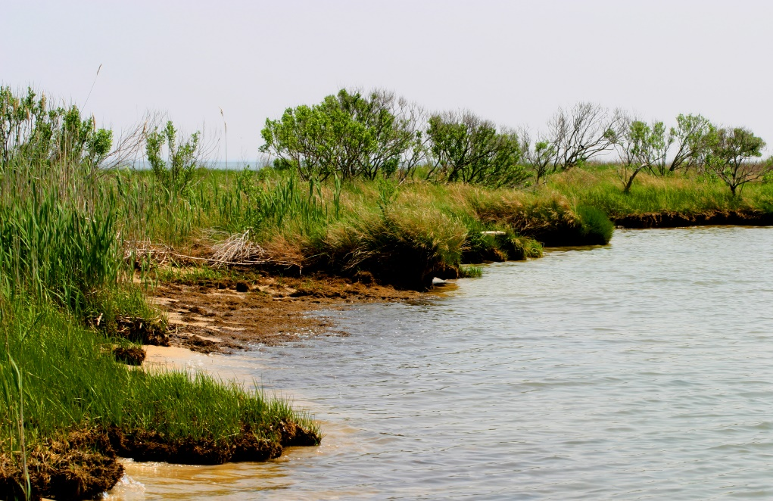
Wetlands
Potential for MP to change the germination strategies of seeds, reduce weight, height, and chlorophyll b synthesis in wetland plants
Microfiber concentration in wetlands can negatively related to plant stem density and percent cover
Potential for MPs to later the structure of soil microbial communities
Potential for plastic particles to disturb N removal in constructed wetlands by inhibiting N uptake
Notes:
Recent studies show evidence that MPs alter plant growth strategies, perhaps impacting the plant communities that wetlands use to filter water and provide other habitat benefits.
Further research into the impact of MP on wetlands might have implications on other outcomes as well. For instance, the effect of MP on wetland N uptake could have effects on water quality standards attainment.

Slide 24
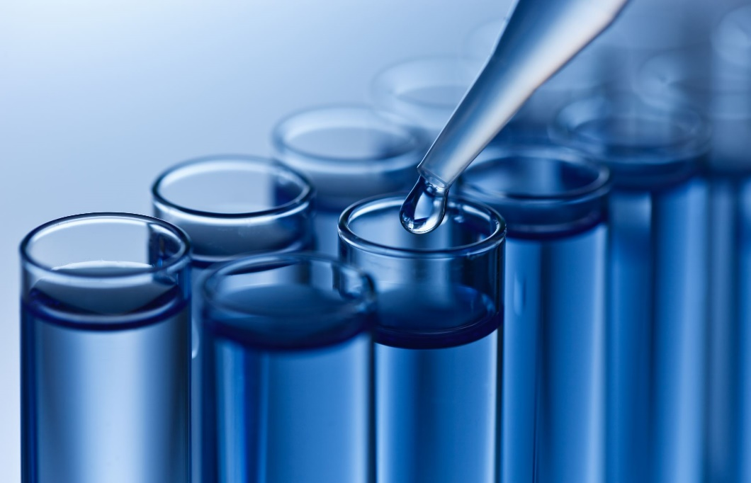
Toxic Contaminants Policy and Prevention
MPs may adsorb and leach plastic additives and potentially toxic contaminants (e.g., PCBs and PHAs)
Potential for human and wildlife exposure to chemical pollutants, pathogens via microplastic leaching and adsorption
Notes:
Research shows that microplastics may leach plastic additives and potentially toxic contaminants (including PCBs and PAHs) that are adsorbed by MPs in high concentrations. This may lead to wildlife exposure of toxic contaminants and human exposure (through consumption of contaminated seafood).
Plastic pollution may affect efforts to reduce and prevent the effects of toxic contaminants on aquatic systems and humans.

Slide 25
Microplastics and the 31 Outcomes
Connecting the PPAT mission to the outcomes –
Citizen Stewardship
Potential for implementing citizen monitoring for plastic debris (e.g., tie in with SAV citizen monitoring)
Environmental Literacy Planning
Potential for classroom learning about microplastic interaction with human and environmental health
Local Leadership
Potential for expansion of local bans on single-use plastics
Water Quality Standards Attainment and Monitoring
Potential for implementation of a formal monitoring strategy using existing monitoring programs and stations around the Bay and tributaries
Notes:
We were not able to establish a negative effect by plastic pollution on most outcomes, but we were able to brainstorm ways to establish a connection between some of these outcomes and the PPAT mission, mostly as opportunities to potentially mitigate the harmful effects of plastic pollution we expect to see in the Chesapeake Bay and its tributaries.

