Slide 1
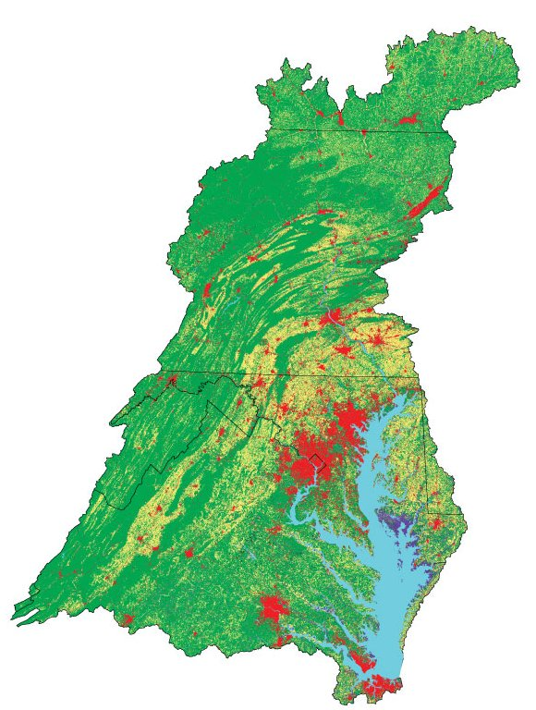
Notes:
What do you see?
56% Forest
Forests can absorb 20 x more runoff than a parking lost and 6x as much as turf
15% N (Air): Retain 85% of atmospheric dep
2% P
Drinking water
Water storage
Stream health
Good BMP: Will talk today about add new forest, but will focus on maintaining existing today

Slide 2
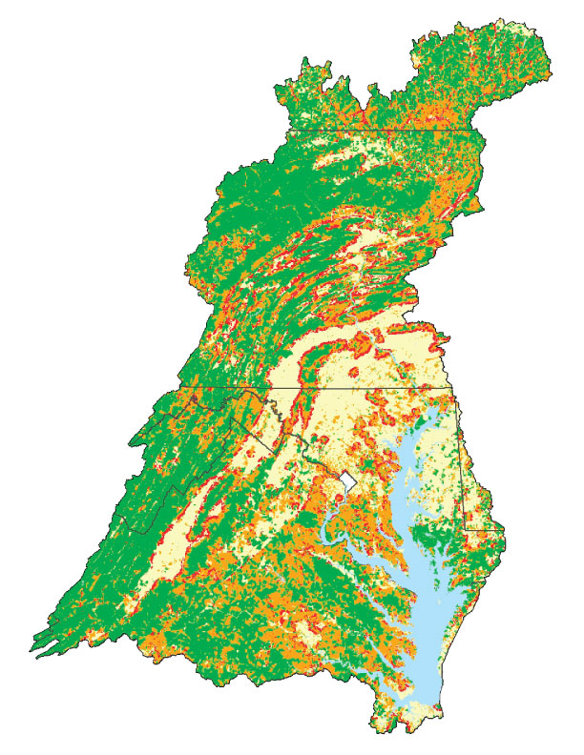
Notes:
40% of all forest is human influenced (1.5 or within)
Invasive plants, pests, deer, development
MD: 60%
DE:58%
VA: 405
Pa: 38%

Slide 3
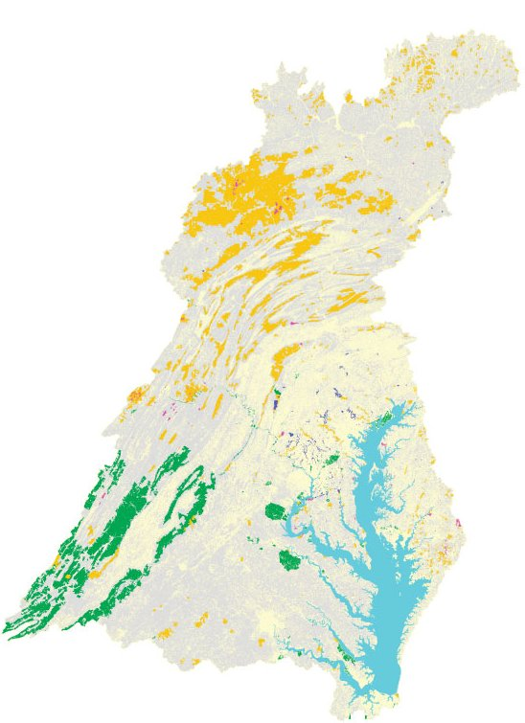
Notes:
Private: 78% (Family, 64%)
State: 14
Federal: 6
Local: 2
Watershed forest owned by majority of small landowners: >900,000 family owners
70% of Pennsylvanian’s believe the state’s forests are publicly owned and protected or did not know
>70% of family forest owners older than 55

Slide 4
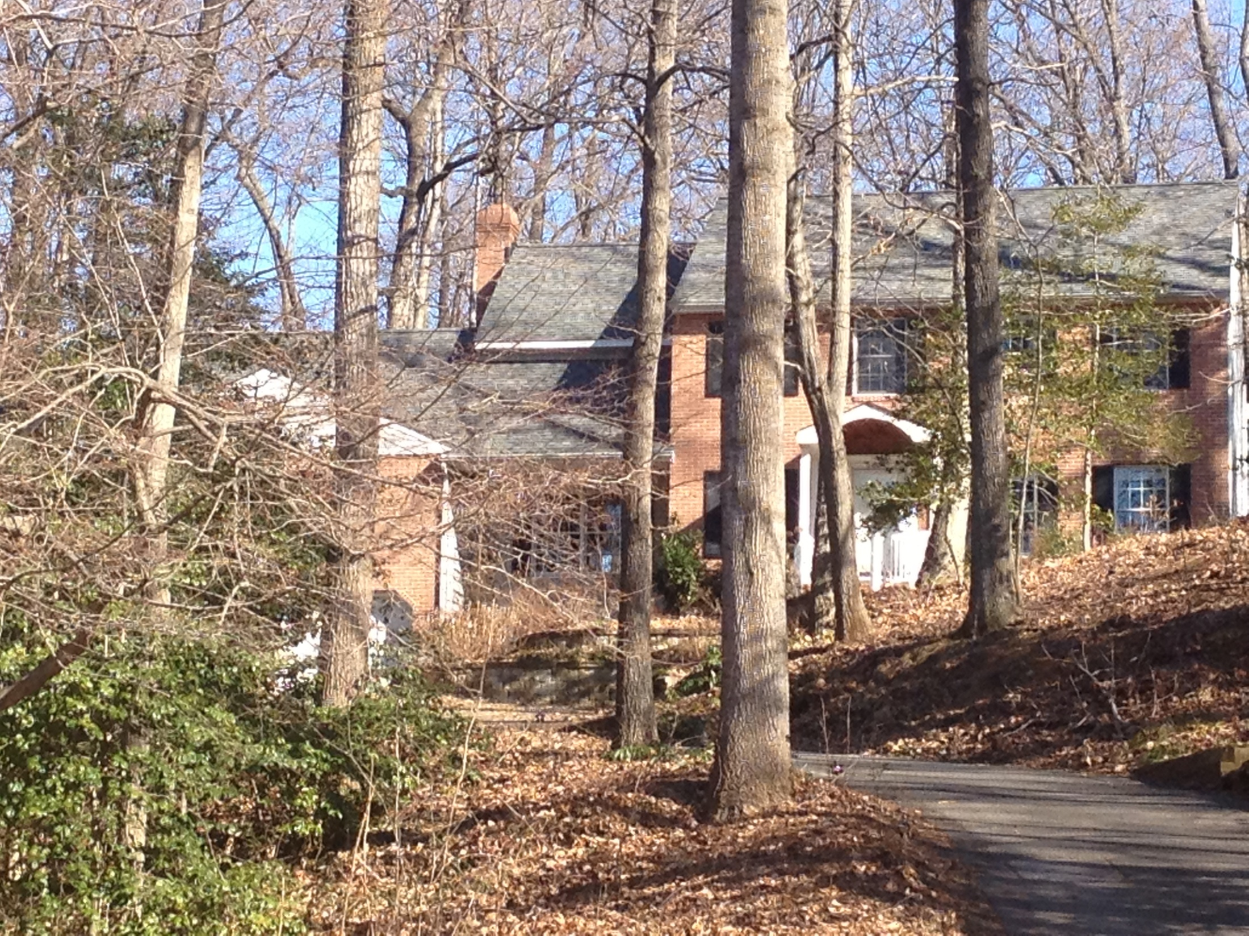
Notes:
Came with the house/natural beauty

Slide 5

Notes:
Recreation

Slide 6
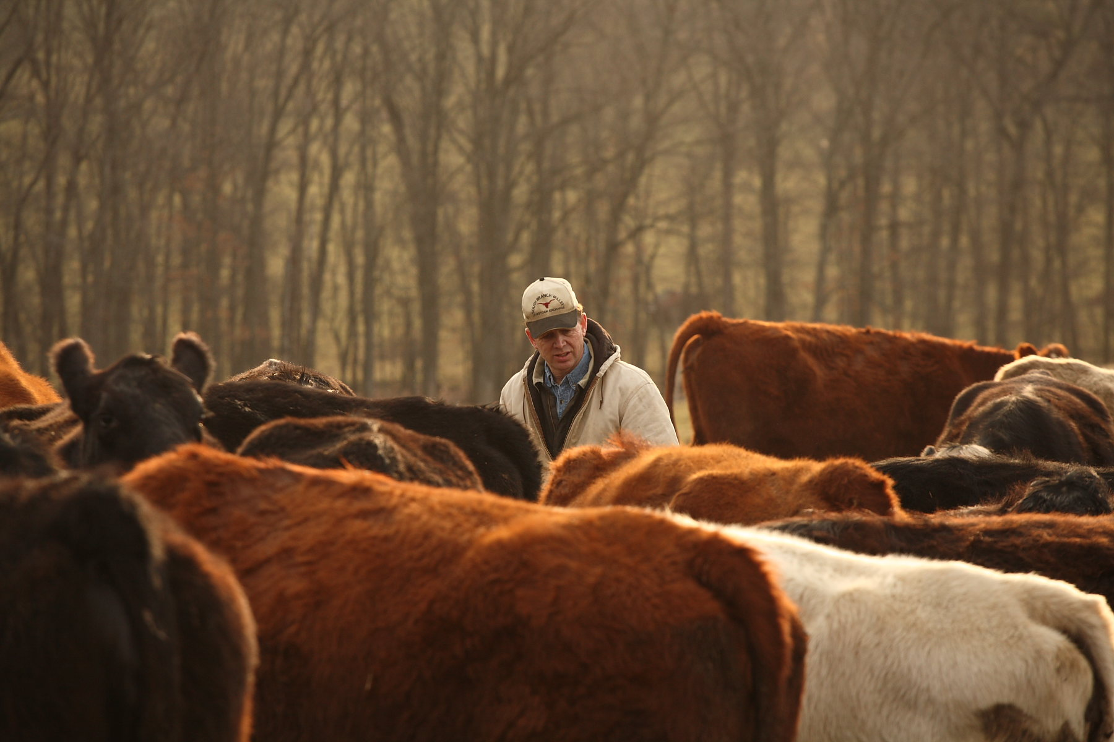
Notes:
Back 40
40% of forest part of a farm

Slide 7
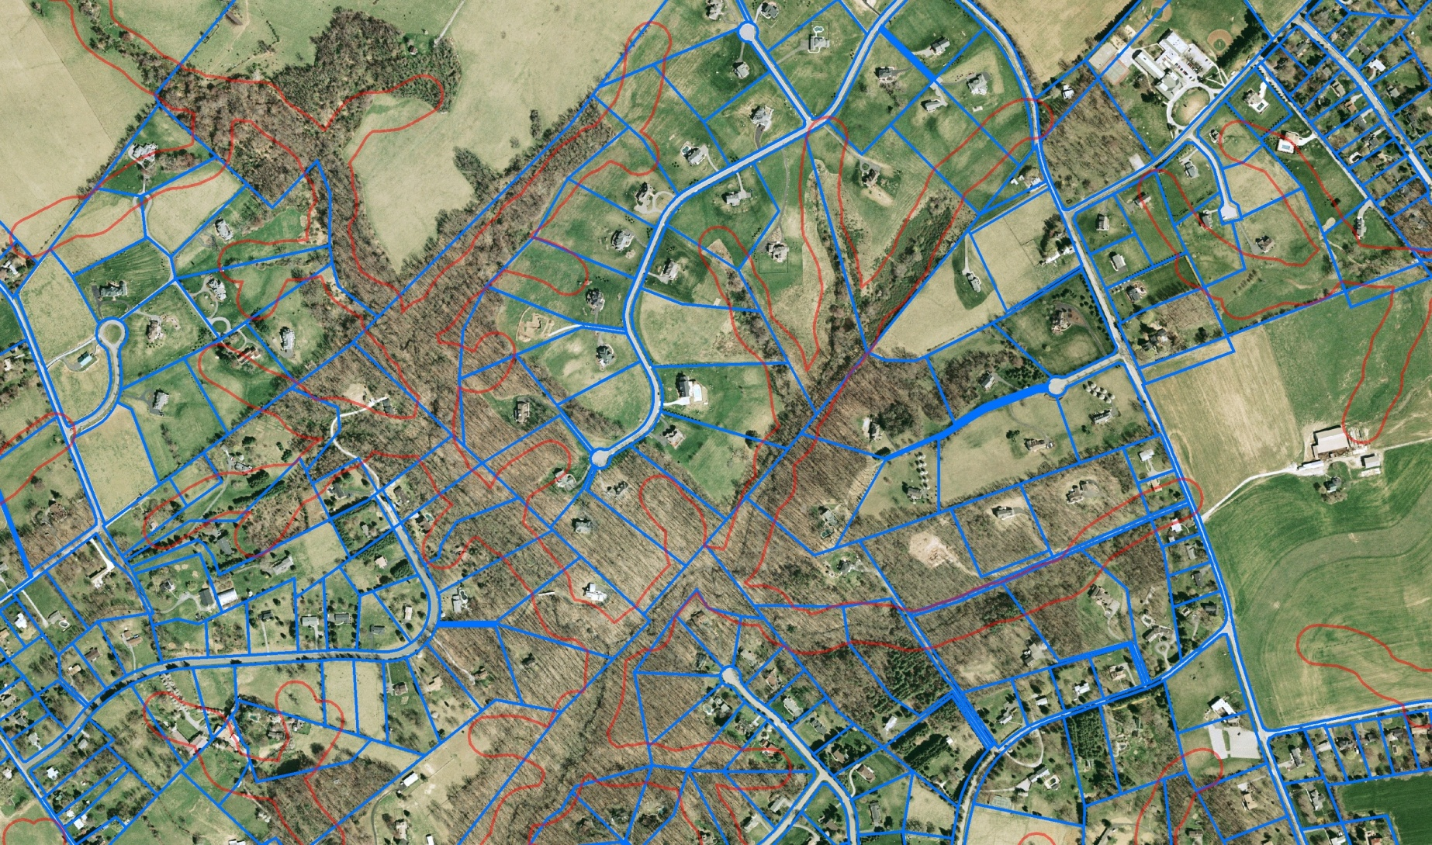
Notes:
Average parcel size decreased by 24% over last 10 years; owners up 25%
Growing number of small, private landowners
Declining gov't budgets for landowner outreach
Confusion mix of landowner programs

Slide 8

Eric Sprague esprague@allianceforthebay.org
Notes:
Outreach: Tools (LandServer), workshops, trainings
Information and assistance: Clearinghouse,
Forestry for the Bay is a free, voluntary membership program made up of small and medium sized landowners who, like you, are interested in actively conserving their woodland or wants to restore woods to their property.
As member you will have access to a wealth of information about local resources, incentive programs and technical assistance that can help you care for your property and meet your conservation goals. You will also be alerted to various workshops and trainings occurring in your region.
Access to the Woodlands Resource page This easy to navigate resource contains a wealth of information on technical and financial assistance, fact sheets specific to your goals and objectives, and links to the variety of incentives being offered in your area.
Guidance in developing a management plan for your woodlands We offer two templates to help you establish goals for your property and a plan to accomplish them.
Free Forestry for the Bay sign All members will receive an official membership sign to post on your property after initiating conservation action.
Free monthly newsletter All members receive an E-newsletter concerning the latest conservation practices, woodland issues and local events and workshops.
Eligibility for awards and recognition of stewardship Forestry for the Bay will award several participants each year for improving the health of their forests, and the health of the Chesapeake Bay.
Participation in Forestry for the Bay Mentoring Program This tool will provide you the opportunity to learn from or share your woodland management experiences and information with other members.
Access to web-based mapping and analysis tool to print maps and reports on your property You will have access to a web based mapping tool that will enable you to view, among many features, the topography, soils, and aerial photos of your property. Registered users can add property boundaries & other natural resource features, upload GPS info, and print custom maps.
Increased information and access to ecosystems service market You will receive the latest information about the burgeoning ecosystems market and how your intact woodland can generate income.
Doing the right thing, for you, for your land, and for the community where you live

