Slide 1
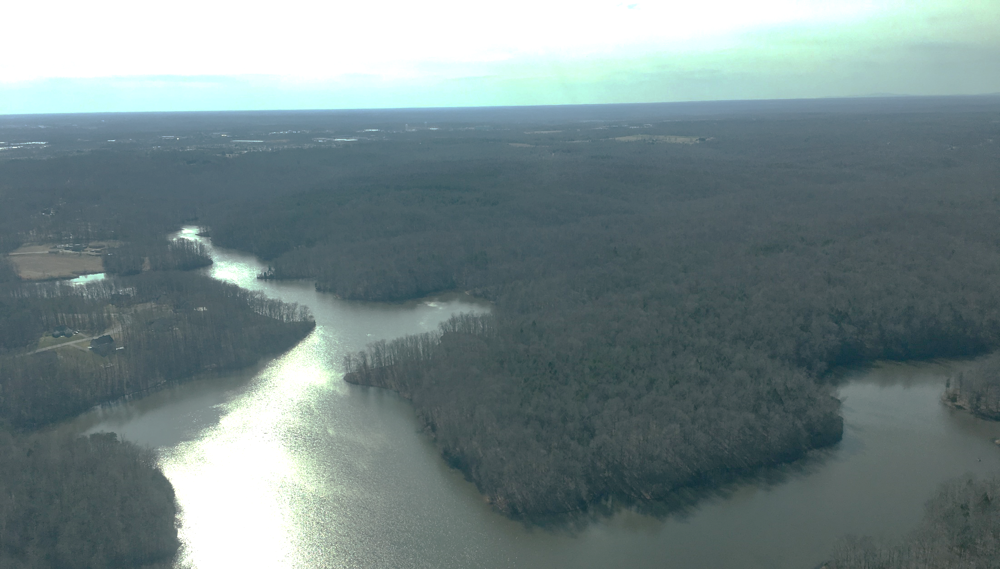

Atlantic Coastal Fish Habitat Partnership General Habitat Conservation RFP
Chesapeake Bay Program Fish Habitat Action Team Meeting
April 6, 2022
Lisa Havel, ACFHP Director

Slide 2
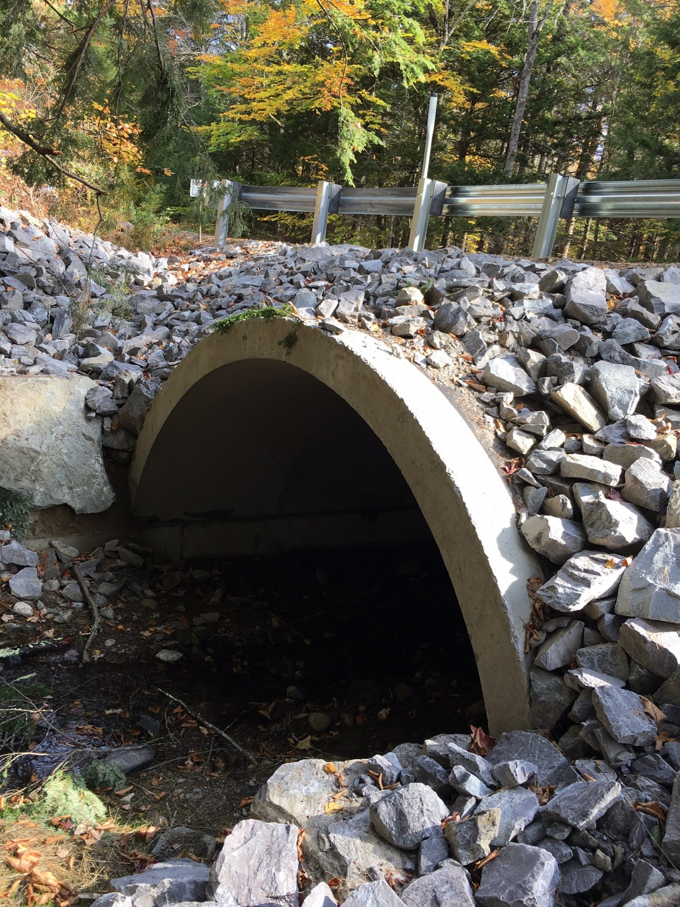
General ACFHP Habitat Conservation Project RFP
Notes:
ACFHP recently released a general habitat conservation project RFP, and this was mostly in response to all of the infrastructure funding that is becoming available. We’ve already received multiple calls from agencies and organizations asking for ranked lists of projects in need of funding to meet specific criteria, with a very fast turnaround, sometimes only 36 hours. We want to build upon our current bank of ACFHP-vetted projects in order to respond quickly to these requests to ensure good projects on the Atlantic coast are getting funded.

Slide 3
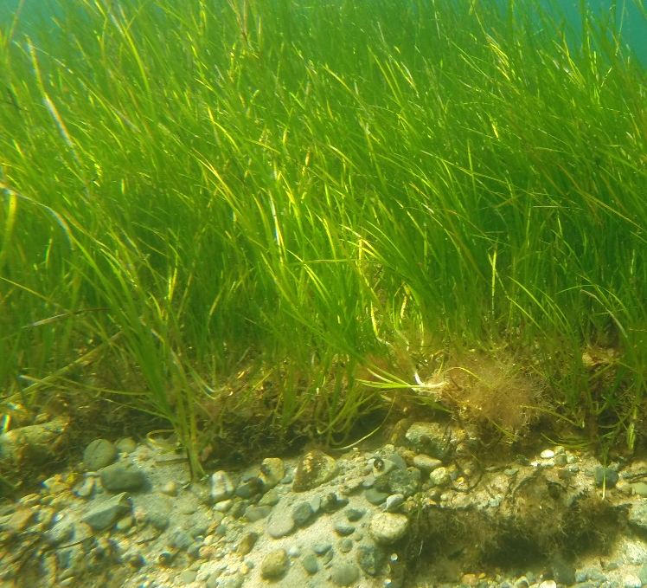
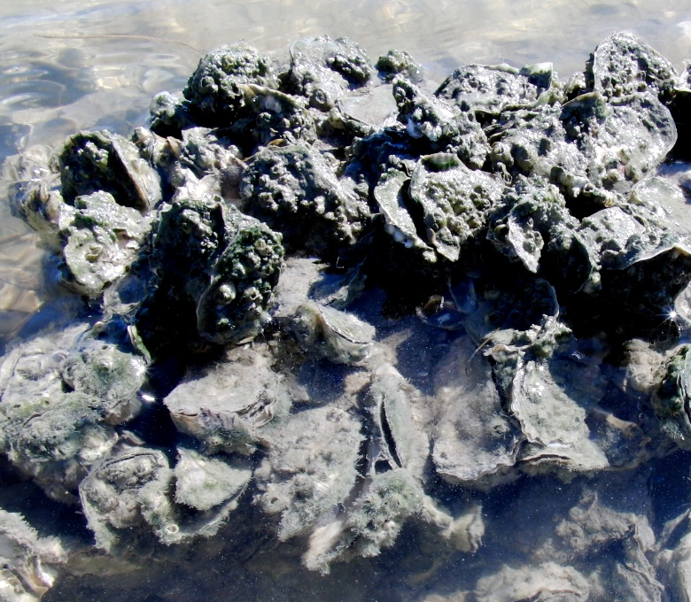
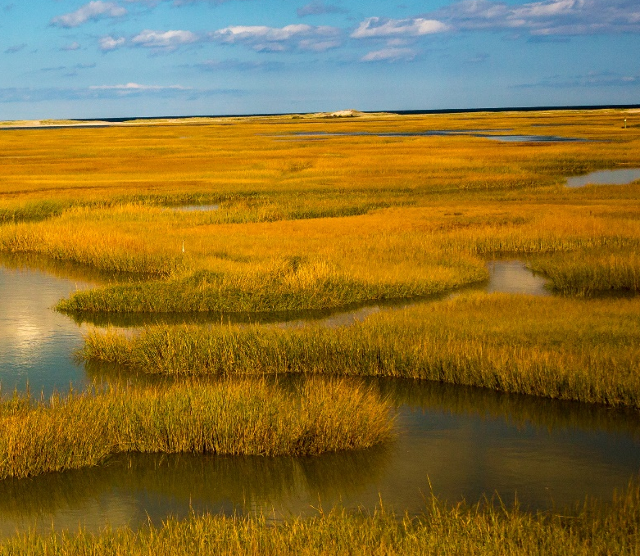
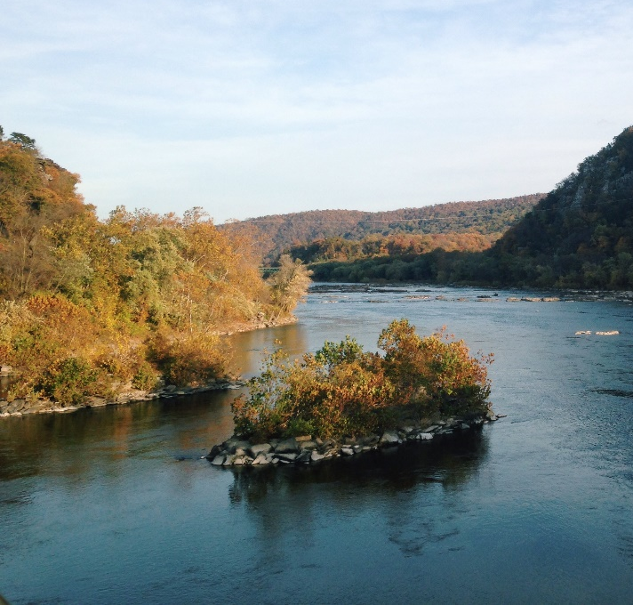
Priority habitats in the Mid-Atlantic
Marine/Estuarine Shellfish Beds
Tidal Vegetation
Riverine Bottom
SAV
EPA
Shutterstock/Bob Pool
Notes:
In order to respond promptly to funding opportunities from various sources, ACFHP is soliciting applications for habitat conservation projects in need of funding that align with ACFHP’s objectives and priority habitats. Those are listed in the appendix of the application instructions, and can also be found in our Strategic Plan on our website. In our Mid-Atlantic subregion, where the Chesapeake Bay watershed is located, our priority habitats are SAV, marine and estuarine shellfish beds, tidal vegetation, and riverine bottom. A lot of times ACFHP’s riverine bottom projects deal with passage. Also we’re open to projects other than on-the-ground restoration. We’ve received requested for science and data projects as well, so this general RFP is pretty broad as long as it aligns with our mission and objectives.

Slide 4
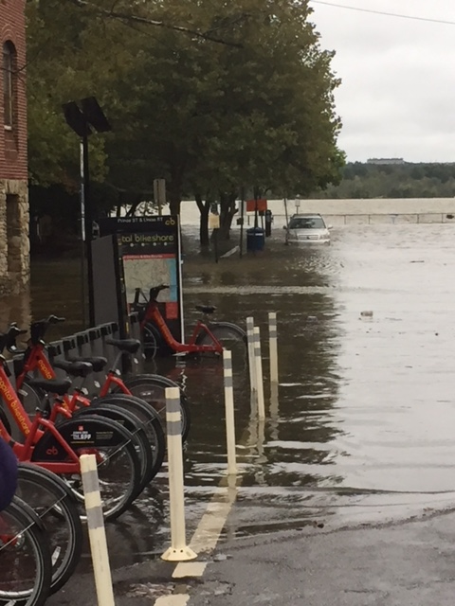
No specific funding source
No guarantee of funding
No deadline
Linking funders with projects in need of funding
Cindy Robertson/ASMFC
Notes:
The Request for Proposals is not linked to a specific funding source and there’s no guarantee of funding. There is also no deadline. Instead, newly submitted projects reviewed and approved by ACFHP will be added to our project database and recommended as funding becomes available. We’re working to position ourselves as a link between the funding source and those looking for funding to make sure both sides are aware of the opportunities out there. So the sooner you submit a project the sooner we can review it and share it if there’s alignment with funding.

Slide 5
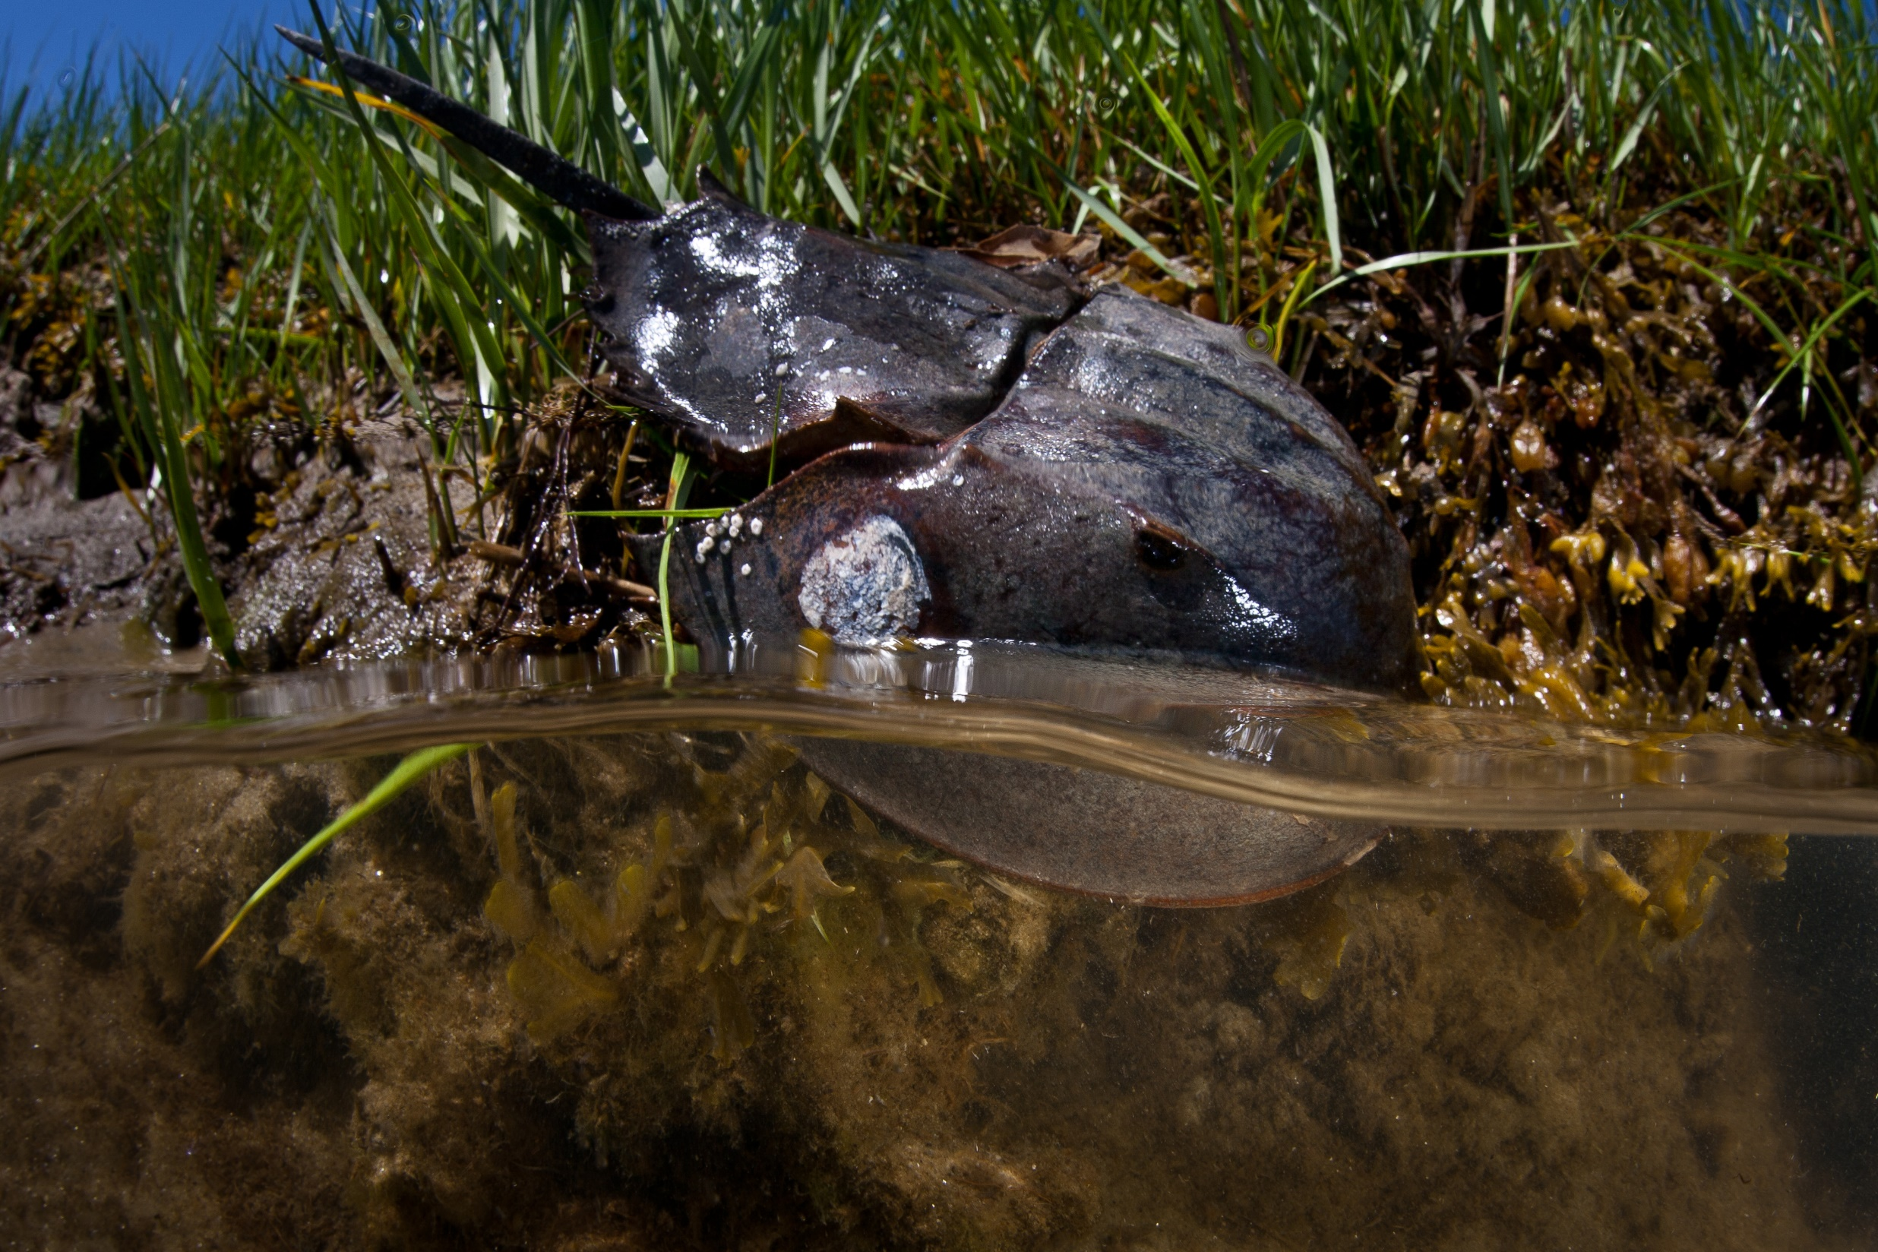
RFP
Shutterstock/Ethan Daniels
Notes:
This RFP is a slimmed down version of our RFP for National Fish Habitat Partnership project funding, which is released in the late summer/fall annually. We did add one question pertaining to DEIJ, and that question will be included in our National Fish Habitat Partnership RFP as well moving forward.

Slide 6
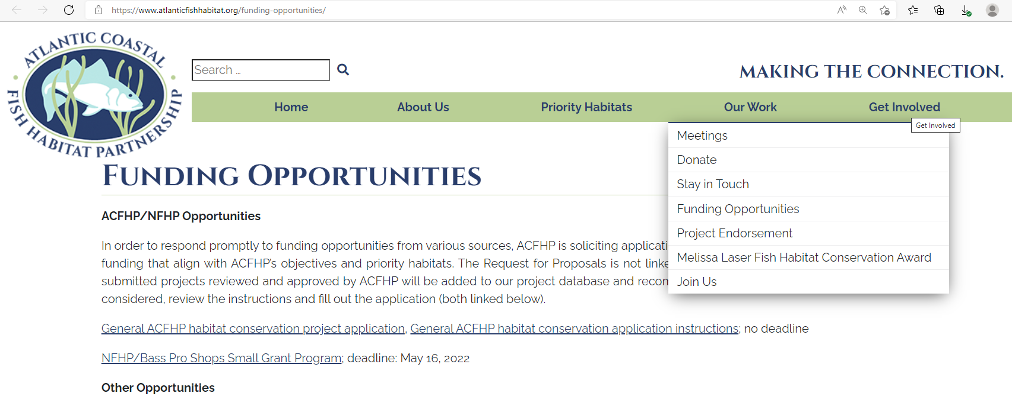
Website
Notes:
The project application and instructions can be found on the ACFHP website at atlanticfishhabitat.org/funding-opportunities/. Or you can go to atlanticfishhabitat.org and click on ‘funding opportunities’ from the ‘Get involved’ dropdown menu. And it’s the first opportunity on the page.

Slide 7
www.atlanticfishhabitat.org
Facebook.com/ACFHP/
Lisa Havel, ACFHP Director
LHavel@asmfc.org
703.842.0743
Notes:
Once again our website is atlanticfishhabitat.org. If you sign up for our newsletter on the website you’ll see our funding announcements. You can also follow us on Facebook where we post our and other funding opportunities there. And with that I’m happy to take any questions.

