Slide 1

Sustainable Fisheries GIT: Fish Habitat
Quarterly Progress Meeting - May 2017
Chesapeake Bay Program
Science. Restoration Partnership.
Bruce Vogt,
NOAA and
Sustainable Fisheries GIT Coordinator
Gina Hunt,
Maryland DNR and
Fish Habitat Action Team Coordinator
Notes:
Context of Fish Habitat Outcome
Under Sustainable Fisheries GIT and Habitat GIT
Fisheries GIT Executive Committee members have authority to manage harvests in their jurisdictions
Harvests are only one contributor to fish population dynamics
We’re looking to the Management Board, because you have authority over the other contributors to fish populations and to fish habitat
_______________________________________
SRS Text:
BACKGROUND: The Strategic Review System is the Chesapeake Bay Partnership's committed adaptive management process to regularly review progress at meeting our Watershed Agreement Outcomes and make appropriate changes. In recognition of the fact that our Outcomes vary considerably, there is no single review process that will fit all Outcomes. However, there is value in ensuring some level of consistency in how we review and discuss our Outcomes. The “Guide to your Quarterly Progress Meeting” and this powerpoint template are intended to provide that level of consistency, while also providing the necessary level of flexibility to adapt the process to your specific Outcome’s needs. The “Guide” provides specific instructions that we expect the Outcome’s lead GIT or Workgroup to follow in conducting the review. This powerpoint template provides a consistent format for presenting only the most important issues resulting from that review to the Management Board at the Quarterly Progress Meeting.
Both documents address four basic questions:
What are our assumptions?
Are we doing what we said we would do?
Are our actions having the expected effect?
How should we adapt?
We understand that you could spend your entire allotted time to any one of these questions. Please keep in mind that the Management Board is trusting that your GIT or Workgroup followed the process outlined in the Guide, and that the issues that you present in this powerpoint are limited to only those high points from that review that you need to bring to the Management Board’s attention and get their feedback.
INSTRUCTIONS: Use this presentation to highlight important AND, BUT, THEREFORE stories that the Management Board should hear, based on GIT analysis using the provided materials.
Find photos on our Flickr site: https://www.flickr.com/photos/29388462@N06/sets/
You can also browse photos by category on our website: http://www.chesapeakebay.net/photos
Find charts and data at ChesapeakeProgress.com.

Slide 2
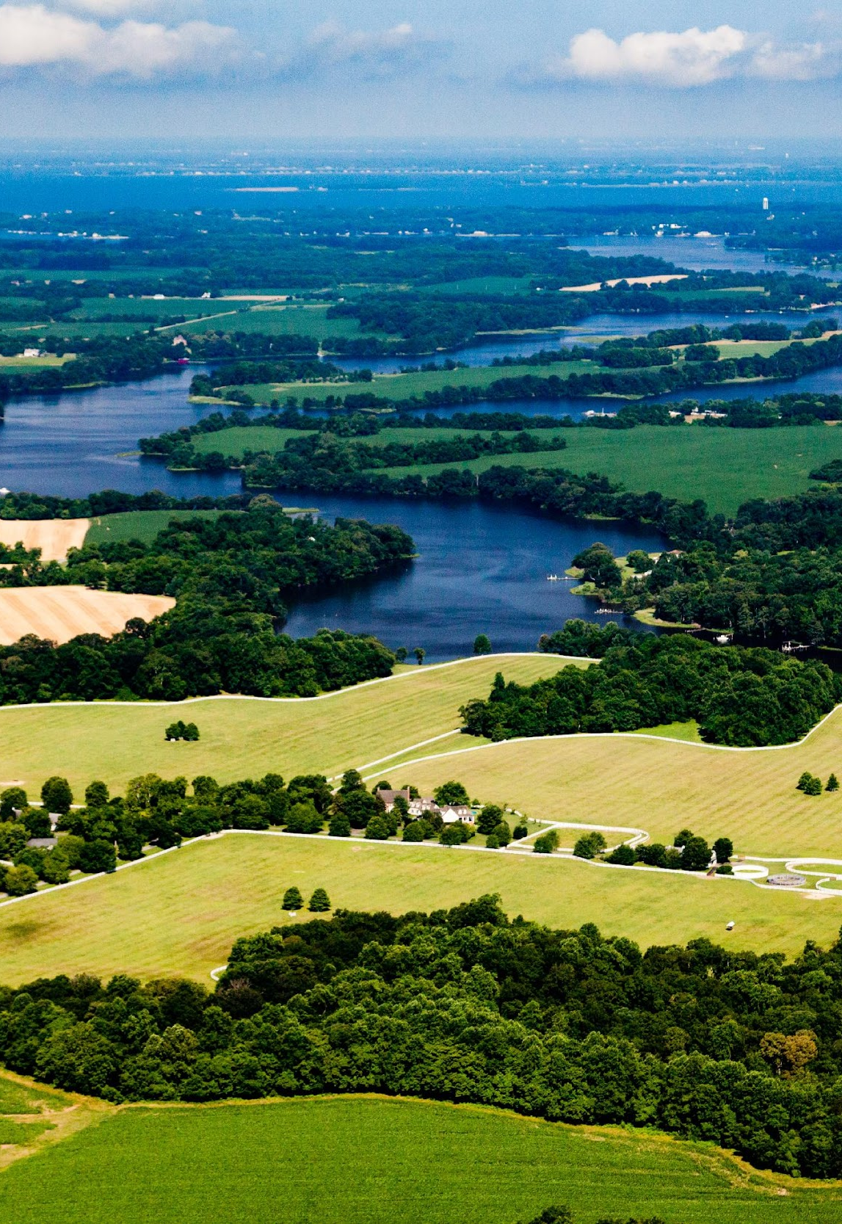
Through the Chesapeake Bay Watershed Agreement, the Chesapeake Bay Program has committed to…
Goal: Sustainable Fisheries
Outcome: Fish Habitat
Continually improve effectiveness of fish habitat conservation and restoration efforts by identifying and characterizing critical spawning, nursery and forage areas within the Bay and tributaries for important fish and shellfish, and use existing and new tools to integrate information and conduct assessments to inform restoration and conservation efforts.
Notes:
Fish Habitat Outcome
Despite the long outcome language, the main objective is to improve effectiveness of fish habitat conservation and restoration efforts and inform restoration and conservation efforts
The fish habitat outcome is extensive, covering the entire tidal and non-tidal Chesapeake Bay
Note that there currently is no quantitative target/goal
Emphasize the need to inform the community
_______________________________________
SRS Text:
INSTRUCTIONS: Add the title of your goal, the language of your outcome from the 2014 Agreement (copy and paste), and a relevant photo, if it all fits. If desired, talking points could include more contextual information, e.g. the importance of the outcome, historic trends, partners, etc.

Slide 3
Fish Habitat Definition:
Any area on which an aquatic organism depends, directly or indirectly, to carry out the life processes of the organism, including, an area for spawning, incubation, nursery, rearing, growth to maturity, food supply, or migration
- National Fish Habitat Action Plan
Notes:
What do we mean by Fish Habitat?
Any area on which an aquatic organism depends to carry out all it’s life processes

Slide 4
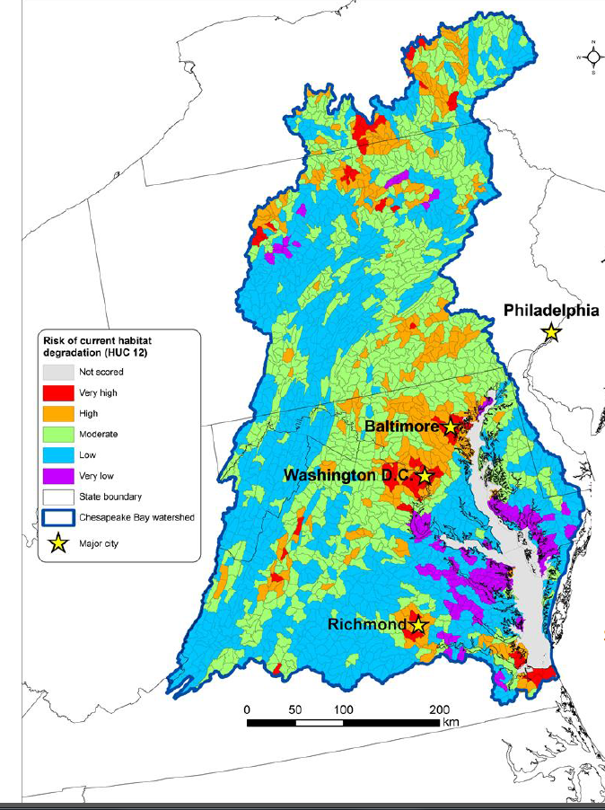
Fish Habitat Map:
Most limiting disturbances for Chesapeake Bay habitats:
Urbanization (impervious surface)
Agriculture
Mining
Nutrients
National Fish Habitat Partnership
Notes:
National Fish Habitat Partnership Map
This map displays habitat vulnerability scores which were calculated by using data from anthropogenic disturbances across the Chesapeake Bay Watershed at HUC 12 resolution
We see orange and red color, representing high and very high current habitat degradation, especially in highly developed areas
We also see blue and purple color, representing low and very low current habitat degradation, especially in areas with lower development
The analysis included urban and agricultural land use and impervious surface as anthropogenic stressors.
Note impervious surface and shoreline hardening as stressors impacting fish habitat
Extra notes:
Anthropogenic Disturbances included:
Urban and Agricultural land use
Impervious surfaces
Mines
Fragmentation by dams
Population density
Water withdrawls
Point Source Pollution
Phosphorus, Nitrogen, Sediment Loading

Slide 5
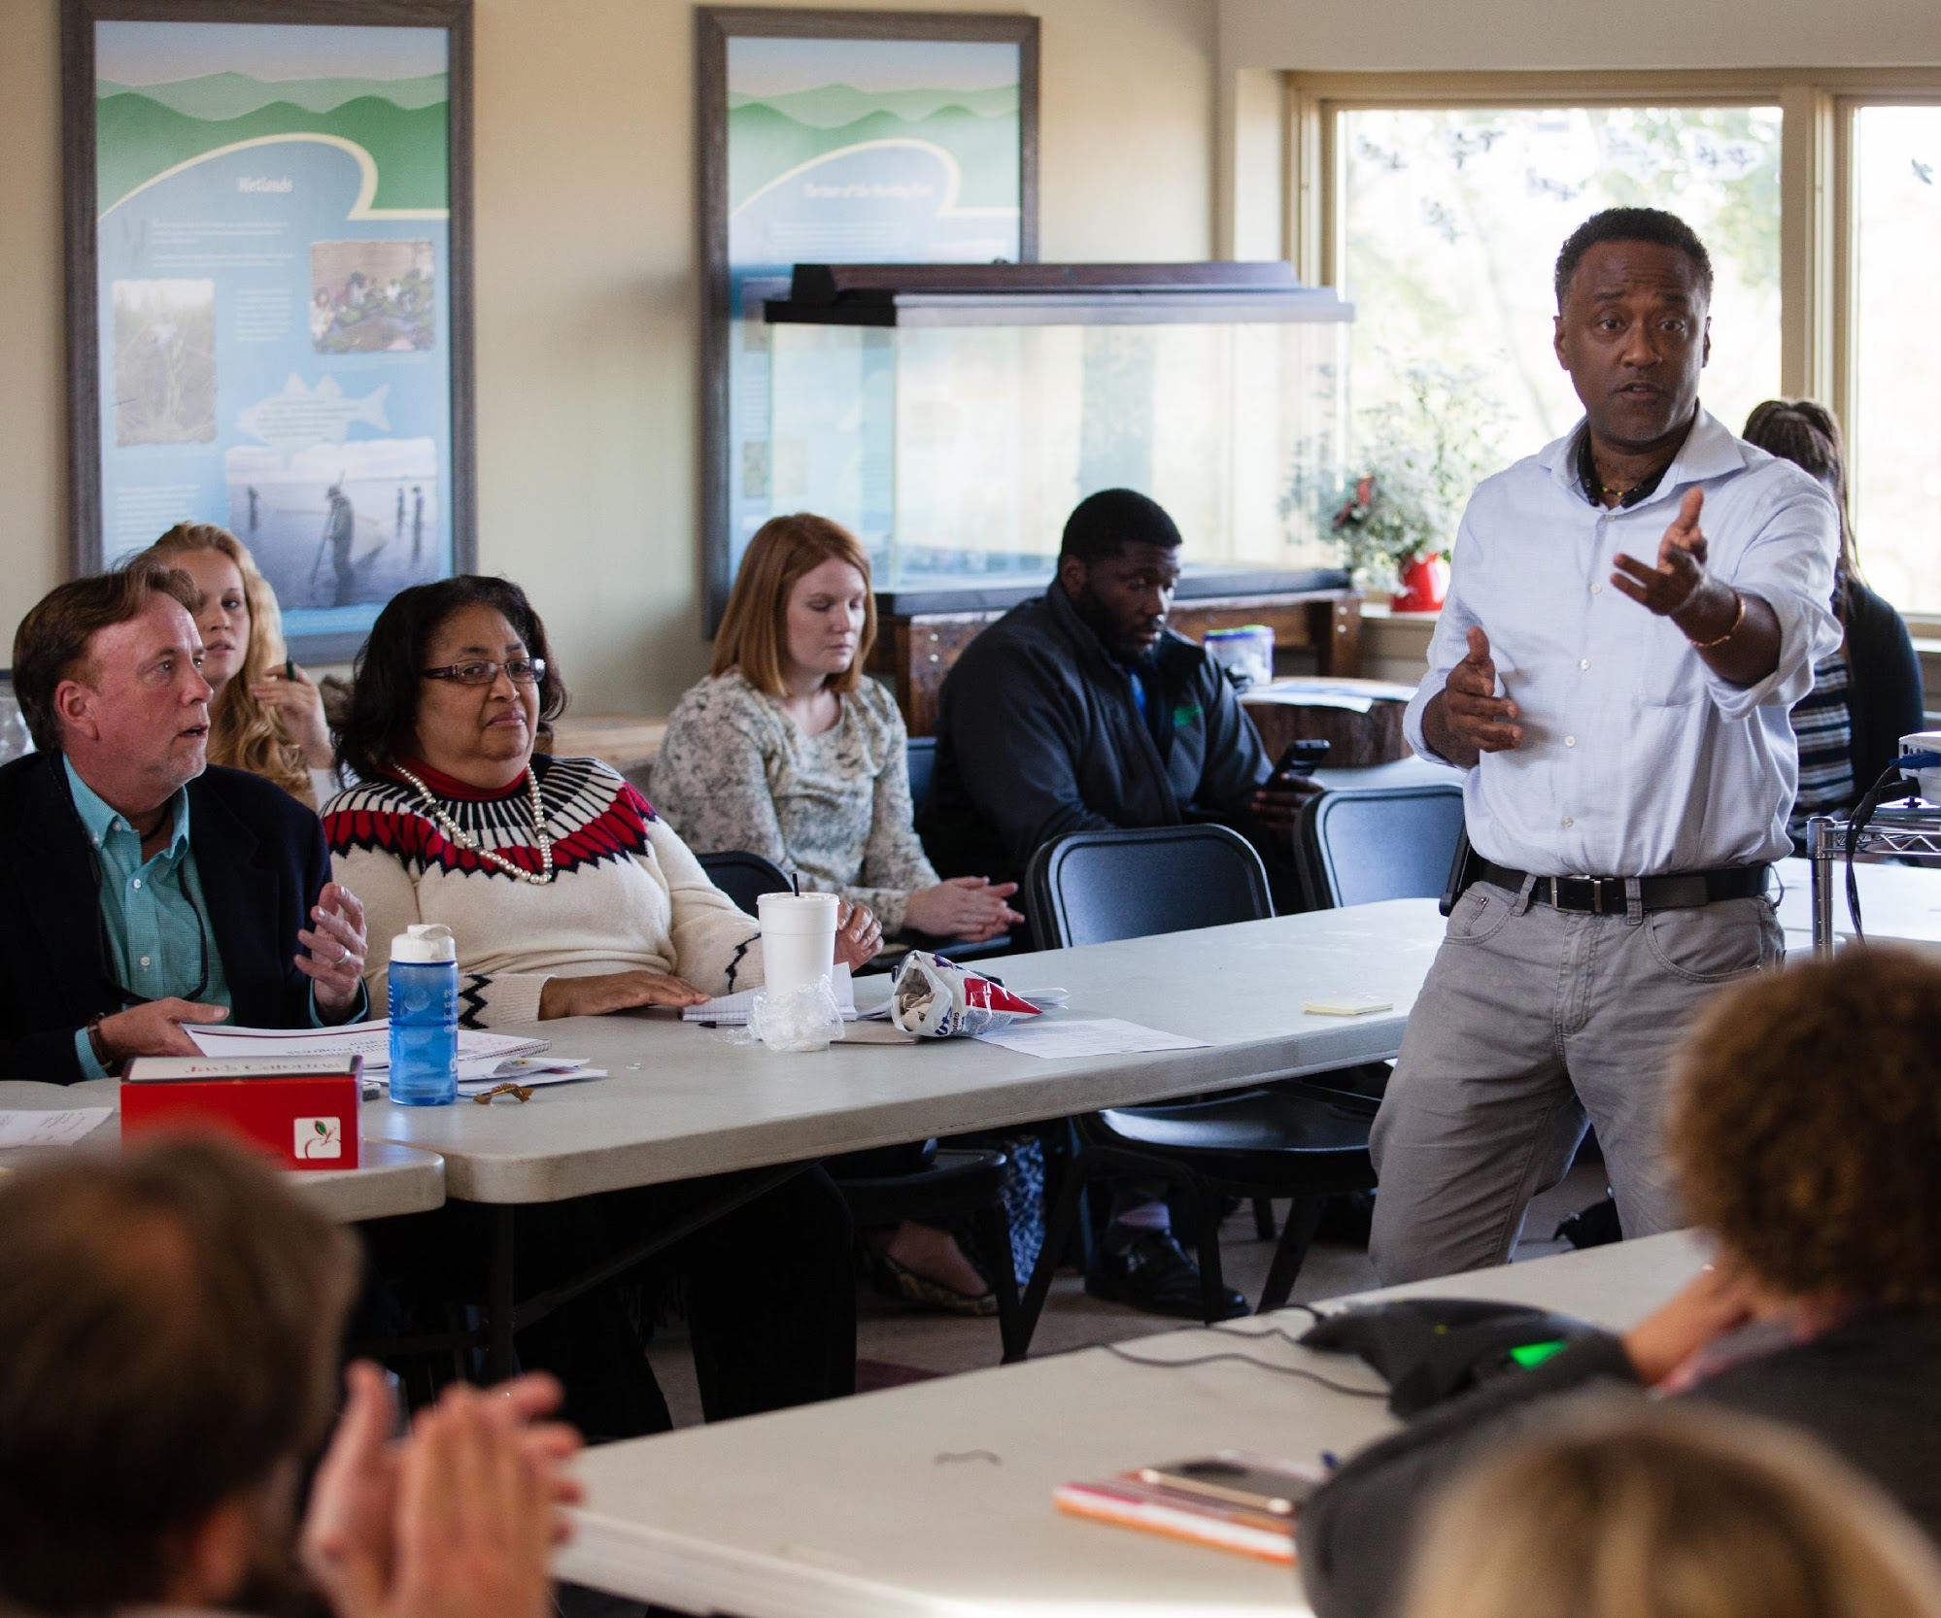

What We Want
We want to drive fish habitat restoration and conservation efforts into local planning.
Notes:
We want to:
Use scientific understanding to inform and improve local fish habitat restoration and conservation efforts
Focus on shoreline hardening and impervious surface could allow for improved planning and more effective efforts.
_______________________________________
SRS Text:
INSTRUCTIONS: Identify the ask(s) for the Management Board up front, or clue them in to what you will be asking them later. All of the information in your presentation should support this. If you don’t necessarily have an ask, identify a few key points you want the Management Board to walk away with, and structure your presentation around those points.

Slide 6
Setting the Stage: What are our assumptions?
1
Notes:
Where is the Fish Habitat Outcome?
New Outcome in the 2014 Chesapeake Bay Watershed Agreement
Management Strategy finalized in 2015
First 2-year Workplan was finalized in April 2016
Have been working on first 2-year workplan for the past year (only half the time)
Assumption - Efforts from other CBP teams would contribute to our Outcome
_______________________________________
SRS Text:
[section header, no action required] The section that follows should provide some brief historical context for the Bay Program’s work toward this outcome. Add slides as needed while being mindful of the time you have.

Slide 7
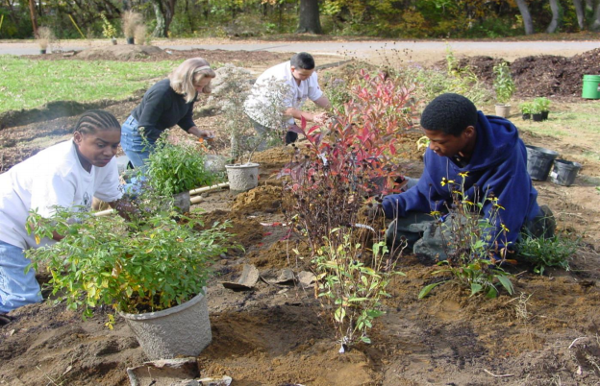
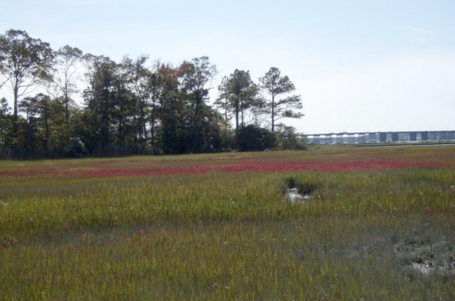
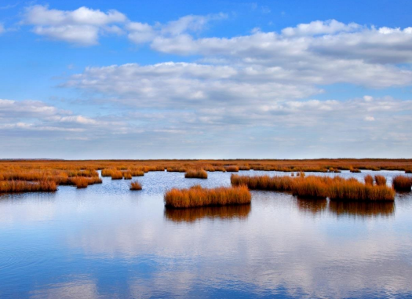
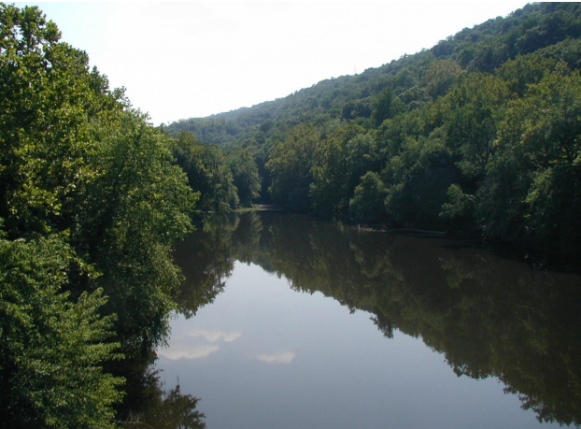
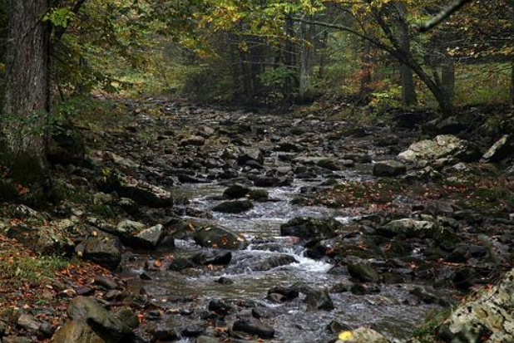
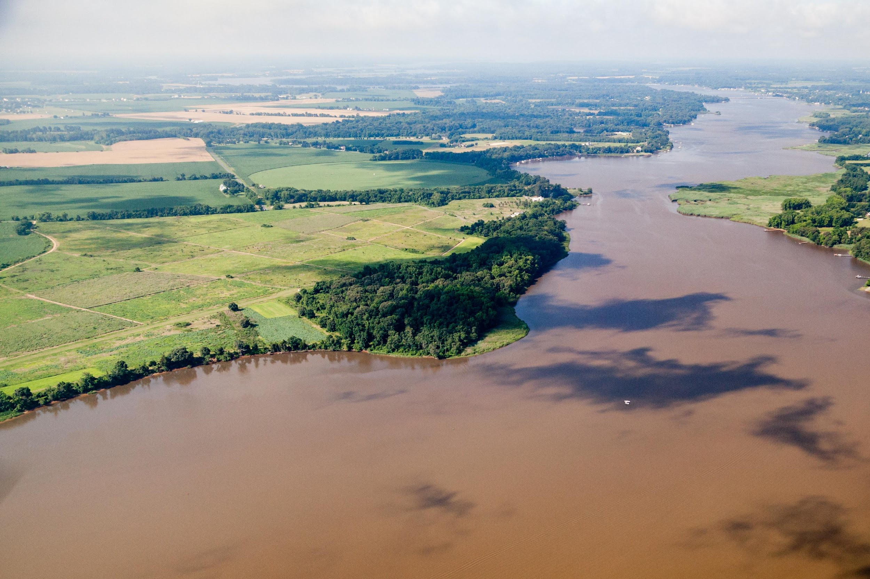
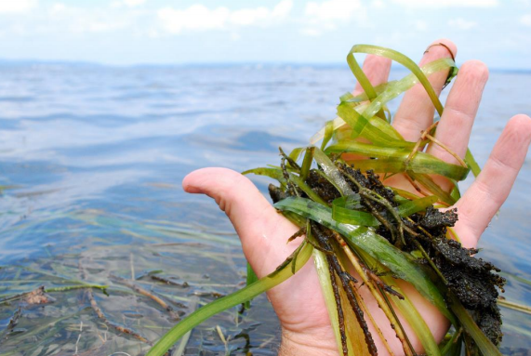
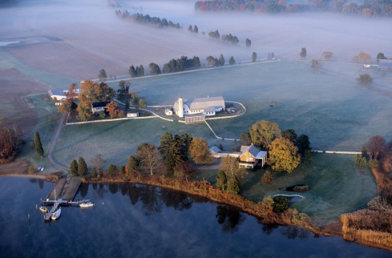
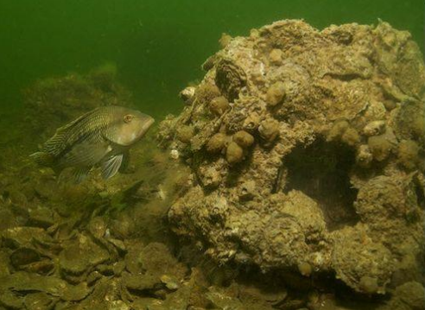
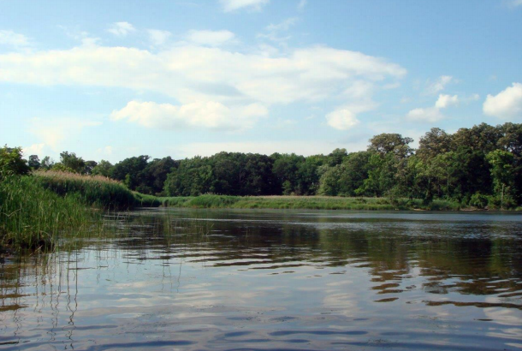
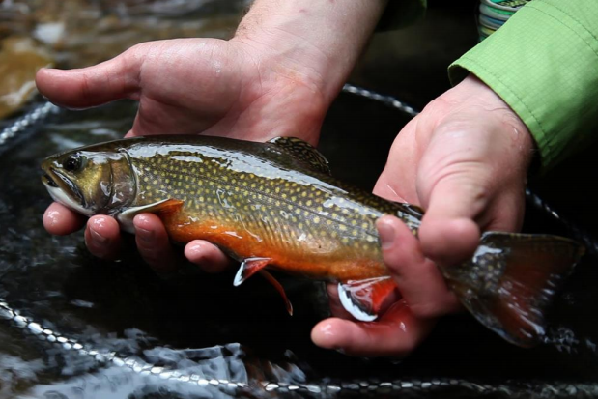
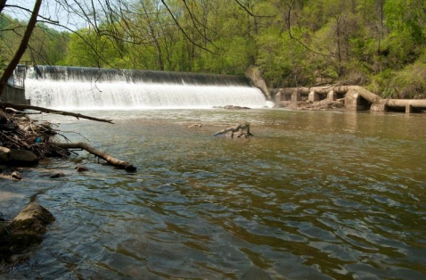
Fish Habitat is the center of the universe!
Citizen Stewardship
Wetlands
Climate
Forest Buffers
Stream Health
Fish Habitat
Water Quality
SAV
Protected Lands
Oyster Restoration
Healthy Watersheds
Brook Trout
Fish Passage
Notes:
Intersections with other Outcomes:
Fish Habitat is notable in its numerous intersections with the other outcomes
While there are 12 outcomes listed on this slide, this is just a subset of the full list of outcomes that have intersections with the Fish Habitat Outcome
_______________________________________
SRS Text:
INSTRUCTIONS: consider these questions and include those that are most relevant to your outcome.
Discussion Question 2: Which actions were most critical in progress thus far? Why? [Indicate which influencing factors these actions were meant to manage.]
Discussion Question 3: Which management actions will be the most critical to your progress in the future? Why? [Indicate which influencing factors these actions were meant to manage.]
Based on this analysis, what management approaches will be carried forward? What new management approaches are necessary?
What gaps have been filled, and how will we build on this in the future?

Slide 8

Logic Behind Our Outcome
Following the Decision Framework:
Factors
Current Efforts and Gaps
Management Approaches
Scientific/Technical Understanding
Government Engagement
Public Engagement
Understanding of habitat stressors to habitat function
Agency coordination
Lack of public engagement
Use priority species to evaluate habitat function
Communicate agency advancements in understanding
Improve communications with partners and local community
Notes:
Decision Framework to Guide Us Moving Forward:
Factors influencing our outcome achievement are:
Scientific and technical understanding (Understanding habitat stressors such as impervious surface on numerous species)
Government Engagement (Ensuring that when trends are observed in habitat impacts on fish, these trends are incorporated into current systems)
Public Engagement (Communicating these trends to the local community, so that the scientific understanding can be implemented into local projects and supported by stakeholders)
Current Efforts and Gaps
Improved understanding, coordination, and communication are needed to address the factors
Management Approaches
The Fish Habitat Action Team has developed approaches to expand on our understanding of fish habitat, improve utilization by government agencies in policies and permitting, and engage the public in efforts
_______________________________________
SRS Text:
INSTRUCTIONS: Describe the factors, efforts & gaps, and management approaches that are relevant to your ask or key takeaway. You could use the analysis and insight gained from your logic table to consider questions like,
What are my critical factors originally identified in the Management Strategy?
What did I originally identify in the Management Strategy as gaps in existing programs that addressed those factors?
What were the management approaches I chose for my strategy and workplan to address those gaps?
REMEMBER: Prioritize the information you want to present based on your story, ask, or key takeaway.

Slide 9
Progress: Are we doing what we said we would do?
2
Notes:
Where are we?
We’re gradually progressing through our 2016 to 2017 workplan, but are currently facing some challenges that are inhibiting our progress
_______________________________________
SRS Text:
[section header, no action required] This second section provides the AND part of the AND, BUT, THEREFORE story structure. This section provides an opportunity to talk about your progress. Use indicator data and charts from ChesapeakeProgress.com where available. If you do not have an indicator, fill in with other relevant information, charts, tables, etc. about your management approaches and workplan actions.

Slide 10
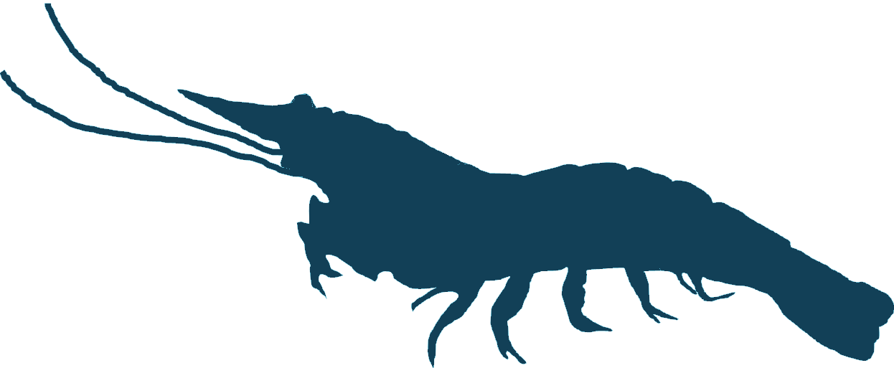
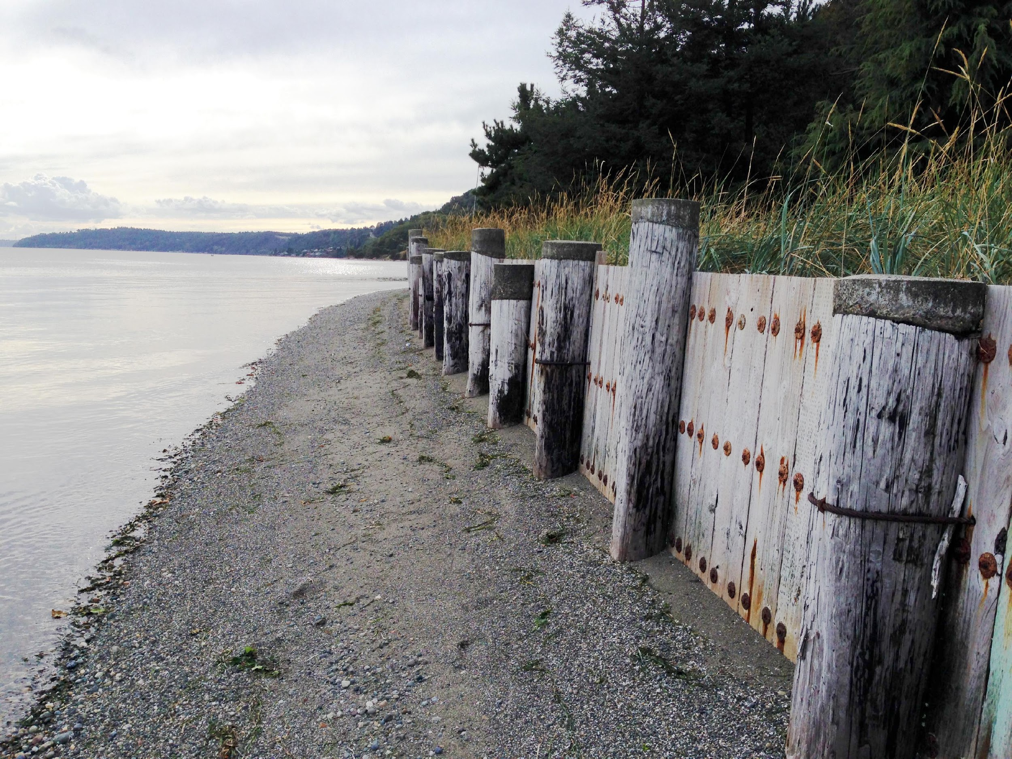
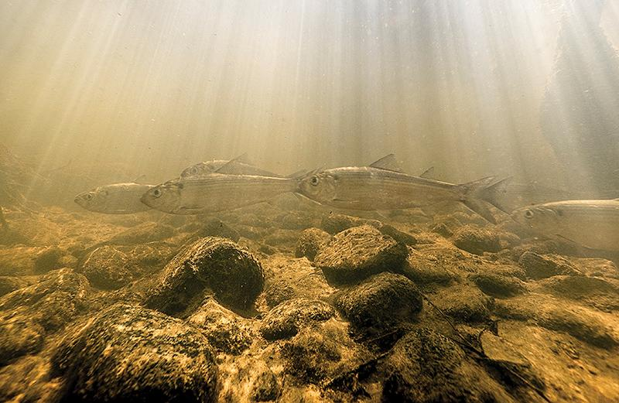
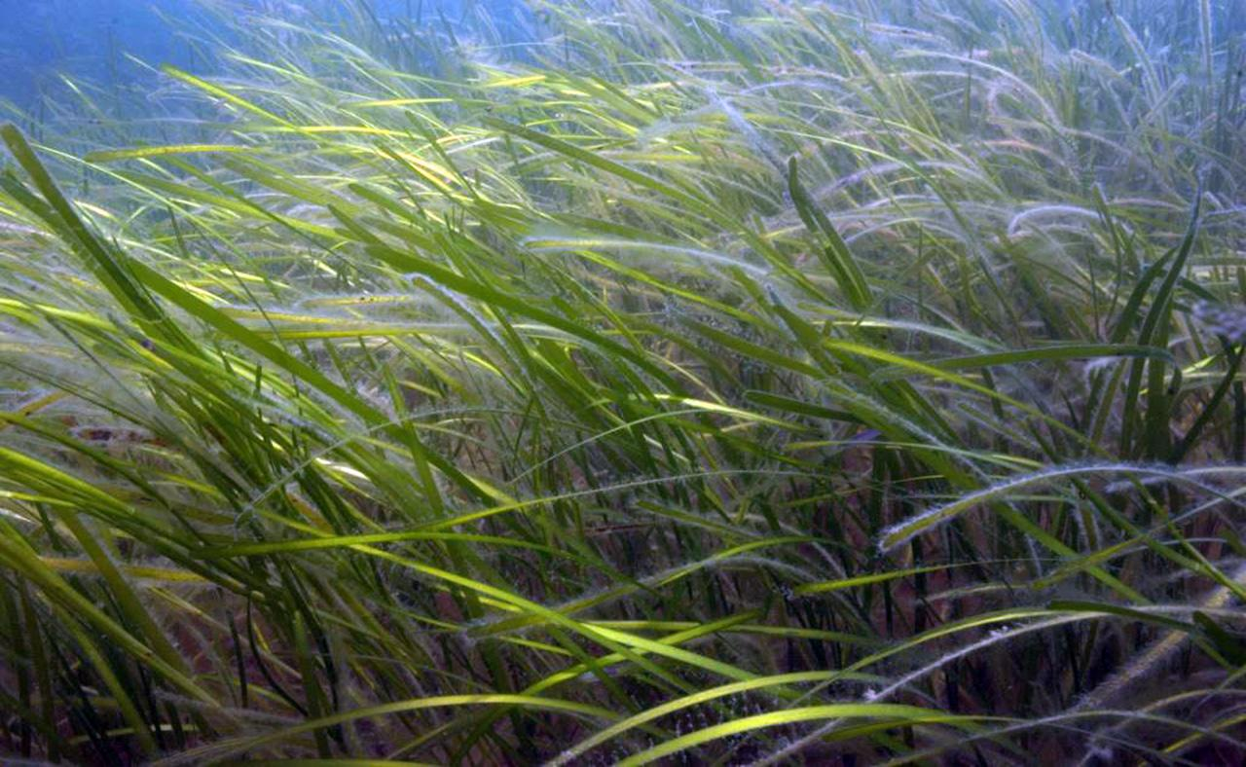
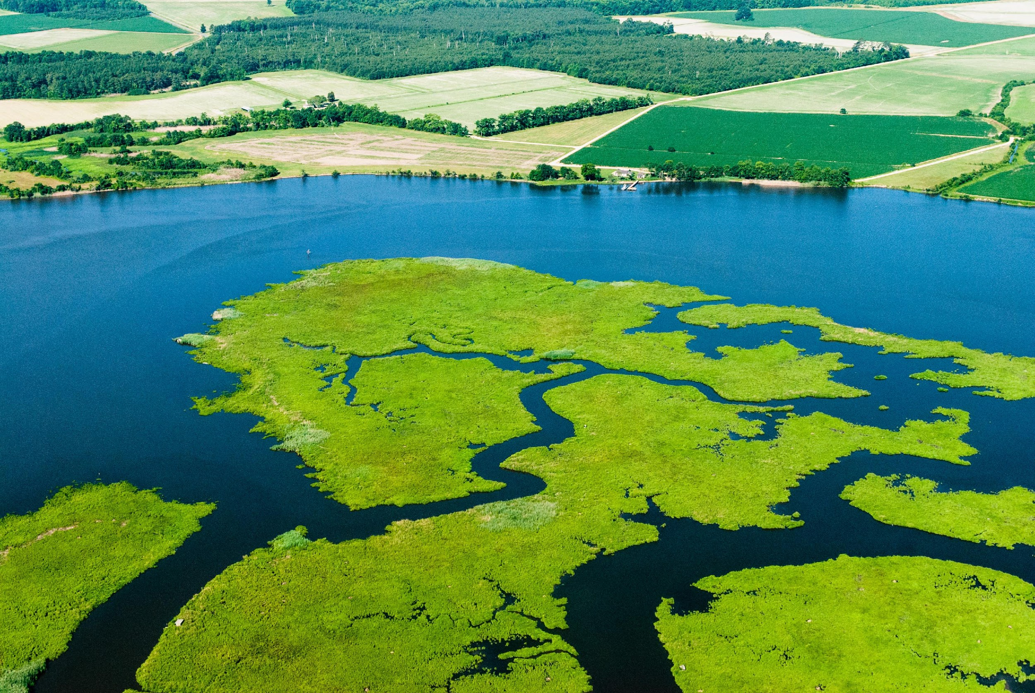
What is our progress?
Identified fish habitat threats and stressors among selected species
Synthesized results from a multiyear shoreline and land use impact study
Identifying critical spawning, nursery and overwintering areas for select species
STAC funded a workshop which will identify representative species and evaluate factors influencing habitat function
Notes:
What is our progress?
Some of the highlights from the past year include:
A TetraTech analysis of fish habitat stressors and threats for lesser-studied species across the Chesapeake Bay watershed
A synthesis of a multiyear study which investigated the impacts of shoreline and land use on birds, benthics, crustaceans and fish
Work in MD and DE to identify critictal spawning, nursery and overwintering areas for species of interest
The recent funding for a STAC Workshop which will identify representative species throughout the Watershed and evaluate factors influencing the habitats these species require
Extra Notes:
TetraTech projects produced a literature review and two matrices which identified and organized stressors and threats to fish habitat for lesser-studied species which occupied varied habitats throughout the Chesapeake Bay
- Both matrices and literature are available online at CBP website
- FHAT is currently organizing information into an executive summary to improve comparison of stressors and threats across species
- Will be one of the sources that the team uses when selecting representative species for the Workshop
The Smithsonian Environmental Research Center lead a multiyear study which investigated land use and shoreline impacts on a variety of nearshore species (including birds, benthics, crustaceans, fish).
- Team is currently synthesizing results and developing a white paper to capture the lessons learned from this study and inform management recommendations to improve the incorporation of habitat into land use decisions
Maryland and Delaware are conducting research to identify important habitat for species of interest in their jurisdictions.
Earlier this year the FHAT applied for and was approved for a Scientific and Technical Advisory Committee Workshop which will identify representative species, evaluate factors influencing habitat function for those species, and qualify the significance of these factors
There still is a great deal of work to do. We have focused on increasing scientific understanding, however, we want to use our lessons learned to inform the larger community and to fulfill our outcome to “continually improve fish habitat conservation and restoration efforts . . .”
_______________________________________
SRS Text:
INSTRUCTIONS: Copy and paste progress chart from: http://www.chesapeakeprogress.com/. If no chart is available, use pictures, other charts, maps, or text to explain Progress.
Talking Points:
Discussion Question 1: Are you on track to achieve your Outcome by the identified date? No identified date. Continually improve fish habitat conservation and restoration. Need further support to improve our efforts.
What is your target? What does this target represent? (e.g., the achievement we believed could be made within a particular timeframe; the achievement we believed would be necessary for an Outcome’s intent to be satisfied; etc.)?

Slide 11
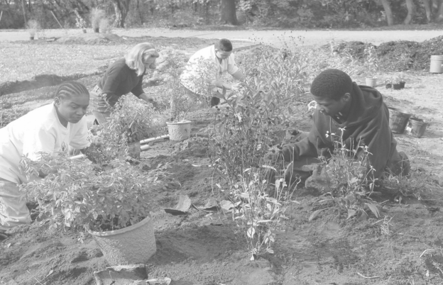
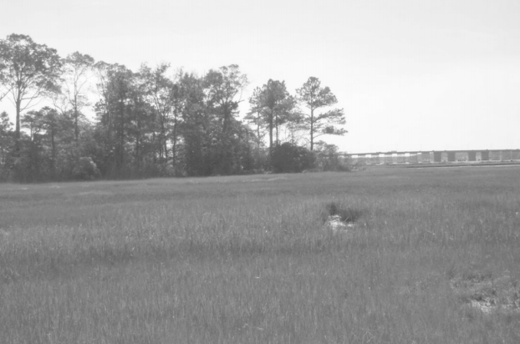
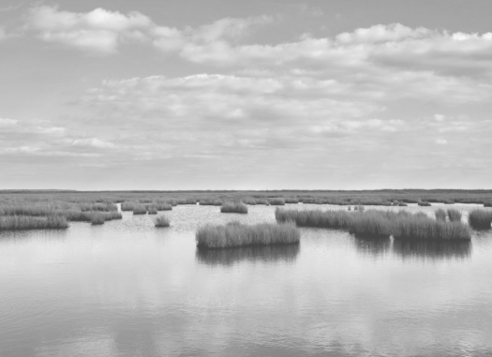
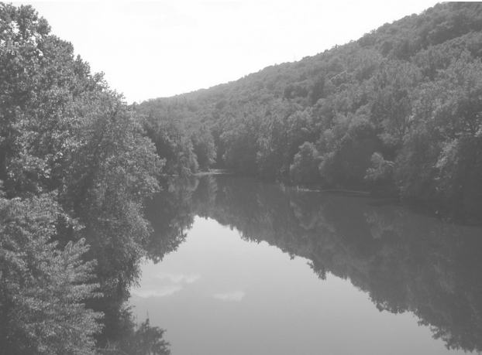
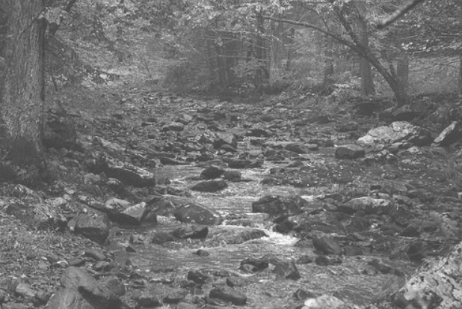
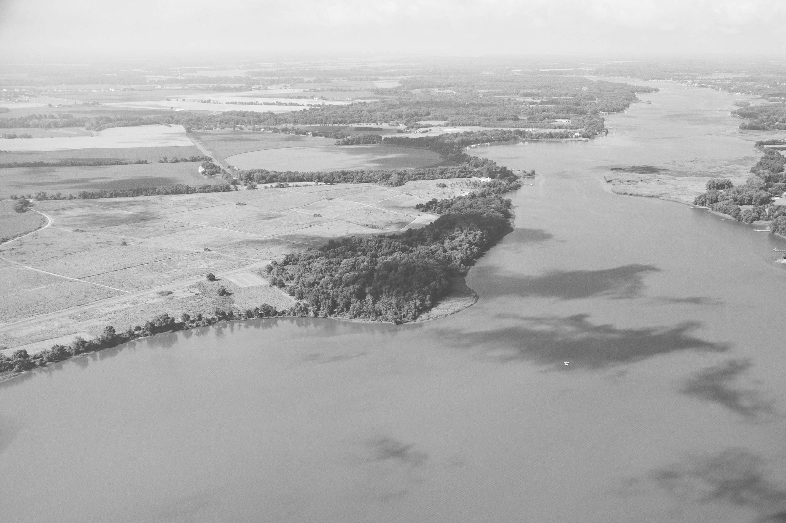
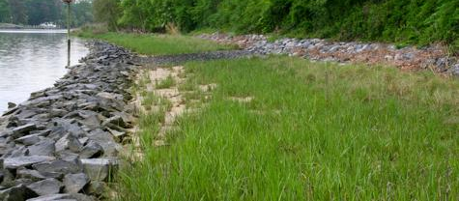
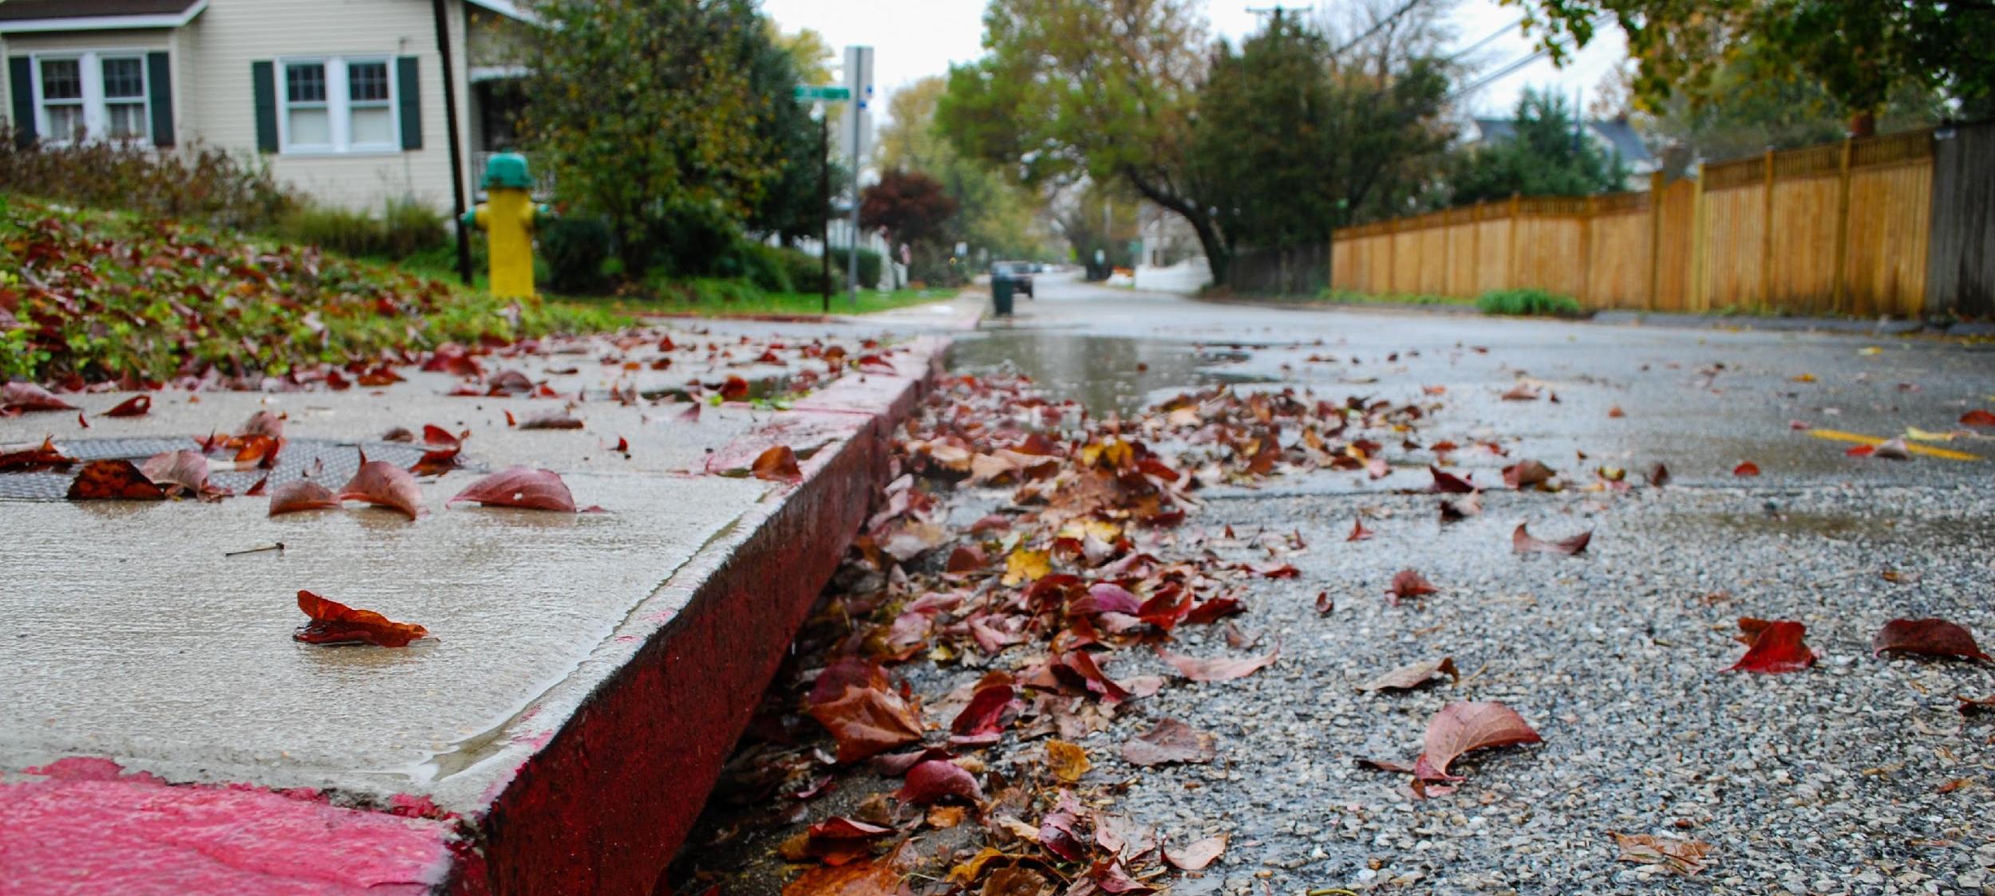
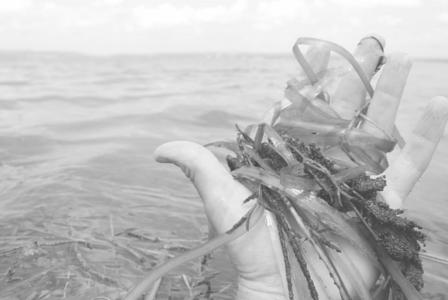
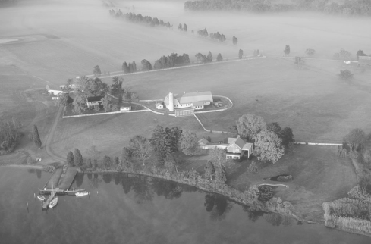
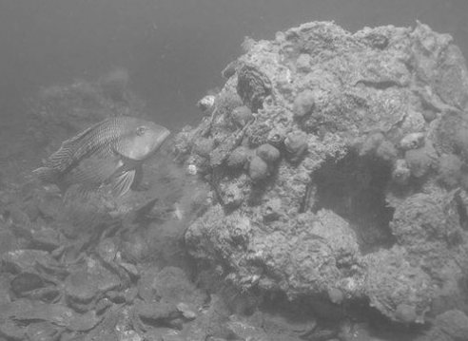
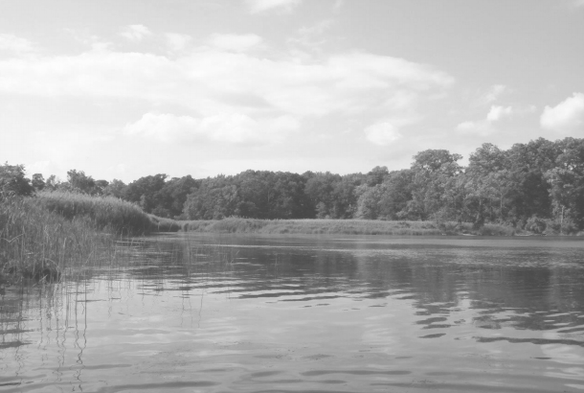
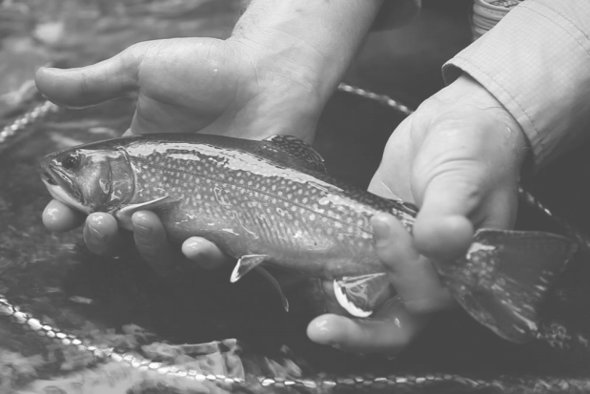
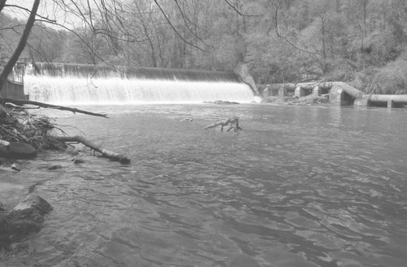
Analysis
While numerous outcomes impact fish habitat, the Fish Habitat Action Team is targeting urbanization stressors:
Shorelines and Impervious Surface
Citizen Stewardship
Wetlands
Climate
Forest Buffers
Stream Health
Water Quality
Hardened Shorelines
Impervious Surface
SAV
Protected Lands
Oyster Restoration
Healthy Watersheds
Brook Trout
Fish Passage
Notes:
Major Stressors to Fish Habitat:
We’ve zeroed in on two major stressors to fish habitat: shorelines and impervious surface to focus our efforts and communication
As shown before in the NFHP map and Kornis’ study, development impacts can degrade fish habitat
You’ll also find that shorelines and impervious surfaces have tie ins with many of the other outcomes as well

Slide 12
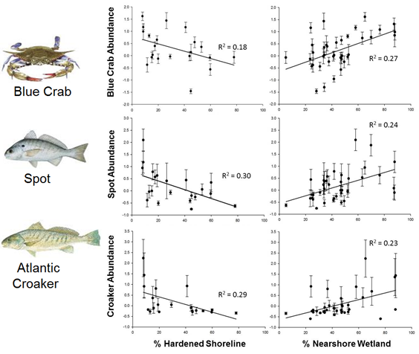
Shoreline and Land Use Impacts:
Kornis et al 2017. Figure 5.
More wetland = More fish
More hardened shoreline = Less fish
Notes:
Study by Kornis et. al. found link to shoreline and land use impacts
Linked the abundance of estuarine fish and crustaceans in nearshore waters to shoreline hardening and land cover
Less % nearshore wetland led to few fish
More hardened shoreline led to less fish
Extra Info:
Study performed at the subestuary scale

Slide 13
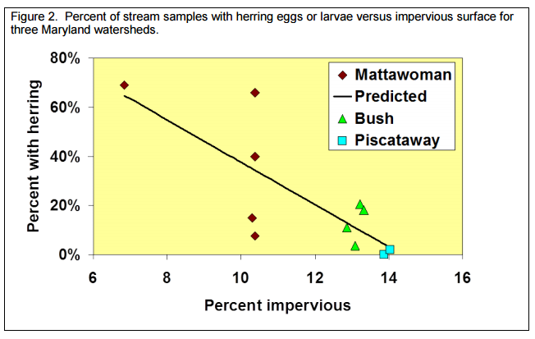
Impervious Surface and Fish
More impervious surface= less river herring
From CBC and MD DNR “Land Conservation = Fish Conservation” presentation
Notes:
Study by Jim Uphoff et. al. found link to impervious surface and fish
Sites with more impervious surface had fewer streams with herring egg and larvae

Slide 14
Challenges: Are our actions having the expected effect?
3
Notes:
What Challenges are we facing?
Fish habitat is incredibly important and ties together almost all the outcomes under the 2014 Chesapeake Watershed Agreement
Fish Habitat is also a driving force behind the sustainable fisheries goal implementation team
_______________________________________
SRS Text:
[section header, no action required] This second section provides the BUT part of the AND, BUT, THEREFORE story structure. This section provides an opportunity to talk about your challenges, based on your analysis using the logic table and the discussion questions in the SRS Quarterly Meeting Guide.

Slide 15

Challenges
We lack an effective mechanism to communicate fish habitat priorities to CBP partners and the local community
We lack a defined measure of progress
We lack a direct connection between fishery managers and habitat decision makers
Notes:
Challenges:
We have identified trends in impervious surface and shoreline hardening on fish species and we need to be able to use this knowledge to more effectively communicate these trends to CBP partners and the local community
To improve overall understanding
To encourage restoration/conservation projects that address major stressors to fish habitat
To more effectively allocate resources to projects that will have the greatest benefit to the Chesapeake Bay
To ensure that we are achieving our outcome of improving fish habitat restoration and conservation efforts, we need to have a defined measure of success
Defined measure of success will allow us to ensure that decisions regarding restoration and conservation efforts incorporate scientific understanding of fish habitat and the factors which influence fish populations
Trying to manage resource without control
Extra Notes:
Scientific, fiscal or policy-related lessons learned?
Advances in climate change research will inform our future restoration and conservation efforts.
We will need to address if we are building resiliency into our management efforts and project where investments will be most effective according to risk of climate change impacts.
Social science should be included in communications efforts.
Educate and involve the public in decision-making process, be transparent in actions/efforts, and look for opportunities for public investment and incentives.
Policy implications – expect for cuts to funding and partners.
Work to make the most efficient use of funding and connect with partners to ensure no duplication of efforts.
_______________________________________
SRS Text:
INSTRUCTIONS: This is the BUT part of the story. Consider the questions above and share something about a challenge encountered, or new information gathered, or a new approach identified, that calls for a change to the existing approach or strategy. You can discuss your plans to address this challenge, or you can talk more broadly about how your workgroup or GIT will work to determine how to address the challenge.
Keep in mind – we are not asking you to paste your Logic Table into this slide! The Logic Table provided in the “Guide” is intended to lead you through a standardized thought process that ensures all Outcomes are reviewed similarly. The Management Board is trusting that your GIT or Workgroup went through that process. All they are looking for here is a presentation of your most important conclusions from that process.
Discussion Question 4: What scientific, fiscal or policy-related developments or lessons learned (if any) have changed your logic or assumptions about your Outcome?
Did any factor, gap, or management approach present a challenge?
Did an unforeseen factor influence your ability to move forward with an approach?

Slide 16
Adaptations: How should we adapt?
4
Notes:
Adaptations
Given these challenges, how should we move forward?
_______________________________________
SRS Text:
[section header, no action required] This second section provides the THEREFORE part of the AND, BUT, THEREFORE story structure. This section provides an opportunity to talk about your adaptations and next steps, based on your analysis using the logic table and the discussion questions in the SRS Quarterly Meeting Guide.

Slide 17

Based on what we’ve learned, we plan to…
Conduct a workshop which will inform priority habitat stressor information
Improve outreach to local communities and counties
Co-benefits in WIPs
Materials and tools
Take meaningful actions that emphasize communication as the end goal
Notes:
We will move forward by:
Conducting the workshop which will further increase our understanding of habitat stressors such as impervious surface and shoreline hardening
Improving our outreach to local communities and counties
Our suggested means of doing so will be to educate communities on materials and tools available to them to improve fish habitat
And to incorporate fish habitat into the Phase III Watershed Implementation Plans (more details on next slide)
And ensuring that our future workplan actions emphasize communication as the end goal
Want to make sure that scientific findings and trends are used in the decision-making and implementation process
Extra info:
Fish Habitat considerations should be included in Phase III Watershed Implementation Plans
Increase focus on engaging local communities
Better considerations of the limitations of time and staff resources (including GIS)
Work to translate fish habitat to for Baywide understanding/application of efforts
Consistent criteria across the Bay
Focus on shorelines and tidal wetlands
Work on engaging community with available resources
Work with local wetland boards (VA)
_______________________________________
SRS Text:
INSTRUCTIONS: This is the THEREFORE piece of the story! Tell the Management Board what you’re going to do with the new information, research, resources, understanding of factors, etc. Refer back to the logic table that you competed—this content could come from the Adaptation column, if you got that far in the table, or it could be a realization that you gained working within the first columns of factors, gaps, approaches, actions and responsible parties.
Discussion Question 5: What (if anything) would you recommend changing about your management approach at this time? Will these changes lead you to add, edit or remove content in your work plan?

Slide 18
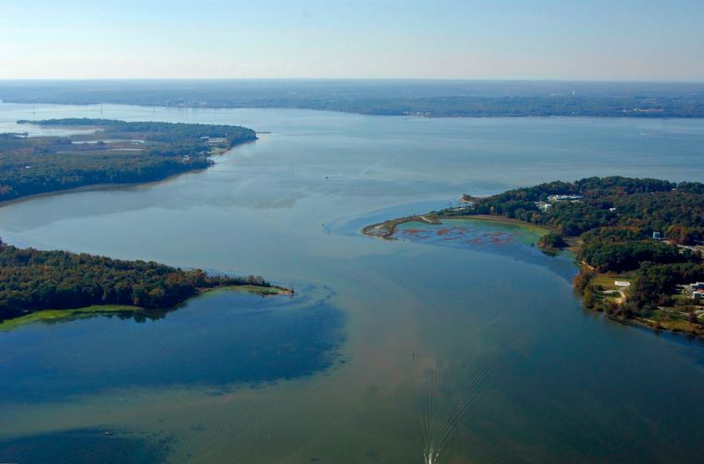
What We Want
We want to incorporate fish habitat into the Phase III Watershed Implementation Plans.
Prioritize BMPs that address water quality and habitat
Serve as a metric of progress
“EPA also encourages state and local jurisdictions to consider the corollary benefits of BMPs that are targeted for implementation. Corollary benefits are those that not only result in water quality improvements but could address other 2014 Chesapeake Bay Watershed Agreement Outcomes.”
-U.S. EPA’s Interim Expectations for the Phase III Watershed Implementation Plans
Notes:
What do we want?
We want to incorporate fish habitat considerations into the Phase III Watershed Implementation Plans
Encourage preference for BMPs which address both water quality and fish habitat improvement
Could utilize the recently completed Water Quality GIT Project which identified concomitant benefits for BMPs with the other outcomes
Top BMPs for fish habitat benefits (score of 4 or higher - top score was a 5):
Ag Forest Buffer
Narrow Forest Buffer
Streamside Forest Buffer
Forest Conservation
Urban Forest Buffers
Urban Shoreline Management
Urban Stream Restoration
Other high scores:
Wetland restoration and Streamside Wetland Restoration
Urban Growth Reduction
This will allow for local communication through the WIPs
And will provide us with metrics for our progress
Shoreline considerations in WIPs
Impervious surface considerations in WIPs
Extra Info:
Phase III WIPs are in planning right now and will be completely finalized in April 2019 (according to draft revised schedule)
WIPs currently focus on:
Local Engagement
Local Targets
Sources of Nutrients and Sediments:
Wastewater, Agriculture, Urban/Suburban Stormwater, Onsite Wastewater, Forest Lands, Resource Extraction
No inclusion of fish habitat considerations
General assumption that improved water quality = improved fish habitat
Incorporating fish habitat will recommend strategies which will improve both water quality and offer increased/improved fish habitat
_______________________________________
SRS Text:
INSTRUCTIONS: Reiterate the ask for the Management Board. If you don’t necessarily have an ask, identify a few key points you want the Management Board to walk away with.
Talking Points:
Discussion Question 7: What is needed from the Management Board to continue or accelerate your progress? (Multiple asks of the Management Board should be prioritized where possible. )

Slide 19
Discussion
Presentation template by SlidesCarnival.
Notes:
[time for discussion at the end of the presentation, before the next outcome presentation]

Slide 20
Photo Credits
Slide 2: Aerial Farm and River (Will Parson)
Slide 4: National Fish Habitat Vulnerability Score Map (National Fish Habitat Partnership)
Slide 7: Diversity Meeting (Darius Stanton)
Slide 11: Aerial Wetlands (Will Parson)
Bulkhead (Encyclopedia of Puget Sound)
Herring Spawn in Choptank (Dave Harp)
Eelgrass (Delaware Inland Bays)
Slide 12 and 13: Forest Buffers (Heather Richards)
Oyster Restoration (Michael Eversmier)
Healthy Watersheds (Mike Zarro)
Climate (Lee Goodwin)
Protected Lands (Middleton Evans)
Impervious Surfaces (Will Parson)
Living Shoreline (Virginia Institute of Marine Science)
All Others found in CBP Management Strategies
Slide 18: Mattawoman Creek Inlet (Marinas.com)
Presentation template by SlidesCarnival.

Slide 21
Extra Slides
Presentation template by SlidesCarnival.

Slide 22










Agreement Goals and Outcomes
Sustainable Fisheries
Vital Habitats Goal
Blue Crab Abundance
Blue Crab Management
Oyster
Forage Fish
Fish Habitat
Wetlands
Black Duck
Stream Health
Brook Trout
Fish Passage
Submerged Aquatic Vegetation (SAV)
Forest Buffer
Tree Canopy
Water Quality Goal
Toxic Contaminants Goal
2017 Watershed Implementation Plans (WIP)
2025 WIP
Water Quality Standards Attainment and Monitoring
Toxic Contaminants Research Toxic Contaminants Policy and Prevention
Healthy Watersheds Goal
Stewardship Goal
Healthy Waters
Citizen Stewardship
Local Leadership
Diversity
Land Conservation Goal
Public Access Goal
Protected Lands
Land Use Methods and
Metrics Development
Land Use Options Evaluation
Public Access Site Development
Environmental Literacy Goal
Climate Resiliency Goal
Student
Sustainable Schools
Environmental Literacy Planning
Monitoring and Assessment
Adaptation Outcome
Notes:
Optional slide if you think it contributes to your message
INSTRUCTIONS: Highlight with bold green text the outcomes which impact your outcome, or which your outcome impacts. (taken from Bruce Vogt’s March 2017 PSC presentation on oysters)

