Slide 1
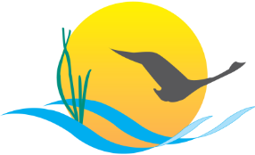
FISH HABITAT OUTCOME
Gina Hunt
MD. Department of Natural Resources
Chesapeake Bay Program
Science. Restoration Partnership.

Slide 2
Update of key actions
Chesapeake Bay Program
Science. Restoration Partnership.
What actions or performance targets have been removed?
  Just a few and they are items that will either not fill a gap or are coordination actions that are ongoing.
What actions have been added?
  Determine new financing opportunities- general language. Attend the finance workshop and work to identify new partners who have a vested interest in fish habitat.
  Communications products for fish habitat incorporation in the WIPs/Workshop/other outreach efforts.
  Citizen monitoring effort for fish habitat. Can we partner with existing efforts? Watershed organizations may not continue the effort following the grant's completion.
  Would like to see if we can coordinate any actions with the brook trout or stream health workplans.

Slide 3
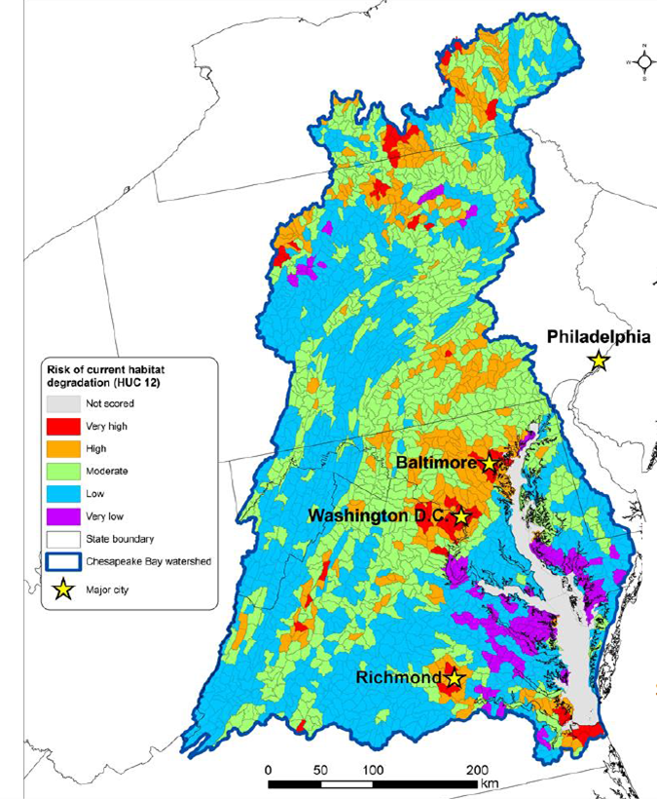
Update of key actions
Chesapeake Bay Program
Science. Restoration Partnership.
What will be the focus of your new Workplan?
  Communication products!!!!
  *WIP *Shorelines *Impervious Surfaces
  Follow-up and communication on Workshop that will be held in February 2018.
    Workshop focus- evaluate factors influencing fish habitat and qualify limitations to fish habitat function and communicate information and actions that can mitigate factors.
    Identify data gaps and structure to develop a regional fish habitat assessment.
    This will fill the understanding gap of habitat stressors to habitat function.
National Fish Habitat Partnership Map

Slide 4
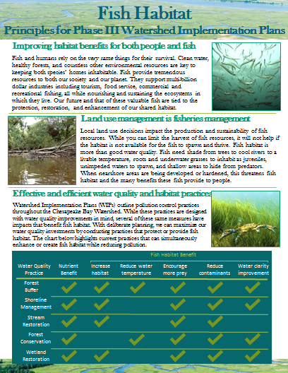
Update of key actions
Chesapeake Bay Program
Science. Restoration Partnership.
How do these changes reflect the asks you presented to the Management Board?
  Our ask was to incorporate Fish Habitat into the Phase III Watershed Implementation Plans.
  Our new workplan includes actions to create message and outreach material for the WIP and WIP implementers that focuses on Co-Benefits.

Slide 5
Gaps and Barriers
Chesapeake Bay Program
Science. Restoration Partnership.
What gaps and barriers will exist even after these key action updates?
  WIP Action and engagement is just one communication tool. We will still need improved:
    Agency coordination.
    Public engagement.
  Understanding the shoreline stabilization performance of living shorelines compared to hardened alternative shoreline structures. Fisheries GIT supported a proposal to ACFHP in September to evaluate shoreline restoration methods. Local communities have been reluctant to invest in innovative techniques that improve fish habitat and address shoreline erosion because information is not available on the performance of the breakwater structure. This study was not funded.
How do you plan on addressing these gaps/barriers?
  We are going to need partners to connect us to certain audiences (development planners, acquiring permits for shoreline modification or restoration sites).
  Partnering with other outcomes and partnering with other groups that can spread a local message.

